Slide 1
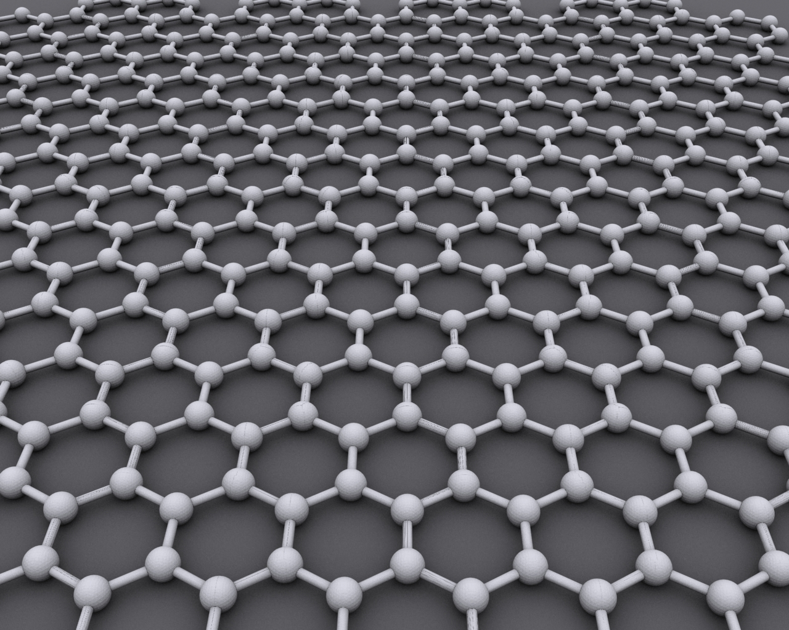
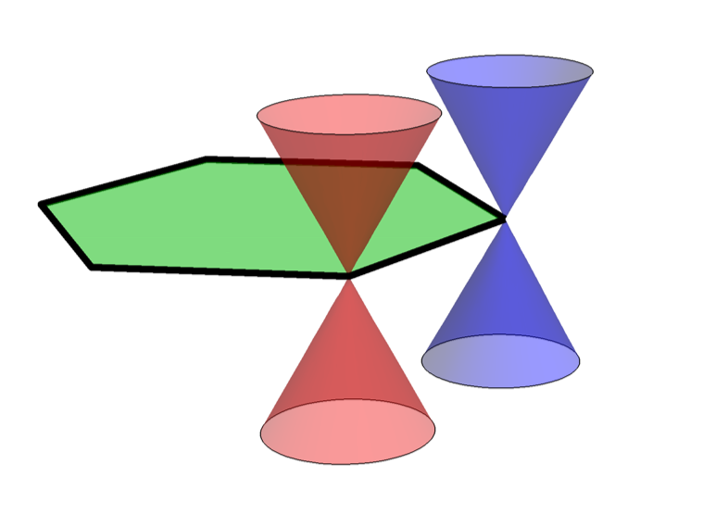
Exploring Topological States with superconductivity or with twists
Graphene
Dirac nodes at the Brillouin zone corners
Wiki
Ching-Kai Chiu
RIKEN iTHEMS
@NCTS-iTHEMS Workshop 2024

Slide 2
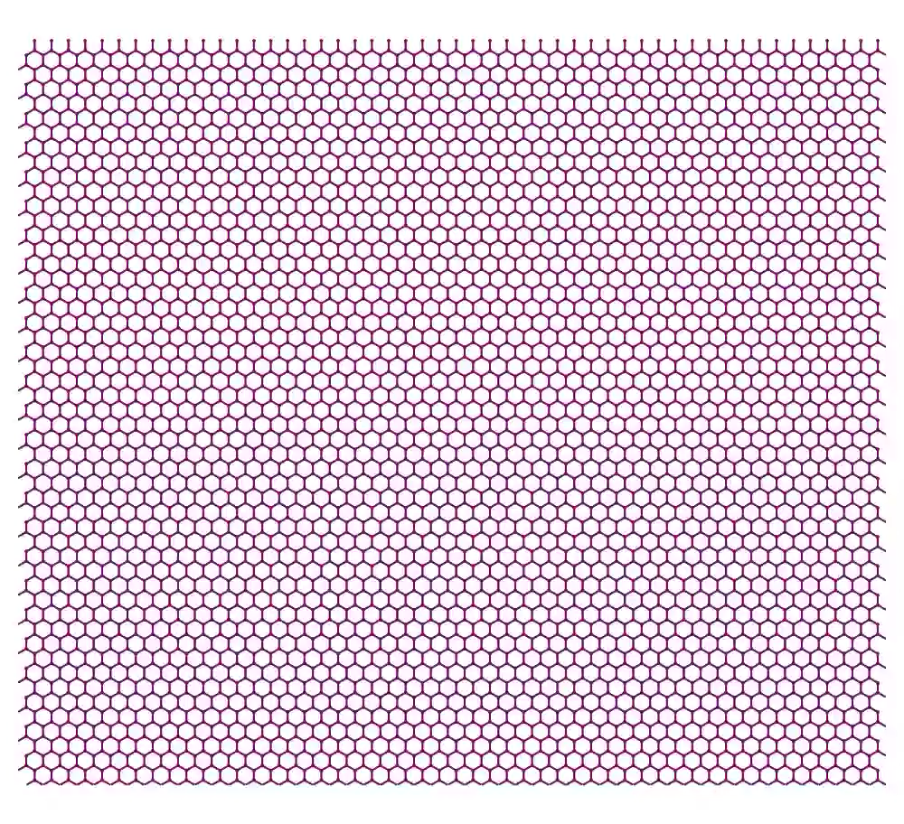
Twisted bilayer graphene
Moiré Patterns
Twisted angle increase, super unit cell is getting smaller

Slide 3
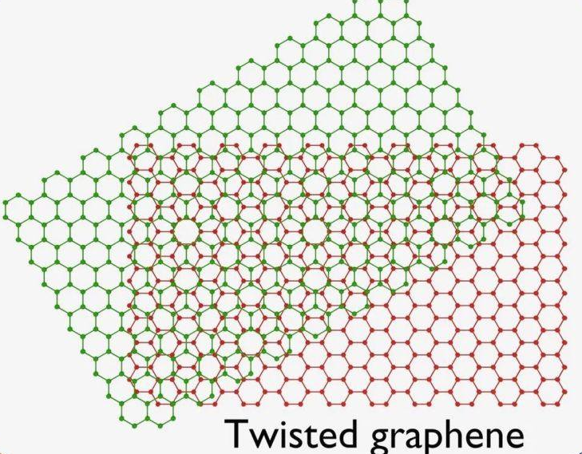
Credit: Bosco Yu

Slide 4

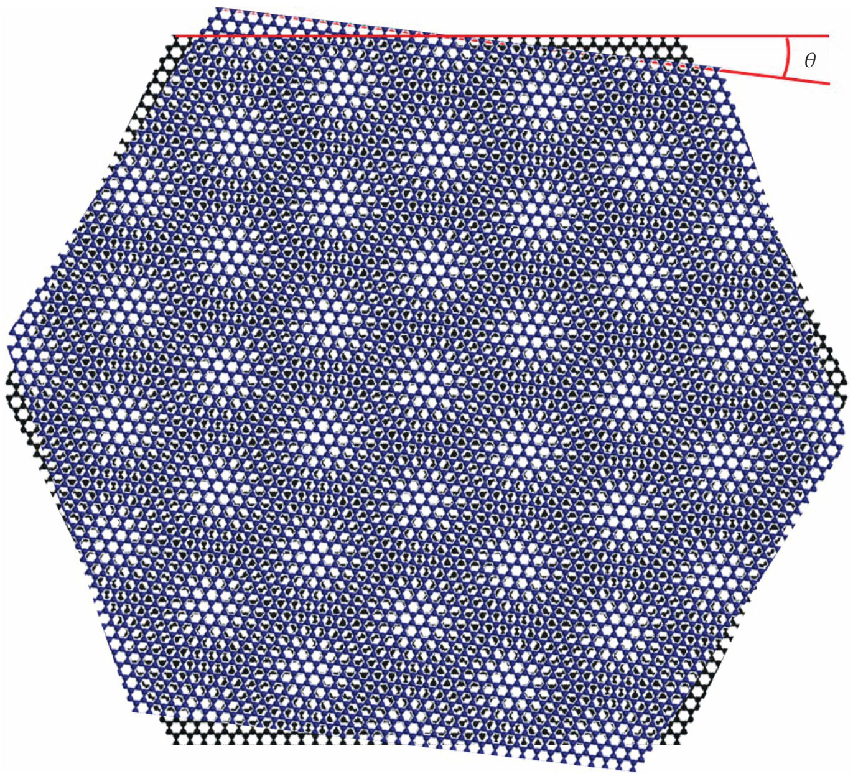

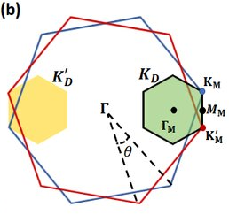
Twisted bilayer graphene
Twisted bilayer graphene
The bilayer of the small twisted angle forms the Moire patterns in the real space
Real space
Bloch’s theorem
Momentum space
Graphene Brillouin zone
Super unit cell
arXiv:2303.15551
Courtesy of ICFO/Xiaobo Lu
Moiré Brillouin zone
R. Bistritzer and A. H. MacDonald, Proc. Natl. Acad. Sci. 108, 12233 (2011).

Slide 5
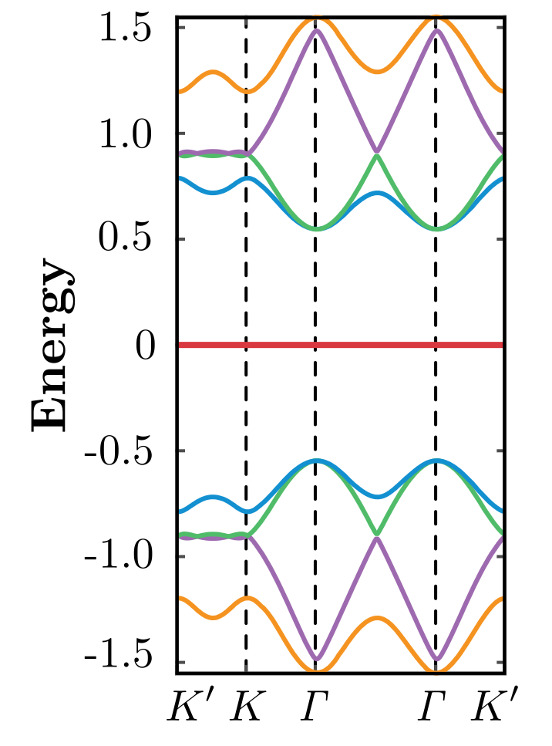
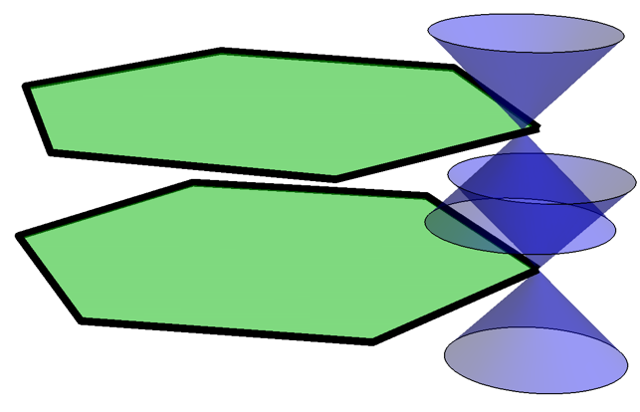
Twisted bilayer graphene forms flat bands with a direct gap
Goal: Why flat bands are formed in twisted bilayer graphene at some twisted (magic) angles?
Moiré Brillouin zone
A. Vishwanath et al. PRL 122, 106405 (2019)
Y. Cao et al. Nature 556, 43–50 (2018)

Slide 6
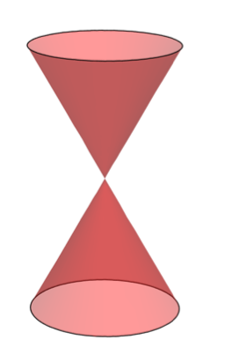
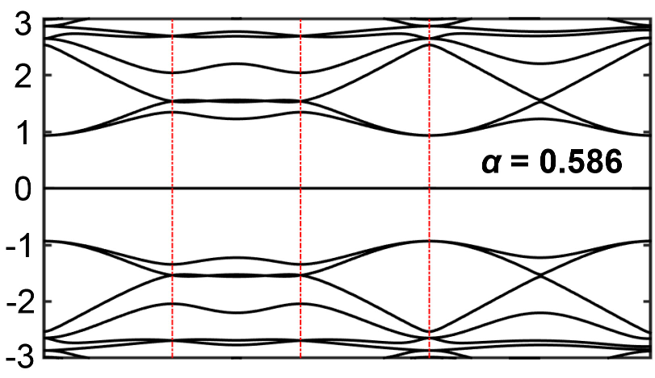
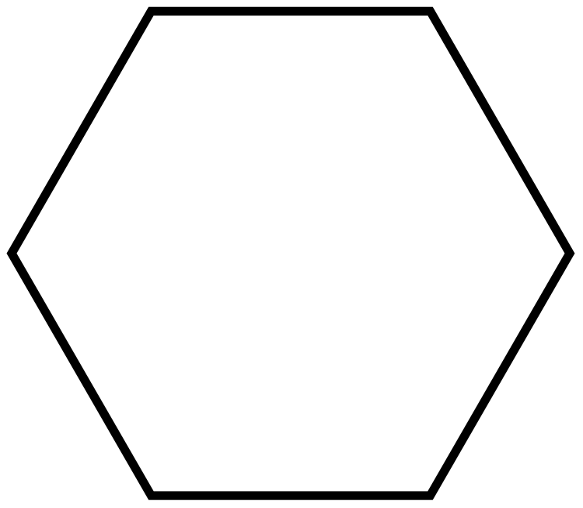

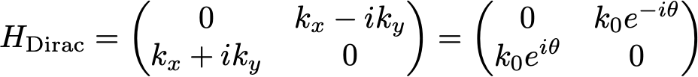
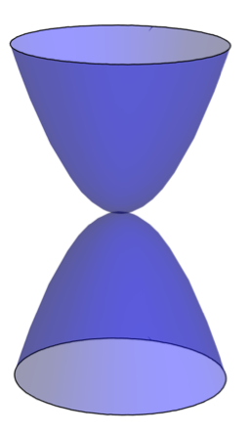
Extension:
How about other topological nodes!
Also other node locations in Brillouin zones!
Flat band?
K
E
M
?

Slide 7
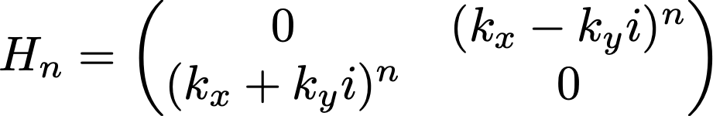



Generalization
n-ordered topological nodes
Chiral symmetry forbids the node to be gapped
Topological
The band touch is robust

Slide 8



Node location and different Brillouin zones
Nodes are located at rotation centers to have equal strength interlayer couplings in all directions
4 possible configurations
K
K
Flat bands?
M
M
Congcong Le, C.-K.C., at el, Phys. Rev. Lett. 132, 246401 (2024)
Fan Cui, C.-K.C., at el, Sci. China Phys. Mech. Astron. 67, 297012 (2024)

Slide 9



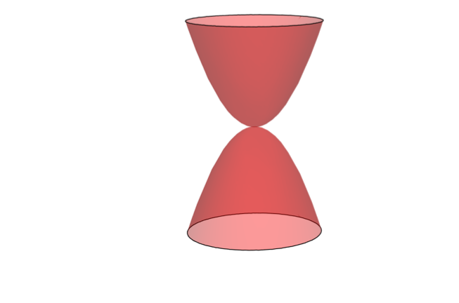






Why choosing rotation centers?
n-ordered topological nodes
C4 rotation center
C6 rotation center
C3 rotation center
Top layer
Equal strength interlayer coupling
Flat bands in entire Moire BZ have a chance to emerge
Button layer

Slide 10
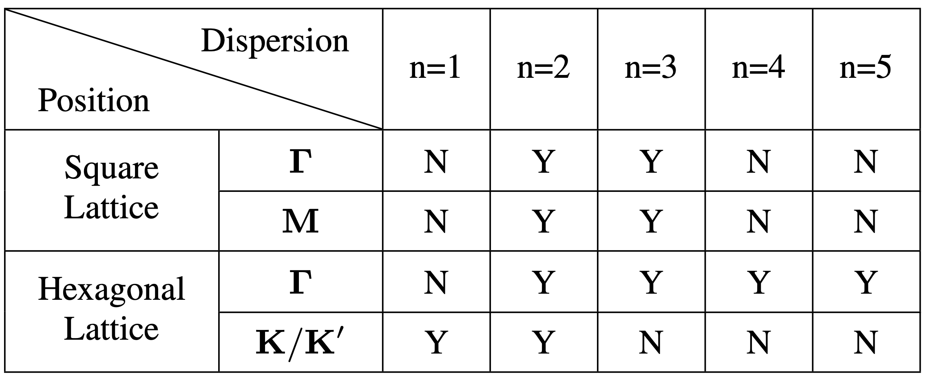


Classification of topological nodes in twisted bilayers
Y: Flat bands in entire Moire Brillouin Zone
Twisted bilayer of quadratic node
M.-R. Li, A.-L. He, Hong Yao, PRR 4, 043151 (2022)
No flat bands
Twisted bilayer graphene
Y. Sheffer, R. Queiroz, A. Stern, PRX 13, 021012 (2023)
Fan Cui, C.-K.C., at el, Sci. China Phys. Mech. Astron. 67, 297012 (2024)

Slide 11

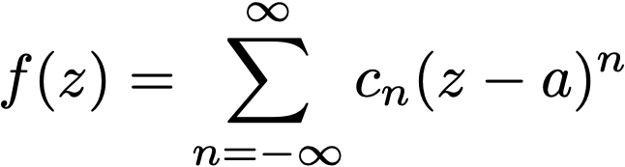

Twisted bilayer graphene
Key mathematical tool is to show the band flatness
Holomorphic functions
Many applications from Holomorphic functions
Conformal field theory, string theory, quantum Hall states
2D problem

Slide 12
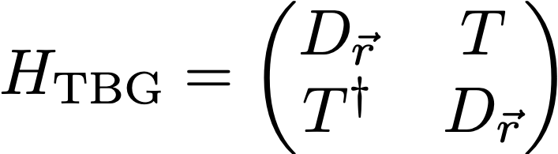
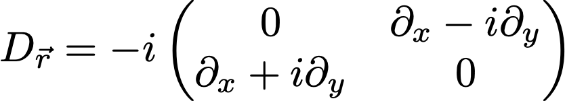
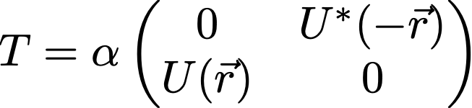

The Hamiltonian of Twisted Bilayer Graphene
Top layer
Bottun layer
Where Dirac cone
Interlayer coupling
Dimensionless controllable parameter (interlayer coupling strength and twisted angle)
Experimentally, we can adjust this parameter to find the flat bands

Slide 13

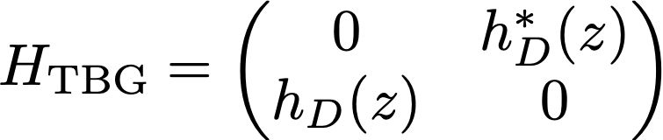
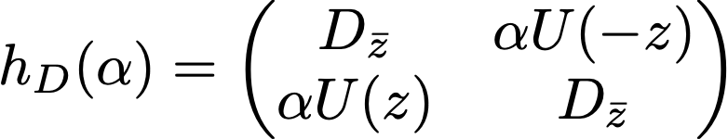

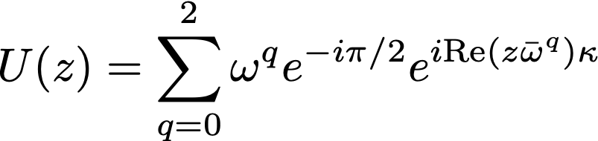



Perform Unitary transformation and
We have a block-off-diagonalized Hamiltonian
Where reduced block
K
Interlayer coupling part: the 3 terms are connected by C3 rotation symmetry
Hexagonal lattice periodicity
Superlattice

Slide 14

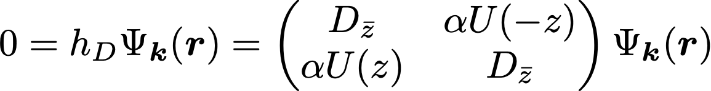






Solve zero-energy eigenvalue problem for all
If
is a zero energy solution at
Use holomorphic function to extend it to any
where
NOT holomorphic
Obey Bloch’s theorem
However, based on Liouville’s theorem
Meromorphic: unbounded = poles

Slide 15
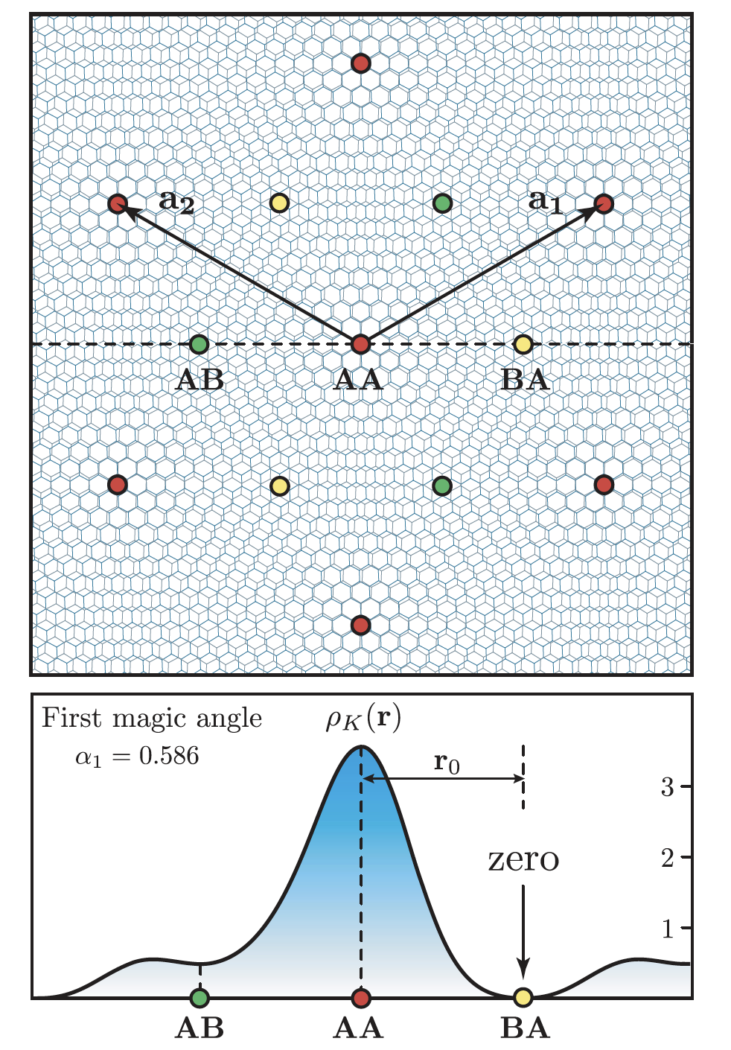





So it is a flat band solution?
Twisted bilayer graphene in real space
Yes, only at magic angles
The wavefunction vanishes
The pole of is adjusted to be located at
Therefore
can be the zero-energy solution in entire Moire Brillouin zone
A. Vishwanath et al. PRL 122, 106405 (2019)
Two-fold degenerate Flat bands

Slide 16
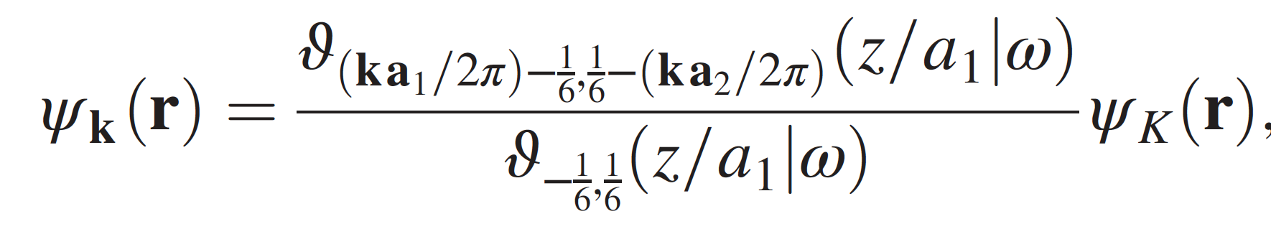

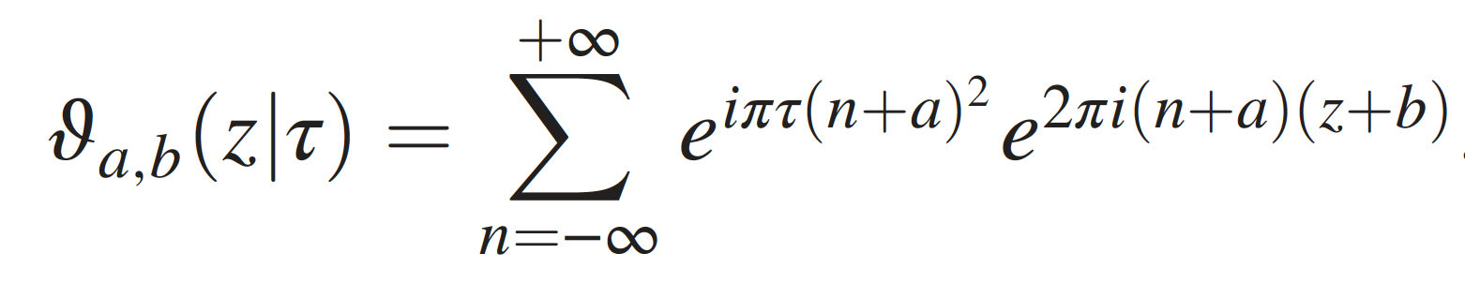

Technical Details of wavefunction construction
A. Vishwanath et al. PRL 122, 106405 (2019)
Adjust its pole to annihilate the zero in
Obey Bloch’s theorem
Theta function

Slide 17

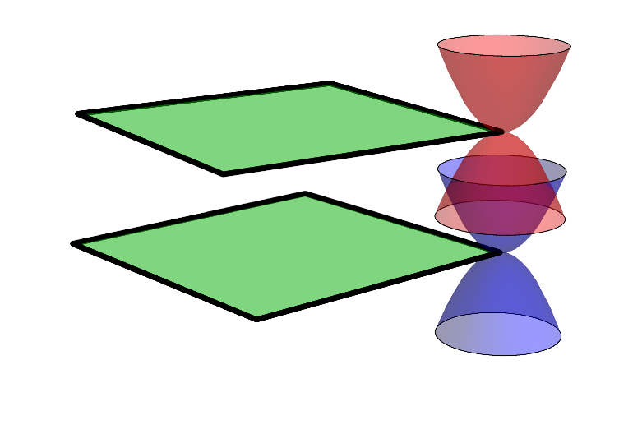
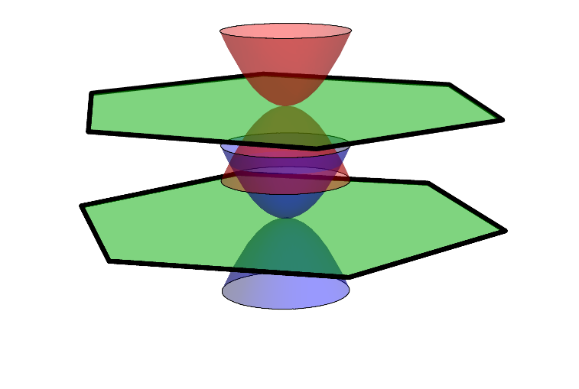
Generalized Cases
1. n-ordered topological nodes
2. Nodes at rotation centers
K
K
M
M

Slide 18

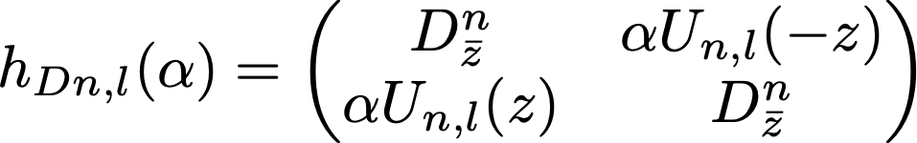
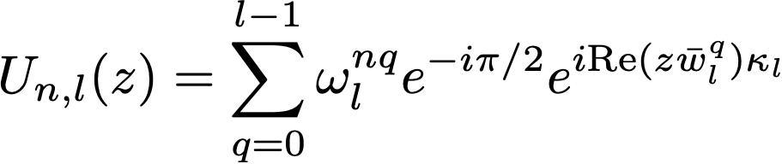


Generalized Twisted Bilayers
Twisted bilayer graphene
Generalized Hamiltonian block
Look for flat bands

Slide 19
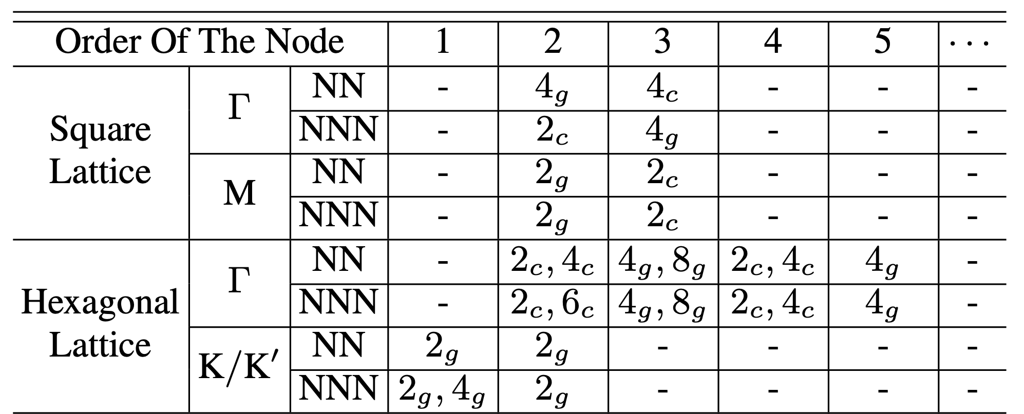
Classification of topological nodes in twisted bilayers
With degeneracy
g: gapped flat bands
c: no gap
Fan Cui, Congcong Le, Qiang Zhang, Xianxin Wu, Jiangping Hu, C.-K. Chiu, Sci. China Phys. Mech. Astron. 67, 297012 (2024)
Two types of interlayer coupling
NN: Nearest Neighbor only
NNN: Next Nearest Neighbor included

Slide 20
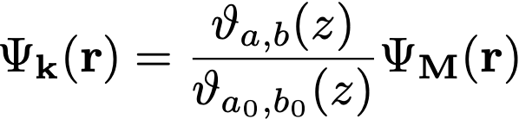

Classification of topological nodes in twisted bilayers
With degeneracy
g: gapped flat bands
c: no gap
Fan Cui, Congcong Le, Qiang Zhang, Xianxin Wu, Jiangping Hu, C.-K. Chiu, Sci. China Phys. Mech. Astron. 67, 297012 (2024)
Number 2: 2-fold degenerate flat bands
Theta function

Slide 21
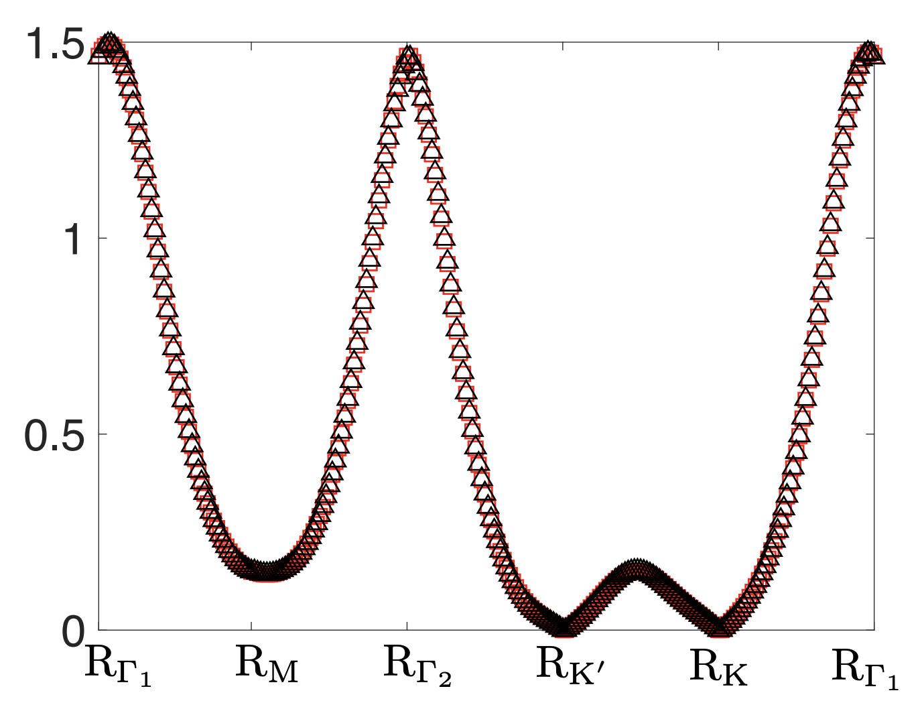


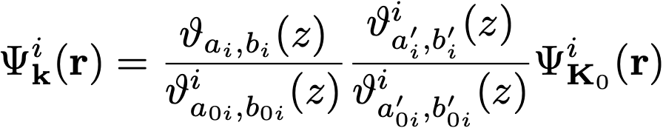
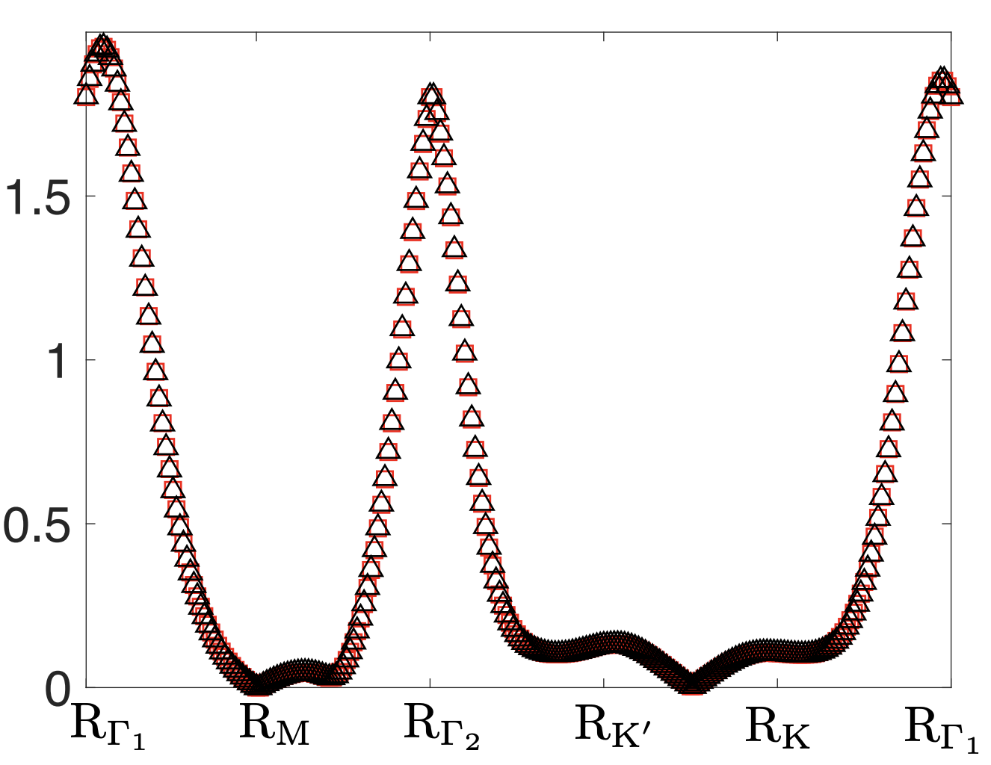

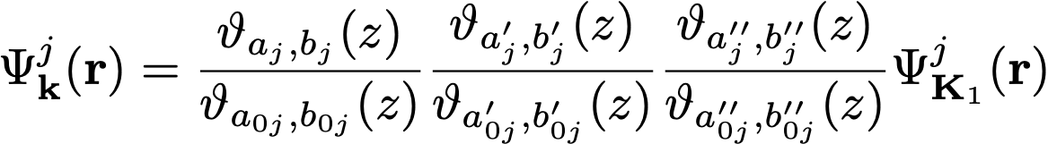
Number 4: The wavefunction has two zero nodes in real space
4-fold degenerate flat bands
Number 6: The wavefunction has three zero nodes in real space
6-fold degenerate flat bands
Real space

Slide 22
Take home message
Once the zero-energy wavefunctions for some k with zero nodes in real space exist
The bands are completely flat in the moire Brillouin zone
How to find the wavefunctions with zero nodes in real space?

Slide 23



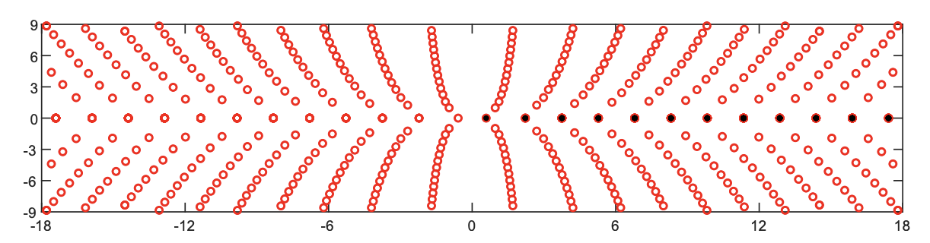
Identify zero-energy solution at k
Define the Birman-Schwinger Operator
When
Real Spectrum
Check if the wavefunction possesses zero nodes in real space
Surprisingly, the zero nodes are always present
Flat bands in the entire Moire BZ
For example: Twisted bilayer graphene
Spectrum
S. Becker, M. Embree, J. Wittsten, and M. Zworski,
Probability and Mathematical Physics 3, 69 (2022)

Slide 24

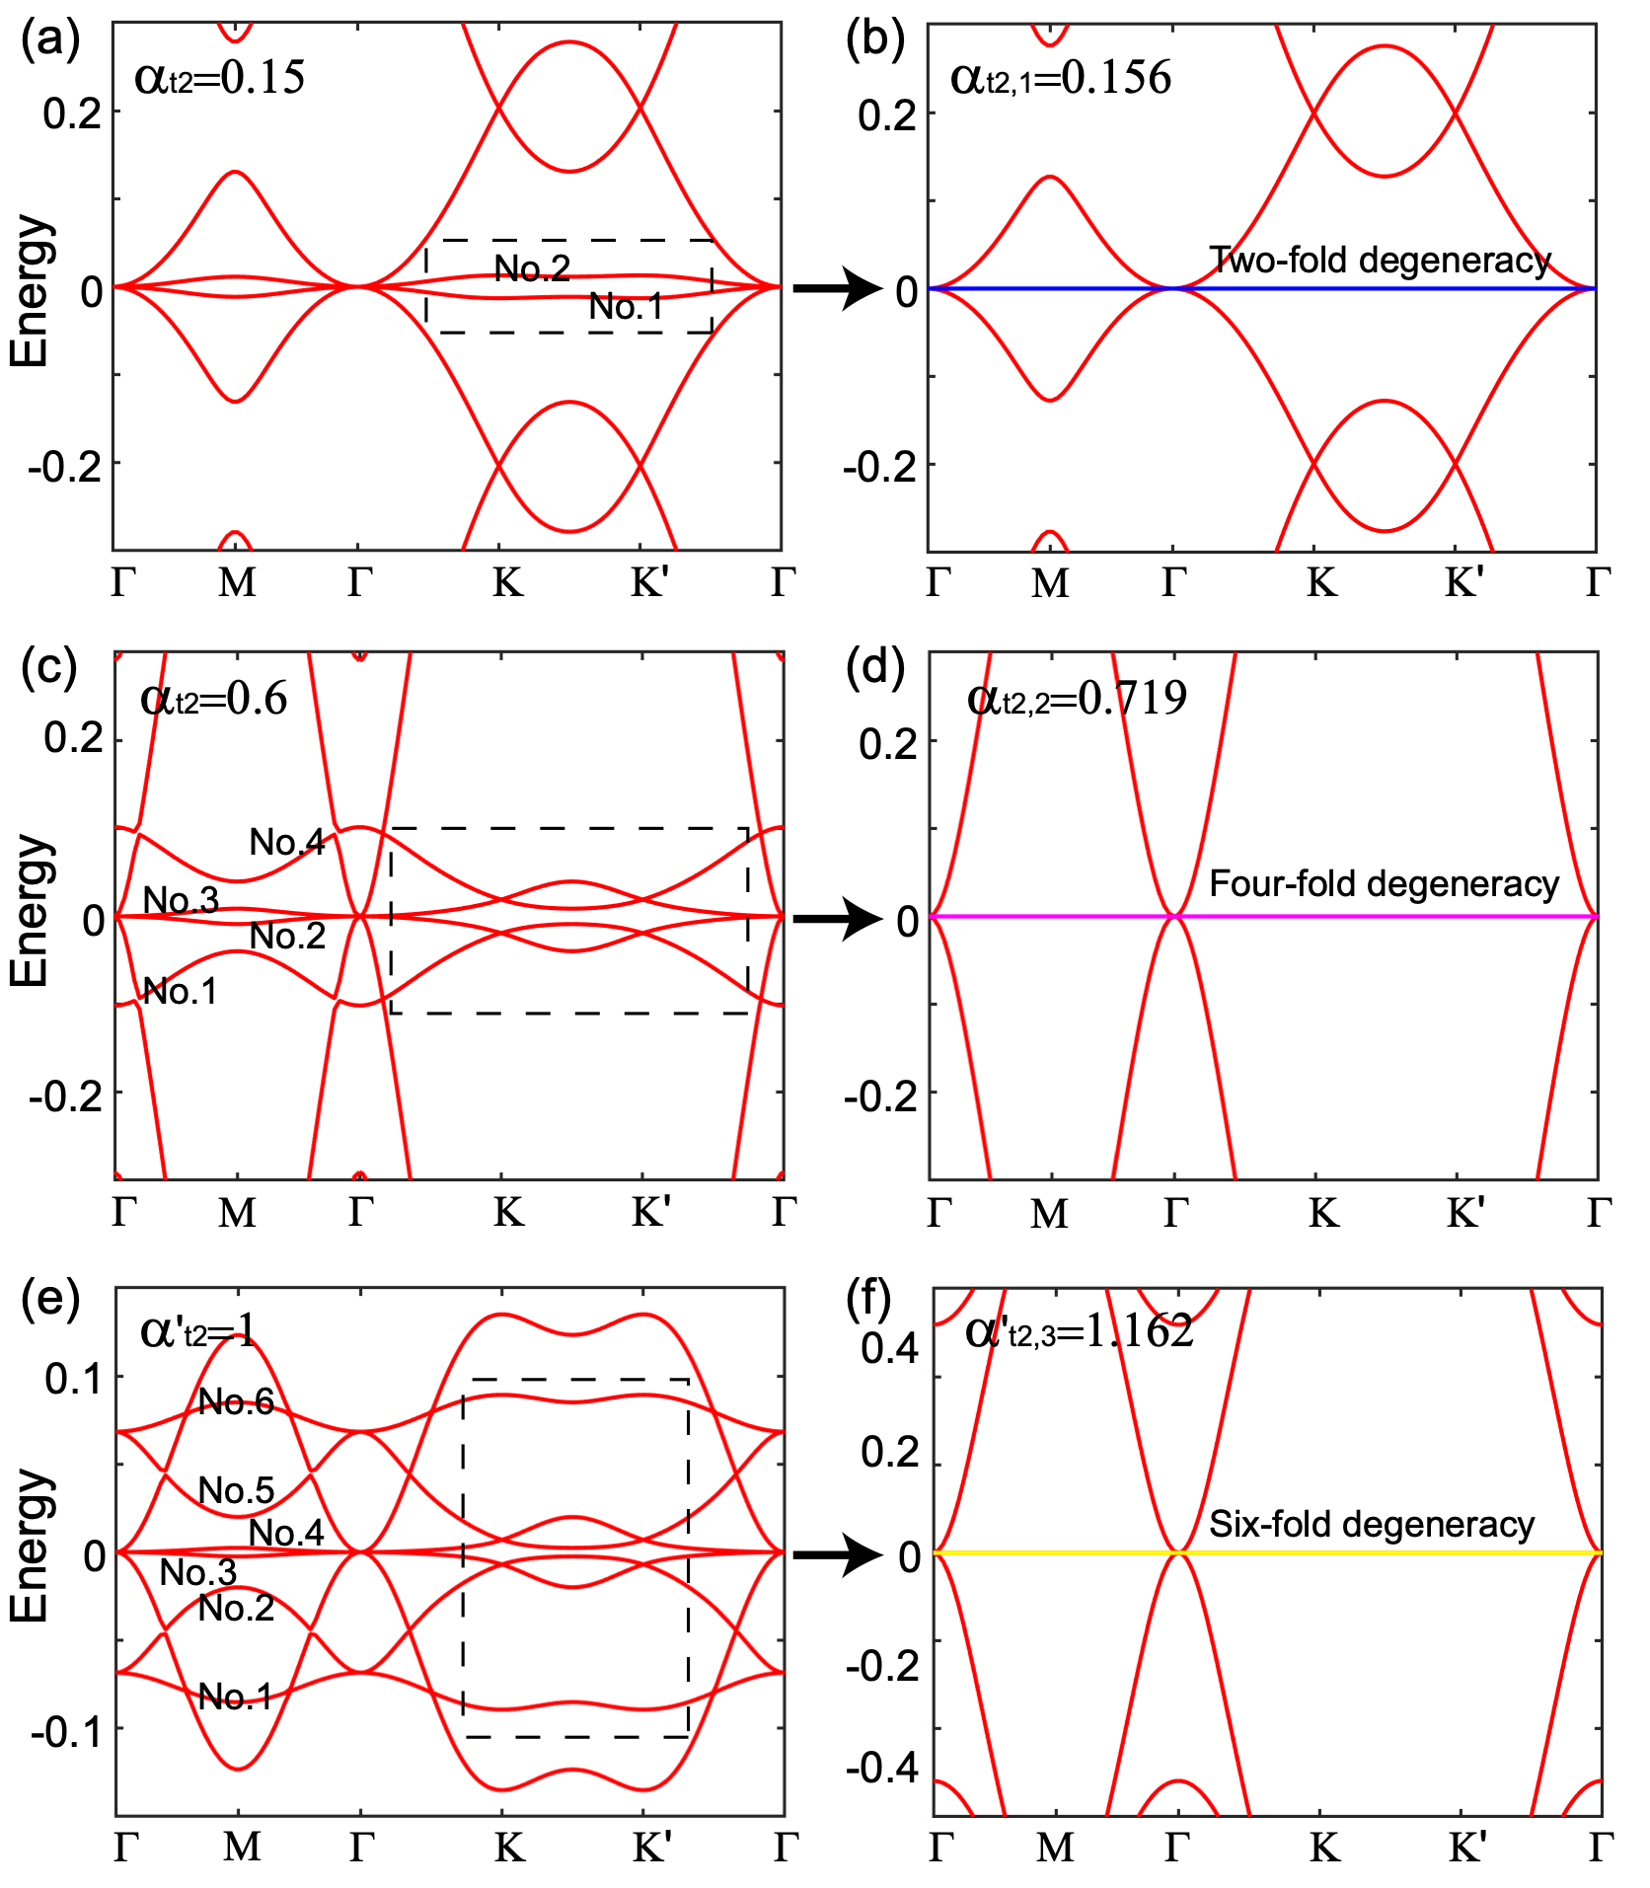

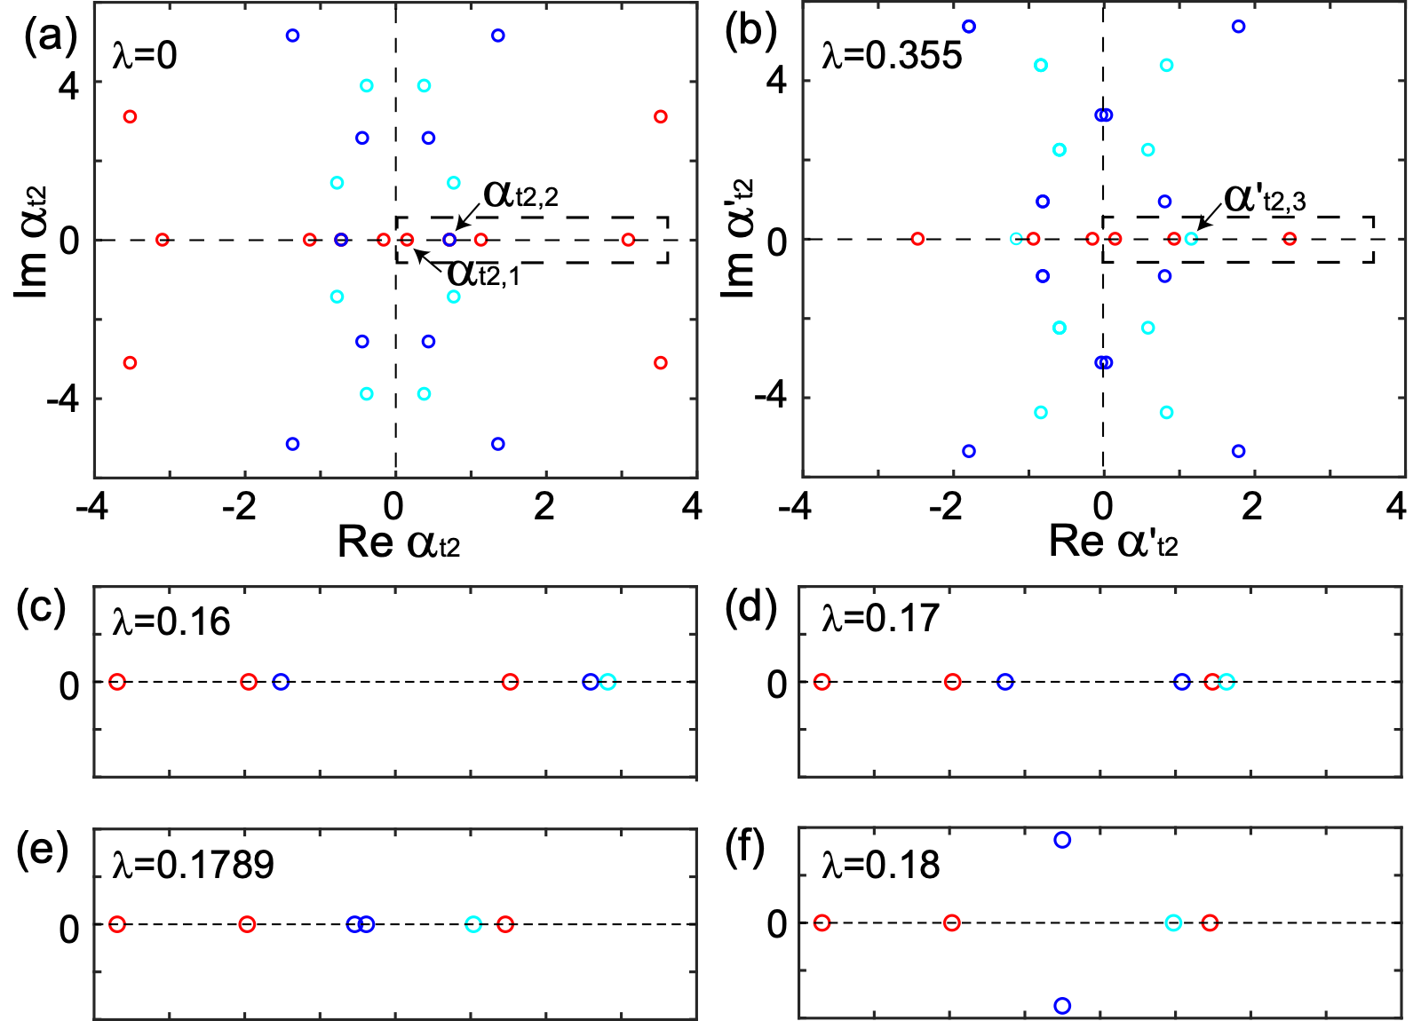
Quadratic node at in hexagonal BZ
NN
NN + NNN
NN : Two-fold & four-fold degenerate flat bands
NN+ NNN : additional six-fold degenerate flat bands

Slide 25

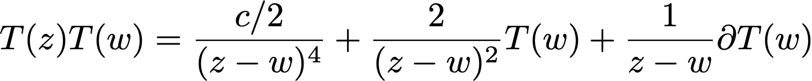


Summary
Beyond topological Dirac semimetals, twisted bilayer with high-ordered topological nodes can also form Moire flat bands. The node location can be 𝛤, M in square Brillouin zone or 𝛤, K, K’ in hexagonal Brillouin zone.
The band flatness in the Moire Brillouin zone can be shown by the extension of holomorphic functions.
Holomorphic functions are used in many fields
Conformal Field Theory
Quantum Hall State
Lowest Landau Level

