Slide 1
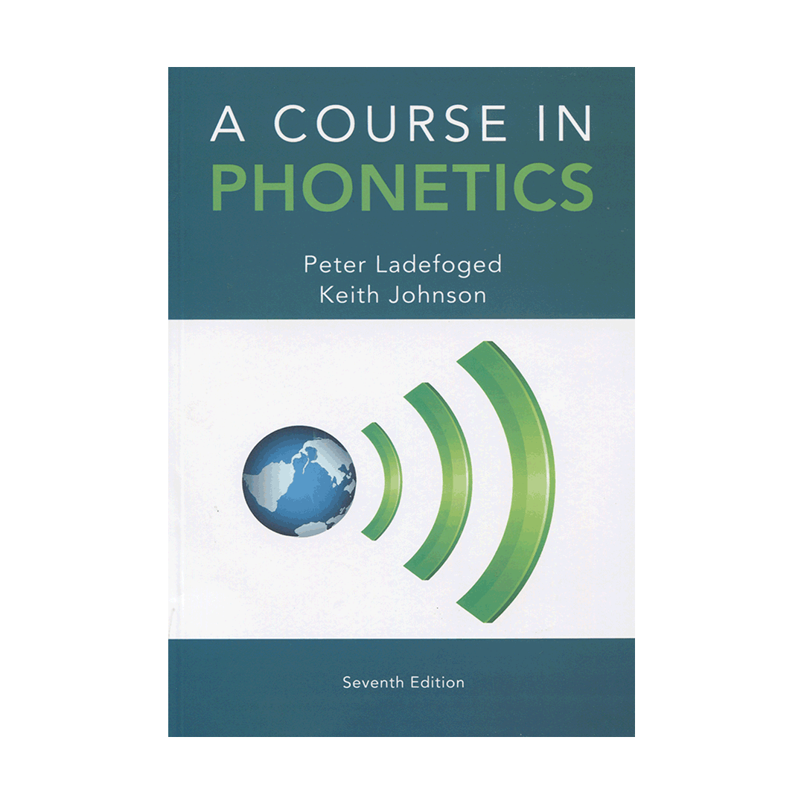
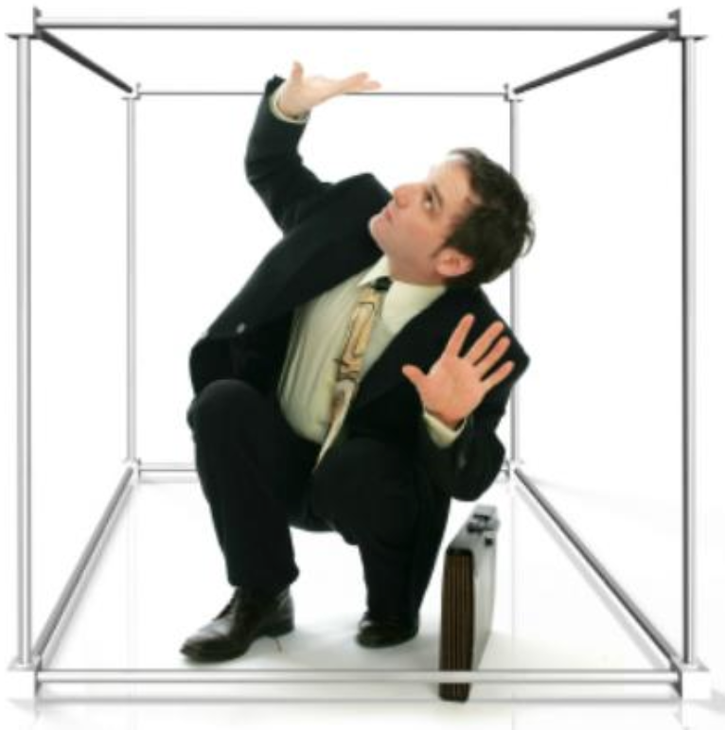
Real-World Phonetics: Don’t get stuck in the textbook! 不被課本綁住的 生活語音學 Karen Steffen Chung 史嘉琳 台大外文系 副教授

Slide 2

Required class?
Introduction to Phonetics

Slide 3
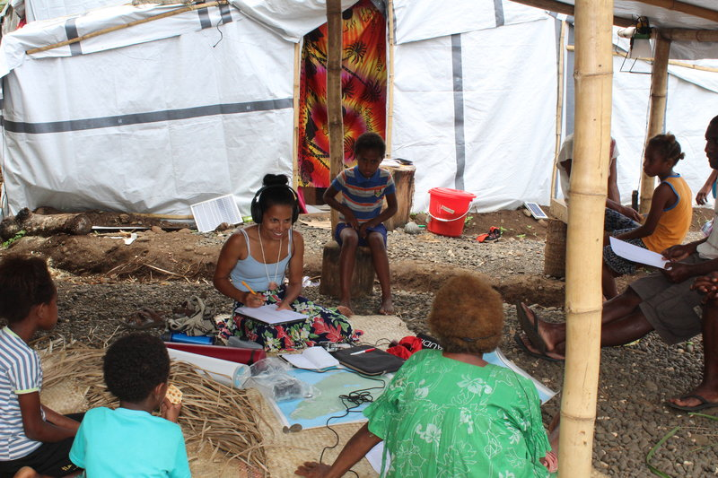
…or eye and ear opener?
Doing phonetic fieldwork

Slide 4
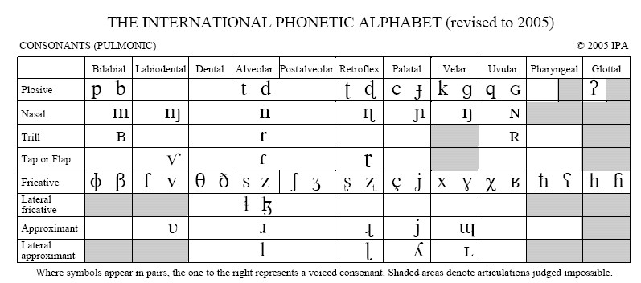
The International Phonetic Alphabet (IPA) symbol chart: Consonants

Slide 5
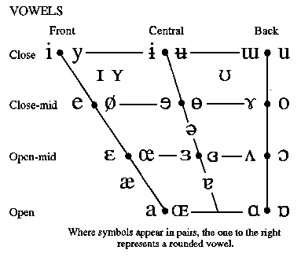
The International Phonetic Alphabet (IPA) symbol chart: Vowels

Slide 6
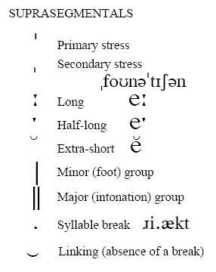
The International Phonetic Alphabet (IPA) symbol chart: Suprasegmentals

Slide 7
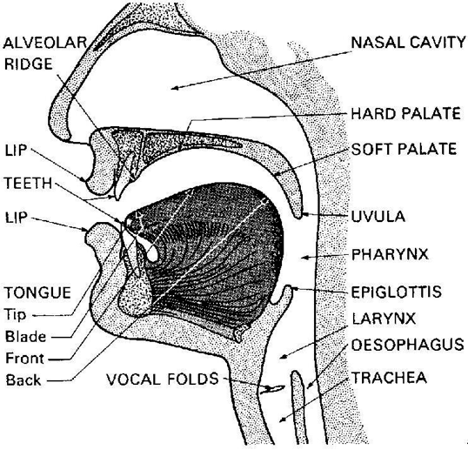
Articulatory phonetics
Mid-sagittal view of the head

Slide 8

What do your vocal folds look like, and how do they work?
Fantastic Voyage: A Journey into the Human Voice
http://homepage.ntu.edu.tw/~karchung/salon/vocalfolds.mp4

Slide 9
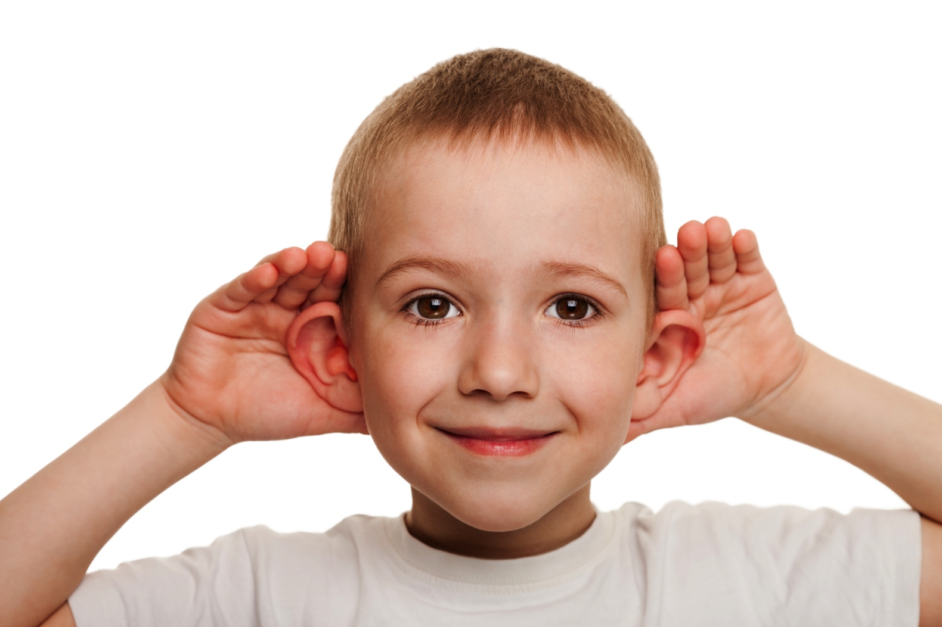
Open your ears!

Slide 10
A short listening quiz
1. a. expansive
b. expensive
2. a. ear
b. year
3. a. wreck
b. rack
4. a. mottoes
b. models
5. a. ran
b. wren c. rain
d. rang
6. a. peak
b. pig
c. pick
7. a. fast
b. fest
c. faced
8. a. larger
b. lodger
9. a. pubs
b. pups
10. a. called
b. cold c. code d. coat e. colt

Slide 11
What is compound noun stress? (1)
1. the final chapter
2. airport terminal
3. initial design
4. search dogs
5. high seas
6. design flaw
7. thankless task 8. construction companies

Slide 12
What is compound noun stress? (2)
9. travel website
10. structural innovation
11. prime minister
12. personal story
13. baby step
14. red tape
15. food specialty
16. street musicians

Slide 13
Does Chinese have contractions,like English do not = don’t?
馬上來 常常來 大家都知道 進去看
非常好 學生證
好像 摩托車
那種 腳踏車
林先生 計程車

Slide 14
Can you propose a rule for contraction and elision in Chinese?

Slide 15
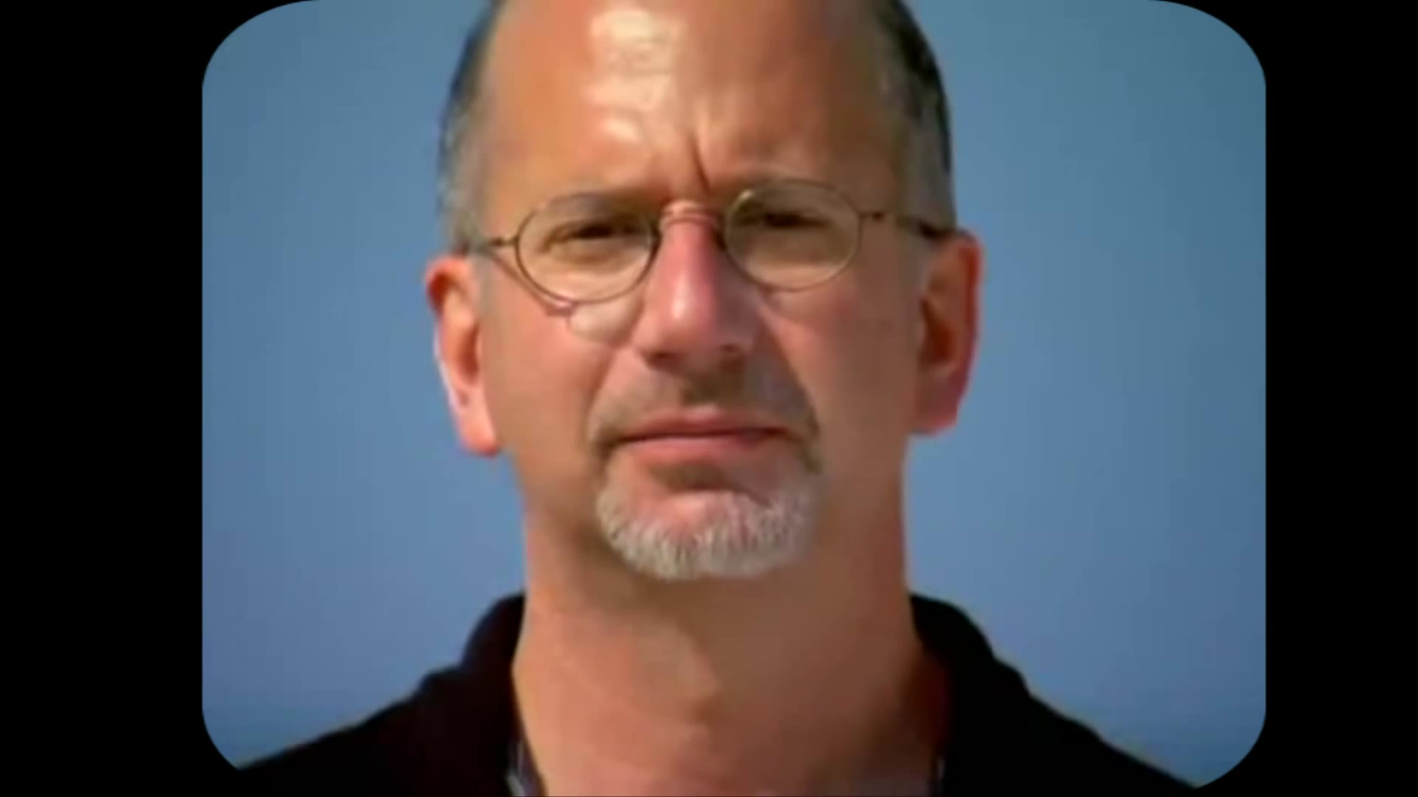
The McGurk Effect: Do you believe your eyes more, or your ears?
http://homepage.ntu.edu.tw/~karchung/salon/McGurk.mp4

Slide 16
Review: Do you remember the names of all the articulatory organs?
Mid-sagittal view of the head

Slide 17
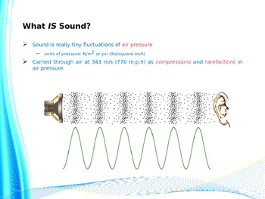
Acoustic phonetics
One of the few liberal arts classes where you can do math and physics again!

Slide 18
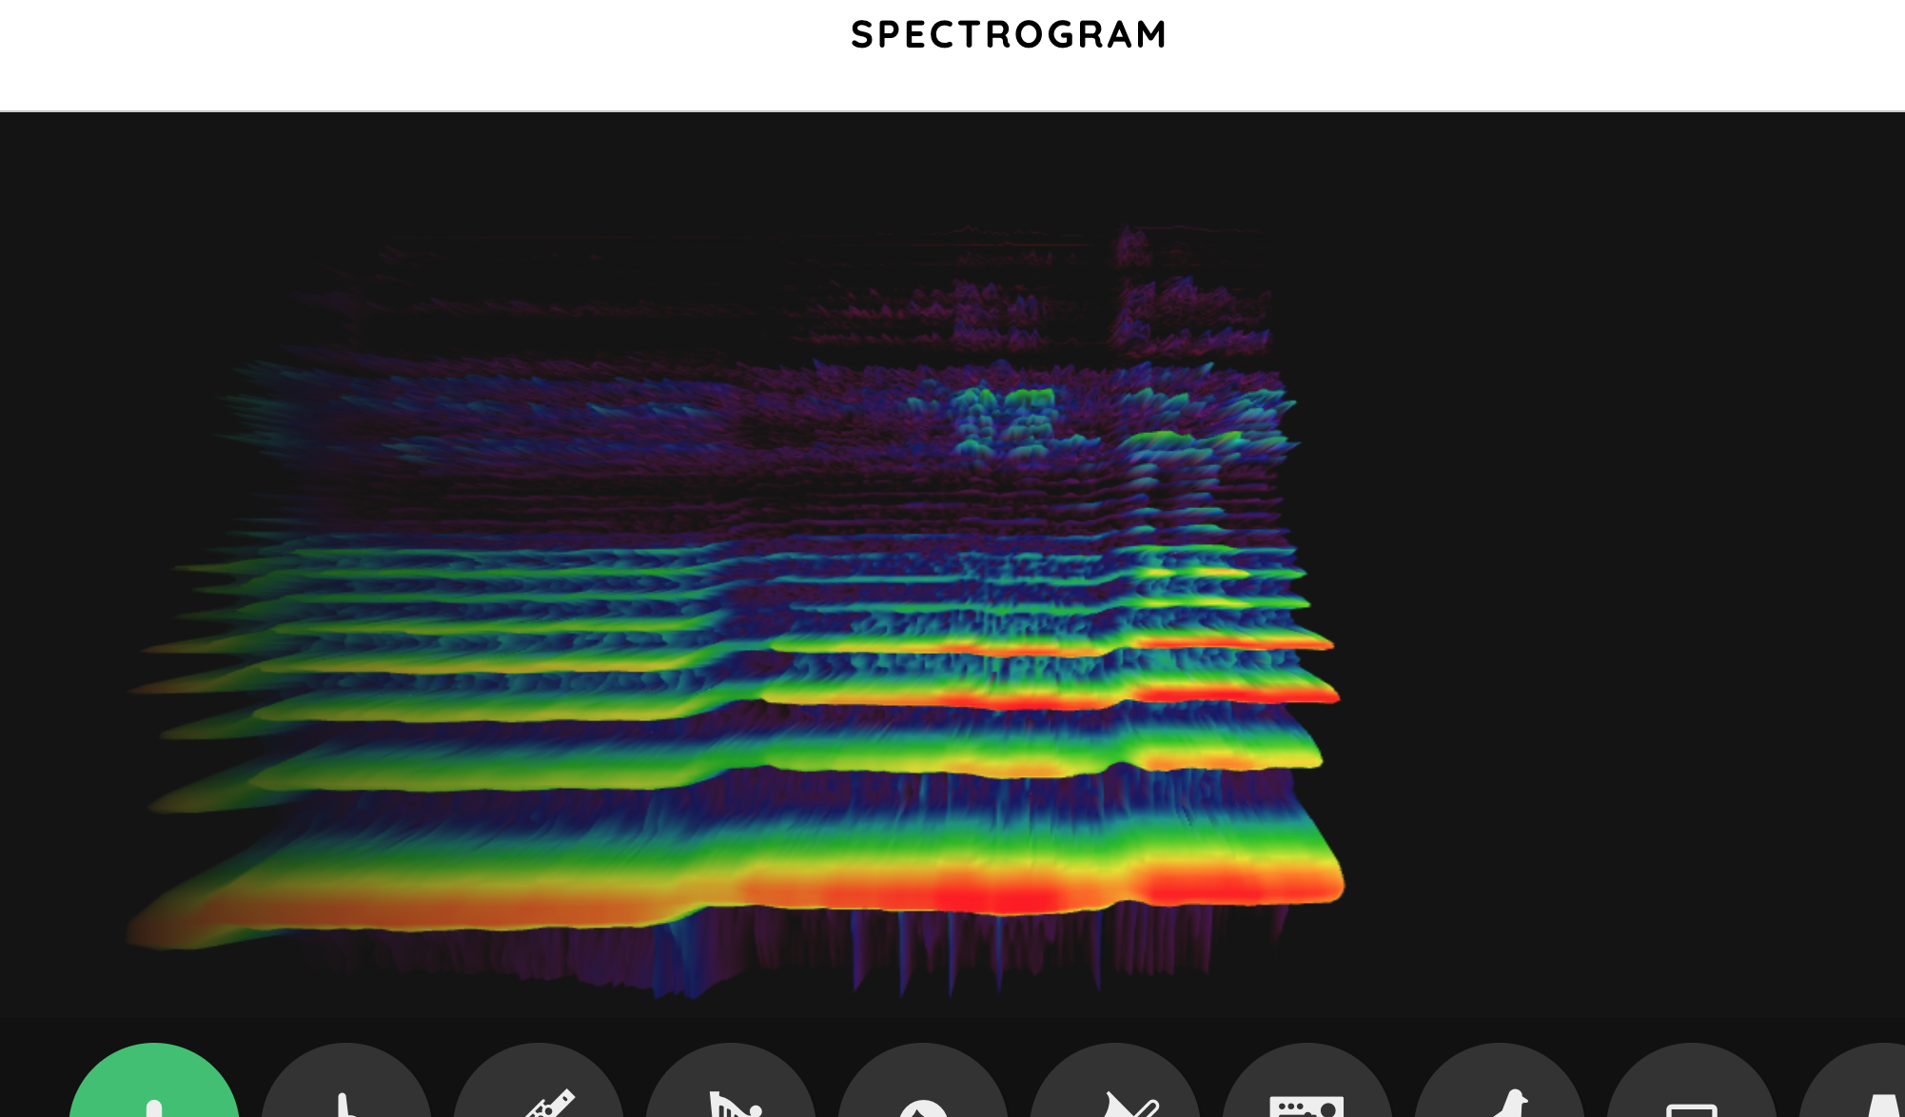
How can you visualize sound?
https://musiclab.chromeexperiments.com/Spectrogram/

Slide 19

Taiwan has a wealth of languages to explore, both indigenous…

Slide 20
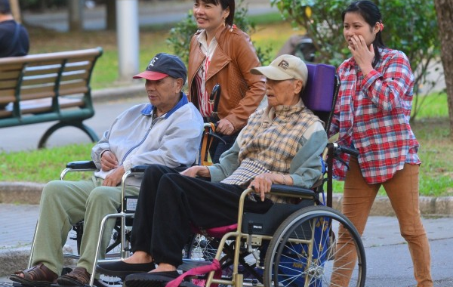
…and more recent additions.

Slide 21

Does your home sing to you?
Commercial for Amazon’s Dash button
http://homepage.ntu.edu.tw/~karchung/salon/AmazonDash.mp4

Slide 22
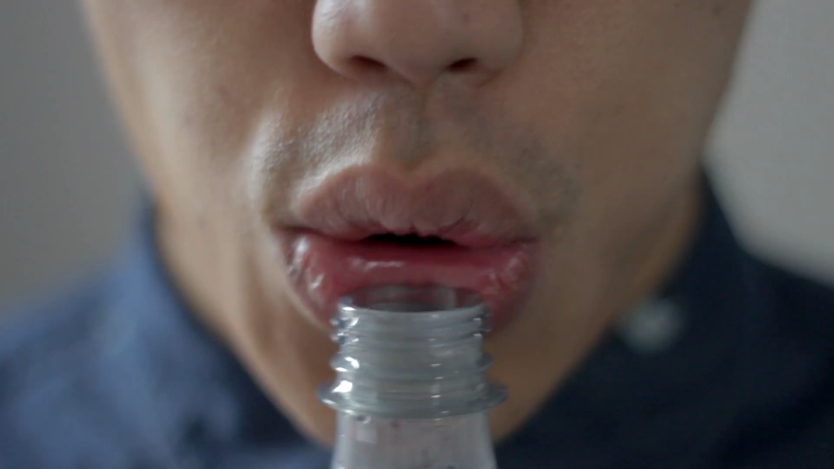
Can it make real music?
Performed with household items by Andrew Huang, 2014
http://homepage.ntu.edu.tw/~karchung/salon/Huang2014.mp4

Slide 23
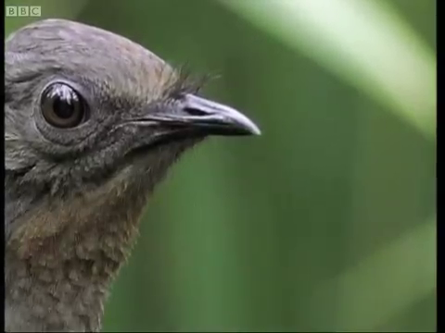
Other species that know how to open their ears
The lyre bird David Attenborough: BBC Earth
http://homepage.ntu.edu.tw/~karchung/salon/Lyrebird.mp4

Slide 24
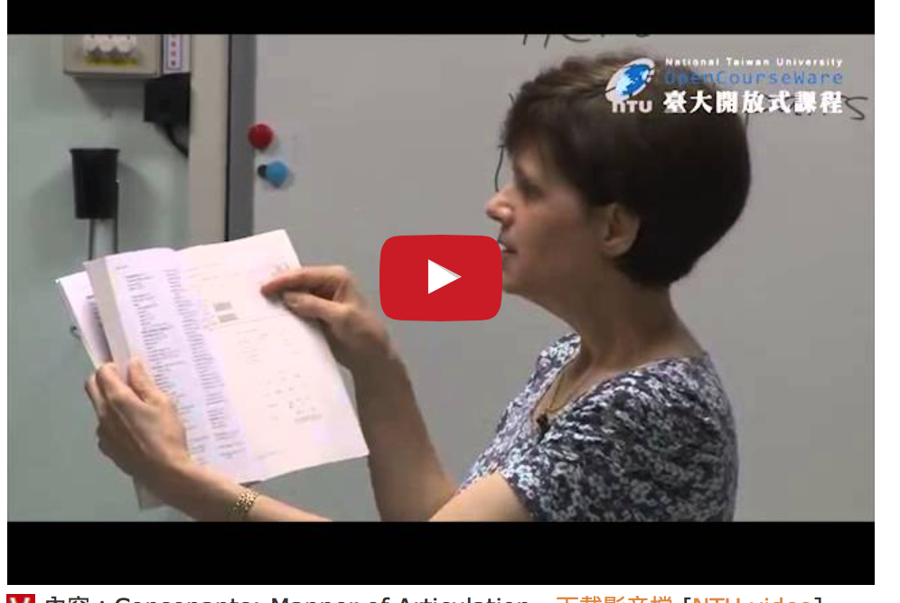
Learn phonetics online
http://ocw.aca.ntu.edu.tw/ntu-ocw/index.php/ocw/cou/101S102

Slide 25
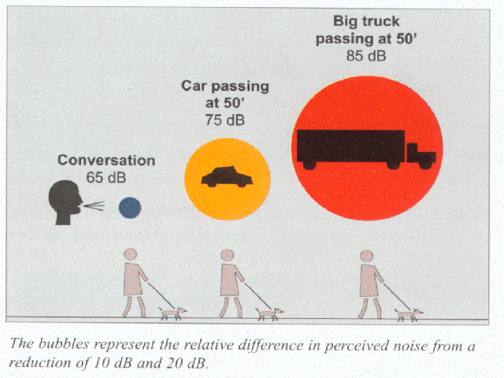
Questions and feedback welcome!

