Slide 1
An Introduction to the and Text Mark-up Chander Tseng 曾國奕 October 2015

Slide 2
IPA = International Phonetic Alphabet

Slide 3
English Consonants

Slide 4
English Vowels

Slide 5
Study the IPA symbol handout before our next class!

Slide 6
Text Mark-up Symbols
For
dictations
text markup
(3) marking compound noun stress
in this class

Slide 7
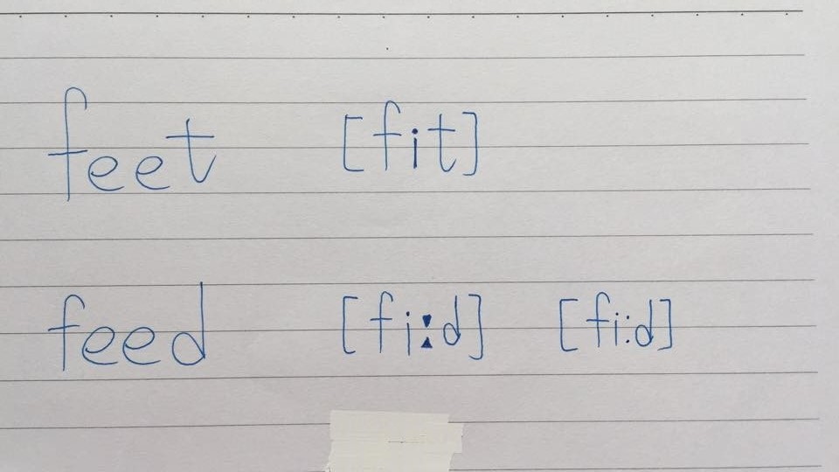
1. How to Mark Length
If a vowel is extra long, add a length mark [ː] or colon [:].

Slide 8
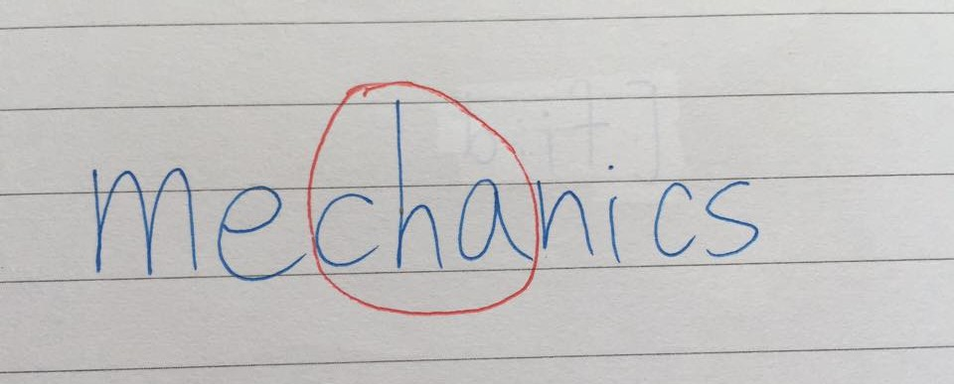
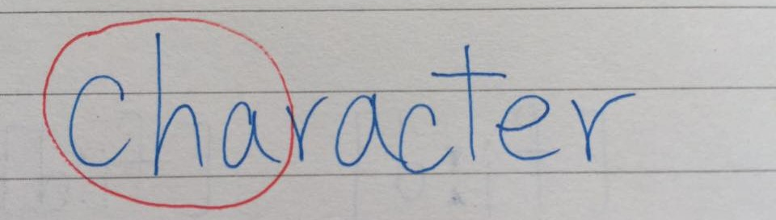
2. How to Mark Stressed Syllables
Circle each stressed syllable.
Watch out for syllable count and syllable boundaries!

Slide 9
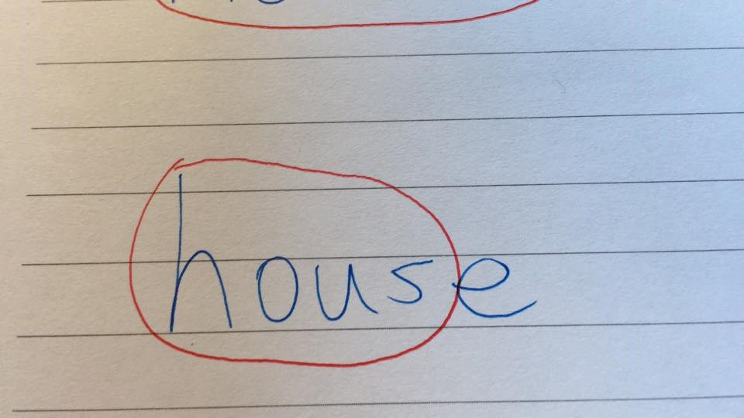
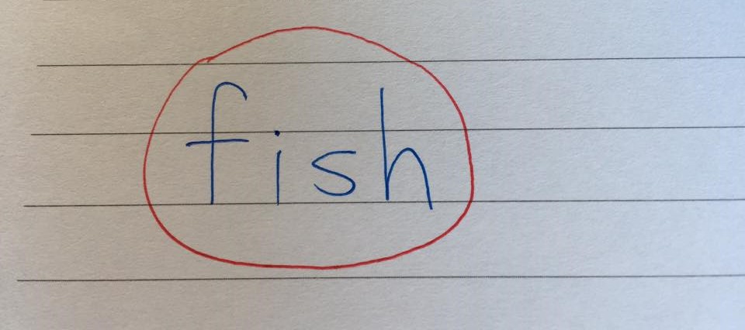
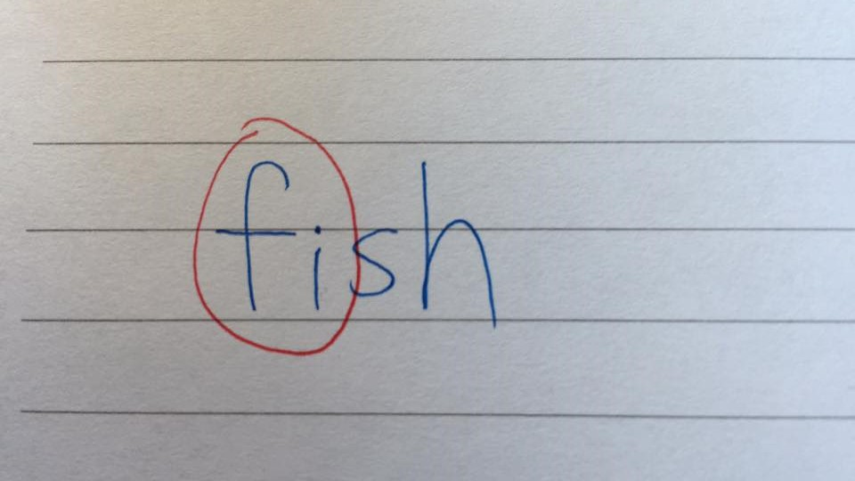
Circle the entire word if it has only one syllable!

Slide 10
3. How to Mark Tonic Stress
Mark the last stressed syllable in each phrase with an asterisk *

Slide 11
4. Mark a short pause with a vertical line |, a longer pause with a double vertical line ||.

Slide 12
5. Use curved lines to mark continuation rises and other rising or falling intonations.

Slide 13
這兩個符號不一樣喔!
//
[]
General, theoretical, a sound category; used in dictionaries
More detailed and precise; how a sound is actually pronounced
/t/ 音位的發音表現可能有很多個：
take → [tʰ]
water → [ɾ] tap
sit → [t̚] 不除阻

Slide 14
Review
Length mark [ː] [:]
Stress marking (circle syllable)
Asterisk * for tonic stress
Vertical line l for short pauses and double vertical line ll for longer pauses
Intonational curves
/ / vs. [ ]

