Slide 1
Linear Algebra 線性代數
顏嗣鈞
台灣大學電機系

Slide 2
Course Information
Instructor: 顏嗣鈞; E-mail: hcyen@ntu.edu.tw
Time: 9:10-12:00, Friday
Place: BL 103
Personal Website:
https://homepage.ntu.edu.tw/~hcyen/index.html
Course Materials: Textbook + Slides
(除了標註※之簡報外，其餘採用李宏毅教授之投影片教材)
Class web page: the following and NTUCool
https://homepage.ntu.edu.tw/~hcyen/courses/LA-2025.html
課程共同網站: https://r10942172.github.io/NTUEELA2025/
TA: 許富盈、 博理館606室
※

Slide 3
顏嗣鈞
https://homepage.ntu.edu.tw/~hcyen/
學歷 博士 Univ. of Texas at Austin (CS) 1986
碩士 交大計算機工程研究所 1982
學士 台大電機系 1980
經歷 台大電機系 教授 1991-present
台大電機系 副教授 1990-1991
美國 Iowa State Univ.
計算機科學系 助理教授 1986-1990
授課: 線性代數、計算理論(研)、資料結構、演算法、離散數學
專長 演算法、計算理論、圖形繪製與資訊視覺化
※

Slide 4

Required Textbook
Elementary Linear Algebra - A Matrix Approach
2nd Ed., by L. E. Spence, A. J. Insel and S. H. Friedberg
(華泰文化代理)
上課不完全按照教科書內容但考試範圍都會講到
※

Slide 5
Course Outline
Chapter 0. Introduction
Chapter 1. Matrices, Vectors, and Systems of Linear
Equations
Chapter 2. Matrices and Linear Transformations
Chapter 3. Determinants
Chapter 4. Subspaces and Their Properties
Chapter 5. Eigenvalues, Eigenvectors, and
Diagonalization
Chapter 6. Orthogonality
Chapter 7. Vector Spaces
※

Slide 6
(Tentative) Class Schedule
Week | Date | Topic | Remark
1 | 9/5 | Intro; Sec.1.1, 1.2
2 | 9/12 | Sec. 1.3, 1.4, 1.6
3 | 9/19 | Sec. 1.7, 2.1, 2.3
4 | 9/26 | Sec. 2.4, 2.7, 2.8
5 | 10/3 | Sec. 3.1, 3.2, 4.1
6 | 10/10 | No class | 國慶日
7 | 10/17 | Sec. 4.2, 4.3, Review
8 | 10/24 | No class | 10月25日台灣光復節(補假)
9 | 10/31 | Midterm Exam Ch. 1-4
10 | 11/7 | Sec. 5.1, 5.2, 5.3
11 | 11/14 | Sec. 6.1, 6.2, 6.3, 6.4
12 | 11/21 | No class | 台大校慶運動會
13 | 11/28 | Sec. 6.5, 6.6
14 | 12/5 | Sec. 7.1, 7.2, 7.3
15 | 12/12 | Sec. 7.4, 7.5, Review
16 | 12/19 | Final Exam Ch. 1-7
Course Schedule
© 2025 NTUEE Linear Algebra. All rights reserved.

Slide 7
Grading
期中考(35%)、期末考(35%)、小考/作業 (30%)
期中和期末考採各班統一時間舉行及命題
作業與考試規則：
作業需準時繳交，遲交者將扣分。嚴禁抄襲，如有違反，將嚴重影響學期成績。
除非生病(需醫師開立證明)，不得請假及要求補考
考試作弊者，除了學期成績不及格外，並將送校議處。

Slide 8
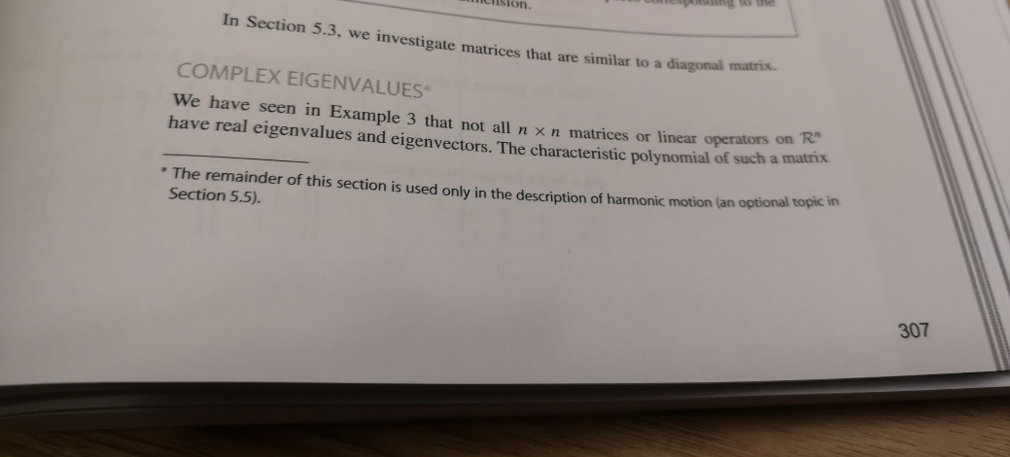
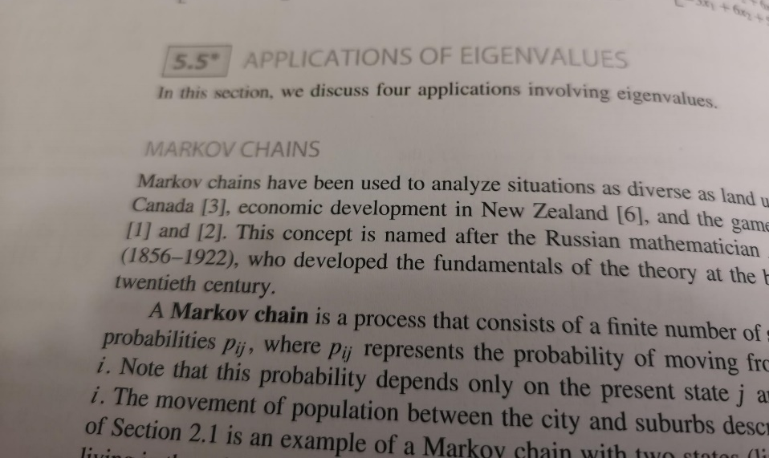
考試範圍
教科書所有未打星號*章節

Slide 9
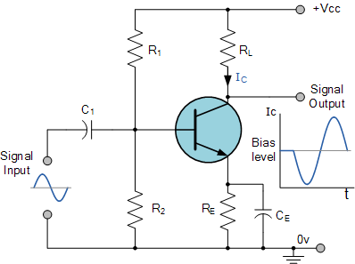
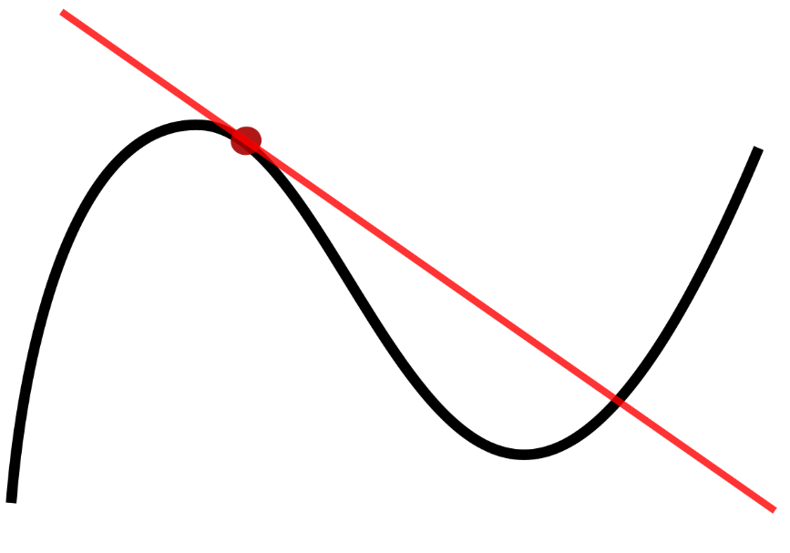
Linear Algebra
Linear: 線性
What is “Linear”? Have to do with line/plane/etc
Advantage: Simple → Efficient algorithms
Disadvantage: Too simple, (sometimes) not realistic.
“Near” linear if we zoom in
Transistor: a non-linear device
Apply bias to operate in the linear region
※
圖片資料來源: 網站

Slide 10
Algebra
(Wikipedia) Algebra is the study of variables and the rules for manipulating these variables in formulas; it is a unifying thread of almost all of mathematics.
Boolean
Algebra
Abstract
Algebra
Linear
Algebra
Boolean
Algebraic
Number Theory
Boolean
Boolean
Tensor
Algebra
Process
Algebra
※

Slide 11
Why Study Algebra?
Algebra provides a unified way of studying many problems in math., science, and engineering. E.g.
Linear Algebra (線性代數): Machine learning, Quantum computing, Coding theory, Circuit theory, Optimization, Control theory, …
Boolean algebra (布林代數): Computer circuits, Computer programming, Formal verification, …
Abstract algebra (抽象代數): Cryptography, Coding theory, Communication, Symmetry, …
※

Slide 12

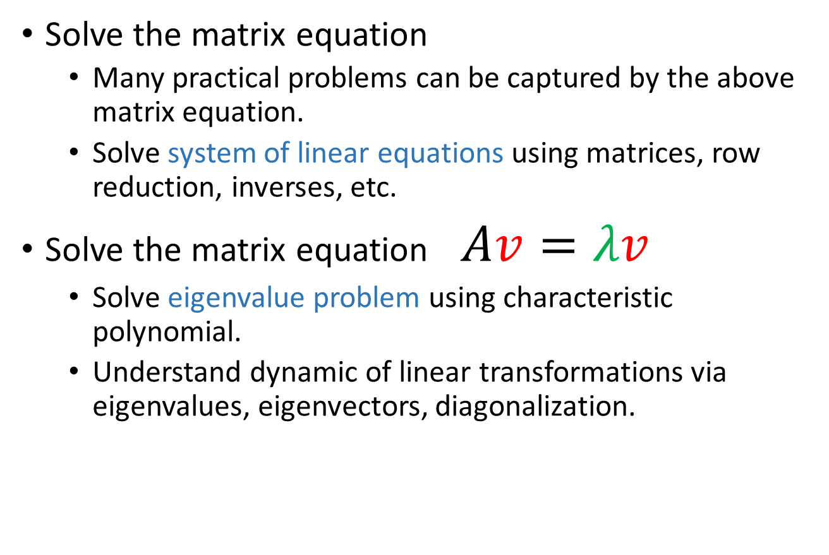
In this Course, Linear Algebra is about …
Solve the matrix equation
Many practical problems can be captured by the above matrix equation.
Solve system of linear equations using matrices, row reduction, inverses, etc.
Solve the matrix equation $Av=λv$
Solve eigenvalue problem using characteristic polynomial.
Understand dynamic of linear transformations via eigenvalues, eigenvectors, diagonalization.
In fact, large classes of engineering problems, no matter how huge, can be reduced to linear algebra.
※

Slide 13
What to learn in Linear Algebra?
Linear System

Slide 14

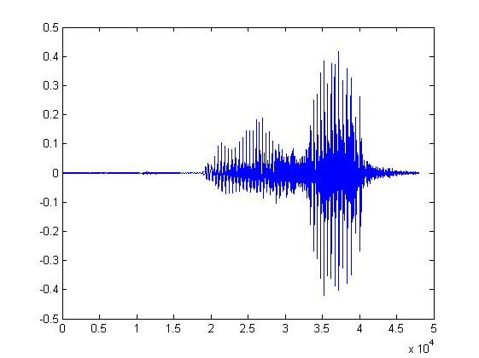


System
A system has input and output (function, transformation, operator)
Speech Recognition System
“How are you”
Dialogue System
(e.g. Siri, Alexa)
“How are you”
“I am fine”
Communication System
“Hello”
“Hello”
Notes:
Can have multiple inputs and outputs

Slide 15








Linear System
1. Persevering Multiplication
2. Persevering Addition
Linear
System
Linear
System
$$k$$
$$k$$
Linear
System
$$+$$
Linear
System
$$+$$
Linear
System
Notes:
我們用符號
可以是很多東西
但是要定義 X +
======
郭波拉第三定律說混合毒藥的解毒劑大於個別成分的解毒劑之
總合

Slide 16















Linear System
When the input and output are vectors
1. Persevering Multiplication
2. Persevering Addition
Linear
System
$$\left[\begin{aligned}3 \\ 4 \\ 5\end{aligned}\right]$$
Linear
System
$$k\left[\begin{aligned}3 \\ 4 \\ 5\end{aligned}\right]$$
$$\left[\begin{aligned}1 \\ 2\end{aligned}\right]$$
$$k\left[\begin{aligned}1 \\ 2\end{aligned}\right]$$
$$k=2$$
$$\left[\begin{aligned}6 \\ 8 \\ 10\end{aligned}\right]$$
$$\left[\begin{aligned}2 \\ 4\end{aligned}\right]$$
Linear
System
$$\left[\begin{aligned}3 \\ 4 \\ 5\end{aligned}\right]$$
$$\left[\begin{aligned}1 \\ 2\end{aligned}\right]$$
$$\left[\begin{aligned}3 \\ 4 \\ 5\end{aligned}\right]+\left[\begin{aligned}7 \\ 8 \\ 9\end{aligned}\right]$$
$$\left[\begin{aligned}1 \\ 2\end{aligned}\right]+\left[\begin{aligned}5 \\ 6\end{aligned}\right]$$
Linear
System
$$\left[\begin{aligned}5 \\ 6\end{aligned}\right]$$
Linear
System
$$\left[\begin{aligned}7 \\ 8 \\ 9\end{aligned}\right]$$
$$\left[\begin{aligned}6 \\ 8\end{aligned}\right]$$
$$\left[\begin{aligned}10 \\ 12 \\ 14\end{aligned}\right]$$
Notes:
我們用符號
可以是很多東西
但是要定義 X +

Slide 17
Are they Linear?

Slide 18



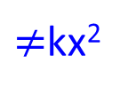




Linear?
System
NO
x
x²
1. Persevering Multiplication
2. Persevering Addition
System
System
x
x²
kx
k²x²
$≠$kx²
$$x_{1}$$
System
$${\left(x_{1}\right)}^{2}$$
$$x_{1}+x_{2}$$
System
$${\left(x_{1}+x_{2}\right)}^{2}$$
System
$$x_{2}$$
$${\left(x_{2}\right)}^{2}$$
$$≠{\left(x_{1}\right)}^{2}+{\left(x_{2}\right)}^{2}$$

Slide 19


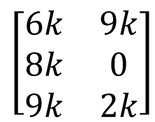

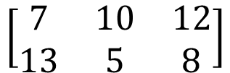


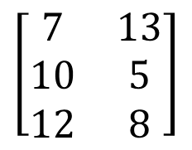


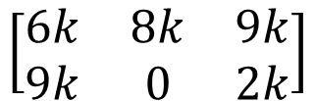

Linear?
以左上到右下的對角線為軸進行翻轉
$$\left[\begin{matrix}6 & 9 \\ 8 & 0 \\ 9 & 2\end{matrix}\right]$$
System
$$\left[\begin{matrix}6 & 8 & 9 \\ 9 & 0 & 2\end{matrix}\right]$$
Transpose
YES
$$×k$$
$$×k$$
$$\left[\begin{matrix}6k & 9k \\ 8k & 0 \\ 9k & 2k\end{matrix}\right]$$
System
$$\left[\begin{matrix}6k & 8k & 9k \\ 9k & 0 & 2k\end{matrix}\right]$$
$$\left[\begin{matrix}6 & 9 \\ 8 & 0 \\ 9 & 2\end{matrix}\right]$$
System
$$\left[\begin{matrix}6 & 8 & 9 \\ 9 & 0 & 2\end{matrix}\right]$$
$$\left[\begin{matrix}7 & 13 \\ 10 & 5 \\ 12 & 8\end{matrix}\right]$$
System
$$\left[\begin{matrix}1 & 4 \\ 2 & 5 \\ 3 & 6\end{matrix}\right]$$
System
$$\left[\begin{matrix}1 & 2 & 3 \\ 4 & 5 & 6\end{matrix}\right]$$
$$\left[\begin{matrix}7 & 10 & 12 \\ 13 & 5 & 8\end{matrix}\right]$$

Slide 20




Linear?
YES
Derivative
function f
function f’
$$f→f^{′}$$
x²
$$g→g^{′}$$
2x
$$kf→kf^{′}$$
$$f+g→f^{′}+g^{′}$$
3x
3
Notes:
導數

Slide 21
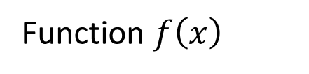
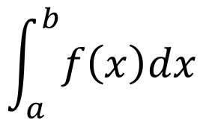
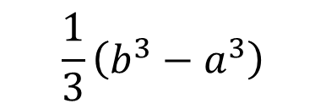

Linear?
$$\frac{1}{3}\left(b^{3}−a^{3}\right)$$
$$f\left(x\right)=x^{2}$$
Integral
(from a to b)
$$\int_{a}^{b}{f\left(x\right)dx}$$
Function $f\left(x\right)$
scalar
Area
a
b

Slide 22

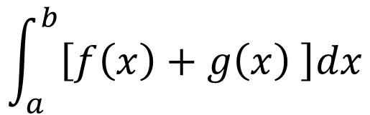



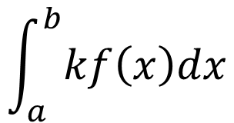





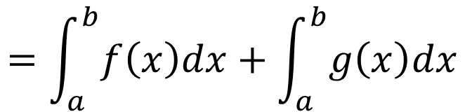
Linear?
$$\int_{a}^{b}{f\left(x\right)dx}$$
$$f\left(x\right)$$
YES
Persevering Multiplication
$$\int_{a}^{b}{kf\left(x\right)dx}$$
$$kf\left(x\right)$$
$$=k\int_{a}^{b}{f\left(x\right)dx}$$
Persevering Addition
$$\int_{a}^{b}{f\left(x\right)dx}$$
$$\int_{a}^{b}{g\left(x\right)dx}$$
$$f\left(x\right)$$
$$g\left(x\right)$$
$$\int_{a}^{b}{\left[f\left(x\right)+g\left(x\right) \right]dx}$$
$$f\left(x\right)+g\left(x\right)$$
$$=\int_{a}^{b}{f\left(x\right)dx}+\int_{a}^{b}{g\left(x\right)dx}$$

Slide 23
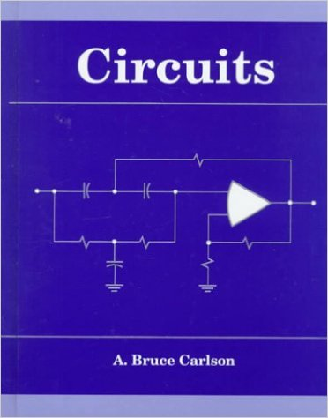


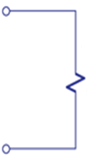
電路學
Input: voltage source, current source
Linear
output: voltage and current on the load (燈泡、引擎)
Circuit
+
-
(大一必修)
input
output
Linear System
Notes:
Desing filtering

Slide 24
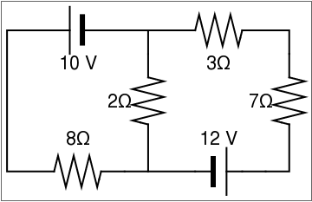



An Application
Kirchhoff’s Laws
10 - 8i₁ -2(i₁ − i₂ ) = 0,
12 -2(i₂ − i₁) −7i₂ − 3i₂ = 0
10i₁ − 2i₂ =10
2 i₁ − 12i₂ = -12
+
-
i₁
i₂
$$A=\left[\begin{matrix}10 & −2 \\ 2 & −12\end{matrix}\right]$$
$$x=\left[\begin{matrix}i_{1} \\ i_{2}\end{matrix}\right]$$
$$b=\left[\begin{matrix}10 \\ −12\end{matrix}\right]$$
※

Slide 25
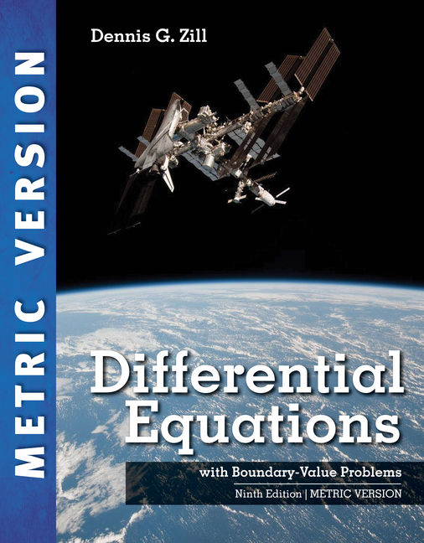
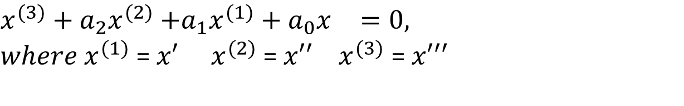
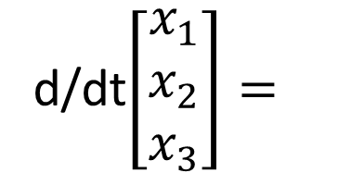
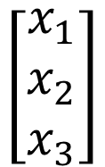
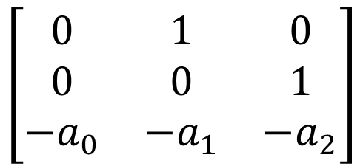
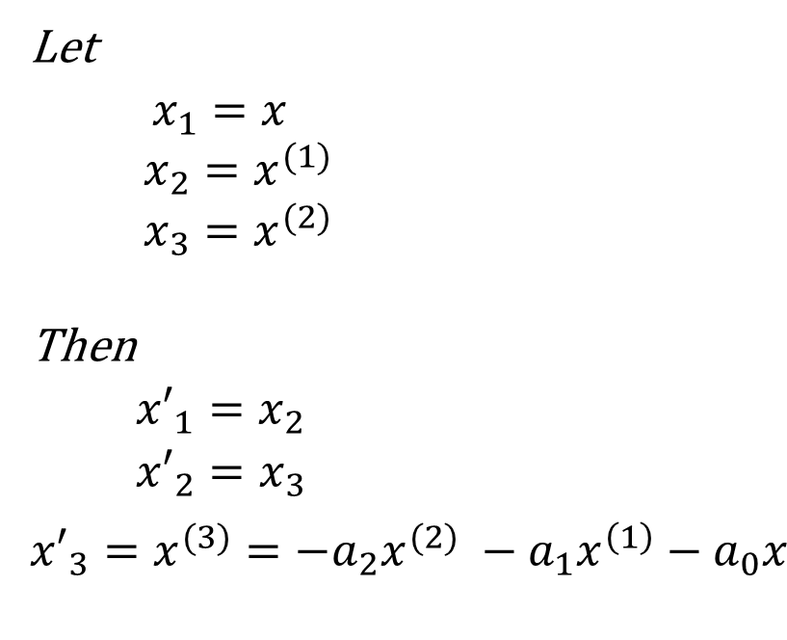
微分方程
(大二上必修)
${x^{(3)}+a_{2}x}^{(2)}$ $+a_{1}x^{(1)}+a_{0}x^{}=0,$
$where x^{(1)}$ = ${x′}^{}$ $x^{(2)}$ = ${x′′}^{}$ $x^{(3)}$ = ${x′′′}^{}$
Let
$$x_{1}{=x}^{}$$
$$x_{2}{=x}^{(1)}$$
$$x_{3}{=x}^{(2)}$$
Then
$${x′}_{1}{=x_{2}}^{}$$
$${x′}_{2}{=x_{3}}^{}$$
$${x′}_{3}{=x^{(3)}={−a_{2}x}^{(2)} −a_{1}x^{\left(1\right)}−a_{0}x^{}}^{}$$
d/dt$\left[\begin{matrix}x_{1} \\ x_{2} \\ x_{3}\end{matrix}\right]=$
$$\left[\begin{matrix}0 & 1 & 0 \\ 0 & 0 & 1 \\ −a_{0} & −a_{1} & −a_{2}\end{matrix}\right]$$
$$\left[\begin{matrix}x_{1} \\ x_{2} \\ x_{3}\end{matrix}\right]$$
x’ = Ax
Linear Algebra meets Differential Equation
※
Notes:
像無線通訊訊號在介質中的傳播就可以用線性系統來模擬

Slide 26
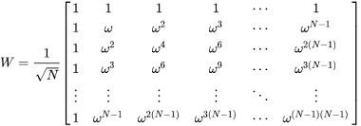
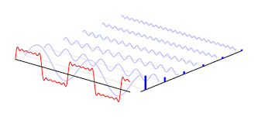
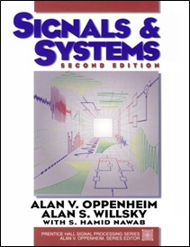
信號與系統
(大二下必修)
Complex …
but linear
Basically just
change of basis
time
frequency
Fourier
Transform
Linear System

Slide 27
Why Taking One Semester?
Most of you know how to solve systems of linear equations in high school (高斯消去法)
Why bother spending a whole semester learning Linear Algebra?
Reason:
Often engineers need to solve lots of equations with lots of variables
Can we gain useful information about the set of solutions without having to solve the equations?
It is also challenging to recognize problems in real-world that can be formulated using linear algebra.
※

Slide 28
How to do well in this course?
Come to the class and pay attention to lectures
Read the textbook and class notes
Do homework and exercises carefully
Ask questions
Discuss with your classmates (when allowed)
Do not be afraid of mathematical proofs
Practice, practice, practice!
※

