Slide 1
Google PageRank and Eigenvector
  (除了標註※之簡報外，其餘採用李宏毅教授之投影片教材)

Slide 2


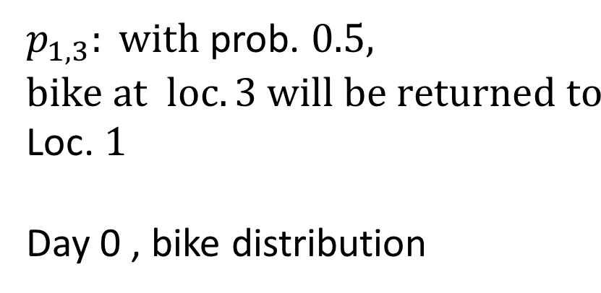


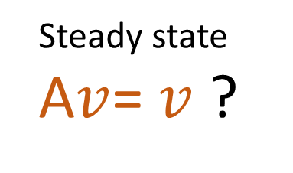

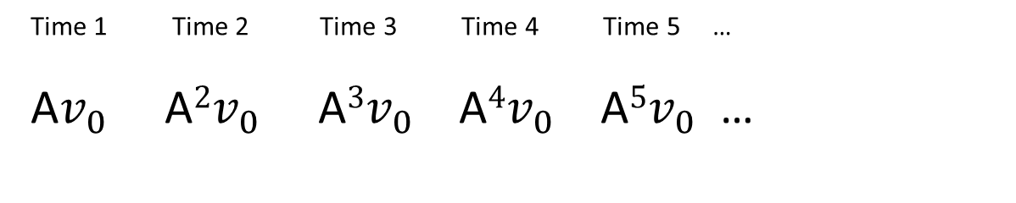
Stochastic Matrix
$$0.4$$
1
3
$$0.5$$
2
Consider 3 YouBike stations 1, 2, 3 on campus. Let $p_{i,j}$ be the probability that a bike rented at location j will be returned to location i.
$p_{1,3}: with$prob. $0.5, bike at loc. 3 will be returned to$
Loc. $1$
Day 0 , bike distribution
$$A=\left[\begin{matrix}0.3 & 0.4 & 0.5 \\ 0.3 & 0.4 & 0.3 \\ 0.4 & 0.2 & 0.2\end{matrix}\right]$$
$$v_{0}=\left[\begin{matrix}10 \\ 5 \\ 8\end{matrix}\right]$$
Sum = 1
Time 1 Time 2 Time 3 Time 4 Time 5 …
A$v_{0}$ A${2v}_{0}$ A${3v}_{0}$ A${4v}_{0}$ A${5v}_{0}$ …
Steady state
A$v$= $v$ ?
※
Notes:
Cv
U + v

Slide 3

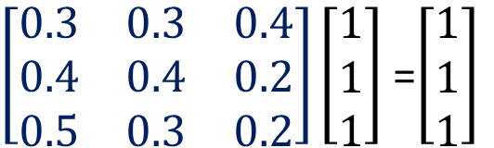


Stochastic Matrix
$$A=\left[\begin{matrix}0.3 & 0.4 & 0.5 \\ 0.3 & 0.4 & 0.3 \\ 0.4 & 0.2 & 0.2\end{matrix}\right]$$
A square matrix A is stochastic of all of its entries are nonnegative, and the sum of each column is 1.
A is positive of all of its entries are positive.
FACT: If A is positive, 1 is an eigenvalue.
$$AT$$
$AT$and $A$ have the
same eigenvalues
$\left[\begin{matrix}0.3 & 0.3 & 0.4 \\ 0.4 & 0.4 & 0.2 \\ 0.5 & 0.3 & 0.2\end{matrix}\right]\left[\begin{matrix}1 \\ 1 \\ 1\end{matrix}\right]$ =$\left[\begin{matrix}1 \\ 1 \\ 1\end{matrix}\right]$
※

Slide 4



Stochastic Matrix
$$A=\left[\begin{matrix}0.3 & 0.4 & 0.5 \\ 0.3 & 0.4 & 0.3 \\ 0.4 & 0.2 & 0.2\end{matrix}\right]$$
FACT: If$λ$ is an eigenvalue, |$λ$| ≤ 1.
$\left[\begin{matrix}0.3 & 0.3 & 0.4 \\ 0.4 & 0.4 & 0.2 \\ 0.5 & 0.3 & 0.2\end{matrix}\right]\left[\begin{matrix}x_{1} \\ x_{2} \\ x_{3}\end{matrix}\right]$ =$λ\left[\begin{matrix}x_{1} \\ x_{2} \\ x_{3}\end{matrix}\right]$
$Suppose {|x}_{2}| is the max$. among${ |x}_{1}|,$ ${|x}_{2}|, { |x}_{3}|$
|$λ{||x}_{2}|$=|$λx_{2}|$= $|$0.4 $x_{1}$+ 0.4 $x_{2}$+ 0.2 $x_{3}|$ ≤
0.4 ${|x}_{1}|$+ 0.4 ${|x}_{2}|$+ 0.2 $|x_{3}|$ ≤
0.4 ${|x}_{2}|$+ 0.4 ${|x}_{2}|$+ 0.2 $|x_{2}|$ ≤ $|x_{2}|$
Hence, |$λ$| ≤ 1
※

Slide 5
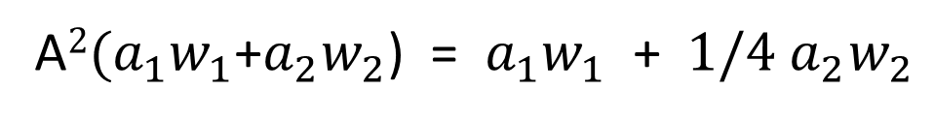

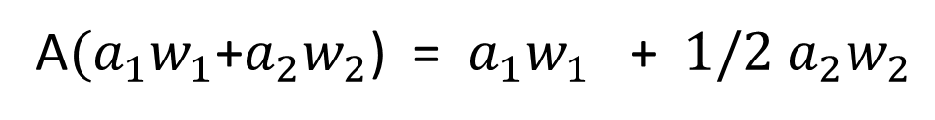



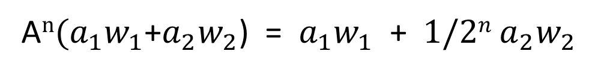
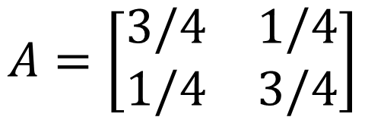
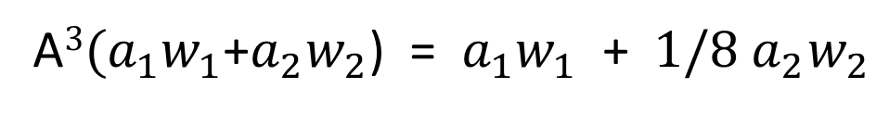
Diagonalizable Stochastic Matrix
$$A=\left[\begin{matrix}3/4 & 1/4 \\ 1/4 & 3/4\end{matrix}\right]$$
Eigenvectors $w_{1}$= $\left[\begin{aligned}1 \\ 1\end{aligned}\right] and{ w}_{2}=\left[\begin{aligned}1 \\ −1\end{aligned}\right]$
Eigenvalues $1 and 1/2$
A$({a_{1}w}_{1}$+${a_{2}w}_{2}$) = ${a_{1}w}_{1}$ +${{ 1/2 a}_{2}w}_{2}$
A$2({a_{1}w}_{1}$+${a_{2}w}_{2}$) = ${a_{1}w}_{1}$ +${{ 1/4 a}_{2}w}_{2}$
A$3({a_{1}w}_{1}$+${a_{2}w}_{2}$) = ${a_{1}w}_{1}$ +${{ 1/8 a}_{2}w}_{2}$
$$……$$
A$n({a_{1}w}_{1}$+${a_{2}w}_{2}$) = ${a_{1}w}_{1}$ +${{ 1/2n a}_{2}w}_{2}$
When $n$is large, A$n$x approaches ${a_{1}w}_{1}$, which is an
eigenvector with eigenvalue 1.
※

Slide 6
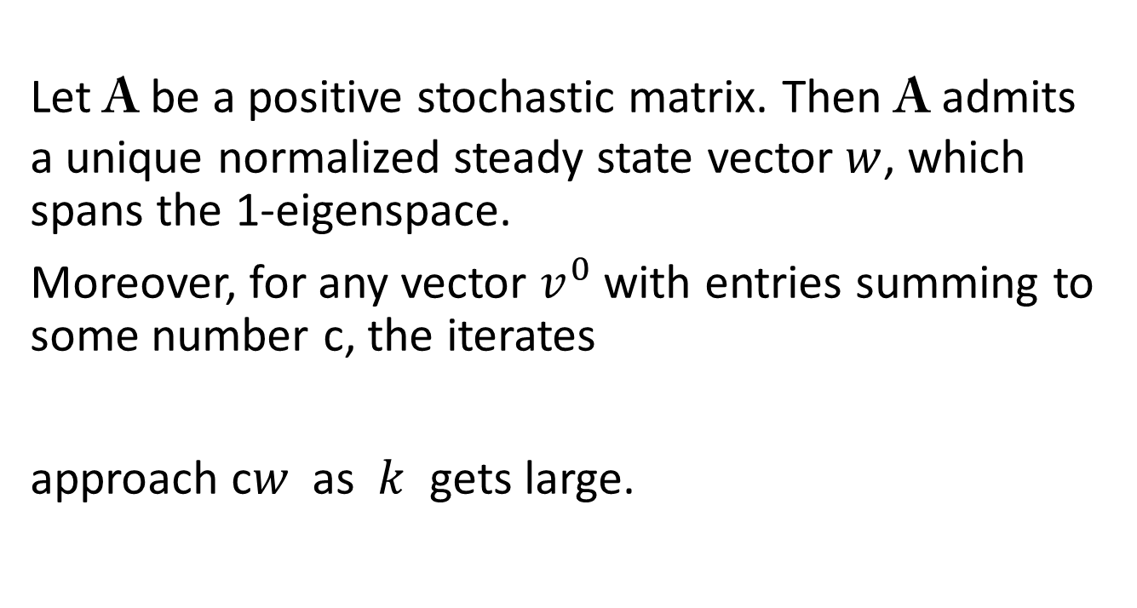



Perron–Frobenius Theorem
Let A be a positive stochastic matrix. Then A admits a unique normalized steady state vector $w$, which spans the 1-eigenspace.
Moreover, for any vector $v^{0}$ with entries summing to some number c, the iterates
approach c$w$ as $k$ gets large.
……
……
$$v^{2}=Av^{1}$$
$$v^{k}=Av^{k−1}$$
$$v^{1}=Av^{0}$$
※

Slide 7
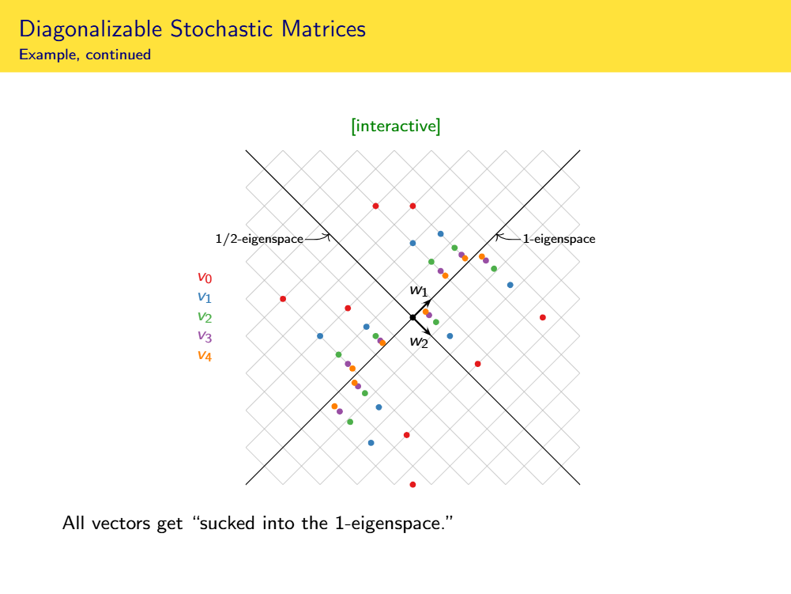

Whether the matrix is diagonalizable or not, all vectors are “sucked into the 1-eigenspace,” which is a line.
……
……
$$x^{k}=Ax^{k−1}$$
https://services.math.duke.edu/~jdr/1819f-1553/materials/11-12-slides-blank.pdf
※

Slide 8

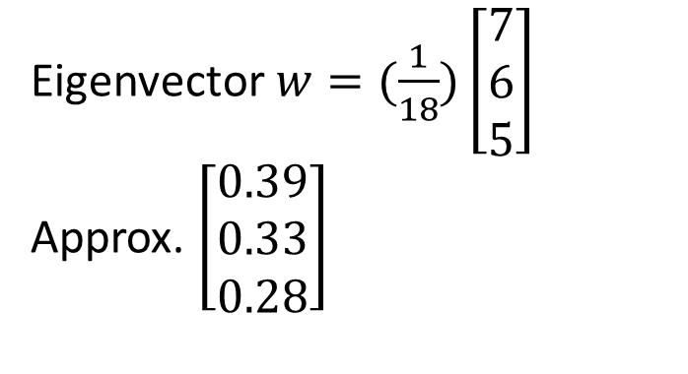
Stochastic Matrix
$$0.4$$
1
3
$$0.5$$
2
Steady state
$$A=\left[\begin{matrix}0.3 & 0.4 & 0.5 \\ 0.3 & 0.4 & 0.3 \\ 0.4 & 0.2 & 0.2\end{matrix}\right]$$
Eigenvector $w=(\frac{1}{18})\left[\begin{matrix}7 \\ 6 \\ 5\end{matrix}\right]$
Approx. $\left[\begin{matrix}0.39 \\ 0.33 \\ 0.28\end{matrix}\right]$
It says that eventually 39% bikes will be in location 1,
33% will be in location 2, and 28% will be in location 3.
If we start with 100 bikes, eventually we would have
(39, 33, 28) bikes in the three locations.
※
Notes:
Cv
U + v

Slide 9


The Most Valuable Eigenvector
  http://userpages.umbc.edu/~kogan/teaching/m430/GooglePageRank.pdf

Slide 10

PageRank
Notes:
Autonomy? 自治???

Slide 11
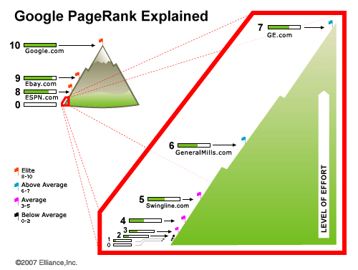
http://www.hobo-web.co.uk/google-pr-update/

Slide 12
PageRank
PageRank is a numeric value that represents how important a page is on the web.
Webpages with a higher PageRank are more likely to appear at the top of Google search results.
Google interprets a link from page A to page B as a vote, by page A, for page B.
  If page A is more important itself, then the vote of A to B should carry more weight.

Slide 13

Importance
很多網頁連到
被重要網頁連到
很多網頁連到
hyperlink

Slide 14

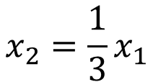

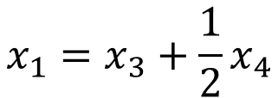


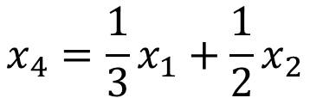

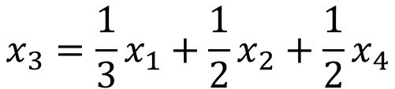
Importance - Formulas
$$x_{1}$$
$$x_{3}$$
$$x_{1}=x_{3}+\frac{1}{2}x_{4}$$
1
3
$$x_{2}=\frac{1}{3}x_{1}$$
$$x_{3}=\frac{1}{3}x_{1}+\frac{1}{2}x_{2}+\frac{1}{2}x_{4}$$
1/2
2
4
$$x_{4}=\frac{1}{3}x_{1}+\frac{1}{2}x_{2}$$
1/2
$$x_{2}$$
$$x_{4}$$
Consider a random surfer
Notes:
Depend on others, but normalization is needed
surfer

Slide 15
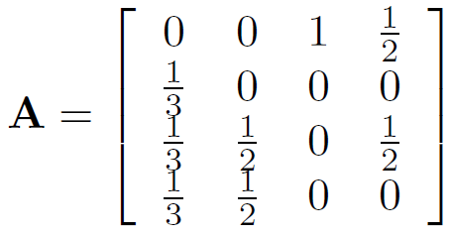

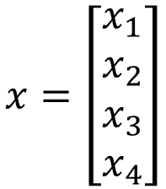
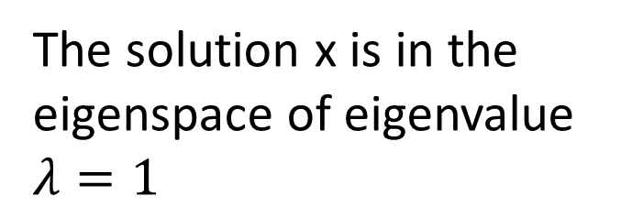
Importance - Formulas
$$x=\left[\begin{aligned}x_{1} \\ x_{2} \\ x_{3} \\ x_{4}\end{aligned}\right]$$
$$x_{1}=x_{3}+\frac{1}{2}x_{4}$$
$$x_{2}=\frac{1}{3}x_{1}$$
$$Ax=x$$
$$x_{3}=\frac{1}{3}x_{1}+\frac{1}{2}x_{2}+\frac{1}{2}x_{4}$$
The solution x is in the eigenspace of eigenvalue $λ=1$
$$x_{4}=\frac{1}{3}x_{1}+\frac{1}{2}x_{2}$$
Notes:
Eigen value = 1

Slide 16





Importance - Formulas
$$x_{1}$$
$$x_{3}$$
12
9
$$x=\left[\begin{aligned}x_{1} \\ x_{2} \\ x_{3} \\ x_{4}\end{aligned}\right]$$
1
3
$$Ax=x$$
The solution x is in the eigenspace of eigenvalue $λ=1$
2
4
$$x_{2}$$
4
6
$$x_{4}$$
$$Span\left\{{\left[\begin{matrix}\begin{matrix}12 & 4\end{matrix} & \begin{matrix}9 & 6\end{matrix}\end{matrix}\right]}^{T}\right\}$$
Notes:
Hack this????????????????????

Slide 17
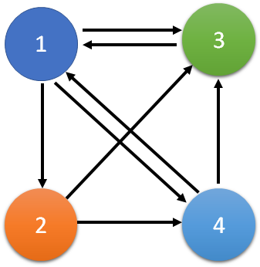


Eigenvalue = 1
$$Ax=x$$
Column-stochastic Matrix
Column-stochastic matrix always have eigenvalue $λ=1$
How about the Dangling nodes (只入不出)?

Slide 18

Unique Ranking?
$$x_{1}$$
$$x_{3}$$
12
9
1
3
Having eigenvalue $λ=1$
If the dimension of the subspace is 1
2
4
Unique Ranking
$$x_{2}$$
4
6
constraint
$$x_{4}$$
Unique Score

Slide 19

Unique Ranking?
How about dimension > 1
Dim for $λ=1$ is 2
Basis:
1/2
1
0
3
0
1
1/2
3
0
5
0
5
1/2
2
0
4
0
2
1/2
4
Any linear combination is in the eigenspace
Not Unique Ranking
Notes:
Example of number
Random surfer

Slide 20

Unique Ranking?
How about dimension > 1
Dim for $λ=1$ is 2
Basis:
1/2
1
0
3
0
1
1/2
3
0
5
0
5
1/2
2
0
4
0
2
1/2
4
Column-stochastic matrix and “positive”
the dim of the eigenvalue $λ=1$ is 1
Notes:
Example of number
Random surfer

Slide 21

Unique Ranking?
Can it be non-uniform?
$$\left[\begin{matrix}1/n & … & 1/n \\ … & … & … \\ 1/n & … & 1/n\end{matrix}\right]$$
All entries are 1/n
0.15
Follow the link
random
There are two ways to surf the web
Prob 1 – m:
Prob m:
1
3
1
3
5
5
2
4
2
4

Slide 22
Challenges ……
Google‘s PageRank is an eigenvector of a matrix of order (in 2008)
The matrix A is sparse (tons of zeros)
One way to compute the eigenvector x would be to start with a good approximate solution, such as the PageRanks from the previous month, and simply repeat the assignment .
Notes:
https://www.gotchseo.com/increase-google-rankings/

Slide 23





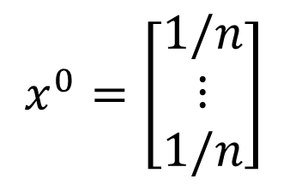


Power method
Start from $x^{0}$
$x^{0}=\left[\begin{matrix}1/n \\ ⋮ \\ 1/n\end{matrix}\right]$
Find $x^{∗}$, such that $x^{∗}=Mx^{∗}$
M is very large
all positive, sum to 1
$$x^{1}=Mx^{0}$$
$$x^{2}=Mx^{1}$$
If $k→∞$
$$x_{k}=x^{∗}$$
……
$$x^{k}=Mx^{k−1}$$
Notes:
The following example shows that stochastic matrices do not need to be diagonalizable
The picture of a positive stochastic matrix is always the same, whether or not it is diagonalizable: all vectors are “sucked into the 1-eigenspace,” which is a line, without changing the sum of the entries of the vectors. This is the geometric content of the Perron–Frobenius theorem.
【數】冪，次方[C]

Slide 24
Actually ……
The Last Toolbar Pagerank Update was December 2013
Google declared thereafter: “PageRank is something that we haven’t updated for over a year now, and we’re probably not going to be updating it again going forward, at least the Toolbar version.“
Notes:
https://www.gotchseo.com/increase-google-rankings/

