Slide 1
Chapter 7
Vector Space
  (除了標註※之簡報外，其餘採用李宏毅教授之投影片教材)

Slide 2
Vector Spaces and Their Subspaces
(Chap. 7.1)

Slide 3



Introduction
Many things can be considered as “vectors”.
  E.g. a function can be regarded as a vector
We can apply the concept we learned on those “vectors”.
  Linear combination
  Span
  Basis
  Orthogonal ……
$$\left[\begin{matrix}1 & 0 \\ 0 & −1\end{matrix}\right]$$
$$\left[\begin{aligned}1 \\ 2 \\ 3 \\ 4\end{aligned}\right]$$
$$t^{2}+t+1$$
R^{n}
W
Chap. 7.1

Slide 4

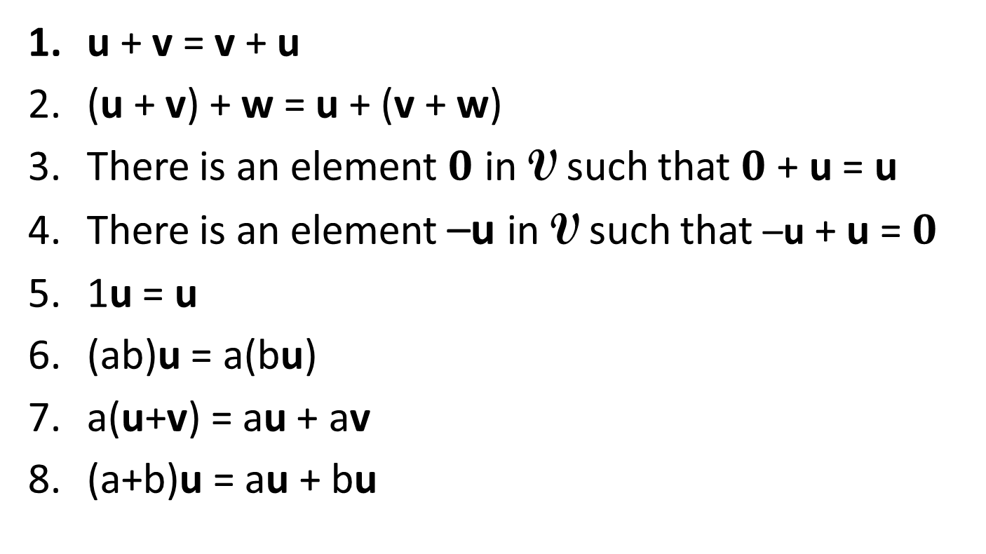
(Abstract) Vector Space
For any vectors u, v and w in V, and scalars a and b in R,
u + v and au are in V, and the following axioms hold
u + v = v + u
(u + v) + w = u + (v + w)
There is an element $0$ in V such that $0$ + u = u
There is an element –u in V such that –u + u = $0$
1u = u
(ab)u = a(bu)
a(u+v) = au + av
(a+b)u = au + bu
$$0=\left[\begin{matrix}0 \\ ⋮ \\ 0\end{matrix}\right]$$
zero vector

Slide 5
Why 0u = 0 and (-1)u = -u ?
Can you prove that 0u = 0 (i.e., zero vector)?
    0u
    = 0+0u (from (3))
    = (-0u + 0u) + 0u (from (4))
    = -0u +( 0u + 0u) (from (2))
    = -0u +( (0+0)u) (from (8))
    = -0u + 0u (0+0=0 as 0 is in R)
    = 0 (from (4))
Can you prove that (-1)u = -u (i.e., inverse of u)?
※

Slide 6
Are they vectors?

Slide 7








Are they vectors?
$$\left[\begin{matrix}1 & 0 \\ 0 & 0\end{matrix}\right]$$
$$\left[\begin{matrix}0 & 1 \\ 0 & 0\end{matrix}\right]$$
$$\left[\begin{matrix}0 & 0 \\ 1 & 0\end{matrix}\right]$$
$$\left[\begin{matrix}0 & 0 \\ 0 & 1\end{matrix}\right]$$
A matrix
A linear transform
A polynomial
$$\left[\begin{aligned}1 \\ 2 \\ 3 \\ 4\end{aligned}\right]$$
$$A=\left[\begin{matrix}1 & 2 \\ 3 & 4\end{matrix}\right]$$
Choose a basis
$$p\left(x\right)=a_{0}+a_{1}x+⋯+a_{n}x^{n}$$
$$\left[\begin{aligned}a_{0} \\ a_{1} \\ ⋮ \\ a_{n}\end{aligned}\right]$$
$$1, x, ⋯, x^{n}$$

Slide 8
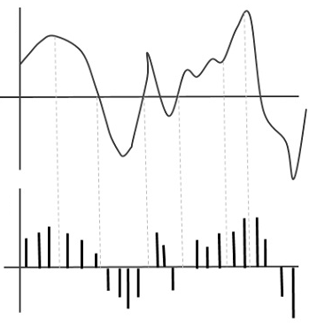









Are they vectors?
What is the zero vector?
$$z\left(t\right)=0$$
Any function from S to R is a vector?
Infinite
function
$$v=\left[\begin{aligned}⋮ \\ ? \\ ⋮\end{aligned}\right]$$
$$v\left(t\right)=e^{t}$$
$$g=\left[\begin{aligned}⋮ \\ ? \\ ⋮\end{aligned}\right]$$
$$g\left(t\right)=t^{2}−1$$
$$h\left(t\right)=e^{t}+t^{2}−1$$
$$v+g$$
$$r\left(t\right)={ce}^{t}$$
$$cv$$
Vector?

Slide 9







Objects in Different Vector Spaces
All the polynomials with degree less than or equal to 2 form a vector space (often denoted as P₂)
w.r.t. Basis {$1$, $t$, $t^{2}$}
$$\left[\begin{aligned}1 \\ 0 \\ 0\end{aligned}\right]$$
$$\left[\begin{aligned}1 \\ 1 \\ 0\end{aligned}\right]$$
$$\left[\begin{aligned}1 \\ 1 \\ 1\end{aligned}\right]$$
$$f\left(t\right)=1$$
$$g\left(t\right)=t+1$$
$$h\left(t\right)=t^{2}+t+1$$
Notes:
Should I mention talr exniosn here

Slide 10
Subspaces
Chap. 6.1

Slide 11
Review: Subspace
A vector set V is called a subspace if it has the following three properties:
1. The zero vector 0 belongs to V
2. If u and w belong to V, then u+w belongs to V
3. If u belongs to V, and c is a scalar, then cu belongs to V
Closed under (vector) addition
Closed under scalar multiplication
Notes:
1. Is kind of redundent

Slide 12




Are they subspaces?
$$trace\left(\left[\begin{matrix}a & b \\ c & d\end{matrix}\right]\right)$$
$$=a+d$$
All the functions pass 0 at t₀
All the matrices whose trace equal to zero
All the matrices of the form
All the continuous functions
All the polynomials with degree n
All the polynomials with degree less than or equal to n
$$\left[\begin{matrix}a & a+b \\ b & 0\end{matrix}\right]$$
$$t^{n},−t^{n}$$
P: all polynomials, P_{n}: all polynomials with degree less than or equal to n

Slide 13
Linear Combination and Span
Chap. 7.2

Slide 14
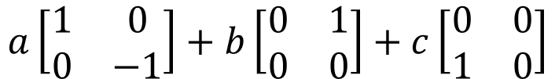
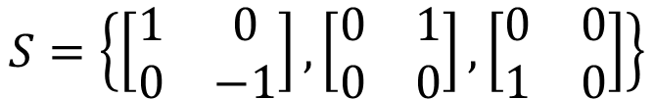

Linear Combination and Span
Matrices
$$S=\left\{\left[\begin{matrix}1 & 0 \\ 0 & −1\end{matrix}\right],\left[\begin{matrix}0 & 1 \\ 0 & 0\end{matrix}\right],\left[\begin{matrix}0 & 0 \\ 1 & 0\end{matrix}\right]\right\}$$
Linear combination with coefficient a, b, c
$$a\left[\begin{matrix}1 & 0 \\ 0 & −1\end{matrix}\right]+b\left[\begin{matrix}0 & 1 \\ 0 & 0\end{matrix}\right]+c\left[\begin{matrix}0 & 0 \\ 1 & 0\end{matrix}\right]$$
$$=\left[\begin{matrix}a & b \\ c & −a\end{matrix}\right]$$
What is Span S?
All 2x2 matrices whose trace equal to zero

Slide 15

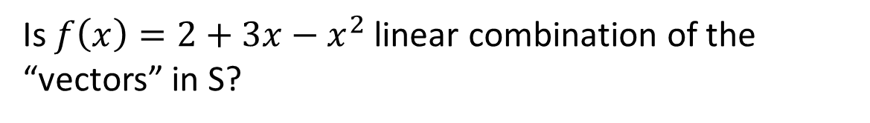





Linear Combination and Span
Polynomials
$$S=\left\{1,x,x^{2},x^{3} \right\}$$
Is $f\left(x\right)=2+3x−x^{2}$ linear combination of the “vectors” in S?
$$f\left(x\right)=2∙1+3∙x+\left(−1\right)∙x^{2}$$
$$Span\left\{1,x,x^{2},x^{3} \right\}$$
$$=P_{3}$$
$$Span\left\{1,x,⋯,x^{n},⋯\right\}$$
$$=P$$

Slide 16
Linear Transformations
(Chap. 7.2)
Chap. 7.2

Slide 17


Linear transformation
A mapping (function) T is called linear if for all “vectors” u, v and scalars c:
Preserving vector addition:
Preserving vector multiplication:
$$T\left(u+v\right)=T\left(u\right)+T\left(v\right)$$
$$T\left(cu\right)=cT\left(u\right)$$
Is matrix transpose linear?
Input: m x n matrices, output: n x m matrices

Slide 18

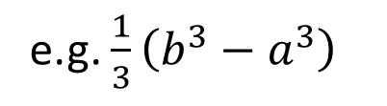
Linear transformation
linear?
Derivative:
Integral from a to b
Derivative
function f
function f’
e.g. x²
e.g. 2x
linear?
scalar
Integral
$$\int_{a}^{b}{f\left(t\right)dt}$$
function f
e.g. x²
(from a to b)
e.g. $\frac{1}{3}\left(b^{3}−a^{3}\right)$

Slide 19
Null Space and Range
Null Space
  The null space of T: V → W is the set of all “vectors” in V such that T(v)=0, where 0 is the zero vector in W.
  What is the null space of matrix transpose ?
  T: M_{m×n} → M_{n×m}
Range (or Image)
  The range of T is the set of all images of T.
  That is, the set of all “vectors” T(v) for all v in the domain
  What is the range of matrix transpose?
0_{m×n}
M_{n×m}

Slide 20



One-to-one and Onto
U: M_{m×n} → M_{n×m} defined by U(A) = A^{T}.
  Is U one-to-one?
  Is U onto?
D: P₃ → P₃ defined by D( f ) = f ′
  Is D one-to-one?
  Is D onto?
yes
yes
no
$$x^{3}+2x+3$$
no
$${3x}^{2}+2x$$
$$x^{3}+2x$$
Notes:
Smooth function

Slide 21
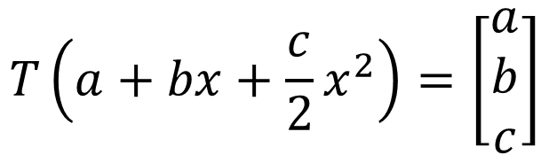
Isomorphism (同構)
W
V
Let V and W be vector space.
A linear transformation T: V→W is called an isomorphism if it is one-to-one and onto
  Invertible linear transform
  W and V are isomorphic.
Example 1: U: M_{m×n} → M_{n×m} defined by U(A) = A^{T}.
Example 2: T: P₂ → R³
$$T\left(a+bx+\frac{c}{2}x^{2}\right)=\left[\begin{aligned}a \\ b \\ c\end{aligned}\right]$$

Slide 22
Basis and Dimension
(Chap. 7.3)
Chap. 7.3

Slide 23
Independent
A basis for subspace V is a linearly independent generation set of V.
Example
Example
S = {x² - 3x + 2, 3x² − 5x, 2x − 3} is a subset of P_{2.}
Is it linearly independent?
No
is a subset of 2x2 matrices.
Is it linearly independent?
implies that a = b = c = 0
Yes

Slide 24
Independent
If {v₁, v₂, ……, v_{k}} are independent, and T is an isomorphism, {T(v₁), T(v₂), ……, T(v_{k})} are independent
Example
Example
The infinite vector set {1, x, x², ☹, x^{n}, ☹}
Is it linearly independent?
Σ_{i}c_{i}x^{i} = 0 implies c_{i} = 0 for all i.
Yes
S = {e^{t}, e^{2t}, e^{3t}}
Is it linearly independent?
Yes
ae^{t} + be^{2t} + ce^{3t} = 0
a + b + c = 0
ae^{t} + 2be^{2t} + 3ce^{3t} = 0
a + 2b + 3c = 0
ae^{t} + 4be^{2t} + 9ce^{3t} = 0
a + 4b + 9c = 0

Slide 25
Independent
Theorem:
If {v₁, v₂, ……, v_{k}} are independent, and T is an isomorphism, {T(v₁), T(v₂), ……, T(v_{k})} are independent
(Proof)
Suppose a₁ T(v₁) + a₂T(v₂) + ……+ a_{k} T(v_{k}) = 0
⇒ T(a₁ v₁) + T(a₂v₂) + ……+ T(a_{k} v_{k}) = 0
⇒ T(a₁ v₁ + a₂v₂ + ……+ a_{k} v_{k}) = 0
⇒ a₁ v₁ + a₂v₂ + ……+ a_{k} v_{k} = 0 ----- (one-to-one)
⇒ a₁ = a₂ = ……= a_{k} = 0
※

Slide 26
Basis
Example
Example
For the subspace of all 2 x 2 matrices,
The basis is
Dim = 4
S = {1, x, x², ☹, x^{n}, ☹} is a basis of P.
Dim = inf

Slide 27
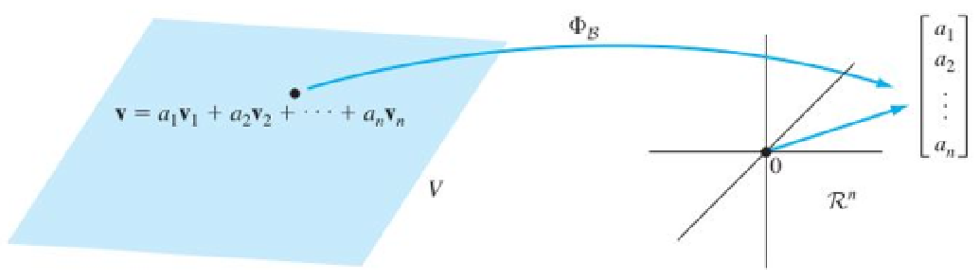

Vector Representation of Object
Coordinate Transformation
basis
P_{n}:
Basis: {1, x, x², ☹, x^{n}}
$$\left[\begin{aligned}a_{0} \\ a_{1} \\ ⋮ \\ a_{n}\end{aligned}\right]$$
$$p\left(x\right)=a_{0}+a_{1}x+⋯+a_{n}x^{n}$$

Slide 28

Coordinate Vectors
Definition
Let B be a basis for V, Φ_{B} : V → R^{n} (coordinate transformation) is an isomorphism. Any vector v in V, Φ_{B} (v) is called the coordinate vector of v relative to B, written as [v]_{B}
Example
B = {1, x, x², ☹, x^{n}} is a basis for P_{n}.
$$\left[p\left(x\right)\right]\text{B}=\left[\begin{aligned}a_{0} \\ a_{1} \\ ⋮ \\ a_{n}\end{aligned}\right]$$
$$p\left(x\right)=a_{0}+a_{1}x+⋯+a_{n}x^{n}$$
※

Slide 29

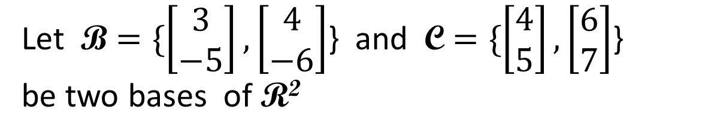
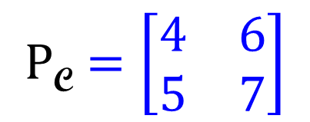
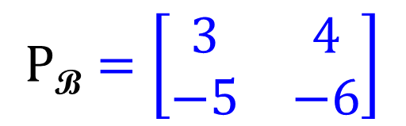
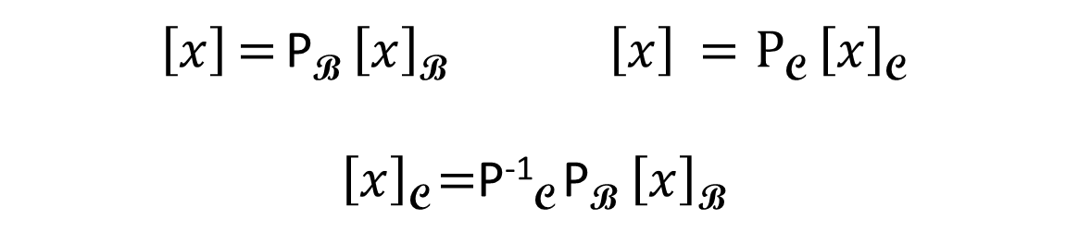
Coordinate Vectors
Let B $=\{\left[\begin{matrix}3 \\ −5\end{matrix}\right],\left[\begin{matrix}4 \\ −6\end{matrix}\right]$} and C $=\{\left[\begin{matrix}4 \\ 5\end{matrix}\right],\left[\begin{matrix}6 \\ 7\end{matrix}\right]$}
be two bases of R²
What is the matrix M such that
$\left[x\right]\text{C}$ $=$ M $\left[x\right]\text{B}$ ?
$$P\text{B}=\left[\begin{matrix}3 & 4 \\ −5 & −6\end{matrix}\right]$$
$$P\text{C}=\left[\begin{matrix}4 & 6 \\ 5 & 7\end{matrix}\right]$$
$\left[x\right]$ $=$ P$\text{B}$ $\left[x\right]\text{B} \left[x\right] =P\text{C} \left[x\right]\text{C}$
$\left[x\right]\text{C}$ $=$P$\text{−1}\text{C}$P$\text{B}$ $\left[x\right]\text{B}$
w.r.t. standard basis
※

Slide 30
Matrix Representations of Linear Operators
(Chap. 7.4)
Chap. 7.3

Slide 31
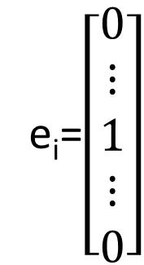
Matrix Representation of Linear Operator
e_{i}=$\left[\begin{aligned}0 \\ ⋮ \\ 1 \\ ⋮ \\ 0\end{aligned}\right]$
i-th coordinate
Let T be a linear operator from R^{n} to R^{n} with standard basis E ={e₁, e₂, …, e_{n}}. Then the matrix representation of T w.r.t. E is
[T]_{E} = [ [T(e₁)_{E} T(e₂)_{E …} T(e_{n})_{E} ]
T(e_{i})
e_{i}
R^{n}
R^{n}
※

Slide 32
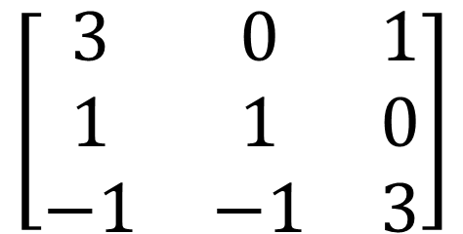


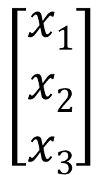
Linear Transformation and Matrix
$${ T(x)}_{}=$$
$$\left[\begin{matrix}3 & 0 & 1 \\ 1 & 1 & 0 \\ −1 & −1 & 3\end{matrix}\right]$$
$$\left[\begin{matrix}x1 \\ x2 \\ x3\end{matrix}\right]$$
$$Ax=$$
※

Slide 33
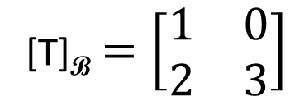
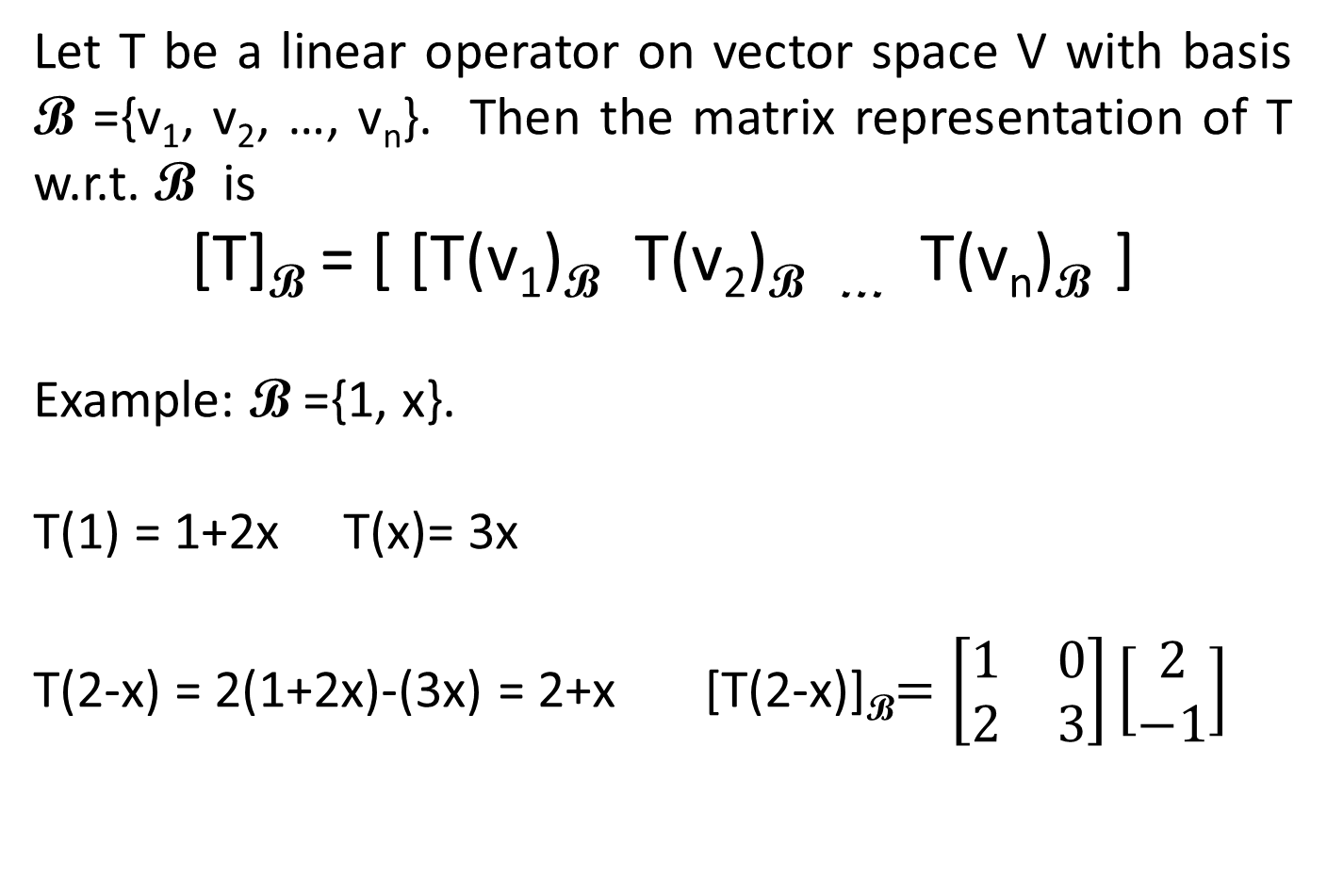
Matrix Representation of Linear Operator
Let T be a linear operator on vector space V with basis B ={v₁, v₂, …, v_{n}}. Then the matrix representation of T w.r.t. B is
[T]_{B} = [ [T(v₁)_{B} T(v₂)_{B …} T(v_{n})_{B} ]
Example: B ={1, x}.
T(1) = 1+2x T(x)= 3x
T(2-x) = 2(1+2x)-(3x) = 2+x [T(2-x)]_{B}$=\left[\begin{matrix}1 & 0 \\ 2 & 3\end{matrix}\right]\left[\begin{aligned}2 \\ −1\end{aligned}\right]$
[T]_{B} $=\left[\begin{matrix}1 & 0 \\ 2 & 3\end{matrix}\right]$
※

Slide 34
Linear Operator T: V → V
What is the matrix for T?
[T]_{B}
[T(x)]_{B}
[x]_{B}
R^{n}
R^{n}
Φ_{B}
Φ_{B}
T
T(x)
x
B ={v₁, v₂, …, v_{n}}
V
V
※
[T]_{B} = [ [T(v₁)_{B} T(v₂)_{B …} T(v_{n})_{B} ]

Slide 35
How to compute [T]_{B} ?
[T]_{B}
T(e_{i})
e_{i}
R^{n}
R^{n}
Φ_{B}⁻¹
Φ_{B}
T
v_{i}
T(v_{i})
B ={v₁, v₂, …, v_{n}}
V
V
※

Slide 36


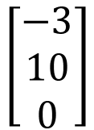
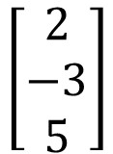
Matrix Representation of Linear Operator
Represent it as a matrix
B = {1, $x$, $x^{2}$} Φ_{B}$(2−3x+5x^{2})$=(2, -3, 5)^{T}
[T] _{B} = Φ_{B} T Φ_{B}⁻¹
$$\left[\begin{aligned}2 \\ −3 \\ 5\end{aligned}\right]$$
$$\left[\begin{aligned}−3 \\ 10 \\ 0\end{aligned}\right]$$
R³
R³
Φ_{B}⁻¹
Φ_{B}
V
V
T
$$2−3x+5x^{2}$$
$$−3+10x+0x^{2}$$
※

Slide 37
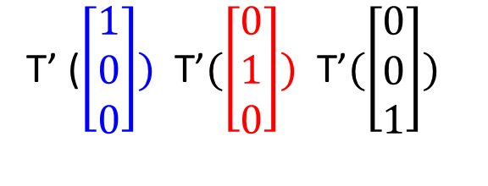
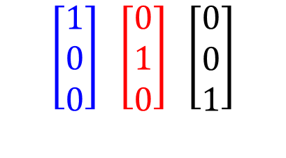
How to find [T] _{B} ?
[T(v₁)] _{B} = 1st col of [T] _{B}
T’ ($\left[\begin{aligned}1 \\ 0 \\ 0\end{aligned}\right]) \text{T}\text{’}(\left[\begin{aligned}0 \\ 1 \\ 0\end{aligned}\right]) \text{T}\text{’}(\left[\begin{aligned}0 \\ 0 \\ 1\end{aligned}\right])$
T’ = [T] _{B}
$$\left[\begin{aligned}1 \\ 0 \\ 0\end{aligned}\right] \left[\begin{aligned}0 \\ 1 \\ 0\end{aligned}\right] \left[\begin{aligned}0 \\ 0 \\ 1\end{aligned}\right]$$
R³
R³
Φ_{B}⁻¹
Φ_{B}
V
V
T
v₁ v₂ v₃
T(v₁) T(v₂) T(v₃)
Basis
※

Slide 38
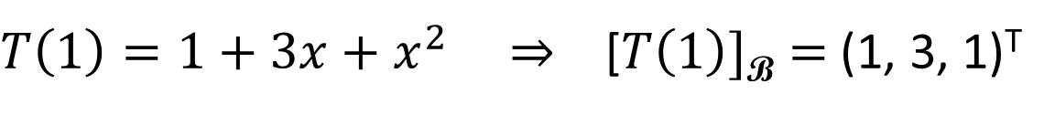

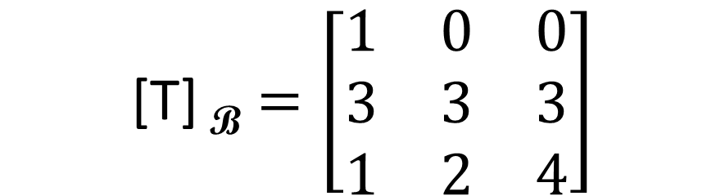
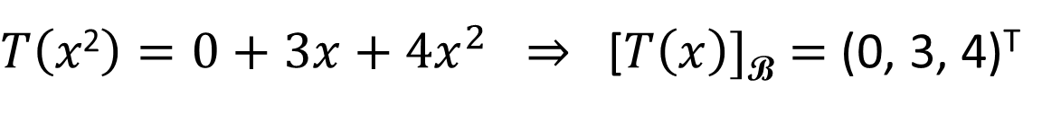
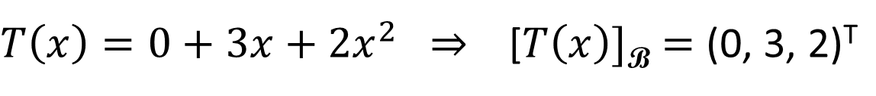
Example
Let T : P₂ → P₂ defined as
T(p($x$))= p(0) + 3p(1) $x$+ p(2)$x$²
B = {1, x, x²} is a basis for P₂.
$T\left(1\right)=1+3x+x^{2}$ ⇒ [$T\left(1\right)]\text{B}=$ (1, 3, 1)^{T}
$T\left(x\right)=0+3x+{2x}^{2}$ ⇒ [$T\left(x\right)]\text{B}=$ (0, 3, 2)^{T}
$T\left(x\text{2}\right)=0+3x+{4x}^{2}$ ⇒ [$T\left(x\right)]\text{B}=$ (0, 3, 4)^{T}
$$\text{[}\text{T}\text{]} \text{B}=\left[\begin{matrix}1 & 0 & 0 \\ 3 & 3 & 3 \\ 1 & 2 & 4\end{matrix}\right]$$
※

Slide 39


Matrix Representation of Linear Operator
Example:
  D (derivative): P₂ → P₂
Represent it as a matrix
$$\left[\begin{aligned}2 \\ −3 \\ 5\end{aligned}\right]$$
$$\left[\begin{aligned}−3 \\ 10 \\ 0\end{aligned}\right]$$
vector
vector
Multiply a matrix
$$2−3x+5x^{2}$$
polynomial
polynomial
$$−3+10x$$
Derivative
※

Slide 40













Matrix Representation of Linear Operator
Example:
  D (derivative): P₂ → P₂
Represent it as a matrix
$$\left[\begin{aligned}0 \\ 1 \\ 0\end{aligned}\right]$$
$$\left[\begin{aligned}0 \\ 0 \\ 0\end{aligned}\right]$$
$$\left[\begin{aligned}1 \\ 0 \\ 0\end{aligned}\right]$$
$$\left[\begin{aligned}0 \\ 2 \\ 0\end{aligned}\right]$$
$$\left[\begin{aligned}1 \\ 0 \\ 0\end{aligned}\right]$$
$$\left[\begin{aligned}0 \\ 0 \\ 1\end{aligned}\right]$$
vector
vector
Multiply a matrix
$$\left[\begin{matrix}0 & 1 & 0 \\ 0 & 0 & 2 \\ 0 & 0 & 0\end{matrix}\right]$$
$$1$$
$$0$$
$$x$$
polynomial
polynomial
$$1$$
Derivative
$$x^{2}$$
2$x$

Slide 41






Matrix Representation of Linear Operator
$$\left[\begin{matrix}0 & 1 & 0 \\ 0 & 0 & 2 \\ 0 & 0 & 0\end{matrix}\right]$$
$$\left[\begin{aligned}5 \\ −4 \\ 3\end{aligned}\right]$$
Example:
  D (derivative): P₂ → P₂
Represent it as a matrix
Not invertible
$$\left[\begin{aligned}5 \\ −4 \\ 3\end{aligned}\right]$$
$$\left[\begin{aligned}−4 \\ 6 \\ 0\end{aligned}\right]$$
vector
vector
Multiply a matrix
$$\left[\begin{matrix}0 & 1 & 0 \\ 0 & 0 & 2 \\ 0 & 0 & 0\end{matrix}\right]$$
$$5−4x+3x^{2}$$
polynomial
polynomial
$$−4+6x$$
Derivative

Slide 42










Matrix Representation of Linear Operator
Example:
  D (derivative): Function set F → Function set F
  Basis of F is $\left\{e^{t}\cos{t},e^{t}\sin{t}\right\}$
invertible
$$\left[\begin{aligned}1 \\ 0\end{aligned}\right]$$
$$\left[\begin{aligned}0 \\ 1\end{aligned}\right]$$
vector
vector
$$\left[\begin{aligned}1 \\ −1\end{aligned}\right]$$
$$\left[\begin{aligned}1 \\ 1\end{aligned}\right]$$
Multiply a matrix
$$\left[\begin{matrix}1 & 1 \\ −1 & 1\end{matrix}\right]$$
Function in F
Function in F
Derivative

Slide 43


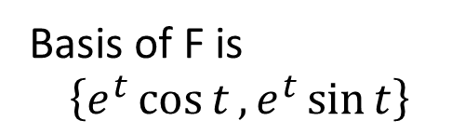


Matrix Representation of Linear Operator
Basis of F is
$$\left\{e^{t}\cos{t},e^{t}\sin{t}\right\}$$
$$\left[\begin{matrix}1/2 & −1/2 \\ 1/2 & 1/2\end{matrix}\right]$$
$$\left[\begin{aligned}−1/2 \\ 1/2\end{aligned}\right]$$
$$\left[\begin{aligned}0 \\ 1\end{aligned}\right]$$
vector
vector
Multiply a matrix
$$\left[\begin{matrix}1 & 1 \\ −1 & 1\end{matrix}\right]$$
Antiderivative
Function in F
Function in F
Derivative

Slide 44
Linear operator between two bases
Let T : V → W be a linear operator between V and W.
B ={b₁ b₂ … b_{n}} and B’={b’₁ b’₂ … b’_{n}} bases of V and W.
What is matrix representation M of T w.r.t. B and B’
i.e., [T(x)] _{B’} = M [x] _{B} ?
M = [ T[b₁]_{B’} , T[b₂]_{B’} , … , T[b_{n}]_{B’} ]
※

Slide 45

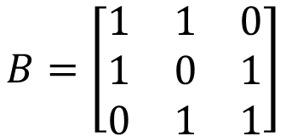
Example (P279)
Determine T
b₁
c₁
b₂
c₂
b₃
c₃
e₁
e₂
e₃
$${\left[v\right]}_{\text{B}}$$
$${\left[T\left(v\right)\right]}_{\text{B}}$$
B⁻¹c₁
B⁻¹c₂
B⁻¹c₃
$${\left[T\right]}_{\text{B}}$$
b₁, b₂, b₃ as a coordinate system
$$B^{−1}$$
$$B^{−1}$$
$$B=\left[\begin{matrix}1 & 1 & 0 \\ 1 & 0 & 1 \\ 0 & 1 & 1\end{matrix}\right]$$
{b₁, b₂, b₃} is a basis of R³
$$\left[T\right]$$
b₁
b₂
b₃
$$v$$
$$T\left(v\right)$$
c₁
c₂
c₃
Notes:
Simple …..
A = C B ^ -1

Slide 46
Example (P279)
Determine T
$${\left[T\right]}_{\text{B}}=\left[\begin{matrix}B^{−1}c_{1} & B^{−1}c_{2} & B^{−1}c_{3}\end{matrix}\right]$$
$$=B^{−1}C$$
$$\text{[}\text{T}\text{]}=B{\left[T\right]}_{\text{B}}B^{−1}$$
$$={BB}^{−1}CB^{−1}$$
$$=CB^{−1}$$
e₁
e₂
e₃
$${\left[v\right]}_{\text{B}}$$
$${\left[T\left(v\right)\right]}_{\text{B}}$$
B⁻¹c₁
B⁻¹c₂
B⁻¹c₃
$${\left[T\right]}_{\text{B}}$$
b₁, b₂, b₃ as a coordinate system
$$B^{−1}$$
$$B^{−1}$$
$$B$$
{b₁, b₂, b₃} is a basis of R³
$$\left[T\right]$$
b₁
b₂
b₃
$$v$$
$$T\left(v\right)$$
c₁
c₂
c₃

Slide 47
Eigenvalue and Eigenvector
$T\left(v\right)=λv$, $v≠0$, $v$ is eigenvector, $λ$ is eigenvalue
Chap. 7.4

Slide 48


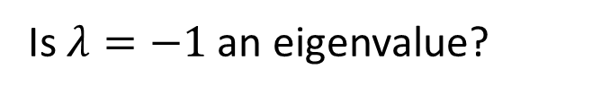
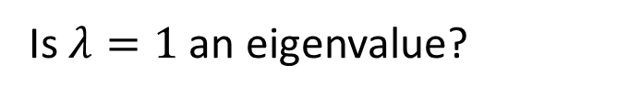



Eigenvalue and Eigenvector
Consider derivative (linear transformation, input & output are functions)
Consider Transpose (also linear transformation, input & output are matrices)
$$ae^{at}$$
$$a$$
Is $e^{at}$ an “eigenvector”?
What is the “eigenvalue”?
Every scalar is an eigenvalue of derivative.
Is $λ=1$ an eigenvalue?
Symmetric:
Symmetric matrices form the eigenspace
$$A^{T}=A$$
Is $λ=−1$ an eigenvalue?
Skew-symmetric:
Skew-symmetric matrices form the eigenspace.
$$A^{T}=−A$$
Notes:
A^T = lambda A
ATT = A = lable AT = label label A

Slide 49











Consider Transpose of 2x2 matrices
$$\left[\begin{aligned}1 \\ 0 \\ 0 \\ 0\end{aligned}\right]$$
$$\left[\begin{aligned}0 \\ 1 \\ 0 \\ 0\end{aligned}\right]$$
$$\left[\begin{aligned}0 \\ 0 \\ 1 \\ 0\end{aligned}\right]$$
$$\left[\begin{aligned}0 \\ 0 \\ 0 \\ 1\end{aligned}\right]$$
$$\left[\begin{aligned}1 \\ 0 \\ 0 \\ 0\end{aligned}\right]$$
$$\left[\begin{aligned}0 \\ 0 \\ 1 \\ 0\end{aligned}\right]$$
$$\left[\begin{aligned}0 \\ 1 \\ 0 \\ 0\end{aligned}\right]$$
$$\left[\begin{aligned}0 \\ 0 \\ 0 \\ 1\end{aligned}\right]$$
vector
vector
What are the eigenvalues?
$$\left[\begin{matrix}1 & 0 \\ 0 & 0\end{matrix}\right]$$
2x2 matrices
2x2 matrices
$$\left[\begin{matrix}1 & 0 \\ 0 & 0\end{matrix}\right]$$
transpose

Slide 50










Eigenvalue and Eigenvector
Consider Transpose of 2x2 matrices
$$det$$
$$−t$$
Matrix representation of transpose
$$−t$$
Characteristic polynomial
$$−t$$
$$−t$$
$${\left(t−1\right)}^{3}\left(t+1\right)$$
$$λ=1$$
$$λ=−1$$
Symmetric matrices
Skew-symmetric matrices
$$\left[\begin{matrix}a & b \\ b & c\end{matrix}\right]$$
$$\left[\begin{matrix}0 & a \\ −a & 0\end{matrix}\right]$$
Dim=3
Dim=1

Slide 51



Diagonalizable Linear Operator
T is diagoalizable if there is a basis
B ={$v$_{1 ,} $v$₂ ... $v$_{n} } s.t. [T]_{B} is diagonal
$$\text{[}\text{T}\text{]}\text{B}=\left[\begin{matrix}d1 & 0 & 0 \\ 0 & d2 & 0 \\ 0 & 0 & d3\end{matrix}\right]$$
R³
R³
Claim:
T($v$_{i} )= $d$_{i} $v$_{i}
Φ_{B}⁻¹
Φ_{B}
T
V
V
※

Slide 52

Diagonalizable Linear Operator
The following statements are equivalent
T is diagoalizable
There is a basis B ={$v$_{1 ,} $v$₂ ... $v$_{n} } s.t. [T]_{B} is diagonal
T has a basis consisting of eigenvectors
For every basis B, [T]_{B} is diagoalizable
※

Slide 53
Inner Product Spaces
(Chap. 7.5)

Slide 54








Inner Product
Norm (length):
$$\left\|v\right\|=\sqrt{\left\langle v,v\right\rangle }$$
Orthogonal:
Inner product is zero
$$\left\langle u,v\right\rangle$$
“vector” v
Inner Product
scalar
“vector” u
For any vectors u, v and w, and any scalar a, the following axioms hold:
1. $\left\langle u,u\right\rangle >0$ if $u≠0$
3. $\left\langle u+v,w\right\rangle =\left\langle u,w\right\rangle +\left\langle v,w\right\rangle$
2. $\left\langle u,v\right\rangle =\left\langle v,u\right\rangle$
4. $\left\langle au,v\right\rangle =a\left\langle u,v\right\rangle$
Dot product is a special case of inner product
$$c\left(u∙v\right)$$
$$c>0$$
Can you define other inner product for normal vectors?

Slide 55










Inner Product
1. $\left\langle u,u\right\rangle >0$ if $u≠0$
2. $\left\langle u,v\right\rangle =\left\langle v,u\right\rangle$
3. $\left\langle u+v,w\right\rangle =\left\langle u,w\right\rangle +\left\langle v,w\right\rangle$
4. $\left\langle au,v\right\rangle =a\left\langle u,v\right\rangle$
Continuous functions in $C$[-1, 1]
$$\left\langle g,h\right\rangle =\int_{−1}^{1}{g\left(x\right)h\left(x\right)dx}$$
$Axiom (1)$:
$f\text{≠}0 \text{⇒} f2 \left(c\right)>0 , for some c in [−1, 1].$
$\text{⇒} f2 \left(t\right)>d>0 , t in [c−ε, c+ε].$
$$\text{⇒}\left\langle f,f\right\rangle =\int_{−1}^{1}{f2 \left(t\right)dt}=f2 \left(t\right)>2εd>0$$
$Axioms (2−4)$:$Easy to check$
※

Slide 56






Inner Product
1. $\left\langle u,u\right\rangle >0$ if $u≠0$
2. $\left\langle u,v\right\rangle =\left\langle v,u\right\rangle$
3. $\left\langle u+v,w\right\rangle =\left\langle u,w\right\rangle +\left\langle v,w\right\rangle$
4. $\left\langle au,v\right\rangle =a\left\langle u,v\right\rangle$
Inner product for any function with input [-1, 1]
$$\left\langle g,h\right\rangle =\int_{−1}^{1}{g\left(x\right)h\left(x\right)dx}$$
Is $g\left(x\right)=1$ and $h\left(x\right)=x$ orthogonal?
yes
$$=\int_{−1}^{1}{xdx}$$
$$=0$$
$$\left\langle g,h\right\rangle =\sum_{i=−10}^{10}{g\left(\frac{i}{10}\right)h\left(\frac{i}{10}\right)}$$
Can it be inner product for general functions?
no
$$u\left(\frac{i}{10}\right)=0, otherwise≠0$$
$$\left\langle u,u\right\rangle =0, but u≠0$$

Slide 57





Inner Product
Check Axioms (1-4)
Inner Product of Matrix
Frobenius inner product
$\left\langle A,B\right\rangle =trace\left(AB^{T}\right)$
$=trace\left(BA^{T}\right)$
Element-wise multiplication
$$A=\left[\begin{matrix}1 & 2 \\ 3 & 4\end{matrix}\right]$$
$$\left\|A\right\|=\sqrt{1^{2}+2^{2}+3^{2}+4^{2}}$$

Slide 58










Orthogonal Projection
Consider a subspace W with orthogonal basis $S =\left\{v_{1},v_{2},⋯,v_{k}\right\}$ of an n-dim vector space V. Let u be any vector in V, which can be written as
orthogonal projection of u on W
If $S$ an orthonormal basis of W.
$\text{∈}$ W
$\text{∈}$ W⊥
$u=c_{1}v_{1}+c_{2}v_{2}+⋯+c_{k}v_{k}$ + ${c_{k+1 }w}_{k+1 }$ $+⋯+$ $c_{n }w_{n }$
$$\frac{u∙v_{1}}{{\left\|v_{1}\right\|}^{2}}$$
$$\frac{u∙v_{2}}{{\left\|v_{2}\right\|}^{2}}$$
$$\frac{u∙v_{k}}{{\left\|v_{k}\right\|}^{2}}$$
$$w=c_{1}v_{1}+c_{2}v_{2}+⋯+c_{k}v_{k}$$
※
$$u∙v_{1}$$
$$u∙v_{2}$$
$$u∙v_{k}$$

Slide 59





Orthogonal Projection
Consider a subspace W with orthonormal basis $S =\left\{v_{1},v_{2},⋯,v_{k}\right\}$ of an n-dim vector space V. The orthogonal projection of $u$ on W can be written as
$$(u∙v_{1})v_{1}+(u∙v_{2})v_{2}+⋯+(u∙k)v_{k}$$
=${ v}_{1}(v_{1}∙u) +v_{2}(v_{2}∙u)+⋯+v_{k}(v_{k}∙u)$
=${ v}_{1}(v_{1}Tu) +v_{2}(v_{2}Tu)+⋯+v_{k}(v_{k}Tu)$
=${ (v}_{1}v_{1}T)u+{(v}_{2}v_{2}T)u+⋯+{(v}_{k}v_{k}T)u$
= ${(v}_{1}v_{1}T+v_{2}v_{2}T+⋯+v_{k}v_{k}T)u$
=
$$[v_{1} v_{2} ⋯v_{k}]\left[\begin{aligned}v_{1}T \\ v_{2}T \\ ⋮ \\ ⋮ \\ v_{k}T\end{aligned}\right] u$$
Recall that is $S$ is an arbitrary basis, the projection matrix is
$$C\left(CTC\right)\text{−1}CT$$
$$=CCT u$$
※

Slide 60


Orthogonal Basis
Let $\left\{u_{1},u_{2},⋯,u_{k}\right\}$ be a basis of a subspace V. How to transform $\left\{u_{1},u_{2},⋯,u_{k}\right\}$ into an orthogonal basis $\left\{v_{1},v_{2},⋯,v_{k}\right\}$?
Gram-Schmidt
Process
Then $\left\{v_{1},v_{2},⋯,v_{k}\right\}$ is an orthogonal basis for W
After normalization, you can get orthonormal basis.

Slide 61







Orthogonal/Orthonormal Basis
Find orthogonal/orthonormal basis for P₂
  Define an inner product of P₂ by
  Find a basis {1, x, x²}
$$u_{1},u_{2},u_{3}$$
$$v_{1},v_{2},v_{3}$$

Slide 62




Orthogonal/Orthonormal Basis
Find orthogonal/orthonormal basis for P₂
  Define an inner product of P₂ by
  Get an orthogonal basis {1, x, x²-1/3}
Orthonormal Basis

Slide 63

Orthonormal Basis

Slide 64








Least square approx. of $x^{3}?$
Orthonormal Basis
$v1 v2$ $v3$
Compute orthogonal projection of ${f=x}^{3}$ on P₂
Orthogonal projection is
$\left\langle f,v1\right\rangle$ $v1$+ $\left\langle f,v2\right\rangle$ $v2$+ $\left\langle f,v3\right\rangle$ $v3$
Hence, the l.s.a. of $x^{3}$ is 2/5 $x$
$\left\langle f,v1\right\rangle =\int_{−1}^{1}{1/\sqrt{2 }t^{3}dt}$ = 0
$\left\langle f,v2\right\rangle =\int_{−1}^{1}{\sqrt{3/2 }t^{4}dt}$ = (2/5)$\sqrt{3/2 }$
$$\left\langle f,v3\right\rangle =\int_{−1}^{1}{\sqrt{45/8 }{(t}^{2}−1/3)t^{3}dt=0}$$

