Slide 1
Chapter 6
Orthogonality
  (除了標註※之簡報外，其餘採用李宏毅教授之投影片教材)

Slide 2
The geometry of vectors
(Chapter 6.1)
Notes:
那放橋的video 嗎?????
http://blog.stata.com/2011/03/09/understanding-matrices-intuitively-part-2/
http://www.slideshare.net/ChristopherGratton/eigenvectors-eigenvalues-the-road-to-diagonalization
http://www.cs.columbia.edu/~jebara/htmlpapers/UTHESIS/node65.html
http://www.snrky.com/2012/07/so-long-as-my-eigenvalue-is-always-1.html
http://sune.tistory.com/22
http://www.mathworks.com/matlabcentral/answers/246053-how-to-rconstruct-image-using-eigenvectors-and-eigenvalues

Slide 3

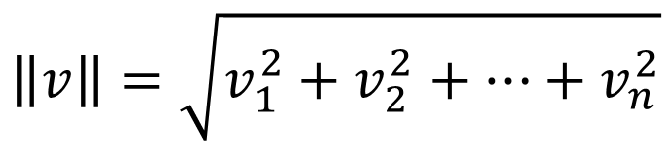

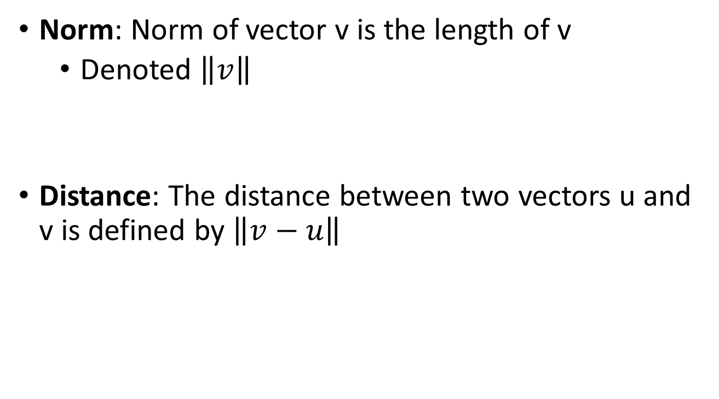





Norm & Distance
Norm: Norm of vector v is the length of v
  Denoted $\left\|v\right\|$
Distance: The distance between two vectors u and v is defined by $\left\|v−u\right\|$
$$\left\|v\right\|=\sqrt{v_{1}^{2}+v_{2}^{2}+⋯+v_{n}^{2}}$$
$$\left\|v\right\|=\sqrt{1^{2}+2^{2}+3^{2}}$$
$$=\sqrt{14}$$
$$v=\left[\begin{aligned}1 \\ 2 \\ 3\end{aligned}\right]$$
$$u=\left[\begin{aligned}2 \\ −3 \\ 0\end{aligned}\right]$$
$$v−u=\left[\begin{aligned}−1 \\ 5 \\ 3\end{aligned}\right]$$
$$\left\|v−u\right\|=\sqrt{{\left(−1\right)}^{2}+5^{2}+3^{2}}$$
$$=\sqrt{35}$$

Slide 4
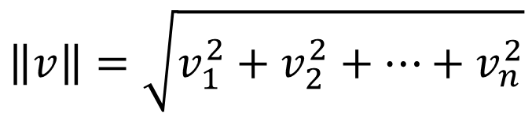
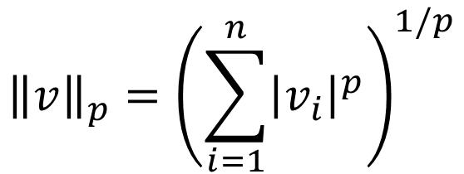
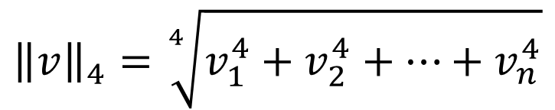
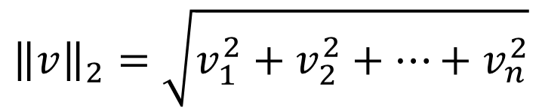
$$\left\|v\right\|=\sqrt{v_{1}^{2}+v_{2}^{2}+⋯+v_{n}^{2}}$$
2-norm
$${\left\|v\right\|}_{p}={\left(\sum_{i=1}^{n}{{\left|v_{i}\right|}^{p}}\right)}^{1/p}$$
$${\left\|v\right\|}_{1}=\left|v_{1}\right|+\left|v_{2}\right|+⋯+\left|v_{n}\right|$$
$${\left\|v\right\|}_{2}=\sqrt{v_{1}^{2}+v_{2}^{2}+⋯+v_{n}^{2}}$$
$${\left\|v\right\|}_{3}=\sqrt[3]{{\left|v_{1}\right|}^{3}+{\left|v_{2}\right|}^{3}+⋯+{\left|v_{n}\right|}^{3}}$$
$${\left\|v\right\|}_{4}=\sqrt[4]{v_{1}^{4}+v_{2}^{4}+⋯+v_{n}^{4}}$$

Slide 5
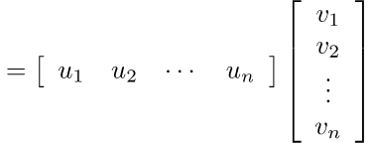


Dot Product & Orthogonal
Dot product: dot product of u and v is
Orthogonal: u and v are orthogonal if $u∙v=0$
$$u∙v=u_{1}v_{1}+u_{2}v_{2}+⋯+u_{n}v_{n}$$
$$=u^{T}v$$
Orthogonal is actually “perpendicular”
Zero vector is orthogonal to every vector

Slide 6
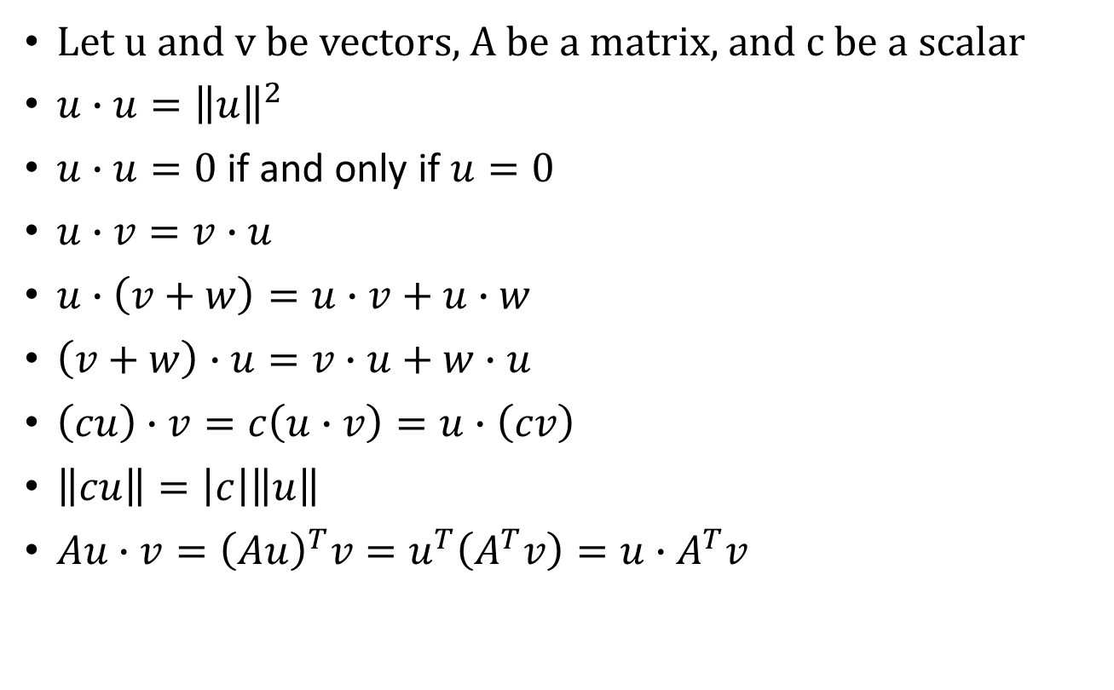
More about Dot Product
Let u and v be vectors, A be a matrix, and c be a scalar
$u∙u={\left\|u\right\|}^{2}$
$u∙u=0$ if and only if $u=0$
$u∙v=v∙u$
$u∙\left(v+w\right)=u∙v+u∙w$
$\left(v+w\right)∙u=v∙u+w∙u$
$\left(cu\right)∙v=c\left(u∙v\right)=u∙\left(cv\right)$
$\left\|cu\right\|=\left|c\right|\left\|u\right\|$
$Au∙v={\left(Au\right)}^{T}v=u^{T}\left(A^{T}v\right)=u∙A^{T}v$
Connect norm and dot product

Slide 7




Example
……
$$=\left(2u+3v\right)∙\left(2u+3v\right)$$
$$=2u∙2u+3v∙2u+2u∙3v+3v∙3v$$
$$=4\left(u∙u\right)+6\left(v∙u\right)+6\left(u∙v\right)+9\left(v∙v\right)$$
$${\left\|u\right\|}^{2}$$
$$12\left(v∙u\right)$$
$${\left\|v\right\|}^{2}$$

Slide 8

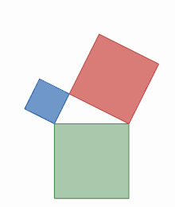
Pythagorean Theorem
Proof:
=0 if and only if u and v are orthogonal
https://en.wikipedia.org/wiki/File:Visual_proof_of_the_Pythagorean_theorem_by_area-preserving_shearing.gif
Notes:
Pythagorean
paiˋθægəriən]
畢達哥拉斯的
geometric condition for perpendicularity
畫個圖說明一下 下面那個
Rhombus 靈行

Slide 9








Dot Product vs. Geometry
The diagonals of a parallelogram are orthogonal.
The parallelogram is a rhombus (菱形).
Proof:
$$\left(u+v\right)∙\left(u−v\right)$$
$$=0$$
||u|| = ||v||
$$={\left\|u\right\|}^{2}−{\left\|v\right\|}^{2}$$
$$=0$$
$$v$$
$$u−v$$
$$u+v$$
$$u$$
Notes:
perəˈleləˌɡram
rhombus. KK[ˋrɑmbəs];

Slide 10






Triangle Inequality
For any vectors u and v,
Proof:
$${\left\|u+v\right\|}^{2}$$
$$={\left\|u\right\|}^{2}+2u∙v+{\left\|v\right\|}^{2}$$
$$≤{\left\|u\right\|}^{2}+2|u∙v|+{\left\|v\right\|}^{2}$$
Cauchy-Schwarz Inequality
$$≤{\left\|u\right\|}^{2}+2\left\|u\right\|\left\|v\right\|+{\left\|v\right\|}^{2}$$
$$≤{\left(\left\|u\right\|+\left\|v\right\|\right)}^{2}$$

Slide 11





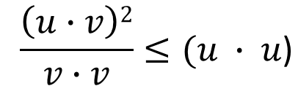

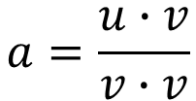

Proof:
$${\left\|u+v\right\|}^{2}$$
$$={\left\|u\right\|}^{2}+2u∙v+{\left\|v\right\|}^{2}$$
$$≤{\left\|u\right\|}^{2}+2|u∙v|+{\left\|v\right\|}^{2}$$
$$|u∙v|≤\left\|u\right\|∙\left\|v\right\|$$
Proof:
$0≤\left(u−av\right)∙\left(u−av\right)=$ $(u$ $∙$ $u$) – 2$a$ $(u$ $∙v)+a^{2}(v∙v)$
Choose
$$a=\frac{u∙v}{v∙v}$$
$0≤$ $(u$ $∙$ $u$) $+$ $(u$ $∙v)(−2\frac{u∙v}{v∙v}+\frac{u∙v}{v∙v}) = (u$ $∙$ $u$) – $\frac{\left(u∙v\right)2}{v∙v}$
$$\frac{\left(u∙v\right)2}{v∙v}≤(u ∙ u\text{)}$$
$$|u∙v|≤\left\|u\right\|∙\left\|v\right\|$$
Cauchy-Schwarz Inequality
$$≤{\left\|u\right\|}^{2}+2\left\|u\right\|\left\|v\right\|+{\left\|v\right\|}^{2}$$
$$≤{\left(\left\|u\right\|+\left\|v\right\|\right)}^{2}$$
※
Notes:
https://yutsumura.com/prove-the-cauchy-schwarz-inequality/

Slide 12
Orthogonal Basis
(Chapter 6.2)
Notes:
There are more exzmplea and another proof, that we can use

Slide 13
Outline
Orthogonal/Orthonormal Basis
Orthogonal Decomposition
How to find Orthogonal Basis
Reference: Textbook Chapter 6.2, 6.3

Slide 14
Orthogonal Set
A set of vectors is called an orthogonal set if every pair of distinct vectors in the set is orthogonal.
An orthogonal set?
By definition, a set with only one vector is an orthogonal set.
Is orthogonal set independent?
NO
(A vector set with all zero vectors)

Slide 15




Independent?
Any orthogonal set of nonzero vectors is linearly independent.
Let S = {v₁, v₂, …, v_{k}} be an orthogonal set v_{i} ≠ 0 for i = 1, 2, 😐, k.
Assume c₁, c₂, …, c_{k} make c₁v₁ + c₂v₂ + ☹ + c_{k}v_{k} = 0
c_{i} = 0
$$≠0$$
$$c_{1}=c_{2}=⋯=c_{k}=0$$

Slide 16



Orthonormal Set
A set of vectors is called an orthonormal set if it is an orthogonal set, and the norm of all the vectors is 1
Is orthonormal set independent?
Yes
$$\frac{1}{\sqrt{14}}\left[\begin{aligned}1 \\ 2 \\ 3\end{aligned}\right]$$
$$\frac{1}{\sqrt{3}}\left[\begin{aligned}1 \\ 1 \\ −1\end{aligned}\right]$$
$$\frac{1}{\sqrt{42}}\left[\begin{aligned}5 \\ −4 \\ 1\end{aligned}\right]$$
A vector that has norm equal to 1 is called a unit vector.

Slide 17

Orthogonal Basis
A basis that is an orthogonal (orthonormal) set is called an orthogonal (orthonormal) basis
$$\left[\begin{matrix}1 & 0 & 0 \\ 0 & 1 & 0 \\ 0 & 0 & 1\end{matrix}\right]$$
Orthogonal basis of R³
Orthonormal basis of R³

Slide 18
Outline
Orthogonal/Orthonormal Basis
Orthogonal Decomposition
How to find Orthogonal Basis

Slide 19


Orthogonal Basis
$${\left[u\right]}_{S}=\left[\begin{aligned}c_{1} \\ c_{2} \\ ⋮ \\ c_{k}\end{aligned}\right]$$
Let $S=\left\{v_{1},v_{2},⋯,v_{k}\right\}$ be an orthogonal basis for a subspace W, and let u be a vector in W.
$$u=c_{1}v_{1}+c_{2}v_{2}+⋯+c_{k}v_{k}$$
$$\frac{u∙v_{1}}{{\left\|v_{1}\right\|}^{2}}$$
$$\frac{u∙v_{2}}{{\left\|v_{2}\right\|}^{2}}$$
$$\frac{u∙v_{k}}{{\left\|v_{k}\right\|}^{2}}$$
Proof
To find $c_{i}$
How about orthonormal basis?
$$u∙v_{i}=\left(c_{1}v_{1}+c_{2}v_{2}+⋯+c_{i}v_{i}+⋯+c_{k}v_{k}\right)∙v_{i}$$
$$=c_{1}v_{1}∙v_{i}+c_{2}v_{2}∙v_{i}+⋯+c_{i}v_{i}∙v_{i}+⋯+c_{k}v_{k}∙v_{i}$$
$$=c_{i}\left(v_{i}∙v_{i}\right)$$
$$=c_{i}{\left\|v_{i}\right\|}^{2}$$
$$c_{i}=\frac{u∙v_{i}}{{\left\|v_{i}\right\|}^{2}}$$

Slide 20

Example
$${\left[u\right]}_{S}=\left[\begin{aligned}c_{1} \\ c_{2} \\ c_{3}\end{aligned}\right]$$
Example: S = {v₁, v₂, v₃} is an orthogonal basis for R³

Slide 21
Outline
Orthogonal/Orthonormal Basis
Orthogonal Decomposition
How to find Orthogonal Basis

Slide 22
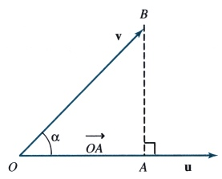

Projection of One vector onto Another Vector
Let v and u be vectors in R^{n} with angle α (0 ≤ α ≤ π) between them.
$$u∙v=\left\|u\right\| \left\|v\right\|cos α{}$$
OA : the projection of v onto u
So we define
※

Slide 23





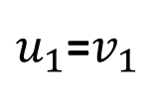







$$u_{3}$$
$$v_{2}$$
$$u_{2}$$
$$\frac{u_{3}∙v_{1}}{{\left\|v_{1}\right\|}^{2}}$$
$$v_{2}$$
$$v_{1}$$
$u_{1}$=$v_{1}$
$$\frac{u_{3}∙v_{2}}{{\left\|v_{2}\right\|}^{2}}$$
$$\frac{u_{2}∙v_{1}}{{\left\|v_{1}\right\|}^{2}}$$
$$v_{2}$$
$$v_{1}$$
$$v_{1}$$
※

Slide 24
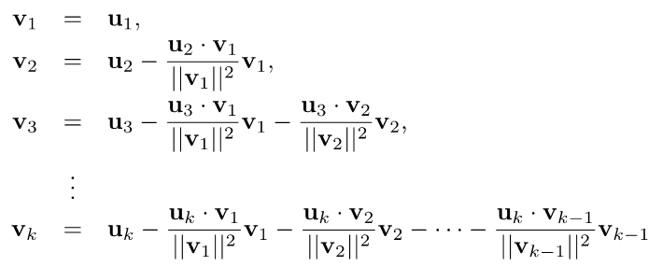
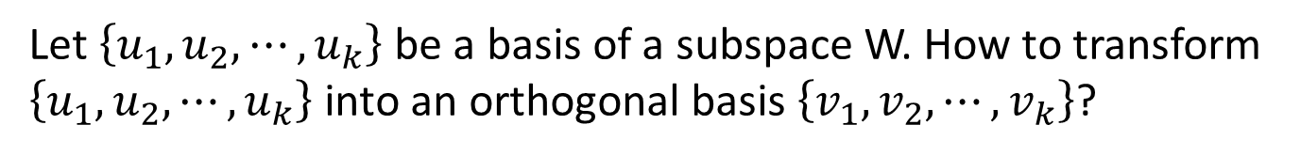


Gram-Schmidt
Process
Orthogonal Basis
Let $\left\{u_{1},u_{2},⋯,u_{k}\right\}$ be a basis of a subspace W. How to transform $\left\{u_{1},u_{2},⋯,u_{k}\right\}$ into an orthogonal basis $\left\{v_{1},v_{2},⋯,v_{k}\right\}$?
$$u_{2}$$
$$v_{2}$$
$u_{1}$=$v_{1}$
$$\frac{u_{2}∙v_{1}}{{\left\|v_{1}\right\|}^{2}}$$
$$v_{1}$$
Then $\left\{v_{1},v_{2},⋯,v_{k}\right\}$ is an orthogonal basis for W

Slide 25
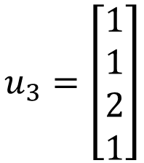
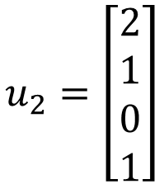
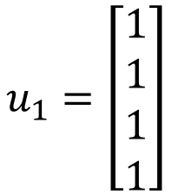
Example
S = {u₁, u₂, u₃}
Is a basis for subspace W
$$u_{1}=\left[\begin{aligned}1 \\ 1 \\ 1 \\ 1\end{aligned}\right]$$
$$u_{2}=\left[\begin{aligned}2 \\ 1 \\ 0 \\ 1\end{aligned}\right]$$
$$u_{3}=\left[\begin{aligned}1 \\ 1 \\ 2 \\ 1\end{aligned}\right]$$
(independent vectors)
Then S ′ = {v₁, v₂, v₃} is an orthogonal basis for W .
S ′′ = {v₁, v₂, 4v₃} is also an orthogonal basis.

Slide 26

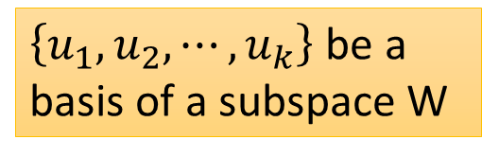
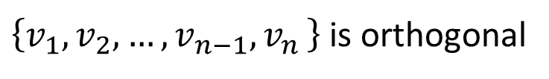
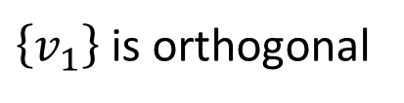
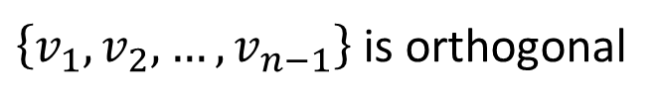

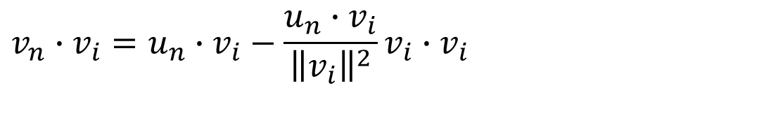
$\left\{u_{1},u_{2},⋯,u_{k}\right\}$ be a basis of a subspace W
How to prove $\left\{v_{1},v_{2},…,v_{k}\right\}$ is an orthogonal basis of W
$\left\{v_{1}\right\}$ is orthogonal
$\left\{v_{1},v_{2},…,v_{n−1}\right\}$ is orthogonal
$\left\{v_{1},v_{2},…,v_{n−1}{,v}_{n}\right\}$ is orthogonal
$$v_{n}∙v_{i}=0?$$
(i < n)
$$v_{n}∙v_{i}=u_{n}∙v_{i}−\frac{u_{n}∙v_{i}}{{\left\|v_{i}\right\|}^{2}}v_{i}∙v_{i}$$
$$=0$$

Slide 27


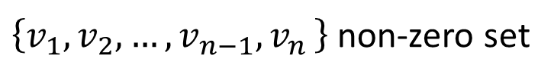

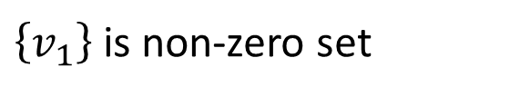
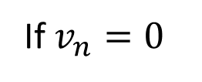
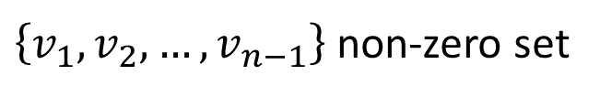
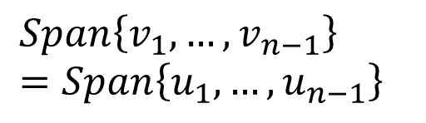

$\left\{u_{1},u_{2},⋯,u_{k}\right\}$ be a basis of a subspace W
How to prove $\left\{v_{1},v_{2},…,v_{k}\right\}$ is an orthogonal basis of W
Induction proof
Independent?
nonzero?
$\left\{v_{1}\right\}$ is non-zero set
Can $v_{n}$ be zero?
$\left\{v_{1},v_{2},…,v_{n−1}\right\}$ non-zero set
$\left\{v_{1},v_{2},…,v_{n−1}{,v}_{n}\right\}$ non-zero set
If $v_{n}=0$
$$Span\left\{v_{1}, …,v_{n−1}\right\}=Span\left\{u_{1}, …,u_{n−1}\right\}$$
$$u_{n}∈Span\left\{v_{1}, …,v_{n−1}\right\}$$
$$u_{n}∈Span\left\{u_{1}, …,u_{n−1}\right\}$$
$$=0$$

Slide 28
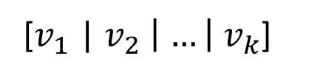
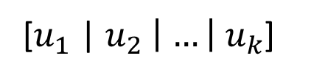
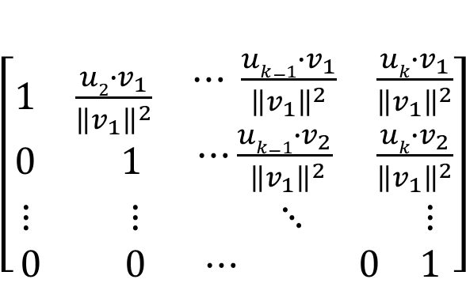
$\left\{u_{1},u_{2},⋯,u_{k}\right\}$ be a basis of a subspace W
Let matrix A = [$u_{1}$ | $u_{2} \left| …\right|{ u}_{k}$]
$\left[\begin{matrix}\begin{matrix}1 & \frac{u2∙v_{1}}{{\left\|v_{1}\right\|}^{2}} \\ 0 & 1\end{matrix} & \begin{matrix}⋯ \frac{uk−1∙v_{1}}{{\left\|v_{1}\right\|}^{2}} & \frac{uk∙v_{1}}{{\left\|v_{1}\right\|}^{2}} \\ ⋯\frac{uk−1∙v_{2}}{{ \left\|v_{1}\right\|}^{2}} & \frac{uk∙v_{2}}{{\left\|v_{1}\right\|}^{2}}\end{matrix} \\ \begin{matrix}⋮ & ⋮ \\ 0 & 0\end{matrix} & \begin{matrix}⋱ & ⋮ \\ ⋯ 0 & 1\end{matrix}\end{matrix}\right]$
[$u_{1}$ | $u_{2} \left| …\right|{ u}_{k}$]
[$v_{1}$ | $v_{2} \left| …\right|{ v}_{k}$]
=
※

Slide 29
QR Decomposition
Following Gram-Schmidt Process, any matrix A in M_{mxn} with linearly independent columns can be decomposed into
A=QR
where R is an upper triangular matrix (nxn) and Q (mxn) consists of orthonormal column vectors.
※

Slide 30
Orthogonal Projection
(Chapter 6.3)
Notes:
TBD:
P5, P6, P9

Slide 31
Orthogonal Projection
What is Orthogonal Complement
What is Orthogonal Projection
How to do Orthogonal Projection
Application of Orthogonal Projection

Slide 32

Orthogonal Complement
The orthogonal complement of a nonempty vector set S is denoted as S⊥ (S perp).
S⊥ is the set of vectors that are orthogonal to every vector in S
$$S^{\text{⊥}}=\left\{v:v⋅u=0,∀u∈S\right\}$$
W⊥
S = R^{n} ⇒ S⊥ = {0}
W
S = {0} ⇒ S⊥ = R^{n}

Slide 33
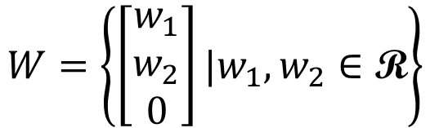

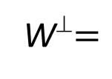

Orthogonal Complement
The orthogonal complement of a nonempty vector set S is denoted as S⊥ (S perp).
S⊥ is the set of vectors that are orthogonal to every vector in S
$$S^{\text{⊥}}=\left\{v:v⋅u=0,∀u∈S\right\}$$
$$W=\left\{\left[\begin{aligned}w_{1} \\ w_{2} \\ 0\end{aligned}\right]|w_{1},w_{2}∈\text{R}\right\}$$
V ⊆ W⊥:
for all v ∈ V and w ∈ W, v • w = 0
W⊥ ⊆ V:
$$\left\{\left[\begin{aligned}0 \\ 0 \\ v_{3}\end{aligned}\right]|v_{3}∈\text{R}\right\}$$
W⊥$=$
$$=\text{V}$$
since e₁, e₂ ∈ W, all z = [ z₁ z₂ z₃ ]^{T} ∈ W⊥ must have z₁ = z₂ = 0
Notes:
by z • e₁ = z • e₂ = 0

Slide 34















Properties of
Orthogonal Complement
Yes ($S$ may not be a subspace)
Is $S^{\text{⊥}}$ always a subspace?
For any nonempty vector set S, ${\left(Span S\right)}^{\text{⊥}}=S^{\text{⊥}}$
$$W$$
$$U$$
$$v∈W$$
$$v∈U$$
$$v$$
$$v∈U$$
$$S=\left\{w_{1},w_{2},…,w_{k}\right\}$$
$$w_{i}∙v=0$$
u
$$u∈Span S$$
$$u={c_{1}w}_{1}+c_{2}w_{2}+…+c_{k}w_{k}$$
$$u∙v=\left({c_{1}w}_{1}+c_{2}w_{2}+…+c_{k}w_{k} \right)∙v$$
$$={c_{1}w}_{1}∙v+c_{2}w_{2}∙v+…+c_{k}w_{k}∙v$$
$$=0$$
$$v∈W$$
Notes:
Use the three propertites

Slide 35


Properties of
Orthogonal Complement
Yes ($S$ may not be a subspace)
Is $S^{\text{⊥}}$ always a subspace?
For any nonempty vector set S, ${\left(Span S\right)}^{\text{⊥}}=S^{\text{⊥}}$
Let W be a subspace, and B be a basis of W.
$B^{\text{⊥}}=W^{\text{⊥}}$
What is ${S∩S}^{\text{⊥}}$?
Zero vector
Notes:
Use the three propertites

Slide 36

Properties of
Orthogonal Complement
Example:
For W = Span{u₁, u₂}, where u₁ = [ 1 1 −1 4 ]^{T} and u₂ =[ 1 −1 1 2 ]^{T}
v ∈ W⊥ if and only if u₁ • v = u₂ • v = 0
i.e., v = [ x₁ x₂ x₃ x₄ ]^{T} satisfies
⇔
⇔
is a basis for W⊥.
W⊥
= Solutions of “Ax=0”
= Null A
Notes:
Proof You show that (a basis of W)∪(a basis of W⊥) = a basis of R^{n}.

Slide 37





Properties of
Orthogonal Complement
$$\left[\begin{matrix}\begin{matrix}a_{11} & a_{12} \\ a_{21} & a_{22}\end{matrix} & \begin{matrix}⋯ & a_{1n} \\ ⋯ & a_{2n}\end{matrix} \\ \begin{matrix}⋮ & ⋮ \\ a_{m1} & a_{m2}\end{matrix} & \begin{matrix}⋱ & ⋮ \\ ⋯ & a_{mn}\end{matrix}\end{matrix}\right]$$
$$\left[\begin{matrix}\begin{matrix}x_{1} \\ x_{2}\end{matrix} \\ \begin{matrix}⋮ \\ x_{n}\end{matrix}\end{matrix}\right]$$
For any matrix A
$${\left(Row A\right)}^{\text{⊥}}=Null A$$
v ∈ (Row A)⊥ ⇔ For all w ∈ Span{rows of A}, w • v = 0
⇔ Av = 0.
${\left(Col A\right)}^{\text{⊥}}=Null A^{T}$
(Col A)⊥ = (Row A^{T}) ⊥ = Null A^{T} .
For any subspace W of R^{n}
$$dimW+dimW^{\text{⊥}}=n$$

Slide 38








Properties of
Orthogonal Complement
$$x_{1}$$
$$r$$
$$x_{0}$$
For any matrix $A:$R^{n} $→$R^{m}
Facts:
If Ax₁=b, then x₁= x₀ + r, for some r in N(A)
If Ay₀=b and y₀ in Row(A), then y₀ = x₀
For every x with Ax=b, $\left\|x\right\|$ ≧ $\left\|\text{x}\text{0}\right\|$
$$\text{R}\text{ow}\text{(}\text{A}\text{)}$$
= $\text{N}\text{(}\text{A}\text{)}$ ⊥
x₀
y₀
Ax₀=b
$$\text{R}\text{n}$$
b
+
x₁
Ax₁=b
r
$\text{N}\text{(}\text{A}\text{):}$ Ax=0
※

Slide 39







Unique
w
$$u={c_{1}w}_{1}+c_{2}w_{2}+…+c_{k}w_{k}$$
$$+{b_{1}z}_{1}+b_{2}z_{2}+…+b_{n−k}z_{n−k}$$
z
For any subspace W of R^{n}
$$dimW+dimW^{\text{⊥}}=n$$
Basis: $\left\{w_{1},w_{2},⋯,w_{k}\right\}$
Basis: $\left\{z_{1},z_{2},⋯,z_{n−k}\right\}$
Basis for R^{n}
For every vector u,
W⊥
u
u = w + z
(unique)
z
W
w
$$∈W$$
$$∈W^{\text{⊥}}$$
0

Slide 40
Orthogonal Projection
What is Orthogonal Complement
What is Orthogonal Projection
How to do Orthogonal Projection
Application of Orthogonal Projection

Slide 41






Orthogonal Projection
orthogonal projection
$$∈W^{\text{⊥}}$$
u = w + z
(unique)
$$z$$
$$∈W$$
$$∈W^{\text{⊥}}$$
Orthogonal Projection Operator:
The function $U_{W}\left(u\right)$ is the orthogonal projection of u on W.
u = w + z
u’ = w’ + z’
Linear?
ku = kw + kz
u+u’ = (w+w’) + (z+z’)

Slide 42


Orthogonal Projection
w in subspace W is “closest” to vector u.
$$∈W^{\text{⊥}}$$
$$z$$
“closest”
Always orthogonal
z is always orthogonal to all vectors in W.

Slide 43
Closest Vector Property
Among all vectors in subspace W, the vector closest to u is the orthogonal projection of u on W
u
∀ w, w′, w − w′ ∈ W.
⇒ (u − w) • (w − w′) = 0.
⇒ ||u − w′||²
= ||(u − w) + (w − w′)||²
= ||u − w||² + ||w − w′||²
> ||u − w||²
w
w’
0
w = U_{W}(u)
W
The distance from a vector u to a subspace W is the distance between u and the orthogonal projection of u on W

Slide 44


Orthogonal Projection Matrix
Orthogonal projection operator is linear.
It has standard matrix.
Orthogonal Projection Matrix P_{w}
u
z = u - w
w = U_{W}(u)
$$=P_{W}u$$
0
v = U_{W}(v)
$$=P_{W}v$$
W
Notes:
Proposition: U_{W} is linear.
Proof If U_{W}(u₁) = w₁ and U_{W}(u₂) = w₂, then ∃ unique z₁, z₂ ∈W⊥
such that u₁ = w₁+z₁ and u₂ = w₂+z₂ ⇒ u₁+u₂ = w₁+w₂ + z₁+z₂
⇒ U_{W}(u₁+u₂) = w₁+w₂ since w₁+w₂ ∈W and z₁+z₂ ∈W⊥
Similarly U_{W}(cu) = cw ∀c, u

Slide 45
Orthogonal Projection
What is Orthogonal Projection
How to do Orthogonal Projection
Application of Orthogonal Projection
What is Orthogonal Complement

Slide 46
Orthogonal Projection on a line
Orthogonal projection of a vector on a line
$$z∙u=0$$
v
v: any vector
u: any nonzero vector on L
w: orthogonal projection of
v onto L , w = cu
z: v − w
z
L
z
u
w
$$\left(v−w\right)∙u$$
$$=\left(v−cu\right)∙u$$
$$=v∙u−cu∙u$$
$$=v∙u−c{\left\|u\right\|}^{2}$$
$$c=\frac{v∙u}{{\left\|u\right\|}^{2}}$$
$$w=cu=\frac{v∙u}{{\left\|u\right\|}^{2}}u$$
=0
Distance from tip of v to L :
$$=\left\|v−\frac{v∙u}{{\left\|u\right\|}^{2}}u \right\|$$
$$\left\|z\right\|=\left\|v−w\right\|$$
Notes:
W in terms of u
Tip: 頂端；尖端

Slide 47







Orthogonal Projection
$$c=\frac{v∙u}{{\left\|u\right\|}^{2}}$$
$$w=cu=\frac{v∙u}{{\left\|u\right\|}^{2}}u$$
Example:
$$z∙u=0$$
v
z
L is y = (1/2)x
L
z
u
$$v=\left[\begin{aligned}4 \\ 1\end{aligned}\right]$$
$$u=\left[\begin{aligned}2 \\ 1\end{aligned}\right]$$
w
$$w=\frac{v∙u}{{\left\|u\right\|}^{2}}u$$
$$=\frac{9}{5}\left[\begin{aligned}2 \\ 1\end{aligned}\right]$$
$$=\left[\begin{aligned}4 \\ 1\end{aligned}\right]−\frac{9}{5}\left[\begin{aligned}2 \\ 1\end{aligned}\right]$$
$$z=v−w$$
Notes:
$$w=\frac{v∙u}{{\left\|u\right\|}^{2}}u$$
$$=\frac{9}{5}\left[\begin{aligned}2 \\ 1\end{aligned}\right]$$
$$\left\|\left[\begin{aligned}4 \\ 1\end{aligned}\right]−\frac{9}{5}\left[\begin{aligned}2 \\ 1\end{aligned}\right]\right\|$$
$$=\frac{1}{5}\left\|\left[\begin{aligned}2 \\ −4\end{aligned}\right]\right\|$$
$$=\frac{2}{5}\sqrt{5}$$

Slide 48











Projection on a Line in R²
$$z∙u=0$$
v
$$w=\frac{v∙u}{{\left\|u\right\|}^{2}}u$$
z
L
$$=u\frac{uTv}{{\left\|u\right\|}^{2}}$$
z
u
w
$$=(\frac{uuT}{{\left\|u\right\|}^{2}})v$$
$$v=\left[\begin{aligned}4 \\ 1\end{aligned}\right]$$
$$u=\left[\begin{aligned}2 \\ 1\end{aligned}\right]$$
$2$x $2$
Projection matrix
Projection Matrix P is
$\frac{1}{5}\left[\begin{aligned}2 \\ 1\end{aligned}\right]$[2 1] =
$$\frac{1}{5}\left[\begin{matrix}4 & 2 \\ 2 & 1\end{matrix}\right]$$
w$=P\left[\begin{aligned}4 \\ 1\end{aligned}\right]=\frac{9}{5}\left[\begin{aligned}2 \\ 1\end{aligned}\right]$
$(\frac{uuT}{{\left\|u\right\|}^{2}})$ $=$
※
Notes:
W in terms of u
Tip: 頂端；尖端

Slide 49


Orthogonal Projection on W in R^{n}
u
u - w
Theorem:
$$P_{W}=C{\left(C^{T}C\right)}^{−1}C^{T}$$
nxk
kxn
nxk
kxn
  $$C=\left[\begin{aligned}| \\ v \\ |\end{aligned}\begin{aligned} | \\ w \\ |\end{aligned}\right]$$
w = Cb= P_{W}(u),
for some b
n x n
nxk
0
Note:
Null(C^{T}) is perp. to Col(C)
u-w is in Null(C^{T})
W= Col(C)
Proof: Let u ∈ R^{n} and w = P_{W}(u).
Since W = Col C, w = Cb for some b ∈ R^{k}
and u − w ∈W⊥
⇒ 0 = C^{T}(u − w) = C^{T}u − C^{T}w = C^{T}u − C^{T}Cb.
⇒ C^{T}u = C^{T}Cb.
⇒ b = (C^{T}C)⁻¹C^{T}u and w = C(C^{T}C)⁻¹C^{T}u as C^{T}C is invertible.
※

Slide 50


Orthogonal Projection Matrix
Let C be an n x k matrix whose columns form a basis for a subspace W
$$P_{W}=C{\left(C^{T}C\right)}^{−1}C^{T}$$
n x n
Let C be a matrix with linearly independent columns. Then $C^{T}C$ is invertible.
Proof: We want to prove that C^{T}C has independent columns.
Suppose C^{T}Cb = 0 for some b.
⇒ b^{T}C^{T}Cb = (Cb)^{T}Cb = (Cb) • (Cb) = ||Cb||² = 0.
⇒ Cb = 0 ⇒ b = 0 since C has linear independent columns.
Thus C^{T}C is invertible.

Slide 51





Orthogonal Projection Matrix
Example: Let W be the 2-dimensional subspace of R³ with equation x₁ − x₂ +2x₃ = 0.
$$P_{W}=C{\left(C^{T}C\right)}^{−1}C^{T}$$
記得起來嗎?
W has a basis
$$C=$$
$$\left[\begin{matrix}5 & 1 & −2 \\ 1 & 5 & 2 \\ −2 & 2 & 2\end{matrix}\right]$$
$$P_{W}\left[\begin{aligned}1 \\ 3 \\ 4\end{aligned}\right]=\left[\begin{aligned}0 \\ 4 \\ 2\end{aligned}\right]$$
$P_{W}=$ 1/6

Slide 52

Properties of Projection Matrices
In R^{n} , suppose C is an n x k matrix with rank(C)=k
P$W$ : R^{n} -> R^{n} is an n x n matrix
(P$W\text{)}$² = P$W$
P$W$ is symmetric
Rank(P$W$)=k
The eigenvalues of P$W$ consists of k 1s and n-k 0s
P$W$C=C
If columns of C are orthonormal,
P$W$ = $CC^{T}$
W= Col(C)
0
dim(W)=k
※

Slide 53









Orthogonal Projection
Let $S=\left\{v_{1},v_{2},⋯,v_{k}\right\}$ be an orthogonal basis for a subspace W, and let u be a vector in W.
Let u be any vector, and w is the orthogonal projection of u on W.
$$u=c_{1}v_{1}+c_{2}v_{2}+⋯+c_{k}v_{k}$$
$$\frac{u∙v_{1}}{{\left\|v_{1}\right\|}^{2}}$$
$$\frac{u∙v_{2}}{{\left\|v_{2}\right\|}^{2}}$$
$$\frac{u∙v_{k}}{{\left\|v_{k}\right\|}^{2}}$$
$$w=c_{1}v_{1}+c_{2}v_{2}+⋯+c_{k}v_{k}$$
$$\frac{u∙v_{1}}{{\left\|v_{1}\right\|}^{2}}$$
$$\frac{u∙v_{2}}{{\left\|v_{2}\right\|}^{2}}$$
$$\frac{u∙v_{k}}{{\left\|v_{k}\right\|}^{2}}$$

Slide 54










Orthogonal Projection
Let $S=\left\{v_{1},v_{2},⋯,v_{k}\right\}$ be an orthogonal basis for a subspace W. Let u be any vector, and w is the orthogonal projection of u on W.
$$w=c_{1}v_{1}+c_{2}v_{2}+⋯+c_{k}v_{k}$$
$$\frac{u∙v_{1}}{{\left\|v_{1}\right\|}^{2}}$$
$$\frac{u∙v_{2}}{{\left\|v_{2}\right\|}^{2}}$$
$$\frac{u∙v_{k}}{{\left\|v_{k}\right\|}^{2}}$$
$$P_{W}=C{\left(C^{T}C\right)}^{−1}C^{T}$$
$$C^{T}=\left[\begin{aligned}v_{1}^{T} \\ v_{2}^{T} \\ ⋮ \\ v_{k}^{T}\end{aligned}\right]$$
$$P_{W}=CD^{−1}C^{T}$$
$$C=\left[\begin{matrix}v_{1} & ⋯ & v_{k}\end{matrix}\right]$$
Projected:
$$w=CD^{−1}C^{T}u$$

Slide 55



Matrix ${\left(A^{T}A\right)}^{−1}A^{T}$, $A$ in R^{mxn}
Consider the standard equation
  If $A$ is invertible, x= $A$⁻¹b.
  What if $A$ is not invertible, can we find some matrix which is like “inverse” of $A$?
  Pseudo-inverse:
  (${\left(A^{T}A\right)}^{−1}A^{T}$) $A$ = ${\left(A^{T}A\right)}^{−1}{(A}^{T}$ $A$) =I
  assuming ${\left(A^{T}A\right)}^{−1}$ exists
※

Slide 56


$${The Magic of A}^{T}A$$
  $A^{T}A$is symmetric
  $A^{T}A$is positive semidefinite ($v^{T}(A^{T}A)v≥0$, for all $v$.
    (pf) $v^{T}(A^{T}A)v$= ${(Av)}^{T}(Av)$ = $\left\|Av\right\|$² $≥0$
  $A^{T}A$is positive definite if$columns are linearly independent$
  Is $A^{T}A$ always invertible?
    Not necessarily unless it is positive definite ($v^{T}\left(A^{T}A\right)v>0$, for all $v$)
    ${If A}^{′}s columns are linearly independent, then$
    ${ A}^{T}A$ is invertible
※

Slide 57













$${The Magic of A}^{T}A$$
$$\left[\begin{aligned}| \\ v \\ |\end{aligned}\begin{aligned} | \\ w \\ |\end{aligned}\right]$$
Theorem
$A^{T}A$x = $A^{T}$b ⟺ the line through b and $A$x is orthogonal to S
$$A^{T}$$
z
b ∉ S
  $$A=\left[\begin{aligned}| \\ v \\ |\end{aligned}\begin{aligned} | \\ w \\ |\end{aligned}\right]$$
$A^{T}$b
$A^{T}$ $A$x
$$A^{T}$$
$A$x
$$\left[\begin{matrix}0 \\ 1\end{matrix}\right]$$
x
$$v=A\left[\begin{matrix}1 \\ 0\end{matrix}\right]$$
$$A^{}$$
y
$$\left[\begin{matrix}1 \\ 0\end{matrix}\right]$$
$$w=A\left[\begin{matrix}0 \\ 1\end{matrix}\right]$$
※
x
dim S=2

Slide 58
Orthogonal Projection
What is Orthogonal Projection
How to do Orthogonal Projection
Application of Orthogonal Projection
What is Orthogonal Complement

Slide 59
Least Square Approximation
(Chapter 6.4)
Notes:
那放橋的video 嗎?????
http://blog.stata.com/2011/03/09/understanding-matrices-intuitively-part-2/
http://www.slideshare.net/ChristopherGratton/eigenvectors-eigenvalues-the-road-to-diagonalization
http://www.cs.columbia.edu/~jebara/htmlpapers/UTHESIS/node65.html
http://www.snrky.com/2012/07/so-long-as-my-eigenvalue-is-always-1.html
http://sune.tistory.com/22
http://www.mathworks.com/matlabcentral/answers/246053-how-to-rconstruct-image-using-eigenvectors-and-eigenvalues

Slide 60
Solution of Inconsistent
System of Linear Equations
Suppose Ax = b is an inconsistent system of linear equations.
b is not in the column space of A
Find vector z minimizing ||Az − b||
b
||Ax − b||
||Az − b||
Ax
0
Az = P_{W}b
W = Col A

Slide 61

Least Square Approximation
data pairs:
x₁ → y₁
x₂ → y₂

x_{i} → y_{i}

predict
e.g.
(今天股票,明天股票)
(今天PM2.5,明天PM2.5)
Find the “least-square line” y = a₀ + a₁x to best fit the data
Regression
Notes:
Regression回歸

Slide 62






Least Square Approximation
$$y=a_{0}+a_{1}x$$
Error Vector:
$$\left(x_{i},a_{0}+a_{1}x_{i}\right)$$
$$y_{i}−\left(a_{0}+a_{1}x_{i}\right)$$
$$\left(x_{i},y_{i}\right)$$
Find a₀ and a₁ minimizing E

Slide 63



Least Square Approximation
Error Vector:
Find a₀ and a₁ minimizing E
E = ||y − (a₀v₁ + a₁v₂)||² = ||y − Ca||²

Slide 64


Least Square Approximation
y
Ca
0
Col(C)
Find a minimizing
E = ||y − Ca||²
B = {v₁, v₂}
Independent
Ca is the orthogonal projection of y on W = Span B .
find a such that Ca = P_{W}y
$$Ca=C{\left(C^{T}C\right)}^{−1}C^{T}y$$
$$a={\left(C^{T}C\right)}^{−1}C^{T}y$$
Pseudo-Inverse

Slide 65

Example 1
⇒ y = 0.056 + 0.745x.
Prediction:
if the rough weight is 2.65,
the finished weight is
0.056 +0.745(2.65) = 2.030.
(estimation)
Notes:
connecting rod

Slide 66


Least Square Approximation
Best quadratic fit: using y = a₀ + a₁x + a₂x² to fit the data points (x₁, y₁), (x₂, y₂), 😐, (x_{n}, y_{n})
$$e=\left[\begin{aligned}y_{1}−\left(a_{0}+a_{1}x_{1}+a_{2}x_{1}^{2}\right) \\ y_{2}−\left(a_{0}+a_{1}x_{2}+a_{2}x_{2}^{2}\right) \\ ⋮ \\ y_{n}−\left(a_{0}+a_{1}x_{n}+a_{2}x_{n}^{2}\right)\end{aligned}\right]$$
y = a₀ + a₁x + a₂x²
Find a₀, a₁ and a₂ minimizing E

Slide 67



Least Square Approximation
Best quadratic fit: using y = a₀ + a₁x + a₂x² to fit the data points (x₁, y₁), (x₂, y₂), 😐, (x_{n}, y_{n})
$$e=\left[\begin{aligned}y_{1}−\left(a_{0}+a_{1}x_{1}+a_{2}x_{1}^{2}\right) \\ y_{2}−\left(a_{0}+a_{1}x_{2}+a_{2}x_{2}^{2}\right) \\ ⋮ \\ y_{n}−\left(a_{0}+a_{1}x_{n}+a_{2}x_{n}^{2}\right)\end{aligned}\right]$$
Find a₀, a₁ and a₂ minimizing E

Slide 68



y = a₀ + a₁x + a₂x²
$$y=101.00+29.77x−16.11x^{2}$$
Best fitting polynomial of any desired maximum degree may be
found with the same method.

Slide 69





Multivariable Least Square Approximation
$$y_{A}$$
$$y_{A}=a_{0}+a_{1}x_{A}+a_{2}x_{B}$$
$$x_{A}$$
$$x_{B}$$
http://www.palass.org/publications/newsletter/palaeomath-101/palaeomath-part-4-regression-iv

Slide 70
Orthogonal Matrices &
Symmetric Matrices
(Chapter 6.5, 6.6)

Slide 71
Outline
Orthogonal Matrices
Reference: Chapter 6.5
Symmetric Matrices
Reference: Chapter 6.6

Slide 72
Orthogonal Matrix
An nxn matrix Q is called an orthogonal matrix if the columns of Q are orthonormal.
Orthogonal operator: standard matrix is an orthogonal matrix.
unit
unit
is an orthogonal matrix.
orthogonal

Slide 73


Norm-preserving
A linear operator is norm-preserving if
$$\left\|T\left(u\right)\right\|=\left\|u\right\|$$
For all u
Example: linear operator T on R² that rotates a vector by θ.
⇒ Is T norm-preserving?
Example: linear operator T is reflection
⇒ Is T norm-preserving?
$$A=\left[\begin{matrix}1 & 0 \\ 0 & −1\end{matrix}\right]$$
Notes:
Anything in Common?

Slide 74

Norm-preserving
A linear operator is norm-preserving if
$$\left\|T\left(u\right)\right\|=\left\|u\right\|$$
For all u
Example: linear operator T is projection
⇒ Is T norm-preserving?
$$A=\left[\begin{matrix}1 & 0 \\ 0 & 0\end{matrix}\right]$$
Example: linear operator U on R^{n} that has an eigenvalue λ ≠ ±1.
⇒ U is not norm-preserving, since for the corresponding
eigenvector v, ||U(v)|| = ||λv|| = |λ|·||v|| ≠ ||v||.

Slide 75
Norm-preserving
Necessary conditions:
Norm-preserving
Orthogonal Matrix
?
???
Linear operator Q is norm-preserving
||q_{j}|| = 1
||q_{j}|| = ||Qe_{j}|| = ||e_{j}||
q_{i} and q_{j} are orthogonal
畢式定理
||q_{i} + q_{j}||² = ||Qe_{i} + Qe_{j}||² = ||Q(e_{i} + e_{j})||² = ||e_{i} + e_{j}||² = 2 = ||q_{i}||² + ||q_{j}||²
Notes:
Why there is no northonormal matrix??????????????????????????????????????????????????????

Slide 76

Orthogonal Matrix
Those properties are used to check orthogonal matrix.
Q is an orthogonal matrix
${QQ}^{T}=I_{n}$
$Q$ is invertible, and $Q^{−1}=Q^{T}$
$Qu∙Qv=u∙v$ for any $u,$ $v$
$\left\|Qu\right\|=\left\|u\right\|$ for any u
Simple inverse
Q preserves dot products
Q preserves norms
Norm-preserving
Orthogonal Matrix
Notes:
Proof (b) ⬄ (c) By definition of invertible matrices
(a) ⇒ (b) with Q = [ q₁ q₂ ☹ q_{n} ], q_{i} • q_{i} = 1 = [Q^{T}Q]_{ii} ∀i,
and q_{i} • q_{j} = 0 = [Q^{T}Q]_{ij} ∀i ≠ j.
⇒ Q^{T}Q = I_{n}
(c) ⇒ (d) ∀u, v ∈ R^{n}, Qu • Qv = u • Q^{T}Qv = u • Q⁻¹Qv = u • v.
(d) ⇒ (e) ∀u ∈ R^{n}, ||Qu|| = (Qu • Qu)^{1/2} = (u • u)^{1/2} = ||u||.
(e) ⇒ (a) The above necessary conditions.

Slide 77















Orthogonal Matrix
1
$$q_{i}∙q_{j}={q_{i}}^{T}q_{j}$$
1
Q is an orthogonal matrix
$Q^{T}Q=I_{n}$
$Q$ is invertible, and $Q^{−1}=Q^{T}$
$Qu∙Qv=u∙v$ for any u and v
$\left\|Qu\right\|=\left\|u\right\|$ for any u
$$i≠j: 0$$
2
$$i=j: 1$$
$$Q^{T}Q$$
3
i-j entry is ${q_{i}}^{T}q_{j}$
2
$$Qu∙Qv={\left(Qu\right)}^{T}Qv$$
$$=u^{T}Q^{T}Qv$$
$$=u^{T}Iv$$
$$=u^{T}v$$
$$=u∙v$$
3
$$Qu∙Qv=u∙v$$
$$Qu∙Qu=u∙u$$
$${\left\|Qu\right\|}^{2}={\left\|u\right\|}^{2}$$
$$\left\|Qu\right\|=\left\|u\right\|$$
Notes:
Proof (b) ⬄ (c) By definition of invertible matrices
(a) ⇒ (b) with Q = [ q₁ q₂ ☹ q_{n} ], q_{i} • q_{i} = 1 = [Q^{T}Q]_{ii} ∀i,
and q_{i} • q_{j} = 0 = [Q^{T}Q]_{ij} ∀i ≠ j.
⇒ Q^{T}Q = I_{n}
(c) ⇒ (d) ∀u, v ∈ R^{n}, Qu • Qv = u • Q^{T}Qv = u • Q⁻¹Qv = u • v.
(d) ⇒ (e) ∀u ∈ R^{n}, ||Qu|| = (Qu • Qu)^{1/2} = (u • u)^{1/2} = ||u||.
(e) ⇒ (a) The above necessary conditions.

Slide 78




Orthogonal Matrix
Let P and Q be n x n orthogonal matrices
  $detQ=±1$
  $PQ$ is an orthogonal matrix
  $Q^{−1}$ is an orthogonal matrix
  $Q^{T}$ is an orthogonal matrix
Check by ${\left(PQ\right)}^{−1}={\left(PQ\right)}^{T}$
Check by ${\left(Q^{−1}\right)}^{−1}={\left(Q^{−1}\right)}^{T}$
=
Proof (a) QQ^{T} = I_{n} ⇒ det(I_{n}) = det(QQ^{T}) = det(Q)det(Q^{T})
= det(Q)² ⇒ det(Q) = ±1.
(b) (PQ)^{T} = Q^{T}P^{T} = Q⁻¹P⁻¹ = (PQ)⁻¹.
(C) (Q⁻¹)⁻¹ = (Q^{T})⁻¹ = (Q⁻¹)^{T}
Rows and columns

Slide 79

Orthogonal Operator
Applying the properties of orthogonal matrices on orthogonal operators
T is an orthogonal operator
  $T\left(u\right)∙T\left(v\right)=u∙v$ for all $u$ and $v$
  $\left\|T\left(u\right)\right\|=\left\|u\right\|$ for all $u$
T and U are orthogonal operators, then $TU$ and $T^{−1}$ are orthogonal operators.
Preserves dot product
Preserves norms

Slide 80












Example: Find an orthogonal operator T on R³ such that
$$T\left(\left[\begin{matrix}1/{\sqrt{2}} \\ 0 \\ 1/{\sqrt{2}}\end{matrix}\right]\right)=\left[\begin{matrix}0 \\ 1 \\ 0\end{matrix}\right]$$
Norm-preserving
$$v=\left[\begin{matrix}1/{\sqrt{2}} \\ 0 \\ 1/{\sqrt{2}}\end{matrix}\right]$$
Find $A^{−1}$ first
$$Av=e_{2}$$
$$v=A^{−1}e_{2}$$
Because $A^{−1}=A^{T}$
$$A^{−1}=\left[\begin{matrix}∗ & 1/{\sqrt{2}} & ∗ \\ ∗ & 0 & ∗ \\ ∗ & 1/{\sqrt{2}} & ∗\end{matrix}\right]$$
Also orthogonal
$$A^{−1}=\left[\begin{matrix}1/{\sqrt{2}} & 1/{\sqrt{2}} & 0 \\ 0 & 0 & 1 \\ {−1}/{\sqrt{2}} & 1/{\sqrt{2}} & 0\end{matrix}\right]$$
$$\left[\begin{matrix}1/{\sqrt{2}} \\ 0 \\ {−1}/{\sqrt{2}}\end{matrix}\right]$$
$$\left[\begin{matrix}0 \\ 1 \\ 0\end{matrix}\right]$$
$$A={\left(A^{−1}\right)}^{T}=\left[\begin{matrix}1/{\sqrt{2}} & 0 & {−1}/{\sqrt{2}} \\ 1/{\sqrt{2}} & 0 & 1/{\sqrt{2}} \\ 0 & 1 & 0\end{matrix}\right]$$
$$1/{\sqrt{2}}x_{1}+0x_{2}+1/{\sqrt{2}}x_{3}=0$$

Slide 81



Conclusion
Orthogonal Matrix (Operator)
  Columns and rows are orthogonal unit vectors
  Preserving norms, dot products
  Its inverse equals its transpose
  NOTE:
  Orthogonal Matrices correspond to Unitary Matrices in complex domain C^{n}
  In quantum computing, operators are always unitary.
※

Slide 82
Outline
Orthogonal Matrices
Reference: Chapter 6.5
Symmetric Matrices
Reference: Chapter 6.6

Slide 83

Eigenvalues are real
The eigenvalues for symmetric matrices are always real.
Consider 2 x 2 symmetric matrices
How about more general cases?
$$det\left(A−tI_{2}\right)=t^{2}−\left(a+c\right)t+ac−b^{2}$$
The symmetric matrices always have real eigenvalues.

Slide 84























Eigenvalues are real
Symmetric matrix $A$ always has eigenvalue.
A symmetric matrix $A$ has an eigenvalue $λ$
$λ=a+bi$
$$Av=λv$$
$$\overline{Av}=\overline{λv}$$
$$\overline{A}\overline{v}=\overline{λ}\overline{v}$$
$$A\overline{v}=\overline{λ}\overline{v}$$
$$\overline{A}=A$$
$${\left(\overline{v}\right)}^{T}λv$$
$${=λ\left(\overline{v}\right)}^{T}v$$
$$v=\left[\begin{aligned}a_{1}+b_{1}i \\ a_{2}+b_{2}i \\ ⋮\end{aligned}\right]$$
$$≠0$$
$${\left(\overline{v}\right)}^{T}Av$$
$${\left(\overline{v}\right)}^{T}A^{T}v$$
$${=\left(A\overline{v}\right)}^{T}v$$
$$\overline{v}=\left[\begin{aligned}a_{1}−b_{1}i \\ a_{2}−b_{2}i \\ ⋮\end{aligned}\right]$$
$${=\left(\overline{λ}\overline{v}\right)}^{T}v$$
$${=\overline{λ}\left(\overline{v}\right)}^{T}v$$
$${\left(\overline{v}\right)}^{T}v=?$$
$$>0$$
$$λ=\overline{λ}$$
$$b=0$$
$={\left(a_{1}\right)}^{2}+{\left(b_{1}\right)}^{2}$+ ${\left(a_{2}\right)}^{2}$+ ${\left(b_{2}\right)}^{2}+…$

Slide 85










Orthogonal Eigenvectors
A is symmetric
$$det\left(A−tI_{n}\right)$$
Factorization
$$={\left(t−λ_{1}\right)}^{m_{1}}{\left(t−λ_{2}\right)}^{m_{2}}…{\left(t−λ_{k}\right)}^{m_{k}}\left(……\right)$$
Eigenvalue:
$$λ_{1}$$
$$λ_{2}$$
……
$$λ_{k}$$
Eigenspace:
$$d_{1}$$
$$≤m_{1}$$
$$d_{2}$$
$$≤m_{2}$$
……
$$d_{k}$$
$$≤m_{k}$$
(dimension)
Independent
orthogonal

Slide 86






Orthogonal Eigenvectors
The set of eigenvectors of a symmetric matrix are orthogonal.
If $u$ and $v$ are eigenvectors corresponding to eigenvalues $λ$ and $μ$ ($λ≠μ$)
$u$ and $v$ are orthogonal.

Slide 87






Diagonalization
$$A=PDP^{T}$$
A is symmetric
$$P^{T}AP=D$$
P is an orthogonal matrix
:
simple
D is a diagonal matrix
$$P^{T}AP=D$$
$$P^{−1}AP=D$$
$$A=PDP^{−1}$$
Diagonalization
$$A=PDP^{T}$$
P consists of eigenvectors
, D are eigenvalues
Notes:
P560

Slide 88

















Diagonalization
A is symmetric
$$P^{T}AP=D$$
$$A:n×n$$
$A$ has eigenvalue $λ$
$$Au_{1}=λu_{1}$$
$u_{1}$ is unit vector
Find an orthonormal basis
$$\left\{u_{1},u_{2},⋯,u_{n}\right\}$$
$$=B$$
eigenvector
don’t care
  by the Extension Theorem and Gram-Schmidt Process
$$B^{T}AB=?$$
$${\left(B^{T}AB\right)}^{T}=B^{T}A^{T}{\left(B^{T}\right)}^{T}=B^{T}AB$$
symmetric
$$B^{T}ABe_{1}$$
$$=B^{T}Au_{1}$$
$$=B^{T}λu_{1}$$
$$=λB^{T}u_{1}$$
$$λ$$
0
$$=λ\left[\begin{matrix}{u_{1}}^{T} \\ {u_{2}}^{T} \\ ⋮\end{matrix}\right]u_{1}$$
0
$A$’
$$=λ\left[\begin{matrix}1 \\ 0 \\ ⋮\end{matrix}\right]$$
$$=\left[\begin{matrix}λ \\ 0 \\ ⋮\end{matrix}\right]$$
symmetric

Slide 89



















Diagonalization
A is symmetric
$$P^{T}AP=D$$
$$A:n×n$$
ortho
$$λ$$
0
$λ$’
0
$$1$$
0
0
$A$’
0
$A$’’
0
$$B′$$
$$B^{T}AB=$$
$${B′}^{T}A^{′}B′=$$
$$C=$$
sym
ortho
symmetric
symmetric
ortho
$$C^{T}B^{T}ABC=?$$
$$1$$
0
$$λ$$
0
$$1$$
0
$$λ$$
0
0
$${B′}^{T}$$
0
$A$’
0
$$B′$$
0
$${B′}^{T}A^{′}B′$$
$$=$$

Slide 90



















Diagonalization
A is symmetric
$$P^{T}AP=D$$
$$A:n×n$$
$$C^{T}B^{T}ABC=?$$
$${B′}^{T}A^{′}B′=$$
$$1$$
0
$$λ$$
0
$$1$$
0
$λ$’
0
0
$${B′}^{T}$$
0
$A$’
0
$$B′$$
0
$A$’’
$$λ$$
0
$$λ$$
0
ortho
ortho
0
$${B′}^{T}A^{′}B′$$
0
$λ$’
0
$$=$$
$$=$$
$$… C^{T}B^{T}ABC…$$
0
$A$’’
$$=D$$

Slide 91



Diagonalization
Example
$$A=PDP^{T}$$
$$A=PDP^{−1}$$
$$P^{T}AP=D$$
A has eigenvalues λ₁ = 6 and λ₂ = 1,
with corresponding eigenspaces E₁ = Span{[ −1 2 ]^{T}} and
E₂ = Span{[ 2 1 ]^{T}}
orthogonal
⇒ B₁ = {[ −1 2 ]^{T}/√5} and B₂ = {[ 2 1 ]^{T}/√5}

Slide 92








Example of Diagonalization of Symmetric Matrix
$$A=PDP^{−1}$$
$$A=PDP^{T}$$
P is an orthogonal matrix
independent
Gram-
Schmidt
λ₁ = 2
$$Span\left\{\left[\begin{aligned}{−1}/{\sqrt{2}} \\ 1/{\sqrt{2}} \\ 0\end{aligned}\right],\left[\begin{aligned}1/{\sqrt{6}} \\ 1/{\sqrt{6}} \\ {−2}/{\sqrt{6}}\end{aligned}\right]\right\}$$
Eigenspace: $Span\left\{\left[\begin{aligned}−1 \\ 1 \\ 0\end{aligned}\right],\left[\begin{aligned}−1 \\ 0 \\ 1\end{aligned}\right]\right\}$
normalization
λ₂ = 8
Not orthogonal
$$Span\left\{\left[\begin{aligned}1/{\sqrt{3}} \\ 1/{\sqrt{3}} \\ 1/{\sqrt{3}}\end{aligned}\right]\right\}$$
Eigenspace: $Span\left\{\left[\begin{aligned}1 \\ 1 \\ 1\end{aligned}\right]\right\}$
normalization
$$P=\left[\begin{aligned}{−1}/{\sqrt{2}} \\ 1/{\sqrt{2}} \\ 0\end{aligned}\begin{aligned}1/{\sqrt{6}} \\ 1/{\sqrt{6}} \\ {−2}/{\sqrt{6}}\end{aligned}\begin{aligned}1/{\sqrt{3}} \\ 1/{\sqrt{3}} \\ 1/{\sqrt{3}}\end{aligned}\right]$$
$$D=\left[\begin{matrix}2 & 0 & 0 \\ 0 & 2 & 0 \\ 0 & 0 & 8\end{matrix}\right]$$

Slide 93



Diagonalization
P is an orthogonal matrix
A is symmetric
$$P^{T}AP=D$$
$$A=PDP^{T}$$
P consists of eigenvectors
, D are eigenvalues
Finding an orthonormal basis consisting of eigenvectors of A
(1) Compute all distinct eigenvalues λ₁, λ₂, 😐, λ_{k} of A.
(2) Determine the corresponding eigenspaces E₁, E₂, 😐, E_{k}.
(3) Get an orthonormal basis B _{i} for each E_{i}.
(4) B = B ₁∪ B ₂∪☹∪ B _{k} is an orthonormal basis for A.
Note: There are always eigenvectors which are real.
A($u$+$\text{i}v$) = λ($u$+i$v$) A$u$=λ$u \text{A}v \text{=λ}v$

Slide 94















Diagonalization of
Symmetric Matrix
$$u=c_{1}v_{1}+c_{2}v_{2}+⋯+c_{k}v_{k}$$
$$u∙v_{1}$$
$$u∙v_{2}$$
$$u∙v_{k}$$
Orthonormal basis
$$D$$
$${\left[T\right]}_{\text{B}}$$
$${\left[v\right]}_{\text{B}}$$
$${\left[T\left(v\right)\right]}_{\text{B}}$$
simple
$$P^{−1}$$
Eigenvectors form the good system
$$P$$
$$B^{−1}$$
$$B$$
Properly selected
Properly selected
$$A=PDP^{−1}$$
$$v$$
$$T\left(v\right)$$
A is symmetric

Slide 95






Spectral Decomposition* quadratic forms、spectral decomposition、spectral approximation (期末考不考)。
Orthonormal basis
A = PDP^{T}
Let P = [ u₁ u₂ ☹ u_{n} ] and D = diag[ λ₁ λ₂ ☹ λ_{n} ].
= P[ λ₁e₁ λ₂e₂ ☹ λ_{n}e_{n} ]P^{T}
= [ λ₁Pe₁ λ₂Pe₂ ☹ λ_{n}Pe_{n} ]P^{T} = [ λ₁u₁ λ₂u₂ ☹ λ_{n}u_{n} ]P^{T}
nx1 1xn
$$P_{1}$$
$$P_{2}$$
$$P_{n}$$
$$=λ_{1}P_{1}+λ_{2}P_{2}+⋯+λ_{n}P_{n}$$
$P_{i}$ are symmetric

Slide 96











Spectral Decomposition
Orthonormal basis
A = PDP^{T}
Let P = [ u₁ u₂ ☹ u_{n} ] and D = diag[ λ₁ λ₂ ☹ λ_{n} ].
$$=λ_{1}P_{1}+λ_{2}P_{2}+⋯+λ_{n}P_{n}$$
$$=u_{i}$$
$$=0$$

Slide 97







Spectral Decomposition
Example
$$A=\left[\begin{matrix}3 & −4 \\ −4 & −3\end{matrix}\right]$$
Find spectral decomposition.
$$P_{1}=u_{1}u_{1}^{T}=\left[\begin{matrix}\frac{4}{5} & \frac{−2}{5} \\ \frac{−2}{5} & \frac{1}{5}\end{matrix}\right]$$
Eigenvalues λ₁ = 5 and λ₂ = −5.
An orthonormal basis consisting of eigenvectors of A is
$$B=\left\{\left[\begin{matrix}{−2}/{\sqrt{5}} \\ 1/{\sqrt{5}}\end{matrix}\right],\left[\begin{matrix}1/{\sqrt{5}} \\ 2/{\sqrt{5}}\end{matrix}\right]\right\}$$
$$P_{2}=u_{2}u_{2}^{T}=\left[\begin{matrix}\frac{1}{5} & \frac{2}{5} \\ \frac{2}{5} & \frac{4}{5}\end{matrix}\right]$$
$$u_{1}$$
$$u_{2}$$
$$A=λ_{1}P_{1}+λ_{2}P_{2}$$

Slide 98



Conclusion
Any symmetric matrix
  has only real eigenvalues
  has orthogonal eigenvectors.
  is always diagonalizable
  NOTE:
  Symmetric Matrices correspond to Hermitian Matrices in complex domain C^{n}
  In quantum computing, measurements are always Hermitian.
A is symmetric
$$P^{T}AP=D$$
$$A=PDP^{T}$$
P is an orthogonal matrix

Slide 99
Quadratic Form
Symmetric matrix
Quadratic form
Quadratic forms occur often in science and engineering
※

Slide 100
Quadratic Form
Diagonal matrix
No cross term (such as x₁x₂)
How to transform an arbitrary quadratic form into one without cross terms? -- Change of Basis
※

Slide 101









Diagonalization of Symmetric Matrix
$$D=\left[\begin{matrix}3 & 0 \\ 0 & −7\end{matrix}\right]$$
$$[y1, y2]$$
3$\left(y1\right)2−7\left(y2\right)2$
$$P^{−1}$$
$$P$$
$$v$$
$$[x1, x2]$$
$$\left(x1\right)2−8x1x2−5\left(x2\right)2$$
$$A=\left[\begin{matrix}1 & −4 \\ −4 & −5\end{matrix}\right]$$
※

Slide 102
Singular Value Decomposition*
(Chapter 6.7)

Slide 103
Outline
Diagonalization can only be applied to some square matrices.
Singular value decomposition (SVD) can be applied to any matrix.
Reference: Chapter 6.7

Slide 104




SVD
$$σ_{1}≥σ_{2}≥⋯≥σ_{k}>0$$
Singular values
Any m x n matrix A
m x n
m x m
m x n
n x n
A
U
∑
V^{T}
V$=[v_{1},v_{2},⋯,v_{n}]$
=
Orthonormal
U$=[u_{1},u_{2},⋯,u_{m}]$
Diagonal
Orthonormal
Independent
The diagonal entries are non-negative
Independent
Notes:
The term diagonal matrix may sometimes refer to a rectangular diagonal matrix, which is an m-by-n matrix with all the entries not of the form d_{i,i} being zero. For example:

Slide 105






SVD
$$σ_{1}≥σ_{2}≥⋯≥σ_{k}>0$$
Any m x n matrix A
m x n
m x m
m x n
n x n
U
$$Rank=k$$
$$Rank=n$$
A
$$Rank=m$$
∑
V^{T}
Orthonormal
=
$$Rank=k$$
Orthonormal
Diagonal
What is the rank of A?
If A is a m x n matrix, and B is a n x k matrix.
$$Rank\left(AB\right)≤min\left(Rank\left(A\right),Rank\left(B\right)\right)$$
If B is a matrix of rank n, then
$$Rank\left(AB\right)=Rank\left(A\right)$$
If A is a matrix of rank n, then
$$Rank\left(AB\right)=Rank\left(B\right)$$

Slide 106














Four fundamental subspaces of
$A:$R^{n} $→$R^{m}
m x n
m x n
n x n
m x m
A
U
∑
V^{T}
=
$$[v_{1},v_{2},⋯,v_{n}]$$
$$[u_{1},u_{2},⋯,u_{m}]$$
$$\text{Row} \text{A}$$
$$\text{Col} \text{A}$$
Orthonormal basis {$v_{1},v_{2},⋯,v_{k}$}
Orthonormal basis {$u_{1},u_{2},⋯,u_{k}$}
$$\text{R}\text{n}$$
$A:$R^{n} $→$R^{m}
$$\text{R}\text{m}$$
Orthonormal basis {$v_{k+1},⋯,v_{n}$}
Orthonormal basis {$u_{k+1},⋯,u_{n}$}
※
$$\text{Null} \text{A}$$
$$\text{Null} \text{A}T$$

Slide 107
SVD
$$σ_{1}≥σ_{2}≥⋯≥σ_{k}>0$$
Any m x n matrix A
m x n
m x m
m x n
n x n
A
U
∑
V^{T}
=
m x n
m x k
k x k
k x n
A
U₁
∑’
V₁^{T}
=

Slide 108











Summation of Matrices
p columns
$$b_{1}^{T}$$
$$b_{2}^{T}$$
……
$$b_{3}^{T}$$
……
$$a_{1}$$
$$a_{2}$$
$$a_{3}$$
$$a_{n}$$
$$b_{n}^{T}$$
$$=a_{1}b_{1}^{T}+a_{2}b_{2}^{T}+⋯+a_{n}b_{n}^{T}$$
matrices
$$m×1$$
$$1×p$$

Slide 109


SVD
Any m x n matrix A
m x n
m x k
k x k
k x n
A
U₁
∑’
V₁^{T}
=
V$1=[v_{1},v_{2},⋯,v_{k}]$
U$1 =[u_{1},u_{2},⋯,u_{k}]$
$$A={σ_{1}u}_{1}v_{1}^{T}+σ_{2}u_{2}v_{2}^{T}+⋯+{σ_{k}u}_{k}v_{k}^{T}$$
m x n
Rank 1 matrices
※

Slide 110




SVD
$$σ_{1}≥σ_{2}≥⋯≥σ_{k}>0$$
$$σ_{k−1}$$
$σ_{k}$ is deleted
Any m x n matrix A
m x n
m x m
m x n
n x n
A
U
∑
V^{T}
=
$$≠$$
What is the rank of A’?
m x n
m x (k-1)
(k-1) x (k-1)
(k-1) x n
k-1
A’
U₁
∑’
V₁^{T}
=
A’ is the rank k-1 matrix minimizing $\left\|A−\text{A}\text{’}\right\|$
Notes:
http://mathworld.wolfram.com/FrobeniusNorm.html
https://www.epfl.ch/labs/anchp/wp-content/uploads/2018/10/lecture1-slides.pdf

Slide 111


How to Find SVD $A=UΣV^{T}$?
$AA^{T}=(UΣV^{T}$)($UΣV^{T}$)$T=(UΣV^{T}$)($VΣ{TU}^{T}$)
$=$ $UΣ{(V}^{T}V)Σ{TU}^{T}$ $=$ $U(ΣΣ{T)U}^{T}$
⇒$U=[u_{1},u_{2},⋯,u_{k}]$ eigenvectors of $AA^{T}$
${(σ}_{i})2$ eigenvalue associated with $u_{i}$
$A^{T}A=\text{(}UΣV^{T}$)$T(UΣV^{T}\text{)} =$($VΣ{TU}^{T}$) $(UΣV^{T}$)
$=$ $VΣ{T(U}^{T}U)ΣU^{T}$ $=$ $V(ΣTΣ{)V}^{T}$
⇒$V=[v_{1},v_{2},⋯,v_{k}]$ eigenvectors of${ A}^{T}A$
${(σ}_{i})2$ eigenvalue associated with $v_{i}$

Slide 112













$A$ is an $m×n$ matrix of rank $k$.
There exist:
Orthonormal basis $\left\{v_{1},v_{2},⋯,v_{n}\right\}$ for $R^{n}$
Orthonormal basis $\left\{u_{1},u_{2},⋯,u_{m}\right\}$ for $R^{m}$
$$σ_{1}≥σ_{2}≥⋯≥σ_{k}>0$$
$$Av_{i}=\left\{\begin{aligned}σ_{i}u_{i}, if 1≤i≤k \\ 0, i>k\end{aligned}\right.$$
$$A\left[\begin{matrix}v_{1} & … & v_{n}\end{matrix}\right]$$
$$=\left[\begin{matrix}σ_{1}u_{1} & …{ σ}_{k}u_{k} & … 0\end{matrix}\right]$$
$$V$$
m x n
m x m
$$=\left[\begin{matrix}u_{1} & … & u_{m}\end{matrix}\right]\left[\begin{matrix}σ_{1} & 0 & 0 \\ 0 & ⋱ & 0 \\ 0 & 0 & 0\end{matrix}\right]$$
$$U$$
$$Σ$$
$$AV=UΣ$$
$$A=UΣV^{T}$$

Slide 113


















$A$ is an $m×n$ matrix of rank $k$.
There exist:
Orthonormal basis $\left\{v_{1},v_{2},⋯,v_{n}\right\}$ for $R^{n}$
Orthonormal basis $\left\{u_{1},u_{2},⋯,u_{m}\right\}$ for $R^{m}$
$$σ_{1}≥σ_{2}≥⋯≥σ_{k}>0$$
$$Av_{i}=\left\{\begin{aligned}σ_{i}u_{i}, if 1≤i≤k \\ 0, i>k\end{aligned}\right.$$
$$A^{T}A$$
$\left\{v_{1},v_{2},⋯,v_{k},v_{k+1},⋯,v_{n}\right\}$ are eigenvectors
symmetric
$$σ_{i}=\sqrt{λ_{i}}$$
semidefinite
$$λ_{1}$$
$$λ_{2}$$
$$λ_{k}$$
$$λ_{k+1}$$
$$λ_{n}$$
Rank $k$
$$λ_{j}v_{j}$$
$$>0$$
$$=0$$
$$u_{i}=\frac{Av_{i}}{σ_{i}}$$
$$u_{i}∙u_{j}=\frac{Av_{i}}{σ_{i}}∙\frac{Av_{j}}{σ_{j}}$$
$$=\frac{1}{{σ_{i}σ}_{j}}{\left(Av_{i}\right)}^{T}Av_{j}$$
$$=\frac{1}{{σ_{i}σ}_{j}}{v_{i}}^{T}A^{T}Av_{j}$$
$\left\{u_{1},u_{2},⋯,u_{k}\right\}$ are orthonormal
Orthonormal basis $\left\{u_{1},u_{2},⋯,u_{m}\right\}$

Slide 114

Application
m x n
m x n
A
U
∑
V^{T}
Image
=
m x n
m x a
a x a
a x n
A’
U₁
∑’
V₁^{T}
approximation
=

Slide 115

Low rank approximation using the singular value decomposition
https://www.youtube.com/watch?v=pAiVb7gWUrM

