Slide 1
Chapter 4
Subspaces and Their Properties
  除了標註※之簡報外，其餘採用李宏毅教授之投影片教材

Slide 2
Subspaces
(Chapter 4.1)

Slide 3
Subspace
A vector set V is called a subspace of a vector space W if it has the following three properties:
1. The zero vector 0 belongs to V
2. If u and w belong to V, then u+w belongs to V
3. If u belongs to V, and c is a scalar, then cu belongs to V
Closed under (vector) addition
Closed under scalar multiplication
2+3 is linear combination
Notes:
1. Is kind of redundent

Slide 4
Examples
Subspace of
R³?
Property 1. 0 ∈ W
6(0) − 5(0) + 4(0) = 0
Property 2. u, v ∈ W ⇒ u+v ∈ W
u = [ u₁ u₂ u₃ ]^{T}, v = [ v₁ v₂ v₃ ]^{T}
u+v=[ u₁+v₁ u₂+v₁ u₃+v₁ ]^{T}
6(u₁+v₁) − 5(u₂+v₂) + 4(u₃+v₃)
= (6u₁ − 5u₂ + 4u₃ ) + (6v₁ − 5v₂ + 4v₃ )
= 0 + 0 = 0
Property 3. u ∈ W ⇒ cu ∈ W
6(cu₁) − 5(cu₂) + 4(cu₃)
= c(6u₁ − 5u₂ + 4u₃)
= c0 = 0

Slide 5
Examples
V = {cw | c ∈ R}
Subspace?
Subspace?
u ∈ S₁, u ≠ 0 ⇒ −u ∉ S₁
Subspace?
R^{n}
Subspace?
{0}
Subspace?
zero subspace

Slide 6
Subspace vs. Span
The span of a vector set is a subspace
Let $S=\left\{w_{1},w_{2},⋯,w_{k}\right\}$
$$V=Span S$$
Property 1. $0∈V$
Property 2. $u,v∈V$, $u+v∈$V
Property 3. $u∈V$, c$u∈V$
Span
Subspace
Next lecture
Notes:
S = {w₁, w₂, …, w_{k}}.
0 = 0w₁ + 0w₂ + ☹ + 0w_{k} ∈ SpanS ;
u = a₁w₁ + a₂w₂ + ☹ + a_{k}w_{k}, v = b₁w₁ + b₂w₂ + ☹ + b_{k}w_{k},
⇒ u + v = (a₁+b₁)w₁ + (a₂+b₂)w₂ + ☹ + (a_{k}+b_{k})w_{k} ∈ SpanS ,
cu = ca₁w₁ + ca₂w₂ + ☹ + ca_{k}w_{k} ∈ SpanS .

Slide 7


Column Space and Row Space
Column space of an $m×n$ matrix A is the span of its columns. It is denoted as Col A.
Row space of an $m×n$ matrix A is the span of its rows. It is denoted as Row A.
If matrix A represents a function A: R^{n} → R^{m}
Col A is the range of the function
(a subspace in R^{m})
(Row A is a subspace in R^{n})

Slide 8
Column Space = Range
The range of a linear transformation is the same as the column space of its matrix.
Linear Transformation
Standard matrix
⇒ Range of T =

Slide 9


RREF
Original Matrix A vs. its RREF R
  Columns:
    The relations between the columns are the same.
    The span of the columns are different.
  Rows:
    The relations between the rows are changed.
    The span of the rows are the same.
$$Col A ≠Col R$$
$$Row A=Row R$$

Slide 10
Consistent
Ax = b have a solution (consistent)
b is the linear combination of columns of A
b is in the span of the columns of A
b is in Col A
Solving Ax = u
Solving Ax = v
RREF([A u]) =
RREF([A v]) =

Slide 11
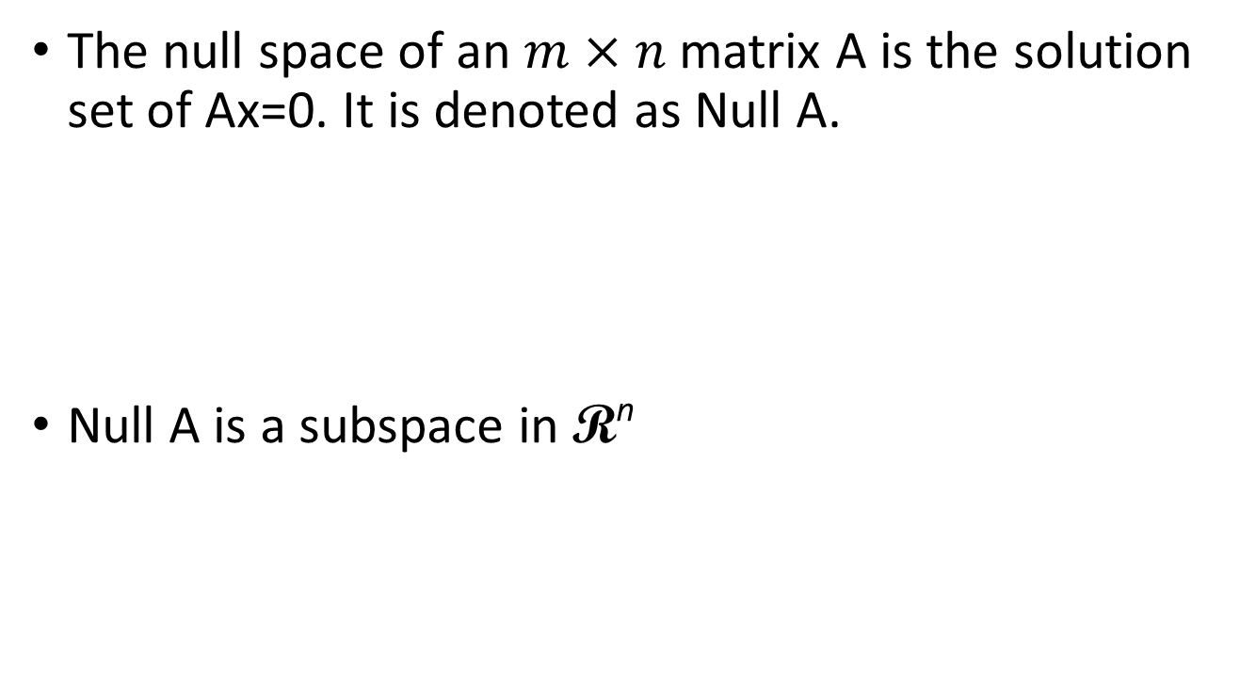
Null Space
The null space of an $m×n$ matrix A is the solution set of Ax=0. It is denoted as Null A.
Null A is a subspace in R^{n}
Null A = { v ∈ R^{n} : Av = 0 }
The solution set of the homogeneous linear equations Av = 0.
A linear function is one-to-one
Null space only contain 0
Notes:
某個線性 function 得值域

Slide 12
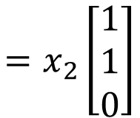
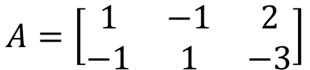
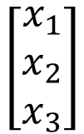

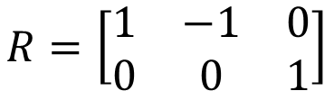
Null Space - Example
Find a generating set for the null space of T.
The null space of T is the set of solutions to Ax = 0
$$A=\left[\begin{matrix}1 & −1 & 2 \\ −1 & 1 & −3\end{matrix}\right]$$
$$R=\left[\begin{matrix}1 & −1 & 0 \\ 0 & 0 & 1\end{matrix}\right]$$
$$x_{1}=x_{2}$$
$$\left[\begin{matrix}x_{1} \\ x_{2} \\ x_{3}\end{matrix}\right]$$
$$=x_{2}\left[\begin{matrix}1 \\ 1 \\ 0\end{matrix}\right]$$
a generating set for the null space

Slide 13
Basis
(Chapter 4.2)

Slide 14
Basis
Why nonzero?
Let V be a nonzero subspace of R^{n}. A basis B for V is a linearly independent generating set of V.
{e₁, e₂, …, e_{n}} is a basis for R^{n}.
1. {e₁, e₂, …, e_{n}} is independent
2. {e₁, e₂, …, e_{n}} generates R^{n}.
{$\left[\begin{matrix}1 \\ 0\end{matrix}\right],\left[\begin{matrix}0 \\ 1\end{matrix}\right]$} is a basis for R²
{$\left[\begin{matrix}1 \\ 1\end{matrix}\right],\left[\begin{matrix}1 \\ −1\end{matrix}\right]$}
{$\left[\begin{matrix}1 \\ 3\end{matrix}\right],\left[\begin{matrix}−3 \\ 1\end{matrix}\right]$}
{$\left[\begin{matrix}1 \\ 1\end{matrix}\right],\left[\begin{matrix}1 \\ 2\end{matrix}\right]$}
…… any two independent vectors form a basis for R²
Notes:
(vector set)

Slide 15
Basis
The pivot columns of a matrix form a basis for its column space.
RREF
pivot columns
Col A
= Span

Slide 16
Property
Basis is always in its subspace
(a) S is contained in Span S
(b) If a finite set S’ is contained in Span S, then Span S’ is also contained in Span S
  Because Span S is a subspace
(c) For any vector z, Span S = Span S$∪${z} if and only if z belongs to the Span S
Span S
Span S’
z
z

Slide 17
Theorem
1. A basis is the smallest generating set.
2. A basis is the largest independent vector set in the subspace.
3. Any two bases for a subspace contain the same number of vectors.
  The number of vectors in a basis for a nonzero subspace V is called dimension of V (dim V).
Notes:
Basis is a vector set
When I say “large” or “small”, I mean the number of elelemtns in the set

Slide 18
Theorem 3
Every basis of R^{n} has n vectors.
The number of vectors in a basis for a subspace V is called the dimension of V, and is denoted dim V
  The dimension of zero subspace is 0
dim R² =2
dim R³=3
Notes:
Understand as how large your span is

Slide 19
Example
●
Find dim V
$$x_{1}=3x_{2}−5x_{3}+6x_{4}$$
dim V = 3
Basis?
Independent vector set that generates V

Slide 20
More from Theorems
Any two bases for a subspace contain the same number of vectors.
R^{m} have a basis {e₁, e₂, …, e_{m}}
All bases have m vectors
dim R^{m} = m
A basis is the smallest generating set.
A vector set generates R^{m} must contain at least m vectors.
Because a basis is the smallest generating set
Any other generating set has at least m vectors.
A basis is the largest independent set in the subspace.
Any independent vector set in R^{m} contain at most m vectors.
Notes:
三神氣
三皇
三人形
Every subset of R^{n} with more than n vectors is L.D. (Section 1.7).
⇒ Every basis of R^{n} contains at most n vectors.
⇒ Every basis of R^{n} contains exactly n vectors.

Slide 21
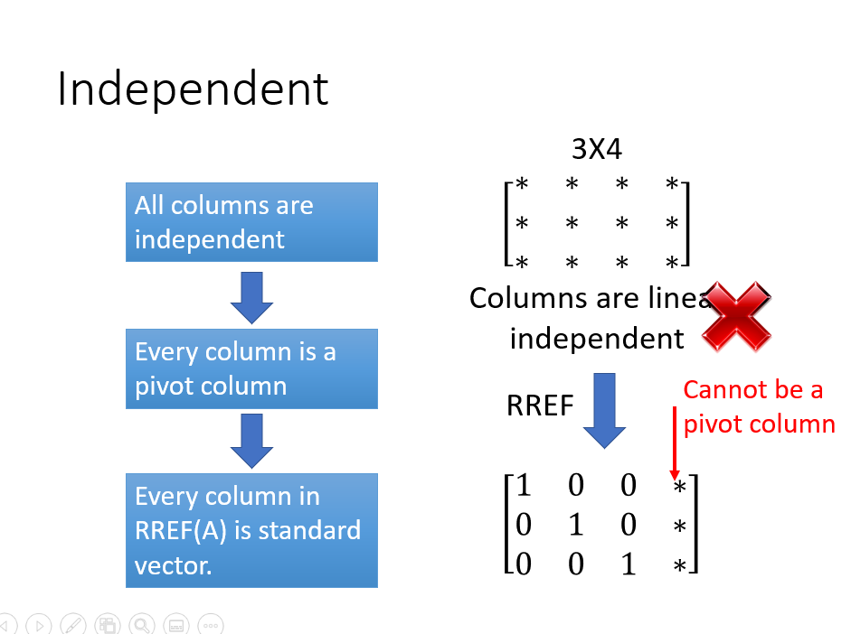

Slide 22
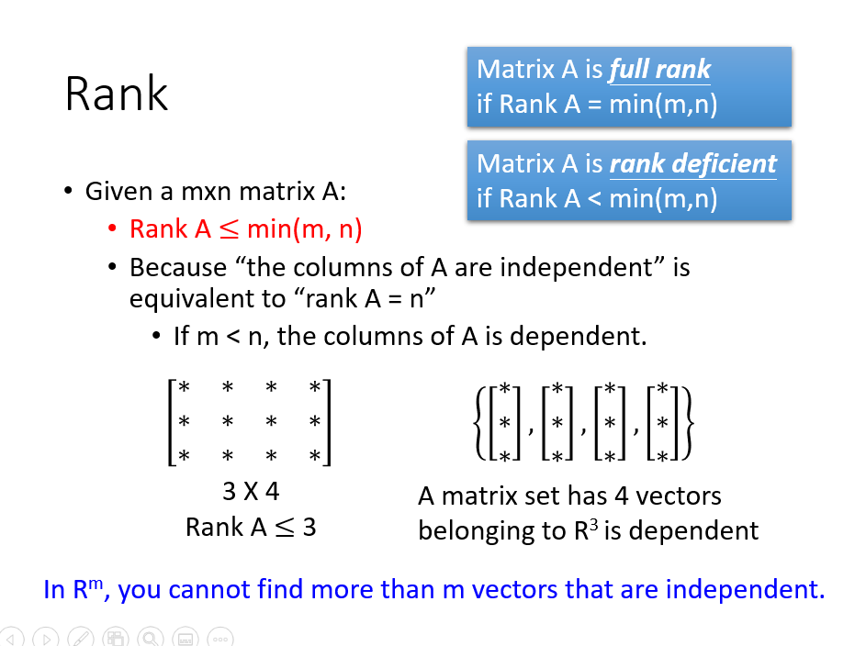

Slide 23
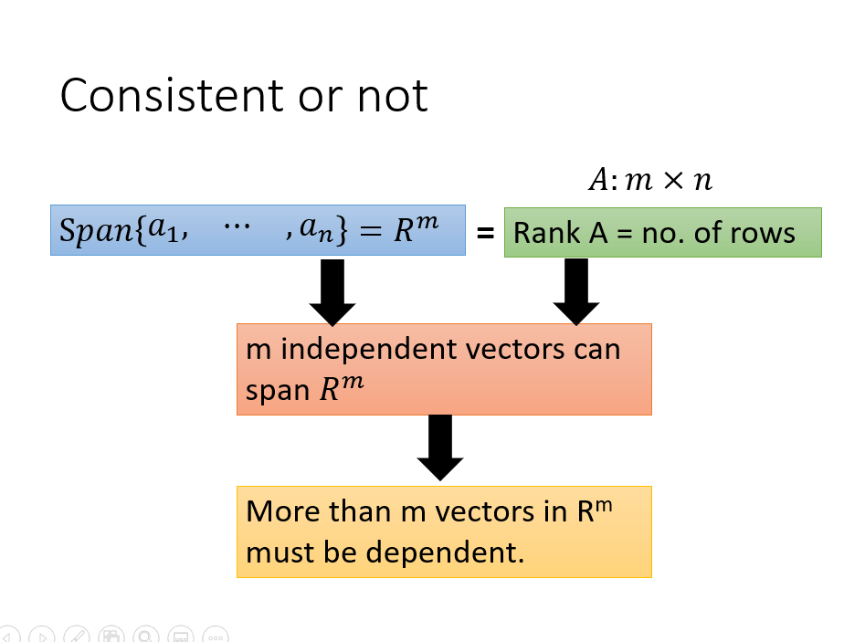

Slide 24
Theorem 1
A basis is the smallest generating set.
If there is a generating set S for subspace V,
The size of basis for V is smaller than or equal to S.
Reduction Theorem
There is a basis containing in any generating set S.
S can be reduced to a basis for V by removing some vectors.

Slide 25
Theorem 1 – Reduction Theorem
所有的 generating set 心中都有一個 basis
S can be reduced to a basis for V by removing some vectors.
Suppose S = {u₁, u₂, …, u_{k}} is a generating set of subspace V
Subspace $V=Span S$
Let A = [ u₁ u₂ ☹ u_{k} ].
$$=Col A$$
The basis of Col A is the pivot columns of A
Subset of S

Slide 26
Theorem 1 – Reduction Theorem
所有的 generating set 心中都有一個 basis
Subspace $V=Span S$
$$=Col A$$
= Span
$$S=\left\{\left[\begin{matrix}\begin{matrix}1 \\ −1\end{matrix} \\ \begin{matrix}2 \\ −3\end{matrix}\end{matrix}\right],\left[\begin{matrix}\begin{matrix}2 \\ −2\end{matrix} \\ \begin{matrix}4 \\ 6\end{matrix}\end{matrix}\right],\left[\begin{matrix}\begin{matrix}−1 \\ 1\end{matrix} \\ \begin{matrix}−3 \\ 2\end{matrix}\end{matrix}\right],\left[\begin{matrix}\begin{matrix}2 \\ 2\end{matrix} \\ \begin{matrix}2 \\ 0\end{matrix}\end{matrix}\right],\left[\begin{matrix}\begin{matrix}1 \\ 3\end{matrix} \\ \begin{matrix}0 \\ 3\end{matrix}\end{matrix}\right],\left[\begin{matrix}\begin{matrix}2 \\ 6\end{matrix} \\ \begin{matrix}3 \\ 9\end{matrix}\end{matrix}\right]\right\}$$
Smallest generating set
Generating set
RREF
$$A=$$

Slide 27
Theorem 2
A basis is the largest independent set in the subspace.
If the size of basis is k, then you cannot find more than k independent vectors in the subspace.
Extension Theorem
Given an independent vector set S in the space
S can be extended to a basis by adding more vectors

Slide 28
Theorem 2 – Extension Theorem
Independent set:
我不是一個 basis 就是正在成為一個 basis
There is a subspace V
Given a independent vector set S (elements of S are in V)
If Span S = V, then S is a basis
If Span S ≠ V, find v₁ in V, but not in Span S
S = S $⋃$ {v₁} is still an independent set
If Span S = V, then S is a basis
If Span S ≠ V, find v₂ in V, but not in Span S
S = S $⋃$ {v₂} is still an independent set
V
……
You will find the basis in the end.

Slide 29
Theorem 3
Textbook P245
Null B
Null C
Any two bases of a subspace V contain the same number of vectors
Suppose {u₁, u₂, …, u_{k}} and {w₁, w₂, …, w_{p}} are two bases of V.
Let A = [u₁ u₂ … u_{k}] and B = [w₁ w₂ … w_{p}].
Since {u₁, u₂, …, u_{k}} spans V, ∃ c_{i} ∈ R^{k} s.t. Ac_{i} = w_{i} for all i
⇒ A[c₁ c₂ … c_{p}] = [w₁ w₂ … w_{p}]
⇒ AC = B
Suppose Cx = 0 for some x ∈ R^{p}
⇒ ACx = Bx = 0
B is independent vector set
⇒ c₁ c₂ … c_{p} are independent
⇒ x= 0
c_{i} ∈ R^{k}
⇒ p ≤ k
Reversing the roles of the two bases one has k ≤ p ⇒ p = k.
Notes:
………………….

Slide 30
Theorem 4.9
If V and W are subspaces of R^{n} with V contained in W, then dim V $≤$ dim W
If dim V = dim W, V=W
Proof:
  B_{V} is a basis of V, V in W, B_{V} in W
  B_{V} is an independent set in W
  By extension theorem, B_{V} is in the basis of W
  dim V $≤$ dim W
  If dim V = dim W =k
  B_{V} is a linear independent set in W, with k elements
  It is also the span of W

Slide 31
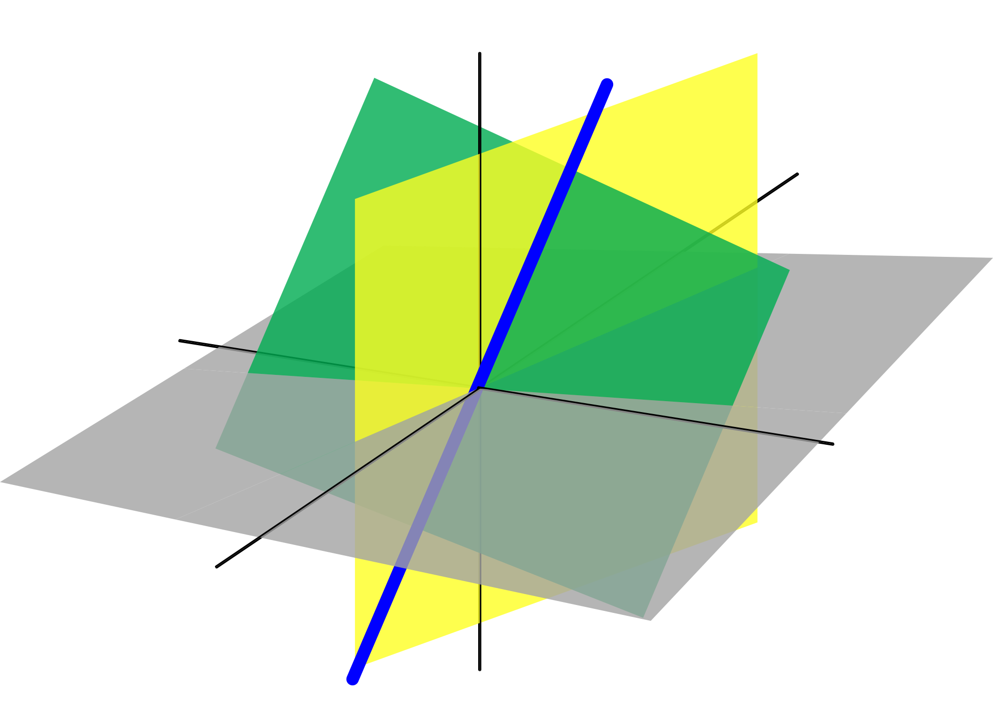
R³ is the only 3-dim subspace of itself
L
W
The 2-dim subspace with basis {u,v}
u
The 0-dim subspace
v
0
The 1-dim subspace with basis {u}

Slide 32
Exercise
If B= {u₁, u₂, …, u_{k}} is a basis for vector space S, then {u₁, u₂, …, u_{k-1}} cannot be a basis.
(Proof) Suppose {u₁, u₂, …, u_{k-1}} were a basis. Then
u_{k} = a₁u₁ + a₂u₂ + … +a_{k-1}u_{k-1}
Hence, a₁u₁ + a₂u₂ + … +a_{n-1}u_{n-1} + (-1)u_{k} =0,
-- contradiction as vectors in B are linearly independent.

Slide 33
Exercise
Rank(A+B) ≤ Rank(A) + Rank(B)
(proof) Suppose A=[u₁, u₂, …, u_{m}] and B=[v₁, v₂, …, v_{m}]. A+B=[u₁+ v₁, u₂ + v₂, …, u_{m} + v_{m}].
Suppose {a₁, a₂, …, a_{k}} is a basis of Col A and {b₁, b₂, …, b_{p}} is a basis of Col B. Then Rank(A)=k, Rank(B)=p.
Span({u₁+ v₁, u₂ + v₂, …, u_{m} + v_{m}}) ⊆
Span( {a₁, a₂, …, a_{k}} ∪ {b₁, b₂, …, b_{p}} ).
Hence, Rank(A+B) ≤ m ≤ k+p = Rank(A) + Rank(B) .

Slide 34
Concluding Remarks
1. A basis is the smallest generating set.
2. A basis is the largest independent vector set in the subspace.
3. Any two bases for a subspace contain the same number of vectors.
  The number of vectors in a basis for a nonzero subspace V is called dimension of V (dim V).
Notes:
Basis is a vector set
When I say “large” or “small”, I mean the number of elelemtns in the set

Slide 35
Confirming that a set is a Basis
(Chapter 4.2)

Slide 36
Intuitive Way
Definition: A basis B for V is an independent generating set of V.
Is C a basis of V ?
Independent?
yes
Generating set?
difficult
generates V

Slide 37
Another way
Find a basis for V
Given a subspace V, assume that we already know that dim V = k. Suppose S is a subset of V with k vectors
If S is independent
S is basis
If S is a generating set
S is basis
Dim V = 2
(parametric representation)
Is C a basis of V ?
C is a subset of V with 2 vectors
C is a basis of V
Independent?
yes
Notes:
本來要兩個
但已經 dim, 一個就夠了 ….

Slide 38
Another way
Assume that dim V = k. Suppose S is a subset of V with k vectors
If S is independent
S is basis
By the extension theorem, we can add more vector into S to form a basis.
However, S already have k vectors, so it is already a basis.
If S is a generating set
S is basis
By the reduction theorem, we can remove some vector from S to form a basis.
However, S already have k vectors, so it is already a basis.
Notes:
https://www.lightnovel.cn/thread-743816-1-1.html
Proof Let S ⊆ V be L.I. and have k vectors.
⇒ By the Extension Theorem, ∃ a basis B s.t. S ⊇ B.
⇒ B has k vectors, since dim. V = k.
⇒ B = S.
Let S ⊆ V be a generating set for V and have k vectors.
⇒ By the Reduction Theorem, ∃ a basis B ⊆ S.
⇒ B has k vectors, since dim. V = k.
⇒ B = S.

Slide 39
Example
●
Is B a basis of V ?
Independent set in V?
yes
Dim V = ?
3
B is a basis of V.

Slide 40




Example
●
B is a subset of V with 3 vectors
Is B a basis of V = Span S ?
$$R_{A}=\left[\begin{matrix}\begin{matrix}1 & 0 \\ 0 & 1\end{matrix} & \begin{matrix}0 & −2/3 \\ 0 & 1/3\end{matrix} \\ \begin{matrix}0 & 0 \\ 0 & 0\end{matrix} & \begin{matrix}1 & 2/3 \\ 0 & 0\end{matrix}\end{matrix}\right]$$
$$dimA=3$$
$$R_{B}=\left[\begin{matrix}\begin{matrix}1 & 0 & 0 \\ 0 & 1 & 0\end{matrix} \\ \begin{matrix}0 & 0 & 1 \\ 0 & 0 & 0\end{matrix}\end{matrix}\right]$$
$$Independent$$
B is a basis of V.
Notes:
Textbook is tedious ???
1. B ⊆ W (you check that rank A = rank [ A B ].)
2. B is L.I. (you check it).
3. dim. W = 3 (you check that rank A = 3.)
⇒ B is a basis of W.

Slide 41
Dimension of Basis
(Chapter 4.3)

Slide 42
Col A = Range
Basis: The pivot columns of A form a basis for Col A.
Dimension:
⇒ Col A = Span
pivot columns
pivot columns
Dim (Col A)
= number of pivot columns
= rank A

Slide 43
Rank A (revisit)
Maximum number of Independent Columns
Number of Pivot Columns
Number of Non-zero rows
Number of Basic Variables
Dim (Col A): dimension of column space
Dimension of the range of A

Slide 44
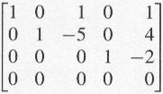
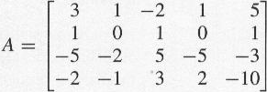
Row A
Basis: Nonzero rows of RREF(A)
Dimension:
RREF
R=
Row A = Row R
a basis of Row R
(The elementary row operations do not change the row space.)
= a basis of Row A
Dim (Row A)
= Number of Nonzero rows
= Rank A

Slide 45
Rank A (revisit)
Maximum number of Independent Columns
Number of Pivot Column
Number of Non-zero rows
Number of Basic Variables
Dim (Col A): dimension of column space
Dimension of the range of A
= Dim (Row A)
= Dim (Col A^{T})

Slide 46
Rank A = Rank A^{T}
Proof
Rank A
= Dim (Col A)
Rank A
= Dim (Row A)
= Dim (Col A^{T})
= Rank A^{T}

Slide 47











Null A
Example 2, P256
$$A=\left[\begin{aligned}3 \\ 1 \\ −5 \\ −2\end{aligned}\begin{aligned}1 \\ 0 \\ −2 \\ −1\end{aligned}\begin{aligned}−2 \\ 1 \\ 5 \\ 3\end{aligned}\begin{aligned}1 \\ 0 \\ −5 \\ 2\end{aligned}\begin{aligned}5 \\ 1 \\ −3 \\ −10\end{aligned}\right]$$
$$R=\left[\begin{aligned}1 \\ 0 \\ 0 \\ 0\end{aligned}\begin{aligned}0 \\ 1 \\ 0 \\ 0\end{aligned}\begin{aligned}1 \\ −5 \\ 0 \\ 0\end{aligned}\begin{aligned}0 \\ 0 \\ 1 \\ 0\end{aligned}\begin{aligned}1 \\ 4 \\ −2 \\ 0\end{aligned}\right]$$
Basis:
  Solving Ax = 0
  Each free variable in the parametric representation of the general solution is multiplied by a vector.
  The vectors form the basis.
$$x_{1}=−x_{3}−x_{5}$$
$$\left[\begin{aligned}x_{1} \\ x_{2} \\ x_{3} \\ x_{4} \\ x_{5}\end{aligned}\right]=x_{3}\left[\begin{aligned}−1 \\ 5 \\ 1 \\ 0 \\ 0\end{aligned}\right]+x_{5}\left[\begin{aligned}−1 \\ −4 \\ 0 \\ 2 \\ 1\end{aligned}\right]$$
$$x_{1}+x_{3}+x_{5}=0$$
$$x_{2}=5x_{3}−4x_{5}$$
$$x_{2}−5x_{3}+4x_{5}=0$$
$$x_{3}=x_{3}$$
(free)
$$x_{4}−2x_{5}=0$$
$$x_{4}=2x_{5}$$
$$x_{5}=x_{5}$$
(free)
Basis
Notes:
Give an example here

Slide 48
Null A
Basis:
  Solving Ax = 0
  Each free variable in the parametric representation of the general solution is multiplied by a vector.
  The vectors form the basis.
Dimension:
Dim (Null A)
= number of free variables
= Nullity A
= n - Rank A

Slide 49
Dimension Theorem
Dim (Col A)
Dim (Null A)
If A is mxn
=Rank A
=n - Rank A
Dim (R^{n}) =n
Dim of Range
+
Dim of Null
=
Dim of Domain
A
A
range

Slide 50

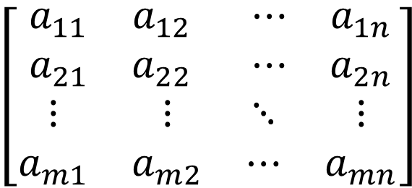

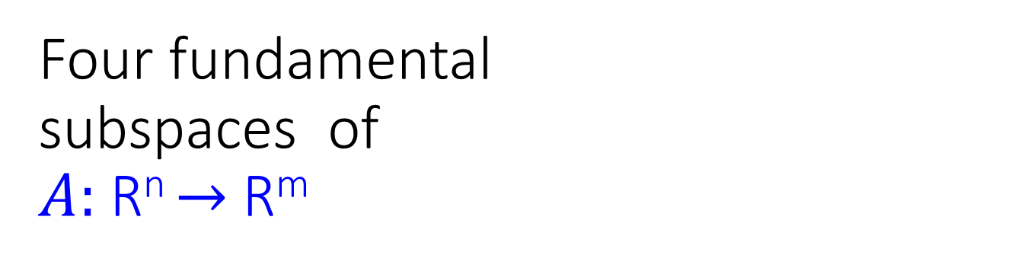





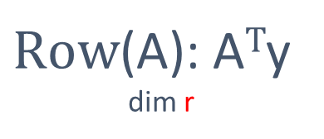
Four fundamental subspaces of
$A:$R^{n} $→$R^{m}
$$\left[\begin{matrix}\begin{matrix}a_{11} & a_{12} \\ a_{21} & a_{22}\end{matrix} & \begin{matrix}⋯ & a_{1n} \\ ⋯ & a_{2n}\end{matrix} \\ \begin{matrix}⋮ & ⋮ \\ a_{m1} & a_{m2}\end{matrix} & \begin{matrix}⋱ & ⋮ \\ ⋯ & a_{mn}\end{matrix}\end{matrix}\right]$$
$A:$R^{n} $→$R^{m}
$\text{R}\text{ow}\text{(}\text{A}\text{): }\text{A}T$y
dim r
R^{n}${ ←\text{R}\text{m} :A}^{T}$
$\text{Col}\text{(}\text{A}\text{):}$ Ax
dim r
one-to-one
$$\text{R}\text{n}$$
$$\text{R}\text{m}$$
$\text{N}\text{(}\text{A}\text{):}$ Ax=0
dim n-r
$\text{N}\text{(}\text{AT}\text{):}$ A$\text{T}$y=0
dim m-r
※

Slide 51







$$Solutions of Ax=b \\ Zero, One, Infinity …$$
No Solution
$$b$$
$$x$$
$$b$$
One Solution
Infinite Solutions
$$b$$
$$x^{′}$$
$$x^{′}+z$$
z
※

Slide 52
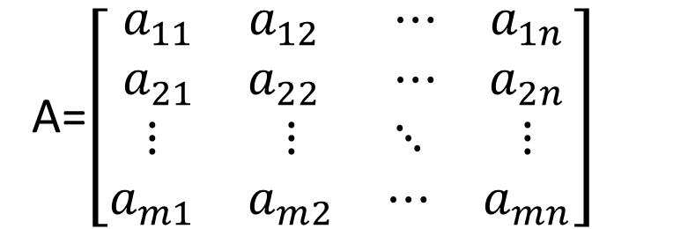

The Meaning of Matrix Transpose
A=$\left[\begin{matrix}\begin{matrix}a_{11} & a_{12} \\ a_{21} & a_{22}\end{matrix} & \begin{matrix}⋯ & a_{1n} \\ ⋯ & a_{2n}\end{matrix} \\ \begin{matrix}⋮ & ⋮ \\ a_{m1} & a_{m2}\end{matrix} & \begin{matrix}⋱ & ⋮ \\ ⋯ & a_{mn}\end{matrix}\end{matrix}\right]$
$A:$R^{n} $→$R^{m} $AT:$R^{m} $→$R^{n}
$$Ax∙y=x∙\text{A}\text{T}y$$
x
Ax
A^{T}y
y
Preservation of dot product in R^{n} and R^{m}
※

Slide 53
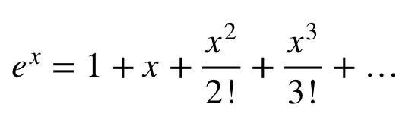
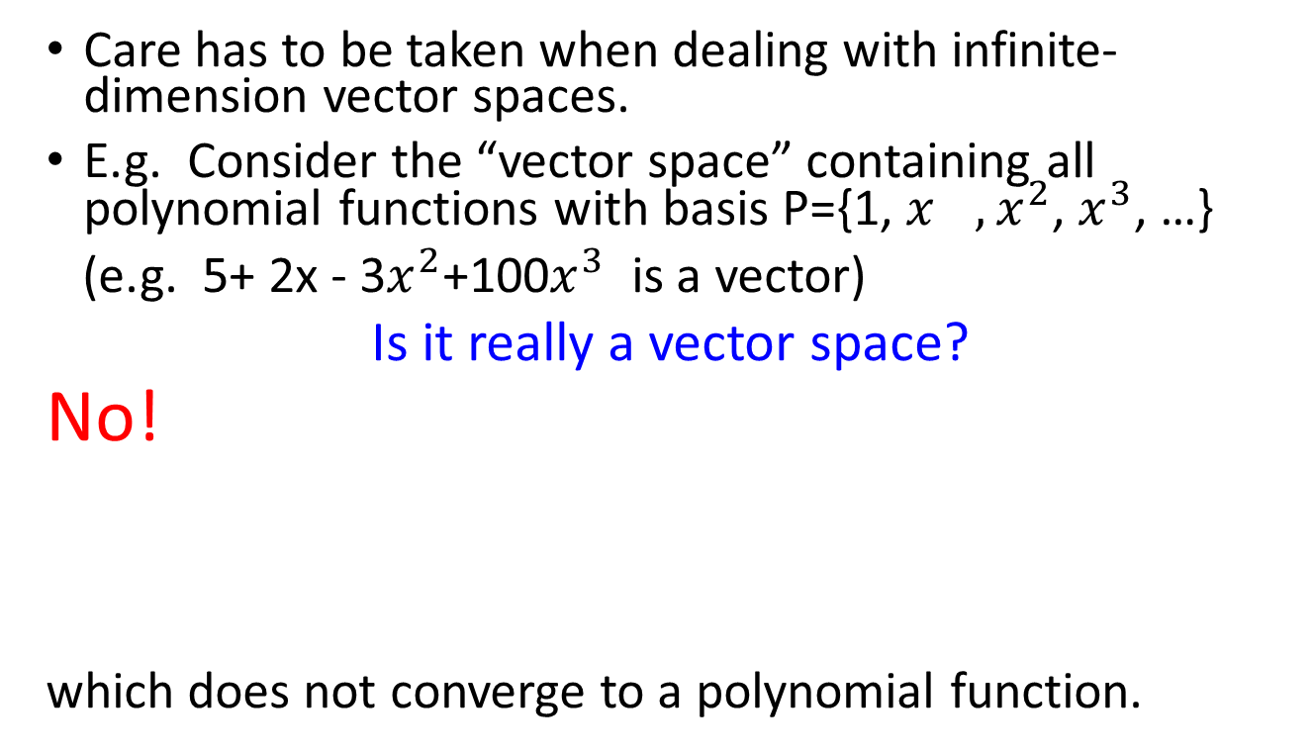
Finite vs. Infinite-dimension Vector Space
Care has to be taken when dealing with infinite-dimension vector spaces.
E.g. Consider the “vector space” containing all polynomial functions with basis P={1, ${x^{}, x}^{2}$, $x^{3}$, …}
(e.g. 5+ 2x - 3$x^{2}$+100$x^{3}$ is a vector)
Is it really a vector space?
No!
which does not converge to a polynomial function.
※

Slide 54
Coordinate System
(Chapter 4.4)

Slide 55
Coordinate System
Each coordinate system is a “viewpoint” for vector representation.
  The same vector is represented differently in different coordinate systems.
  Different vectors can have the same representation in different coordinate systems.
A vector set $\text{B}$ can be considered as a coordinate system for R^{n} if:
  1. The vector set $\text{B}$ spans the R^{n}
  2. The vector set $\text{B}$ is independent
$\text{B}$ is a basis of R^{n}
Notes:
ㄑ一ㄡ
ㄆㄧㄢˋ ㄐㄩ
除 換
神話傳說中的野獸。形似猿猴。《莊子．齊物論》：「猨，猵狙以為雌。」

Slide 56
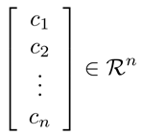
Coordinate System
Let vector set $\text{B}\text{=}\left\{u_{1},u_{2},⋯,u_{n}\right\}$ be a basis for a subspace R^{n}
For any v in R^{n}, there are unique scalars $c_{1},c_{2},⋯,c_{n}$ such that $v=c_{1}u_{1}+c_{2}u_{2}+⋯+c_{n}u_{n}$
$\text{B}$ is a coordinate system
$\text{B}$-coordinate vector of v:
$${\left[v\right]}_{\text{B}}=$$
(用 $\text{B}$ 的觀點來看 $v$)
Notes:
$$\text{(}\text{某種觀點}\text{)}$$
根據某種觀點所看到的結果

Slide 57
New Coordinate System
$$\text{B}$$
$$\text{E}$$
$$b_{1}=\left[\begin{aligned}1 \\ 1\end{aligned}\right]$$
$$b_{2}=\left[\begin{aligned}−1 \\ 1\end{aligned}\right]$$
{e₁, e₂} is a coordinate system
$${6b}_{1}$$
$$\left[\begin{aligned}8 \\ 4\end{aligned}\right]$$
$$\left[\begin{aligned}8 \\ 4\end{aligned}\right]$$
$${\left[v\right]}_{\text{E} }=$$
$${\left[v\right]}_{\text{B}}=$$
$${4e}_{2}$$
$$\left[\begin{aligned}6 \\ −2\end{aligned}\right]$$
$$b_{1}$$
$$e_{2}$$
$$b_{2}$$
$$e_{1}$$
$${8e}_{1}$$
$${−2b}_{2}$$
$$\left[\begin{aligned}8 \\ 4\end{aligned}\right]=8e_{1}+4e_{2}$$
$$\left[\begin{aligned}8 \\ 4\end{aligned}\right]=6b_{1}+(−2)b_{2}$$

Slide 58
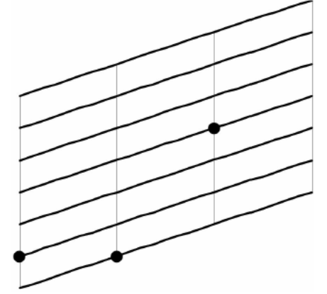
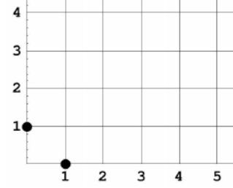
Vector
$$e_{1}=\left[\begin{aligned}1 \\ 0\end{aligned}\right]$$
$$e_{2}=\left[\begin{aligned}0 \\ 1\end{aligned}\right]$$
$$b_{1}=\left[\begin{aligned}2 \\ 0.5\end{aligned}\right]$$
$$b_{2}=\left[\begin{aligned}0 \\ 0.5\end{aligned}\right]$$
$$\left[\begin{aligned}2 \\ 3\end{aligned}\right]$$
$$\left[\begin{aligned}2 \\ 3\end{aligned}\right]$$
$\left[\begin{aligned}4 \\ 2.5\end{aligned}\right]$ for left
$$e_{2}$$
$$b_{2}$$
$$b_{1}$$
$$e_{1}$$
$$2b_{1}+3b_{2}=\left[\begin{aligned}4 \\ 2.5\end{aligned}\right]$$

Slide 59
Vector
$$e_{1}=\left[\begin{aligned}1 \\ 0\end{aligned}\right]$$
$$e_{2}=\left[\begin{aligned}0 \\ 1\end{aligned}\right]$$
$$b_{1}=\left[\begin{aligned}2 \\ 0.5\end{aligned}\right]$$
$$b_{2}=\left[\begin{aligned}0 \\ 0.5\end{aligned}\right]$$
$$\left[\begin{aligned}2 \\ 3\end{aligned}\right]$$
home
$$\left[\begin{aligned}2 \\ 3\end{aligned}\right]$$
home
$\left[\begin{aligned}4 \\ 2.5\end{aligned}\right]$ for left
$$e_{2}$$
$$b_{2}$$
$$b_{1}$$
$$e_{1}$$
$$2b_{1}+3b_{2}=\left[\begin{aligned}4 \\ 2.5\end{aligned}\right]$$

Slide 60
New Coordinate System
$$\text{B}$$
$$\text{E}$$
$$b_{1}=\left[\begin{aligned}1 \\ 1\end{aligned}\right]$$
$$b_{2}=\left[\begin{aligned}−1 \\ 1\end{aligned}\right]$$
{e₁, e₂} is a coordinate system
$${6b}_{1}$$
$$\left[\begin{aligned}8 \\ 4\end{aligned}\right]$$
$${\left[v\right]}_{\text{B}}=$$
$${\left[v\right]}_{\text{E} }=$$
$${4e}_{2}$$
$$\left[\begin{aligned}6 \\ −2\end{aligned}\right]$$
$$b_{1}$$
$$e_{2}$$
$$b_{2}$$
$$e_{1}$$
$${8e}_{1}$$
$${−2b}_{2}$$
$$\left[\begin{aligned}8 \\ 4\end{aligned}\right]=8e_{1}+4e_{2}$$
$$\left[\begin{aligned}8 \\ 4\end{aligned}\right]=6b_{1}+(−2)b_{2}$$
$$\text{E}\text{=}\left\{e_{1},e_{2},⋯,e_{n}\right\}$$
(standard vectors)
$v={\left[v\right]}_{\text{E}}$
$\text{E}$ is Cartesian coordinate system
(直角坐標系)

Slide 61
Coordinate System
A vector set $\text{B}$ can be considered as a coordinate system for R^{n} if:
1. The vector set $\text{B}$ spans the R^{n}
2. The vector set $\text{B}$ is independent
Every vector should have a representation
Unique representation
$\text{B}$ is a basis of R^{n}

Slide 62
Why Basis?
Let vector set $\text{B}\text{=}\left\{u_{1},u_{2},⋯,u_{k}\right\}$ be independent.
Any vector v in Span $\text{B}$ can be uniquely represented as a linear combination of the vectors in $\text{B}$.
That is, there are unique scalars $a_{1},a_{2},⋯,a_{k}$ such that $v=a_{1}u_{1}+a_{2}u_{2}+⋯+a_{k}u_{k}$
Proof:
Unique?
$$v=a_{1}u_{1}+a_{2}u_{2}+⋯+a_{k}u_{k}$$
$$v=b_{1}u_{1}+b_{2}u_{2}+⋯+b_{k}u_{k}$$
$$\left({a_{1}−b}_{1}\right)u_{1}+\left({a_{2}−b}_{2}\right)u_{2}+⋯+\left({a_{k}−b}_{k}\right)u_{k}=0$$
B is independent
a₁ − b₁ = a₂ − b₂ = ☹ = a_{k} − b_{k} = 0

Slide 63
Change Coordinate
(Chapter 4.4)

Slide 64
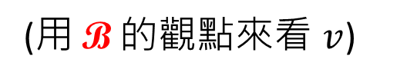



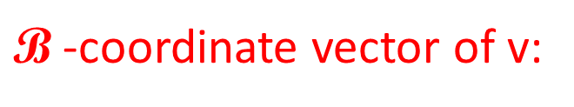
Coordinate System
Let vector set $\text{B}\text{=}\left\{u_{1},u_{2},⋯,u_{n}\right\}$ be a basis for a subspace R^{n}
For any v in R^{n}, there are unique scalars $c_{1},c_{2},⋯,c_{n}$ such that $v=c_{1}u_{1}+c_{2}u_{2}+⋯+c_{n}u_{n}$
$\text{B}$ is a coordinate system
$\text{B}$-coordinate vector of v:
$${\left[v\right]}_{\text{B}}=$$
(用 $\text{B}$ 的觀點來看 $v$)
Notes:
$$\text{(}\text{某種觀點}\text{)}$$
根據某種觀點所看到的結果

Slide 65
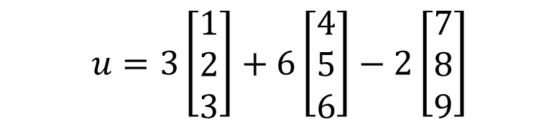
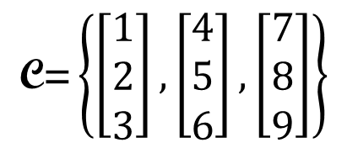

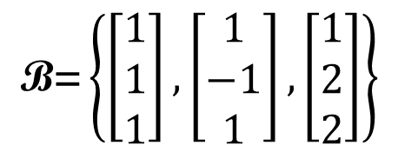
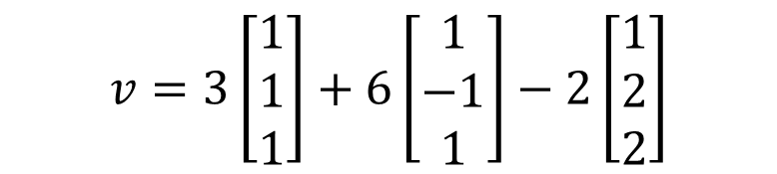
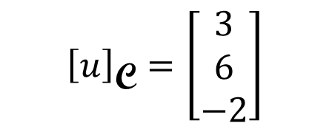
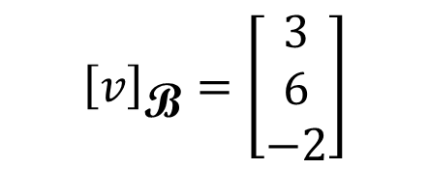

Other System → Cartesian
$$\text{B}\text{=}\left\{\left[\begin{aligned}1 \\ 1 \\ 1\end{aligned}\right],\left[\begin{aligned}1 \\ −1 \\ 1\end{aligned}\right],\left[\begin{aligned}1 \\ 2 \\ 2\end{aligned}\right]\right\}$$
$${\left[v\right]}_{\text{B}}=\left[\begin{aligned}3 \\ 6 \\ −2\end{aligned}\right]$$
$$=\left[\begin{aligned}7 \\ −7 \\ 5\end{aligned}\right]$$
$$v=3\left[\begin{aligned}1 \\ 1 \\ 1\end{aligned}\right]+6\left[\begin{aligned}1 \\ −1 \\ 1\end{aligned}\right]−2\left[\begin{aligned}1 \\ 2 \\ 2\end{aligned}\right]$$
$$\text{C}\text{=}\left\{\left[\begin{aligned}1 \\ 2 \\ 3\end{aligned}\right],\left[\begin{aligned}4 \\ 5 \\ 6\end{aligned}\right],\left[\begin{aligned}7 \\ 8 \\ 9\end{aligned}\right]\right\}$$
$${\left[u\right]}_{\text{C}}=\left[\begin{aligned}3 \\ 6 \\ −2\end{aligned}\right]$$
$$=\left[\begin{aligned}13 \\ 20 \\ 27\end{aligned}\right]$$
$$u=3\left[\begin{aligned}1 \\ 2 \\ 3\end{aligned}\right]+6\left[\begin{aligned}4 \\ 5 \\ 6\end{aligned}\right]−2\left[\begin{aligned}7 \\ 8 \\ 9\end{aligned}\right]$$

Slide 66





Other System → Cartesian
Let vector set $\text{B}\text{=}\left\{u_{1},u_{2},⋯,u_{n}\right\}$ be a basis for a subspace R^{n}
Matrix $B=\left[\begin{matrix}\begin{matrix}u_{1} & u_{2}\end{matrix} & \begin{matrix}⋯ & u_{n}\end{matrix}\end{matrix}\right]$
$${\left[v\right]}_{\text{B}}=\left[\begin{aligned}c_{1} \\ c_{2} \\ ⋮ \\ c_{n}\end{aligned}\right]$$
Given ${\left[v\right]}_{\text{B}}$, how to find v?
$$v=c_{1}u_{1}+c_{2}u_{2}+⋯+c_{n}u_{n}$$
$=B{\left[v\right]}_{\text{B}}$
(matrix-vector product)

Slide 67
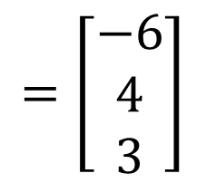
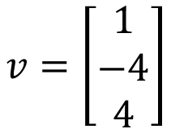


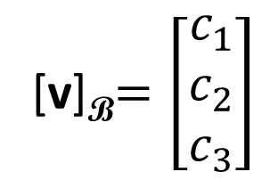
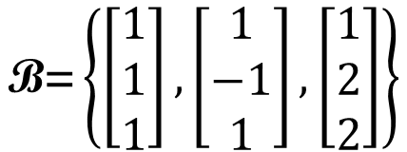
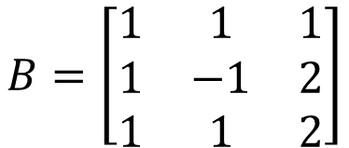
Cartesian → Other System
$$v=\left[\begin{aligned}1 \\ −4 \\ 4\end{aligned}\right]$$
$$\text{B}\text{=}\left\{\left[\begin{aligned}1 \\ 1 \\ 1\end{aligned}\right],\left[\begin{aligned}1 \\ −1 \\ 1\end{aligned}\right],\left[\begin{aligned}1 \\ 2 \\ 2\end{aligned}\right]\right\}$$
find [v]_{B}
[v]_{B}$=\left[\begin{aligned}c_{1} \\ c_{2} \\ c_{3}\end{aligned}\right]$
$$B=\left[\begin{matrix}1 & 1 & 1 \\ 1 & −1 & 2 \\ 1 & 1 & 2\end{matrix}\right]$$
B is invertible (?)
independent
$$=\left[\begin{aligned}−6 \\ 4 \\ 3\end{aligned}\right]$$
$$B{\left[v\right]}_{\text{B}}=v$$
$${\left[v\right]}_{\text{B}}=B^{−1}v$$

Slide 68

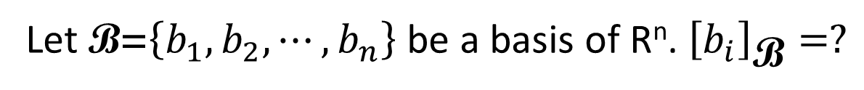






Cartesian $↔$ Other System
Let B = {b₁ , b₂ , 😐, b_{n}}
$${\left[v\right]}_{\text{B}}=B^{−1}v$$
$$v$$
$${\left[v\right]}_{\text{B}}$$
$$=\left[\begin{aligned}c_{1} \\ c_{2} \\ ⋮ \\ c_{n}\end{aligned}\right]$$
$$v=B{\left[v\right]}_{\text{B}}$$
= c₁b₁ + c₂b₂ + ☹ + c_{n}b_{n}
Let $\text{B}\text{=}\left\{b_{1},b_{2},⋯,b_{n}\right\}$ be a basis of R^{n}. ${\left[b_{i}\right]}_{\text{B}}=?$
$$e_{i}$$
(Standard vector)

Slide 69


Equation of ellipse
●
Rotate 45◦
2
2
3
3
?
Notes:
Draw by
http://web.geogebra.org/app/

Slide 70





Equation of ellipse
●
Use another coordinate system
$$b_{1}$$
$$b_{2}$$
B = {$\left[\begin{aligned}\frac{\sqrt{2}}{2} \\ \frac{\sqrt{2}}{2}\end{aligned}\right],\left[\begin{aligned}−\frac{\sqrt{2}}{2} \\ \frac{\sqrt{2}}{2}\end{aligned}\right]$}
2
3
$$b_{2}$$
$$b_{1}$$
What is the equation of the ellipse in the new coordinate system?
Notes:
is

Slide 71



Equation of ellipse
●
B = {$\left[\begin{aligned}\frac{\sqrt{2}}{2} \\ \frac{\sqrt{2}}{2}\end{aligned}\right],\left[\begin{aligned}−\frac{\sqrt{2}}{2} \\ \frac{\sqrt{2}}{2}\end{aligned}\right]$}

Slide 72
Linear Function in Coordinate System
(Chapter 4.5)

Slide 73
Basic Idea
Simple Function
Another coordinate system
output’
Input’
Cartesian coordinate system
Input
Output
Complex Function
Notes:
Why we have to do that?

Slide 74
Basic Idea
Simple Function
Another coordinate system
output’
Input’
Cartesian coordinate system
Input
Output
Complex Function
Notes:
Why we have to do that?

Slide 75

Sometimes a function can be complex ……
T: reflection about a line L through the origin in R²
$$\left[\begin{aligned}x_{1} \\ x_{2}\end{aligned}\right]$$
$$T\left(\left[\begin{aligned}x_{1} \\ x_{2}\end{aligned}\right]\right)=?$$
$$\left[T\right]=\left[\begin{matrix}T\left(e_{1}\right) & T\left(e_{2}\right) \end{matrix}\right]$$
$$=?$$
$$T\left(\left[\begin{aligned}x_{1} \\ x_{2}\end{aligned}\right]\right)$$

Slide 76
Sometimes a function can be complex ……
T: reflection about a line L through the origin in R²
special case: L is the horizontal axis
$$T′\left(\left[\begin{aligned}x_{1} \\ x_{2}\end{aligned}\right]\right)=?$$
$$\left[\begin{aligned}x_{1} \\ {−x}_{2}\end{aligned}\right]$$
$$\left[\begin{aligned}x_{1} \\ x_{2}\end{aligned}\right]$$
$$\left[T′\right]=\left[\begin{matrix}1 & 0 \\ 0 & −1\end{matrix}\right]$$
$$T′\left(\left[\begin{aligned}x_{1} \\ x_{2}\end{aligned}\right]\right)$$
$$T′\left(e_{1}\right)$$
$$T′\left(e_{2}\right)$$
$$=e_{1}$$
$$=−e_{2}$$
Notes:
A similar but simpler function

Slide 77

Describing the function in another coordinate system
T: reflection about a line L through the origin in R²
In another coordinate system B ….
B = $\left\{b_{1},b_{2}\right\}$
$$T\left(b_{2}\right)=−b_{2}$$
$$b_{2}$$
$$b_{1}$$
$$T\left(b_{1}\right)=b_{1}$$

Slide 78
Describing the function in another coordinate system
T: reflection about a line L through the origin in R²
$${\left[T\right]}_{\text{B}}$$
$$=\left[\begin{matrix}1 & 0 \\ 0 & −1\end{matrix}\right]$$
In another coordinate system B ….
Input and output are both in B
$\text{B}$ matrix of T:
$${\left[b_{2}\right]}_{\text{B}}=$$
$$e_{2}$$
$$\left[T\right]b_{1}=b_{1}$$
$${\left[T\right]}_{\text{B}}\left({\left[b_{1}\right]}_{\text{B}}\right)={\left[b_{1}\right]}_{\text{B}}$$
$${\left[T\right]}_{\text{B}}\left(e_{1}\right)=e_{1}$$
$${\left[b_{1}\right]}_{\text{B}}=$$
$$\left[T\right]b_{2}=−b_{2}$$
$$e_{1}$$
$${\left[T\right]}_{\text{B}}\left({\left[b_{2}\right]}_{\text{B}}\right)={\left[−b_{2}\right]}_{\text{B}}$$
$${\left[T\right]}_{\text{B}}\left(e_{2}\right)=−e_{2}$$
Notes:
T 下標 B 上標 gamma

Slide 79
Flowchart
$${\left[T\right]}_{\text{B}}$$
$$=\left[\begin{matrix}1 & 0 \\ 0 & −1\end{matrix}\right]$$
$${\left[v\right]}_{\text{B}}$$
$${\left[T\left(v\right)\right]}_{\text{B}}$$
$$b_{1}$$
$$b_{2}$$
reflection about the horizontal line
$$e_{2}$$
$$\left[T\right]=?$$
$$v$$
$$T\left(v\right)$$
$$e_{1}$$
reflection about a line L

Slide 80










Linear Operator vs. Matrix
$$v$$
$$T\left(v\right)$$
$$Matrix D$$
$${\left[T\right]}_{\text{B}}$$
$${\left[v\right]}_{\text{B}}$$
$${\left[T\left(v\right)\right]}_{\text{B}}$$
$$Matrix E$$
$${\left[T\right]}_{\text{C}}$$
$${\left[v\right]}_{\text{C}}$$
$${\left[T\left(v\right)\right]}_{\text{C}}$$
Corresponding matrix of operator T depends on the coordinate system
※
Properly selected
Properly selected

Slide 81
$${\left[T\right]}_{\text{B}}$$
$$=\left[\begin{matrix}1 & 0 \\ 0 & −1\end{matrix}\right]$$
$${\left[v\right]}_{\text{B}}$$
$${\left[T\left(v\right)\right]}_{\text{B}}$$
reflection about the horizontal line
同一件事情
不同的詮釋
$$\left[T\right]=?$$
$$v$$
$$T\left(v\right)$$
reflection about a line L

Slide 82
Flowchart
$${\left[T\right]}_{\text{B}}$$
$${\left[v\right]}_{\text{B}}$$
$${\left[T\left(v\right)\right]}_{\text{B}}$$
$\text{B}$coordinate system
$$B$$
Cartesian coordinate system
$$B^{−1}$$
$$\left[T\right]$$
$$v$$
$$T\left(v\right)$$
$$\left[T\right]=B{\left[T\right]}_{\text{B}}B^{−1}$$
$${\left[T\right]}_{\text{B}}=B^{−1}\left[T\right]B$$
similar
similar
Notes:
invertible n-by-n matrix P.

Slide 83
Example: reflection operator T about the line y = (1/2)x
$$B^{−1}=\left[\begin{matrix}0.4 & 0.2 \\ −0.2 & 0.4\end{matrix}\right]$$
$$B=\left[\begin{matrix}2 & −1 \\ 1 & 2\end{matrix}\right]$$
$$b_{2}=\left[\begin{aligned}−1 \\ 2\end{aligned}\right]$$
y = (1/2)x
$${\left[T\right]}_{\text{B}}$$
$${\left[v\right]}_{\text{B}}$$
$${\left[T\left(v\right)\right]}_{\text{B}}$$
$$b_{1}=\left[\begin{aligned}2 \\ 1\end{aligned}\right]$$
$$\left[\begin{matrix}1 & 0 \\ 0 & −1\end{matrix}\right]$$
$$B^{−1}$$
$$B$$
y = (1/2)x
$$e_{2}=\left[\begin{aligned}0 \\ 1\end{aligned}\right]$$
$$\left[T\right]=?$$
$$v$$
$$T\left(v\right)$$
$$e_{1}=\left[\begin{aligned}1 \\ 0\end{aligned}\right]$$
$$\left[T\right]=B{\left[T\right]}_{\text{B}}B^{−1}$$

Slide 84
Example: reflection operator T about the line y = (1/2)x
$$B^{−1}=\left[\begin{matrix}0.4 & 0.2 \\ −0.2 & 0.4\end{matrix}\right]$$
$$B=\left[\begin{matrix}2 & −1 \\ 1 & 2\end{matrix}\right]$$
$$\left[T\right]=$$
$$\left[\begin{matrix}0.6 & 0.8 \\ 0.8 & −0.6\end{matrix}\right]$$
$${\left[T\right]}_{\text{B}}$$
$${\left[v\right]}_{\text{B}}$$
$${\left[T\left(v\right)\right]}_{\text{B}}$$
$$c_{2}=\left[\begin{aligned}−0.5 \\ 1\end{aligned}\right]$$
y = (1/2)x
$$\left[\begin{matrix}1 & 0 \\ 0 & −1\end{matrix}\right]$$
$$c_{1}=\left[\begin{aligned}4 \\ 2\end{aligned}\right]$$
$$B^{−1}$$
$$B$$
$$\left[T\right]=?$$
$$\left[T\right]=C{\left[T\right]}_{\text{C}}C^{−1}$$
$$v$$
$$T\left(v\right)$$
$$=\left[\begin{matrix}0.6 & 0.8 \\ 0.8 & −0.6\end{matrix}\right]$$
$$\left[T\right]=B{\left[T\right]}_{\text{B}}B^{−1}$$
Notes:
0.6000 0.8000
0.8000 -0.6000

Slide 85

Example (P279)
$${\left[T\right]}_{\text{B}}=?$$
$$\left[T\right]=\left[\begin{matrix}3 & 0 & 1 \\ 1 & 1 & 0 \\ −1 & −1 & 3\end{matrix}\right]$$
$${\left[v\right]}_{\text{B}}$$
$${\left[T\left(v\right)\right]}_{\text{B}}$$
$${ \left[T\right]}_{\text{B}}=B^{−1}\left[T\right]B$$
$$B=\left[\begin{matrix}1 & 1 & 2 \\ 1 & 2 & 1 \\ 1 & 3 & 1\end{matrix}\right]$$
$$B^{−1}$$
$$B$$
$$\left[\begin{matrix}3 & −9 & 8 \\ −1 & 3 & −3 \\ 1 & 6 & 1\end{matrix}\right]$$
$\left[T\right]$ is known
$$v$$
$$T\left(v\right)$$
$${ \left[T\right]}_{\text{B}}=$$
$$\left[T\right]=B{ \left[T\right]}_{\text{B}}B^{−1}$$
Notes:
3 -9 8
-1 3 -3
1 6 1

Slide 86
Example (P279)
Determine T
b₁
c₁
b₂
c₂
b₃
c₃
e₁
e₂
e₃
$${\left[v\right]}_{\text{B}}$$
$${\left[T\left(v\right)\right]}_{\text{B}}$$
B⁻¹c₁
B⁻¹c₂
B⁻¹c₃
$${\left[T\right]}_{\text{B}}$$
b₁, b₂, b₃ as a coordinate system
$$B^{−1}$$
$$B^{−1}$$
{b₁, b₂, b₃} is a basis of R³
$$\left[T\right]$$
b₁
b₂
b₃
$$v$$
$$T\left(v\right)$$
c₁
c₂
c₃
Notes:
Simple …..
A = C B ^ -1

Slide 87
Example (P279)
Determine T
$${\left[T\right]}_{\text{B}}=\left[\begin{matrix}B^{−1}c_{1} & B^{−1}c_{2} & B^{−1}c_{3}\end{matrix}\right]$$
$$=B^{−1}C$$
$$\text{[}\text{T}\text{]}=B{\left[T\right]}_{\text{B}}B^{−1}$$
$$={BB}^{−1}CB^{−1}$$
$$=CB^{−1}$$
e₁
e₂
e₃
$${\left[v\right]}_{\text{B}}$$
$${\left[T\left(v\right)\right]}_{\text{B}}$$
B⁻¹c₁
B⁻¹c₂
B⁻¹c₃
$${\left[T\right]}_{\text{B}}$$
b₁, b₂, b₃ as a coordinate system
$$B^{−1}$$
$$B^{−1}$$
$$B$$
{b₁, b₂, b₃} is a basis of R³
$$\left[T\right]$$
b₁
b₂
b₃
$$v$$
$$T\left(v\right)$$
c₁
c₂
c₃

Slide 88


Conclusion
$${\left[T\right]}_{\text{B}}$$
$\text{B}$coordinate system
$${\left[v\right]}_{\text{B}}$$
$${\left[T\left(v\right)\right]}_{\text{B}}$$
$${ \left[T\right]}_{\text{B}}=B^{−1}\left[T\right]B$$
$$B$$
Cartesian coordinate system
$$B^{−1}$$
$$\left[T\right]$$
$$v$$
$$T\left(v\right)$$
$$\left[T\right]=B{ \left[T\right]}_{\text{B}}B^{−1}$$

