Slide 1
Chapter 1
  Matrices, Vectors, and Systems of Linear Equations
  除了標註※之簡報外，其餘採用李宏毅教授之投影片教材

Slide 2
Vectors and Matrices
(Chapter 1.1)

Slide 3

What is a vector?
Physics student: Vectors have lengths and directions.
Math student: Vectors satisfy a set of rules:
u + v, 3u are vectors, u + v = v + u,
(u + v) + w = u + (v + w), …
EE/CS student: A vector v is a sequence of
numbers
$$\left[\begin{matrix}1 \\ 2 \\ 3\end{matrix}\right]$$
v =
※
Notes:
http://mathinsight.org/vectors_cartesian_coordinates_2d_3d#vector3D

Slide 4
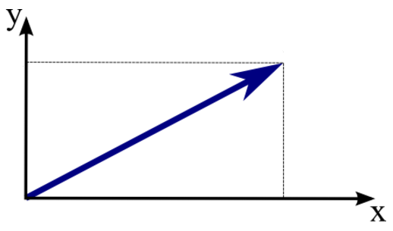

Vectors (from EE/CS viewpoint)
$$\left[\begin{matrix}1 \\ 2 \\ 3\end{matrix}\right]$$
v =
A vector v is a sequence of numbers
Components: the entries of a vector.
  The i-th component of vector v refers to v_{i}
  v₁=1, v₂=2, v₃=3
If a vector only has less than four components, you can visualize it.
v₂
v
NOTE: Later we will see a more general definition of a “vector”
v₁
Notes:
http://mathinsight.org/vectors_cartesian_coordinates_2d_3d#vector3D

Slide 5
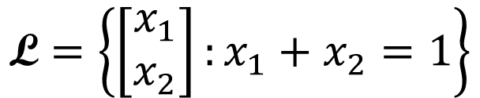

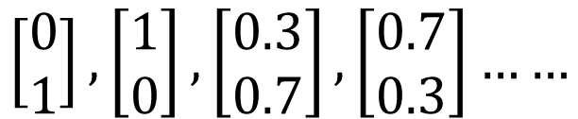
Vector Set
$$\left\{\left[\begin{matrix}1 \\ 2 \\ 3\end{matrix}\right],\left[\begin{matrix}4 \\ 5 \\ 6\end{matrix}\right],\left[\begin{matrix}6 \\ 8 \\ 9\end{matrix}\right],\left[\begin{matrix}9 \\ 0 \\ 2\end{matrix}\right]\right\}$$
A vector set with 4 elements
A vector set can contain infinite elements
$$\text{L}=\left\{\left[\begin{matrix}x_{1} \\ x_{2}\end{matrix}\right]:x_{1}+x_{2}=1\right\}$$
$$\left[\begin{matrix}0 \\ 1\end{matrix}\right],\left[\begin{matrix}1 \\ 0\end{matrix}\right],\left[\begin{matrix}0.3 \\ 0.7\end{matrix}\right],\left[\begin{matrix}0.7 \\ 0.3\end{matrix}\right]……$$
……
……

Slide 6
Vector Set
R^{n} :We denote the set of all vectors with n entries by R^{n}

Slide 7

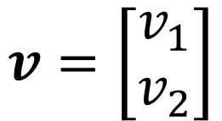






Scalar Multiplication
$$v=\left[\begin{matrix}v_{1} \\ v_{2}\end{matrix}\right]$$
$${2v}_{2}$$
$$2v$$
$$v_{2}$$
$$v$$
$$cv=\left[\begin{matrix}cv_{1} \\ cv_{2}\end{matrix}\right]$$
$$v_{1}$$
$${2v}_{1}$$
Notes:
scalar multiplication
for a vector

Slide 8
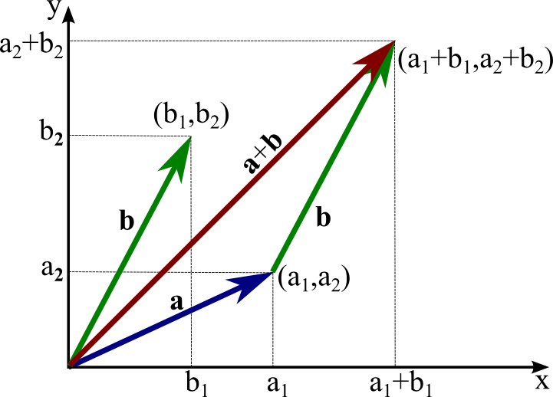
Vector Addition

Slide 9
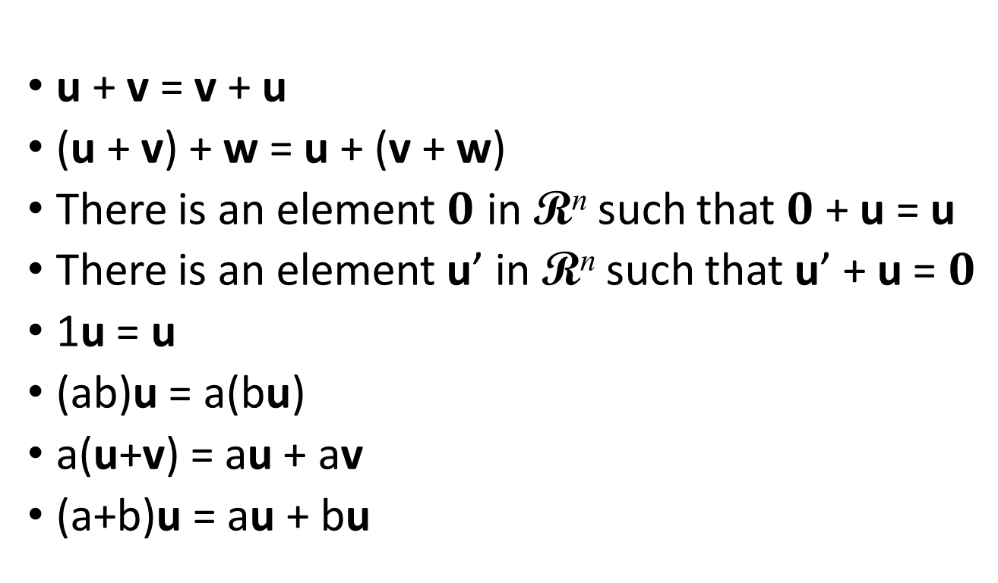
Properties of Vector
Objects having the following 8 properties are “vectors”.
For any vectors u, v and w in R^{n}, and any scalars a and b
u + v = v + u
(u + v) + w = u + (v + w)
There is an element $0$ in R^{n} such that $0$ + u = u
There is an element u’ in R^{n} such that u’ + u = $0$
1u = u
(ab)u = a(bu)
a(u+v) = au + av
(a+b)u = au + bu
= - u
$$0=\left[\begin{matrix}0 \\ ⋮ \\ 0\end{matrix}\right]$$
zero vector
In Chapter 7, the above will be generalized to “vector space”

Slide 10





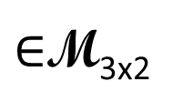
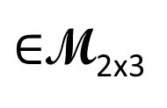
Matrix
$$\left[\begin{matrix}1 & 2 & 3\end{matrix}\right]$$
$$A=\left[\begin{matrix}2 & 3 & 5 \\ 3 & 1 & −1 \\ −2 & 1 & 1\end{matrix}\right]$$
$$\left[\begin{matrix}1 \\ 2 \\ 3\end{matrix}\right]$$
1 X 3
3 X 1
If the matrix has m rows and n columns, we say the size of the matrix is m by n, written m x n
We use M_{mxn} to denote the set that contains all matrices of size m x n
2 columns
3 columns
$$\left[\begin{matrix}1 & 4 \\ 2 & 5 \\ 3 & 6\end{matrix}\right]$$
$$\left[\begin{matrix}1 & 2 & 3 \\ 4 & 5 & 6\end{matrix}\right]$$
3 rows
$∈$M_{3x2}
2 rows
$∈$M_{2x3}
2 X 3
3 X 2
先 Row 再 Column

Slide 11



Matrix
先 Row 再 Column
Index of component: the scalar in the i-th row and j-th column is called (i,j)-entry of the matrix
(1,2)-entry
$$A=\left[\begin{matrix}\begin{matrix}a_{11} & a_{12} \\ a_{21} & a_{22}\end{matrix} & \begin{matrix}⋯ & a_{1n} \\ ⋯ & a_{2n}\end{matrix} \\ \begin{matrix}⋮ & ⋮ \\ a_{m1} & a_{m2}\end{matrix} & \begin{matrix}⋱ & ⋮ \\ ⋯ & a_{mn}\end{matrix}\end{matrix}\right]$$
$$A=\left[\begin{matrix}2 & 3 & 5 \\ 3 & 1 & −1 \\ −2 & 1 & 1\end{matrix}\right]$$
(3,1)-entry
$$A=\left[\begin{matrix}\begin{matrix}a_{1} & a_{2}\end{matrix} & \begin{matrix}… & a_{n}\end{matrix}\end{matrix}\right]$$
(3,3)-entry
vectors
Notes:
RCRCRC

Slide 12


Matrix
Two matrices with the same size can add or subtract.
Matrix can be multiplied by a scalar
$$A=\left[\begin{matrix}1 & 4 \\ 2 & 5 \\ 3 & 6\end{matrix}\right]$$
$$B=\left[\begin{matrix}6 & 9 \\ 8 & 0 \\ 9 & 2\end{matrix}\right]$$
$$9B=\left[\begin{matrix}54 & 81 \\ 72 & 0 \\ 81 & 18\end{matrix}\right]$$
$$A+B=\left[\begin{matrix}7 & 13 \\ 10 & 5 \\ 12 & 8\end{matrix}\right]$$
$$A−B=\left[\begin{matrix}−5 & −5 \\ −6 & 5 \\ −6 & 4\end{matrix}\right]$$

Slide 13
Properties
A, B, C are mxn matrices, and s and t are scalars
  A + B = B + A
  (A + B) + C = A + (B + C)
  (st)A = s(tA)
  s(A + B) = sA + sB
  (s+t)A = sA + tA

Slide 14





有名有姓的 Matrix
$$n$$
Square matrix
$$m$$
$$m=n$$
diagonal
$$\left[\begin{matrix}2 & 3 & 5 \\ 0 & 1 & −1 \\ 0 & 0 & 1\end{matrix}\right]$$
$$\left[\begin{matrix}2 & 0 & 0 \\ 3 & 1 & 0 \\ −2 & 1 & 1\end{matrix}\right]$$
Upper Triangular Matrix
Lower Triangular Matrix

Slide 15
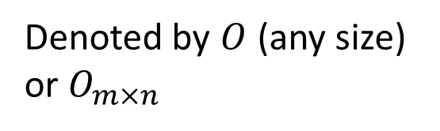



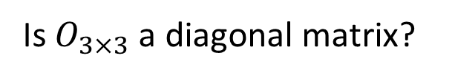
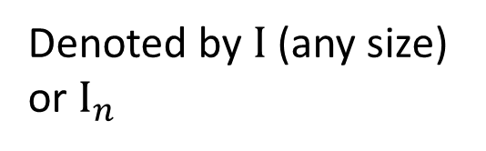
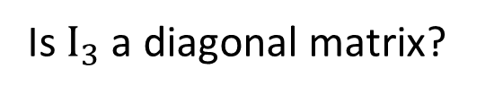


有名有姓的 Matrix
Is $I_{3}$ a diagonal matrix?
YES
Is $O_{3×3}$ a diagonal matrix?
YES
Diagonal Matrix
Identity Matrix
Zero Matrix
$$\left[\begin{matrix}2 & 0 & 0 \\ 0 & 1 & 0 \\ 0 & 0 & 2\end{matrix}\right]$$
All non-diagonal elements are “0”.
$$\left[\begin{matrix}1 & 0 & 0 \\ 0 & 1 & 0 \\ 0 & 0 & 1\end{matrix}\right]$$
$$I_{3}=$$
Denoted by $I$ (any size) or $I_{n}$
$$\left[\begin{matrix}0 & 0 & 0 \\ 0 & 0 & 0\end{matrix}\right]$$
Denoted by $O$ (any size) or $O_{m×n}$
$$O_{2×3}=$$
Notes:
In addition, one term that is often used is a trace. The trace is the sum of all the diagonal elements of a square matrix.

Slide 16


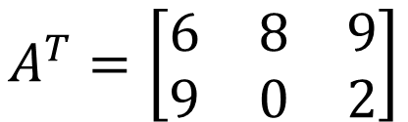
Transpose
If A is an mxn matrix, $A^{T}$ (transpose of A) is an nxm matrix whose (i,j)-entry is the (j-i)-entry of A
(1,2)
Transpose
$$A=\left[\begin{matrix}6 & 9 \\ 8 & 0 \\ 9 & 2\end{matrix}\right]$$
$$A^{T}=\left[\begin{matrix}6 & 8 & 9 \\ 9 & 0 & 2\end{matrix}\right]$$
(2,1)
(2,3)
(3,2)
Column 變成 Row ; Row 變成 Column
Why do we care about the transpose of a matrix?
Will explain later!

Slide 17


Transpose
A and B are mxn matrices, and s is a scalar
${\left(A^{T}\right)}^{T}=A$
${\left(sA\right)}^{T}=sA^{T}$
${\left(A+B\right)}^{T}=A^{T}+B^{T}$
This is a linear system ☺
Symmetric Matrix
$$A^{T}=A$$

Slide 18
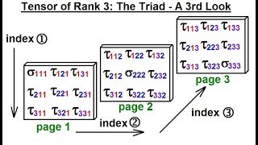
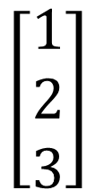
Vectors and matrices are special cases of tensors?
$$\left[\begin{matrix}1 \\ 2 \\ 3\end{matrix}\right]$$
S
Scalar (Rank 0)
Vector (Rank 1)
Matrix (Rank 2)
Rank 3 tensor
The above is an over-simplified definition of a tensor.
So what is a tensor?
Informal Definition: An object that is invariant under a change of coordinates, and has components that change in a special, predictable way under a change of coordinates.
※

Slide 19
Matrix-Vector Product
(Chapter 1.2)

Slide 20
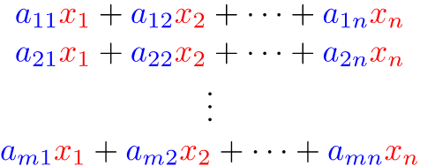
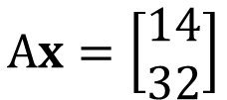

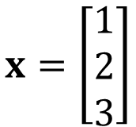
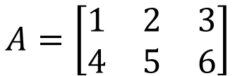

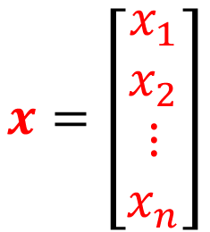
Matrix-Vector Product
$$A=\left[\begin{matrix}\begin{matrix}a_{11} & a_{12} \\ a_{21} & a_{22}\end{matrix} & \begin{matrix}⋯ & a_{1n} \\ ⋯ & a_{2n}\end{matrix} \\ \begin{matrix}⋮ & ⋮ \\ a_{m1} & a_{m2}\end{matrix} & \begin{matrix}⋱ & ⋮ \\ ⋯ & a_{mn}\end{matrix}\end{matrix}\right]$$
$$x=\left[\begin{matrix}\begin{matrix}x_{1} \\ x_{2}\end{matrix} \\ \begin{matrix}⋮ \\ x_{n}\end{matrix}\end{matrix}\right]$$
m X n
n X 1
Dot Product
with Row
$$Ax=$$
m X 1
$$x=\left[\begin{matrix}1 \\ 2 \\ 3\end{matrix}\right]$$
$$A=\left[\begin{matrix}1 & 2 & 3 \\ 4 & 5 & 6\end{matrix}\right]$$
$$Ax=\left[\begin{matrix}14 \\ 32\end{matrix}\right]$$

Slide 21
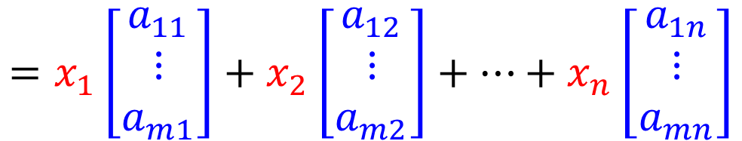
Matrix-Vector Product
$$A=\left[\begin{matrix}\begin{matrix}a_{11} & a_{12} \\ a_{21} & a_{22}\end{matrix} & \begin{matrix}⋯ & a_{1n} \\ ⋯ & a_{2n}\end{matrix} \\ \begin{matrix}⋮ & ⋮ \\ a_{m1} & a_{m2}\end{matrix} & \begin{matrix}⋱ & ⋮ \\ ⋯ & a_{mn}\end{matrix}\end{matrix}\right]$$
$$x=\left[\begin{matrix}\begin{matrix}x_{1} \\ x_{2}\end{matrix} \\ \begin{matrix}⋮ \\ x_{n}\end{matrix}\end{matrix}\right]$$
Dot Product
with Row
$$Ax=$$
$$=x_{1}\left[\begin{matrix}a_{11} \\ ⋮ \\ a_{m1}\end{matrix}\right]+x_{2}\left[\begin{matrix}a_{12} \\ ⋮ \\ a_{m2}\end{matrix}\right]+…+x_{n}\left[\begin{matrix}a_{1n} \\ ⋮ \\ a_{mn}\end{matrix}\right]$$
Weighted sum of Columns
Notes:
Linear combination of columns of A whose coefficients are the components in x

Slide 22


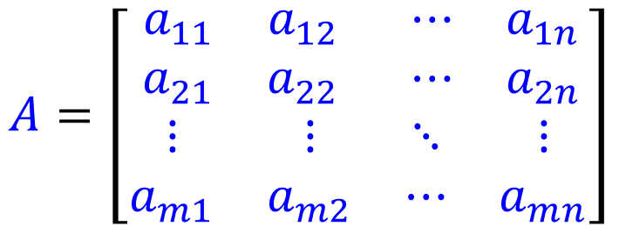



$$A=\left[\begin{matrix}\begin{matrix}a_{11} & a_{12} \\ a_{21} & a_{22}\end{matrix} & \begin{matrix}⋯ & a_{1n} \\ ⋯ & a_{2n}\end{matrix} \\ \begin{matrix}⋮ & ⋮ \\ a_{m1} & a_{m2}\end{matrix} & \begin{matrix}⋱ & ⋮ \\ ⋯ & a_{mn}\end{matrix}\end{matrix}\right]$$
$$x=\left[\begin{matrix}\begin{matrix}x_{1} \\ x_{2}\end{matrix} \\ \begin{matrix}⋮ \\ x_{n}\end{matrix}\end{matrix}\right]$$
$$x_{1}$$
Linear
System
$$x_{2}$$
……
$$x_{n}$$
$$Ax$$
Linear
System
$$x$$
$$b=Ax$$
The matrix $A$ represents the system.

Slide 23

$$x_{1}$$
Linear
System
$$b_{1}$$
$$x_{2}$$
$$b_{2}$$
……
……
$$x_{n}$$
$$b_{m}$$
Matrix-vector product:

Slide 24
Properties of
Matrix-Vector Product
(Chapter 1.2)

Slide 25




Matrix-vector Product
The sizes of matrix and vector should match.
$$A=\left[\begin{matrix}2 & 3 & 5 \\ 3 & 1 & −1 \\ −2 & 1 & 1\end{matrix}\right]$$
$$x=\left[\begin{matrix}1 \\ −1\end{matrix}\right]$$
$$A^{′′}=\left[\begin{matrix}\begin{matrix}2 \\ 3\end{matrix} & \begin{matrix}1 \\ 2\end{matrix} \\ \begin{matrix}0 \\ 1\end{matrix} & \begin{matrix}−1 \\ −3\end{matrix}\end{matrix}\right]$$
$$A′=\left[\begin{matrix}1 & −1 \\ 2 & 3 \\ 1 & 4\end{matrix}\right]$$

Slide 26
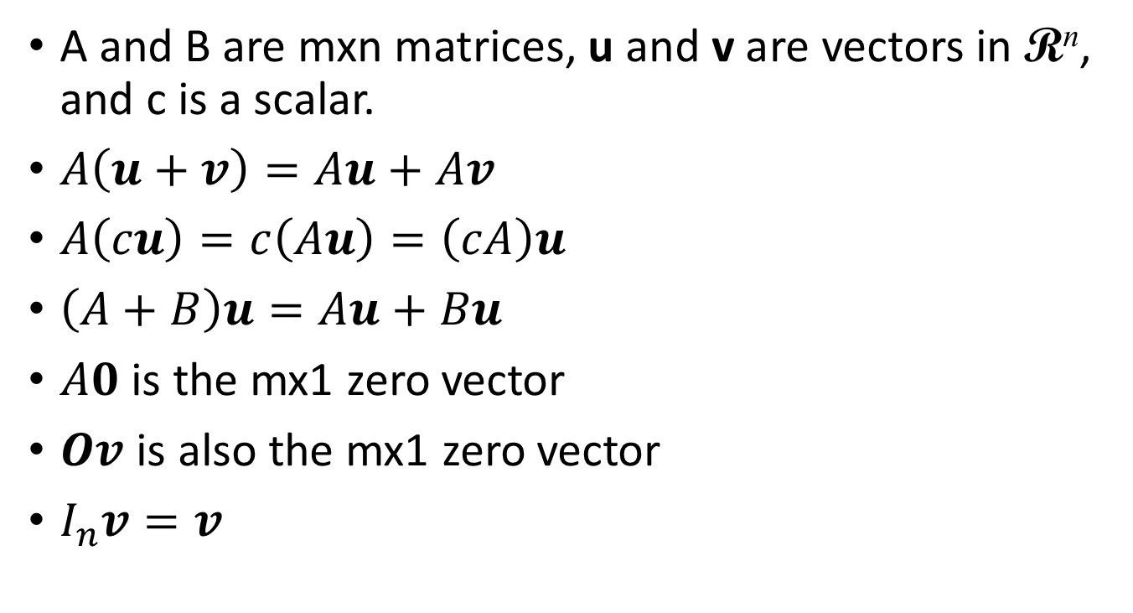



Properties of
Matrix-vector Product
A and B are mxn matrices, u and v are vectors in R^{n}, and c is a scalar.
$A\left(u+v\right)=Au+Av$
$A\left(cu\right)=c\left(Au\right)=\left(cA\right)u$
$\left(A+B\right)u=Au+Bu$
$A0$ is the mx1 zero vector
$Ov$ is also the mx1 zero vector
$I_{n}v=v$
$$\left[\begin{matrix}1 & 0 & 0 \\ 0 & 1 & 0 \\ 0 & 0 & 1\end{matrix}\right]$$
$$\left[\begin{matrix}v_{1} \\ v_{2} \\ v_{3}\end{matrix}\right]$$
$$=\left[\begin{matrix}v_{1} \\ v_{2} \\ v_{3}\end{matrix}\right]$$
Notes:
The last one can say something.

Slide 27












Properties of
Matrix-vector Product
A and B are mxn matrices. If $Aw=Bw$ for all $w$ in R^{n}. Is it true that $A=B$?
$Ae_{j}=a_{j}$, where $e_{j}$ is the j-th standard vector in R^{n}
$$e_{1}=\left[\begin{matrix}1 \\ ⋮ \\ 0\end{matrix}\right]$$
$$Ae_{1}=\left[\begin{matrix}a_{1} & ⋯ & a_{n}\end{matrix}\right]\left[\begin{matrix}1 \\ ⋮ \\ 0\end{matrix}\right]$$
Column Aspect
$$=1∙a_{1}+0∙a_{2}+⋯+0∙a_{n}$$
j
$$=a_{1}$$
j
$$Ae_{1}=Be_{1}$$
$$Ae_{2}=Be_{2}$$
$$Ae_{n}=Be_{n}$$
……
$$A=B$$
$$a_{1}=b_{1}$$
$$a_{2}=b_{2}$$
$$a_{n}=b_{n}$$
Notes:
http://betterexplained.com/articles/linear-algebra-guide/

Slide 28
Linear Combination
(Chapter 1.2)

Slide 29





Linear Combination
Given a vector set $\left\{u_{1},u_{2},⋯,u_{k}\right\}$
The linear combination of the vectors in the set
  $v=c_{1}u_{1}+c_{2}u_{2}+⋯+c_{k}u_{k}$
  $c_{1},c_{2},⋯,c_{k}$ are scalars (coefficients of linear combination)
vector set: $\left\{\left[\begin{matrix}1 \\ 1\end{matrix}\right],\left[\begin{matrix}1 \\ 3\end{matrix}\right],\left[\begin{matrix}1 \\ −1\end{matrix}\right]\right\}$
$$−3\left[\begin{matrix}1 \\ 1\end{matrix}\right]+4\left[\begin{matrix}1 \\ 3\end{matrix}\right]+\left[\begin{matrix}1 \\ −1\end{matrix}\right]$$
coefficients: $\left\{−3,4,1\right\}$
$$=\left[\begin{matrix}2 \\ 8\end{matrix}\right]$$
其實就是 weighted sum 啦 ☺
Notes:
[2 8]

Slide 30








Column Aspect
$$a_{1}$$
$$a_{2}$$
$$a_{n}$$
$$A=\left[\begin{matrix}\begin{matrix}a_{1} & a_{2}\end{matrix} & ⋯ & a_{n}\end{matrix}\right]$$
$$x=\left[\begin{matrix}\begin{matrix}x_{1} \\ x_{2}\end{matrix} \\ ⋮ \\ x_{n}\end{matrix}\right]$$
Vector set
coefficients
Linear Combination
$$=x_{1}a_{1}+x_{2}a_{2}+⋯+x_{n}a_{n}$$
Notes:
[2 8]

Slide 31




System of Linear Equations vs.
Linear Combination
Non empty solution set?
Has solution or not?
(A system of linear equations)
Consistent?
The Same question
Column Aspect
$$=b$$
Is $b$ the linear combination of columns of $A?$
$$=x_{1}a_{1}+x_{2}a_{2}+⋯+x_{n}a_{n}$$
linear combination of columns of $A$
Notes:
The coefficient is the solution

Slide 32








Example 1
$$3x_{1}+6x_{2}=3$$
$$2x_{1}+4x_{2}=4$$
$$A=\left[\begin{matrix}3 & 6 \\ 2 & 4\end{matrix}\right]$$
$$x=\left[\begin{matrix}x_{1} \\ x_{2}\end{matrix}\right]$$
$$b=\left[\begin{matrix}3 \\ 4\end{matrix}\right]$$
Has solution or not?
Is $b$ the linear combination of columns of $A?$
$$\left[\begin{matrix}3 \\ 4\end{matrix}\right]$$
$$\left\{\left[\begin{matrix}3 \\ 2\end{matrix}\right],\left[\begin{matrix}6 \\ 4\end{matrix}\right]\right\}$$
Notes:
高中、大學分隔線

Slide 33






Example 1
$$3x_{1}+6x_{2}=3$$
$$2x_{1}+4x_{2}=4$$
Has solution or not?
Vector set: $\left\{\left[\begin{matrix}3 \\ 2\end{matrix}\right],\left[\begin{matrix}6 \\ 4\end{matrix}\right]\right\}$
Is $\left[\begin{matrix}3 \\ 4\end{matrix}\right]$ a linear combination of $\left\{\left[\begin{matrix}3 \\ 2\end{matrix}\right],\left[\begin{matrix}6 \\ 4\end{matrix}\right]\right\}$?
NO
$$\left[\begin{matrix}3 \\ 4\end{matrix}\right]$$
The linear combination is always on the dotted line.
$$\left[\begin{matrix}6 \\ 4\end{matrix}\right]$$
$$\left[\begin{matrix}3 \\ 2\end{matrix}\right]$$

Slide 34







Example 2
$$2x_{1}+3x_{2}=4$$
$$3x_{1}+1x_{2}=−1$$
$$A=\left[\begin{matrix}2 & 3 \\ 3 & 1\end{matrix}\right]$$
$$x=\left[\begin{matrix}x_{1} \\ x_{2}\end{matrix}\right]$$
$$b=\left[\begin{matrix}4 \\ −1\end{matrix}\right]$$
Has solution or not?
Is $b$ a linear combination of columns of $A?$
$$\left[\begin{matrix}4 \\ −1\end{matrix}\right]$$
$$\left\{\left[\begin{matrix}2 \\ 3\end{matrix}\right],\left[\begin{matrix}3 \\ 1\end{matrix}\right]\right\}$$
Notes:
高中、大學分隔線

Slide 35









Example 2
$$2x_{1}+3x_{2}=4$$
$$3x_{1}+1x_{2}=−1$$
Has solution or not?
$$\left\{\left[\begin{matrix}2 \\ 3\end{matrix}\right],\left[\begin{matrix}3 \\ 1\end{matrix}\right]\right\}$$
$$\left[\begin{matrix}2 \\ 3\end{matrix}\right]$$
$$\left[\begin{matrix}4 \\ −1\end{matrix}\right]$$
2$\left[\begin{matrix}3 \\ 1\end{matrix}\right]$
$$\left[\begin{matrix}3 \\ 1\end{matrix}\right]$$
$$\left[\begin{matrix}4 \\ −1\end{matrix}\right]$$
(-1)$\left[\begin{matrix}2 \\ 3\end{matrix}\right]$
Notes:
Unique solution
在第二項限如何、在第三項限如何

Slide 36



Example 2
If u and v are any nonparallel vectors in R², then every vector in R² is a linear combination of u and v
  Nonparallel: u and v are nonzero vectors, and u ≠ cv.
If u, v and w are any nonparallel vectors in R³, then every vector in R³ is a linear combination of u, v and w?
$$\begin{matrix}u_{1}x_{1} & +v_{1}x_{2} & =b_{1} \\ u_{2}x_{1} & +v_{2}x_{2} & =b_{2}\end{matrix}$$
$$u$$
$$v$$
u and v are not parallel
?
Has solution
NO
Notes:
It is easy to understand for e1 and e2
Unique coefficient
Obviously, every vector in R^{n} may be uniquely linearly combined by these standard vectors.
劍圍???

Slide 37






Example 3
$$2x_{1}+6x_{2}=−4$$
$$1x_{1}+3x_{2}=−2$$
$$A=\left[\begin{matrix}2 & 6 \\ 1 & 3\end{matrix}\right]$$
$$x=\left[\begin{matrix}x_{1} \\ x_{2}\end{matrix}\right]$$
$$b=\left[\begin{matrix}−4 \\ −2\end{matrix}\right]$$
Has solution or not?
Is $b$ the linear combination of columns of $A?$
$$\left[\begin{matrix}−4 \\ −2\end{matrix}\right]$$
$$\left\{\left[\begin{matrix}2 \\ 1\end{matrix}\right],\left[\begin{matrix}6 \\ 3\end{matrix}\right]\right\}$$
Notes:
高中、大學分隔線

Slide 38






Example 3
$$2x_{1}+6x_{2}=−4$$
$$1x_{1}+3x_{2}=−2$$
Has solution or not?
Vector set: $\left\{\left[\begin{matrix}2 \\ 1\end{matrix}\right],\left[\begin{matrix}6 \\ 3\end{matrix}\right]\right\}$
Is $\left[\begin{matrix}−4 \\ −2\end{matrix}\right]$ a linear combination of $\left\{\left[\begin{matrix}2 \\ 1\end{matrix}\right],\left[\begin{matrix}6 \\ 3\end{matrix}\right]\right\}$?
Yes
$$\left[\begin{matrix}6 \\ 3\end{matrix}\right]$$
$$\left[\begin{matrix}2 \\ 1\end{matrix}\right]$$
$$\left[\begin{matrix}−4 \\ −2\end{matrix}\right]$$
u and v are not parallel
Has solution
Notes:
Infinite many solutions

Slide 39
Having Solutions or Not
(Chapter 1.3)

Slide 40
Review
Linear
System
x
b
System of Linear Equations
Matrix-vector product:
Given A and b, let’s find x

Slide 41


$$Zero, One, Infinity …$$
More Variables?
Considering any system of linear equations with 2 variables and 2 equations
$$\begin{matrix}a_{11}x_{1}+a_{12}x_{2}=b_{1} \\ a_{21}x_{1}+a_{22}x_{2}=b_{2}\end{matrix}$$
…… line 1
…… line 2
1ine 1
line 1
=line 2
1ine 1
1ine 2
1ine 2
unique solution
no solution
infinite solutions
consistent
inconsistent
consistent

Slide 42




















Only Unique and Infinite?
為什麼不能只有兩個解？
A
一旦找到兩個解，
就可以找到無窮多解
$$x?$$
$$b$$
A
A
$$u$$
$$b$$
$$v$$
$$b$$
$$0.3u$$
A
$$0.3b$$
$$0.7v$$
A
$$0.7b$$
$$0.4u$$
$$0.4b$$
$$0.6v$$
$$0.6b$$
3rd solution
$$0.3u+0.7v$$
A
$$0.3b+0.7b$$
$$=b$$
4th solution
$$0.4u+0.6v$$
$$0.4b+0.6b$$
$$=b$$

Slide 43
Solving System of
Linear Equations
(Chapter 1.4)

Slide 44
Equivalent
Two systems of linear equations are equivalent if they have exactly the same solution set.
$$\left\{\begin{matrix}\begin{matrix}3x_{1} & +x_{2} & =10\end{matrix} \\ \begin{matrix}x_{1} & −3x_{2} & =0\end{matrix}\end{matrix}\right.$$
$$\left\{\begin{matrix}\begin{matrix}x_{1} & & =3\end{matrix} \\ \begin{matrix} & x_{2} & =1\end{matrix}\end{matrix}\right.$$
Solution set: $\left\{\left[\begin{matrix}3 \\ 1\end{matrix}\right]\right\}$
equivalent
Solution set: $\left\{\left[\begin{matrix}3 \\ 1\end{matrix}\right]\right\}$

Slide 45
Equivalent
Applying the following three operations on a system of linear equations will produce an equivalent one.
1. Interchange
2. Scaling
3. Row Addition
$$\left\{\begin{matrix}\begin{matrix}3x_{1} & +x_{2} & =10\end{matrix} \\ \begin{matrix}x_{1} & −3x_{2} & =0\end{matrix}\end{matrix}\right.$$
$$\left\{\begin{matrix}\begin{matrix}x_{1} & −3x_{2} & =0\end{matrix} \\ \begin{matrix}3x_{1} & +x_{2} & =10\end{matrix}\end{matrix}\right.$$
(non zero)
$$\left\{\begin{matrix}\begin{matrix}3x_{1} & +x_{2} & =10\end{matrix} \\ \begin{matrix}x_{1} & −3x_{2} & =0\end{matrix}\end{matrix}\right.$$
$$\left\{\begin{matrix}\begin{matrix}3x_{1} & +x_{2} & =10\end{matrix} \\ \begin{matrix}−3x_{1} & +9x_{2} & =0\end{matrix}\end{matrix}\right.$$
X(-3)
$$\left\{\begin{matrix}\begin{matrix}3x_{1} & +x_{2} & =10\end{matrix} \\ \begin{matrix}x_{1} & −3x_{2} & =0\end{matrix}\end{matrix}\right.$$
$$\left\{\begin{matrix}\begin{matrix} & 10x_{2} & =10\end{matrix} \\ \begin{matrix}x_{1} & −3x_{2} & =0\end{matrix}\end{matrix}\right.$$
X(-3)
Notes:
Simple operations defined on a system of linear equations
not change the solution set of the system of linear equations
They are all equivalent.
Used for solving systems of linear equations
Equivalent systems of linear equations: having the same solution set.
An elementary row operation taken on a system of linear equations will result in another equivalent system of linear equations
Elementary row operations for solving systems of linear equations:

Slide 46
Solving system of linear equation
Strategy
  We know how to transform a given system of linear equations into another equivalent one.
  We do it again and again until the system of linear equation is very simple
  Finally, we know the answer at a glance.
$$\left\{\begin{matrix}\begin{matrix}x_{1} & −3x_{2} & =0\end{matrix} \\ \begin{matrix}{3x}_{1} & +x_{2} & =10\end{matrix}\end{matrix}\right.$$
X (-3)
$$\left\{\begin{matrix}\begin{matrix}x_{1} & −3x_{2} & =0\end{matrix} \\ \begin{matrix} & 10x_{2} & =10\end{matrix}\end{matrix}\right.$$
X 1/10
$$\left\{\begin{matrix}\begin{matrix}x_{1} & & =3\end{matrix} \\ \begin{matrix} & x_{2} & =1\end{matrix}\end{matrix}\right.$$
$$\left\{\begin{matrix}\begin{matrix}x_{1} & −3x_{2} & =0\end{matrix} \\ \begin{matrix} & x_{2} & =1\end{matrix}\end{matrix}\right.$$
X 3

Slide 47
Augmented Matrix
a system of linear equation
$$A=\left[\begin{matrix}\begin{matrix}a_{11} & a_{12} \\ a_{21} & a_{22}\end{matrix} & \begin{matrix}⋯ & a_{1n} \\ ⋯ & a_{2n}\end{matrix} \\ \begin{matrix}⋮ & ⋮ \\ a_{m1} & a_{m2}\end{matrix} & \begin{matrix}⋱ & ⋮ \\ ⋯ & a_{mn}\end{matrix}\end{matrix}\right]$$
$$x=\left[\begin{matrix}\begin{matrix}x_{1} \\ x_{2}\end{matrix} \\ \begin{matrix}⋮ \\ x_{n}\end{matrix}\end{matrix}\right]$$
$$b=\left[\begin{matrix}\begin{matrix}b_{1} \\ b_{2}\end{matrix} \\ \begin{matrix}⋮ \\ b_{m}\end{matrix}\end{matrix}\right]$$
m x n
coefficient matrix

Slide 48

Augmented Matrix
a system of linear equation
m x (n+1)
m x n
m x 1
augmented matrix

Slide 49
Back to Equivalent
1. Interchange
2. Scaling
3. Row Addition
$$\left\{\begin{matrix}\begin{matrix}3x_{1} & +x_{2} & =10\end{matrix} \\ \begin{matrix}x_{1} & −3x_{2} & =0\end{matrix}\end{matrix}\right.$$
$$\left\{\begin{matrix}\begin{matrix}x_{1} & −3x_{2} & =0\end{matrix} \\ \begin{matrix}3x_{1} & +x_{2} & =10\end{matrix}\end{matrix}\right.$$
(non zero)
$$\left\{\begin{matrix}\begin{matrix}3x_{1} & +x_{2} & =10\end{matrix} \\ \begin{matrix}x_{1} & −3x_{2} & =0\end{matrix}\end{matrix}\right.$$
$$\left\{\begin{matrix}\begin{matrix}3x_{1} & +x_{2} & =10\end{matrix} \\ \begin{matrix}−3x_{1} & +9x_{2} & =0\end{matrix}\end{matrix}\right.$$
X(-3)
$$\left\{\begin{matrix}\begin{matrix}3x_{1} & +x_{2} & =10\end{matrix} \\ \begin{matrix}x_{1} & −3x_{2} & =0\end{matrix}\end{matrix}\right.$$
$$\left\{\begin{matrix}\begin{matrix} & 10x_{2} & =10\end{matrix} \\ \begin{matrix}x_{1} & −3x_{2} & =0\end{matrix}\end{matrix}\right.$$
X(-3)
Notes:
Simple operations defined on a system of linear equations
not change the solution set of the system of linear equations
They are all equivalent.
Used for solving systems of linear equations
Equivalent systems of linear equations: having the same solution set.
An elementary row operation taken on a system of linear equations will result in another equivalent system of linear equations
Elementary row operations for solving systems of linear equations:

Slide 50
Back to Equivalent
elementary row operations
Interchange any two rows of the matrix
1. Interchange
2. Scaling
3. Row Addition
$$\left[\begin{matrix}3 & 1 & 10 \\ 1 & −3 & 0\end{matrix}\right]$$
$$\left[\begin{matrix}1 & −3 & 0 \\ 3 & 1 & 10\end{matrix}\right]$$
(non zero)
Multiply every entry of some row by the same nonzero scalar
$$\left[\begin{matrix}3 & 1 & 10 \\ 1 & −3 & 0\end{matrix}\right]$$
$$\left[\begin{matrix}3 & 1 & 10 \\ −3 & 9 & 0\end{matrix}\right]$$
X(-3)
Add a multiple of one row of the matrix to another row
$$\left[\begin{matrix}3 & 1 & 10 \\ 1 & −3 & 0\end{matrix}\right]$$
$$\left[\begin{matrix}0 & 10 & 10 \\ 1 & −3 & 0\end{matrix}\right]$$
X(-3)
Notes:
Simple operations defined on a system of linear equations
not change the solution set of the system of linear equations
They are all equivalent.
Used for solving systems of linear equations
Equivalent systems of linear equations: having the same solution set.
An elementary row operation taken on a system of linear equations will result in another equivalent system of linear equations
Elementary row operations for solving systems of linear equations:

Slide 51
Solving system of linear equation
A complex system of linear equations
A simple system of linear equations
Ax = b
R′x = b′
equivalent
A’=[ A b ]
A’’
A’’’
……
R=[ R′ b′ ]
elementary row operations
1. Interchange any two rows of the matrix
2. Multiply every entry of some row by the same nonzero scalar
3. Add a multiple of one row of the matrix to another row
Notes:
Every elementary row operations are reversible.
For interchange operation it is obvious, for scaling operation
multiply the inverse of the nonzero constant, and for row addition
operation add the negative multiple of the row to the other row.

Slide 52
$$\left\{\begin{matrix}\begin{matrix}x_{1} & −3x_{2} & =0\end{matrix} \\ \begin{matrix}{3x}_{1} & +x_{2} & =10\end{matrix}\end{matrix}\right.$$
X 3
X 3
$$\left[\begin{matrix}1 & −3 & 0 \\ 3 & 1 & 10\end{matrix}\right]$$
$$\left\{\begin{matrix}\begin{matrix}x_{1} & −3x_{2} & =0\end{matrix} \\ \begin{matrix} & 10x_{2} & =10\end{matrix}\end{matrix}\right.$$
$$\left[\begin{matrix}1 & −3 & 0 \\ 0 & 10 & 10\end{matrix}\right]$$
X 1/10
X 1/10
$$\left\{\begin{matrix}\begin{matrix}x_{1} & −3x_{2} & =0\end{matrix} \\ \begin{matrix} & x_{2} & =1\end{matrix}\end{matrix}\right.$$
$$\left[\begin{matrix}1 & −3 & 0 \\ 0 & 1 & 1\end{matrix}\right]$$
X 3
X 3
$$\left\{\begin{matrix}\begin{matrix}x_{1} & & =3\end{matrix} \\ \begin{matrix} & x_{2} & =1\end{matrix}\end{matrix}\right.$$
$$\left[\begin{matrix}1 & 0 & 3 \\ 0 & 1 & 1\end{matrix}\right]$$

Slide 53
Solving system of linear equation
A complex system of linear equations
A simple system of linear equations
?????
Ax = b
R′x = b′
equivalent
A’=[ A b ]
A’’
A’’’
……
R=[ R′ b′ ]
Reduced Row Echelon Form (RREF)
elementary row operations:
1. Interchange any two rows of the matrix
2. Multiply every entry of some row by the same nonzero scalar
3. Add a multiple of one row of the matrix to another row
Notes:
Every elementary row operations are reversible.
For interchange operation it is obvious, for scaling operation
multiply the inverse of the nonzero constant, and for row addition
operation add the negative multiple of the row to the other row.

Slide 54
Reduced Row
Echelon Form (RREF)
(Chapter 1.4)

Slide 55

Reduced Row Echelon Form
階層
A system of linear equations is easily solvable if its augmented matrix is in reduced row echelon form
Row Echelon Form (REF)
  1. Each nonzero row lies above every zero row
  2. The leading entries are in echelon form
Notes:
Echelon 【軍】梯次編隊,階層
(Actually condition 3 is implied by 2.)

Slide 56

Reduced Row Echelon Form
A system of linear equations is easily solvable if its augmented matrix is in reduced row echelon form
Row Echelon Form (REF)
NO
  1. Each nonzero row lies above every zero row
  2. The leading entries are in echelon form
No zero rows
Notes:
Echelon 【軍】梯次編隊,階層
(Actually condition 3 is implied by 2.)

Slide 57


Reduced Row Echelon Form
A system of linear equations is easily solvable if its augmented matrix is in reduced row echelon form
Reduced Row Echelon Form (RREF)
  1-2 The matrix is in row echelon form
  3. The columns containing the leading entries are standard vectors.

Slide 58

Reduced Row Echelon Form
A system of linear equations is easily solvable if its augmented matrix is in reduced row echelon form
Reduced Row Echelon Form (RREF)
  1-2 The matrix is in row echelon form
  3. The columns containing the leading entries are standard vectors.
Notes:
4. If a column contains the leading entry, then all the other entries are 0
5. The leading entries are 1

Slide 59
Reduced Row Echelon Form
A
R
Leading Entry
The pivot positions of A are (1,1), (2,3) and (3,4).
The pivot columns of A are 1st, 3rd and 4th columns.
Notes:
Pi (闢) vət

Slide 60





RREF is unique!
Not going to prove
A matrix can be transformed into multiple REFs by row operations, but only one RREF
REF
$$\left[\begin{matrix}\begin{matrix}1 & −2 \\ 0 & 3 \\ 0 & 0\end{matrix} & \begin{matrix}−1 & 3 \\ 3 & −6 \\ 1 & 3\end{matrix}\end{matrix}\right]$$
RREF
REF
$$\left[\begin{matrix}\begin{matrix}1 & −2 \\ 0 & 3 \\ 0 & 0\end{matrix} & \begin{matrix}−1 & 3 \\ 3 & −6 \\ 3 & 9\end{matrix}\end{matrix}\right]$$
REF
$$\left[\begin{matrix}\begin{matrix}1 & −2 \\ 0 & 3 \\ 0 & 0\end{matrix} & \begin{matrix}−1 & 3 \\ 0 & −15 \\ 3 & 9\end{matrix}\end{matrix}\right]$$
Notes:
https://www.isical.ac.in/~arnabc/isivm2/rrefunique.pdf
===========
Can different matrices have the same RREF?

Slide 61
RREF is unique – Proof (by Induction)
$$\left[\begin{matrix}\begin{matrix}1 & 2 \\ 0 & 0 \\ 0 & 0\end{matrix} & \begin{matrix}0 & 3 r1 \\ 1 & 4 r2 \\ 0 & 0 t1\end{matrix}\end{matrix}\right]$$
S=
$$\left[\begin{matrix}\begin{matrix}1 & 2 \\ 0 & 0 \\ 0 & 0\end{matrix} & \begin{matrix}0 & 3 s1 \\ 1 & 4 s2 \\ 0 & 0 u1\end{matrix}\end{matrix}\right]$$
$$\left[\begin{matrix}\begin{matrix}0 & 0 \\ 0 & 0 \\ 0 & 0\end{matrix} & \begin{matrix}0 & 0 r1−s1 \\ 0 & 0 r2−s2 \\ 0 & 0 t1−u1\end{matrix}\end{matrix}\right]$$
R=
R-S=
$$\left[\begin{aligned}x1 \\ x2 \\ x3 \\ x4 \\ x5\end{aligned}\right]$$
Ax=0 ↔ Rx=0 and Sx=0;
hence (R-S)x=0 x₅ =0
R, S are RREF of A.
Consider x =
Claim: t$1$ ≠ 0.
If t$1$ = 0, consider y=
$$\left[\begin{aligned}r1 \\ 0 \\ r2 \\ 0 \\ −1\end{aligned}\right]$$
Ry=0 -- a contradiction, since y₅ ≠ 0
If t$1$ ≠ 0 t$1$ = 1, $r1$ = $r2$ = 0
Likewise, we can show that u$1$ ≠ 0 u$1$ = 1, $s1$ = s$2$ = 0
※
R = S
Notes:
https://www.isical.ac.in/~arnabc/isivm2/rrefunique.pdf
===========
Can different matrices have the same RREF?

Slide 62
How to find RREF
(Chapter 1.4)

Slide 63
Reduced Row Echelon Form (RREF)
Gaussian elimination: an algorithm for finding the reduced row echelon form of a matrix.
Because RREF of a matrix is unique, the order of elementary row operations in not important.
Original
augmented matrix
The reduced row echelon form
A row echelon form
Elementary row operations
Elementary row operations
Notes:
MATLAB
RREF of a matrix is unique.
Please refer to the steps of Gaussian Elimination in the textbook by yourself.
http://www.ams.org/notices/201106/rtx110600782p.pdf
http://www.dougbabcock.com/matrix.php

Slide 64
Example 1
1
-2
3

Slide 65
Example 1

Slide 66
Example 1
-1

Slide 67
Example 1
-2

Slide 68
Example 1
-2
2
1
1
2

Slide 69
Example 1
1
1
-3

Slide 70





Example 1
x₁
x₂
x₃
x₄
x₅
b
Move Free Variables to the right
$$\left[\begin{aligned}x_{1} \\ x_{2} \\ x_{3} \\ x_{4} \\ x_{5}\end{aligned}\right]$$
$$=\left[\begin{aligned}−5−2x_{2}+x_{5} \\ x_{2} \\ −3 \\ 2−x_{5} \\ x_{5}\end{aligned}\right]$$
$$=x_{2}\left[\begin{aligned}−2 \\ 1 \\ 0 \\ 0 \\ 0\end{aligned}\right]$$
$$+x_{5}\left[\begin{aligned}1 \\ 0 \\ 0 \\ −1 \\ 1\end{aligned}\right]$$
$$+\left[\begin{aligned}−5 \\ 0 \\ −3 \\ 2 \\ 0\end{aligned}\right]$$
Solution in parametric form

Slide 71












$$\left[\begin{aligned}x_{1} \\ x_{2} \\ x_{3} \\ x_{4} \\ x_{5}\end{aligned}\right]$$
$$=\left[\begin{aligned}−5−2x_{2}+x_{5} \\ x_{2} \\ −3 \\ 2−x_{5} \\ x_{5}\end{aligned}\right]$$
-8
$$+\left[\begin{aligned}−5 \\ 0 \\ −3 \\ 2 \\ 0\end{aligned}\right]$$
$$=x_{2}\left[\begin{aligned}−2 \\ 1 \\ 0 \\ 0 \\ 0\end{aligned}\right]$$
$$+x_{5}\left[\begin{aligned}1 \\ 0 \\ 0 \\ −1 \\ 1\end{aligned}\right]$$
1
1
-1
3
-1
$$x_{1} free$$
$$x_{2}=−\frac{5}{2}−\frac{1}{2}x_{1}+\frac{1}{2}x_{5}$$
-8
$$=\left[\begin{aligned}x_{1} \\ −5/2−1/2x_{1}+1/2x_{5} \\ −3 \\ 2−x_{5} \\ x_{5}\end{aligned}\right]$$
$$\left[\begin{aligned}x_{1} \\ x_{2} \\ x_{3} \\ x_{4} \\ x_{5}\end{aligned}\right]$$
1
$$=x_{1}\left[\begin{aligned}1 \\ −1/2 \\ 0 \\ 0 \\ 0\end{aligned}\right]$$
$$+x_{5}\left[\begin{aligned}0 \\ 1/2 \\ 0 \\ −1 \\ 1\end{aligned}\right]$$
$$+\left[\begin{aligned}0 \\ −5/2 \\ −3 \\ 2 \\ 0\end{aligned}\right]$$
-8
-1
3
-1

Slide 72
Span
(Chapter 1.6)

Slide 73

Span
A vector set $S=\left\{u_{1},u_{2},⋯,u_{k}\right\}$
$Span S$ is the vector set of all linear combinations of $u_{1},u_{2},⋯,u_{k}$
Vector set $V=Span S$
  “$S$ is a generating set for $V$” or “$S$ generates V”
  One way to describe a vector set with infinite elements
  $$Span S=\left\{{c_{1}u}_{1}+{c_{2}u}_{2}+⋯+{c_{k}u}_{k}| for all c_{1},c_{2},⋯,c_{k}\right\}$$

Slide 74




Span
$$c_{1}\left[\begin{matrix}0 \\ 0\end{matrix}\right]=\left[\begin{matrix}0 \\ 0\end{matrix}\right]$$
Let $S_{0}=\text{\{}\left[\begin{matrix}0 \\ 0\end{matrix}\right]\text{\}}$, what is $Span S_{0}$?
  Ans: $\text{\{}\left[\begin{matrix}0 \\ 0\end{matrix}\right]\text{\}}$ (only one member)
Let $S_{1}=\text{\{}\left[\begin{matrix}1 \\ −1\end{matrix}\right]\text{\}}$, what is $Span S_{1}$?
  $Span S_{1}=\text{\{}\left[\begin{matrix}1 \\ −1\end{matrix}\right]\text{,}\left[\begin{matrix}2 \\ −2\end{matrix}\right],\left[\begin{matrix}−1 \\ 1\end{matrix}\right],……\text{\}}$
  If S contains a non zero vector, then Span S has infinitely many vectors
$$Span S_{1}$$
$$\left[\begin{matrix}1 \\ −1\end{matrix}\right]$$

Slide 75








Span
Let $S_{1}=\text{\{}\left[\begin{matrix}1 \\ −1\end{matrix}\right]\text{\}}$
$Span S_{1}=$?
Let $S_{2}=\text{\{}\left[\begin{matrix}1 \\ −1\end{matrix}\right],\left[\begin{matrix}−2 \\ 2\end{matrix}\right]\text{\}}$
what is $Span S_{2}$?
$$Span S_{1}$$
$$Span S_{2}$$
$$\left[\begin{matrix}−2 \\ 2\end{matrix}\right]$$
$$\left[\begin{matrix}1 \\ −1\end{matrix}\right]$$
$$\left[\begin{matrix}1 \\ −1\end{matrix}\right]$$
$$Span S_{1}=Span S_{2}$$
(Different number of vectors can generate the same space.)

Slide 76







Span
Let $S_{3}=\text{\{}\left[\begin{matrix}1 \\ −1\end{matrix}\right],\left[\begin{matrix}−2 \\ 2\end{matrix}\right],\left[\begin{matrix}2 \\ 1\end{matrix}\right]\text{\}}$, what is $Span S_{3}$?
Every vector in $\text{R}\text{2}$
is their linear combination
$$\left[\begin{matrix}−2 \\ 2\end{matrix}\right]$$
$$\left[\begin{matrix}2 \\ 1\end{matrix}\right]$$
$$\left[\begin{matrix}1 \\ −1\end{matrix}\right]$$
$$Span S_{3}$$
$$=\text{R}\text{2}$$
Notes:
則編
角色重疊
(其中一個是冗員)

Slide 77













Span
Let $S_{3}=\text{\{}\left[\begin{matrix}1 \\ −1\end{matrix}\right],\left[\begin{matrix}−2 \\ 2\end{matrix}\right],\left[\begin{matrix}2 \\ 1\end{matrix}\right]\text{\}}$
what is $Span S_{3}=?$
Let $S_{4}=\text{\{}\left[\begin{matrix}1 \\ −1\end{matrix}\right],\left[\begin{matrix}−2 \\ 2\end{matrix}\right],\left[\begin{matrix}2 \\ 1\end{matrix}\right],\left[\begin{matrix}−1 \\ 3\end{matrix}\right]\text{\}}$
what is $Span S_{4}=$?
$$\left[\begin{matrix}−1 \\ 3\end{matrix}\right]$$
$$\left[\begin{matrix}−2 \\ 2\end{matrix}\right]$$
$$\left[\begin{matrix}2 \\ 1\end{matrix}\right]$$
$$\left[\begin{matrix}−2 \\ 2\end{matrix}\right]$$
$$\left[\begin{matrix}2 \\ 1\end{matrix}\right]$$
$$\left[\begin{matrix}1 \\ −1\end{matrix}\right]$$
$$\left[\begin{matrix}1 \\ −1\end{matrix}\right]$$
$$Span S_{3}$$
$$=\text{R}\text{2}$$
$$Span S_{4}$$
$$=\text{R}\text{2}$$

Slide 78
Useless Vector in Span
(Chapter 1.6)

Slide 79


Span
$$\left[\begin{matrix}1 & −2 & 2 \\ −1 & 2 & 1\end{matrix}\right]$$
$$\left[\begin{aligned}1 \\ 2\end{aligned}\right]$$
Every b has solution
Let $S_{3}=\text{\{}\left[\begin{matrix}1 \\ −1\end{matrix}\right],\left[\begin{matrix}−2 \\ 2\end{matrix}\right],\left[\begin{matrix}2 \\ 1\end{matrix}\right]\text{\}}$, what is $Span S_{3}$?
拿掉其中一個並不會影響 Span 後的 Vector Set
Every vector in $\text{R}\text{2}$
is their linear combination
$$\left[\begin{matrix}−2 \\ 2\end{matrix}\right]$$
$$\left[\begin{matrix}2 \\ 1\end{matrix}\right]$$
$$\left[\begin{matrix}1 \\ −1\end{matrix}\right]$$
$$Span S_{3}$$
$$=\text{R}\text{2}$$
其中一個是多餘的
只要其中一個在，另一個就是多餘的

Slide 80














多餘Vector 的特徵
  Given vector set $S=\left\{u_{1},u_{2}⋯u_{k},v\right\}$
  Given vector set $S′=\left\{u_{1},u_{2}⋯u_{k}\right\}$
  $v$ 是多餘:
  $v$ 是 $S$ 其餘成員的 linear combination
  ($v∈$ $Span S′$)
  $$Span S$$
  $$=Span S′$$
$$v={b_{1}u}_{1}+b_{2}u_{2}+…+b_{k}u_{k}$$
Target
$$w∈Span S$$
$$w={c_{1}u}_{1}+c_{2}u_{2}+…+c_{k}u_{k}+cv$$
$$∈Span S′$$
$$w∈Span S$$
$$={\left(c_{1}+cb_{1}\right)u}_{1}+\left(c_{2}+cb_{2}\right)u_{2}…$$
$$+\left(c_{k}+cb_{k}\right)u_{k}$$
$$w∈Span S′$$
$$w∈Span S′$$
$$w={c_{1}u}_{1}+c_{2}u_{2}+…+c_{k}u_{k}$$
$$c=0$$
$$={c_{1}u}_{1}+c_{2}u_{2}+…+c_{k}u_{k}+cv$$
$$∈Span S$$

Slide 81




多餘Vector 的特徵
  Given vector set $S=\left\{u_{1},u_{2}⋯u_{k},v\right\}$
  Given vector set $S′=\left\{u_{1},u_{2}⋯u_{k}\right\}$
  $v$ 是多餘:
  $v$ 是 $S$ 其餘成員的 linear combination
  ($v∈$ $Span S′$)
  $$Span S$$
  $$=Span S′$$
$$v={0u}_{1}+0u_{2}+…+0u_{k}+1v$$
$$w∈Span S$$
$$v∈Span S$$
$$w∈Span S′$$
$$v∈Span S′$$

Slide 82





Has solution or not?
The same question
$$x_{1}\left[\begin{matrix}a_{11} \\ ⋮ \\ a_{m1}\end{matrix}\right]+x_{2}\left[\begin{matrix}a_{12} \\ ⋮ \\ a_{m2}\end{matrix}\right]+…+x_{n}\left[\begin{matrix}a_{1n} \\ ⋮ \\ a_{mn}\end{matrix}\right]=\left[\begin{matrix}b_{1} \\ ⋮ \\ b_{m}\end{matrix}\right]$$
Is $b$ the linear combination of columns of $A?$
The same question
$$\left[\begin{matrix}b_{1} \\ ⋮ \\ b_{m}\end{matrix}\right]∈$$
$$Span \left\{\left[\begin{matrix}a_{11} \\ ⋮ \\ a_{m1}\end{matrix}\right],\left[\begin{matrix}a_{12} \\ ⋮ \\ a_{m2}\end{matrix}\right]…\left[\begin{matrix}a_{1n} \\ ⋮ \\ a_{mn}\end{matrix}\right]\right\}$$
Is $b$in the span of the columns of $A?$

Slide 83
Dependent and Independent
(Chapter 1.7)

Slide 84



Definition
Ax=0
$$x_{1}\left[\begin{matrix}a_{11} \\ ⋮ \\ a_{m1}\end{matrix}\right]+x_{2}\left[\begin{matrix}a_{12} \\ ⋮ \\ a_{m2}\end{matrix}\right]+…+x_{n}\left[\begin{matrix}a_{1n} \\ ⋮ \\ a_{mn}\end{matrix}\right]=\left[\begin{matrix}0 \\ ⋮ \\ 0\end{matrix}\right]$$
A set of n vectors $\left\{a_{1},a_{2},⋯,a_{n}\right\}$ is linearly dependent
  If there exist scalars $x_{1},x_{2},⋯,x_{n}$, not all zero, such that
A set of n vectors $\left\{a_{1},a_{2},⋯,a_{n}\right\}$ is linearly independent
Find one
Obtain many
$$x_{1}a_{1}+x_{2}a_{2}+⋯+x_{n}a_{n}=0$$
2
2
2
$$x_{1}a_{1}+x_{2}a_{2}+⋯+x_{n}a_{n}=0$$
Only if $x_{1}=x_{2}=⋯=x_{n}=0$
unique
Notes:
How about the vector with only one element?

Slide 85






A set of n vectors $\left\{a_{1},a_{2},⋯,a_{n}\right\}$ is linearly dependent
  If there exist scalars $x_{1},x_{2},⋯,x_{n}$, not all zero, such that
A set of n vectors $\left\{a_{1},a_{2},⋯,a_{n}\right\}$ is linearly independent
$$x_{1}a_{1}+x_{2}a_{2}+⋯+x_{n}a_{n}=0$$
$$x_{1}a_{1}+x_{2}a_{2}+⋯+x_{n}a_{n}=0$$
Only if $x_{1}=x_{2}=⋯=x_{n}=0$
$$\left\{\begin{matrix}\left[\begin{matrix}−4 \\ 12 \\ 6\end{matrix}\right], & \left[\begin{matrix}−10 \\ 30 \\ 15\end{matrix}\right]\end{matrix}\right\}$$
Dependent or Independent?
dependent
$$x_{1}\left[\begin{matrix}−4 \\ 12 \\ 6\end{matrix}\right]+x_{2}\left[\begin{matrix}−10 \\ 30 \\ 15\end{matrix}\right]=0$$
5
-2
Notes:
How about the vector with only one element?

Slide 86


A set of n vectors $\left\{a_{1},a_{2},⋯,a_{n}\right\}$ is linearly dependent
  If there exist scalars $x_{1},x_{2},⋯,x_{n}$, not all zero, such that
A set of n vectors $\left\{a_{1},a_{2},⋯,a_{n}\right\}$ is linearly independent
$$x_{1}a_{1}+x_{2}a_{2}+⋯+x_{n}a_{n}=0$$
$$x_{1}a_{1}+x_{2}a_{2}+⋯+x_{n}a_{n}=0$$
Only if $x_{1}=x_{2}=⋯=x_{n}=0$
$$\left\{\begin{matrix}\left[\begin{matrix}6 \\ 3 \\ 3\end{matrix}\right], & \left[\begin{matrix}1 \\ 8 \\ 3\end{matrix}\right], & \left[\begin{matrix}7 \\ 11 \\ 6\end{matrix}\right]\end{matrix}\right\}$$
Dependent or Independent?
dependent
$$x_{1}\left[\begin{matrix}6 \\ 3 \\ 3\end{matrix}\right]+x_{2}\left[\begin{matrix}1 \\ 8 \\ 3\end{matrix}\right]+x_{3}\left[\begin{matrix}7 \\ 11 \\ 6\end{matrix}\right]=0$$
1
1
-1
Notes:
How about the vector with only one element?

Slide 87


A set of n vectors $\left\{a_{1},a_{2},⋯,a_{n}\right\}$ is linearly dependent
  If there exist scalars $x_{1},x_{2},⋯,x_{n}$, not all zero, such that
A set of n vectors $\left\{a_{1},a_{2},⋯,a_{n}\right\}$ is linearly independent
$$x_{1}a_{1}+x_{2}a_{2}+⋯+x_{n}a_{n}=0$$
$$x_{1}a_{1}+x_{2}a_{2}+⋯+x_{n}a_{n}=0$$
Only if $x_{1}=x_{2}=⋯=x_{n}=0$
$$\left\{\begin{matrix}\left[\begin{matrix}3 \\ −1 \\ 7\end{matrix}\right], & \left[\begin{matrix}0 \\ 0 \\ 0\end{matrix}\right], & \left[\begin{matrix}−2 \\ 5 \\ 1\end{matrix}\right]\end{matrix}\right\}$$
Dependent or Independent?
dependent
$$x_{1}\left[\begin{matrix}3 \\ −1 \\ 7\end{matrix}\right]+x_{2}\left[\begin{matrix}0 \\ 0 \\ 0\end{matrix}\right]+x_{3}\left[\begin{matrix}−2 \\ 5 \\ 1\end{matrix}\right]=0$$
0
Any
0
Any set containing zero vector would be linearly dependent
Notes:
How about the vector with only one element?

Slide 88




Linearly Dependent
(for $n≥2$)
Given a vector set {a₁, a₂, …, a_{n}}, there exists scalars x₁, x₂, …, x_{n}, that are not all zero, such that x₁a₁ + x₂a₂ + ☹ + x_{n}a_{n} = 0.
$$x_{1}a_{1}+x_{2}a_{2}…+x_{i}a_{i}+…+x_{n}a_{n}=0$$
永遠可以找到某一項有非 0係數
$$x_{i}≠0$$
$$x_{1}a_{1}+x_{2}a_{2}…+x_{n}a_{n}=−x_{i}a_{i}$$
$$−\left(\frac{x_{n}}{x_{1}}\right)a_{1}−\left(\frac{x_{n}}{x_{2}}\right)a_{2}…−\left(\frac{x_{n}}{x_{i}}\right)a_{n}=a_{i}$$
Given a vector set {a₁, a₂, …, a_{n}}, if there exists any a_{i} that is a linear combination of other vectors
Notes:
How about the vector with only one element?

Slide 89


Linearly Dependent
(for $n≥2$)
Given a vector set {a₁, a₂, …, a_{n}}, there exists scalars x₁, x₂, …, x_{n}, that are not all zero, such that x₁a₁ + x₂a₂ + ☹ + x_{n}a_{n} = 0.
$$a_{i}=c_{1}a_{1}+c_{2}a_{2}…+c_{n}a_{n}$$
$$−c_{1}a_{1}−c_{2}a_{2}…+a_{i}…−c_{n}a_{n}=0$$
至少這項有非 0係數
$$x_{i}≠0$$
Given a vector set {a₁, a₂, …, a_{n}}, if there exists any a_{i} that is a linear combination of other vectors
Notes:
How about the vector with only one element?

Slide 90

Linearly Dependent
=
Vector Set 中有多餘的
Given a vector set {a₁, a₂, …, a_{n}}, there exists scalars x₁, x₂, …, x_{n}, that are not all zero, such that x₁a₁ + x₂a₂ + ☹ + x_{n}a_{n} = 0.
(for $n≥2$)
Given a vector set {a₁, a₂, …, a_{n}}, if there exists any a_{i} that is a linear combination of other vectors
Linearly Independent
=
Vector Set 中沒有多餘的
Notes:
How about the vector with only one element?

Slide 91








Ax=0 has infinite solutions
Columns of A are dependent → If Ax=b has a solution, it will have Infinite solutions
If Ax=b has Infinite solutions → Columns of A are dependent
We can find non-zero solution u such that $Au=0$
$$A\left(u+v\right)=b$$
$u+v$ is another solution different to v
There exists v such that $Av=b$
Ax=0 has infinite solutions
$$Au=b$$
$$u≠v$$
$$A\left(u−v\right)=0$$
$$Av=b$$
Non-zero

Slide 92
Column Correspondence Theorem
(Chapter 1.7)

Slide 93






Column Correspondence Theorem
RREF
$$A=\left[\begin{matrix}a_{1} & ⋯ & a_{n}\end{matrix}\right]$$
$$R=\left[\begin{matrix}r_{1} & ⋯ & r_{n}\end{matrix}\right]$$
If $a_{j}$ is a linear combination of other columns of A
$r_{j}$ is a linear combination of the corresponding columns of R with the same coefficients
a₅ = −a₁+a₄
r₅ = −r₁+r₄
$a_{j}$ is a linear combination of the corresponding columns of A with the same coefficients
If $r_{j}$ is a linear combination of other columns of R
a₃ = 3a₁-2a₂
r₃ = 3r₁-2r₂

Slide 94
Column Correspondence Theorem - Example
a₁
a₂
a₃
a₄
a₅
a₆
r₁
r₂
r₃
r₄
r₅
r₆
a₂ = 2a₁
r₂ = 2r₁
a₅ = −a₁+a₄
r₅ = −r₁+r₄
Notes:
P118 – 122 (Chapter 2.3)

Slide 95







Augmented Matrix:
$$\left[\begin{matrix}A & b\end{matrix}\right]$$
$$\left[\begin{matrix}R & b\end{matrix}′\right]$$
The RREF of matrix A is R
The RREF of augmented matrix $\left[\begin{matrix}A & b\end{matrix}\right]$ is $\left[\begin{matrix}R & b′\end{matrix}\right]$
The RREF of matrix A is R
$Ax=b$ and $Rx=b$ have the same solution set?
$Ax=b$ and $Rx=b′$ have the same solution set
$Ax=0$ and $Rx=0$ have the same solution set
If $b=0$, then $b′=0$.
Notes:
P120

Slide 96










How about Rows?
NO
Are there row correspondence theorem?
$$a_{1}^{T}$$
$$r_{1}^{T}$$
$$a_{2}^{T}$$
$$r_{2}^{T}$$
$$a_{3}^{T}$$
$$r_{3}^{T}$$
$$a_{4}^{T}$$
$$r_{4}^{T}$$

Slide 97
Check Independence
(Chapter 1.7)

Slide 98
Checking Independence
Linearly independent or not?
A set of n vectors {a₁, a₂, …, a_{n}} is linearly dependent
Given a vector set {a₁, a₂, …, a_{n}}, if there exists any a_{i} that is a linear combination of other vectors
matrix A
Given a vector set {a₁, a₂, …, a_{n}}, there exists scalars x₁, x₂, …, x_{n}, that are not all zero, such that x₁a₁ + x₂a₂ + ☹ + x_{n}a_{n} = 0.
vector x
$Ax=0$ have non-zero solution

Slide 99
Checking Independence
Linearly independent or not?
A
$$\left[\begin{matrix}\begin{matrix}x_{1} \\ x_{2}\end{matrix} \\ \begin{matrix}x_{3} \\ x_{4}\end{matrix}\end{matrix}\right]$$
$$\left[\begin{matrix}\begin{matrix}1 & 1 \\ 2 & 0 \\ 1 & 1\end{matrix} & \begin{matrix}1 & 1 \\ 4 & 2 \\ 1 & 3\end{matrix}\end{matrix}\right]$$
$$=\left[\begin{matrix}0 \\ 0 \\ 0\end{matrix}\right]$$
$Ax=0$ have non-zero solution or not
x₁
x₂
x₃
x₄
x₁
x₂
x₃
x₄
RREF

Slide 100
Checking Independence
x₁
x₂
x₃
x₄
x₁
x₂
x₃
x₄
RREF
dependent
$$x_{1}+2x_{3}=0$$
$$x_{1}=−2x_{3}$$
$$x_{2}−x_{3}=0$$
$$x_{2}=x_{3}$$
$$x_{3} is free$$
$$x_{4}=0$$
$$x_{4}=0$$
$$\left[\begin{matrix}\begin{matrix}x_{1} \\ x_{2}\end{matrix} \\ \begin{matrix}x_{3} \\ x_{4}\end{matrix}\end{matrix}\right]$$
$$=\left[\begin{matrix}\begin{matrix}−2x_{3} \\ x_{3}\end{matrix} \\ \begin{matrix}x_{3} \\ 0\end{matrix}\end{matrix}\right]$$
$$x_{3}\left[\begin{matrix}\begin{matrix}−2 \\ 1\end{matrix} \\ \begin{matrix}1 \\ 0\end{matrix}\end{matrix}\right]$$
setting x₃ = 1
$$\left[\begin{matrix}\begin{matrix}x_{1} \\ x_{2}\end{matrix} \\ \begin{matrix}x_{3} \\ x_{4}\end{matrix}\end{matrix}\right]=\left[\begin{matrix}\begin{matrix}−2 \\ 1\end{matrix} \\ \begin{matrix}1 \\ 0\end{matrix}\end{matrix}\right]$$
$$=$$

Slide 101
Checking Independence
Linearly independent or not?
其實這題用看的就知道答案了!
A set of n vectors {a₁, a₂, …, a_{n}} is linearly dependent
Given a vector set {a₁, a₂, …, a_{n}}, if there exists any a_{i} that is a linear combination of other vectors
matrix A
Given a vector set {a₁, a₂, …, a_{n}}, there exists scalars x₁, x₂, …, x_{n}, that are not all zero, such that x₁a₁ + x₂a₂ + ☹ + x_{n}a_{n} = 0.
vector x
$Ax=0$ have non-zero solution

Slide 102
Column Correspondence Theorem
pivot columns
Leading entries
linearly independent
linearly independent
The pivot columns are linearly independent.

Slide 103
Column Correspondence Theorem
pivot columns
Leading entries
a₂ = 2a₁
a₅ = −a₁+a₄
a₆ = −5a₁−3a₃+2a₄
r₂ = 2r₁
r₅ = −r₁+r₄
r₆ = −5r₁−3r₃+2r₄
The non-pivot columns are the linear combination of the previous pivot columns.

Slide 104
Independent
Dependent
All columns are independent
The column is the linear combination of left pivot column.
Every column is a pivot column
If a column is not pivot
Every column in RREF(A) is a standard vector.

Slide 105


Independent
3X3
All columns are independent
$$\left[\begin{matrix}∗ & ∗ & ∗ \\ ∗ & ∗ & ∗ \\ ∗ & ∗ & ∗\end{matrix}\right]$$
Columns are linearly independent
Every column is a pivot column
RREF
Every column in RREF(A) is standard vector.
$$\left[\begin{matrix}1 & 0 & 0 \\ 0 & 1 & 0 \\ 0 & 0 & 1\end{matrix}\right]$$
Identity matrix

Slide 106



Independent
4X3
$$\left[\begin{matrix}\begin{matrix}∗ & ∗ & ∗ \\ ∗ & ∗ & ∗\end{matrix} \\ \begin{matrix}∗ & ∗ & ∗ \\ ∗ & ∗ & ∗\end{matrix}\end{matrix}\right]$$
All columns are independent
Columns are linearly independent
Every column is a pivot column
RREF
Every column in RREF(A) is standard vector.
$$\left[\begin{matrix}\begin{matrix}1 & 0 & 0 \\ 0 & 1 & 0\end{matrix} \\ \begin{matrix}0 & 0 & 1 \\ 0 & 0 & 0\end{matrix}\end{matrix}\right]$$
$$\left[\begin{matrix}I \\ O\end{matrix}\right]$$

Slide 107


Independent
3X4
All columns are independent
$$\left[\begin{matrix}\begin{matrix}∗ & ∗ \\ ∗ & ∗ \\ ∗ & ∗\end{matrix} & \begin{matrix}∗ & ∗ \\ ∗ & ∗ \\ ∗ & ∗\end{matrix}\end{matrix}\right]$$
Columns are linearly independent
Every column is a pivot column
RREF
Cannot be a pivot column
Every column in RREF(A) is standard vector.
$$\left[\begin{matrix}\begin{matrix}1 & 0 \\ 0 & 1 \\ 0 & 0\end{matrix} & \begin{matrix}0 & ∗ \\ 0 & ∗ \\ 1 & ∗\end{matrix}\end{matrix}\right]$$

Slide 108


Independent
$$\left[\begin{matrix}1 & 1 \\ 2 & 2 \\ 3 & 3\end{matrix}\right]$$
dependent
$$\left[\begin{matrix}\begin{matrix}∗ & ∗ \\ ∗ & ∗ \\ ∗ & ∗\end{matrix} & \begin{matrix}∗ & ∗ \\ ∗ & ∗ \\ ∗ & ∗\end{matrix}\end{matrix}\right]$$
The columns are dependent
(矮胖型)
Dependent or Independent?
dependent
More than 3 vectors in R³ must be dependent.
More than m vectors in R^{m} must be dependent.
Notes:
Can I explain this in an intuitive way?
Independent – Intuition

Slide 109
Rank of a Matrix
(Chapter 1.7)

Slide 110


Rank
Rank R = Rank A
Maximum number of Independent Columns
$$=$$
3
Rank = ?
Number of Pivot Column
$$=$$
Number of Non-zero rows
Rank = ?
3
Notes:
Maximum number of Independent Columns = Number of Pivot Column
??????

Slide 111



Rank
Maximum number of Independent Columns
Rank A $≤$ Number of columns
$$=$$
Number of Pivot Column
Rank A $≤$ Min( Number of columns, Number of rows)
$$=$$
Number of Non-zero rows
Rank A $≤$ Number of rows

Slide 112




Rank
Matrix A is full rank
if Rank A = min(m,n)
Matrix A is rank deficient if Rank A < min(m,n)
Given an mxn matrix A:
  Rank A $≤$ min(m, n)
  Because “the columns of A are independent” is equivalent to “rank A = n”
    If m < n, the columns of A are dependent.
$$\left[\begin{matrix}\begin{matrix}∗ & ∗\end{matrix} & \begin{matrix}∗ & ∗\end{matrix} \\ \begin{matrix}∗ & ∗\end{matrix} & \begin{matrix}∗ & ∗\end{matrix} \\ \begin{matrix}∗ & ∗\end{matrix} & \begin{matrix}∗ & ∗\end{matrix}\end{matrix}\right]$$
$$\left\{\left[\begin{matrix}∗ \\ ∗ \\ ∗\end{matrix}\right],\left[\begin{matrix}∗ \\ ∗ \\ ∗\end{matrix}\right],\left[\begin{matrix}∗ \\ ∗ \\ ∗\end{matrix}\right],\left[\begin{matrix}∗ \\ ∗ \\ ∗\end{matrix}\right]\right\}$$
3 X 4
A matrix set has 4 vectors belonging to R³ is dependent
Rank A $≤$ 3
In R^{m}, you cannot find more than m vectors that are independent.
Notes:
未看先猜
A is said to be rank deficient if it does not have full rank.

Slide 113





Basic, Free Variables vs. Rank
3 useful
equations
$$Ax=b$$
$$A$$
$$b$$
RREF($A$)
$$b’$$
rank
=
non-zero row
=
3 basic variables
No. column –non-zero row
nullity
=
=
2 free variables
Notes:
The rank of [A b] is the number of “useful” equations in the system of linear equations Ax = b (i.e., the number of nonzero rows in [R c]).
The rank of A represents the number of basic variables while the nullity of A is the number of free variables.

Slide 114
Rank
Rank
Maximum number of Independent Columns
Number of Pivot Columns
Number of Non-zero rows of RREF
Number of Basic Variables
Nullity = no. column - rank
Number of zero rows
of RREF
Number of Free Variables
Notes:
One of the statement is fake!!!!!!!!!!!!!!

Slide 115
RREF vs. Span
(Chapter 1.7)

Slide 116

Consistent or not
Given Ax=b, if the reduced row echelon form of [ A b ] is
Given Ax=b, if the reduced row echelon form of [ A b ] is
Consistent
b is in the span of the columns of A
inconsistent
b is NOT in the span of the columns of A
$$0∙x_{1}+0∙x_{2}+0∙x_{3}=1$$

Slide 117



Consistent or not
Ax =b is inconsistent (no solution)
The RREF of [A b] is
$$\left[\begin{matrix}\begin{matrix}∗ & ∗ & ∗ \\ ∗ & ∗ & ∗ \\ ∗ & ∗ & ∗\end{matrix} & \begin{matrix}∗ & ∗ & ∗ \\ ∗ & ∗ & ∗ \\ ∗ & ∗ & ∗\end{matrix} \\ \begin{matrix}0 & 0 & 0 \\ 0 & 0 & 0 \\ 0 & 0 & 0\end{matrix} & \begin{matrix}0 & 0 & d \\ 0 & 0 & 0 \\ 0 & 0 & 0\end{matrix}\end{matrix}\right]$$
Only the last column is non-zero
$$d≠0$$
3
4
Rank A $≠$ Rank [A b]
Need to know b

Slide 118



Ax =b is consistent for every b
$$A:m×n$$
=
Every b is in the span of the columns of A$=\left[\begin{matrix}a_{1} & ⋯ & a_{n}\end{matrix}\right]$
=
Every b belongs to $Span\left\{\begin{matrix}a_{1}, & ⋯ & ,a_{n}\end{matrix}\right\}$
=
$Span\left\{\begin{matrix}a_{1}, & ⋯ & ,a_{n}\end{matrix}\right\}=R^{m}$
=
RREF of [A b] cannot have a row whose only non-zero entry is at the last column
=
RREF of A cannot have zero row
沒有任何破綻
=
Rank A = no. of rows

Slide 119



Consistent or not
$$A:m×n$$
$Span\left\{\begin{matrix}a_{1}, & ⋯ & ,a_{n}\end{matrix}\right\}=R^{m}$
=
Rank A = no. of rows
m independent vectors can span $R^{m}$
More than m vectors in R^{m} must be dependent.

Slide 120




Example
m independent vectors can span $R^{m}$
$$a$$
Consider R²
$$b$$
$$c$$
yes
independent

Slide 121











The Big Picture of $Ax=b$
Square Matrix:
方程式數 = 變數個數
唯一解? 無窮多解? 無解?
$$\left[\begin{matrix}∗ & ∗ & ∗ \\ ∗ & ∗ & ∗ \\ ∗ & ∗ & ∗\end{matrix}\right]$$
$$\left[\begin{matrix}x_{1} \\ x_{2} \\ x_{3}\end{matrix}\right]$$
$$=\left[\begin{matrix}∗ \\ ∗ \\ ∗\end{matrix}\right]$$
Fat Matrix:
方程式數 <<變數個數
很可能有無窮多解
$$\left[\begin{matrix}\begin{matrix}∗ & ∗ \\ ∗ & ∗ \\ ∗ & ∗\end{matrix} & \begin{matrix}∗ & ∗ \\ ∗ & ∗ \\ ∗ & ∗\end{matrix}\end{matrix}\right]$$
$$\left[\begin{matrix}\begin{matrix}x_{1} \\ x_{2}\end{matrix} \\ \begin{matrix}x_{3} \\ x_{4}\end{matrix}\end{matrix}\right]$$
$$=\left[\begin{matrix}∗ \\ ∗ \\ ∗\end{matrix}\right]$$
$$\left[\begin{matrix}\begin{matrix}∗ \\ \begin{matrix}∗ \\ ∗\end{matrix}\end{matrix} \\ ∗\end{matrix}\right]$$
Tall Matrix:
方程式數 > 變數個數
很可能無解
$$\left[\begin{matrix}\begin{matrix}∗ & ∗ & ∗ \\ ∗ & ∗ & ∗\end{matrix} \\ \begin{matrix}∗ & ∗ & ∗ \\ ∗ & ∗ & ∗\end{matrix}\end{matrix}\right]$$
$$\left[\begin{matrix}x_{1} \\ x_{2} \\ x_{3}\end{matrix}\right]$$
$$=$$
※

Slide 122

$Number of Solutions of Ax=b$
One Solution
No Solution
Infinite Solutions
可否找到好的近似解? (Linear regression)
可否找到最小的解?
Pseudo-inverse Matrix
(based on SVD)
※

Slide 123




$$Solutions of Ax=b \\ Zero, One, Infinity …$$
No Solution
$b$ is NOT a linear combination of column vectors of A
$b$ is a linear combination of column vectors of A
Ax=0 only has zero solution
One Solution
$b$ is a linear combination of column vectors of A
Ax=0 has a non-zero solution
Infinite Solutions
※

Slide 124








Summary
$$A:m×n$$
$$x∈R^{n}$$
$$b∈R^{m}$$
Is $b$ a linear combination of columns of $A$?
Is $b$ in the span of the columns of $A$?
NO
YES
No solution
The columns of $A$ are independent.
The columns of $A$ are dependent.
Rank A = n
Rank A < n
Nullity A = 0
Nullity A > 0
Unique solution
Infinite solution
Notes:
Check existence first
One or infinite soluiton

Slide 125















Summary
$$A:m×n$$
$$x∈R^{n}$$
$$b∈R^{m}$$
The columns of $A$ are independent.
$$\left[\begin{matrix}\begin{matrix}∗ & ∗ \\ ∗ & ∗ \\ ∗ & ∗\end{matrix} & \begin{matrix}∗ & ∗ \\ ∗ & ∗ \\ ∗ & ∗\end{matrix}\end{matrix}\right]$$
$$\left[\begin{matrix}\begin{matrix}x_{1} \\ x_{2}\end{matrix} \\ \begin{matrix}x_{3} \\ x_{4}\end{matrix}\end{matrix}\right]$$
$$=\left[\begin{matrix}∗ \\ ∗ \\ ∗\end{matrix}\right]$$
$$\left[\begin{matrix}\begin{matrix}∗ & ∗ & ∗ \\ ∗ & ∗ & ∗\end{matrix} \\ \begin{matrix}∗ & ∗ & ∗ \\ ∗ & ∗ & ∗\end{matrix}\end{matrix}\right]$$
$$\left[\begin{matrix}x_{1} \\ x_{2} \\ x_{3}\end{matrix}\right]$$
$$\left[\begin{matrix}\begin{matrix}∗ \\ \begin{matrix}∗ \\ ∗\end{matrix}\end{matrix} \\ ∗\end{matrix}\right]$$
$$=$$
Rank A = n
Nullity A = 0
NO
YES
Is $b$ a linear combination of columns of $A$?
Is $b$ a linear combination of columns of $A$?
Is $b$ in the span of the columns of $A$?
Is $b$ in the span of the columns of $A$?
NO
YES
NO
YES
No solution
Infinite
solution
No solution
Unique solution

