Slide 1
Lecture 7 : Web Search & Mining (2)
楊立偉教授
台灣科大資管系
wyang@ntu.edu.tw
本投影片修改自Introduction to Information Retrieval一書之投影片 Ch 20 & 21

Slide 2
More topics
Ads and search engine optimization
Web capture and spider
Link analysis
Duplicate detection

Slide 3
Ads and
search engine optimization (SEO)

Slide 4
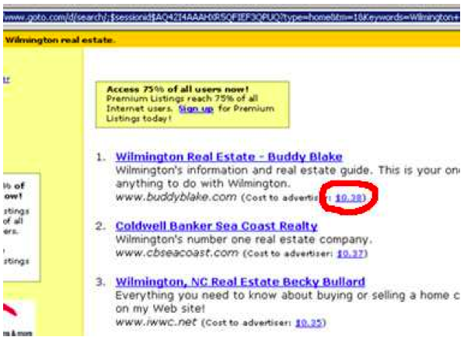
1st generation of search ads: Goto (1996)
  Buddy Blake bid the maximum ($0.38) for this search.
    paid $0.38 to Goto every time somebody clicked on it.
  No separation of ads/docs.
  Pages were simply ranked according to bid 只依競價排序
    revenue maximization 可最大化利潤
4

Slide 5
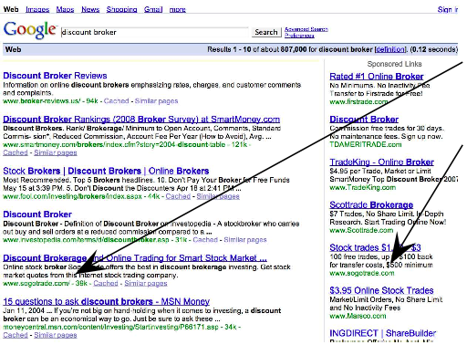
2nd generation of search ads: Google (2000)
  Strict separation of search results and search ads 廣告分離
SogoTrade appears
in search results.
SogoTrade appears
in ads.

Slide 6
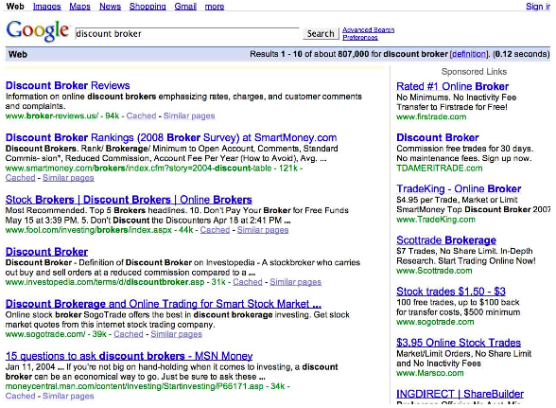
How are the ads on the right ranked?
6

Slide 7
How are ads ranked?
  Advertisers bid for keywords – sale by auction.
  Advertisers are only charged when somebody clicks on your ad. (i.e. CPC : cost per click, or CPA : cost per action)
  How does the auction determine an ad’s rank and the price paid for the ad?
    second price auction
7

Slide 8
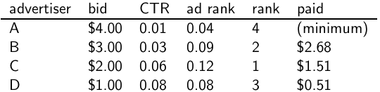
Google’s second price auction
  bid: maximum bid for a click by advertiser
  CTR: click-through rate: when an ad is displayed, what percentage of time do users click on it? CTR is a measure of relevance. 判斷相關程度
  ad rank: bid × CTR: this trades off (i) how much money the advertiser is willing to pay against (ii) how relevant the ad is
  rank: rank in auction
  paid: second price auction price paid by advertiser
8

Slide 9
Search ads: A win-win-win 創造三贏的模式
  The search engine company gets revenue every time somebody clicks on an ad.
  The user only clicks on an ad if they are interested in the ad.
    Search engines punish misleading and nonrelevant ads. 不好的廣告不會被點，自然會較少出現
    As a result, users are often satisfied with what they find after clicking on an ad.
  The advertiser finds new customers in a cost-effective way.
    only charged when click.
9

Slide 10
How to affect the left ranked (no paid) ?
10

Slide 11
Search Engine Optimization (SEO)
The alternative to paid ads.
Search Engine Optimization:
  "Tuning" your web page to rank highly in the search results for select keywords 提高搜尋排名
  Alternative to paying for placement 卻不用付錢
  Thus, is a marketing function
Performed by companies and consultants (“Search engine optimizers”) for their clients
  Some perfectly legitimate, some very shady 黑帽 / 白帽

Slide 12
Basic form of SEO (1)
First generation engines relied heavily on tf/idf
  The top-ranked pages for the query maui resort were the ones containing the most maui’s and resort’s
try dense repetitions of chosen terms
  e.g., maui resort maui resort maui resort
  Often, the repetitions would be in the non-visible part of the web page
    ex. use tiny font, or the same color as the background
  Repeated terms got indexed by crawlers, but not visible to humans on browsers

Slide 13
Basic form of SEO (2)
Variants of keyword stuffing (spam)
Misleading meta-tags, excessive repetition
Hidden text with colors, style sheet tricks, etc.
but these don't work for PageRank
Meta-Tags =
“… London hotels, hotel, holiday inn, hilton, discount, booking, reservation, sex, mp3, britney spears, viagra, …”

Slide 14
Advanced form of SEO
Doorway pages
  Pages optimized for a single keyword that re-direct to the real target page
Link spamming 造出假的連結
  hidden links, cross links
  domain flooding: numerous domains that point or re-direct to a target page
Robots 造出假的查詢
  Fake queries and promotions. (ex. Google +1)

Slide 15
Search Engine Optimization 方法簡介
網頁標題要簡短、明確、獨特，網頁描述亦然，且不要重複
避免網站下所有或大部份網頁都用同一個描述
縮短網址與層數，網址名稱有意義，避免無意義的變數
提交Sitemap給Google
在網頁底部加上一排主要導覽連結
圖片檔名也盡量使用有意義的字，並加上替代文字
經常更新
被具有影響力的網站引用

Slide 16
The war against spam
Quality signals - Prefer authority pages based on:
  Votes from authors (linkage signals)
  Votes from users (usage signals)
Policing of URL submissions
  Anti robot test
Limits on meta-keywords
Robust link analysis
  Use link analysis to detect spammers
  Ignore statistically fake linkas
Spam recognition by machine learning
  Training set based on known spam
Family friendly filters
  Linguistic analysis, general classification techniques, etc.
  For images: flesh tone detectors, source text analysis, etc.
Editorial intervention
  Blacklists
  Top queries audited
  Complaints addressed
  Suspect pattern detection

Slide 17
Web capture and spider

Slide 18
Basic crawler operation
Initialize queue with URLs of known seed pages
先有種子URL
Repeat
  Take URL from queue
  Fetch and parse page 連線抓取
  Extract URLs from page 取出URL後準備逐一加入
  Add URLs to queue
Assumption: The web is well linked.

Slide 19
Crawling picture
URLs crawled
and parsed
Unseen Web
Seed
pages
URLs frontier
Web

Slide 20
Design issues for crawler
  Distribute to scale up
  sub-select instead of crawling everything
    eliminate duplication
    prevent from spam and spider traps
  Politeness: need to be "nice" when requests for a site
  Freshness: need to re-crawl periodically.
    Prioritize the crawling tasks.
20

Slide 21
Exercise: What’s wrong with this crawler?
urlqueue := (some carefully selected set of seed urls)
while urlqueue is not empty:
myurl := urlqueue.getlastanddelete() 取出一個URL開始工作
mypage := myurl.fetch() 抓取網頁
fetchedurls.add(myurl) 加入歷史紀錄
newurls := mypage.extracturls() 取出更多連結
for myurl in newurls:
if myurl not in fetchedurls and not in urlqueue:
urlqueue.add(myurl) 若是新的連結，則再加入工作佇列
addtoinvertedindex(mypage) 處理該網頁內容
21

Slide 22
What’s wrong with the simple crawler
  Scale: we need to distribute.
  We can’t index everything: we need to subselect. How?
  Duplicates: need to integrate duplicate detection
  Spam and spider traps: need to integrate spam detection
  Politeness: we need to be “nice” and space out all requests for a site over a longer period (hours, days)
  Freshness: we need to recrawl periodically.
    Because of the size of the web, we can do frequent recrawls only for a small subset.
    Again, subselection problem or prioritization
22

Slide 23
Magnitude of the crawling problem
  To fetch 20,000,000,000 pages in one month . . .
  . . . need to fetch almost 8000 pages per second.
    Use a distributed architecture.
    Eliminate duplicates, unfetchable, spam pages.
23

Slide 24
What any crawler must do
Be Polite: Respect implicit and explicit politeness considerations for a website
  Don't hit a site too often
  Only crawl pages you are allowed to
  Respect robots.txt (more on this shortly)
Be Robust: Be immune to spider traps, duplicates, very large pages, very large websites, dynamic pages, etc.
要有逾時與錯誤處理機制

Slide 25
Robots.txt
  Protocol for giving crawlers (“robots”) limited access to a website, originally from 1994
  Examples:
    User-agent: *
    Disallow: /yoursite/temp/
    User-agent: searchengine
    Disallow: /
    User-agent: PicoSearch/1.0
    Disallow: /news/information/knight/
    Disallow: /nidcd/
25

Slide 26
What any crawler should do (1)
Be capable of distributed operation
可多台同時進行
Be scalable: designed to increase the crawl rate by adding more machines
Performance/efficiency: permit full use of available processing and network resources
儘可能的使用頻寬

Slide 27
What any crawler should do (2)
Fetch pages of "higher quality" first
Continuous operation: Continue fetching fresh copies of a previously fetched page
可持續性作業
Extensible: Adapt to new data formats, protocols 保有擴充性

Slide 28
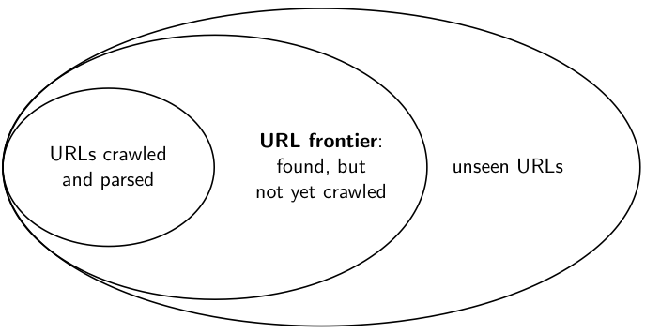
URL frontier
28

Slide 29
URLs crawled
and parsed
Unseen Web
Seed
Pages
URL frontier
Crawling thread

Slide 30
URL frontier
  The URL frontier is the data structure that holds and manages URLs we’ve seen, but that have not been crawled yet.
  Can include multiple pages from the same host
  Must avoid trying to fetch them all at the same time
  需能夠自動分散流量
  Must keep all crawling threads busy
  但又能最大限度地利用頻寬等資源
30

Slide 31
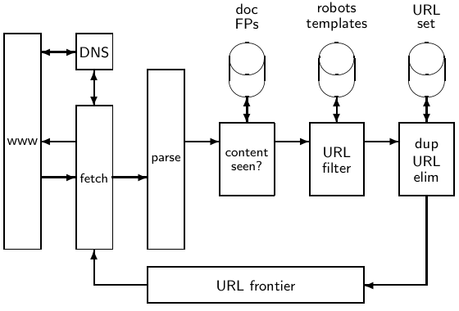
Basic crawl architecture
31

Slide 32
Processing steps in crawling
Pick a URL from the frontier with priority
Fetch the document at the URL
Parse the URL
  Extract links from it to other docs (URLs)
Check if URL has content already seen
  If not, add to indexes
For each extracted URL
  Ensure it passes certain URL filter tests (i.e. sub-select)

Slide 33
Implementation issue (1)
Crawling
  follow the links
  enumerate the HTTP/FORM parameters
    Use Chrome or HttpFox to view the 'real' parameters.
Implementation
  using HTTP API and Queue
  using site mirroring tools
    HTTrack or Teleport

Slide 34
Implementation issue (2)
Parsing
  extract all links and other information from the pages
Implementation
  using Browser API (ex. IE Control) to list the parsed URLs
    it works even for dynamic links (JavaScript)
  using String processing (ex. Regular expression)
  using HTML DOM (Document Object Model) and XPATH

Slide 35
Exercise
  use regular expression to remove html tags
    str=str.replaceAll("<{1}[^>]{1,}>{1}", "").trim();
  use regular expression to remove redundant spaces
    str=str.replaceAll(" {2}", " ").trim();
  use XPATH to extract all links from Google result page
    //ol[@id='rso']/li/div/h3/a

Slide 36
URL normalization
  Some URLs extracted from a document are relative URLs.
  E.g., at http://mit.edu, we may have aboutsite.html
    This is the same as: http://mit.edu/aboutsite.html
  During parsing, we must normalize (expand) all relative URLs.
36

Slide 37
Distributing the crawler
  Run multiple crawl threads, potentially at different nodes
    Usually geographically distributed nodes
  Partition hosts being crawled into nodes
37

Slide 38
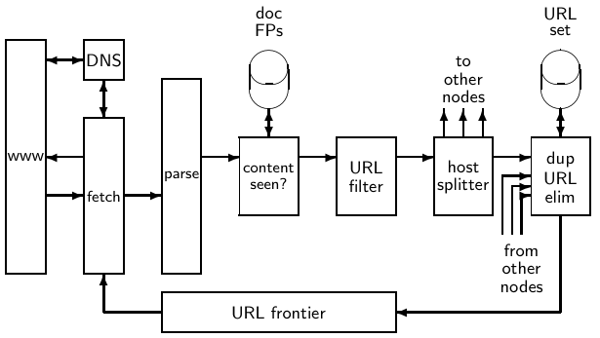
Distributed crawler
38

Slide 39
URL frontier: two main considerations
Politeness: do not hit a web server too frequently
Freshness: crawl some pages more often than others
  pages (Ex. News sites) changes often
These goals may conflict each other.
Tips
  Insert time gap between successive requests to a host
  shuffle the traffic for hosts

Slide 40
Duplicate detection

Slide 41
Duplicate detection
  The web is full of duplicated content.
  Exact duplicates
    Easy to eliminate (ex. use hash)
  Near-duplicates
    For the user, it’s annoying to get a search result with near-identical documents.
    Difficult to eliminate
  Marginal relevance is zero: even a highly relevant document becomes nonrelevant if it appears below a (near-)duplicate.
    So need to eliminate it.
41

Slide 42
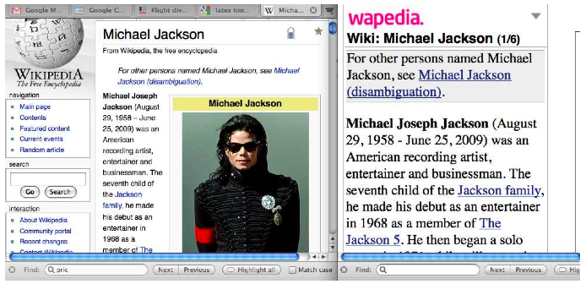
Near-duplicates: Example
42

Slide 43
Detecting near-duplicates
  Compute similarity with edit-distance, n-gram overlapping, or vector space model.
  use “syntactic” (as opposed to semantic) similarity.
    do not consider documents near-duplicates if they have the same content, but express it with different words.
  Use similarity threshold θ to judge
    E.g., two documents are near-duplicates if similarity > θ = 80%.
43

Slide 44


Recall: ngram overlapping + Jaccard coefficient
  A commonly used measure of overlap of two sets
  Let A and B be two sets
  Jaccard coefficient:
  JACCARD(A,A) = 1
  JACCARD(A,B) = 0 if A ∩ B = 0
  A and B don’t have to be the same size.
  Always assigns a number between 0 and 1.
44

Slide 45
Link analysis : anchor text

Slide 46
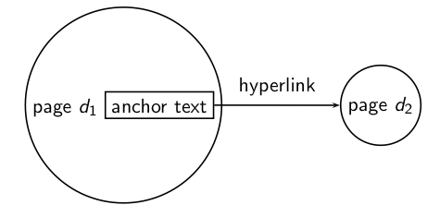
The web as a directed graph
Assumption 1: A hyperlink is a quality signal.
  The hyperlink d₁ → d₂ indicates that d₁‘s author deems d₂
  high-quality and relevant.
Assumption 2: The anchor text describes the content of d₂.
  Example: “You can find cheap cars ˂a href =http://…˃here ˂/a ˃. ”
  Anchor text: “You can find cheap cars here”
46

Slide 47
Anchor text
Searching on [text of d₂] + [anchor text → d₂] is often
more effective than searching on [text of d₂] only.
For query IBM, how to distinguish between: McBryan [Mcbr94]
  IBM’s home page (mostly graphical)
  IBM’s copyright page (high term freq. for ‘ibm’)
  Rival’s spam page (arbitrarily high term freq.)
“ibm”
“ibm.com”
“IBM home page”
A million pieces of anchor text with “ibm” send a strong signal
www.ibm.com

Slide 48
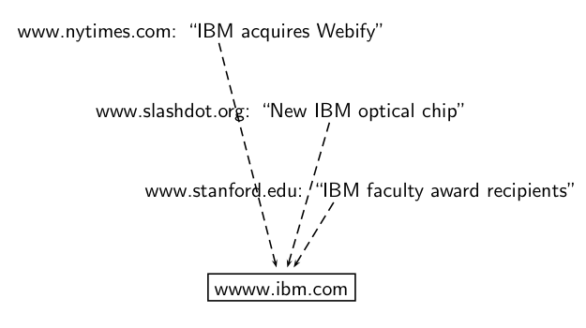
Anchor text containing IBM pointing to www.ibm.com
48

Slide 49
Indexing anchor text
When indexing a document D, include anchor text from links pointing to D.
Anchor text can be weighted more highly than document text.
Armonk, NY-based computer
giant IBM announced today
www.ibm.com
Big Blue today announced
record profits for the quarter
Joe’s computer hardware links
Compaq
HP
IBM

Slide 50
Anchor Text
Other applications
  Weighting/filtering links in the graph
    HITS [Chak98], Hilltop [Bhar01]
  Generating page descriptions from anchor text [Amit98, Amit00]

Slide 51
Link analysis

Slide 52
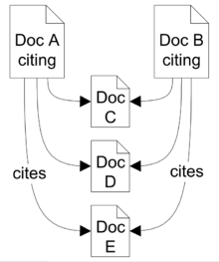
Origins of PageRank: Citation analysis (1)
Citation analysis: analysis of citations in the scientific literature.
Co-citation analysis and Bibliographic coupling analysis
  articles that are cited together are related. Ex. C, D, E
  articles that co-cite the same articles are related . Ex. A, B
Citation analysis works for scientific literature,
patents, web pages, and directed documents.
  Google use co-citation similarity on the
  web for "find pages like this" feature.
52

Slide 53
Origins of PageRank: Citation analysis (2)
Citation frequency can be used to measure the impact of an article .
  Ex. Google Scholar, CiteSeer
On the web: citation frequency = inlink count
  Simplest measure: Each article gets one vote
  A high inlink count mean high quality.
  … but not very accurate because of link spam.
Better measure: weighted citation frequency or citation rank
  An article’s vote is weighted according to its citation impact.
  Ex. NY Times inlink is much more important than a nobody's inlink.
53

Slide 54
Origins of PageRank: Citation analysis (3)
Weighted citation frequency or citation rank is basically PageRank
  invented in the context of citation analysis by Pinsker and Narin in the 1960s.
  Google uses it and other heuristics for web page ranking.
    (independent from query)
54

Slide 55
Link analysis : hub and authority

Slide 56
Hits – Hyperlink-Induced Topic Search
Premise: there are two different types of relevance on the web.
Relevance type 1: Hubs. A hub page is a good list of links to pages answering the information need.
  E.g, for query [chicago bulls]: Bob’s list of recommended resources on the Chicago Bulls sports team
Relevance type 2: Authorities. An authority page is a direct answer to the information need.
  The home page of the Chicago Bulls sports team
  By definition: Links to authority pages occur repeatedly on hub pages.
Most approaches to search (including PageRank ranking) don’t make the distinction between these two very different types of relevance.
56

Slide 57
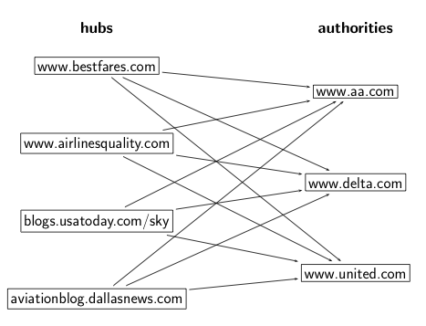
Hubs and authorities : definition
A good hub page for a topic links to many authority pages for that topic.
A good authority page for a topic is linked to by many hub pages for that topic.
Example :
57

Slide 58
How to compute hub and authority scores
Do a regular web search first
  Call the search result the root set
Find all pages that are linked to or link to pages in the root set
  Call it as the base set
Finally, compute hubs and authorities from the base set
58

Slide 59
Root set and base set
base set
root set

Slide 60
Hub and authority scores
Root set typically has 200-1000 nodes, and base set may have up to 5000 nodes
Compute for each page d in the base set a hub score h(d) and an authority score a(d)
Initialization: for all d: h(d) = 1, a(d) = 1
Iteratively update all h(d), a(d)
After convergence:
  Output pages with highest h scores as top hubs
  Output pages with highest a scores as top authorities
60

Slide 61
Discussions

