Slide 1
Lecture 7 : Web Search & Mining (1)
楊立偉教授
台灣科大資管系
wyang@ntu.edu.tw
本投影片修改自Introduction to Information Retrieval一書之投影片 Ch 19

Slide 2
Web Search : Overview

Slide 3
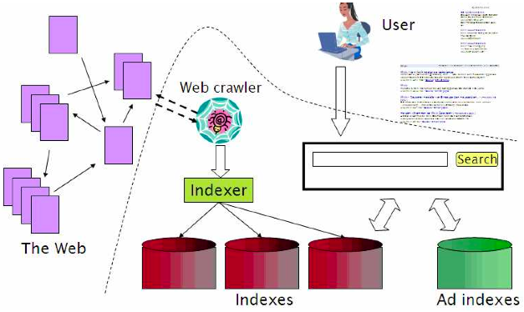
Web search overview
3

Slide 4
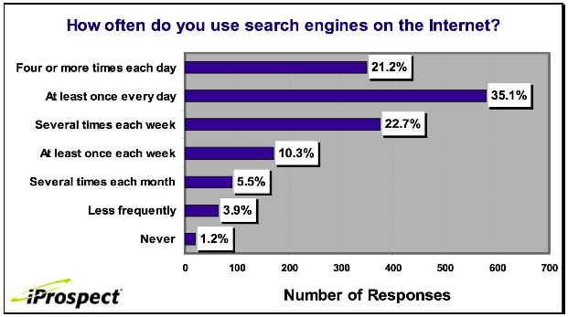
Search is the top activity on the web
4

Slide 5
Without search engines, the web wouldn’t work
Without search, content is hard to find.
→ Without search, there is no incentive to create content.
Why publish something if nobody will read it?
Why publish something if I don’t get ad revenue from it?
Somebody needs to pay for the web.
Servers, web infrastructure, content creation
A large part today is paid by search ads.
Search pays for the web.
5

Slide 6
Interest aggregation
Unique feature of the web: A small number of geographically dispersed people with similar interests can find each other.
Elementary school kids with hemophilia 血友病
Search engines are a key enabler for interest aggregation.
6

Slide 7
IR on the web vs. IR in general
On the web, search is not just a nice feature.
Search is a key enabler of the web: . . .
. . . financing, content creation, interest aggregation etc.
→ look at search ads
The web is a chaotic and uncoordinated collection. → lots of duplicates – need to detect duplicates
No control / restrictions on who can author content → lots of spam – need to detect spam
The web is very large. → need to know how big it is
7

Slide 8
Web IR vs. Classical IR

Slide 9
Basic assumptions of Classical IR
傳統 IR 兩大特點
Corpus : Fixed document collection
有固定的文件集合
Goal: Retrieve documents with information content that is relevant to user's information need
有特定目標→目標是要找到與需求相關的內容

Slide 10
Classic IR Goal
Classic relevance
For each query Q and stored document D in a given corpus assume there exists relevance Score(Q, D)
Score is average over users U and contexts C
Optimize Score(Q, D) as opposed to Score(Q, D, U, C)
傳統IR強調[Q查詢]與[D文件], 較少看[U使用者]與[C上下文]
That is, usually:
Context ignored
Individuals ignored
Corpus predetermined
Bad assumptions
in the web context

Slide 11
Classic IR Goal (續)
However, In Web IR :
查詢所提供的資訊更少; 文件的多樣性更大; 服務的人更多
因此要跟上下文有關→Apple是水果還是電腦公司？
因此要跟誰來查有關→Rock是音樂家還是地質學家來查？
語料與文件集合是會變動與成長的

Slide 12
Recap : Web search
12

Slide 13
User Needs 使用者需求
Need [Brod02, RL04] 兩篇研究結果分別為：
Informational – want to learn about something (~40% / 65%)
Navigational – want to go to that page (~25% / 15%)
Transactional – want to do something (web-mediated) (~35% / 20%)
Access a service
Downloads
Shop
Gray areas
Find a good hub
Exploratory search : see what is there” 試試看能找出什麼
Low hemoglobin 低血紅素
United Airlines 聯合航空
Seattle weather 西雅圖天氣
Mars surface images 火星表面照片
Canon S410 某款數位相機
Car rental Brasil 巴西租車

Slide 14
Web search users 使用者行為特性
Make ill-defined queries
Short 查詢很短 [Silv98]
AV 2001: 2.54 terms avg, 80% < 3 words
AV 1998: 2.35 terms avg, 88% < 3 words
Imprecise terms 用詞不精確
Sub-optimal syntax (most queries without operator) 不(會)用查詢運算元
Low effort 懶
Wide variance in
Needs 需求不同
Expectations 期望不同
Knowledge 知識背景不同
Bandwidth 用的頻寬有快有慢
Specific behavior
85% look over one result screen only (mostly above the fold)
大多只看第一頁結果
78% of queries are not modified (one query/session) 大多不懂得修改查詢
Follow links – "the scent of information"
很容易跟著link就跑了

Slide 15
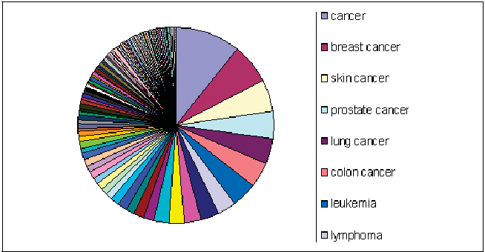
Query Distribution – long tail 長尾
Power law: few popular broad queries, many rare specific queries.
Notes:
prostate 攝護腺 colon cancer 直腸癌 leukemia 白血病 lymphoma 淋巴瘤

Slide 16
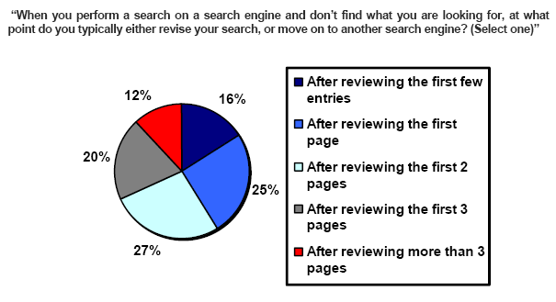
How far do people look for results?
會看超過3頁
(Source: iprospect.com WhitePaper_2006_SearchEngineUserBehavior.pdf)

Slide 17
True example*
Noisy building fan in courtyard 大樓中庭風扇很吵
TASK
Mis-conception
Info Need
Info about EPA regulations
Mis-translation
Verbal form
What are the EPA rules about noise pollution 噪音條例
Mis-formulation
Query
EPA sound pollution
SEARCH ENGINE
Polysemy 一詞多義
Synonimy 一義多詞 (同義詞)
Query Refinement
Results
Corpus
* To Google or to GOTO, Business Week Online, September 28, 2001

Slide 18
Users' empirical evaluation of results (1)
Quality of pages varies widely
Relevance is not enough 光用相關性還不夠
Other desirable qualities
內容 Content: Trustworthy, new info, non-duplicates, well maintained,
可讀性高 Web readability: display correctly & fast
去掉雜訊 No annoyances: pop-ups, etc

Slide 19
Users' empirical evaluation of results (2)
Precision vs. recall
On the web, recall seldom matters 召回率變成不重要
What matters
Precision at 1? Precision above the fold ? 上半頁都正確
Comprehensiveness – deal with obscure queries 語意不清的查詢
Recall matters when the number of matches is very small
User perceptions may be unscientific, but are significant over a large aggregate 使用者的感受最重要
Notes:
obscure 模糊的

Slide 20
Users' empirical evaluation of engines
Relevance and validity of results 相關且正確的結果
UI – Simple, no clutter, error tolerant 界面清爽
Trust – Results are objective 可信的結果
Coverage - for poly-semic queries 包含一詞多義的主題
Pre/Post process tools provided 提供前後處理
Mitigate user errors (ex. auto spell check) 修正使用者錯誤
Explicit: Search within results, more like this… 進一步查詢
Anticipative: related searches 猜測使用者意向
Deal with characteristics of web behavior 針對Web特性
Web specific vocabulary : 特殊或網路慣用語
Web addresses typed in the search box 以網址搜尋

Slide 21
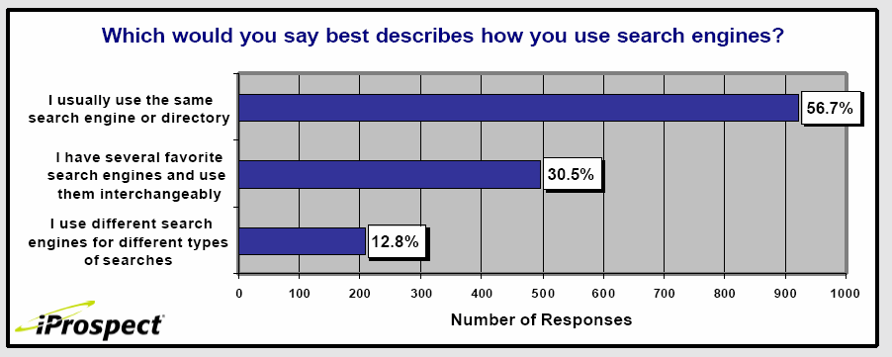
Loyalty to a given search engine

Slide 22
The Web corpus
No design/co-ordination 未事先設計或協調
Distributed content creation, linking, democratization of publishing 分散、開放
Content includes truth, lies, obsolete information, contradictions … 真假新舊交參
Unstructured (text), semi-structured (html, annotated photos), structured (databases)… 同時有多種類型的內容
Scale much larger 規模大
Growth – slowed down but still expanding 會成長
Content can be dynamically generated 動態內容
The Web

Slide 23
The Web: Dynamic content
A page without a static html version
Usually, assembled at the time of a request from a browser
Typically, URL has a '?' character in it 有帶URL參數的
Spiders commonly view web pages just as a browser
? id=XXXX
Application server
Browser
Back-end
databases

Slide 24
The web: size
What is being measured?
Number of hosts
Number of (static) html pages
Volume of data
Number of hosts – netcraft survey
Monthly report on how many web hosts & servers are out there
http://news.netcraft.com/archives/web_server_survey.html
Number of pages – numerous estimates
will discuss later

Slide 25
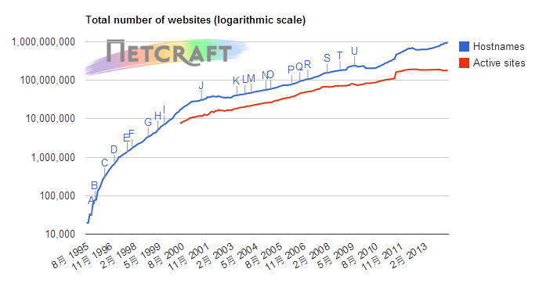
Netcraft Web Server Survey (1)

Slide 26
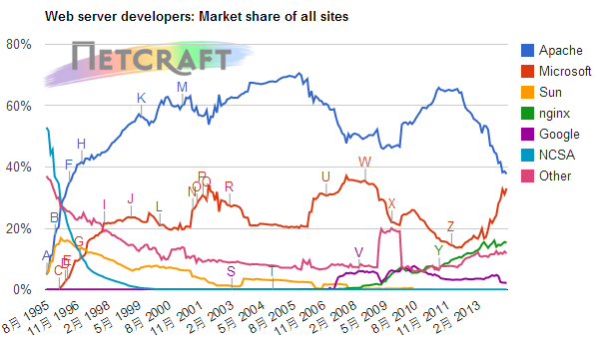
Netcraft Web Server Survey (2)

Slide 27
The web: evolution
All of these numbers keep changing
Relatively few scientific studies of the evolution of the web [Fetterly & al, 2003]
http://research.microsoft.com/research/sv/sv-pubs/p97-fetterly/p97-fetterly.pdf
Sometimes possible to extrapolate from small samples (fractal models) [Dill & al, 2001] 用外推法估計
http://www.vldb.org/conf/2001/P069.pdf

Slide 28
Rate of change
[Cho00] 720K pages from 270 popular sites sampled daily from Feb 17 – Jun 14, 1999
Any changes: 40% weekly, 23% daily
[Fett02] Massive study 151M pages checked over few months
Significant changed -- 7% weekly
Small changes – 25% weekly
[Ntul04] 154 large sites re-crawled from scratch weekly
8% new pages/week
8% die
5% new content
25% new links/week

Slide 29
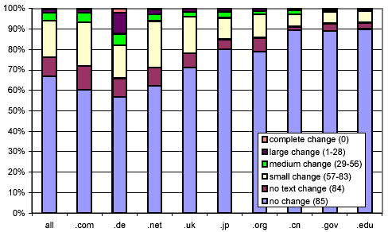
Static pages: rate of change
Fetterly et al. study (2002): several views of data, 150 million pages over 11 weekly crawls
Bucketed into 85 groups by extent of change

Slide 30
Other characteristics
Significant duplication 重複的很多
Syntactic – 30%-40% (near) duplicates [Brod97, Shiv99b, etc.]
Semantic – not known yet 尚未有語義上的重複統計
High linkage 連結性高
More than 8 links/page in the average
Complex graph topology
Not a small world ; bow-tie structure [Brod00] 蝴蝶結結構
Spam
Billions of pages 數十億垃圾網頁

Slide 31
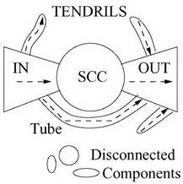
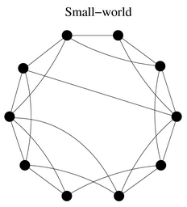
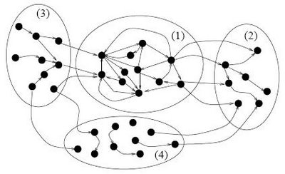
Ex. Small world network
Ex. Bow-tie structure
Notes:
小世界網路 : 大部份節點不相連, 但平均路徑卻短
蝴蝶結結構 : core部份嚴格, 限制多, 效率高; 其它部份鬆散; 島間靠少部份做連結

Slide 32
More topics
Web capture and spider
Link analysis
Duplicate detection
Ads and search engine optimization

