Slide 1
Lecture 1 : Full-text Indexing
楊立偉教授
台灣科大資管系
wyang@ntu.edu.tw
本投影片修改自Introduction to Information Retrieval一書之投影片 Ch 1 & 2

Slide 2
Definition of information retrieval
Information retrieval (IR) is finding material (usually documents) of
an unstructured nature (usually text) that satisfies an information
need from within large collections (usually stored on computers).
2

Slide 3
Boolean retrieval
The Boolean model is arguably the simplest model to base an information retrieval system on.
Queries are Boolean expressions, e.g., CAESAR AND BRUTUS
The search engine returns all documents that satisfy the
Boolean expression.
3

Slide 4
Inverted Index

Slide 5
Unstructured data in 1650
Which plays of Shakespeare contain the words
BRUTUS AND CAESAR, but not CALPURNIA ?
One could grep all of Shakespeare’s plays for BRUTUS and CAESAR, then strip out lines containing CALPURNIA
Why is grep not the solution?
Slow (for large collections)
grep is line-oriented, IR is document-oriented
“NOT CALPURNIA” is non-trivial
Other operations (e.g., find the word ROMANS near COUNTRYMAN ) not feasible
5

Slide 6
Term-document incidence matrix
 | Anthony and Cleopatra | Julius Caesar | The Tempest | Hamlet | Othello | Macbeth . . .
ANTHONY BRUTUS CAESAR CALPURNIA CLEOPATRA MERCY WORSER . . . | 1 1 1 0 1 1 1 | 1 1 1 1 0 0 0 | 0 0 0 0 0 1 1 | 0 1 1 0 0 1 1 | 0 0 1 0 0 1 1 | 1 0 1 0 0 1 0
Entry is 1 if term occurs. Example: CALPURNIA occurs in Julius Caesar. Entry is 0 if term doesn’t occur. Example: CALPURNIA
doesn’t occur in The tempest.
6

Slide 7
Incidence vectors
So we have a 0/1 vector for each term.
To answer the query BRUTUS AND CAESAR AND NOT CALPURNIA:
Take the vectors for BRUTUS, CAESAR AND NOT CALPURNIA
Complement the vector of CALPURNIA
Do a (bitwise) and on the three vectors
110100 AND 110111 AND 101111 = 100100
7

Slide 8
0/1 vector for BRUTUS
 | Anthony and Cleopatra | Julius Caesar | The Tempest | Hamlet | Othello | Macbeth . . .
ANTHONY BRUTUS CAESAR CALPURNIA CLEOPATRA MERCY WORSER . . . | 1 1 1 0 1 1 1 | 1 1 1 1 0 0 0 | 0 0 0 0 0 1 1 | 0 1 1 0 0 1 1 | 0 0 1 0 0 1 1 | 1 0 1 0 0 1 0
result: | 1 | 0 | 0 | 1 | 0 | 0
答案是Antony and Cleopatra與Hamlet
8

Slide 9
Bigger collections
Consider N = 10⁶ documents, each with about 1000 tokens
⇒ total of 10⁹ tokens (10億)
average 6 bytes per token, including spaces / punctuation
⇒ size of document collection is about 6 ・ 10⁹ = 6 GB
Assume there are M = 500,000 distinct terms in the collection
9

Slide 10
Can’t build the incidence matrix
M = 500,000 × 10⁶ = half a trillion 0s and 1s. (5000億)
But the matrix has no more than 10⁹ 1s.
Matrix is extremely sparse. (only 10/5000 has values)
What is a better representations?
We only record the 1s.
10

Slide 11
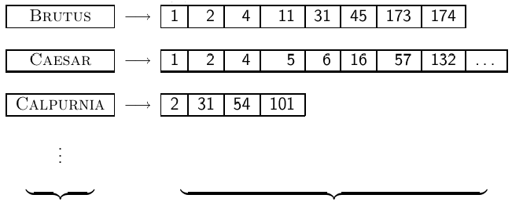
Inverted Index
For each term t, we store a list of all documents that contain t.
dictionary (sorted) postings
11

Slide 12
Inverted Index
Linked lists generally preferred to arrays
優點 Dynamic space allocation
優點 Insertion of terms into documents easy
缺點 Space overhead of pointers

Slide 13
Inverted Index construction
Documents to
be indexed.
Friends, Romans, countrymen.
Tokenizer
Token stream.
Friends
Romans
Countrymen
Linguistic modules
之後會討論
friend
roman
countryman
Modified tokens.
正規化…等處理
Indexer
friend
2
4
roman
1
2
Inverted index.
countryman
13
16

Slide 14
(1) Tokenizing and preprocessing
14

Slide 15
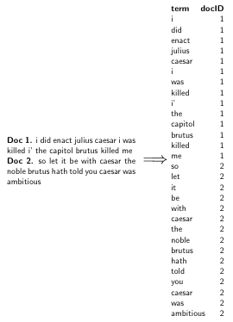
(2) Generate posting
15

Slide 16
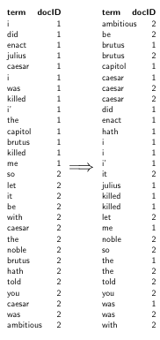
(3) Sort postings
Sorting by docID is important
16

Slide 17
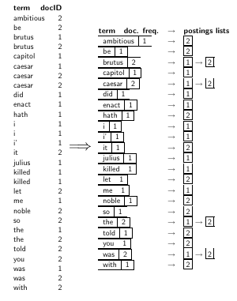
(4) Create postings lists
Group by term and docID
Get the document frequency
17

Slide 18
(5) Split the result into dictionary and postings
dictionary postings
18

Slide 19
Processing Boolean queries

Slide 20
Simple conjunctive query (two terms)
Consider the query: BRUTUS AND CALPURNIA
To find all matching documents using inverted index:
Locate BRUTUS in the dictionary
Retrieve its postings list from the postings file
Locate CALPURNIA in the dictionary
Retrieve its postings list from the postings file
Intersect the two postings lists
Return intersection to user
20

Slide 21
Intersecting two posting lists
This is linear in the length of the postings lists.
→ If the list lengths are x and y, the merge takes O(x+y)
Note: This only works if postings lists are sorted.
21

Slide 22
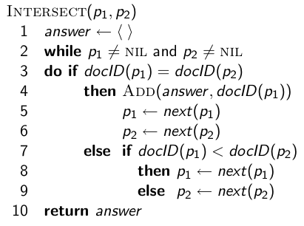
Intersecting two posting lists
22

Slide 23
Query processing: Exercise
Compute hit list for ((paris AND NOT france) OR lear)
23

Slide 24
Boolean queries
The Boolean retrieval model can answer any query that is a Boolean expression.
Boolean queries are queries that use AND, OR and NOT to join
query terms. 可包含括號
Views each document as a set of terms. 依集合理論
Is precise: Document matches condition or not.
Primary commercial retrieval tool for 3 decades
Professional searchers (e.g., lawyers) like Boolean queries.
You know exactly what you are getting.
24

Slide 25
Westlaw: Example queries
Largest commercial (paying subscribers) legal search service since 1975; Tens of terabytes of data; 700,000 users
Information need: legal theories involved in preventing the disclosure of trade secrets by employees
Query: “trade secret” /s disclos! /s prevent /s employe!
Information need: Requirements for disabled people to be able to access a workplace
Query: disab! /p access! /s work-place (employment /3 place)
25

Slide 26
Westlaw: Comments
Proximity operators: /3 = within 3 words, /s = within a sentence, /p = within a paragraph
Why professional searchers often like Boolean search: precision, transparency, control
Long, precise queries: incrementally developed
(not like web search)
26

Slide 27
Query optimization

Slide 28
Problem
Given an Boolean formula?
(Brutus OR Caesar) AND NOT (Antony OR Cleopatra)
How to get the answer ?
process from the left, or from the right
"NOT"
How to do it faster?

Slide 29
Query optimization
Consider a query that is an and of n terms, n > 2
For each of the terms, get its postings list,
then and them together
Example query: BRUTUS AND CALPURNIA AND CAESAR
What is the best order for processing this query?
29

Slide 30
Query optimization
Example query: BRUTUS AND CALPURNIA AND CAESAR
Simple and effective optimization: Process in order of increasing frequency
Start with the shortest postings list, then keep cutting further
In this example, first CAESAR, then CALPURNIA, then BRUTUS
30

Slide 31
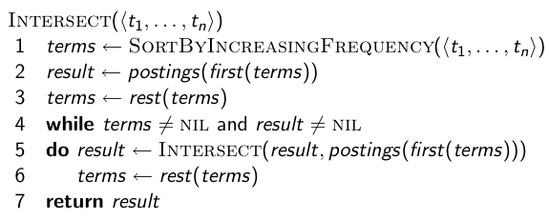
Optimized intersection algorithm
每次做最短的，其餘以遞迴處理
31

Slide 32
More general optimization
Example query: (tangerine OR trees) AND (marmalade OR skies)
Get frequencies for all terms
Estimate the size of the answer
or : get the sum of its frequencies
and : get the min. value of its frequencies
Process in increasing order of or sizes
32

Slide 33
Exercise
Recommend a query processing order for
(tangerine OR trees) AND
(marmalade OR skies) AND
(kaleidoscope OR eyes)
Notes:
kaleidoscope 萬花筒 marmalade 果醬

Slide 34
Excerise

Slide 35
Inverted indexing (1)
傳回查詢結果為Doc1

Slide 36
Inverted indexing (2)
當文件讀入完畢，或是記憶體不夠時，必需寫入磁碟（序列化）

Slide 37
Inverted indexing (3) Design issue
為了很快跳至某個term list，於檔案起始處增加Dictionary index
實作設計
自行寫入Dictionary與term list，並於新增修改時做維護 (需做defragment)
採用Persistent Dictionary套件

Slide 38
Inverted Indexing (4) Compression
能否節省索引空間？
略去不重要的 term (ex. stop words)
Compression
用時間換取空間，若CPU資源過多，且較磁碟存取快，
則壓縮有利提升整體系統速度
目前磁碟傳輸都是透過system bus完成，
因此CPU是可以在磁碟傳輸時另外做些事的
Compression 1: dictionary中較常用的 term 用較少的 bit 來表示
main idea: frequency v.s. variable-length
Compression 2: term list內的位置改存offset

Slide 39
Conclusion
Why is Search engine much faster than Relational database ?
Relational database : row-oriented and B-tree index
Search engine : column-oriented (i.e. term) and Inverted index
Inverted index is much faster than B-tree index
any limitation ?

