Slide 1
Domestic Violence, Parenting, and Behavior Outcomes of Children
Chien-Chung Huang
Rutgers University

Slide 2
Introduction
Domestic violence is serious social programs, as its negative impact on both victim and members of her/his family, especially on children
Studies have show the effects not only have immediately impacts but also have long- term effects. E.g. Abuse as a risk factor for sleep problems in adulthood

Slide 3
How serious of domestic violence?
Prevalence: Sample largely from non-representative, welfare-, and/or low-income samples
Lifetime prevalence: 34% to 65%, with most rates in the 50% to 60% range
Current prevalence: 8% to 33%, with most rates in 20% to 30% range
Factors: age, race, education, employment, social support, and marital status

Slide 4
Limitation on Literature
Sample not representative
Majority of studies focus solely on physical abuse without assessing the impact of other forms of domestic violence such as psychological and economic abuse
Some studies that include measures of other forms of abuse often report the results collectively, without distinguishing the significance of each form of violence, or their interaction

Slide 5
Domestic Violence: Unmarried Mothers
Fragile Families and Child Well-Being Study, a recent and representative data
Overall prevalence (Year 1 to Year 3): 16.3% -> 20.2%
Physical violence: 5.0% -> 7.4%
Psychological & economic: 13.2% -> 16.2%
Sexual abuse: 4.1% -> 5.8%
A serious social program

Slide 6
Domestic Violence during Pregnancy
Studies found that about 4-8% of pregnant women experience some form(s) of IPV (including physical, psychological and sexual abuse), ranged from 1 to 20%
Based on Fragile Families data:
Physical abuse: 6%
Psychological abuse: 29%

Slide 7
Effects of Domestic Violence
Studies have shown physical violence has negative effects on maternal mental health and parenting skills (e.g. unable to provide warmth and engage with children)
How about psychological abuse and economic abuse?

Slide 8
Violence During Pregnancy
Overall Maternal health: emotional abuse significantly and negatively affected mother’s health, while physical abuse had nonsignificant effects
Maternal Depression: both physical and emotional abuse significantly increased the chance of depression
Physical abuse increased the odds by 56%, and emotional abuse increased the odds by 34%

Slide 9
Violence During Pregnancy
Overall Child health: both physical and emotional abuse were significant and negative predictors
Child temperament: emotional abuse significantly affected child temperament, while physical abuse has no effects
Emotional and psychological abuse is important factor of well-being

Slide 10
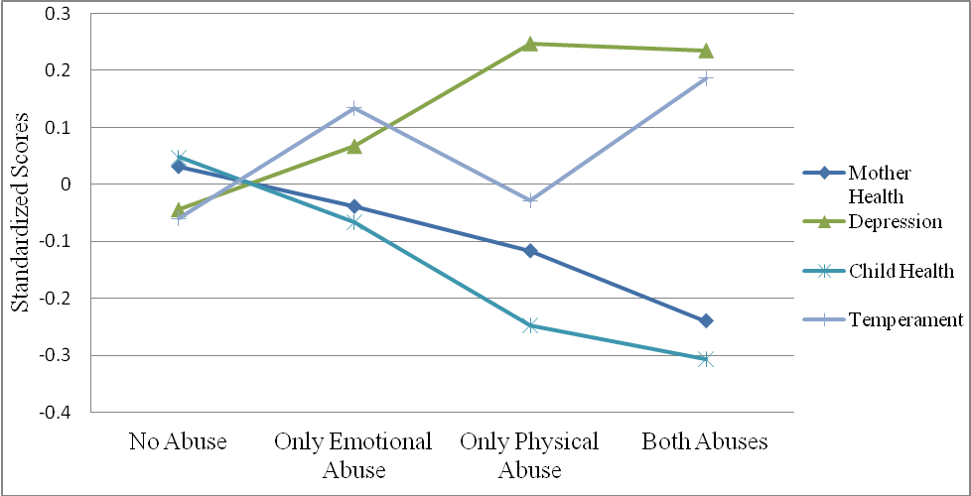
Joint Effects of physical and emotional abuse

Slide 11
Violence During Pregnancy
Emotional abuse was significantly associated with poorer outcomes in all four areas, combined with the fact that 29% of mothers reported emotional abuse, this finding highlights the urgent need to more fully understand of the effects
Physical abuse was negatively associated with two outcomes, maternal depression and child’s health, with bigger effects than emotional abuse in these areas

Slide 12
Violence During Pregnancy
Joint effects of physical and emotional abuse were more negative than individual abuse
Findings suggest that occurrence and accumulation of abuse are important factors to consider when working with pregnant women

Slide 13
Young Kids?
Sample: Follow one-year-old kids to five-year-old. Mothers and fathers were involved at Year 1.
Psychological Abuse and economic abuse have strong effects on maternal depression, and parenting behavior such as engagement with children and using spanking

Slide 14
Young Kids?

Slide 15
Young Kids?

Slide 16
Young Kids?
Both level and change of economic, psychological, and physical violence between Year 1 and Year 3 matter
Mothers experienced increase of economic, psychological, and physical violence between Year 1 and 3 had poor mental health, engaged less with their children, and more likely to use spanking to discipline their kids

Slide 17
Children Behavior Problems

Slide 18
Children Behavior Problems
Domestic violence at Year 1 had direct effects on children’s externalizing and internalizing behavior problems at Year 5
These results suggest that there are long-term effects of domestic violence on the behavior problems of preschool-aged children and that early interventions are needed to prevent later problems

Slide 19
Long-Term Effects
Outcomes at Year 5 are linked to later achievement and problems in later and adulthood
Outcomes of children in kindergarten are good predictors of third grade performance, that good indicators of high-school and later achievement.
Abuse in childhood linked to later behavior problems

Slide 20
Discussion
Domestic violence is a serious social problem, that have long term effects on victims and their family members
Understanding different forms of violence, physical, psychological, and economic abuse, and their effects are important as they have different prevalence and effects on the outcomes

Slide 21
Discussion
Screening tools must be carefully constructed not only to assess whether abuse is occurring, but to collect further information about the co-occurrence with other forms of abuse, which may assist practitioners on the potential risk.
Interventions need to take into account the variable ways in which abuse manifests itself both with frequency and type

