Slide 1
國人生理年齡與 五項肥胖指標的關聯性 Associations of five obesity metrics with epigenetic age acceleration
台大公衛學院流預所林菀俞副教授
Wan-Yu Lin, Ph.D
Institute of Epidemiology and Preventive Medicine, College of Public Health, National Taiwan University
Web: http://homepage.ntu.edu.tw/~linwy/

Slide 2
實際年齡 Chronological age

Slide 3
年紀相仿，他/她為何看起來比較年輕？
若有詩書藏於心，歲月從不敗美人 《抱得美人歸》

Slide 4
生理年齡 Biological age
染色體頂端的「端粒」(telomere)長度 => 抽血進行 DNA 檢測
Phenotypic age => 抽血驗腎功能指標 (creatinine)、肝功能指標 (albumin) 、代謝功能指標 (fasting glucose) 等
Methylation age => 抽血驗特定基因位點的甲基化程度

Slide 5
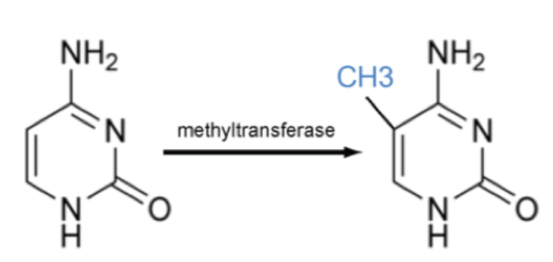
甲基化
胞嘧啶（cytosine, C），組成DNA的四種基本鹼基之一
http://www.ks.uiuc.edu/Research/methylation/

Slide 6
DNA 甲基化
可能弱化基因表現，進而使其失去功能
能在不改變 DNA 序列的前提下，改變遺傳表現

Slide 7
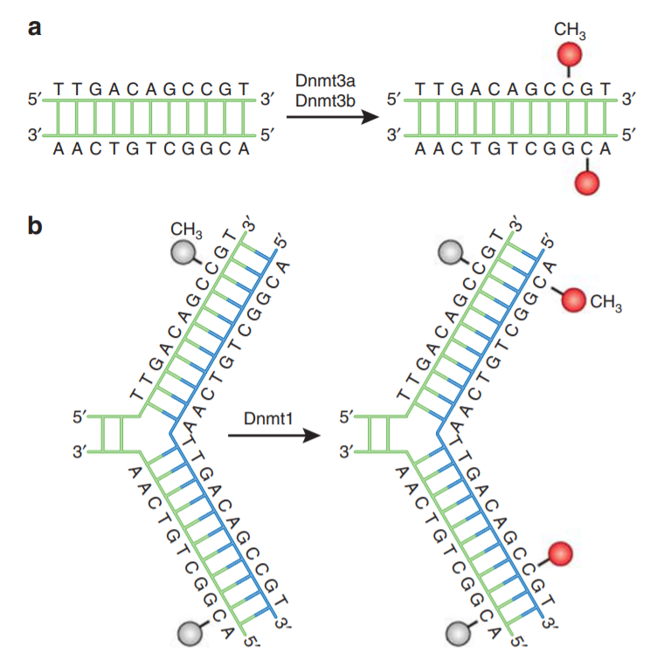

Slide 8
Taiwan Biobank (TWB)
From 2012 to 2020, TWB has recruited 122,071 community-based volunteers
Ages: 30-70
During 2016-2021, TWB researchers randomly selected 2,474 TWB participants and submitted their blood samples for DNAm quantification.
Illumina Infinium MethylationEPIC BeadChip (Illumina, Inc., San Diego, CA)
~860,000 CpG sites

Slide 9
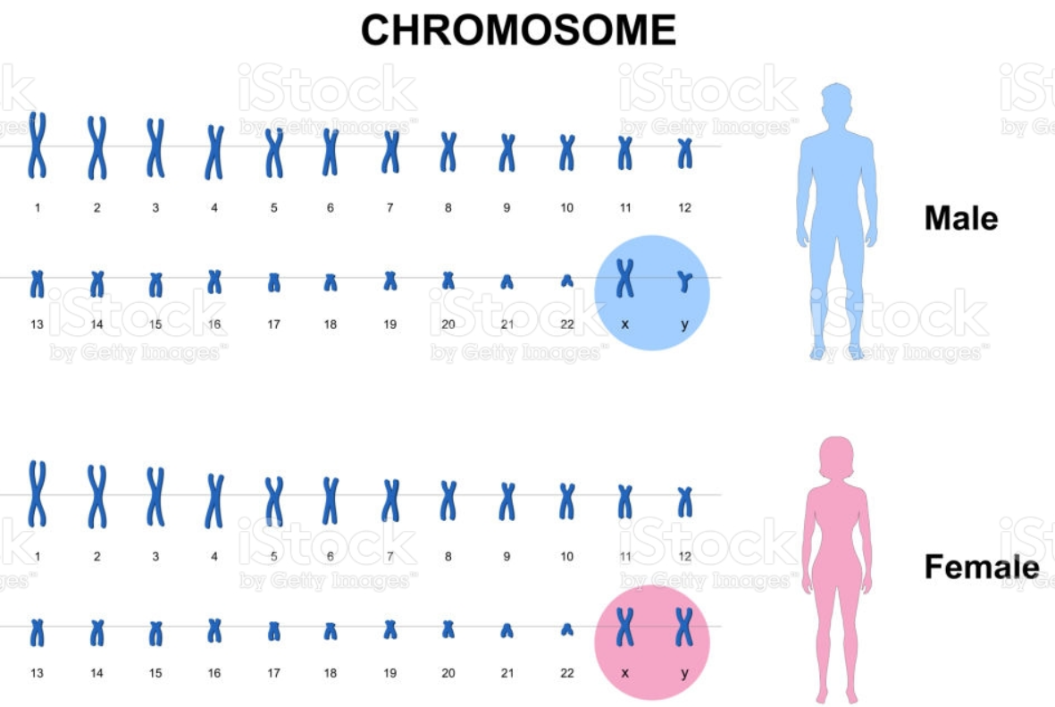

Slide 10
PhenoAge
The third National Health and Nutrition Examination Survey (NHANES III)
Levine et al. (Aging, 2018) used a Cox regularized regression model to regress the hazard of aging-related mortality on 42 clinical markers and chronological age

Slide 11
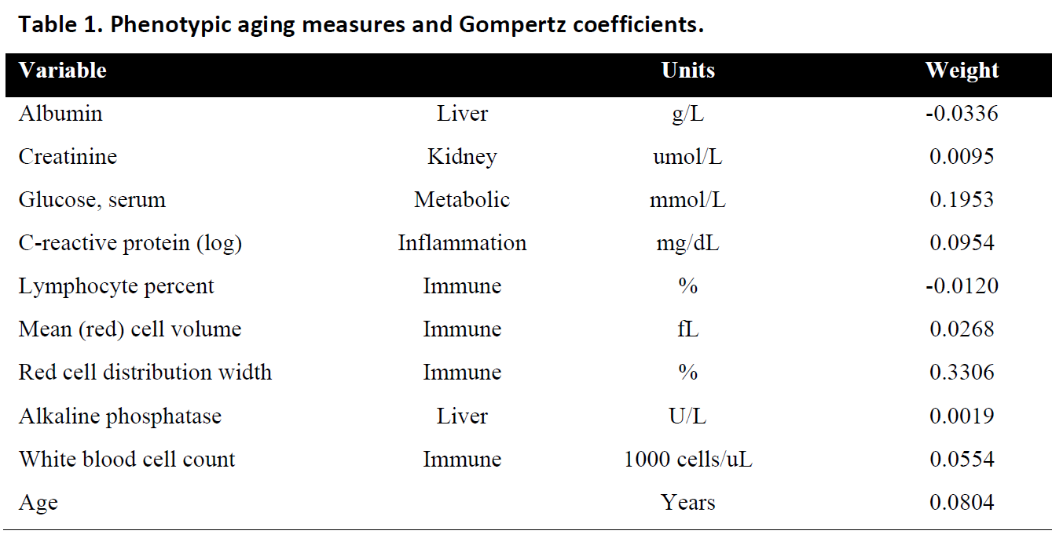
Levine et al. (Aging, 2018)
513 CpG sites

Slide 12
磷酸
5'—C—phosphate—G—3'
By Helixitta - Own work, CC BY-SA 4.0, https://commons.wikimedia.org/w/index.php?curid=47075331
基因內CpG位點的甲基化會改變此基因的表達

Slide 13
Among the 513 CpGs, 226 (44.1%) were significantly associated with chronological age in the TWB (p < 0.05/513 = 9.7×10⁻⁵).
CpG = Age + sex + BMI + smoking + drinking + …

Slide 14
Among the 513 CpGs, 226 (44.1%) were significantly associated with chronological age in the TWB (p < 0.05/513 = 9.7×10⁻⁵).
Among the 226 CpGs, 223 (98.7%) exhibited the same direction of the correlations shown by Levine et al.
This suggests that many of the 513 aging-related CpGs identified by Levine et al. can be well replicated in the TWB.
Among the 513 CpGs, 102 (19.9%) showed different directions from the correlations of Levine et al.
However, 89 of these 102 sites (87.3%) were not significantly associated with chronological age in the TWB (p > 0.05).

Slide 15
$PhenoAge={\hat{α}}_{0}+\sum_{j=1}^{513}{{\hat{α}}_{j}X_{j}}$
${\hat{α}}_{0}=60.664,{ \hat{α}}_{1}=63.124$, etc.
$X_{j}: β$-value according to $\frac{M}{M+U}$, where M is the methylated intensity and U is the unmethylated intensity. Therefore, $β$-values ranged from 0 to 1.

Slide 16
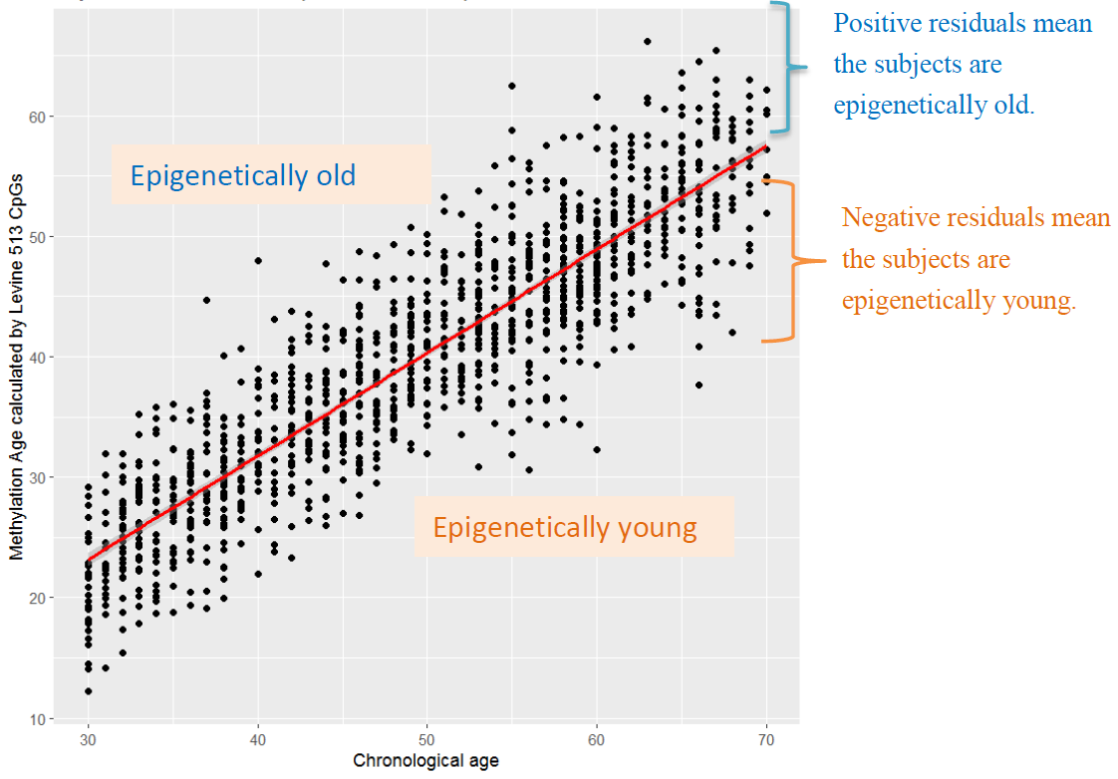

Slide 17
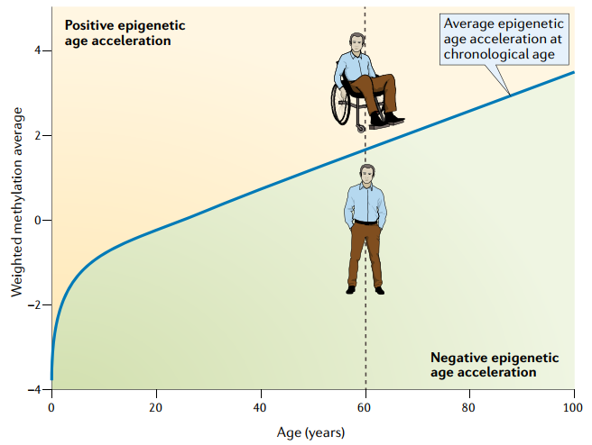

Slide 18
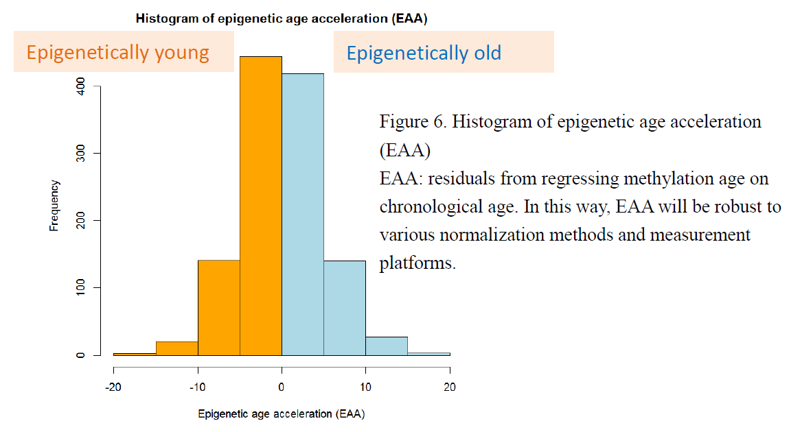

Slide 19
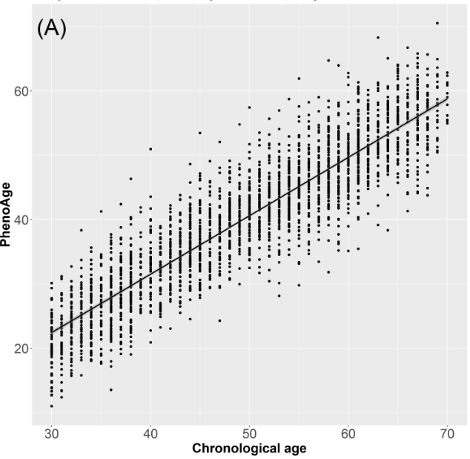

Slide 20
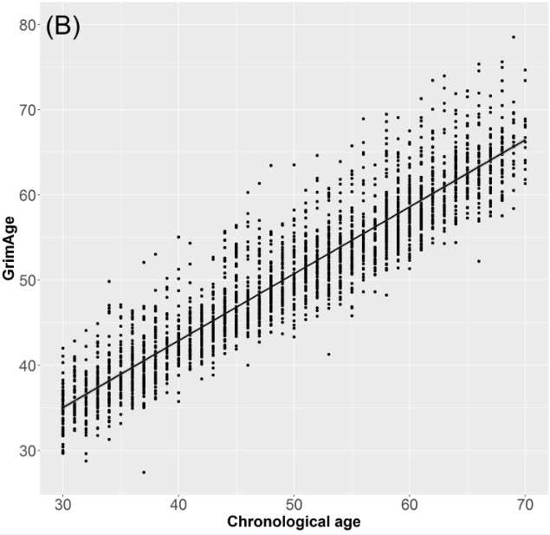
GrimAge is based on 1,030 CpGs that are associated with DNAm-based biomarkers for 7 plasma proteins and smoking pack-years.
Lu AT et al. Aging (Albany NY) 2019;11: 303-327

Slide 21
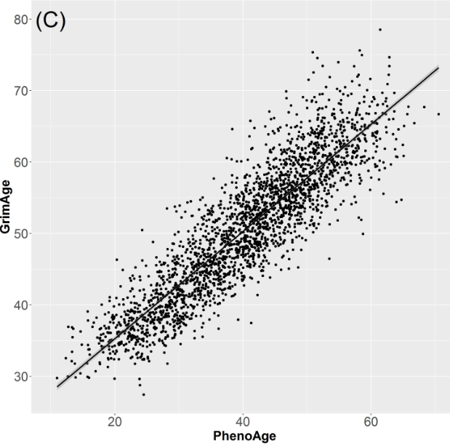

Slide 22
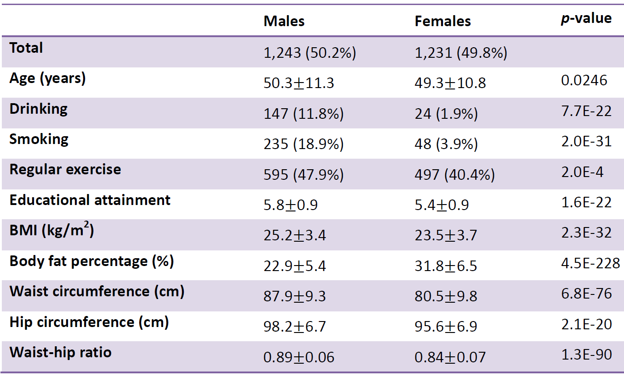
Educational attainment ranges from 1 to 7: 1 “illiterate”, 2 “no formal education but literate”, 3 “primary school graduate”, 4 “junior high school graduate”, 5 “senior high school graduate”, 6 “college graduate”, and 7 “Master’s or higher degree”.

Slide 23
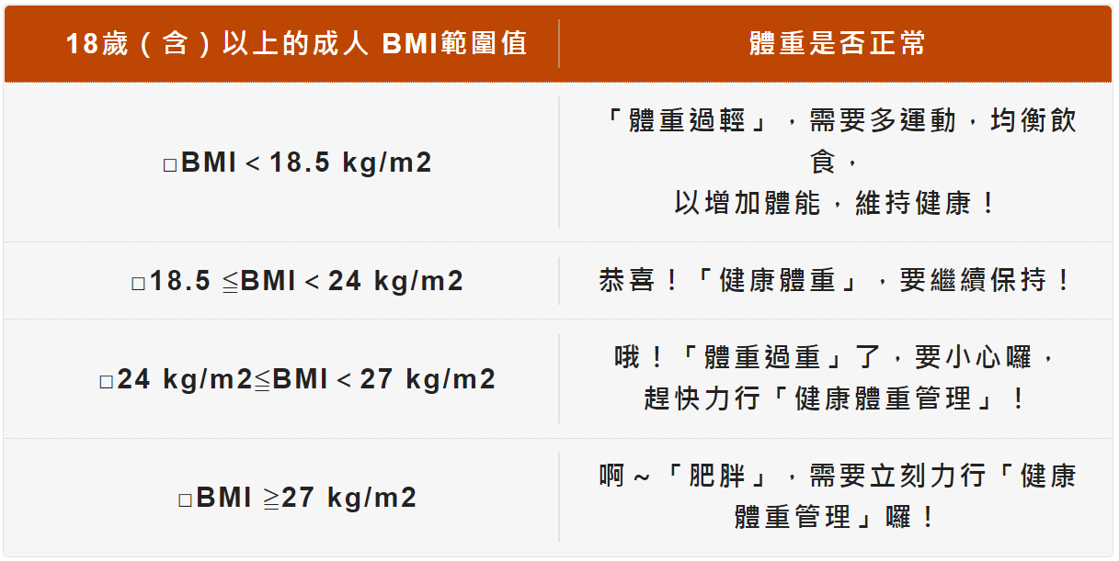
Males | Females
-0.23 (p=0.857) | -0.90 (p=0.224)
0.57 (p=0.068) | 0.81 (p=0.023)
1.04 (p=0.002) | 1.17 (p=0.004)
PhenoEAA ~ underweight + overweight + obesity + smoking + place + drinking + exercise + education
EAA: epigenetic age acceleration

Slide 24
Males | Females
-1.00 (p=0.227) | 0.03 (p=0.943)
0.47 (p=0.018) | 0.36 (p=0.044)
0.45 (p=0.033) | 0.77 (p=0.0002)
GrimEAA ~ underweight + overweight + obesity + smoking + place + drinking + exercise + education
EAA: epigenetic age acceleration

Slide 25
3.7
0.06
PhenoEAA ~ BMI + smoking + place + drinking + exercise + education
PhenoEAA ~ BFP + smoking + place + drinking + exercise + education
PhenoEAA ~ WC + smoking + place + drinking + exercise + education
PhenoEAA ~ HC + smoking + place + drinking + exercise + education
PhenoEAA ~ WHR + smoking + place + drinking + exercise + education

Slide 26
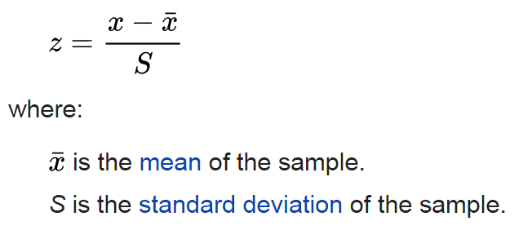
Z-score transformation
By Heds 1 at English Wikipedia - Transferred from en.wikipedia to Commons by Abdull., Public Domain, https://commons.wikimedia.org/w/index.php?curid=2799839

Slide 27
3.7
0.06
GrimEAA ~ BMI + smoking + place + drinking + exercise + education
GrimEAA ~ BFP + smoking + place + drinking + exercise + education
GrimEAA ~ WC + smoking + place + drinking + exercise + education
GrimEAA ~ HC + smoking + place + drinking + exercise + education
GrimEAA ~ WHR + smoking + place + drinking + exercise + education

Slide 28
Summary
Prevention of abdominal obesity is associated with a lower risk of EAA in men
Prevention of general obesity is associated with a lower risk of EAA in women

Slide 29
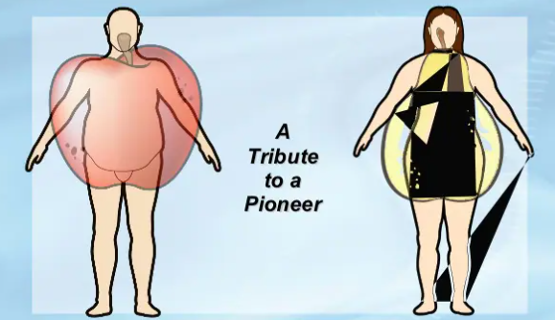

Slide 30
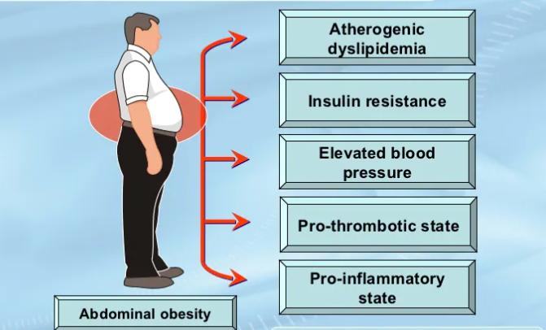
致動脈粥樣化的血脂肪異常
胰島素阻抗
血壓上升
前血栓狀態
前發炎狀態

Slide 32
http://homepage.ntu.edu.tw/~linwy/

