Slide 1
How We Learn:
The Surprising Truth
Part 1
Chander Tseng 曾國奕 November 2015

Slide 2
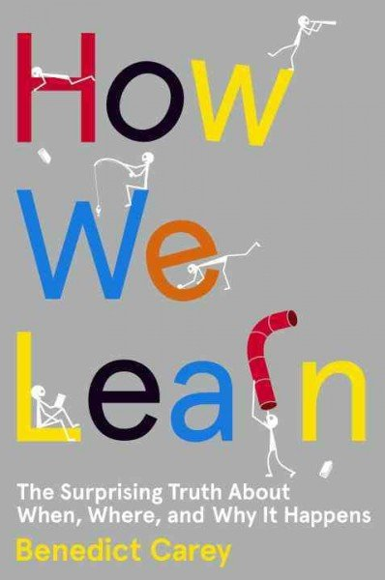

Slide 3
How YOU Learn: True or False?
To forget is to fail.
If a memory is lost, it’s gone.
Repeating a practice routine helps the most.
It’s better if you study a new concept right after you learn it.
Cramming is useful in the long run.
6. To learn the new content, straight
memorization helps the most.

Slide 4
1. Forget to Learn
Storage strength
How well something is learned
Retrieval strength
How easily information comes to mind
Large capacity
Small capacity

Slide 5
1. Forget to Learn
To forget
(filter)
To remember
(reuse)
Storage and retrieval strength
Desired Difficulty

Slide 6
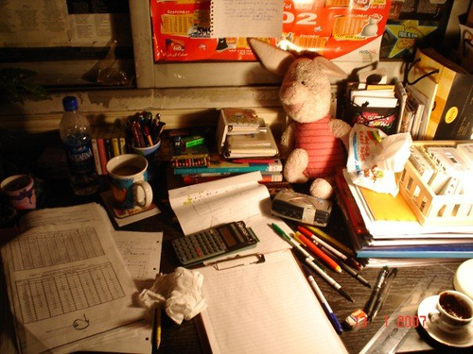
2. Breaking Good Habits
Same room
Same time
Same way

Slide 7
2. Breaking Good Habits
Different rooms
Different time
Different ways

Slide 8
2. Breaking Good Habits
Varying the environment
Enriching the skills/content
Sharper, longer, more accessible

Slide 9
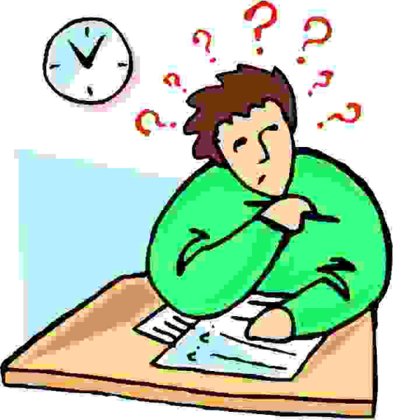
3. Spacing Out
The Spacing Effect; Distributed Learning
Time to Test | First Study Interval
1 Week | 1-2 Days
1 Month | 1 Week
3 Months | 2 Weeks
6 Months | 3 Weeks
1 Year | 1 Month

Slide 10
4. The Hidden Value of Ignorance
Fluency Illusion: Now doesn’t mean forever.

Slide 11
4. The Hidden Value of Ignorance
Guessing
Imprint of the correct answers

Slide 12
REVIEW: Part 1
To forget is to relearn.
A memory is never lost. It just requires retrieval.
It helps the most if you alternate the practice routine.
It’s better if you space your study time.
Cramming is only useful in a pinch.
To learn the new content, testing or teaching
helps the most.

Slide 13
Check your answers.
Think again!
Questions or Comments?

