Slide 1
Introduction to
Hanyu Pinyin
Andrea Lay 賴宜謙
Freshman English Spring 2017

Slide 2
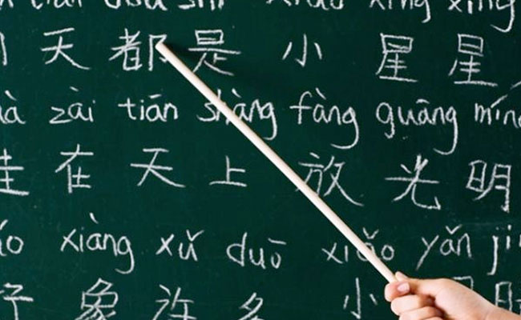
What is Hanyu Pinyin?
One of the Romanization systems for transcribing Mandarin Chinese
The worldwide standard and the most commonly used system
It shows the pronunciation of a character for those who can’t read Chinese

Slide 3
Why Should We Learn Hanyu Pinyin?
correctly read Chinese words used in the international media.
use Chinese in the global sphere as a global citizen.
interact and communicate with foreigners more easily, especially in professional contexts and language exchanges.

Slide 4

The vast majority of Chinese speakers and learners in the world are literate in Pinyin.
Just like knowing simplified characters enables you to access more materials in Chinese, knowing Pinyin helps you access more information in the world.

Slide 5

Let’s Learn Hanyu PinYin

Slide 6
Basic consonant symbols
注音符號 | 漢語拼音 | 例子
ㄅ | b | 把 bǎ
ㄆ | p | 普 pǔ
ㄇ | m | 木 mù
ㄈ | f | 服 fú

Slide 7
Basic consonant symbols
注音符號 | 漢語拼音 | 例子
ㄉ | d | 大 dà
ㄊ | t | 梯 tī
ㄋ | n | 你 nǐ
ㄌ | l | 樂 lè

Slide 8
Basic consonant symbols
注音符號 | 漢語拼音 | 例子
ㄍ | g | 乾 gān
ㄎ | k | 康 kāng
ㄏ | h | 好 hǎo

Slide 9
Special consonant symbols
注音符號 | 漢語拼音 | 例子
ㄐ | j | 金 jīn 君 jūn
ㄑ | q | 琴 qín 群 qún
ㄒ | x | 心 xīn 訊 xùn

Slide 10
Special consonant symbols
注音符號 | 漢語拼音 | 例子
ㄓ | zh (by itself: 知 zhī) | 沾 zhān
ㄔ | ch (by itself: 吃 chī) | 炒 chǎo
ㄕ | sh (by itself: 師 shī) | 蛇 shé
ㄖ | r (by itself: 日 rì) | 肉 ròu

Slide 11
Special consonant symbols
注音符號 | 漢語拼音 | 例子
ㄗ | z (by itself: 資 zī) | 讚 zàn
ㄘ | c (by itself: 次 cì) | 慘 cǎn
ㄙ | s (by itself: 斯 sī) | 傘 sǎn

Slide 12
Monophthongs (單母音)
注音符號 | 漢語拼音 | 例子
ㄚ | a | 拿 ná
ㄛ | o | 頗 pǒ
ㄜ | e | 樂 lè
ㄦ | r (by itself: 兒 ér) | 那兒 (兒化韻) nàr

Slide 13
Monophthongs (單母音)
注音符號 | 漢語拼音 | 例子
ㄧ | i (by itself: ㄧ yī) | 梯 tī
ㄨ | u (by itself: 吳 wú) | 讀 dú
ㄩ | ü (by itself: 與 yǔ) | 綠 lǜ

Slide 14
Monophthongs (單母音)
ㄨ (u)
ㄨ (u)
ㄋ (n)
ㄌ (l)
ㄩ (ü)
ㄩ (ü)
Both ㄨ (u) and ㄩ (ü) are possible!
We need to distinguish between “u” and “ü”.
We need to use “ü” for ㄩ when it comes after ㄋ (n) and ㄌ (l).

Slide 15
Monophthongs (單母音)
ㄨ (u)
ㄨ (u)
ㄐ (j)
ㄒ (x)
ㄩ (ü)
ㄩ (ü)
ㄨ (u)
ㄨ (u)
ㄑ (q)
ㄧ (y)
ㄩ (ü)
ㄩ (ü)
ㄨ (u) is impossible!
There’s no need to distinguish between “u” and “ü”.
We use “u” for ㄩ only when it comes after ㄐ, ㄑ, ㄒ, ㄧ (y).

Slide 16
Monophthongs (單母音) ：ㄩ
ㄐ(j)
ㄑ(q)
ㄒ(x)
ㄧ (i)
ㄩ(u)
ONLY
(這裡寫u，不寫ü)

Slide 17
Falling Diphthongs (雙母音)
注音符號 | 漢語拼音 | 例子
ㄞ | ai | 愛 ài
ㄟ | ei | 誰 shéi
ㄠ | ao | 少 shǎo
ㄡ | ou | 手 shǒu

Slide 18
Vowel + Nasal Rhymes (韻尾) (I)
注音符號 | 漢語拼音 | 例子
ㄢ | an | 山 shān
ㄤ | ang | 倉 cāng
ㄣ | en | 陳 chén
ㄥ | eng | 夢 mèng

Slide 19
Rising Diphthongs and Triphthongs (I):
與 i (y) 一起
注音符號 | 漢語拼音 | 例子
ㄧㄚ | ia (by itself: 牙 yá) | 洽 qià
ㄧㄠ | iao (by itself: 要 yào) | 橋 qiáo
ㄧㄝ | ie (by itself: 也 yě) | 寫 xiě
ㄧㄡ | iu (NOT iou) (by itself: 有 yǒu) | 秋 qiū

Slide 20
Vowel + Nasal Rhymes (II)
注音符號 | 漢語拼音 | 例子
ㄧㄢ | ian (by itself: 言 yán) | 前 qián
ㄧㄤ | iang (by itself: 羊 yáng) | 想 xiǎng
ㄧㄣ | in (by itself: 音 yīn) | 新 xīn
ㄧㄥ | ing (by itself: 英 yīng) | 興 xīng

Slide 21
Rising Diphthongs and Triphthongs (II):
與 u (w) 一起
注音符號 | 漢語拼音 | 例子
ㄨㄚ | ua (by itself: 瓦 wǎ) | 誇 kuā
ㄨㄛ | uo (by itself: 我 wǒ) | 陀 tuó
ㄨㄞ | uai (by itself: 外 wài) | 甩 shuǎi
ㄨㄟ | ui (NOT uei) (by itself: 未 wèi) | 瑞 ruì

Slide 22
Vowel + Nasal Rhymes (III)
注音符號 | 漢語拼音 | 例子
ㄨㄢ | uan (by itself: 完 wán) | 喘 chuǎn
ㄨㄤ | uang (by itself: 王 wáng) | 床 chuáng
ㄨㄣ | un (NOT uen) (by itself: 問 wèn) | 村 cūn
ㄨㄥ | ong (by itself: 翁 wēng) | 龍 lóng

Slide 23
Rhymes Containing ㄩ (ü)
注音符號 | 漢語拼音 | 例子
ㄩㄝ | ue (by itself: 月 yuè) | 絕 jué
ㄩㄢ | uan (by itself: 圓 yuán) | 全 quán
ㄩㄣ | un (by itself: 雲 yún) | 群 qún
ㄩㄥ | iong (by itself: 用 yòng) | 胸 xiōng

Slide 24
REVIEW (I)
注音符號 | 字中的韻母 (ㄧ般情況) | 單獨成字
ㄨ | u (ex: 出 chū) | wu (ex: 烏 wū)
ㄣ | en (ex: 陳 chén) | en (ex: 恩 ēn)
ㄥ | eng (ex: 成 chéng)
ㄨㄣ | un (ex: 春 chūn) | wen (ex: 溫 wēn)
ㄨㄥ | ong (ex: 衝 chōng) | weng (ex: 翁 wēng)

Slide 25
REVIEW (II)
注音符號 | 字中的韻母 (ㄧ般情況) | 單獨成字
ㄧ | i (ex: 希 xī) | yi (ex: 依 yī)
ㄩ | ü: only after ㄋand ㄌ (ex: 女 nǚ) u: otherwise (ex: 區 qū) | yu (ex: 淤 yū)
ㄩㄣ | un (ex: 群 qún) | yun (ex: 雲 yún)
ㄩㄥ | iong (ex: 瓊 qióng) | yong (ex: 傭 yōng)

Slide 26
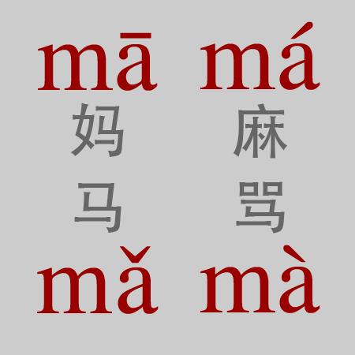
Tone Marking Rules
Always on the vowel.
on the left for the diphthongs “ai, ei, ao , ou”.
in the middle for triphthongs like iao and uai.
Usually tone marks are omitted on public signs and in names.

Slide 27
Thank You!

