Slide 1
The Greek Letters
Chapter 17

Slide 2
The Goals of Chapter 17
Introduce Delta ($Δ)$ and dynamic Delta hedge
Introduce Gamma ($Γ$) and Theta ($Θ$)
Introduce Vega ($𝒱$) and Rho ($ρ)$
Hedging in practice
Notes:
2

Slide 3
17.1 Delta and Dynamic Delta Hedge

Slide 4
Delta and Dynamic Delta Hedge
Illustrative example for hedging an option position
A bank has sold for $300,000 a European call option on 100,000 shares of a non-dividend paying stock
The associated information is $S_{0}=49$, $K=50$, $r=5\%$, $σ=20\%$, $T=20 weeks$, and the expected growth rate of the underlying stock is $μ=13\%$
The Black-Scholes value of the option is $240,000
How does the bank hedge its risk?
Four strategies will be discussed, including the no hedge strategy, fully covered hedge strategy, stop-loss strategy, and dynamic delta hedge strategy

Slide 5
Delta and Dynamic Delta Hedge
No hedge strategy
Take no action and maintain the naked position
If the call is ITM ($S_{T}≥K)$ at $T$, the bank needs to sell 100,000 shares to the call holder for $K=50$ dollars per share
The bank loses $(S_{T}−K)$ dollars per share
The loss amount could be unlimitedly
If the call is OTM ($S_{T}<K)$ at $T$, the call holder will not his exercising right and thus the bank needs to do nothing
The bank can earn the call premium of $300,000, which is received up front

Slide 6
Delta and Dynamic Delta Hedge
Fully covered hedge strategy
Buy 100,000 shares today at $S_{0}=49$ per share
If the call is ITM ($S_{T}≥K)$ at $T$, the bank sells 100,000 shares to the call holder for $K=50$ per share
The bank can earn $K−S_{0}=1$ dollar per share minus the interest cost to purchase 100,000 shares at $S_{0}$ initially
Note that if $S_{0}>K$, the bank will suffer a loss definitely
If the call is OTM ($S_{T}<K)$ at $T$, the call holder will give up his right and the bank needs to do nothing
The bank can earn the call premium, but the stock shares position could suffer a large loss if $S_{T}<S_{0}$ substantially
※Both the above two strategies leave the bank exposed to significant risk

Slide 7
Delta and Dynamic Delta Hedge
Stop-loss strategy
Buying 100,000 shares as soon as if the share price reaches $50, i.e., when the call becomes just ITM
Selling 100,000 shares as soon as price falls below $50, i.e., when the call becomes just OTM
If the call is ITM ($S_{T}≥K)$ at $T$, the bank owns 100,000 shares, which can meet the obligation of selling shares to the call holder at $K=50$ per share
Since the cost to purchase 100,000 is always 50 dollars per share, there is no gain or loss at $T$ in this scenario
For the bank, the net profit of selling this call option is the call premium of $300,000

Slide 8
Delta and Dynamic Delta Hedge
If the call is OTM ($S_{T}<K)$ at $T$, the bank owns no shares in hand and the call holder will not exercise the right
The bank can earn the call premium of $300,000 in this scenario
Does this simple hedging strategy work?
Note that if the stock price moves upward and downward around $K=50$ many times, the transaction cost is high
In practice, the purchasing price will be always higher than or equal to $50 and the selling price will be always lower than or equal to $50, so every round transaction incurs a capital loss
If the transaction cost and capital loss are taken into account, it is very likely that the bank will face a net loss

Slide 9
Delta and Dynamic Delta Hedge
Delta ($Δ$) is the rate of change of the option price with respect to the price of the underlying asset
For calls (puts), it is defined as $\frac{∂c}{∂S}$ ($\frac{∂p}{∂S}$) at $S=S_{0}$ (for simplicity, the term “at $S=S_{0}$” is omitted afterward)
The geometric meaning is the slope of the tangent line for the option price curve at $S=S_{0}$
$$c$$
$$p$$
Slope = $\frac{∂c}{∂S}$
Slope = $\frac{∂p}{∂S}$
$$S$$
$$S$$
$$S_{0}$$
$$S_{0}$$

Slide 10
Delta and Dynamic Delta Hedge
By performing the partial differentiation with respect to $S$ based on the Black-Scholes formula
The delta of a European call on a stock paying dividend yield $q$ is $e^{−qT}N(d_{1})$
The delta of a European put on a stock paying dividend yield $q$ is $e^{−qT}\left[N\left(d_{1}\right)−1\right]$

Slide 11
Delta and Dynamic Delta Hedge
Dynamic delta hedge strategy (taking a call option as example)
This involves maintaining a delta neutral portfolio
The nonzero $\frac{∂c}{∂S}$ indicates that the call option is exposed to the risk of the movement of the stock price
Consider a portfolio $Π=c+A$ such that $\frac{∂Π}{∂S}=\frac{∂c}{∂S}+\frac{∂A}{∂S}=0$, i.e., the deltas of $c$ and $A$ can offset for each other, the value of the portfolio $P$ is independent of small stock price movements and thus called a delta neutral portfolio
Note that the delta for the stock share is 1, i.e., $\frac{∂S}{∂S}=1$
Thus, if we know the value of $Δ=\frac{∂c}{∂S}$, then we can buy or short sell stock shares to create a delta neutral portfolio

Slide 12
Delta and Dynamic Delta Hedge
The hedge position must be frequently rebalanced due to the following two reasons
The delta neutral portfolio maintains only for small changes in the underlying price
Even when the stock price does not change, the value of the delta still changes with the passage of time
Delta hedging a written call involves a “buy high, sell low” trading rule
Writing a call option indicates a $(−c)$ position for the bank
When $S$ is high, the $Δ$ of a call is high and thus $\frac{∂(−c)}{∂S}$ is more negative ⇒ buy more shares to main delta neutrality
When $S$ is low, the $Δ$ of a call is lower and thus $\frac{∂(−c)}{∂S}$ is less negative ⇒ sell shares to main delta neutrality

Slide 13
Delta and Dynamic Delta Hedge
A scenario of ITM at $T$
Week | Stock price | Delta | Shares purchased | Cost of shares purchased ($000) | Cumulative cost ($000) | Interest cost ($000)
0 | 49.00 | 0.522 | 52,200 | 2,557.8 = 52,200×49 | 2,557.8 | 2.5 = 2,557.8×5%/52
1 | 48.12 | 0.458 | (6,400) | (308.0) = –6,400×48.12 | 2,252.3 = 2,557.8–308+2.5 | 2.2 = 2,252.3×5%/52
2 | 47.37 | 0.400 | (5,800) | (274.7) = –5,800×47.37 | 1,979.8 = 2,252.3–274.7+2.2 | 1.9 = 1,979.8×5%/52
....... | ....... | ....... | ....... | ....... | ....... | .......
19 | 55.87 | 1.000 | 1,000 | 55.9 | 5,258.2 | 5.1
20 | 57.25 | 1.000 | 0 | 0 | 5,263.3
※ At maturity $T$, the 100,000 shares owned by the bank can meet the exercise request of the call holder and sell the 100,000 shares for 100,000×$50 = $5,000,000
※ Hence, the net hedging cost is $5,263,300 - $5,000,000 = $263,300

Slide 14
Delta and Dynamic Delta Hedge
A scenario of OTM at $T$
Week | Stock price | Delta | Shares purchased | Cost of shares purchased ($000) | Cumulative Cost ($000) | Interest cost ($000)
0 | 49.00 | 0.522 | 52,200 | 2,557.8 = 52,200×49 | 2,557.8 | 2.5 = 2,557.8×5%/52
1 | 49.75 | 0.568 | 4,600 | 228.9 = 4,600×49.75 | 2,789.2 = 2,557.8+228.9+2.5 | 2.7 = 2,789.2×5%/52
2 | 52.00 | 0.705 | 13,700 | 712.4 = 13,700×52 | 3,504.3 = 2789.2+712.4+2.7 | 3.4 = 3,504.3×5%/52
....... | ....... | ....... | ....... | ....... | ....... | .......
19 | 46.63 | 0.007 | (17,600) | (820.7) | 290.0 | 0.3
20 | 48.12 | 0.000 | (700) | (33.7) | 256.6
※ At maturity $T$, the bank owns zero share and does not need to do anything
※ Hence, the net hedging cost is simply $256,600
※ By observing the shares purchased at $T$ in the above two tables, we can understand the “buy high, sell low” dynamic delta hedge strategy replicate a call option in effect

Slide 15
Delta and Dynamic Delta Hedge
In either scenario, the hedging costs ($263,300 in the ITM case vs. $256,600 in the OTM case) are close
In fact, the hedging cost of the dynamic delta hedge is very stable regardless different stock price paths
If the rebalancing frequency increases, the hedging cost will converge to the Black-Scholes theoretically option value ($240,000)
The dynamic delta hedge strategy can bring a stable profit ($300,000 – net hedging cost) for the bank
In practice, the transaction cost for trading stock shares should be taken into account, so option premiums charged by financial institutions are usually higher than theoretical Black-Scholes values

Slide 16
Delta and Dynamic Delta Hedge
Implement the dynamic delta hedge with futures contract:
Due to the chain rule, we can derive
$\frac{∂c}{∂F}=\frac{∂c}{∂S}\frac{∂S}{∂F}=Δ\frac{∂S}{∂F}=Δe^{−\left(r−q\right)T}$
where the last equality is due to $F=Se^{(r−q)T}$ and thus $\frac{∂F}{∂S}=e^{(r−q)T}$
Hence, the position required in futures for delta hedging is therefore $e^{−\left(r−q\right)T}$ times the position required in the corresponding spot contract

Slide 17
17.2 Gamma and Theta

Slide 18
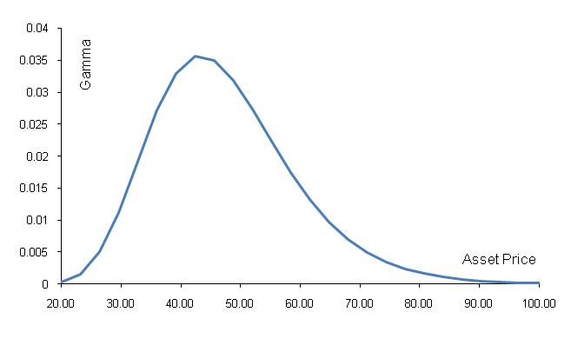
Gamma and Theta
Gamma ($Γ$) is the rate of change of delta ($Δ$) with respect to the price of the underlying asset
$Γ$ of both calls and puts are identical and positive
$\frac{∂^{2}c}{∂S^{2}}=\frac{∂Δ}{∂S}=\frac{e^{−qT}N^{′}(d_{1})}{S_{0}σ\sqrt{T}}$
The curve of Gamma with respect to $S_{0}$ when $K=50$, $r=5\%$, $q=0$, $σ=25\%$, and $T=1$

Slide 19
Gamma and Theta
Since Gamma measures the curvature of the option value function, it can measure the error of the delta hedge, which is a linear approximation method
Higher Gamma ⇒ larger error of the delta hedge
How to make a portfolio Gamma neutral?
A position in the underlying asset has zero gamma and cannot be used to change the gamma of a portfolio
This is because the gamma of a portfolio $Π=c+A$ can be derived via $\frac{∂^{2}Π}{∂S^{2}}=\frac{∂^{2}c}{∂S^{2}}+\frac{∂^{2}A}{∂S^{2}}$ and $\frac{∂^{2}S}{∂S^{2}}=0$
We need a derivative on the same underlying asset with a nonlinear payoff to construct a zero-gamma portfolio, for example, other options traded in the market

Slide 20
Gamma and Theta
Suppose a portfolio is delta neutral and has a gamma of (–3000), and the delta and gamma of a traded call option are 0.62 and 1.5
Including a long position of 3000/1.5 = 2,000 shares of the traded call option can make the portfolio gamma neutral
However, the delta of the portfolio will change from zero to 2,000 × 0.62 = 1240
Therefore, 1,240 units of the underlying asset must be sold (short) to keep it delta neutral

Slide 21
Gamma and Theta
Theta ($Θ$) of a derivative is the rate of change of the value with respect to the passage of time, i.e., it measures the time decay of option values
$\frac{∂c}{∂t}=−\frac{∂c}{∂T}=−\frac{S_{0}{e^{−qT}N}^{′}\left(d_{1}\right)σ}{2\sqrt{T}}+qS_{0}e^{−qT}N\left(d_{1}\right)−rKe^{−rT}N(d_{2})$
$\frac{∂p}{∂t}=−\frac{∂p}{∂T}=−\frac{S_{0}{e^{−qT}N}^{′}\left(d_{1}\right)σ}{2\sqrt{T}}−qS_{0}e^{−qT}N\left(−d_{1}\right)+rKe^{−rT}N(−d_{2})$
The theta of an option is usually negative except ITM European put options
This means that, if time passes, the value of the option declines even if the price of the underlying asset and its volatility remaining the same
This is because the dividend payment could make the value of European put rise to cover the time decay of the put value

Slide 22
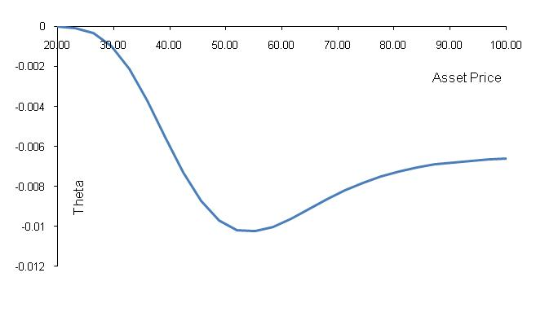
Gamma and Theta
Note that time is not a risk factor because the time passing is predictable, so it does not make sense to hedge against the passage of time
The theta of a call option with respect to $S_{0}$ when $K=50$, $σ=25\%$, $r=5\%$, and $T=1$
The time decay of ATM calls is faster than that of OTM and ITM calls (This property is in general true for put options)
Most negative around ATM area

Slide 23
Gamma and Theta
Based on the bivariate Taylor expansion, the approximation of the change in the value of a portfolio $Π$ is
$ΔΠ≈Δ\left(ΔS\right)+\frac{1}{2}Γ{\left(ΔS\right)}^{2}+Θ\left(Δt\right)$
Note that for both calls and puts, their gammas are positive, which is a desirable feature
If the portfolio $Π$ is delta neutral, then
$ΔΠ≈\frac{1}{2}Γ{\left(ΔS\right)}^{2}+Θ\left(Δt\right)$

Slide 24
Gamma and Theta
Black-Scholes also derive the following partial differential equation expressed with Greek letters
For any portfolio of derivatives on a stock paying a continuous dividend yield $q$,
$Θ+\left(r−q\right)S_{0}Δ+\frac{1}{2}σ^{2}S_{0}^{2}Γ=rΠ$,
where $Θ$, $Δ$, and $Γ$ are the theta, delta, and gamma of the portfolio $Π$
If $Π$ is delta neutral, then $Θ+\frac{1}{2}σ^{2}S_{0}^{2}Γ=rΠ$, which implies that when $Θ$ is small and negative, $Γ$ of this portfolio $Π$ should be large and positive, and vice versa

Slide 25
17.3 Vega and Rho

Slide 26
Vega and Rho
Vega ($𝒱$) is the rate of change of the value of a derivatives portfolio with respect to volatility
For both calls and puts, their vegas are the same
$\frac{∂c}{∂σ}=\frac{∂p}{∂σ}=S_{0}e^{−qT}\sqrt{T}N^{′}(d_{1})$
Note that vega is always positive since $N^{′}(⋅)$ represents the probability density function of the standard normal distribution and always returns a positive result
Vega reaches its maximum if the option is ATM
This is because $N^{′}(d_{1})$ is maximal when $d_{1}$ is 0.5, and when the option is around ATM, $d_{1}$ is near 0.5

Slide 27
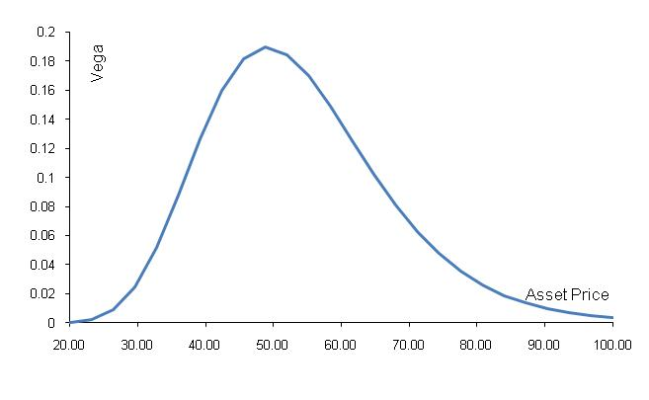
Vega and Rho
Vega for calls or puts with respect to $S_{0}$ when $K=50$, $r=5\%$, $q=0$, $σ=25\%$, and $T=1$
Highest around ATM area

Slide 28
Vega and Rho
How to make a portfolio delta, gamma, and vega neutral?
Delta can be changed by taking a position in the underlying asset
To adjust gamma and vega, it is necessary to take a position in options or other nonlinear-payoff derivatives
This is because both gamma and vega of the underlying asset is zero
Consider a portfolio that is delta neutral, with a gamma of –5000 and a vega of –8000 and two options as follows

Slide 29
Vega and Rho
If $w_{1}$ and $w_{2}$ are the quantities of Option 1 and Option 2 that are added to the portfolio, we require
$−5000+0.5w_{1}+0.8w_{2}=0$ (for Gamma)
$−8000+2.0w_{1}+1.2w_{2}=0$ (for Vega)
The solution is $w_{1}=400$ and $w_{2}=6000$
After this adjustment, the delta of the new portfolio is $400×0.6+6000×0.5=3240$
To maintain delta neutrality, 3240 units of the underlying asset should be sold
 | Delta | Gamma | Vega
Option 1 | 0.6 | 0.5 | 2.0
Option 2 | 0.5 | 0.8 | 1.2

Slide 30
Rho
Rho ($ρ$) is the rate of change of the value of a derivative with respect to the interest rate
$\frac{∂c}{∂r}=Ke^{−rT}TN\left(d_{2}\right)>0$
$\frac{∂p}{∂r}=−Ke^{−rT}TN\left(d_{2}\right)<0$
Note that when $r$ ↑, the expected return of the underlying asset ↑, and the discount rate ↑ such that the PV of future CFs ↓
For calls, option value ↑ because the higher expected $S_{T}$ and the higher prob. to be ITM dominate the effect of lower PVs
For puts, option value ↓ due to the higher expected $S_{T}$, the lower prob. to be ITM, and the effect of lower PVs

Slide 31
Rho
In the case of currency options, there are two rhos corresponding to $r$ and $r_{f}$
In addition to the rhos corresponding to $r$ specified on the previous page, the rhos corresponding to $r_{f}$ are
$\frac{∂c}{∂r_{f}}=−S_{0}e^{−r_{f}T}TN\left(d_{1}\right)<0$
$\frac{∂p}{∂r_{f}}=S_{0}e^{−r_{f}T}TN\left(−d_{1}\right)>0$

Slide 32
17.4 Hedging in Practice

Slide 33
Hedging in Practice
Traders usually ensure that their portfolios are delta-neutral at least once a day
Whenever the opportunity arises, they improve gamma and vega
As portfolio becomes larger, hedging becomes less expensive
Two advantages for managing a large portfolio
Enjoy a lower transaction cost
Avoid the indivisible problem of the securities shares, e.g., it is impossible to trade 0.5 shares of a security

Slide 34
Hedging in Practice
In addition to monitoring Greek letters, option traders often carry out scenario analyses
A scenario analysis involves testing the effect on the value of a portfolio of different assumptions concerning asset prices and their volatilities
Consider a bank with a portfolio of options on a foreign currency
There are two main variables affecting the portfolio value: the exchange rate and the exchange rate volatility
The bank can analyze the profit or loss of this portfolio given different combinations of the exchange rate to be 0.94, 0.96,…, 1.06 and the exchange rate volatility to be 8%, 10%,…, 20%

Slide 35
Hedging in Practice
Creation of an option synthetically (人工合成地)
Since we can take positions to offset Greek letters, by the same reasoning we can create an option synthetically by taking positions to match Greek letter
Recall that on pages 17.12-17.14, we employ the “buy high, sell low” dynamic delta hedge strategy to replicate a call option synthetically
We can infer that if we consider the delta of a put option (which is negative) and perform “short less when $S$ is high, short more when $S$ is low” dynamic delta hedge strategy, we can replicate a put option synthetically

Slide 36
Hedging in Practice
In October of 1987, many portfolio managers attempted to create a put option on a portfolio synthetically
The put position can insure the value of the portfolio against the decline of the market
Why to create a put synthetically rather than purchase a put from financial institutions?
The put sold by other financial institutions are more expensive than the cost to create the put synthetically

Slide 37
Hedging in Practice
This strategy involves initially selling enough of the index portfolio (or index futures) to match the delta of the put option
As the value of the portfolio increases, the delta of the put becomes less negative and some of the index portfolio is repurchased
As the value of the portfolio decreases, the delta of the put becomes more negative and more of the index portfolio must be sold
※ Note that the side effect of this strategy is to increase the volatility of the market

Slide 38
Hedging in Practice
This strategy to create synthetic puts did not work well on October 19, 1987 (Black Monday), but real puts work
This is because there are so many portfolio managers adopting this strategy to create synthetic puts
They design computer programs to carry out this strategy automatically
When the market falls, the selling actions exacerbate the decline, which triggers more selling actions from the portfolio managers who adopt this strategy
The resulting vicious cycle makes the stock exchange system overloaded, and thus many selling orders cannot be executed

