Slide 1
Futures Options
Chapter 16

Slide 2
The Goals of Chapter 16
Introduce mechanics of futures options
Properties of futures options
Pricing futures options using binomial trees
Pricing futures options with Black’s formula
Introduce futures-style options
Notes:
2

Slide 3
16.1 Mechanics of Futures Options

Slide 4
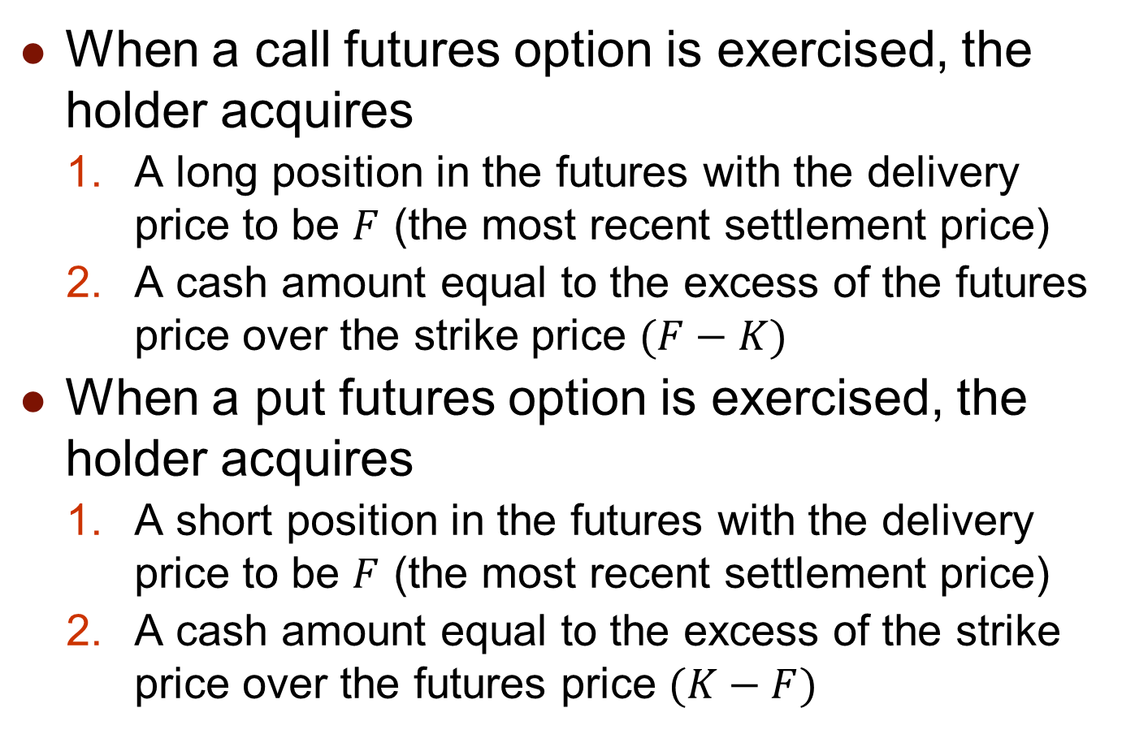
Mechanics of Futures Options
When a call futures option is exercised, the holder acquires
  A long position in the futures with the delivery price to be $F$ (the most recent settlement price)
  A cash amount equal to the excess of the futures price over the strike price $(F−K)$
When a put futures option is exercised, the holder acquires
  A short position in the futures with the delivery price to be $F$ (the most recent settlement price)
  A cash amount equal to the excess of the strike price over the futures price $(K−F)$

Slide 5
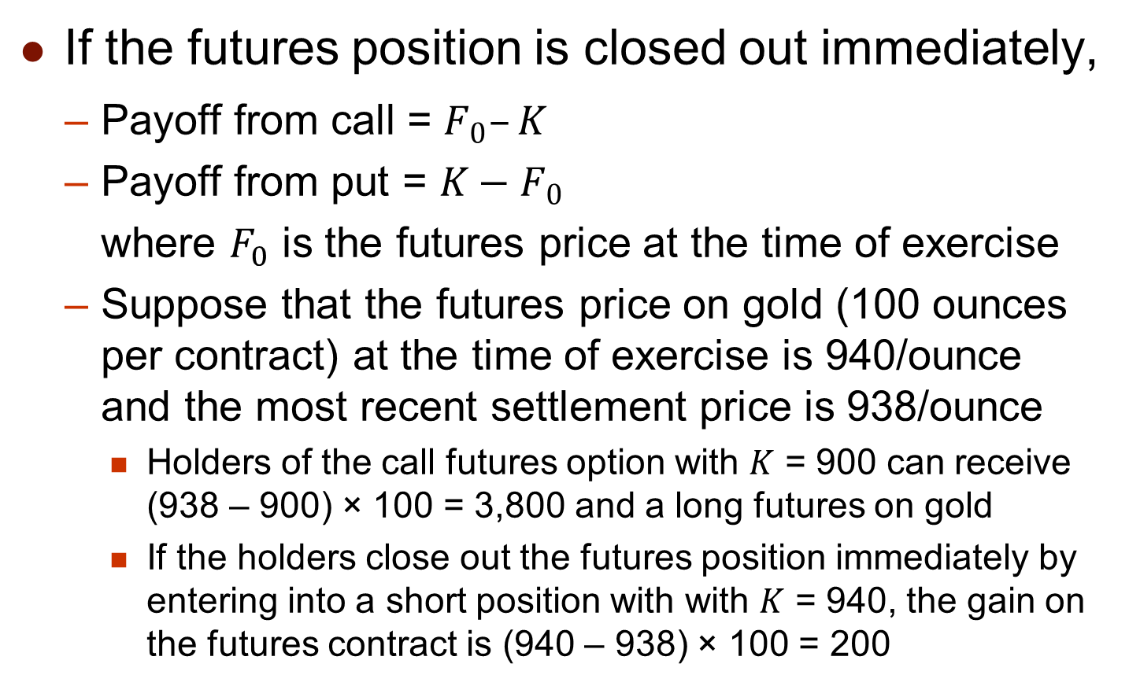
Mechanics of Futures Options
If the futures position is closed out immediately,
  Payoff from call = $F_{0}–K$
  Payoff from put = $K−F_{0}$
  where $F_{0}$ is the futures price at the time of exercise
  Suppose that the futures price on gold (100 ounces per contract) at the time of exercise is 940/ounce and the most recent settlement price is 938/ounce
    Holders of the call futures option with $K$ = 900 can receive (938 – 900) × 100 = 3,800 and a long futures on gold
    If the holders close out the futures position immediately by entering into a short position with with $K$ = 940, the gain on the futures contract is (940 – 938) × 100 = 200

Slide 6
Futures Options vs. Spot Options
Advantages of futures options
  Futures contracts may be more convenient to trade than underlying assets
    1000 barrels of oil vs. one oil futures contract
  Futures prices are more readily available
    Treasury bonds in dealers markets vs. Treasury bond futures on exchanges
  The liquidity of futures contract is in general better than underlying assets
    This is because the leverage effect of the margin mechanism or that many speculators intend to bid the direction of the price movement but do not want to hold the underlying assets physically

Slide 7
Futures Options vs. Spot Options
  Exercise of the futures option does not lead to the delivery of the underlying asset
    The futures contracts are usually closed out before maturity and thus settled in cash
  Futures options and futures usually trade in pits side by side on the same exchanges
    In most cases, if an exchange offers a futures contract, it also offers the corresponding futures option contract
    This arrangement can facilitates the needs of hedging, arbitrage, and speculation and in effect enhance the overall trading volume
  Futures options may entail lower transactions costs than spot options in many situations

Slide 8
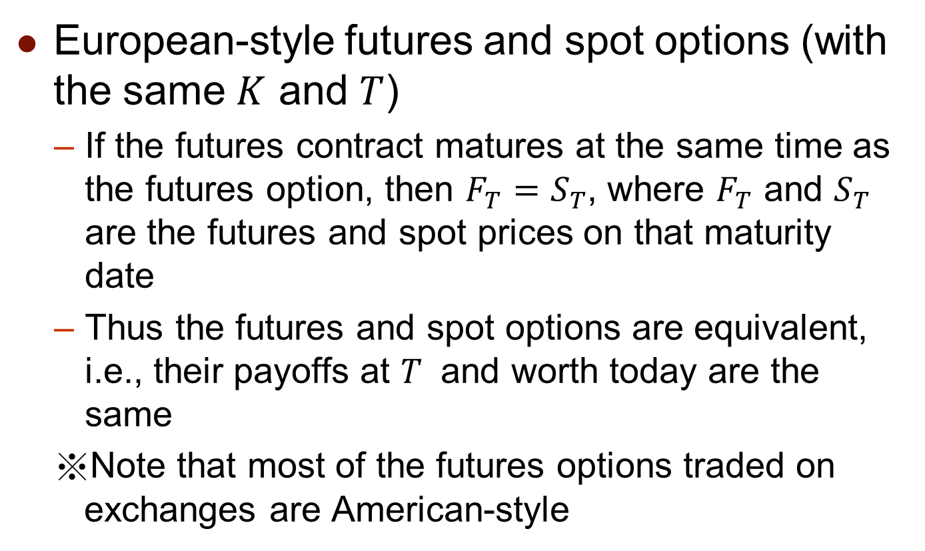
Futures Options vs. Spot Options
European-style futures and spot options (with the same $K$ and $T$)
  If the futures contract matures at the same time as the futures option, then $F_{T}=S_{T}$, where $F_{T}$ and $S_{T}$ are the futures and spot prices on that maturity date
  Thus the futures and spot options are equivalent, i.e., their payoffs at $T$ and worth today are the same
  ※Note that most of the futures options traded on exchanges are American-style

Slide 9
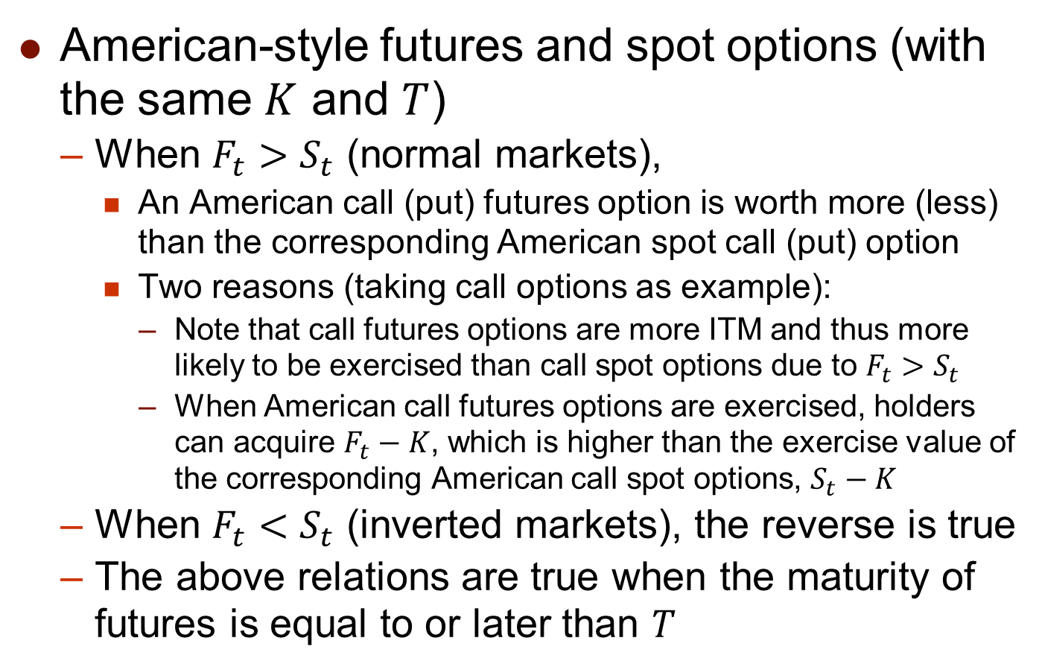
Futures Options vs. Spot Options
American-style futures and spot options (with the same $K$ and $T$)
  When $F_{t}>S_{t}$ (normal markets),
    An American call (put) futures option is worth more (less) than the corresponding American spot call (put) option
    Two reasons (taking call options as example):
      Note that call futures options are more ITM and thus more likely to be exercised than call spot options due to $F_{t}>S_{t}$
      When American call futures options are exercised, holders can acquire $F_{t}−K$, which is higher than the exercise value of the corresponding American call spot options, $S_{t}−K$
  When $F_{t}<S_{t}$ (inverted markets), the reverse is true
  The above relations are true when the maturity of futures is equal to or later than $T$

Slide 10
16.2 Properties of Futures Options

Slide 11

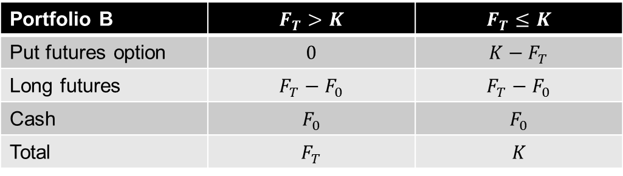
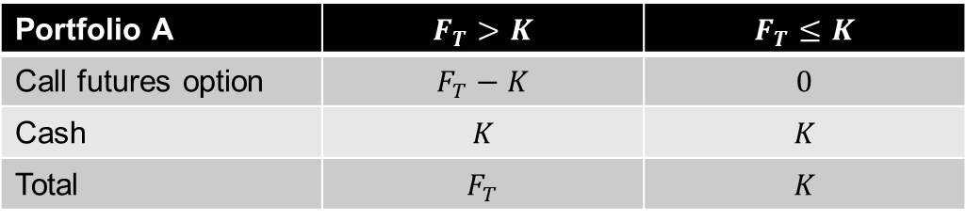
Properties of Futures Options
Put-call parity for futures options
  Consider the following two portfolios:
    Portfolio A: a European call futures option + $Ke^{−rT}$ of cash
    Portfolio B: a European put futures option + a long futures contract (with the delivery price $F_{0}$) + $F_{0}e^{−rT}$ of cash
Portfolio A | $$F_{T}>K$$ | $$F_{T}≤K$$
Call futures option | $$F_{T}−K$$ | $$0$$
Cash | $$K$$ | $$K$$
Total | $$F_{T}$$ | $$K$$
Portfolio B | $$F_{T}>K$$ | $$F_{T}≤K$$
Put futures option | $$0$$ | $$K−F_{T}$$
Long futures | $$F_{T}−F_{0}$$ | $$F_{T}−F_{0}$$
Cash | $$F_{0}$$ | $$F_{0}$$
Total | $$F_{T}$$ | $$K$$

Slide 12
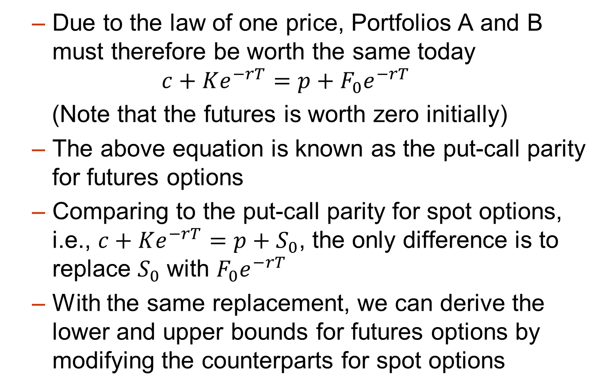
Properties of Futures Options
  Due to the law of one price, Portfolios A and B must therefore be worth the same today
  $$c+Ke^{−rT}=p+F_{0}e^{−rT}$$
  (Note that the futures is worth zero initially)
  The above equation is known as the put-call parity for futures options
  Comparing to the put-call parity for spot options, i.e., $c+Ke^{−rT}=p+S_{0}$, the only difference is to replace $S_{0}$ with $F_{0}e^{−rT}$
  With the same replacement, we can derive the lower and upper bounds for futures options by modifying the counterparts for spot options

Slide 13
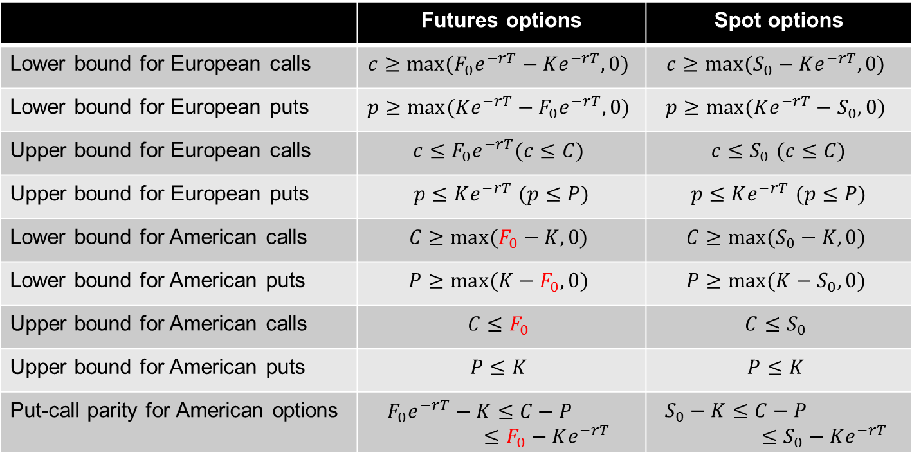
Properties of Futures Options
 | Futures options | Spot options
Lower bound for European calls | $$c≥max⁡(F_{0}e^{−rT}−Ke^{−rT},0)$$ | $$c≥max⁡(S_{0}−Ke^{−rT},0)$$
Lower bound for European puts | $$p≥max⁡(Ke^{−rT}−F_{0}e^{−rT},0)$$ | $$p≥max⁡(Ke^{−rT}−S_{0},0)$$
Upper bound for European calls | $$c≤F_{0}e^{−rT}(c≤C)$$ | $c≤S_{0}$ $(c≤C)$
Upper bound for European puts | $p≤Ke^{−rT}$ $(p≤P)$ | $p≤Ke^{−rT}$ $(p≤P)$
Lower bound for American calls | $$C≥max⁡(F_{0}−K,0)$$ | $$C≥max⁡(S_{0}−K,0)$$
Lower bound for American puts | $$P≥max⁡(K−F_{0},0)$$ | $$P≥max⁡(K−S_{0},0)$$
Upper bound for American calls | $$C≤F_{0}$$ | $$C≤S_{0}$$
Upper bound for American puts | $$P≤K$$ | $$P≤K$$
Put-call parity for American options | $$F_{0}e^{−rT}−K≤C−P≤F_{0}−Ke^{−rT}$$ | $$S_{0}−K≤C−P≤S_{0}−Ke^{−rT}$$
The red $F_{0}$ indicate that the replacement of $S_{0}$ with $F_{0}e^{−rT}$ is not applicable

Slide 14
16.3 Pricing Futures Options with Binomial Tree Model

Slide 15
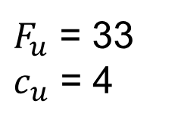
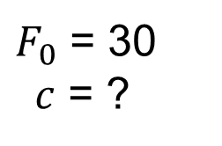
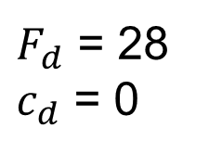
Binomial Tree for Futures Options
One-period binomial tree model for futures options
  A 1-month call option on futures has a strike price of 29
  The current futures price is 30 and it will move either upward to 33 or downward to 28 over 1 month
$F_{u}$ = 33
$c_{u}$ = 4
$F_{0}$ = 30
$c$ = ?
$F_{d}$ = 28
$c_{d}$ = 0

Slide 16
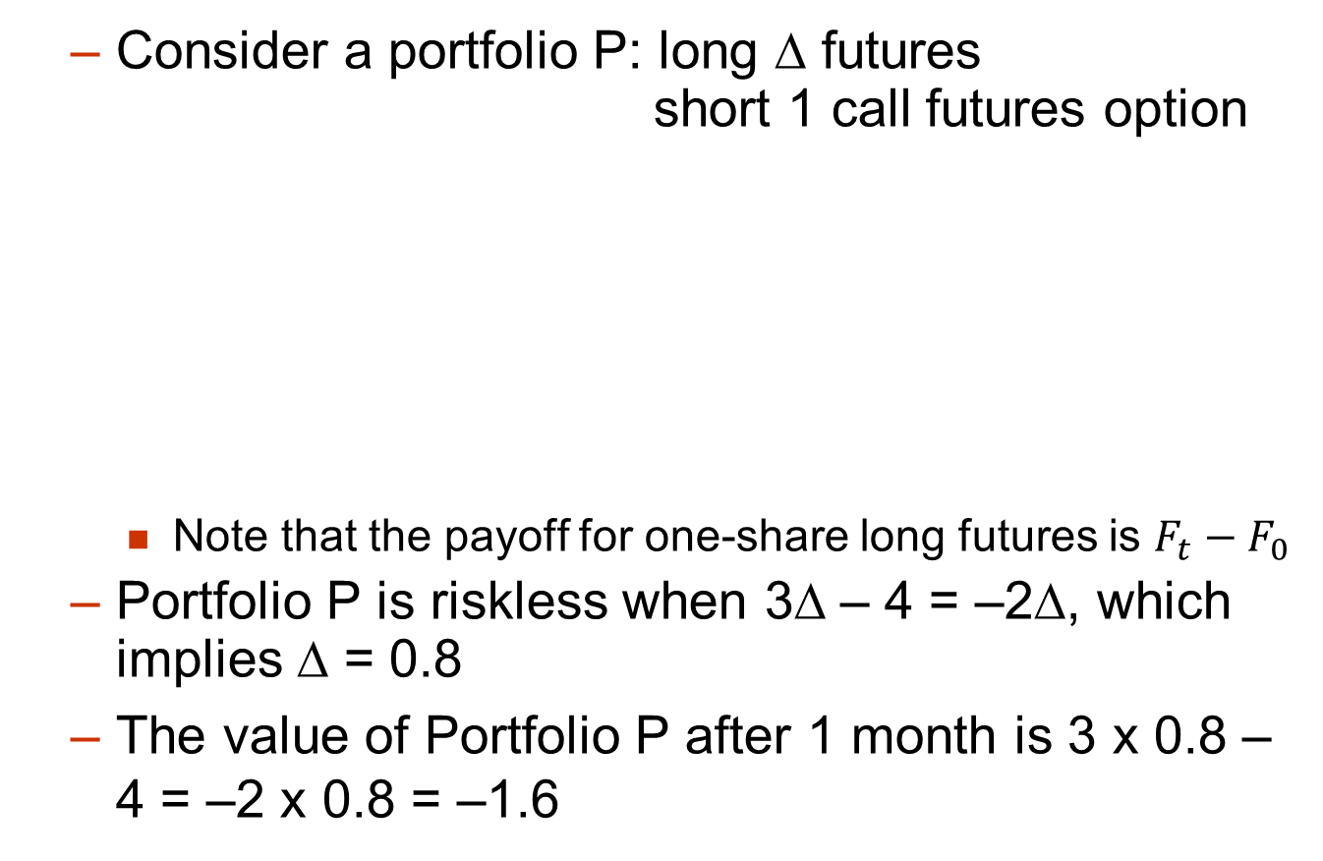
Binomial Tree for Futures Options
  Consider a portfolio P: long Δ futures short 1 call futures option
    Note that the payoff for one-share long futures is $F_{t}−F_{0}$
  Portfolio P is riskless when 3Δ – 4 = –2Δ, which implies Δ = 0.8
  The value of Portfolio P after 1 month is 3 x 0.8 – 4 = –2 x 0.8 = –1.6
3Δ – 4
–2Δ

Slide 17
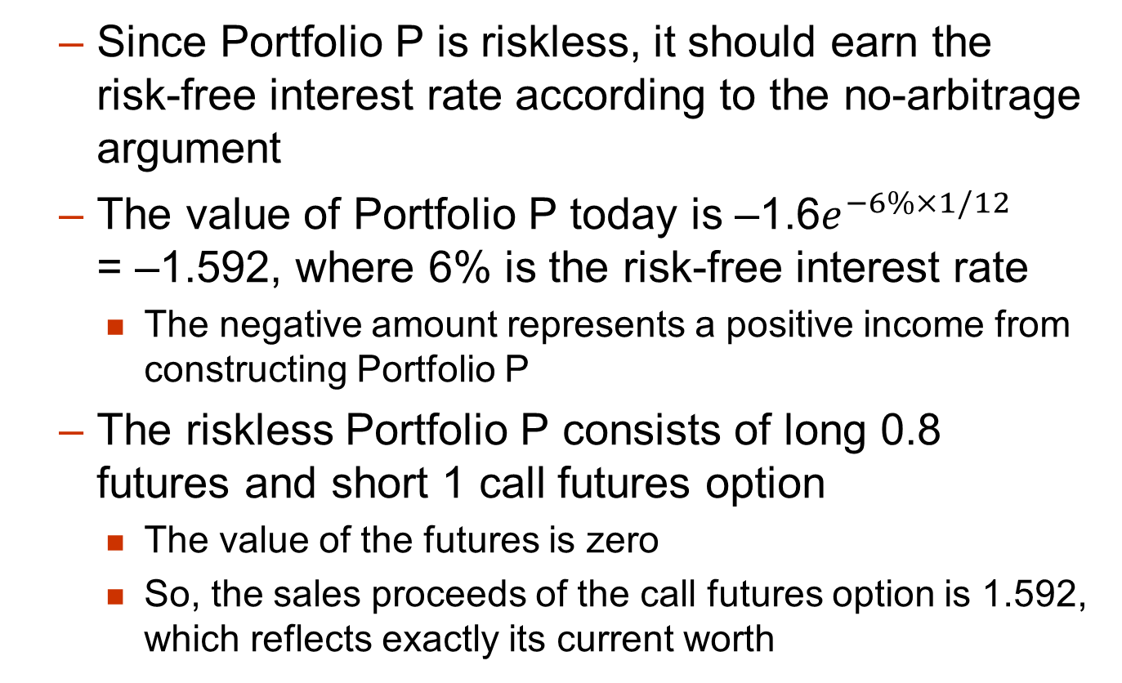
Binomial Tree for Futures Options
  Since Portfolio P is riskless, it should earn the risk-free interest rate according to the no-arbitrage argument
  The value of Portfolio P today is –1.6$e^{−6\%×1/12}$ = –1.592, where 6% is the risk-free interest rate
    The negative amount represents a positive income from constructing Portfolio P
  The riskless Portfolio P consists of long 0.8 futures and short 1 call futures option
    The value of the futures is zero
    So, the sales proceeds of the call futures option is 1.592, which reflects exactly its current worth

Slide 18
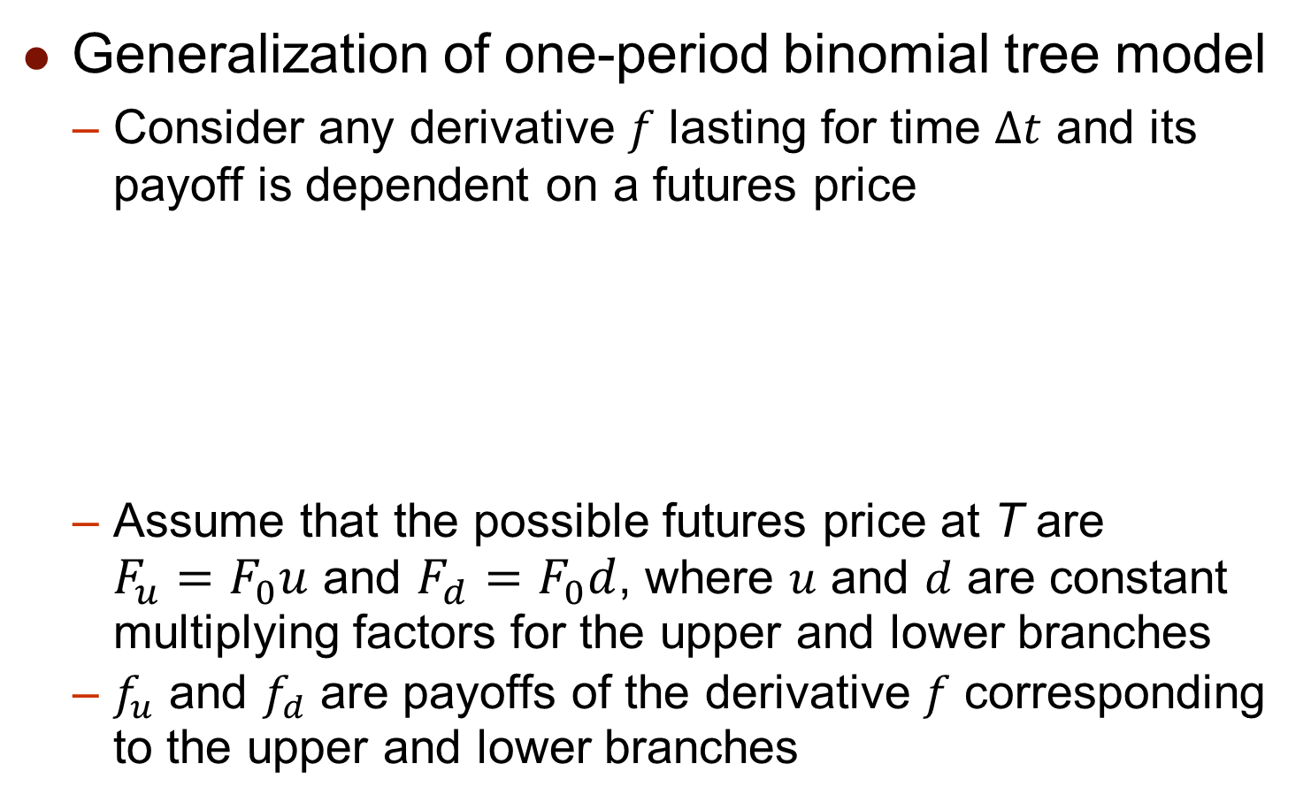

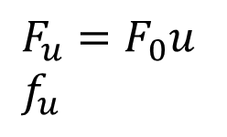
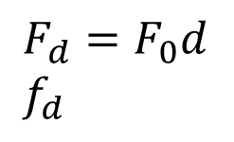
Binomial Tree for Futures Options
Generalization of one-period binomial tree model
  Consider any derivative $f$ lasting for time $Δt$ and its payoff is dependent on a futures price
  Assume that the possible futures price at T are $F_{u}=F_{0}u$ and $F_{d}=F_{0}d$, where $u$ and $d$ are constant multiplying factors for the upper and lower branches
  $f_{u}$ and $f_{d}$ are payoffs of the derivative $f$ corresponding to the upper and lower branches
$F_{u}=F_{0}u$
$f_{u}$
$F_{0}$ $f$
$F_{d}=F_{0}d$
$f_{d}$

Slide 19
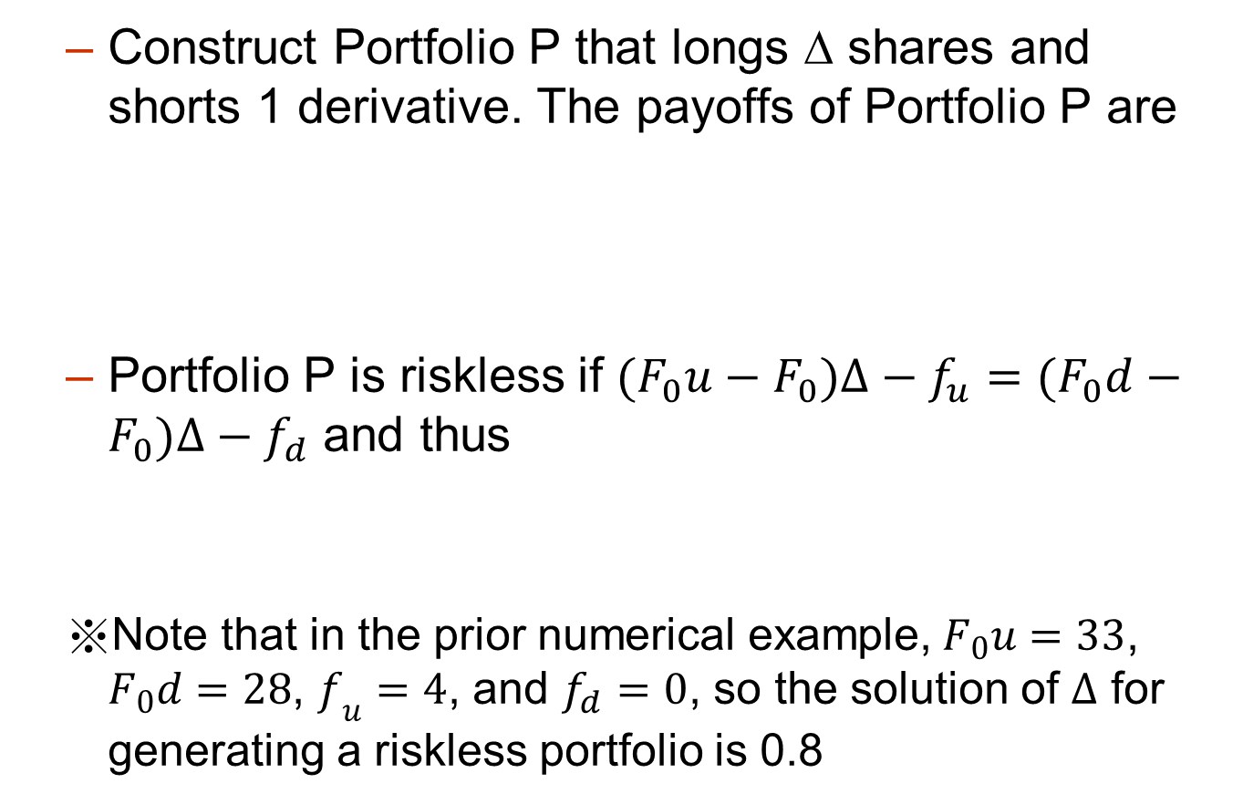



Binomial Tree for Futures Options
  Construct Portfolio P that longs Δ shares and shorts 1 derivative. The payoffs of Portfolio P are
  Portfolio P is riskless if $(F_{0}u−F_{0})Δ−f_{u}=(F_{0}d−F_{0})Δ−f_{d}$ and thus
  Note that in the prior numerical example,$F_{0}u=33$, $F_{0}d=28$, $f_{u}=4$, and $f_{d}=0$, so the solution of $Δ$ for generating a riskless portfolio is 0.8
$$(F_{0}u−F_{0})Δ−f_{u}$$
$$(F_{0}d−F_{0})Δ−f_{d}$$
$$Δ=\frac{f_{u}−f_{d}}{F_{0}u−F_{0}d}$$

Slide 20
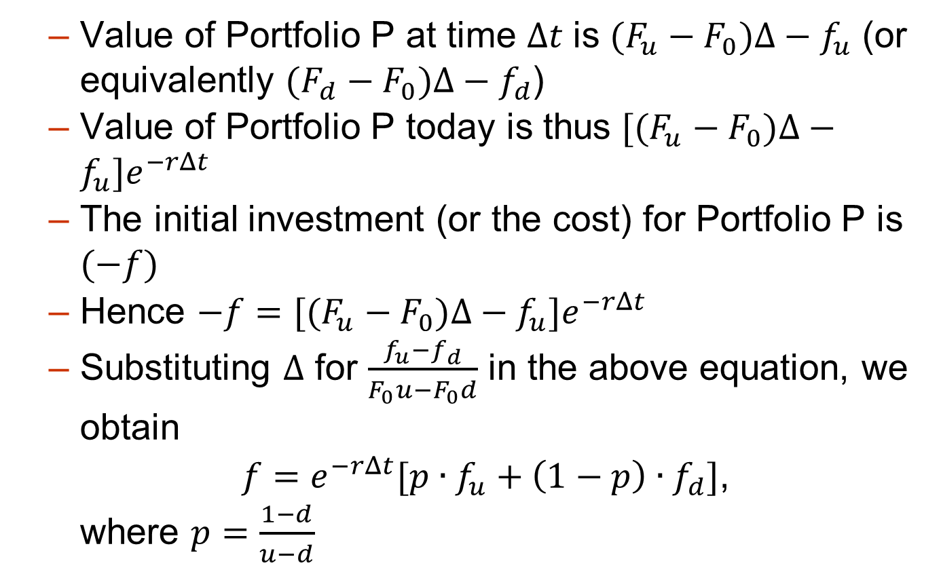
Binomial Tree for Futures Options
  Value of Portfolio P at time $Δt$ is $(F_{u}−F_{0})Δ−f_{u}$ (or equivalently $(F_{d}−F_{0})Δ−f_{d}$)
  Value of Portfolio P today is thus $[(F_{u}−F_{0})Δ−f_{u}]e^{−rΔt}$
  The initial investment (or the cost) for Portfolio P is $(−f)$
  Hence $−f=[(F_{u}−F_{0})Δ−f_{u}]e^{−rΔt}$
  Substituting $Δ$ for $\frac{f_{u}−f_{d}}{F_{0}u−F_{0}d}$ in the above equation, we obtain
  $f=e^{−rΔt}[p∙f_{u}+\left(1−p\right)∙f_{d}]$,
  where $p=\frac{1−d}{u−d}$

Slide 21
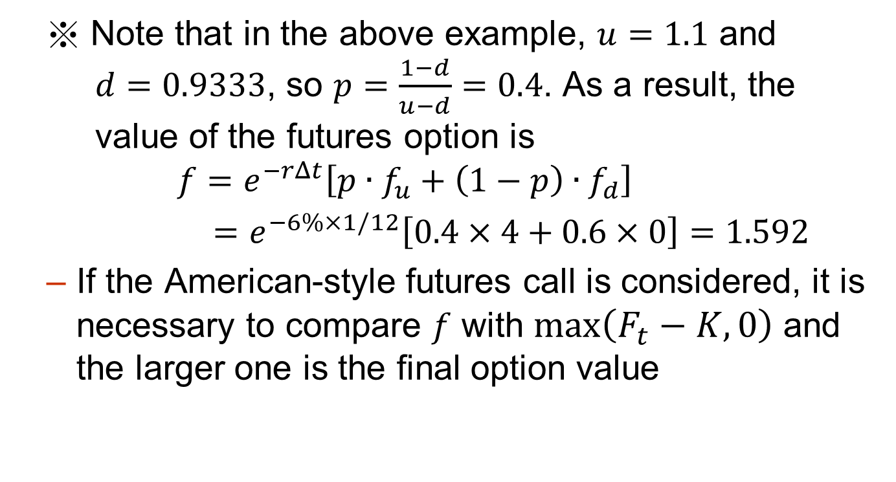
Binomial Tree for Futures Options
  ※ Note that in the above example, $u=1.1$ and $d=0.9333$, so $p=\frac{1−d}{u−d}=0.4$. As a result, the value of the futures option is
  $$f=e^{−rΔt}\left[p∙f_{u}+\left(1−p\right)∙f_{d}\right]$$
  $=e^{−6\%×1/12}\left[0.4×4+0.6×0\right]=1.592$
  If the American-style futures call is considered, it is necessary to compare $f$ with $\max\left(F_{t}−K,0\right)$ and the larger one is the final option value

Slide 22
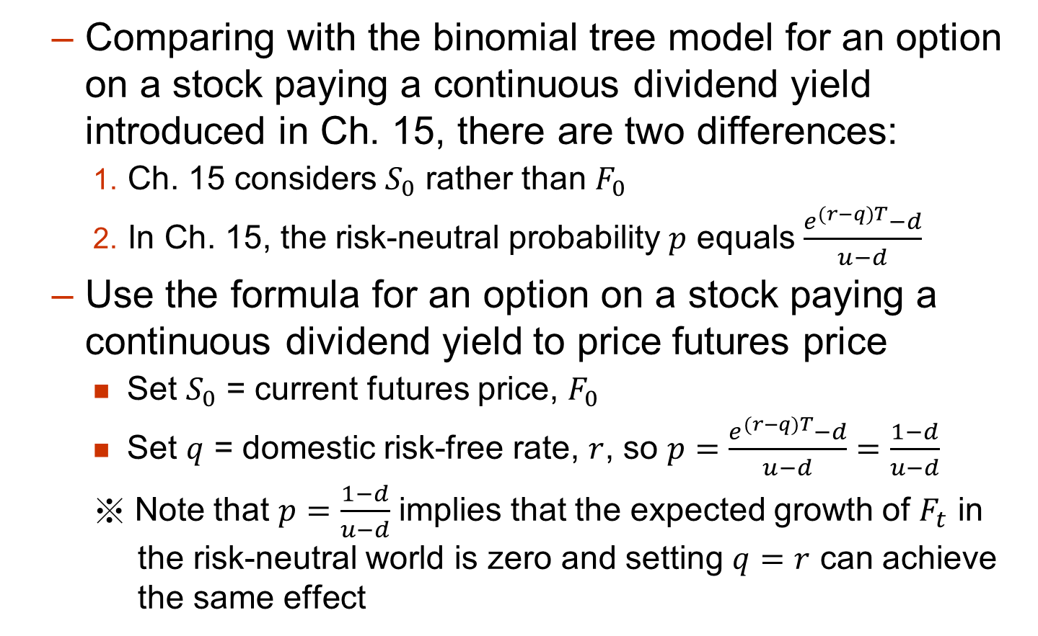
Binomial Tree for Futures Options
  Comparing with the binomial tree model for an option on a stock paying a continuous dividend yield introduced in Ch. 15, there are two differences:
    Ch. 15 considers $S_{0}$ rather than $F_{0}$
    In Ch. 15, the risk-neutral probability $p$ equals $\frac{e^{(r−q)T}−d}{u−d}$
  Use the formula for an option on a stock paying a continuous dividend yield to price futures price
    Set $S_{0}$ = current futures price, $F_{0}$
    Set $q$ = domestic risk-free rate, $r$, so $p=\frac{e^{(r−q)T}−d}{u−d}=\frac{1−d}{u−d}$
    ※ Note that $p=\frac{1−d}{u−d}$ implies that the expected growth of $F_{t}$ in the risk-neutral world is zero and setting $q=r$ can achieve the same effect

Slide 23
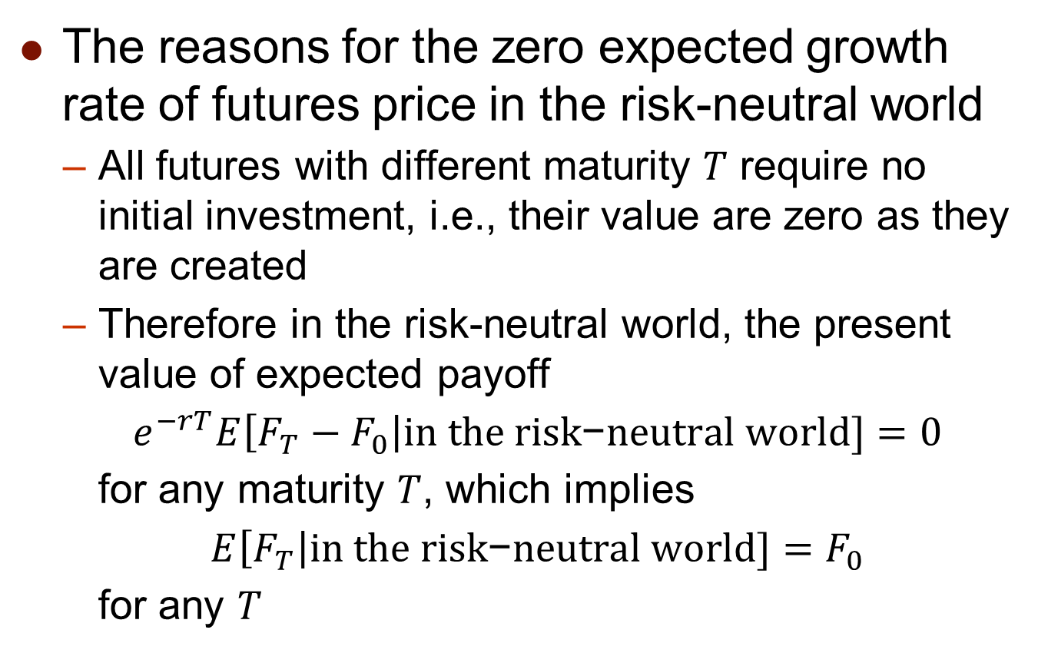
Growth Rates For Futures Prices
The reasons for the zero expected growth rate of futures price in the risk-neutral world
  All futures with different maturity $T$ require no initial investment, i.e., their value are zero as they are created
  Therefore in the risk-neutral world, the present value of expected payoff
  $e^{−rT}E\left[F_{T}−F_{0}\right|in the ri\text{sk}\text{−}\text{neutral} \text{world}\text{]}=0$
  for any maturity $T$, which implies
  $E\left[F_{T}\right|in the ri\text{sk}\text{−}\text{neutral} \text{world}\text{]}=F_{0}$
  for any $T$

Slide 24
Growth Rates For Futures Prices
  Consequently, the expected growth rate of the futures price is therefore zero
  The futures price can therefore be treated like a stock paying a dividend yield of r
  This is consistent with the results we have presented so far (put-call parity, bounds, binomial trees)
  Based on the same reasoning, we can modifying the Black-Scholes formula to price futures options shown in the next section

Slide 25
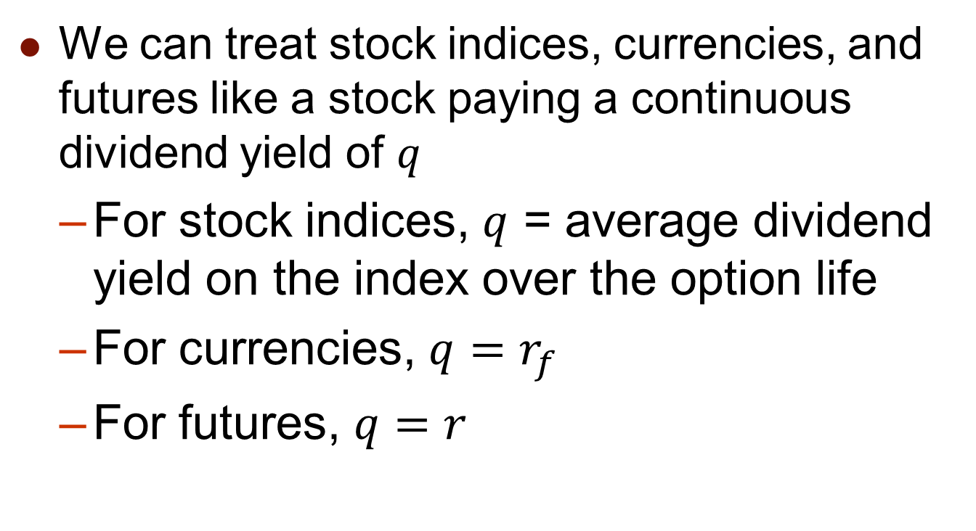
Summary of Key Results from Chapters 15 and 16
We can treat stock indices, currencies, and futures like a stock paying a continuous dividend yield of $q$
  For stock indices, $q$ = average dividend yield on the index over the option life
  For currencies, $q=r_{f}$
  For futures, $q=r$

Slide 26
16.4 Pricing Futures Options with Black’s Model

Slide 27
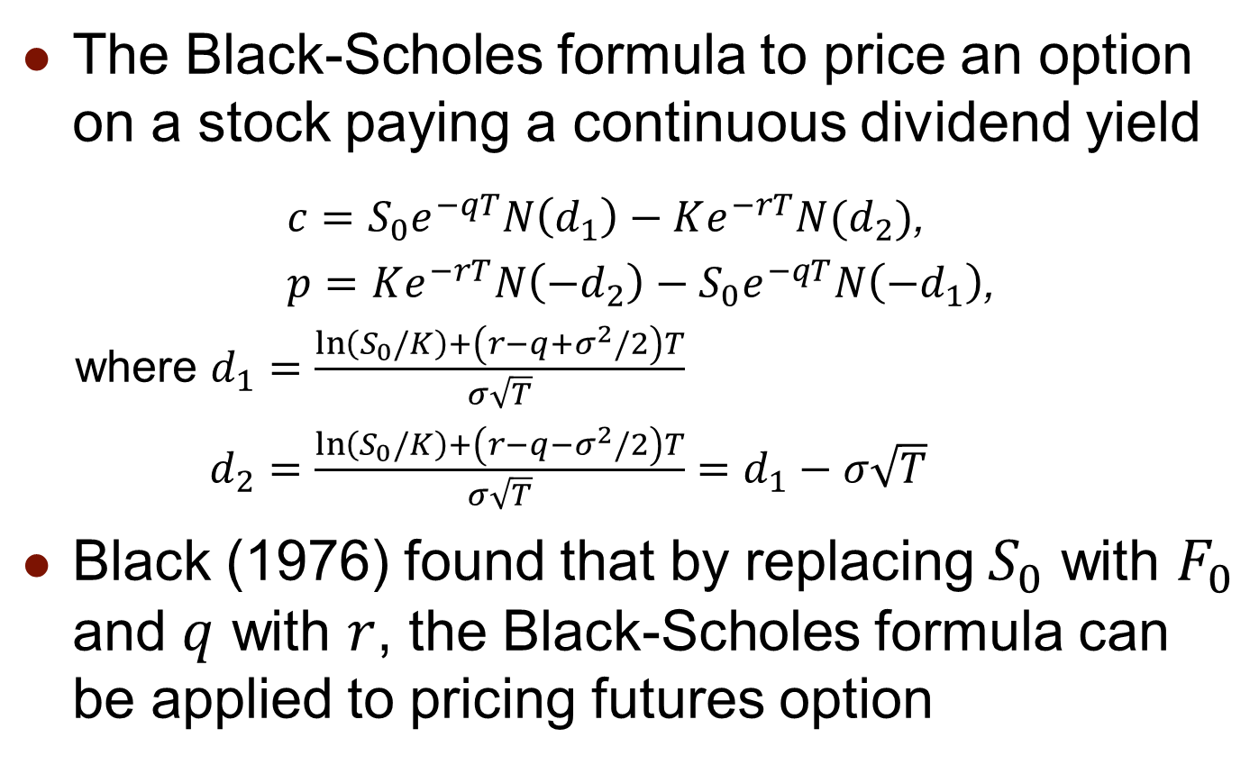
Black’s Model for Pricing Futures Options
The Black-Scholes formula to price an option on a stock paying a continuous dividend yield
  $c=S_{0}e^{−qT}N\left(d_{1}\right)−Ke^{−rT}N(d_{2})$,
$p=Ke^{−rT}N\left(−d_{2}\right)−S_{0}e^{−qT}N\left(−d_{1}\right)$,
where $d_{1}=\frac{\ln\left(S_{0}/K\right)+\left(r−q+σ^{2}/2\right)T}{σ\sqrt{T}}$
$d_{2}=\frac{\ln\left(S_{0}/K\right)+\left(r−q−σ^{2}/2\right)T}{σ\sqrt{T}}=d_{1}−σ\sqrt{T}$
Black (1976) found that by replacing $S_{0}$ with $F_{0}$ and $q$ with $r$, the Black-Scholes formula can be applied to pricing futures option

Slide 28
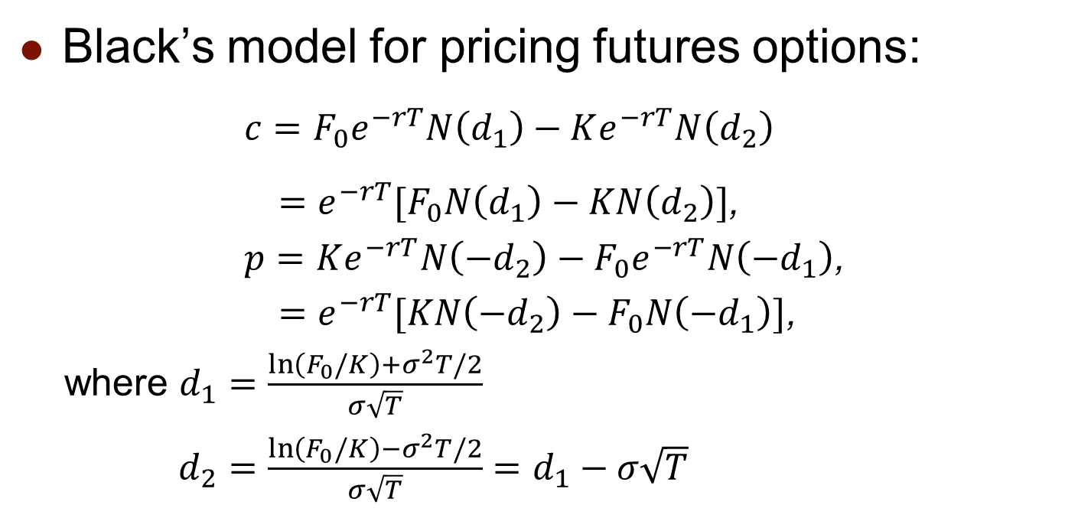
Black’s Model for Pricing Futures Options
Black’s model for pricing futures options:
  $c=F_{0}e^{−rT}N\left(d_{1}\right)−Ke^{−rT}N\left(d_{2}\right)$
  $=e^{−rT}[F_{0}N\left(d_{1}\right)−KN\left(d_{2}\right)]$,
$p=Ke^{−rT}N\left(−d_{2}\right)−F_{0}e^{−rT}N\left(−d_{1}\right)$,
  $=e^{−rT}[KN\left(−d_{2}\right)−F_{0}N\left(−d_{1}\right)]$,
where $d_{1}=\frac{\ln\left(F_{0}/K\right)+σ^{2}T/2}{σ\sqrt{T}}$
$d_{2}=\frac{\ln\left(F_{0}/K\right)−σ^{2}T/2}{σ\sqrt{T}}=d_{1}−σ\sqrt{T}$

Slide 29
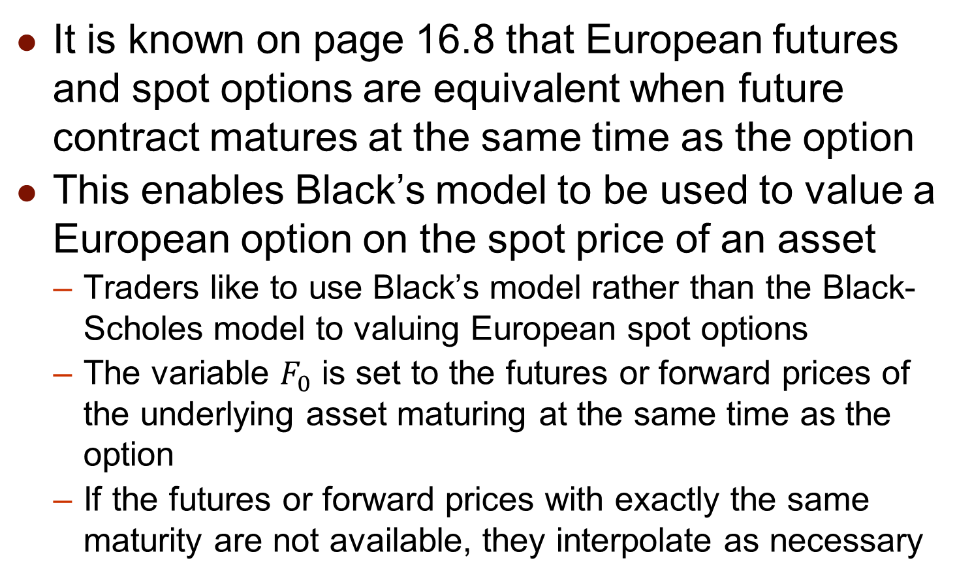
Black’s Model for Pricing Spot Options
It is known on page 16.8 that European futures and spot options are equivalent when future contract matures at the same time as the option
This enables Black’s model to be used to value a European option on the spot price of an asset
  Traders like to use Black’s model rather than the Black-Scholes model to valuing European spot options
  The variable $F_{0}$ is set to the futures or forward prices of the underlying asset maturing at the same time as the option
  If the futures or forward prices with exactly the same maturity are not available, they interpolate as necessary

Slide 30
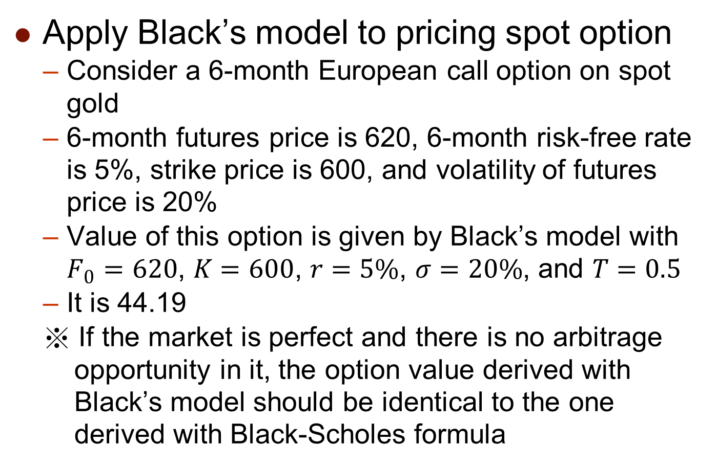
Black’s Model for Pricing Spot Options
Apply Black’s model to pricing spot option
  Consider a 6-month European call option on spot gold
  6-month futures price is 620, 6-month risk-free rate is 5%, strike price is 600, and volatility of futures price is 20%
  Value of this option is given by Black’s model with $F_{0}=620$, $K=600$, $r=5\%$, $σ=20\%$, and $T=0.5$
  It is 44.19
  ※ If the market is perfect and there is no arbitrage opportunity in it, the option value derived with Black’s model should be identical to the one derived with Black-Scholes formula

Slide 31
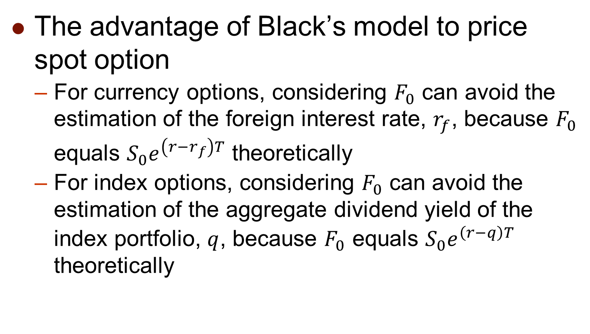
Black’s Model for Pricing Spot Options
The advantage of Black’s model to price spot option
  For currency options, considering $F_{0}$ can avoid the estimation of the foreign interest rate, $r_{f}$, because $F_{0}$ equals $S_{0}e^{\left(r−r_{f}\right)T}$ theoretically
  For index options, considering $F_{0}$ can avoid the estimation of the aggregate dividend yield of the index portfolio, $q$, because $F_{0}$ equals $S_{0}e^{\left(r−q\right)T}$ theoretically

Slide 32
16.5 Futures-Style Options

Slide 33
Futures-Style Options
A futures-style option is a futures contract on the option payoff
  Note that to trade either spot or futures options, traders should pay (receive) cash up front
  In contrast, traders who trade a futures-style option post margin in the same way that they do on a regular futures contract
  The contract is settled daily to reflect the current option value and the final settlement price is the payoff (or equivalently the final value) of the option
  Due to the attraction of the leverage effect, some exchanges trade futures-style options in preference to regular futures options

Slide 34
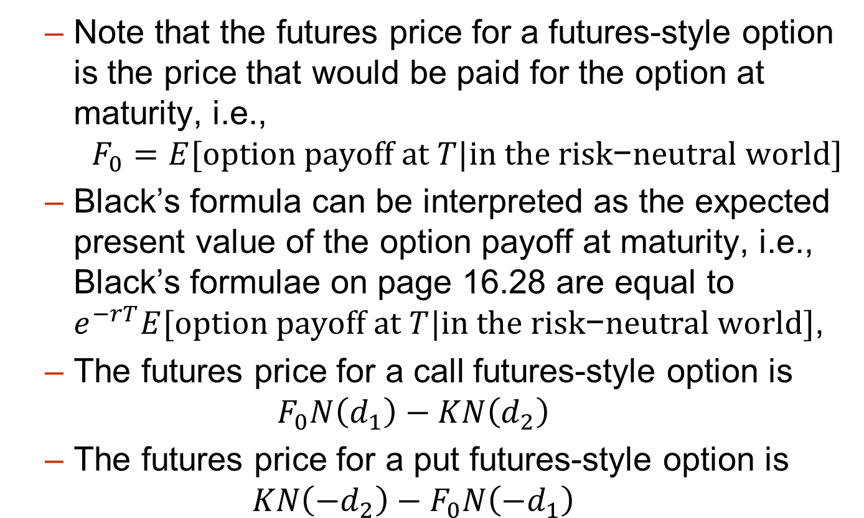
Futures-Style Options
  Note that the futures price for a futures-style option is the price that would be paid for the option at maturity, i.e.,
  $$F_{0}=E[option payoff at T|in the ri\text{sk}\text{−}\text{neutral} \text{world}]$$
  Black’s formula can be interpreted as the expected present value of the option payoff at maturity, i.e., Black’s formulae on page 16.28 are equal to $e^{−rT}E[option payoff at T|in the ri\text{sk}\text{−}\text{neutral} \text{world}]$,
  The futures price for a call futures-style option is
  $$F_{0}N\left(d_{1}\right)−KN\left(d_{2}\right)$$
  The futures price for a put futures-style option is
  $$KN\left(−d_{2}\right)−F_{0}N\left(−d_{1}\right)$$

