Slide 1
Options on Stock Indices and Currencies
Chapter 15

Slide 2
Goals of Chapter 15
The effects of introducing the dividend yield on option pricing
Introduce index options (指數選擇權)
  How to hedge portfolios with index options
  The valuation of index options
Introduce currency options (貨幣選擇權)
  The valuation of currency options
  Introduce the range-forward contracts (範圍遠期合約), which consist of a currency call and a currency put with different strike prices
Notes:
2

Slide 3
15.1 Dividend Yield and Option Pricing

Slide 4
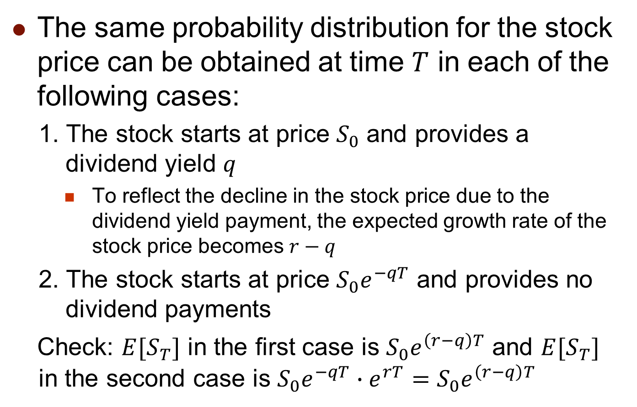
European Options on Stocks
Paying Dividend Yields
The same probability distribution for the stock price can be obtained at time $T$ in each of the following cases:
  1. The stock starts at price $S_{0}$ and provides a dividend yield $q$
    To reflect the decline in the stock price due to the dividend yield payment, the expected growth rate of the stock price becomes $r−q$
  2. The stock starts at price $S_{0}e^{−qT}$ and provides no dividend payments
  Check: $E[S_{T}]$ in the first case is $S_{0}e^{\left(r−q\right)T}$ and $E[S_{T}]$ in the second case is $S_{0}e^{−qT}∙e^{rT}=S_{0}e^{\left(r−q\right)T}$

Slide 5
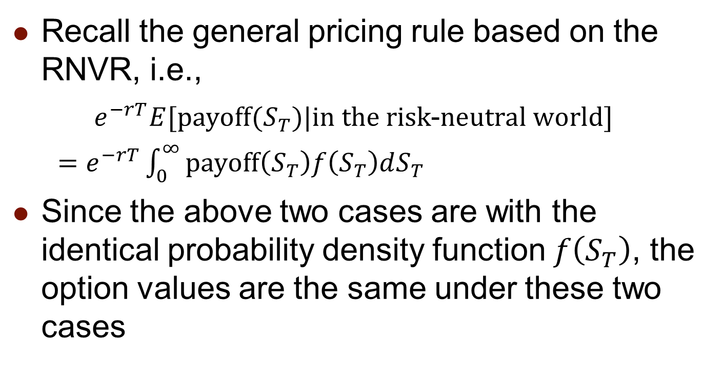
European Options on Stocks
Paying Dividend Yields
Recall the general pricing rule based on the RNVR, i.e.,
$e^{−rT}E[payoff(S_{T})|in the risk\text{−}neutral world]$
  $=e^{−rT}\int_{0}^{∞}{payoff\left(S_{T}\right)f\left(S_{T}\right)dS_{T}}$
Since the above two cases are with the identical probability density function $f\left(S_{T}\right)$, the option values are the same under these two cases

Slide 6
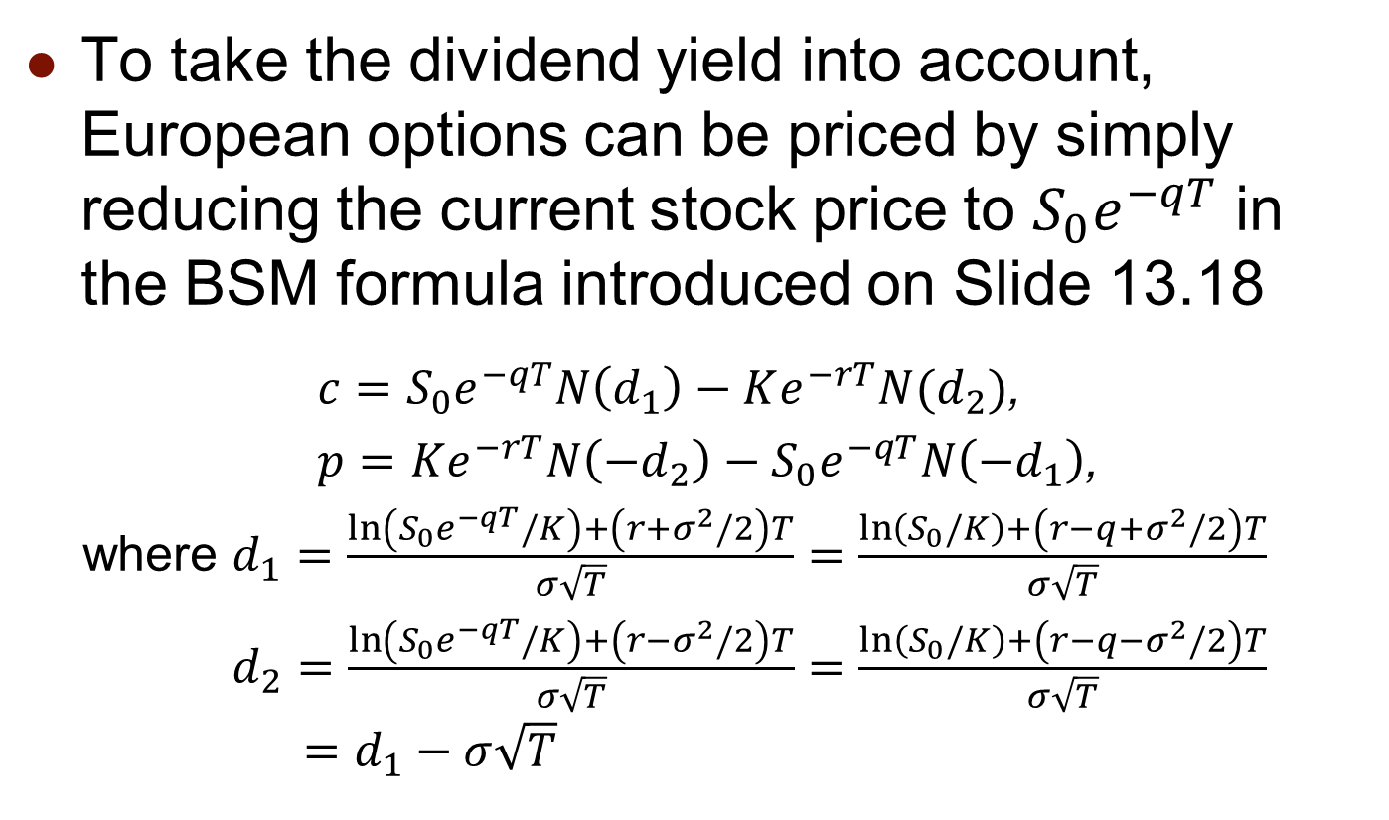
European Options on Stocks
Paying Dividend Yields
To take the dividend yield into account, European options can be priced by simply reducing the current stock price to $S_{0}e^{−qT}$ in the BSM formula introduced on Slide 13.18
  $c=S_{0}e^{−qT}N\left(d_{1}\right)−Ke^{−rT}N(d_{2})$,
$p=Ke^{−rT}N\left(−d_{2}\right)−S_{0}e^{−qT}N\left(−d_{1}\right)$,
where $d_{1}=\frac{\ln\left(S_{0}e^{−qT}/K\right)+\left(r+σ^{2}/2\right)T}{σ\sqrt{T}}=\frac{\ln\left(S_{0}/K\right)+\left(r−q+σ^{2}/2\right)T}{σ\sqrt{T}}$
$d_{2}=\frac{\ln\left(S_{0}e^{−qT}/K\right)+\left(r−σ^{2}/2\right)T}{σ\sqrt{T}}=\frac{\ln\left(S_{0}/K\right)+\left(r−q−σ^{2}/2\right)T}{σ\sqrt{T}}$
$$=d_{1}−σ\sqrt{T}$$

Slide 7
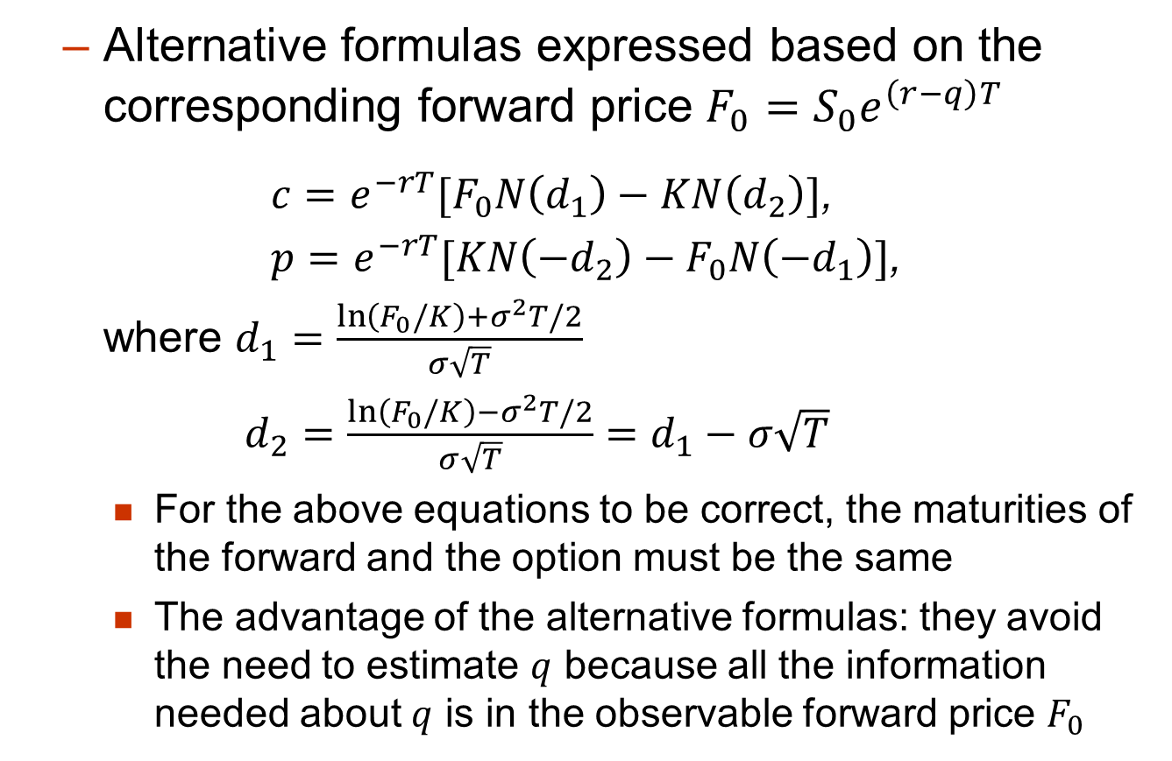
Currency Options
  Alternative formulas expressed based on the corresponding forward price $F_{0}=S_{0}e^{\left(r−q\right)T}$
  $c=e^{−rT}[F_{0}N\left(d_{1}\right)−KN\left(d_{2}\right)]$,
$p=e^{−rT}[KN\left(−d_{2}\right)−F_{0}N\left(−d_{1}\right)]$,
where $d_{1}=\frac{\ln\left(F_{0}/K\right)+σ^{2}T/2}{σ\sqrt{T}}$
$d_{2}=\frac{\ln\left(F_{0}/K\right)−σ^{2}T/2}{σ\sqrt{T}}=d_{1}−σ\sqrt{T}$
    For the above equations to be correct, the maturities of the forward and the option must be the same
    The advantage of the alternative formulas: they avoid the need to estimate $q$ because all the information needed about $q$ is in the observable forward price $F_{0}$

Slide 8

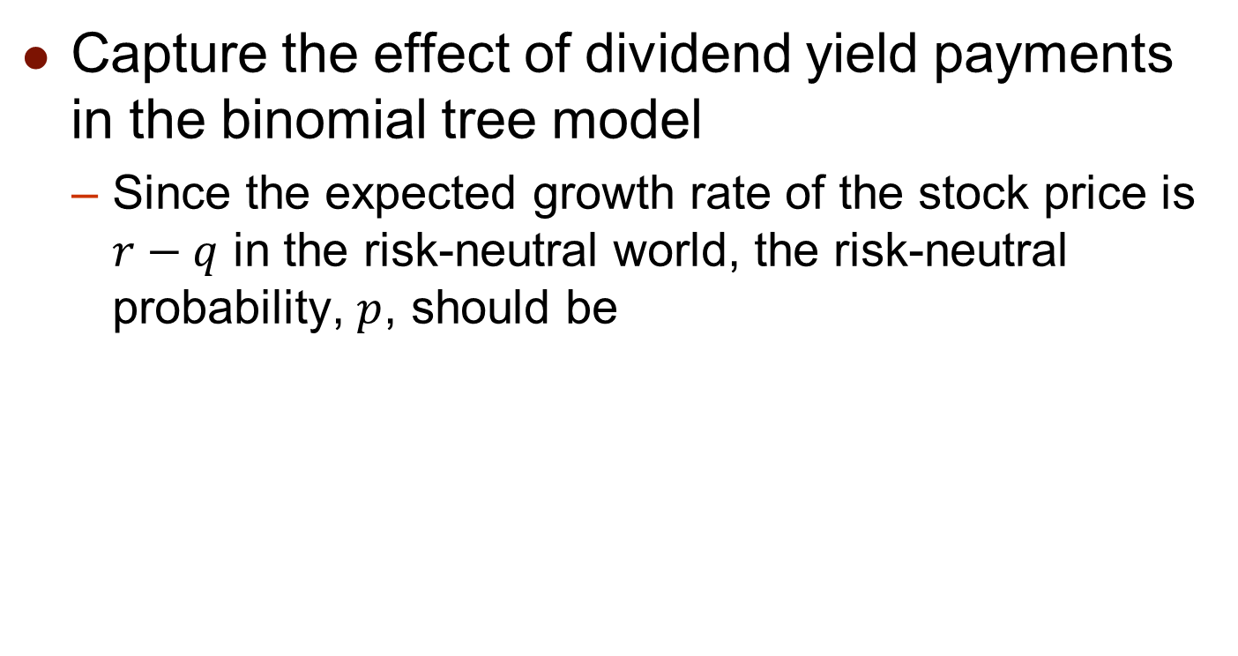





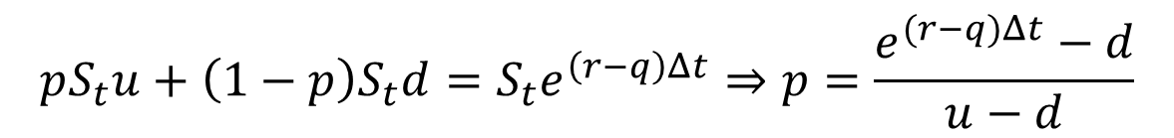

Binomial Tree Model for Stocks
Paying Dividend Yields
Capture the effect of dividend yield payments in the binomial tree model
  Since the expected growth rate of the stock price is $r−q$ in the risk-neutral world, the risk-neutral probability, $p$, should be
$$S_{t}u$$
$$p$$
$$S_{t}$$
$$1−p$$
$$S_{t}d$$
$$t$$
$$t+Δt$$
$$pS_{t}u+\left(1−p\right)S_{t}d=S_{t}e^{\left(r−q\right)Δt}⇒p=\frac{e^{(r−q)Δt}−d}{u−d}$$

Slide 9
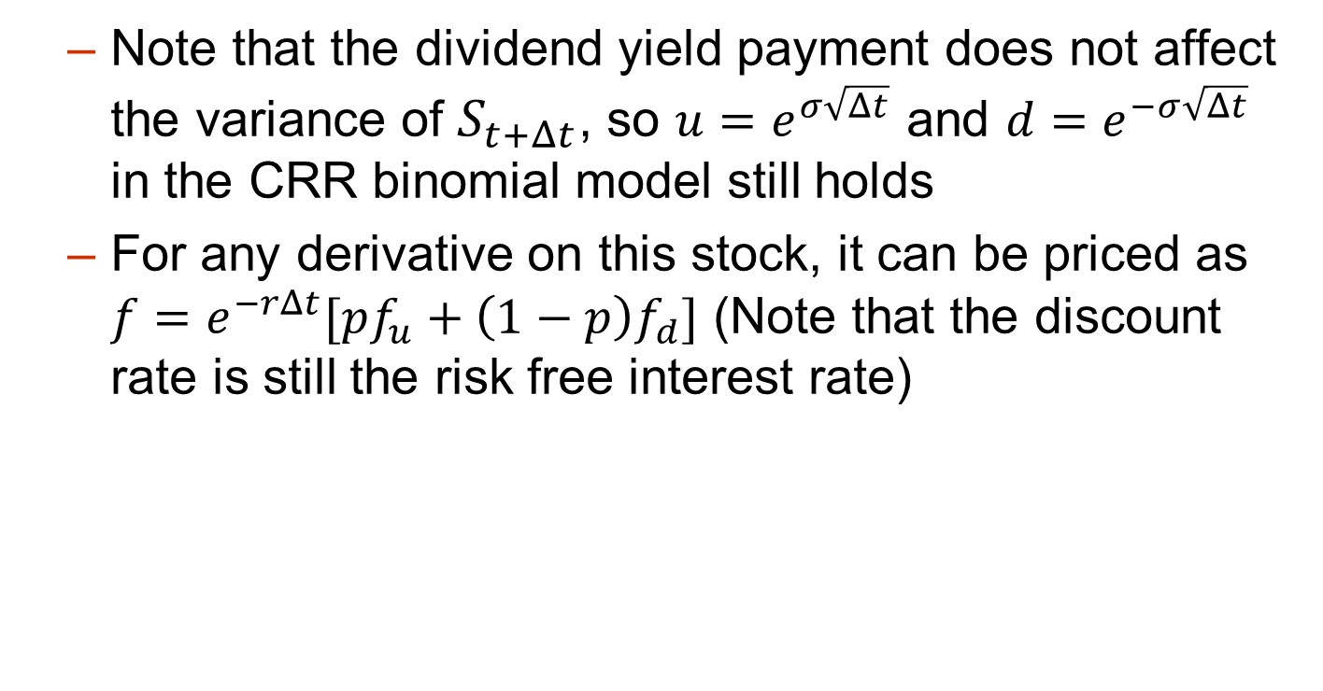



Binomial Tree Model for Stocks
Paying Dividend Yields
  Note that the dividend yield payment does not affect the variance of $S_{t+Δt}$, so $u=e^{σ\sqrt{Δt}}$ and $d=e^{−σ\sqrt{Δt}}$ in the CRR binomial model still holds
  For any derivative on this stock, it can be priced as $f=e^{−rΔt}[pf_{u}+\left(1−p\right)f_{d}]$ (Note that the discount rate is still the risk free interest rate)
$$f_{u}$$
$$p$$
$$f$$
$$1−p$$
$$f_{d}$$
$$t$$
$$t+Δt$$

Slide 10
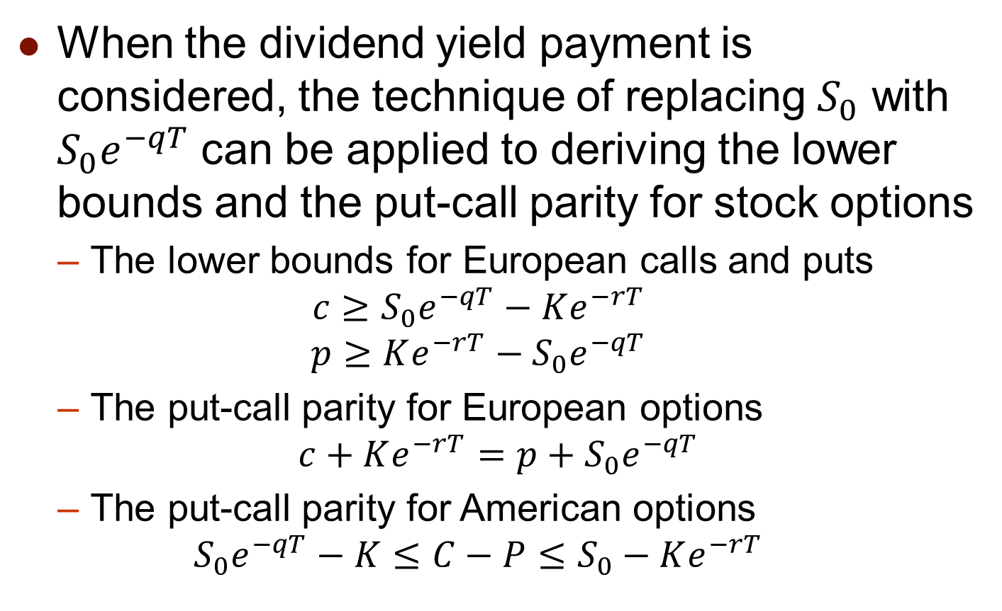
Extension of Results in Ch. 10
When the dividend yield payment is considered, the technique of replacing $S_{0}$ with $S_{0}e^{−qT}$ can be applied to deriving the lower bounds and the put-call parity for stock options
  The lower bounds for European calls and puts
  $$c≥S_{0}e^{−qT}−Ke^{−rT}$$
  $$p≥Ke^{−rT}−S_{0}e^{−qT}$$
  The put-call parity for European options
  $$c+Ke^{−rT}=p+S_{0}e^{−qT}$$
  The put-call parity for American options
  $$S_{0}e^{−qT}−K≤C−P≤S_{0}−Ke^{−rT}$$

Slide 11
15.2 Index Options (指數選擇權)

Slide 12
Index Options
The most popular indices underlying index options in the U.S. are
  Dow Jones Industrial Average times 0.01 (DJX)
  Nasdaq 100 Index (NDX)
  Russell 2000 Index (RUT)
  S&P 100 Index (OEX and XEO)
  S&P 500 Index (SPX)
  Contracts are on 100 times index, or equivalently, one point of index level is worth $100
  They are settled in cash
  OEX is American and the rests are European

Slide 13
LEAPS
Long-term Equity AnticiPation Securities (LEAPS) (長期選擇權)
  Leaps are options on stock indices that last up to 3 years
  They have December expiration dates
    For other index options, they are issued on January, February, or March cycle
  The index is adjusted appropriately (divided by five or ten) for the purposes of quoting the strike price and the option price
  Leaps also trade on some individual stocks

Slide 14
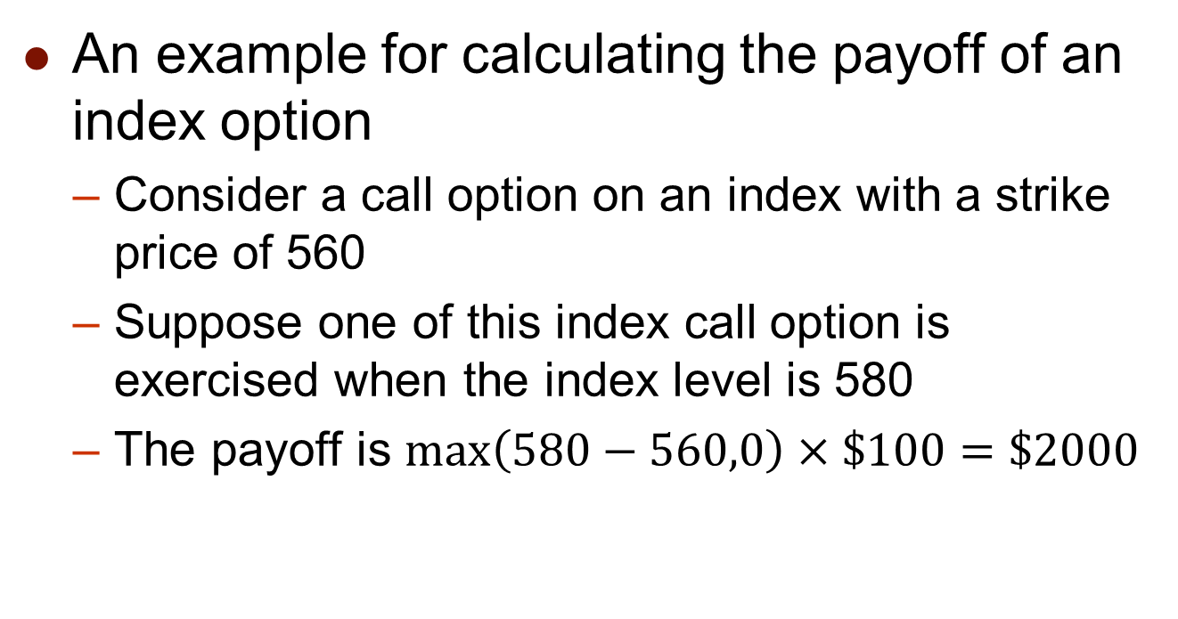
Portfolio Insurance with Index Options
An example for calculating the payoff of an index option
  Consider a call option on an index with a strike price of 560
  Suppose one of this index call option is exercised when the index level is 580
  The payoff is $\max\left(580−560,0\right)×\$100=\$2000$

Slide 15
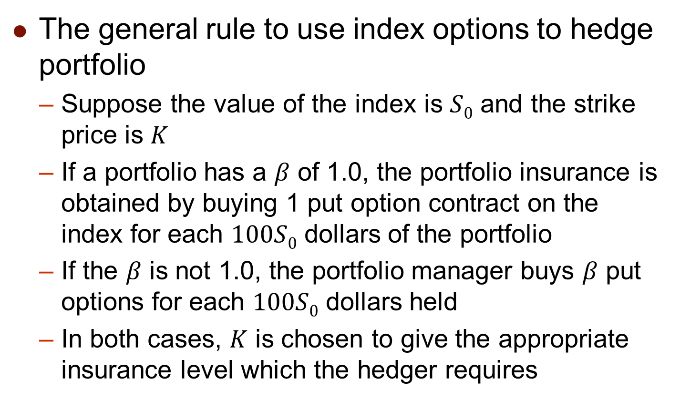
Portfolio Insurance with Index Options
The general rule to use index options to hedge portfolio
  Suppose the value of the index is $S0$ and the strike price is $K$
  If a portfolio has a $β$ of 1.0, the portfolio insurance is obtained by buying 1 put option contract on the index for each $100S0$ dollars of the portfolio
  If the $β$ is not 1.0, the portfolio manager buys $β$ put options for each $100S0$ dollars held
  In both cases, $K$ is chosen to give the appropriate insurance level which the hedger requires

Slide 16
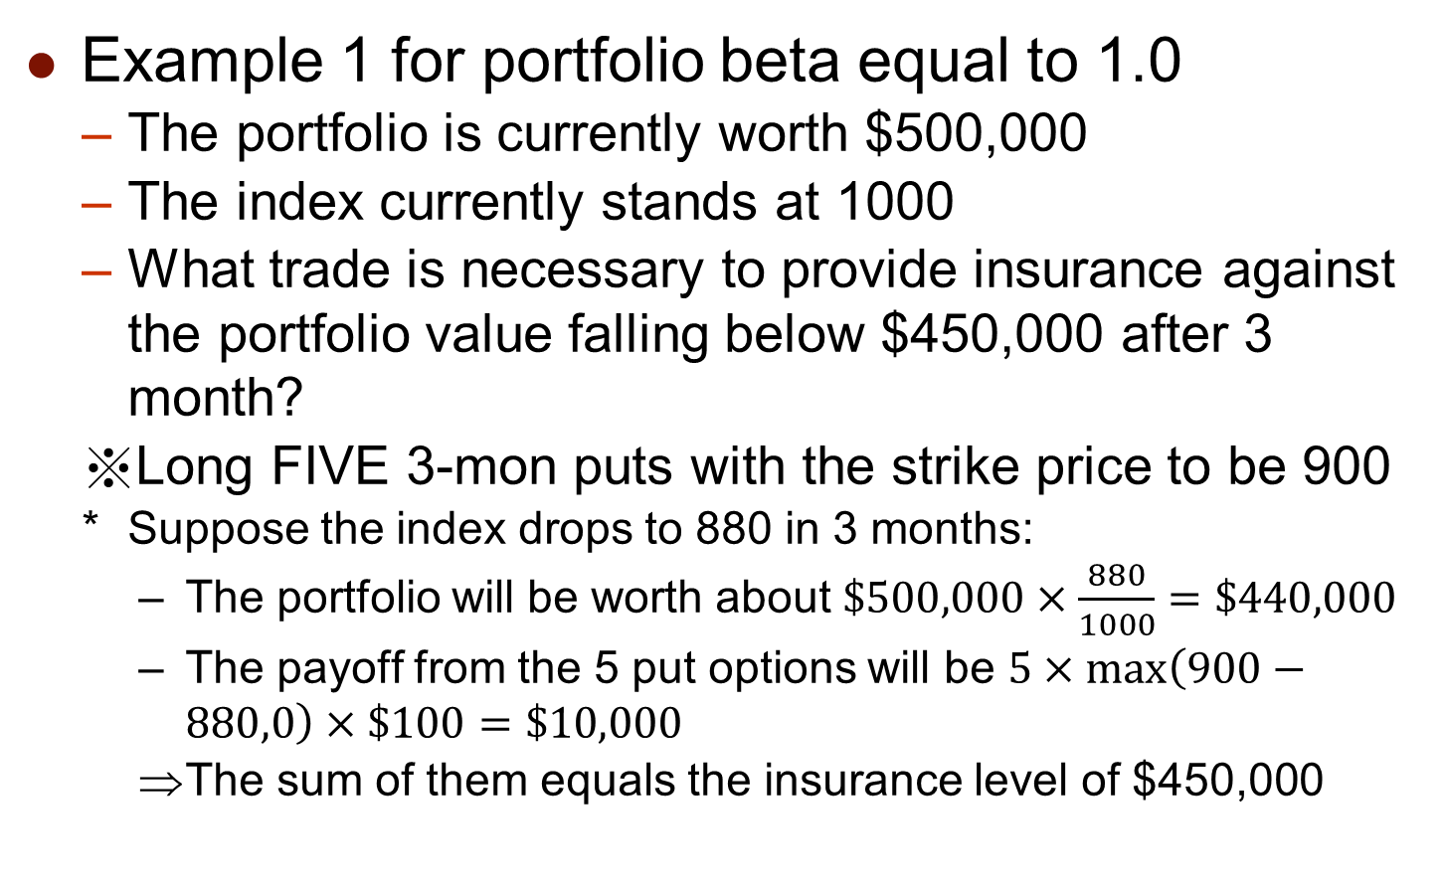
Portfolio Insurance with Index Options
Example 1 for portfolio beta equal to 1.0
  The portfolio is currently worth $500,000
  The index currently stands at 1000
  What trade is necessary to provide insurance against the portfolio value falling below $450,000 after 3 month?
  Long FIVE 3-mon puts with the strike price to be 900
  Suppose the index drops to 880 in 3 months:
    The portfolio will be worth about $\$500,000×\frac{880}{1000}=\$440,000$
    The payoff from the 5 put options will be $5×\max\left(900−880,0\right)×\$100=\$10,000$
    The sum of them equals the insurance level of $450,000

Slide 17
Portfolio Insurance with Index Options
Example 2 for portfolio beta equal to 2.0
  The portfolio is currently worth $500,000
  The index currently stands at 1000
  The risk-free rate is 12% per annum
  The dividend yield on both the portfolio and the index is 4%
  How many put option contracts should be purchased to ensure the value of the portfolio higher than $450,000?
  Long TEN puts with the strike price to be 960

Slide 18
Portfolio Insurance with Index Options
Calculating the relation between the index level and the portfolio value after 3 months
  If the index rises to 1040, it provides a 40/1000 or 4% return in 3 months
  Total return (including dividends) = 5%
  Excess return over the risk-free rate = 2%
    Note that the risk-free rate is 3% in 3 months
  Based on the CAPM, the total return of the portfolio being hedged = 3% + 2×2% = 7%
  The net return of the portfolio excluding dividends = 7% – 1% = 6%
  The end-period portfolio value = $500,000×(1 + 6%) = $530,000

Slide 19
Portfolio Insurance with Index Options
Examine the expected portfolio value given different scenarios of the stock index
  A put with a strike price of 960 will provide the protection such that the portfolio value will not be lower than $450,000 after 3 months

Slide 20
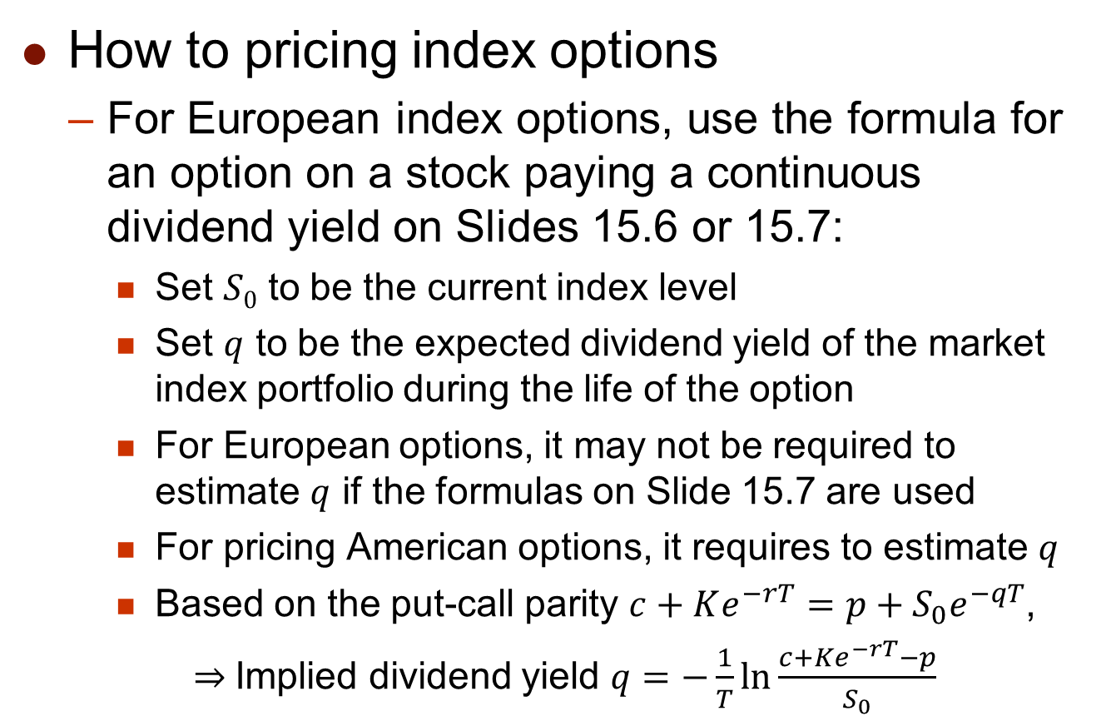
Valuing Index Options
How to pricing index options
  For European index options, use the formula for an option on a stock paying a continuous dividend yield on Slides 15.6 or 15.7:
    Set $S0$ to be the current index level
    Set $q$ to be the expected dividend yield of the market index portfolio during the life of the option
    For European options, it may not be required to estimate $q$ if the formulas on Slide 15.7 are used
    For pricing American options, it requires to estimate $q$
    Based on the put-call parity $c+Ke^{−rT}=p+S_{0}e^{−qT}$,
    $⇒$Implied dividend yield $q=−\frac{1}{T}\ln{\frac{c+Ke^{−rT}−p}{S_{0}}}$

Slide 21
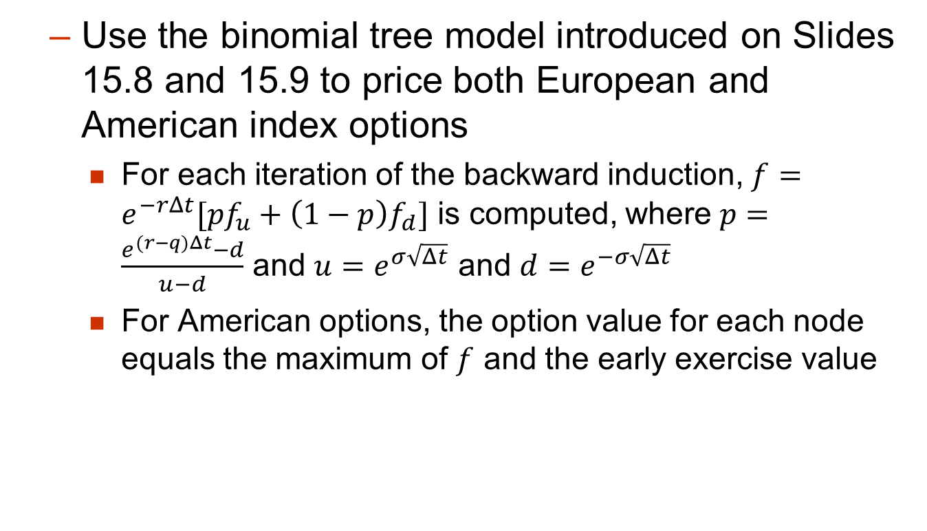
Valuing Index Options
  Use the binomial tree model introduced on Slides 15.8 and 15.9 to price both European and American index options
    For each iteration of the backward induction, $f=e^{−rΔt}[pf_{u}+\left(1−p\right)f_{d}]$ is computed, where $p=\frac{e^{(r−q)Δt}−d}{u−d}$ and $u=e^{σ\sqrt{Δt}}$ and $d=e^{−σ\sqrt{Δt}}$
    For American options, the option value for each node equals the maximum of $f$ and the early exercise value

Slide 22
15.3 Currency Options (貨幣選擇權)

Slide 23
Currency Options
Currency options trade on the NASDAQ OMX
There also exists an active over-the-counter (OTC) market
  The exchange-traded market for currency options is much smaller than the OTC market
Currency options are commonly used by corporations to buy insurance when they have an foreign exchange exposure

Slide 24
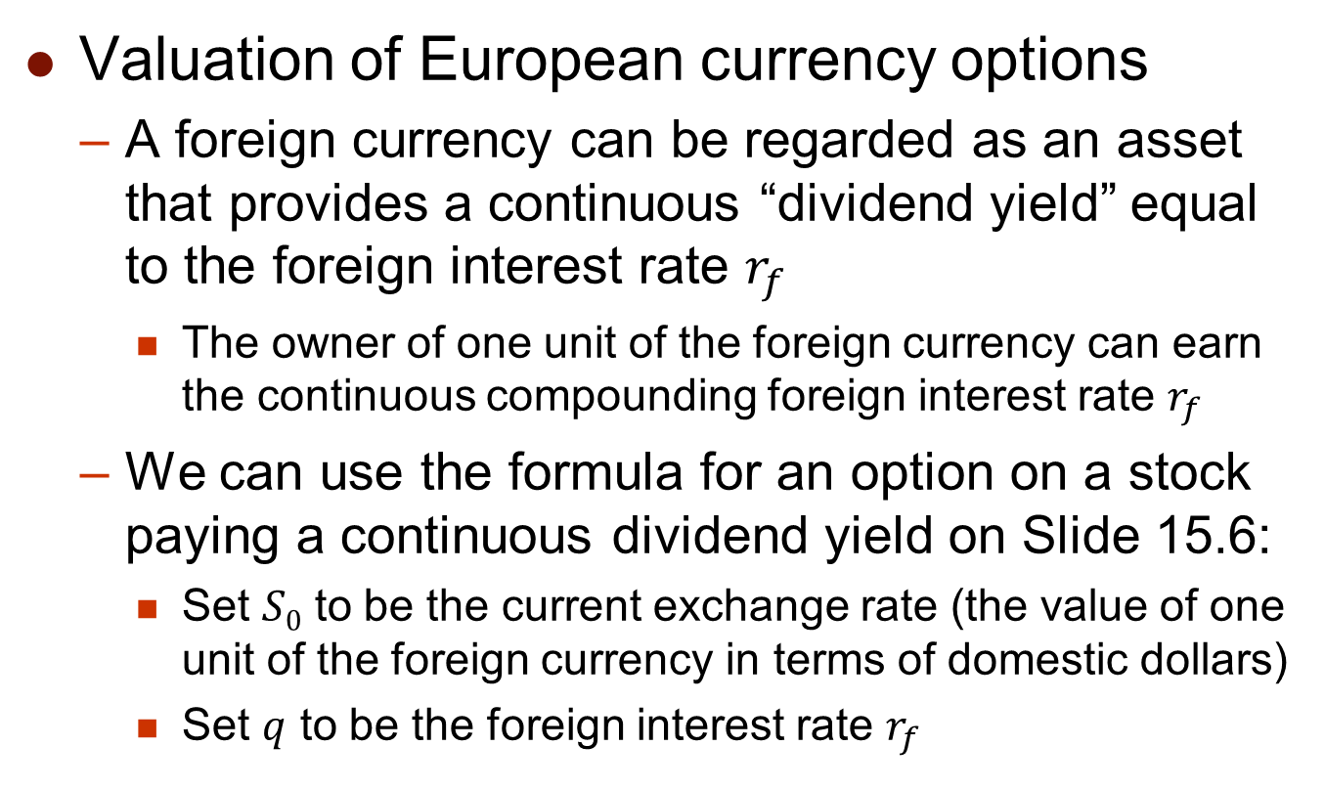
Currency Options
Valuation of European currency options
  A foreign currency can be regarded as an asset that provides a continuous “dividend yield” equal to the foreign interest rate $r_{f}$
    The owner of one unit of the foreign currency can earn the continuous compounding foreign interest rate $r_{f}$
  We can use the formula for an option on a stock paying a continuous dividend yield on Slide 15.6:
    Set $S0$ to be the current exchange rate (the value of one unit of the foreign currency in terms of domestic dollars)
    Set $q$ to be the foreign interest rate $r_{f}$

Slide 25
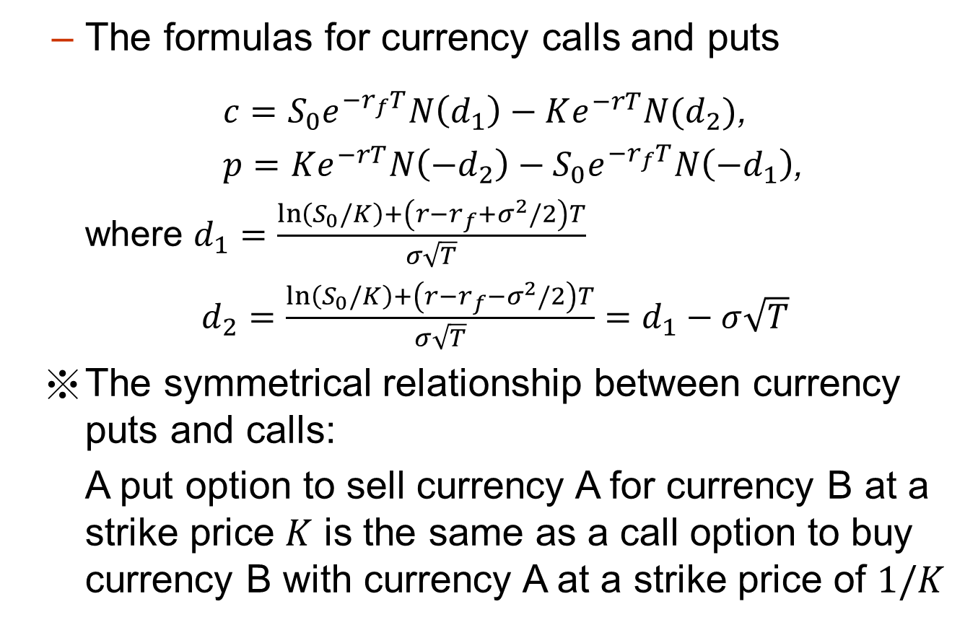
Currency Options
  The formulas for currency calls and puts
  $c=S_{0}e^{−r_{f}T}N\left(d_{1}\right)−Ke^{−rT}N(d_{2})$,
$p=Ke^{−rT}N\left(−d_{2}\right)−S_{0}e^{−r_{f}T}N\left(−d_{1}\right)$,
where $d_{1}=\frac{\ln\left(S_{0}/K\right)+\left(r−r_{f}+σ^{2}/2\right)T}{σ\sqrt{T}}$
$d_{2}=\frac{\ln\left(S_{0}/K\right)+\left(r−r_{f}−σ^{2}/2\right)T}{σ\sqrt{T}}=d_{1}−σ\sqrt{T}$
The symmetrical relationship between currency puts and calls:
A put option to sell currency A for currency B at a strike price $K$ is the same as a call option to buy currency B with currency A at a strike price of $1/K$

Slide 26
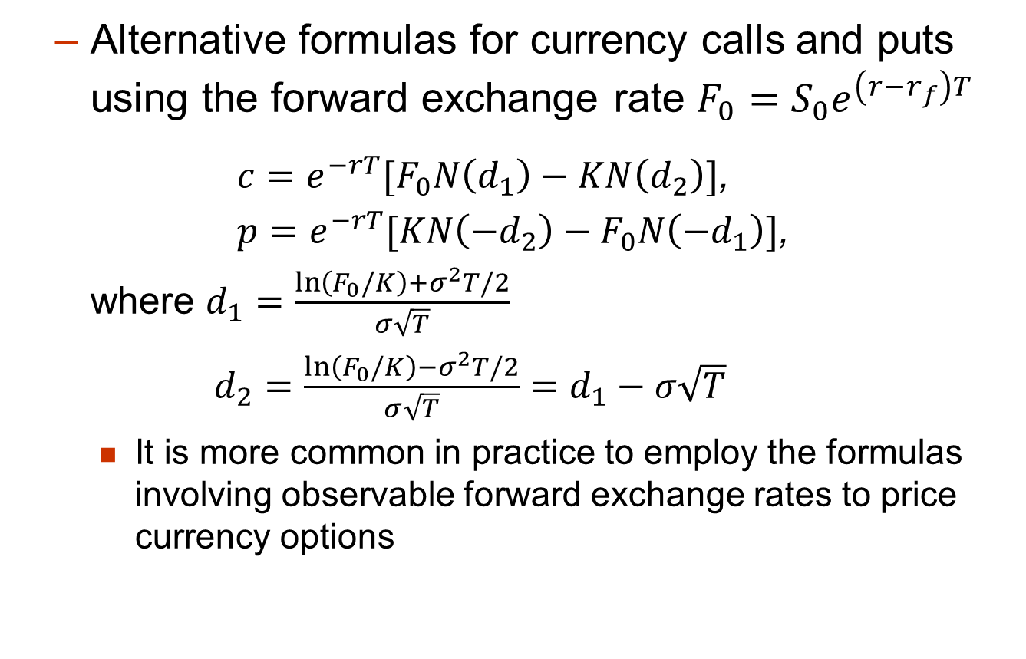
Currency Options
  Alternative formulas for currency calls and puts using the forward exchange rate $F_{0}=S_{0}e^{\left(r−r_{f}\right)T}$
  $c=e^{−rT}[F_{0}N\left(d_{1}\right)−KN\left(d_{2}\right)]$,
$p=e^{−rT}[KN\left(−d_{2}\right)−F_{0}N\left(−d_{1}\right)]$,
where $d_{1}=\frac{\ln\left(F_{0}/K\right)+σ^{2}T/2}{σ\sqrt{T}}$
$d_{2}=\frac{\ln\left(F_{0}/K\right)−σ^{2}T/2}{σ\sqrt{T}}=d_{1}−σ\sqrt{T}$
    It is more common in practice to employ the formulas involving observable forward exchange rates to price currency options

Slide 27
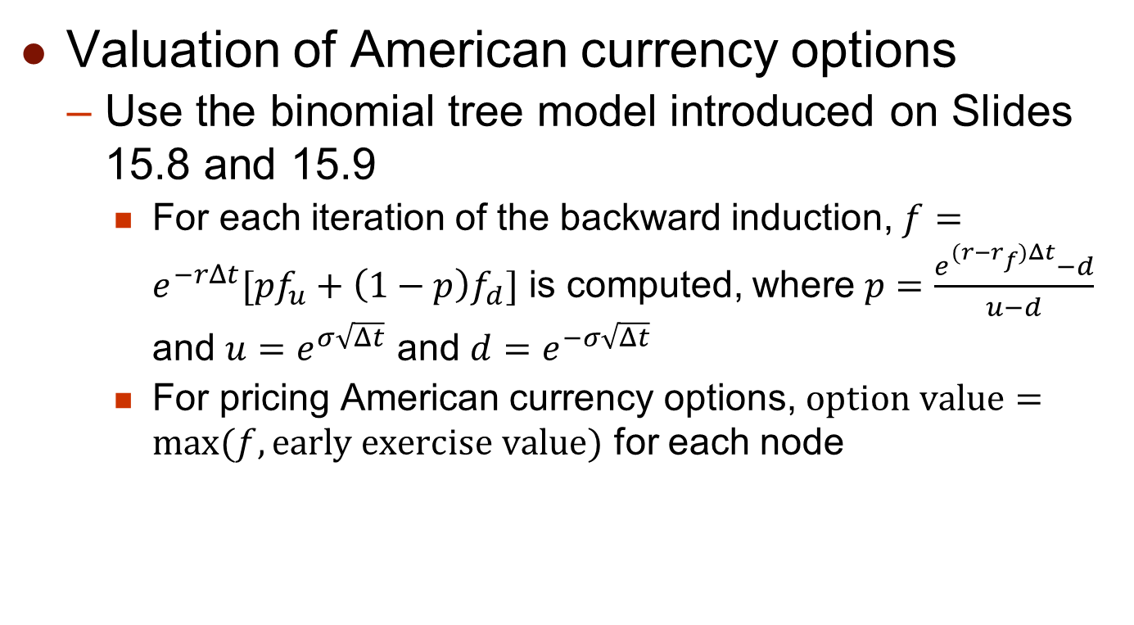
Currency Options
Valuation of American currency options
  Use the binomial tree model introduced on Slides 15.8 and 15.9
    For each iteration of the backward induction, $f=e^{−rΔt}[pf_{u}+\left(1−p\right)f_{d}]$ is computed, where $p=\frac{e^{(r−r_{f})Δt}−d}{u−d}$ and $u=e^{σ\sqrt{Δt}}$ and $d=e^{−σ\sqrt{Δt}}$
    For pricing American currency options, $option value=max⁡(f,early exercise value)$ for each node

Slide 28
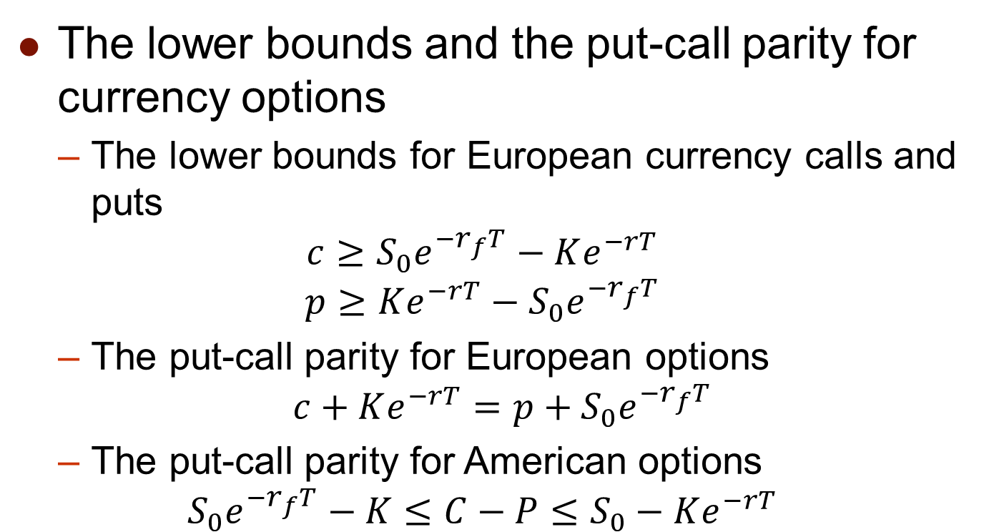
Extension of Results in Ch. 10
The lower bounds and the put-call parity for currency options
  The lower bounds for European currency calls and puts
  $$c≥S_{0}e^{−r_{f}T}−Ke^{−rT}$$
  $$p≥Ke^{−rT}−S_{0}e^{−r_{f}T}$$
  The put-call parity for European options
  $$c+Ke^{−rT}=p+S_{0}e^{−r_{f}T}$$
  The put-call parity for American options
  $$S_{0}e^{−r_{f}T}−K≤C−P≤S_{0}−Ke^{−rT}$$

Slide 29
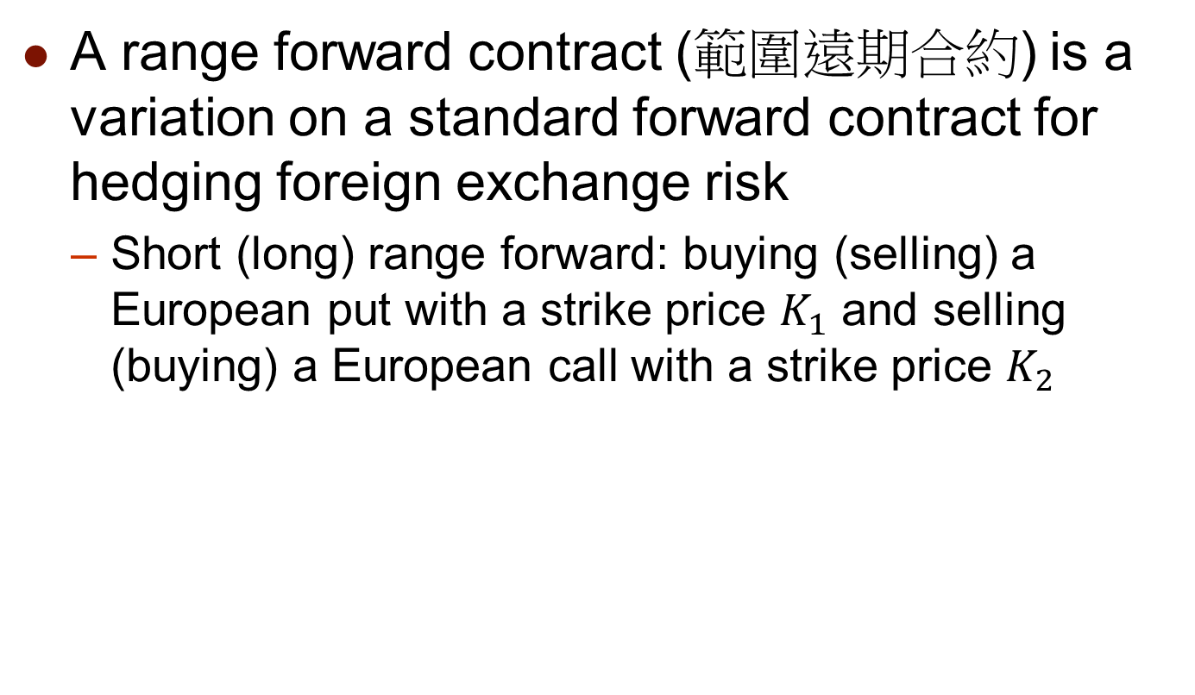
Range Forward Contracts
A range forward contract (範圍遠期合約) is a variation on a standard forward contract for hedging foreign exchange risk
  Short (long) range forward: buying (selling) a European put with a strike price $K_{1}$ and selling (buying) a European call with a strike price $K_{2}$
Payoff of short range forward
Payoff of long range forward
Asset Price
K₁
K₂
K₁
K₂
Asset Price
Short forward
Long forward

Slide 30

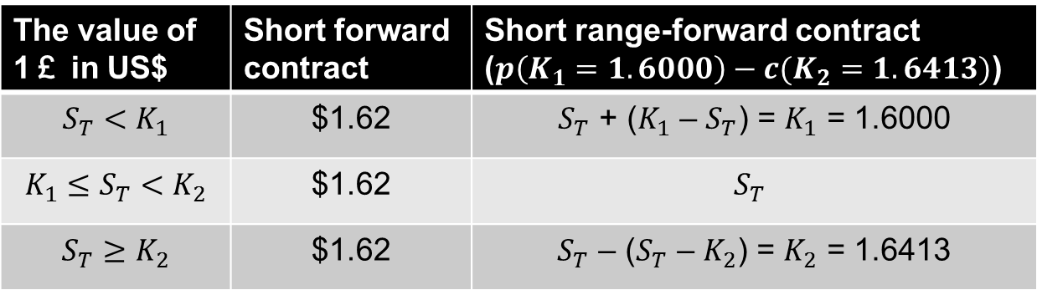
Range Forward Contracts
  Consider a U.S. company that knows it will receive one million pounds sterling in three months
    Entering into a short forward contract with the delivery price to be $1.6200/￡
    Entering into a short range-forward contract with $K_{1}=$ $1.6000/￡ and $K_{2}=$ $1.6413/￡
The value of 1￡ in US$ | Short forward contract | Short range-forward contract ($p\left(K_{1}=1.6000\right)−c(K_{2}=1.6413)$)
$$S_{T}<K_{1}$$ | $1.62 | $S_{T}$ + ($K_{1}$ – $S_{T}$) = $K_{1}$ = 1.6000
$$K_{1}≤S_{T}<K_{2}$$ | $1.62 | $$S_{T}$$
$$S_{T}≥K_{2}$$ | $1.62 | $S_{T}$ – ($S_{T}$ – $K_{2}$) = $K_{2}$ = 1.6413
$S_{T}$ denotes the final exchange rate after 3 months

Slide 31
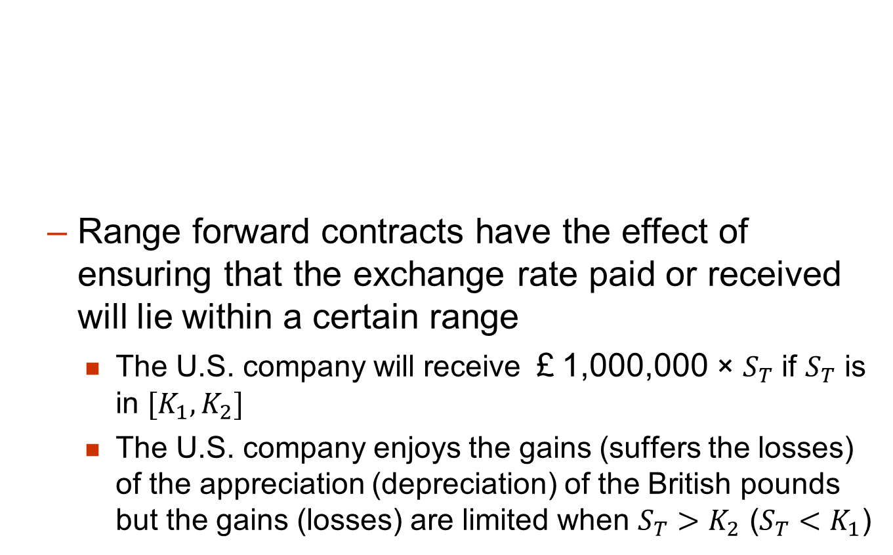
Range Forward Contracts
  Range forward contracts have the effect of ensuring that the exchange rate paid or received will lie within a certain range
    The U.S. company will receive ￡1,000,000 × $S_{T}$ if $S_{T}$ is in $[K_{1},K_{2}]$
    The U.S. company enjoys the gains (suffers the losses) of the appreciation (depreciation) of the British pounds but the gains (losses) are limited when $S_{T}>K_{2}$ ($S_{T}<K_{1}$)

Slide 32
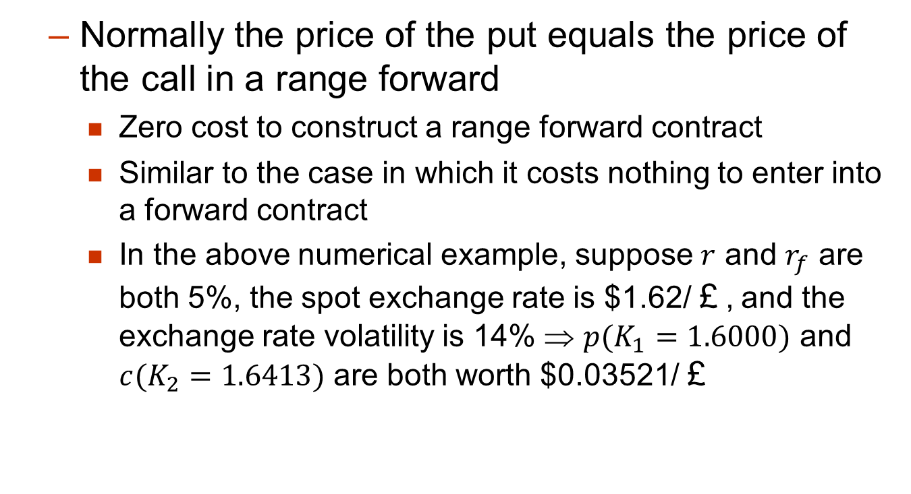
Range Forward Contracts
  Normally the price of the put equals the price of the call in a range forward
    Zero cost to construct a range forward contract
    Similar to the case in which it costs nothing to enter into a forward contract
    In the above numerical example, suppose $r$ and $r_{f}$ are both 5%, the spot exchange rate is $1.62/￡, and the exchange rate volatility is 14% ⇒ $p(K_{1}=1.6000)$ and $c(K_{2}=1.6413)$ are both worth $0.03521/￡

