Slide 1
Trading Strategies Involving Options
Chapter 11

Slide 2
Goals of Chapter 11
Principal-protected notes (保本債券): a bond plus options
Three categories of trading strategies based on options:
  Strategies involving a single European option and a stock share
  Spread strategies: involving two or more European options of the same type, i.e., using either European calls or puts
  Combination strategies: involving both European calls and puts
Notes:
2

Slide 3
11.1 Principal-Protected Notes (保本債券)

Slide 4
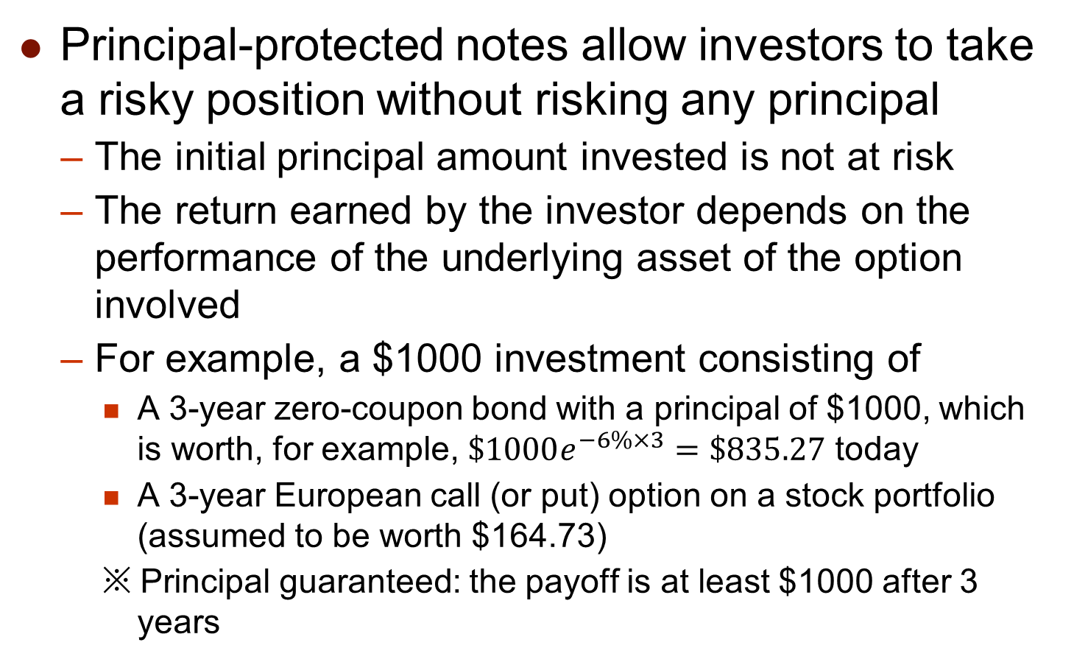
Principal-Protected Notes
Principal-protected notes allow investors to take a risky position without risking any principal
  The initial principal amount invested is not at risk
  The return earned by the investor depends on the performance of the underlying asset of the option involved
  For example, a $1000 investment consisting of
    A 3-year zero-coupon bond with a principal of $1000, which is worth, for example, $\$1000e^{−6\%×3}=\$835.27$ today
    A 3-year European call (or put) option on a stock portfolio (assumed to be worth $164.73)
    ※ Principal guaranteed: the payoff is at least $1000 after 3 years

Slide 5
Principal-Protected Notes
  For issuing banks, in order to make profit, the actual value of the involved option is lower than $164.73
    For example, the bank earns the price spread by choosing a more OTM strike price and thus a cheaper option
  Is it better off if investors buy the considered options and invest the remaining principal at the risk-free rate?
    Avoid the spread earned by the bank but cannot enjoy the bank’s service of bookkeeping and settling the option
    Individual investors face wider bid-ask spreads on options
  Variations of principal-protected notes
    Investors’ maximal return could be capped (設定報酬上界)
    Use the average price instead of the final price to determine the option payoff

Slide 6
11.2 Strategies Involving a Single Option and a Stock Share

Slide 7
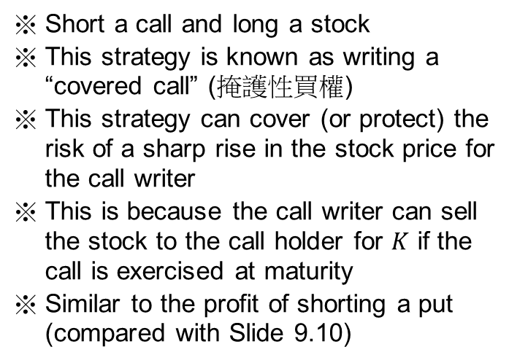




Positions in a Call and The Underlying Asset
(a)
profit for $S$ at $T$
(b)
Profit
Profit
profit for $c\left(K\right)$ at $T$
K
K
S_{T}
S_{T}
profit for $−c\left(K\right)$ at $T$
profit for $−S$ at $T$
Short a call and long a stock
This strategy is known as writing a “covered call” (掩護性買權)
This strategy can cover (or protect) the risk of a sharp rise in the stock price for the call writer
This is because the call writer can sell the stock to the call holder for $K$ if the call is exercised at maturity
Similar to the profit of shorting a put (compared with Slide 9.10)
Buy a call and short a stock
The opposite of writing a covered call
Similar to the profit of longing a put (compared with Slide 9.9)

Slide 8
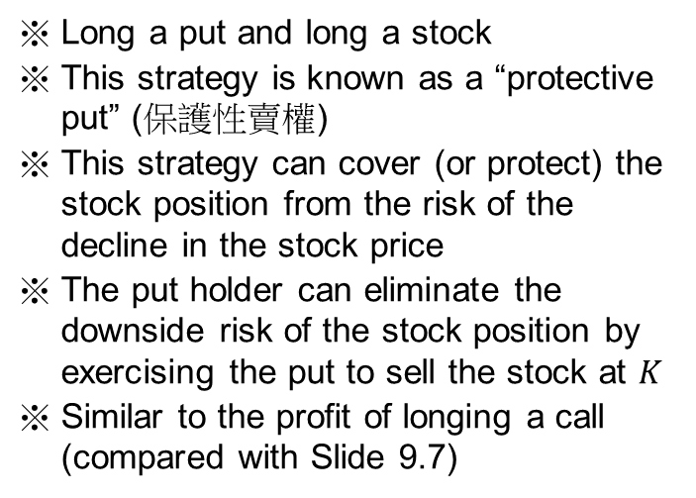




Positions in a Put and The Underlying Asset
(c)
(d)
Profit
Profit
profit for $S$ at $T$
K
profit for $−p\left(K\right)$ at $T$
S_{T}
profit for $p\left(K\right)$ at $T$
K
S_{T}
profit for $−S$ at $T$
Long a put and long a stock
This strategy is known as a “protective put” (保護性賣權)
This strategy can cover (or protect) the stock position from the risk of the decline in the stock price
The put holder can eliminate the downside risk of the stock position by exercising the put to sell the stock at $K$
Similar to the profit of longing a call (compared with Slide 9.7)
Sell a put and short a stock
The opposite of a protective put
Similar to the profit of shorting a call (compared with Slide 9.8)

Slide 9
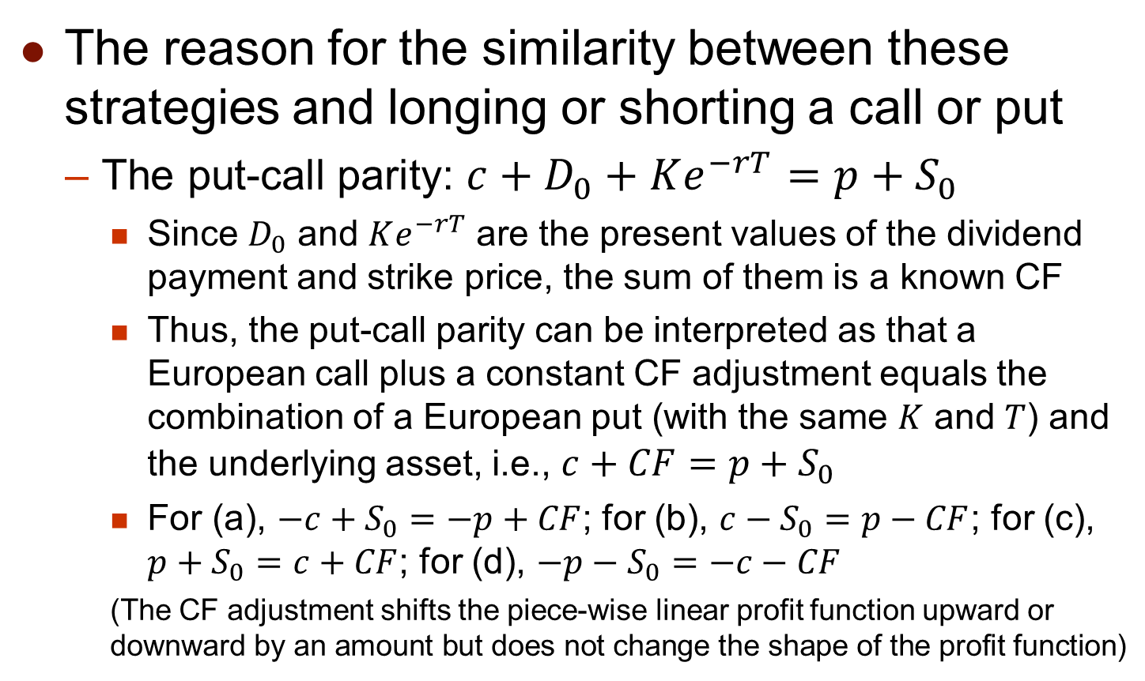
Positions in a Option and The Underlying Asset
The reason for the similarity between these strategies and longing or shorting a call or put
  The put-call parity: $c+D_{0}+Ke^{−rT}=p+S_{0}$
    Since $D_{0}$ and $Ke^{−rT}$ are the present values of the dividend payment and strike price, the sum of them is a known CF
    Thus, the put-call parity can be interpreted as that a European call plus a constant CF adjustment equals the combination of a European put (with the same $K$ and $T$) and the underlying asset, i.e., $c+CF=p+S_{0}$
    For (a), $−c+S_{0}=−p+CF$; for (b), $c−S_{0}=p−CF$; for (c), $p+S_{0}=c+CF$; for (d), $−p−S_{0}=−c−CF$
    (The CF adjustment shifts the piece-wise linear profit function upward or downward by an amount but does not change the shape of the profit function)

Slide 10
11.3 Strategies Involving a Position in Two or More Options of The Same Type

Slide 11
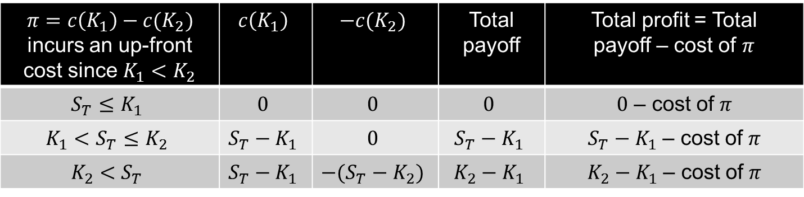


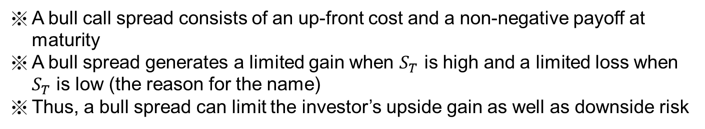
Bull Spread (牛市價差) Using Calls with The Same T
Profit
profit for $c\left(K_{1}\right)$ at $T$
K₁
  K₂
S_{T}
profit for $−c\left(K_{2}\right)$ at $T$
$π=c\left(K_{1}\right)−c(K_{2})$ incurs an up-front cost since $K_{1}<K_{2}$ | $$c\left(K_{1}\right)$$ | $$−c(K_{2})$$ | Total payoff | Total profit = Total payoff – cost of $π$
$$S_{T}≤K_{1}$$ | $$0$$ | $$0$$ | $$0$$ | $0$ – cost of $π$
$$K_{1}<S_{T}≤K_{2}$$ | $$S_{T}−K_{1}$$ | $$0$$ | $$S_{T}−K_{1}$$ | $S_{T}−K_{1}$ – cost of $π$
$$K_{2}<S_{T}$$ | $$S_{T}−K_{1}$$ | $$−(S_{T}−K_{2})$$ | $$K_{2}−K_{1}$$ | $K_{2}−K_{1}$ – cost of $π$
A bull call spread consists of an up-front cost and a non-negative payoff at maturity
A bull spread generates a limited gain when $S_{T}$ is high and a limited loss when $S_{T}$ is low (the reason for the name)
Thus, a bull spread can limit the investor’s upside gain as well as downside risk

Slide 12
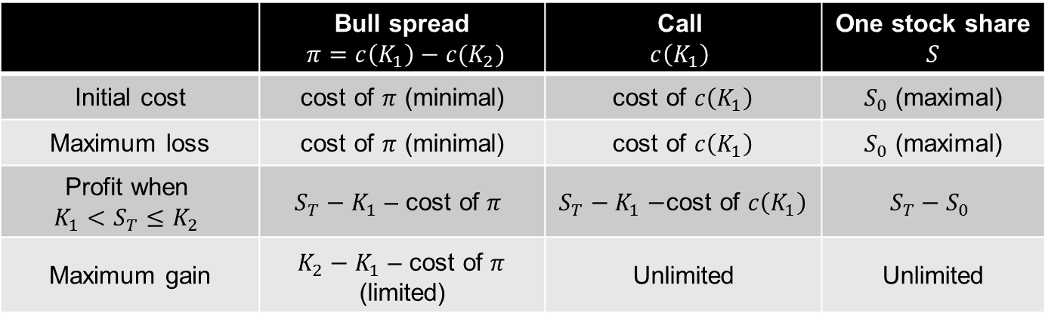
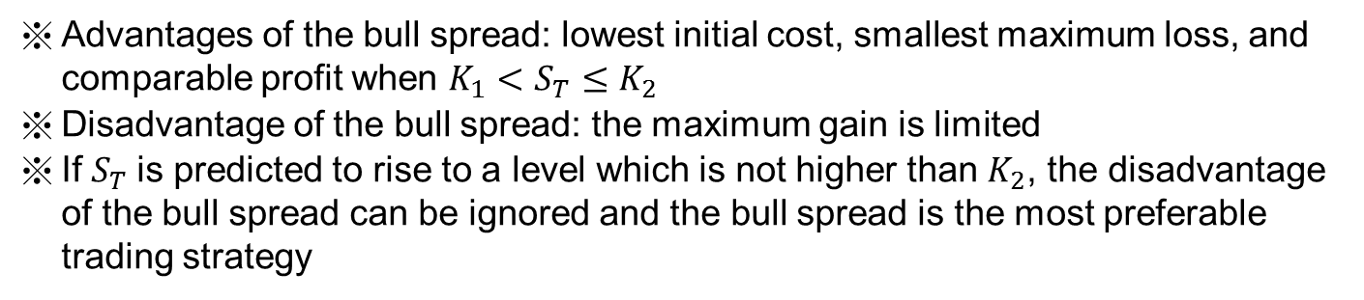
Bull Spread (牛市價差) Using Calls with The Same T
Comparison among a bull spread using calls, holding a call option, and longing a stock share
 | Bull spread $π=c\left(K_{1}\right)−c(K_{2})$ | Call $$c\left(K_{1}\right)$$ | One stock share $$S$$
Initial cost | cost of $π$ (minimal) | cost of $c\left(K_{1}\right)$ | $S_{0}$ (maximal)
Maximum loss | cost of $π$ (minimal) | cost of $c\left(K_{1}\right)$ | $S_{0}$ (maximal)
Profit when $$K_{1}<S_{T}≤K_{2}$$ | $$S_{T}−K_{1} \text{– }\text{cost} \text{of} π$$ | $S_{T}−K_{1}−$cost of $c\left(K_{1}\right)$ | $$S_{T}−S_{0}$$
Maximum gain | $K_{2}−K_{1} \text{– }\text{cost} \text{of} π$ (limited) | Unlimited | Unlimited
Advantages of the bull spread: lowest initial cost, smallest maximum loss, and comparable profit when $K_{1}<S_{T}≤K_{2}$
Disadvantage of the bull spread: the maximum gain is limited
If $S_{T}$is predicted to rise to a level which is not higher than $K_{2}$, the disadvantage of the bull spread can be ignored and the bull spread is the most preferable trading strategy

Slide 13
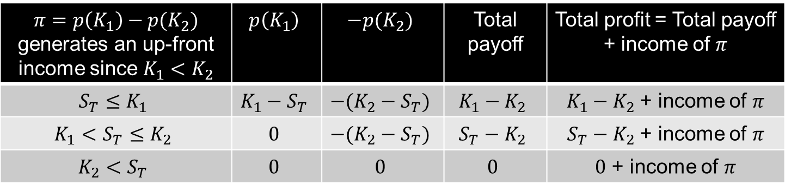


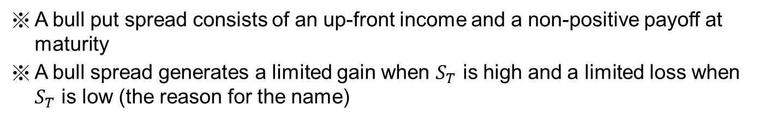
Bull Spread (牛市價差) Using Puts with The Same T
Profit
profit for $−p\left(K_{2}\right)$ at $T$
K₁
K₂
S_{T}
profit for $p\left(K_{1}\right)$ at $T$
$π=p\left(K_{1}\right)−p(K_{2})$ generates an up-front income since $K_{1}<K_{2}$ | $$p\left(K_{1}\right)$$ | $$−p(K_{2})$$ | Total payoff | Total profit = Total payoff + income of $π$
$$S_{T}≤K_{1}$$ | $$K_{1}−S_{T}$$ | $$−(K_{2}−S_{T})$$ | $$K_{1}−K_{2}$$ | $K_{1}−K_{2}$ + income of $π$
$$K_{1}<S_{T}≤K_{2}$$ | $$0$$ | $$−(K_{2}−S_{T})$$ | $$S_{T}−K_{2}$$ | $S_{T}−K_{2}$ + income of $π$
$$K_{2}<S_{T}$$ | $$0$$ | $$0$$ | $$0$$ | $0$ + income of $π$
A bull put spread consists of an up-front income and a non-positive payoff at maturity
A bull spread generates a limited gain when $S_{T}$ is high and a limited loss when $S_{T}$ is low (the reason for the name)

Slide 14
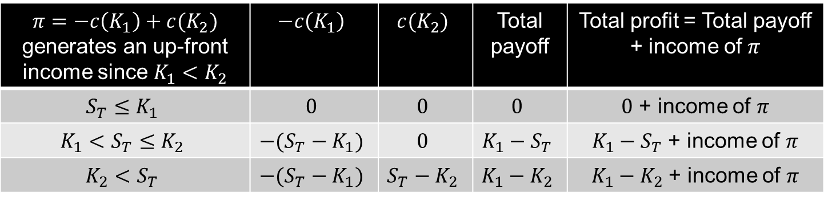


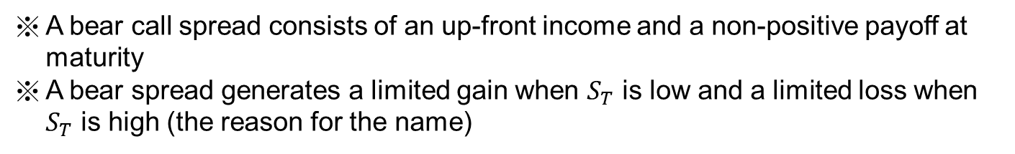
Bear Spread (熊市價差) Using Calls with The Same T
Profit
profit for $c\left(K_{2}\right)$ at $T$
K₁
K₂
S_{T}
profit for $−c\left(K_{1}\right)$ at $T$
$π=−c\left(K_{1}\right)+c(K_{2})$ generates an up-front income since $K_{1}<K_{2}$ | $$−c\left(K_{1}\right)$$ | $$c(K_{2})$$ | Total payoff | Total profit = Total payoff + income of $π$
$$S_{T}≤K_{1}$$ | $$0$$ | $$0$$ | $$0$$ | $0$ + income of $π$
$$K_{1}<S_{T}≤K_{2}$$ | $$−(S_{T}−K_{1})$$ | $$0$$ | $$K_{1}−S_{T}$$ | $K_{1}−S_{T}$ + income of $π$
$$K_{2}<S_{T}$$ | $$−(S_{T}−K_{1})$$ | $$S_{T}−K_{2}$$ | $$K_{1}−K_{2}$$ | $K_{1}−K_{2}$ + income of $π$
A bear call spread consists of an up-front income and a non-positive payoff at maturity
A bear spread generates a limited gain when $S_{T}$ is low and a limited loss when $S_{T}$ is high (the reason for the name)

Slide 15
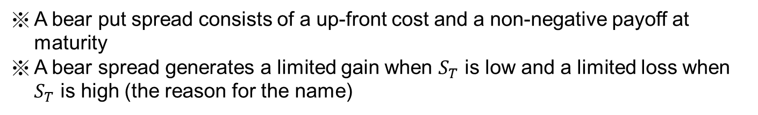


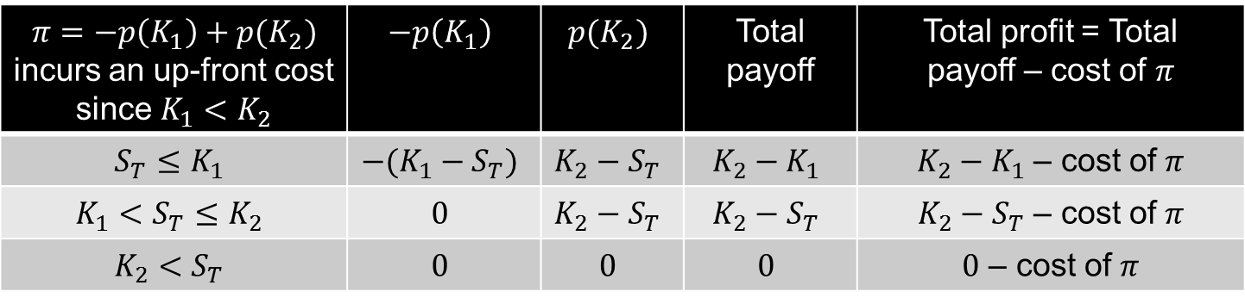
Bear Spread (熊市價差) Using Puts with The Same T
Profit
profit for $−p\left(K_{1}\right)$ at $T$
S_{T}
K₁
K₂
profit for $p\left(K_{2}\right)$ at $T$
$π=−p\left(K_{1}\right)+p(K_{2})$ incurs an up-front cost since $K_{1}<K_{2}$ | $$−p\left(K_{1}\right)$$ | $$p(K_{2})$$ | Total payoff | Total profit = Total payoff – cost of $π$
$$S_{T}≤K_{1}$$ | $$−(K_{1}−S_{T})$$ | $$K_{2}−S_{T}$$ | $$K_{2}−K_{1}$$ | $K_{2}−K_{1}$ – cost of $π$
$$K_{1}<S_{T}≤K_{2}$$ | $$0$$ | $$K_{2}−S_{T}$$ | $$K_{2}−S_{T}$$ | $K_{2}−S_{T}$ – cost of $π$
$$K_{2}<S_{T}$$ | $$0$$ | $$0$$ | $$0$$ | $0$ – cost of $π$
A bear put spread consists of a up-front cost and a non-negative payoff at maturity
A bear spread generates a limited gain when $S_{T}$ is low and a limited loss when $S_{T}$ is high (the reason for the name)

Slide 16
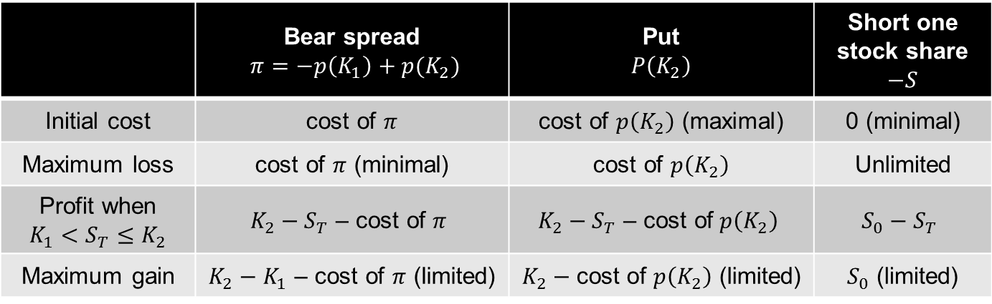
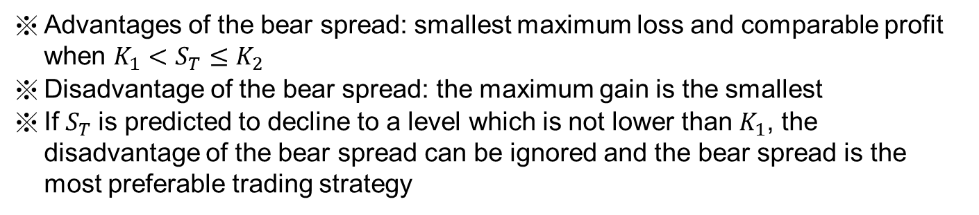
Bear Spread (熊市價差) Using Puts with The Same T
Comparison among a bear spread using puts, holding a put option, and shorting a stock share
 | Bear spread $π=−p\left(K_{1}\right)+p(K_{2})$ | Put $$P\left(K_{2}\right)$$ | Short one stock share $$−S$$
Initial cost | cost of $π$ | cost of $p\left(K_{2}\right)$ (maximal) | 0 (minimal)
Maximum loss | cost of $π$ (minimal) | cost of $p\left(K_{2}\right)$ | Unlimited
Profit when $$K_{1}<S_{T}≤K_{2}$$ | $$K_{2}−S_{T}\text{ – }\text{cost} \text{of} π$$ | $$K_{2}−S_{T}\text{ – }\text{cost} \text{of} p\left(K_{2}\right)$$ | $$S_{0}−S_{T}$$
Maximum gain | $K_{2}−K_{1}$ – cost of $π$ (limited) | $K_{2}−\text{cost} \text{of} p\left(K_{2}\right)$ (limited) | $S_{0}$ (limited)
Advantages of the bear spread: smallest maximum loss and comparable profit when $K_{1}<S_{T}≤K_{2}$
Disadvantage of the bear spread: the maximum gain is the smallest
If $S_{T}$is predicted to decline to a level which is not lower than $K_{1}$, the disadvantage of the bear spread can be ignored and the bear spread is the most preferable trading strategy

Slide 17
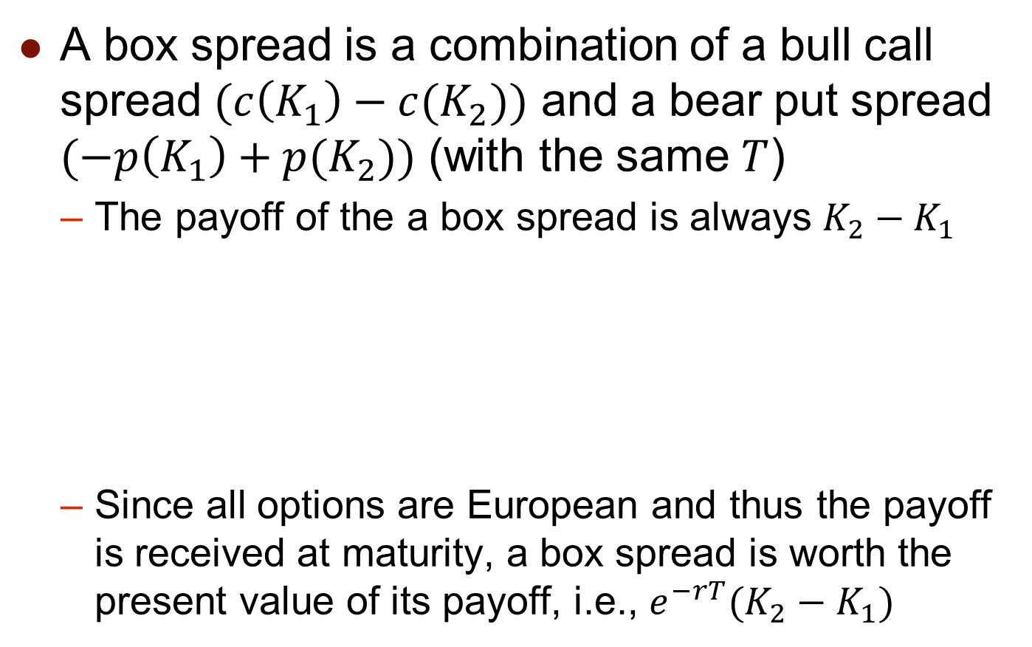
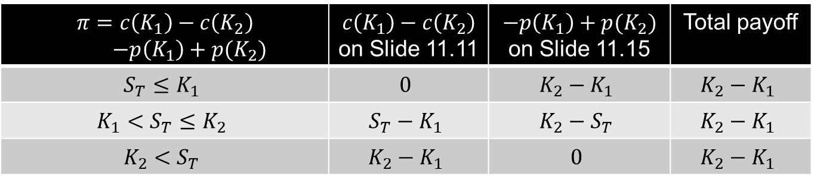
Box Spread (盒型價差)
A box spread is a combination of a bull call spread $(c\left(K_{1}\right)−c(K_{2}))$ and a bear put spread $(−p\left(K_{1}\right)+p(K_{2}))$ (with the same $T$)
  The payoff of the a box spread is always $K_{2}−K_{1}$
  Since all options are European and thus the payoff is received at maturity, a box spread is worth the present value of its payoff, i.e., $e^{−rT}(K_{2}−K_{1})$
$π=c\left(K_{1}\right)−c\left(K_{2}\right)$ $−p\left(K_{1}\right)+p(K_{2})$ | $$c\left(K_{1}\right)−c\left(K_{2}\right)$$ on Slide 11.11 | $−p\left(K_{1}\right)+p(K_{2})$ on Slide 11.15 | Total payoff
$$S_{T}≤K_{1}$$ | $$0$$ | $$K_{2}−K_{1}$$ | $$K_{2}−K_{1}$$
$$K_{1}<S_{T}≤K_{2}$$ | $$S_{T}−K_{1}$$ | $$K_{2}−S_{T}$$ | $$K_{2}−K_{1}$$
$$K_{2}<S_{T}$$ | $$K_{2}−K_{1}$$ | $$0$$ | $$K_{2}−K_{1}$$

Slide 18
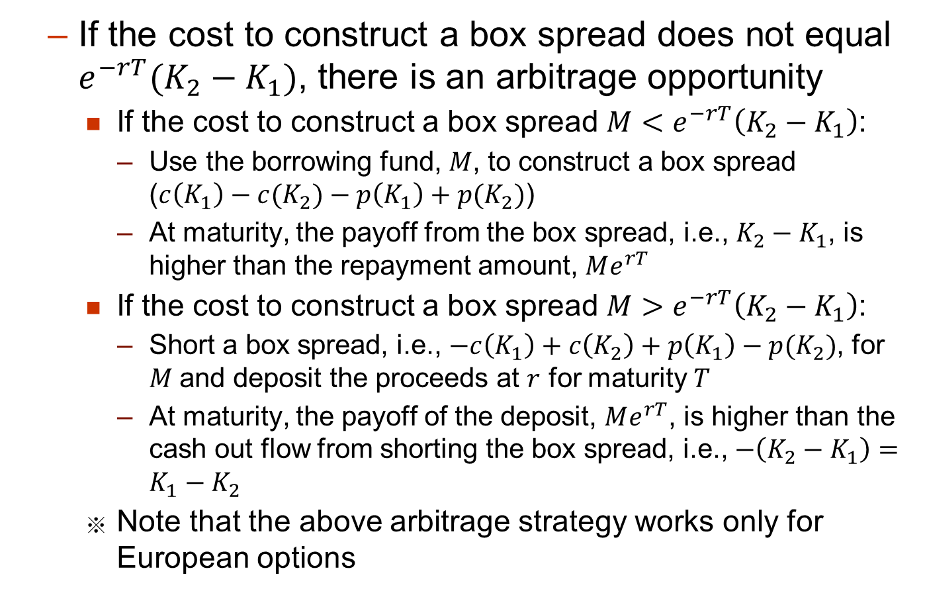
Box Spread (盒型價差)
  If the cost to construct a box spread does not equal $e^{−rT}(K_{2}−K_{1})$, there is an arbitrage opportunity
    If the cost to construct a box spread $M<e^{−rT}\left(K_{2}−K_{1}\right)$:
      Use the borrowing fund, $M$, to construct a box spread ($c\left(K_{1}\right)−c(K_{2})−p\left(K_{1}\right)+p(K_{2})$)
      At maturity, the payoff from the box spread, i.e., $K_{2}−K_{1}$, is higher than the repayment amount, $Me^{rT}$
    If the cost to construct a box spread $M>e^{−rT}\left(K_{2}−K_{1}\right)$:
      Short a box spread, i.e., $−c\left(K_{1}\right)+c\left(K_{2}\right)+p\left(K_{1}\right)−p(K_{2})$, for $M$and deposit the proceeds at $r$ for maturity $T$
      At maturity, the payoff of the deposit, $Me^{rT}$, is higher than the cash out flow from shorting the box spread, i.e.,$−\left(K_{2}−K_{1}\right)=K_{1}−K_{2}$
    Note that the above arbitrage strategy works only for European options

Slide 19
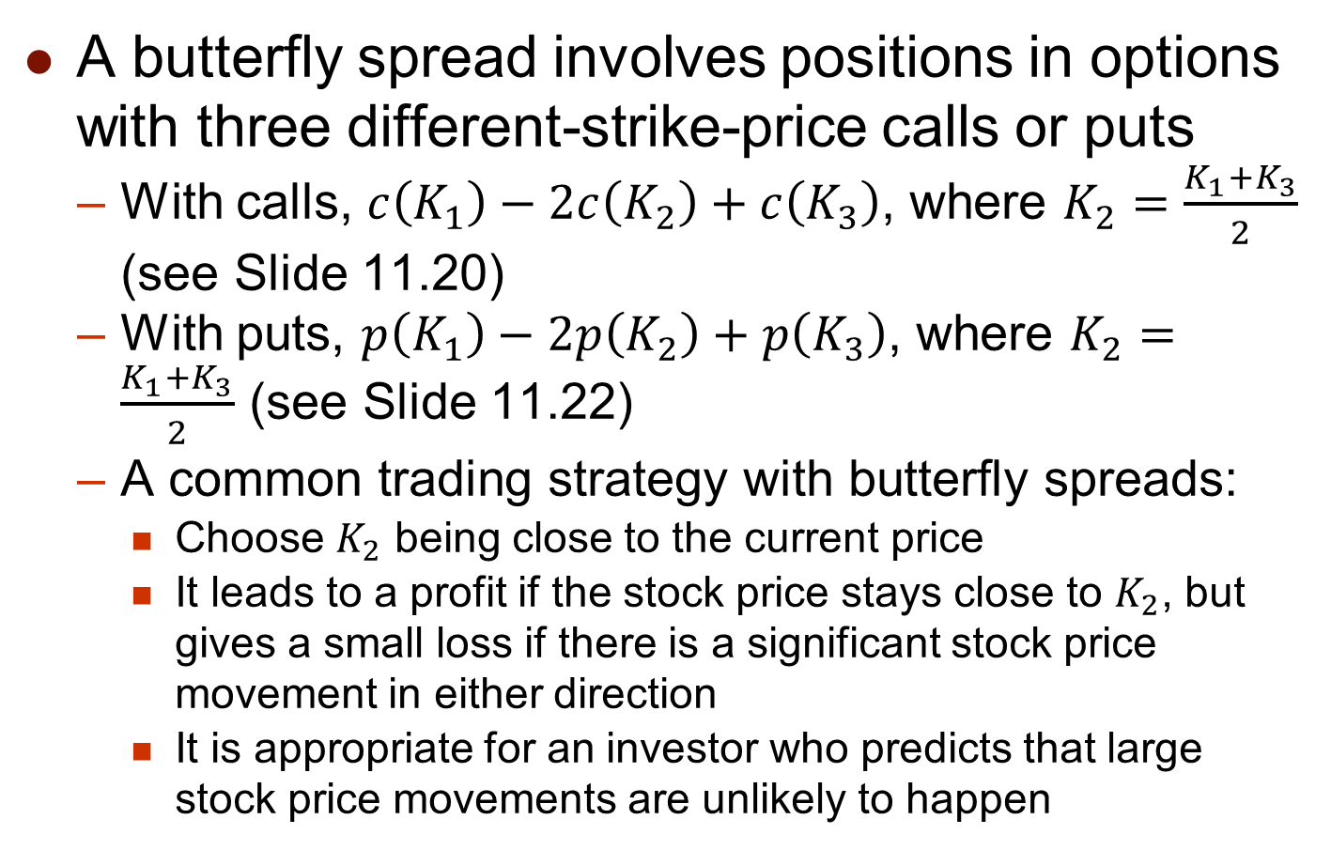
Butterfly Spread (蝶式價差)
A butterfly spread involves positions in options with three different-strike-price calls or puts
  With calls, $c\left(K_{1}\right)−2c\left(K_{2}\right)+c\left(K_{3}\right)$, where $K_{2}=\frac{K_{1}+K_{3}}{2}$ (see Slide 11.20)
  With puts, $p\left(K_{1}\right)−2p\left(K_{2}\right)+p\left(K_{3}\right)$, where $K_{2}=\frac{K_{1}+K_{3}}{2}$ (see Slide 11.22)
  A common trading strategy with butterfly spreads:
    Choose $K_{2}$ being close to the current price
    It leads to a profit if the stock price stays close to $K_{2}$, but gives a small loss if there is a significant stock price movement in either direction
    It is appropriate for an investor who predicts that large stock price movements are unlikely to happen

Slide 20
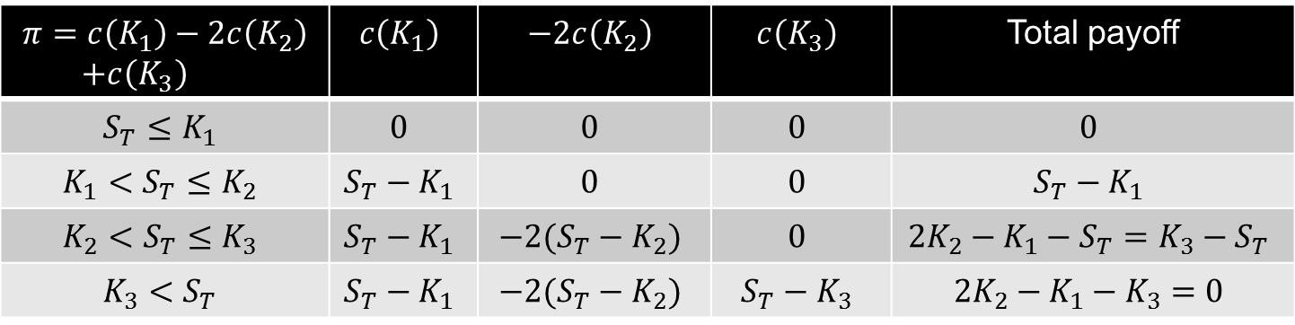


Butterfly Spread (蝶式價差) Using Calls with The Same T
profit for $c\left(K_{1}\right)$ at $T$
Profit
profit for $c\left(K_{3}\right)$ at $T$
K₁
K₂
K₃
S_{T}
profit for $−2c\left(K_{2}\right)$ at $T$
$$π=c\left(K_{1}\right)−2c\left(K_{2}\right)$$ $+c\left(K_{3}\right)$ | $$c\left(K_{1}\right)$$ | $$−2c\left(K_{2}\right)$$ | $$c\left(K_{3}\right)$$ | Total payoff
$$S_{T}≤K_{1}$$ | $$0$$ | $$0$$ | $$0$$ | $$0$$
$$K_{1}<S_{T}≤K_{2}$$ | $$S_{T}−K_{1}$$ | $$0$$ | $$0$$ | $$S_{T}−K_{1}$$
$$K_{2}<S_{T}≤K_{3}$$ | $$S_{T}−K_{1}$$ | $$−2(S_{T}−K_{2})$$ | $$0$$ | $$2K_{2}−K_{1}−S_{T}=K_{3}−S_{T}$$
$$K_{3}<S_{T}$$ | $$S_{T}−K_{1}$$ | $$−2(S_{T}−K_{2})$$ | $$S_{T}−K_{3}$$ | $$2K_{2}−K_{1}−K_{3}=0$$
Since the payoff is non-negative, there should be an initial cost to construct the butterfly spread (see the next slide)
After deducting the initial cost from the payoff function, we can derive the profit function, which is shown above

Slide 21
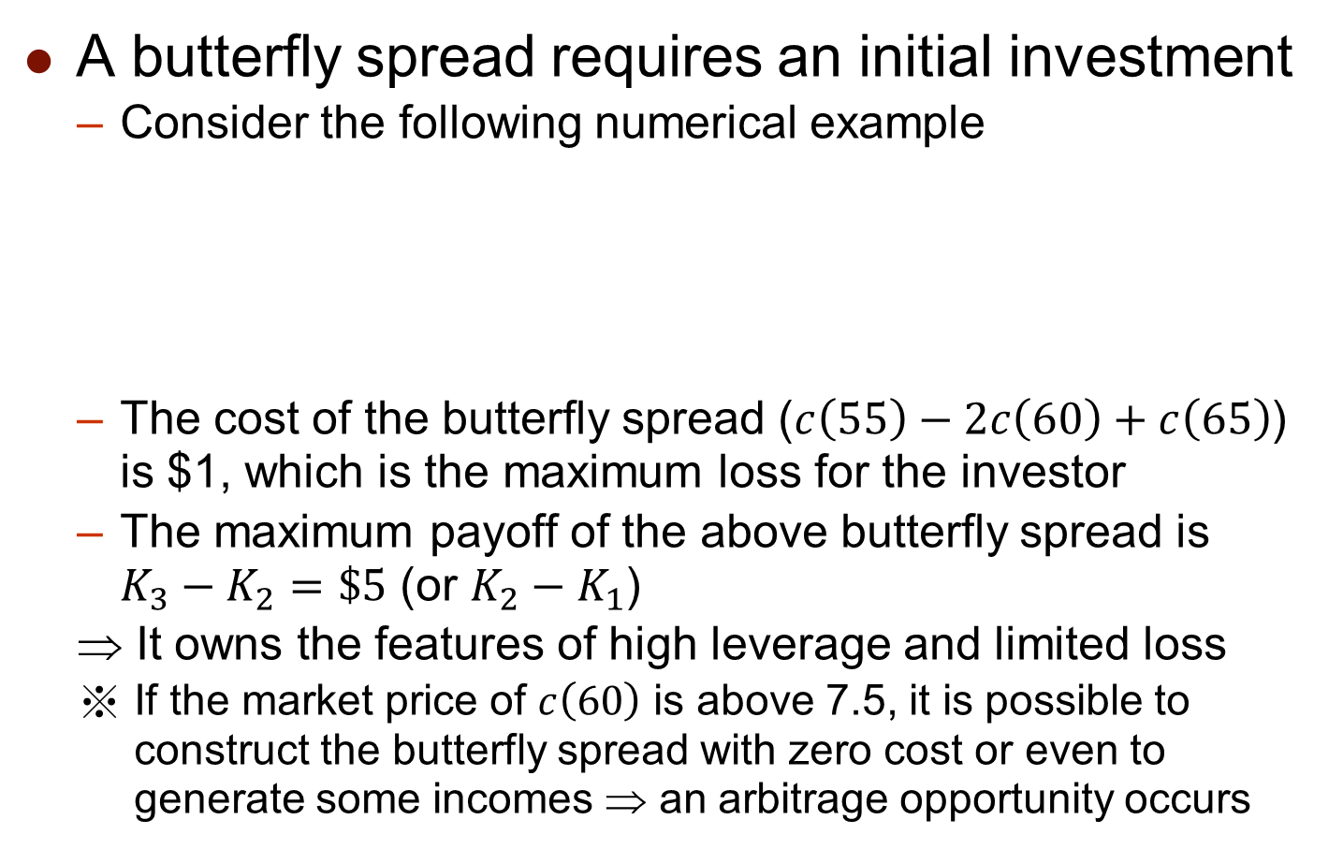
Butterfly Spread (蝶式價差) Using Calls with The Same T
A butterfly spread requires an initial investment
  Consider the following numerical example
  The cost of the butterfly spread ($c\left(55\right)−2c\left(60\right)+c\left(65\right)$) is $1, which is the maximum loss for the investor
  The maximum payoff of the above butterfly spread is $K_{3}−K_{2}=\$5$ (or $K_{2}−K_{1}$)
  It owns the features of high leverage and limited loss
  If the market price of $c\left(60\right)$ is above 7.5, it is possible to construct the butterfly spread with zero cost or even to generate some incomes ⇒ an arbitrage opportunity occurs
Strike price ($) | Call price ($)
55 | 10
60 | 7
65 | 5

Slide 22
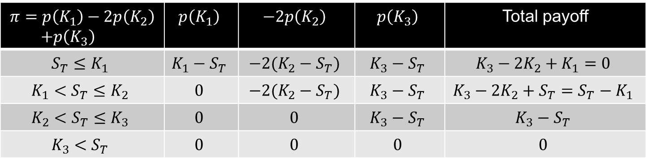



Butterfly Spread (蝶式價差) Using Puts with The Same T
Profit
profit for $−2p\left(K_{2}\right)$ at $T$
K₁
K₂
K₃
S_{T}
profit for $p\left(K_{1}\right)$ at $T$
profit for $p\left(K_{3}\right)$ at $T$
$$π=p\left(K_{1}\right)−2p\left(K_{2}\right)$$ $+p\left(K_{3}\right)$ | $$p\left(K_{1}\right)$$ | $$−2p\left(K_{2}\right)$$ | $$p\left(K_{3}\right)$$ | Total payoff
$$S_{T}≤K_{1}$$ | $$K_{1}−S_{T}$$ | $$−2(K_{2}−S_{T})$$ | $$K_{3}−S_{T}$$ | $$K_{3}−2K_{2}+K_{1}=0$$
$$K_{1}<S_{T}≤K_{2}$$ | $$0$$ | $$−2(K_{2}−S_{T})$$ | $$K_{3}−S_{T}$$ | $$K_{3}−2K_{2}+S_{T}=S_{T}−K_{1}$$
$$K_{2}<S_{T}≤K_{3}$$ | $$0$$ | $$0$$ | $$K_{3}−S_{T}$$ | $$K_{3}−S_{T}$$
$$K_{3}<S_{T}$$ | $$0$$ | $$0$$ | $$0$$ | $$0$$
The payoff of the butterfly put spread is identical to the payoff of the butterfly call spread

Slide 23



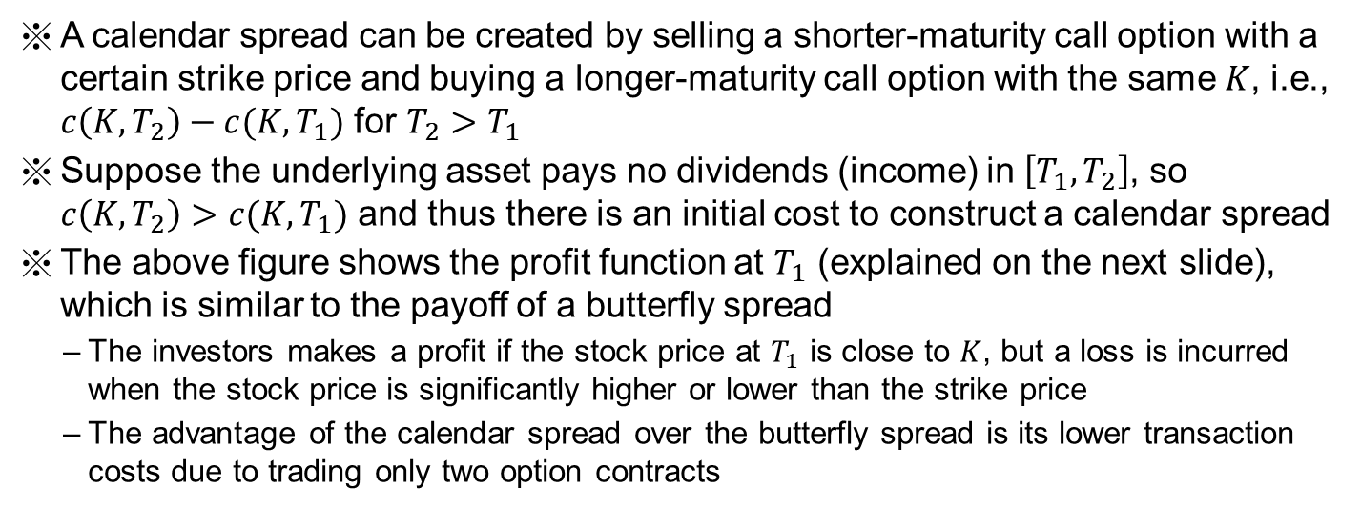
Calendar Spread (日曆價差) Using Calls
Profit
profit for $c\left(K,T_{2}\right)$ at $T_{1}$
$${S_{T}}_{1}$$
K
profit for $−c\left(K,T_{1}\right)$ at $T_{1}$
A calendar spread can be created by selling a shorter-maturity call option with a certain strike price and buying a longer-maturity call option with the same $K$, i.e., $c\left(K,T_{2}\right)−c(K,T_{1})$ for $T_{2}>T_{1}$
Suppose the underlying asset pays no dividends (income) in $\left[T_{1},T_{2}\right]$, so $c\left(K,T_{2}\right)>c(K,T_{1})$ and thus there is an initial cost to construct a calendar spread
The above figure shows the profit function at $T_{1}$ (explained on the next slide), which is similar to the payoff of a butterfly spread
  The investors makes a profit if the stock price at $T_{1}$ is close to $K$, but a loss is incurred when the stock price is significantly higher or lower than the strike price
  The advantage of the calendar spread over the butterfly spread is its lower transaction costs due to trading only two option contracts

Slide 24
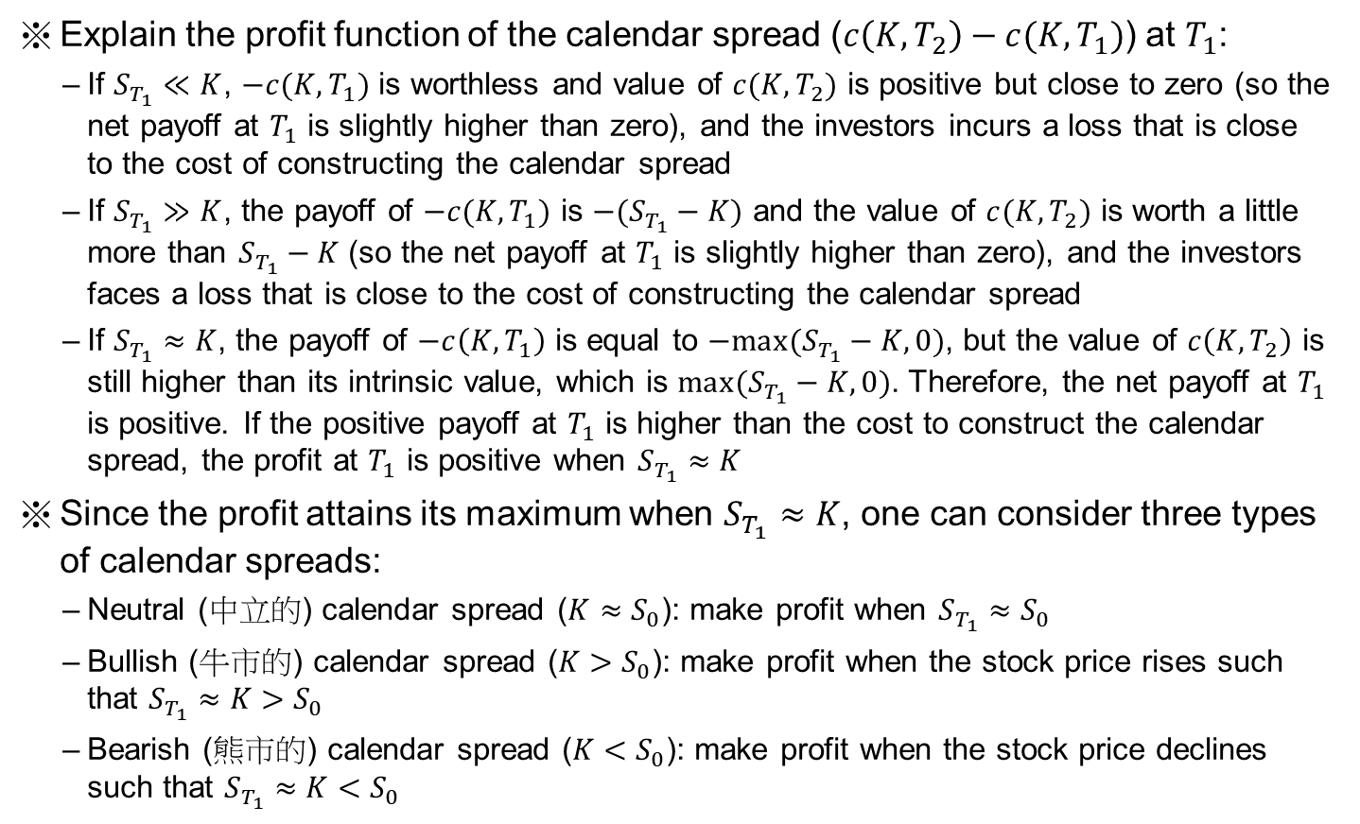
Calendar Spread (日曆價差) Using Calls
Explain the profit function of the calendar spread ($c\left(K,T_{2}\right)−c(K,T_{1})$) at $T_{1}$:
  If $S_{T_{1}}≪K$, $−c(K,T_{1})$ is worthless and value of $c(K,T_{2})$ is positive but close to zero (so the net payoff at $T_{1}$ is slightly higher than zero), and the investors incurs a loss that is close to the cost of constructing the calendar spread
  If $S_{T_{1}}≫K$, the payoff of $−c(K,T_{1})$ is $−(S_{T_{1}}−K)$ and the value of $c(K,T_{2})$ is worth a little more than $S_{T_{1}}−K$ (so the net payoff at $T_{1}$ is slightly higher than zero), and the investors faces a loss that is close to the cost of constructing the calendar spread
  If $S_{T_{1}}≈K$, the payoff of $−c\left(K,T_{1}\right)$ is equal to $−max(S_{T_{1}}−K,0)$, but the value of $c\left(K,T_{2}\right)$ is still higher than its intrinsic value, which is $max(S_{T_{1}}−K,0)$. Therefore, the net payoff at $T_{1}$ is positive. If the positive payoff at $T_{1}$ is higher than the cost to construct the calendar spread, the profit at $T_{1}$ is positive when $S_{T_{1}}≈K$
Since the profit attains its maximum when $S_{T_{1}}≈K$, one can consider three types of calendar spreads:
  Neutral (中立的) calendar spread ($K≈S_{0}$): make profit when $S_{T_{1}}≈S_{0}$
  Bullish (牛市的) calendar spread ($K>S_{0}$): make profit when the stock price rises such that $S_{T_{1}}≈K>S_{0}$
  Bearish (熊市的) calendar spread ($K<S_{0}$): make profit when the stock price declines such that $S_{T_{1}}≈K<S_{0}$

Slide 25
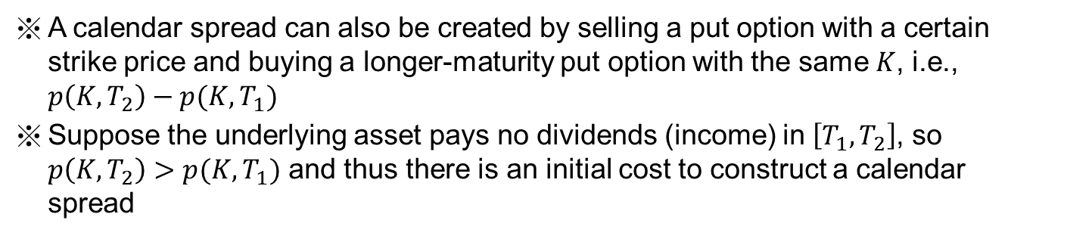



Calendar Spread (日曆價差) Using Puts
Profit
profit for $−p\left(K,T_{1}\right)$ at $T_{1}$
$${S_{T}}_{1}$$
K
profit for $p\left(K,T_{2}\right)$ at $T_{1}$
A calendar spread can also be created by selling a put option with a certain strike price and buying a longer-maturity put option with the same $K$, i.e., $p\left(K,T_{2}\right)−p(K,T_{1})$
Suppose the underlying asset pays no dividends (income) in $\left[T_{1},T_{2}\right]$, so $p\left(K,T_{2}\right)>p(K,T_{1})$ and thus there is an initial cost to construct a calendar spread

Slide 26
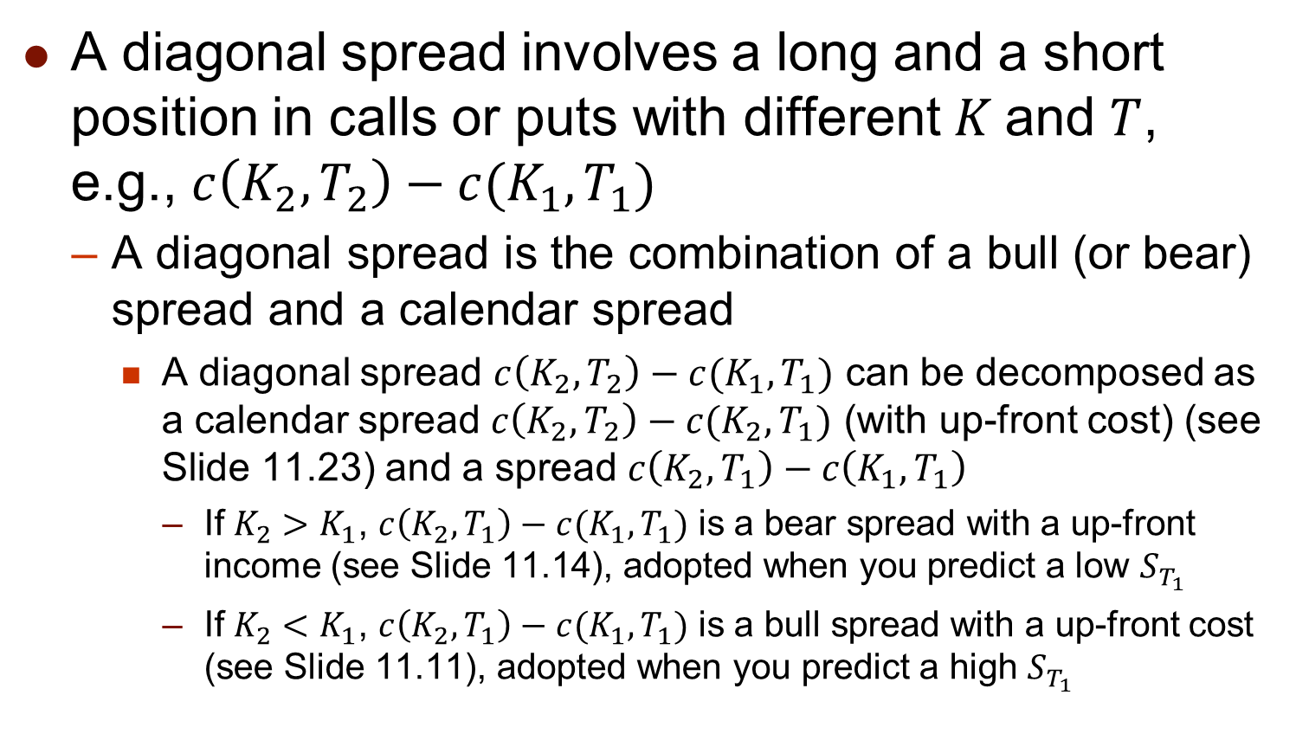
Diagonal Spread (對角線價差)
A diagonal spread involves a long and a short position in calls or puts with different $K$and $T$, e.g., $c\left(K_{2},T_{2}\right)−c(K_{1},T_{1})$
  A diagonal spread is the combination of a bull (or bear) spread and a calendar spread
    A diagonal spread $c\left(K_{2},T_{2}\right)−c(K_{1},T_{1})$ can be decomposed as a calendar spread $c\left(K_{2},T_{2}\right)−c(K_{2},T_{1})$ (with up-front cost) (see Slide 11.23) and a spread $c\left(K_{2},T_{1}\right)−c\left(K_{1},T_{1}\right)$
      If $K_{2}>K_{1}$, $c\left(K_{2},T_{1}\right)−c(K_{1},T_{1})$ is a bear spread with a up-front income (see Slide 11.14), adopted when you predict a low $S_{T_{1}}$
      If $K_{2}<K_{1}$, $c\left(K_{2},T_{1}\right)−c(K_{1},T_{1})$ is a bull spread with a up-front cost (see Slide 11.11), adopted when you predict a high $S_{T_{1}}$

Slide 27
11.4 Combination Strategies

Slide 28
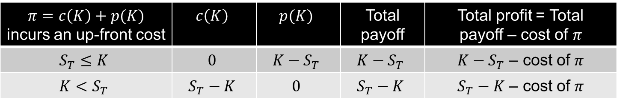


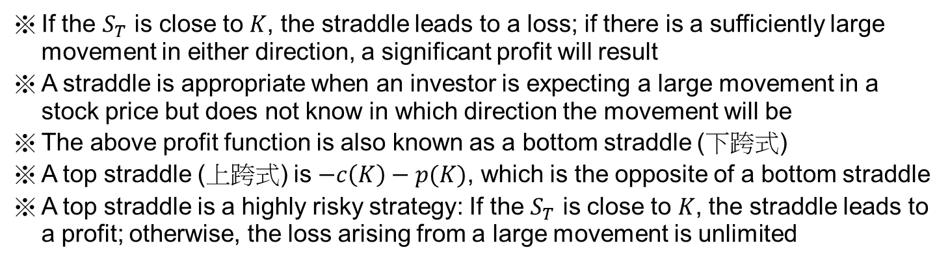
Straddle Combination (跨式組合)
Profit
profit for $c\left(K\right)$ at $T$
S_{T}
K
profit for $p\left(K\right)$ at $T$
$π=c\left(K\right)+p(K)$ incurs an up-front cost | $$c\left(K\right)$$ | $$p(K)$$ | Total payoff | Total profit = Total payoff – cost of $π$
$$S_{T}≤K$$ | $$0$$ | $$K−S_{T}$$ | $$K−S_{T}$$ | $K−S_{T}$ – cost of $π$
$$K<S_{T}$$ | $$S_{T}−K$$ | $$0$$ | $$S_{T}−K$$ | $S_{T}−K$ – cost of $π$
If the $S_{T}$ is close to $K$, the straddle leads to a loss; if there is a sufficiently large movement in either direction, a significant profit will result
A straddle is appropriate when an investor is expecting a large movement in a stock price but does not know in which direction the movement will be
The above profit function is also known as a bottom straddle (下跨式)
A top straddle (上跨式) is $−c\left(K\right)−p(K)$, which is the opposite of a bottom straddle
A top straddle is a highly risky strategy: If the $S_{T}$ is close to $K$, the straddle leads to a profit; otherwise, the loss arising from a large movement is unlimited

Slide 29
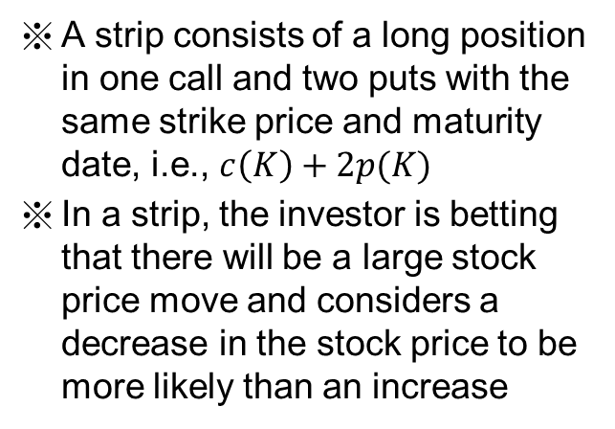
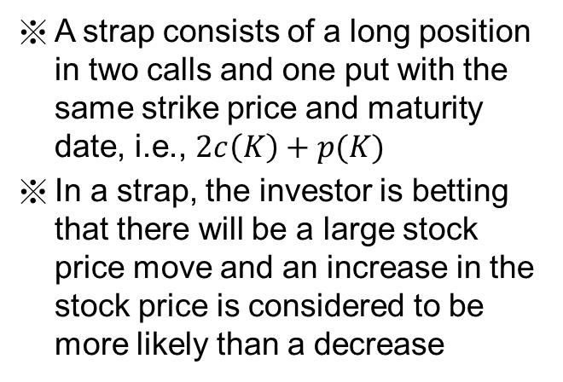
Strip and Strap
Profit
Profit
K
K
S_{T}
S_{T}
Strip
Strap
A strip consists of a long position in one call and two puts with the same strike price and maturity date, i.e., $c\left(K\right)+2p(K)$
In a strip, the investor is betting that there will be a large stock price move and considers a decrease in the stock price to be more likely than an increase
A strap consists of a long position in two calls and one put with the same strike price and maturity date, i.e., $2c\left(K\right)+p(K)$
In a strap, the investor is betting that there will be a large stock price move and an increase in the stock price is considered to be more likely than a decrease

Slide 30
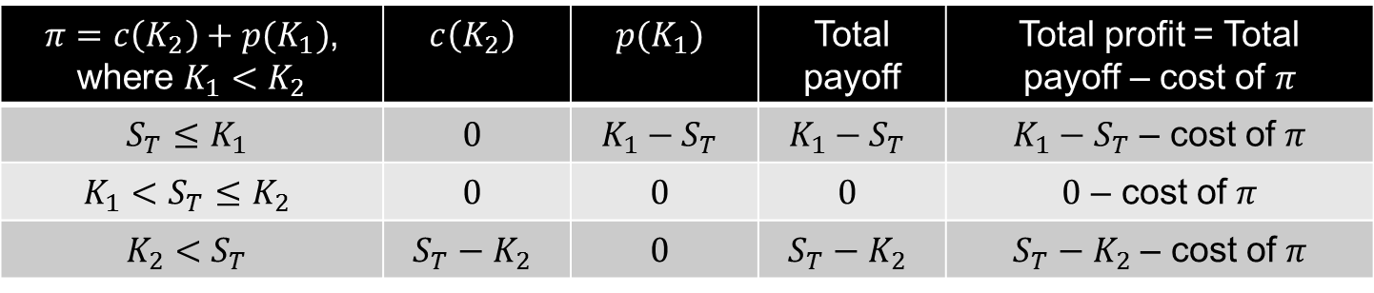


Strangle Combination (勒式組合)
Profit
profit for $c\left(K_{2}\right)$ at $T$
K₁
K₂
S_{T}
profit for $p\left(K_{1}\right)$ at $T$
$π=c\left(K_{2}\right)+p(K_{1})$, where $K_{1}<K_{2}$ | $$c\left(K_{2}\right)$$ | $$p(K_{1})$$ | Total payoff | Total profit = Total payoff – cost of $π$
$$S_{T}≤K_{1}$$ | $$0$$ | $$K_{1}−S_{T}$$ | $$K_{1}−S_{T}$$ | $K_{1}−S_{T}$ – cost of $π$
$$K_{1}<S_{T}≤K_{2}$$ | $$0$$ | $$0$$ | $$0$$ | $0$ – cost of $π$
$$K_{2}<S_{T}$$ | $$S_{T}−K_{2}$$ | $$0$$ | $$S_{T}−K_{2}$$ | $S_{T}−K_{2}$ – cost of $π$
A strangle is similar to a straddle:
  The investor is betting that there will be a large price movement but is uncertain whether it will be an increase or a decrease
  Comparing to straddle, the stock price has to move farther in either direction for an investor to make profit in a strangle

Slide 31
Strangle Combination (勒式組合)
A strangle is also called a bottom strangle (下勒式) or a bottom vertical combination
The sale of a strangle is sometimes referred to as a top strangle (上勒式) or a top vertical combination
  It can be appropriate for an investor who feels that large stock price movement are unlikely
  However, similar to the top straddle, it is a risky strategy involving unlimited potential loss to the trader

