Slide 1
Properties of Stock Options
Chapter 10

Slide 2
Goals of Chapter 10
Six factors affecting option values
Including the current stock price, strike price, time to maturity, volatility of the stock price, risk-free interest rate, and paid-out dividends
Identify the upper and lower bounds for European- and American-style option prices
Introduce the put-call parity (買賣權平價公式)
The optimal early exercise (提早履約) decision
Consider the impact of dividend payments on
Upper and lower bounds of option prices, the put-call parity, and the early exercise decision
Notes:
2

Slide 3
10.1 Six Factors Affecting Option Values

Slide 4
Notation
$c$: European call option price | $C$: American call option price
$p$: European put option price | $P$: American put option price
$S_{0}$: Current stock price | $S_{T}$: Stock price at option maturity
$K$: Strike price | $D$: Dividends that are expected to be paid during option’s life
$T$: Life of option | $r$: Risk-free rate for maturity T with continuously compounding
$σ$: Volatility of the stock price

Slide 5
Sensitivity Analysis on Option Prices
Factors | $$c$$ | $$p$$ | $$C$$ | $$P$$
$$S_{0}$$ | + | – | + | –
$$K$$ | – | + | – | +
$$T$$ | ? | ? | + | +
$$σ$$ | + | + | + | +
$$r$$ | + | – | + | –
$$D$$ | – | + | – | +
The European call (put) value can be derived as
$c=e^{−rT}E[max(S_{T}−K,0)]$ (${p=e}^{−rT}E[max(K−S_{T},0)]$)
The American call (put) value can be derived as
$C=E[e^{−rτ}max(S_{τ}−K,0)]$ ($P=E[e^{−rτ}max(K−S_{τ},0)]$),
where $τ$ is the time point to exercise American options (Since $τ∈[0,T]$ is a random variable, one should take the expectation for it)

Slide 6
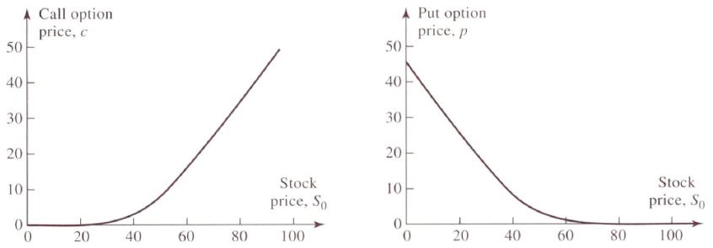
Effect of Factors on Option Pricing
Stock price $S_{0}$ ↑
For both European and American calls, prob. of being ITM ↑ and thus call values ↑
For both European and American puts, prob. of being ITM ↓ and thus put values ↓
European options: $K=50,r=5\%,σ=30\%,D=0, and T=1$

Slide 7
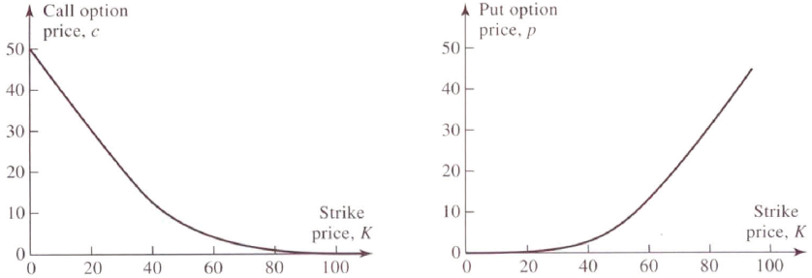
Effect of Factors on Option Pricing
Strike price $K$ ↑
For both European and American calls, prob. of being ITM ↓ and thus call values ↓
For both European and American puts, prob. of being ITM ↑ and thus put values ↑
European options: $S_{0}=50,r=5\%,σ=30\%,D=0, and T=1$

Slide 8
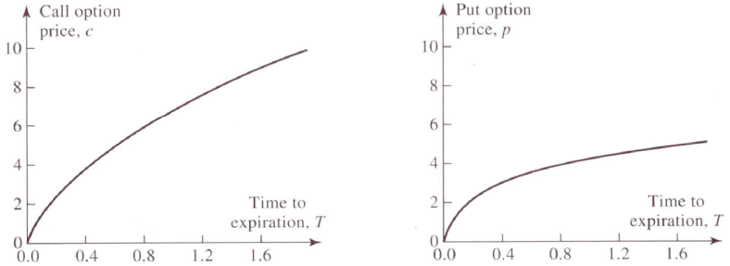
Effect of Factors on Option Pricing
Time to maturity $T$ ↑
For American options, the holder of the long-life option has all the exercise opportunities open to the holder of the short-life option and more ⇒ The long-life American option must be worth as least as the short-life American option
European calls and puts generally (not always) become more valuable as the time to expiration increases
European options: $S_{0}=50,K=50,r=5\%,σ=30\%,and D=0$

Slide 9
Effect of Factors on Option Pricing
For European calls,
Suppose two European call options, $c_{1}$ and $c_{2}$, on a stock with the same $K$ and with different maturity $T_{1}$ and $T_{2}$ ${(>T}_{1})$
If there is a cash dividends paid in ${[T}_{1},T_{2}]$, the stock price declines on the dividend payment date so that the short-life call $c_{1}$could be worth more than the long-life call $c_{2}$
For deeply ITM European put options, short-life put $p_{1}$ (with $T_{1}$ time to maturity) could be worth more than the long-life put $p_{2}$ (with $T_{2}$ time to maturity)
Note that the put value can be derived as $e^{−rT}E[max(K−S_{T},0)]$
Consider an extreme scenario where the stock price is close to 0 so that $S_{T}$ can be almost ignored when calculating payoffs of puts
The option values of the above two put options are $p_{1}=$ $e^{−rT_{1}}E\left[K−0\right]$ $=e^{−rT_{1}}K$ and $p_{2}=e^{−rT_{2}}E\left[K−0\right]=e^{−rT_{2}}K$ $⇒p_{1}>p_{2}$ (an inverse relationship between put values and $T$)

Slide 10
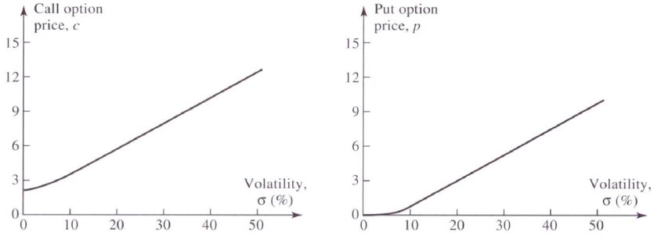
Effect of Factors on Option Pricing
Volatility $σ$ ↑
The prob. that the stock performs very well or poor increases
For calls (puts) which have limited downside (upside) risk, call (put) holders benefit from the more prob. of high (low) prices ⇒ option value ↑ when $σ$ ↑
European options: $S_{0}=50,K=50,r=5\%, D=0, and T=1$

Slide 11
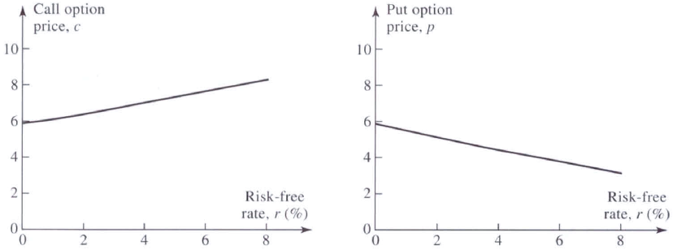
Effect of Factors on Option Pricing
Risk-free rate $r$ ↑
Two impacts: The expected return of the underlying asset ↑; the discount rate ↑ such that the PV of future CFs ↓
For calls, option value ↑ because the higher expected $S_{T}$ and the higher prob. to be ITM dominate the effect of lower PVs
For puts, option value ↓ due to the higher expected $S_{T}$, the lower prob. to be ITM, and the effect of lower PVs
European options: $S_{0}=50,K=50,σ=30\%, D=0, and T=1$

Slide 12
Effect of Factors on Option Pricing
Dividend payment ↑
Dividends have the effect of reducing the stock price on the ex-dividend date (除息日)
For calls, prob. of being ITM ↓ and thus call values ↓
For puts, prob. of being ITM ↑ and thus put values ↑
European options $S_{0}=50, K=50,r=5\%,σ=30\%,and T=1$

Slide 13
10.2 Upper and Lower Bounds for Option Prices

Slide 14
Upper and Lower Bounds for Option Prices
Some assumptions
There are no transactions costs
The tax rate issue is ignored in this chapter
However, all results in this chapter hold when all trading profits (net of trading losses) are subject to the same tax rate
Borrowing and lending are always possible at the risk-free interest rate
There is no dividends payment during the option life
In the last section of this chapter, this constraint will be released

Slide 15
Upper and Lower Bounds for Option Prices
Upper bounds for the European and American call and put
Since both American and European calls grant the holders the right to buy one share of a stock for a certain price, the option can never be worth more than the value of the stock share today
An American put grants the holder the right to sell one share of a stock for $K$ at any time point, so the option value today can never be worth more than $K$
For a European put, since its payoff at maturity cannot be worth more than $K$, it cannot be worth more than the PV of $K$ today
An American option is worth at least as much as the counterpart European option, so $c≤C$ and $p≤P$
 | Upper bound for call | Upper bound for put
American | $$C≤S_{0}$$ | $$P≤K$$
European | $c≤S_{0}$ $(c≤C)$ | $p≤Ke^{−rT}$ $(p≤P)$

Slide 16
Upper and Lower Bounds for Option Prices
Lower bounds for European calls and puts
The lower bound for European calls
Portfolio A: one European call option plus a zero-coupon bond that provides a payoff of $K$ at time $T$
If $S_{T}>K$ at $T$, the call is exercised and one stock share is purchased with the principal of the bond ⇒ Portfolio A is worth $S_{T}$
If $S_{T}≤K$ at $T$, the portfolio holder receives the repayment of the principal of the bond ⇒ Portfolio A is worth $K$
Portfolio A is worth $max(S_{T}, K)$ at $T$
Portfolio B: one share of the stock ⇒ worth $S_{T}$ at $T$
Portfolio A is more valuable than Portfolio B ⇒ $c+Ke^{−rT}≥S_{0}$ ⇒ $c≥S_{0}−Ke^{−rT}$
 | Lower bound for call | Lower bound for put
European | $$c≥max⁡(S_{0}−Ke^{−rT},0)$$ | $$p≥max⁡(Ke^{−rT}−S_{0},0)$$

Slide 17
Upper and Lower Bounds for Option Prices
Is there any an arbitrage opportunity if $c=3$, $S_{0}=20$, $K=18$, $r=10\%$, and $T=1$?
Since the call price violates the lower bound constraint ($\$20−\$18e^{−0.1∙1}=\$3.71$) , the following strategy can arbitrage from this distortion of the call price
Buy the underestimated call and short one share of stock ⇒ Generate a cash inflow of $20 – $3 = $17
Deposit $17 at $r=10\%$ for one year ⇒ Generate an income of $\$17e^{10\%∙1}=\$18.79$ at the end of the year
If $S_{T}>\$18$, exercise the call to purchase one share of stock at $18 and close out the short position in stock ⇒ The net income is $18.79 – $18 = $0.79
If $S_{T}<\$18$, give up the right of the call, purchase 1 share at $S_{T}$ in the market, and close out the short position in stock ⇒ The net income is $18.79 – $S_{T}$, which must be higher than $0.79

Slide 18
Upper and Lower Bounds for Option Prices
The lower bound for European puts
Portfolio C: one European put option plus one share
If $S_{T}≤K$ at $T$, the put is exercised and sell the one share of stock owned for $K$ ⇒ Portfolio C is worth $K$
If $S_{T}>K$ at $T$, the put expires worthless ⇒ Portfolio C is worth $S_{T}$
Portfolio C is worth $max⁡(S_{T}, K)$ at $T$
Portfolio D: an amount of cash equal to $Ke^{−rT}$ (or equivalently a zero-coupon bond with the payoff $K$ at time $T$)
Portfolio C is more valuable than Portfolio D ⇒ $p+S_{0}≥Ke^{−rT}$ ⇒ $p≥{Ke^{−rT}−S}_{0}$

Slide 19
Upper and Lower Bounds for Option Prices
Is there any arbitrage opportunity if $p=1$, $S_{0}=37$, $K=40$, $r=5\%$, and $T=0.5$?
Since the put price violates the lower bound constraint ($\$40e^{−0.05∙0.5}−\$37=\$2.01$) , the following strategy can arbitrage from this distortion of the put price
Borrow $38 at $r=5\%$ for 6 months ⇒ Need to pay off $\$38e^{5\%∙0.5}=\$38.96$ after half a year
Use the borrowing fund to buy the underestimated put and one share of stock
If $S_{T}>\$40$, discard the put, sell the stock for $S_{T}$, and repay the loan ⇒ The net income is $S_{T}$ – $38.96 > 0
If $S_{T}<\$40$, exercise the right of the put to sell the share of stock at $\$40$ and repay the loan ⇒ The net income is $40 – $38.96 = $1.04

Slide 20
Upper and Lower Bounds for Option Prices
Lower bounds for American calls and puts
Possible lower bounds for American calls and puts are their current intrinsic value
Because the holders of them always can exercise them to obtain the current intrinsic value
Note also that if an American option holder is rational, he never exercises the American option when it is out of the money
Another lower bounds for American options:
American options are worth at least as much as the counterpart European options, so $C≥c$ and $P≥p$
 | Lower bound for call | Lower bound for put
American | $$C≥max⁡(S_{0}−K,0)$$ | $$P≥max⁡(K−S_{0},0)$$

Slide 21
10.3 Put-Call Parity (買賣權平價公式)

Slide 22
Put-Call Parity for European Options
Recall Portfolios A and C just mentioned:
Portfolio A: one European call option plus a zero-coupon bond that provides a payoff of $K$ at time $T$
Portfolio C: one European put plus one share of the stock
Portfolio A | $$S_{T}>K$$ | $$S_{T}≤K$$
Call option | $$S_{T}−K$$ | $$0$$
Zero-coupon bond | $$K$$ | $$K$$
Total | $$S_{T}$$ | $$K$$
Portfolio C | $$S_{T}>K$$ | $$S_{T}≤K$$
Put option | $$0$$ | $$K−S_{T}$$
1 share of stock | $$S_{T}$$ | $$S_{T}$$
Total | $$S_{T}$$ | $$K$$

Slide 23
Put-Call Parity for European Options
Due to having an identical payoff, Portfolios A and C must therefore be worth the same today
$$c+Ke^{−rT}=p+S_{0}$$
The above equation is known as the put-call parity
The put-call parity defines a relationship between the prices of a European call and put option, both of which are with the identical $K$ and $T$
Is there any arbitrage opportunity if $p=1$ or $p=2.25$ given $c=3$, $S_{0}=31$, $K=30$, $r=10\%$, and $T=0.25$?
The theoretical price of the put option is 1.26 by solving $3+30e^{−0.1∙0.25}=p+31$
The arbitrage strategies for $p=2.25$ and $p=1$ are shown in the following table

Slide 24
Put-Call Parity for European Options
Rewrite the put-call parity: $c+Ke^{−rT}=p+S_{0}⇒c+Ke^{−rT}−S_{0}=p$, based on which it is simpler to identify the arbitrage opportunity if one treated the left-hand side as a portfolio
Three-month put price = $2.25 (Long $c+Ke^{−rT}−S_{0}$ and short $p$) | Three-month put price = $1 (Short $c+Ke^{−rT}−S_{0}$ and long $p$)
Buy the call at $3, short the stock to realize $31, and short the put to realize $2.25 ⇒ Deposit the net cash flow $30.25 at 10% for 3 months | Short the call to realize $3, buy the stock at $31, buy put at $1, and borrow $29 at 10% for 3 months ⇒ The net cash flow is 0
If $S_{T}>30$ after 3 months: Receive $31.02 from the deposit, exercise the call to buy the stock at $30 ⇒ Net profit = $1.02 | If $S_{T}>30$ after 3 months: The call is exercised and thus need to sell the stock for $30, and use $29.73 to repay loan ⇒ Net profit = $0.27
If $S_{T}<30$ after 3 months: Receive $31.02 from the deposit, the put is exercised and thus need to buy the stock at $30 ⇒ Net profit = $1.02 | If $S_{T}<30$ after 3 months: Exercise the put to sell the stock for $30, and use $29.73 to repay loan ⇒ Net profit = $0.27

Slide 25
Put-Call Parity for American Options
Extension of the put-call parity for the American call and put
$$S_{0}−K≤C−P≤S_{0}−Ke^{−rT}$$
Identify the upper and lower bounds of $P$ given $C=1.5$, $S_{0}=19$, $K=20$, $r=10\%$, and $T=5/12$
$$19−20≤1.5−P≤19−20e^{−0.1∙5/12}$$
$$⇒1.68≤P≤2.50$$
※ Refer to Question 10.18 for the proofs: Use the put-call parity to derive the right inequality; Compare the portfolios of 1) a European call plus cash $K$ and 2) a American put plus a share to derive the left inequality) (Note that the proofs are correct under the assumption of no dividend payment such that $C=c$, an important characteristic for American calls introduced in the next section)

Slide 26
10.4 Optimal Early Exercise Decision (最佳提早履約決策)

Slide 27
Early Exercise
American options could be exercised early
Early exercise occurs when (option value) < (exercise value), where option value reflects the expected PV of holding all future exercise opportunities
Early exercise occurs only when American options are ITM
American calls on a non-dividend paying stock ($D=0$) should never be exercised early
$∵c≥S_{0}−Ke^{−rT}$ and $C≥c$
$∴C≥c≥S_{0}−Ke^{−rT}≥S_{0}−K=exercise value$
⇒ It is not optimal to exercise American call option if there is no dividend payments

Slide 28
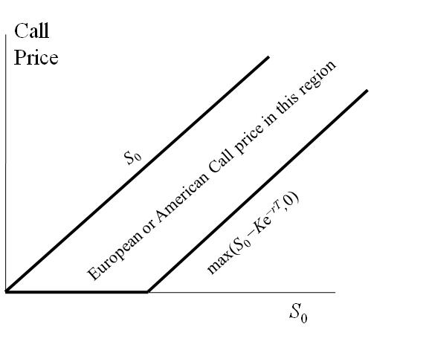
Early Exercise
So, American calls are equivalent to European calls if there is no dividend payment
$$\max\left(S_{0}−Ke^{−rT},0\right)≤c, C≤S_{0}$$
(based on Slides 10.15 (upper bounds) and 10.16 (lower bounds))
$$S_{0}$$
$$Ke^{−rT}$$

Slide 29
Intuitions for Not Early Exercising American Calls without $D$
For a deeply ITM American call option: $C=42$, $S_{0}=100$, $K=60$, $T=0.25$, and $D=0$
Should you exercise the call immediately if
You intend to hold the stock for the next 3 months?
No, it is better to delay paying the strike price 3 months later
You still want to hold the stock but you do not feel that the stock is worth holding for the next 3 months?
No, it is possible to purchase the stock at a price lower than $K=60$ after 3 months
You decide to sell the stock immediately after the exercise?
No, selling the American call for $42 is better than undertaking the above strategy, which is with the payoff of $100 – $60 = $40
Transaction cost issue: pay a commission when selling option vs. pay a commission to buy shares by exercising the American call and a second commission to sell shares and thus realize $40 gain

Slide 30
Early Exercise
Reasons for not exercising an American call early if there are no dividends ($D=0$)
Due to no dividends, no income is sacrificed if you hold the American call instead of holding the underlying stock shares for the following 3 months
Payment of the strike price can be delayed (Q1 on Slide 10.29)
Holding the call provides the possibility that the purchasing price could be lower than but never higher than the strike price (Q2 on Slide 10.29)
The payoff from exercising the American call is lower than the payoff from selling the American call directly (Q3 on Slide 10.29)

Slide 31
Early Exercise
However, it can be optimal to exercise an American put option on a non-dividend-paying stock ($D=0$) early
$∵p≥Ke^{−rT}−S_{0}$ and $P≥p$
$∴P≥p≥Ke^{−rT}−S_{0}$,
which is lower than the exercise price $K−S_{0}$
⇒ The relationship between the American put price, $P$, and its exercise value, $K−S_{0}$, is uncertain
⇒ For American puts, as long as their values $P$are lower than $K−S_{0}$, they are early exercised and the option value rises to become $K−S_{0}$

Slide 32
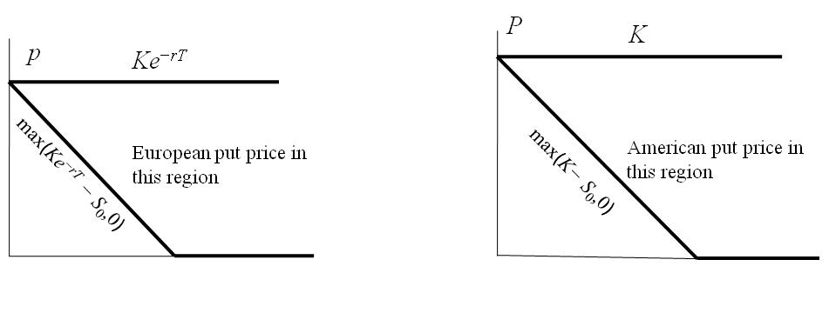
Early Exercise
Geometric representation of the upper and lower bounds for European and American puts
For European puts:
$$Ke^{−rT}≥ p≥max(Ke^{−rT}−S_{0},0)$$
(based on Slides 10.15 and 10.16)
For American puts
$$K≥P≥max(K−S_{0},0)$$
(based on Slides 10.15 and 10.20)
$$p$$
$$S_{0}$$
$$S_{0}$$
$$Ke^{−rT}$$
$$Ke^{−rT}$$
$$K$$
Both the upper and lower bounds of American puts are higher than those of European puts

Slide 33
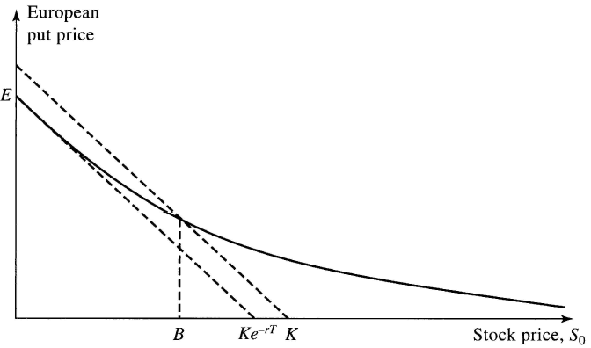
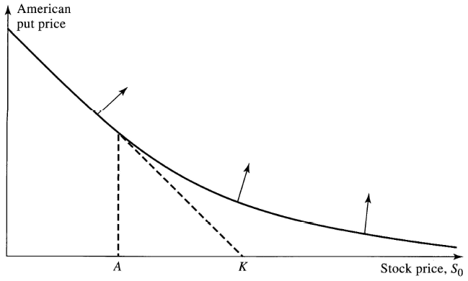
Geometric Meaning of Early Exercise
$$\max{(K−S_{0},0)}$$
Since the lower bound for European puts is $max(Ke^{−rT}−S_{0},0)$, it is possible for $p<max(K−S_{0},0)$ when $S_{0}<B$
$$\max{(Ke^{−rT}−S_{0},0)}$$
Whenever the value of an ITM American put is lower than $K−S_{0}$, e.g., entering the region to the left of points $B$ and $A$, the put holder should exercise the American put
Therefore, for these regions, the option value curve should be replaced by the straight line of $K−S_{0}$
Note that this replacement occurs at any time point (not only time 0) during the life of an American put
$$\max{(K−S_{0},0)}$$

Slide 34
10.5 Effects of Dividend Payments

Slide 35
Effects of Dividend Payments
The no dividends ($D=0$) assumption is unrealistic
The underlying stocks of most exchange-traded stock options are issued by large firms
Large firms usually pay dividends periodically (quarterly or annually)
Denote $D$to be the amount of dividend payment at time $t$ ($t<T$) and $D_{0}=De^{−rt}$ to be the PV of the dividend payment
If there are multiple dividend payments during the life of the option, $D_{0}$ is the sum of the PV of these dividend payments

Slide 36
Effects of Dividend Payments
Similar to determining the forward (or future) price, $D_{0}$ should be deducted from the current stock price to derive the lower bounds and the put-call parity of options
The lower bounds for European calls and puts
$$c≥\left(S_{0}−D_{0}\right)−Ke^{−rT}=S_{0}−D_{0}−Ke^{−rT}$$
$$p≥Ke^{−rT}−\left(S_{0}−D_{0}\right)=D_{0}+Ke^{−rT}−S_{0}$$
The put-call parity for European options
$$c+Ke^{−rT}=p+\left(S_{0}−D_{0}\right)⇒c+D_{0}+Ke^{−rT}=p+S_{0}$$

Slide 37
Effects of Dividend Payments
The put-call parity for American options
$$(S_{0}−D_{0})−K≤C−P≤S_{0}−Ke^{−rT}$$
(The only exception for using the rule of replacing $S_{0}$ with $\left(S_{0}−D_{0}\right)$ is the upper bounds of the put-call parity for American options)
※ Refer to Question 10.19 for the proofs (the right inequality must be true since dividends reduces $C$and increases $P$ and compare the portfolios of 1) a European call plus cash $K+D_{0}$ and 2) a American put plus a share to derive the left inequality)

Slide 38
Effects of Dividend Payments
When dividends are expected, we can no longer assert that an American call option will not be exercised early
$∵c≥S_{0}−D_{0}−Ke^{−rT}$ and $C≥c$
$∴C≥c≥S_{0}−D_{0}−Ke^{−rT}$,
which is not necessarily larger than the exercise value, $S_{0}−K$
It is inclined to exercise an American call immediately prior to an ex-dividend date (美式買權除息日前可能被提早履約)
In fact, it is never optimal to exercise a call at any other time points (discussed in Appendix of Ch. 13)

