Slide 1
Mechanics of Options Markets
Chapter 9

Slide 2
Goals of Chapter 9
Introduce different types of options
Including call and put options, European vs. American options, and options with different underlying assets
Items in the contracts of stock options
Details of trading options on exchanges
Introduce three option-like instruments
Warrants (權證), employee stock options (員工股票選擇權), and convertible bonds (可轉換公司債)
Notes:
2

Slide 3
9.1 Different Types of Options

Slide 4
Types of Options
Two basic types of options
A call (買權) (put (賣權)) option gives option holders the right to buy (sell) an asset at a certain price by a certain date
The date specified in the contract is known as the expiration date or the maturity date (到期日)
The price specified in the contract is known as the exercise price or the strike price (執行價)
European vs. American options
A European (歐式) option can be exercised only at the end of its life, i.e., on the maturity date
American (美式) options can be exercised at any time

Slide 5
Types of Options
Options vs. Forward and Futures
An option gives holders the right to do something, but holders do not have to exercise this right
In forwards or futures, the two parties have committed themselves to do some action in the future
Purchase of an option requires an up-front payment
Forwards or futures cost a trader nothing (except for the margin requirements) when they are initiated
Special assumption in this text book
Time value of money of the option price is not considered to calculate the option profit, which equals the final payoff (received at the end of the option life) minus the option price (paid at the beginning of the option life)

Slide 6
Option Positions
Four positions for option traders
Long call
Long put
Short call
Short put
The term of “long” means to buy options, and the term of “short” means to sell or issue (or write) (發行) options
The holder of an option pay the up front cost to acquire the option with a right to do something in the future
The writer of an option receives cash up front but has potential liabilities in the future

Slide 7
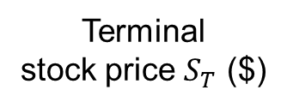
Profit of Longing a Call
Profit at maturity for buying one European call option: option price = $5, strike price = $100, option life = 4 months
30
Profit ($)
20
10
Terminal
stock price $S_{T}$ ($)
70
80
90
100
0
–5
$${45}^{°}$$
110
120
130
Note that as long as $S_{T}$ is higher (lower) than the strike price, the call holder should (should not) exercise this option
Since the cost to acquire the call option is $5, the call holder earn a positive profit when $S_{T}$ is higher than (strike price + $5)

Slide 8
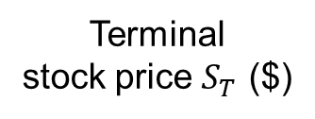
Profit of Shorting a Call
Profit from writing the same European call option: option price = $5, strike price = $100, option life = 4 months
Profit ($)
5
110
120
130
$${45}^{°}$$
0
70
80
90
100
Terminal
stock price $S_{T}$ ($)
–10
–20
–30
When $S_{T}$ is lower than the strike price, the call holder gives up his right and thus the option writer can earn the whole $5 of option price
If this call is exercised, the maximum losses of the call writer are unlimited
The call writer’s profit or loss is the negative of that for the call holder

Slide 9
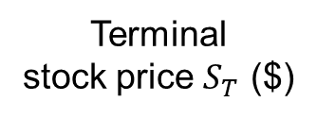
Profit of Longing a Put
Profit from buying a European put option: option price = $7, strike price = $70, option life = 3 months
Profit ($)
30
20
10
Terminal
stock price $S_{T}$ ($)
0
40
50
60
70
80
90
100
–7
$${45}^{°}$$
Note that as long as $S_{T}$ is lower (higher) than the strike price, the put holder should (should not) exercise this option
Since the cost to acquire the put option is $7, the put holder earn a positive profit when $S_{T}$ is lower than (strike price – $7)

Slide 10
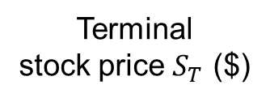
Profit of Shorting a Put
Profit from writing the same European put option: option price = $7, strike price = $70, option life = 3 months
Profit ($)
7
Terminal
stock price $S_{T}$ ($)
40
50
60
$${45}^{°}$$
0
70
80
90
100
–10
–20
–30
The put writer’s profit or loss is the negative of that for the put holder
The put writer’s profit declines when the stock price falls below the strike price ($70), and the breakeven point for the put writer is $63 (=$70 – $7)

Slide 11
Payoff Functions of European Options
Payoff is the final payment at maturity. The deduction of the option price is not necessary
Payoff of longing a call
Payoff of longing a put
S_{T}
S_{T}
K
K
Note the opposite relationship between the payoff functions of longing and shorting options
$$max⁡(S_{T}−K,0)$$
$$max⁡(K−S_{T},0)$$
Payoff of shorting a call
Payoff of shorting a put
K
K
S_{T}
S_{T}
$$−max⁡(S_{T}−K,0)$$
$$−max⁡(K−S_{T},0)$$

Slide 12
Types of Options
Several exchange-traded options
Stock options (個股選擇權)
Most stock options are traded on exchanges
In the U.S., one stock options gives the holder the right to buy or sell 100 shares of stock at the specified strike price
In the U.S., exchange-traded stock options are American-style options
ETF options (股票指數型基金選擇權)
ETFs (Exchange-Traded Funds) are listed on an exchange and traded like a share of company’s stock
ETFs are designed to track an equity or bond index and provide traders with the return they would earn as if they invested in the component assets that constitute the index
ETF options are traded like stock options, which are American style and settle for shares of the underlying ETF

Slide 13
Types of Options
Index options (指數選擇權)
The most popular exchange-traded option contracts in the U.S. are the index options on S&P 500 index, S&P100 index, NASDAQ-100 index, and Dow Jones Industrial Average Index
All of the above are traded on Chicago Board Options Exchange (CBOE)
Most index options are European
An exception is the index option on S&P 100 index
Cash settlement
One index option contract is to buy or sell, for example 50, times the index at the specified strike price
Consider a call option with a strike price of 980, which is exercised when the index value is 992. The option writer pays the option holder max(992 – 980,0) × $50 = $600

Slide 14
Types of Options
Foreign currency options (外幣選擇權)
Most currency options trading occurs in OTC markets, but there is some exchange trading
In the U.S., NASDAQ OMX offers European-style option contracts on a variety of different currencies
One option contract is for trading 10,000 units of a foreign currency (for 1,000,000 units of Japanese yen)
Futures options (期貨選擇權)
The underlying asset of a futures option is a futures contract with a longer time to maturity
When an exchange trades a particular futures contract, it often also trades (American) options on that futures contract

Slide 15
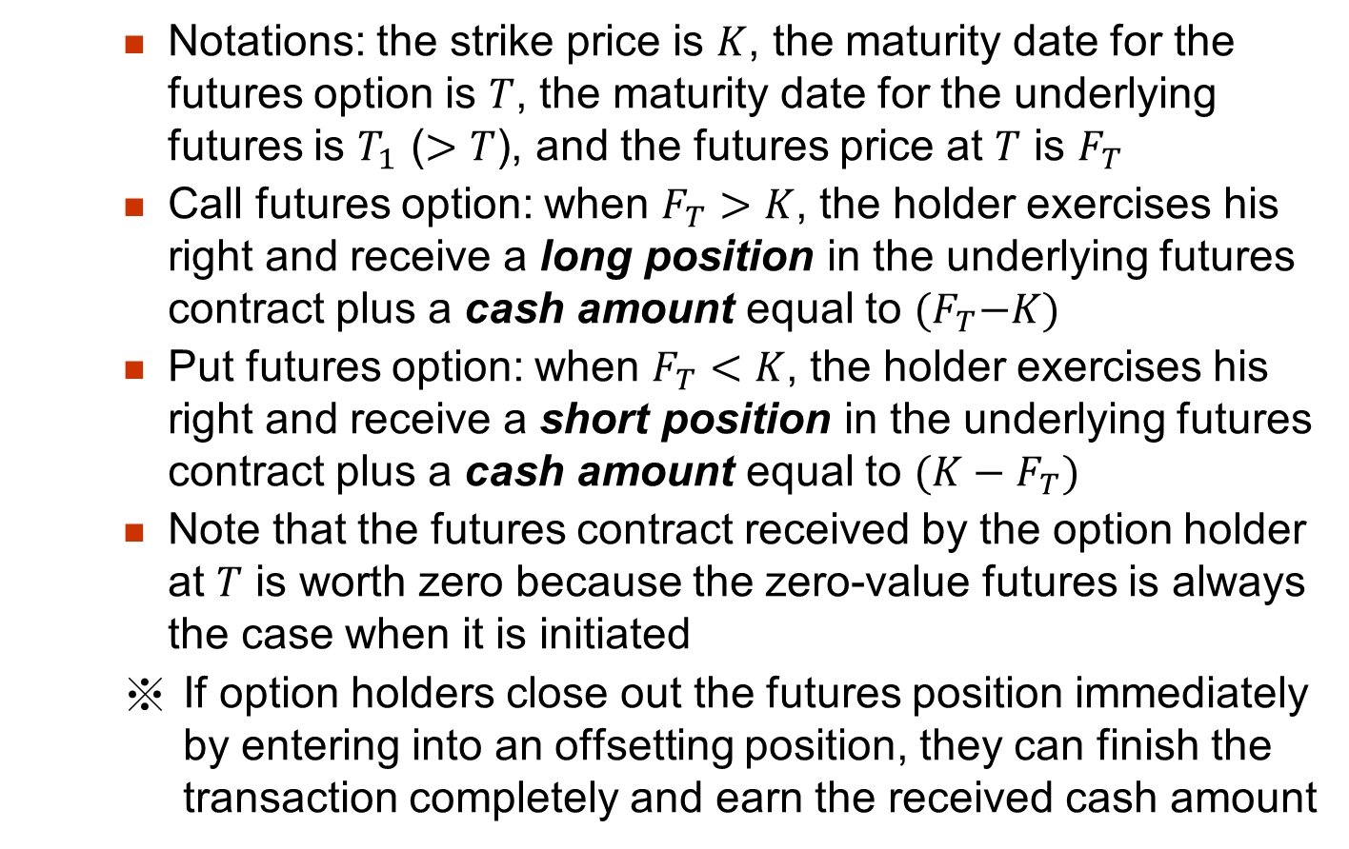
Types of Options
Notations: the strike price is $K$, the maturity date for the futures option is $T$, the maturity date for the underlying futures is $T_{1}$ ($>T$), and the futures price at $T$ is $F_{T}$
Call futures option: when $F_{T}>K$, the holder exercises his right and receive a long position in the underlying futures contract plus a cash amount equal to ${(F}_{T}−K)$
Put futures option: when $F_{T}<K$, the holder exercises his right and receive a short position in the underlying futures contract plus a cash amount equal to ${(K−F}_{T})$
Note that the futures contract received by the option holder at $T$ is worth zero because the zero-value futures is always the case when it is initiated
If option holders close out the futures position immediately by entering into an offsetting position, they can finish the transaction completely and earn the received cash amount

Slide 16
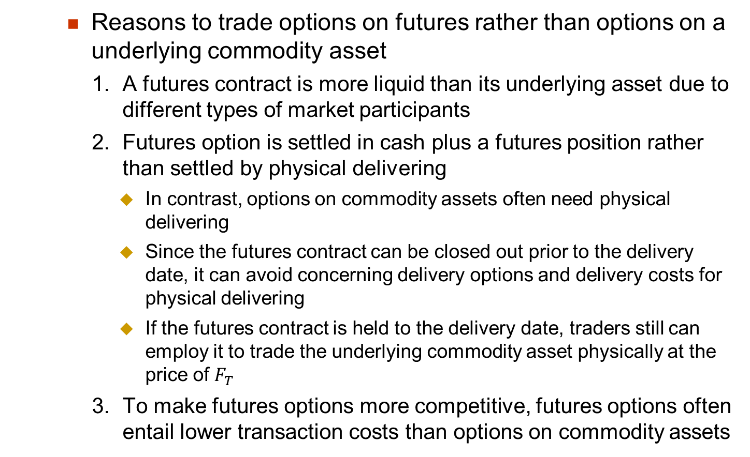
Types of Options
Reasons to trade options on futures rather than options on a underlying commodity asset
A futures contract is more liquid than its underlying asset due to different types of market participants
Futures option is settled in cash plus a futures position rather than settled by physical delivering
In contrast, options on commodity assets often need physical delivering
Since the futures contract can be closed out prior to the delivery date, it can avoid concerning delivery options and delivery costs for physical delivering
If the futures contract is held to the delivery date, traders still can employ it to trade the underlying commodity asset physically at the price of $F_{T}$
To make futures options more competitive, futures options often entail lower transaction costs than options on commodity assets

Slide 17
9.2 Trading Options on Exchanges

Slide 18
Trading Options on Exchanges
Standard stock options in the U.S. are employed to explain option trading on exchanges
Items in option contracts
European or American
In Taiwan, both index and stock options are European style, but warrants (introduced later) are American style
Expiration date (or maturity date) (到期日)
Expiration date: the third Friday of the expiration month
Trading takes places every business day (8:30 a.m. to 3:00 p.m. Central time) until the expiration date
Long-term equity anticipation securities (LEAPs) trade on many stocks with the time to maturity up to 39 months and the expiration date to be the third Friday of January

Slide 19
Trading Options on Exchanges
Stock options are issued on the Jan., Feb., or Mar. cycle
The Jan. cycle months consists of Jan., Apr., July, and Oct. (similar for Feb. and Mar. cycles)
The following two rules determine listing options with different maturity months at any time during a year
If the expiration date in the current month has not yet been reached, options trade for the current month (until the expiration date), the following month, and the next two months in the cycle
If the expiration date in the current month has passed, options trade for the next month, the next-but-one month, and the next two months in the cycle
(When one option expires, trading in another month option is started such that the above two rules can be satisfied)
※ Exchanges can use their own rules for listing options with different maturity months, e.g., maybe the next three cycle months are considered

Slide 20
Trading Options on Exchanges
Strike price
For each maturity, there is a series of strike prices spaced $2.5 (for stock prices between $5 and $25), $5 (for stock prices between $25 and $200), or $10 (for stock prices above $200) apart
When options with a new expiration month debuts (首次出現), the two or three strike prices closest to the current stock price are selected as the strike prices for the options
If the stock price moves outside the range, a new strike price is introduced to extend the range to cover the stock price
Suppose the stock price is $82, the initial strike prices for options may be $80, $85, $90. If the stock price rises above $90 (declines below $80), the option with the strike price of $95 ($75) is initiated

Slide 21
Trading Options on Exchanges
※ Some terminologies
Intrinsic value (內含價值) vs. Time value (時間價值)
Option value = Time value + Intrinsic value
The intrinsic value of an option is defined as the payoff of the option if it were exercised immediately
For calls, the intrinsic value is $\max\left(S_{t}−K,0\right)$
For puts, the intrinsic value is $\max\left(K−S_{t},0\right)$
An American-style option is worth at least as much as its intrinsic value because the option holder always can realize the intrinsic value by exercising the option immediately
Example: If the current stock price $S_{t}$ is $110 and the strike price $K$ is $100, a call is worth $12, which can be decomposed as $2 (time value) and $(110 – 100) = $10 (intrinsic value)

Slide 22
Trading Options on Exchanges
Moneyness (價值狀況)
In the money (ITM) (價內): Options are referred to as in the money if they have positive intrinsic values, i.e., $S_{t}>K$ for calls and $S_{t}<K$ for puts
Out of the money (OTM) (價外): Options are referred to as out of the money if they have zero intrinsic value, i.e., $S_{t}<K$ for calls and $S_{t}>K$ for puts
At the money (ATM) (價平): $S_{t}=K$ for both calls and puts
An ITM option will always be exercised on the expiration date ($T$), i.e., if $S_{T}>K$ for calls or $S_{T}<K$ for puts, those options will always be exercised

Slide 23
Trading Options on Exchanges
Anti-dilution provisions (防稀釋條款)
Adjustment for cash dividends
Some OTC options are cash dividend protected
If a company declares a cash dividend, the strike price for calls (puts) on the company’s stock decreases (increases) on the ex-dividend day (付息日或除息日) by the cash dividend amount
Most exchange-traded options in the U.S. are not adjusted in response to cash dividends, which therefore reduce (increase) values of call (put) options
Exchange-traded options are adjusted for stock split or stock dividends
An $n$-for-$m$ stock split is to use $n$ newly-issued stock shares to exchange for $m$ outstanding stock shares
A 20% stock dividend is equivalent to a 6-for-5 stock split because shareholders receive 0.2 additional shares for each 1 share owned

Slide 24
Trading Options on Exchanges
The effect of stock split and paying stock dividends is to issue more shares to replace existing shares, so there is no impact on the asset value or the earning ability of a company
An $n$-for-$m$ stock split or stock dividends theoretically cause the stock price to go downward to $m/n$ of its previous value
Two items in option contracts are adjusted to offset expected changes in a stock price arising from a stock split or a payment of stock dividends
The strike price is reduced to $m/n$ of its previous value
The number of shares covered by one options is increased to $n/m$ of its previous value
In Taiwan, both warrants and stock options traded on exchanges have provisions of cash-dividend protection
Index options may be still stock-dividend (-split) protected, although there is no explicit clauses of adjustments for stock splits and stock dividends in index option contracts
As long as the index level does not change after stock splits and distributions of stock dividends, e.g., Taiwan weighted index or S&P 500

Slide 25
Trading Options on Exchanges
※ Consider a call option to buy 100 shares for the strike price to be $20/share
How should terms be adjusted:
For a 2-for-1 stock split?
The strike price is reduced to $10 (=$20 × (1/2))
The number of shares covered by one options is 200 (=100 × 2)
For a 25% stock dividend?
It is equivalent to a 5-for-4 stock split
The strike price is reduced to $16 (=$20 × (4/5))
The number of shares covered by one options is 125 (=100 × (5/4))

Slide 26
Trading Options on Exchanges
Position and exercise limits
A position (exercise) limit defines the maximum number of option contracts that an investor can hold (exercise) on one side of the market
Prevent from being unduly influenced by one investor
Long calls and short puts are treated to be on the same side of the market (bull’s view)
Short calls and long puts are treated to be on the same side of the market (bear’s view)
The exercise limit usually equals the position limit
Determined by the number of understanding shares and trading volume associated with each underlying stock
For the largest and most frequently traded underlying stocks, the position limit can be 250,000 contracts on CBOE

Slide 27
Trading Options on Exchanges
Commissions (佣金): charged by a broker and calculated as a fix cost plus a proportion of the dollar amount of the trade of options
The commission is charged both when an option position is initiated and when it is closed out by an offsetting trade
For retail traders, a commission schedule is
Maximum (minimum) commission is $30 per contracts for the first 5 contracts plus $20 ($2) for each additional contract
Dollar amount of trade | < $2,500 | $2,500 to $10,000 | > $10,000
Commission | $20 + 0.02 of dollar amount | $45 + 0.01 of dollar amount | $120 + 0.0025 of dollar amount

Slide 28
Trading Options on Exchanges
Note that if the option is exercised, the option holders need to pay the commission for trading the underlying shares, which is a proportion, e.g., 1.5%, of the trade amount on the underlying shares
The commissions for trading options vary significantly for different brokers and exchanges
For Taifex, the commissions for trading futures and options can refer to https://www.taifex.com.tw/cht/4/feeSchedules

Slide 29
Trading Options on Exchanges
Most exchanges use market makers (造市者) to facilitate options trading
Since so many option contracts are concurrently traded on exchanges, some of them are with thin trading volume
Market makers enhance the liquidity by always being ready to trade options with other traders
Market makers quote both bid and ask (offer) prices
The bid (ask) is the price at which the market maker is prepared to buy (sell) the options
The ask is always higher than the bid, and the bid-ask spread is the source of the profit for market makers
The bid-ask spread is a hidden cost for option traders

Slide 30
Trading Options on Exchanges
Margins (保證金)
In the U.S., when stock shares are purchased, a trader can either pay cash or borrow using a margin account (this is known as buying on margin)
In contrast, for option buyers, buying on margin is not always allowed
For options with times to maturity less than 9 months, the option price must be paid in full
For options with times to maturity longer than 9 months, investors can buy on margin, borrowing up to 25% of the option price
(Options already contain substantial leverage effect (see Slide 1.30), so it is improper to further raise leverage level with buying on margin)

Slide 31
Trading Options on Exchanges
For option writers, it is required to maintain funds in a margin account to minimize their default risk
The required margin amount for writing a naked option is the greater of the following two quantities:
A total of 100% of the proceeds of the sale plus 20% of the underlying share price less the amount (if any) by which the option is out of the money
A total of 100% of the proceeds of the sale plus 10% of the underlying share price for calls (10% of the strike price for puts)
A naked option is an option that is not combined with an offsetting position in the underlying asset initially (an example of a non-naked option is shown on the next slide)
The above is the margin requirement imposed by the OCC to its members (Slide 9.33 will discuss OCC and its members)
A brokerage house may require a higher (but no less) margin than the above from its clients

Slide 32
Trading Options on Exchanges
The above calculation are performed everyday (but with the prevailing prices of options and the underlying asset instead) to determine daily required margins
For index options, the 20% is replaced by 15% because a stock index is usually less volatile than the price of an individual stock
For other trading strategies, such as covered calls, protective puts, spreads, combinations, straddles, and strangles, the CBOE defines special rules for determining the margin requirements (Option trading strategies will be discussed in Ch. 11)
For example, a covered call is a written call option when the shares that might have to be delivered are already owned by the call writer
Therefore, the worst scenario for the writer of a covered call is to sell the shares he owns at the strike price when the call is exercised by the call holder
Since the default risk of the writer of covered calls is minor, there is no margin requirements for writing covered calls

Slide 33
Trading Options on Exchanges
The Options Clearing Corporation (選擇權結算公司, OCC)
The OCC plays the same role in option markets as the clearing house does in futures market (see Ch. 2)
Funds to purchase an option must be deposited with the OCC by the morning of the business day following the trade
The OCC records all long and short positions
The OCC has a number of members, and all options trades must be cleared through its members
Hierarchy of the required margin for writing options:
Option writers maintains a margin account with a broker
The broker maintains a margin account with a OCC member
The OCC member maintains a margin account with the OCC

Slide 34
Trading Options on Exchanges
Clearing process of exercising options:
When a trader notifies a broker to exercise an option, the broker in turn notifies the OCC member which will place an exercise order with the OCC
The OCC randomly selects a member with an outstanding short position in the same option, and that member selects a particular trader who has written the option according to some pre-specified rules
In the U.S., the Commodity Futures Trading Commission is responsible for regulating markets for options or futures

Slide 35
Trading Options on Exchanges
Taxation issues for options
When the option position is closed out or expires unexercised
The gains and losses from the trading of stock options are taxed as capital gains or losses
When the option is exercised
The gain or loss from the option is rolled into the position taken in the stock and recognized when the stock position is closed out
For the holder who exercises a call (For the call writer), he can acquire a long (short) position in the underlying stock at the strike price plus the call price
For the holder who exercises a put (For the put writer), he can acquire a short (long) position in the underlying stock and the net income (cost) equals the strike price less the put price

Slide 36
Trading Options in OTC Market
Trading options in OTC markets
The OTC market for options has become increasingly important since the early 1980s and is now larger than the exchange-traded market
OTC options on foreign exchange and interest rates are particularly popular
The advantage of OTC options is that they can be custom-made to meet the precise needs of investors
The disadvantage of OTC options is that option writer may default
To overcome this disadvantage, option writers are sometimes required to post collateral

Slide 37
9.3 Warrants, Employee Stock Options, and Convertible Bonds

Slide 38
Warrants, ESOs, and CBs
Warrants, employee stock options (ESOs), and convertible bonds (CBs) are option-like instruments
Warrant (權證):
Warrants are options issued by financial institutions or nonfinancial corporations
The warrant issuer settles up with the warrant holder when a warrant is exercised
A financial institution might issue put warrants (認售權證) on gold and then to proceed to create a market (by offering bid and ask prices) for trading these warrants
The warrants issued by financial institutions can be traded on an exchange or in an OTC market, and the issuing financial institution acts as the market maker for this warrant

Slide 39
Warrants, ESOs, and CBs
A common use of warrants by a nonfinancial corporation is to issue call warrants (認購權證) on its own stock and attaches them to the bond issue
To make the corporate bond more attractive to investors
To reduce the coupon rate of the corporate bond and thus save the funding cost
Employee stock option (ESO) (員工股票選擇權):
ESOs are call options issued to employees by their company to align the interests between the employees and the shareholders
Usually are issued to be at the money at issuance
If the performance of the company is improved and thus the share price rises, the ESO becomes in the money and brings profit for employees

Slide 40
Warrants, ESOs, and CBs
ESOs cannot be exercised within a period of time (usually 1 to 4 years)
ESOs cannot be sold to others
ESOs can last for as long as 10 or 15 years
Today, ESOs are recorded as expenses at their fair market in the company’s income statement in most nations (rather than recorded as the distribution of the stock dividends in the balance sheet in the past)
This accounting principle makes ESOs a less attractive form of compensation than they used to be
Classified as the expense: affect the income statement as well as the net worth the of firm on the balance sheet
Classified as the stock dividends: affect the number of outstanding shares and the net worth per share of the firm on the balance sheet (it does not affect the net worth of the firm)

Slide 41
Warrants, ESOs, and CBs
Convertible bond (CB) (可轉換公司債)
CBs are bonds issued by a company that can be converted into equity at certain time points using a predetermined conversion ratio
A CB is a hybrid security of bond and equity
Note that CBs are different from bonds with an attached call warrant on the company’s stock
This is because you cannot separate the conversion right clearly from a CB
Very often a convertible is callable (可贖回)
The call-back provision is a way in which the issuer can force the conversion at a time point earlier than the holder might otherwise choose
CB holders can choose to exercise the conversion right after receiving the call back notification

Slide 42
Warrants, ESOs, and CBs
Different from the options traded on exchanges, the numbers of outstanding warrants, ESOs, and CBs are predetermined on the issue day
The numbers of outstanding warrants, ESOs, and CBs are determined by the size of the original issue and decrease when they are exercised or when they expire
In contrast, as more people trade a particular option contract on an exchange, the number of outstanding exchanged-traded options increases

Slide 43
Warrants, ESOs, and CBs
When these three instruments are exercised, the company issues more shares of its own stock and sells the stock shares to the option holder for the strike (or conversion) price
Thus, the exercise of these three instruments leads to an increase in the number of outstanding shares of the issuing company
Note that the above statement is not true for warrants issued by financial institutions
As warrant writers, financial institutions need to buy or sell underlying assets from markets for settlement

