Slide 1
Hedging Strategies Using Futures
Chapter 3

Slide 2
Goals of Chapter 3
Basic principles and reasons of hedge (避險) using futures
Discuss three types of basis risk (基差風險), which causes hedge imperfectly
Derive optimal hedge ratio for cross hedging (交叉避險)
  The asset being hedged is not the same as the underlying asset of futures, but these two assets share some common sources of risk
Introduce stock index futures (股價指數期貨) and how to hedge equity portfolios with stock index futures
Notes:
2

Slide 3
3.1 Basic Principles of and Reasons of Hedge Using Futures

Slide 4
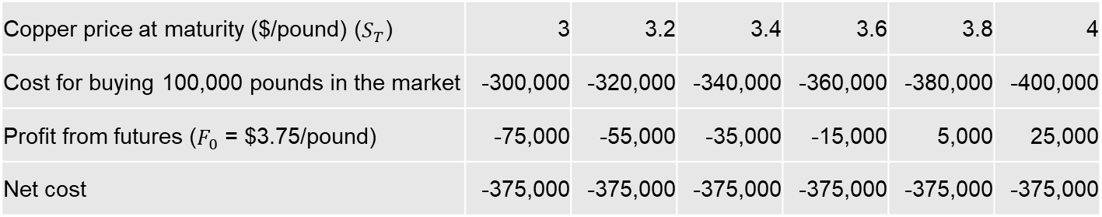
Understand Hedge Using Futures with Margin Mechanism
A long futures hedge is appropriate when you know you need to BUY an asset at a future time point and intend to lock in the price
  A manufacturer needs to buy 100,000 pounds of copper after one month ⇒ take a long position of 4 contracts (each can deliver 25,000 pounds of copper after one month) on NYMEX
  (“+” (“-”) indicates cash inflow (outflow) or gains (losses) from the futures position)
Copper price at maturity ($/pound) ($S_{T}$) | 3 | 3.2 | 3.4 | 3.6 | 3.8 | 4
Cost for buying 100,000 pounds in the market | -300,000 | -320,000 | -340,000 | -360,000 | -380,000 | -400,000
Profit from futures ($F_{0}$ = $3.75/pound) | -75,000 | -55,000 | -35,000 | -15,000 | 5,000 | 25,000
Net cost | -375,000 | -375,000 | -375,000 | -375,000 | -375,000 | -375,000
※ Note the opposite changes in the values of the hedged and futures positions

Slide 5
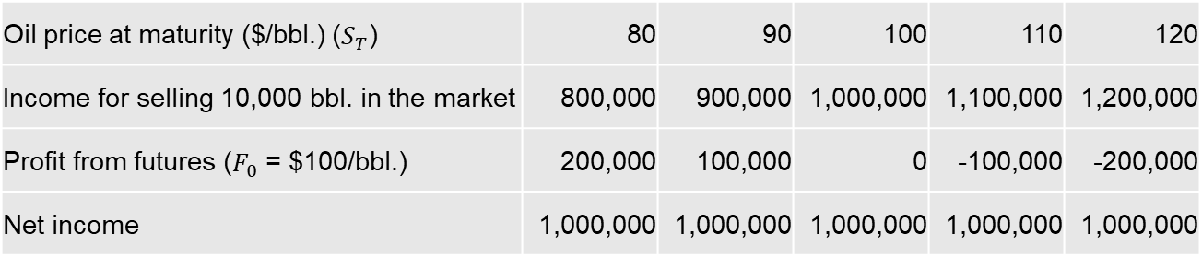
Understand Hedge Using Futures with Margin Mechanism
A short futures hedge is appropriate when you know you will SELL an asset at a future time point and intend to lock in the price
  An oil producer will sell 10,000 barrels of crude oil after two months ⇒ take a short position of 10 contracts (each can deliver 1,000 barrels of crude oil after two months) on NYMEX
  (“+” (“-”) indicates cash inflow (outflow) or gains (losses) from the futures position)
Oil price at maturity ($/bbl.) ($S_{T}$) | 80 | 90 | 100 | 110 | 120
Income for selling 10,000 bbl. in the market | 800,000 | 900,000 | 1,000,000 | 1,100,000 | 1,200,000
Profit from futures ($F_{0}$ = $100/bbl.) | 200,000 | 100,000 | 0 | -100,000 | -200,000
Net income | 1,000,000 | 1,000,000 | 1,000,000 | 1,000,000 | 1,000,000
※ Note the opposite changes in the values of the hedged and futures positions

Slide 6
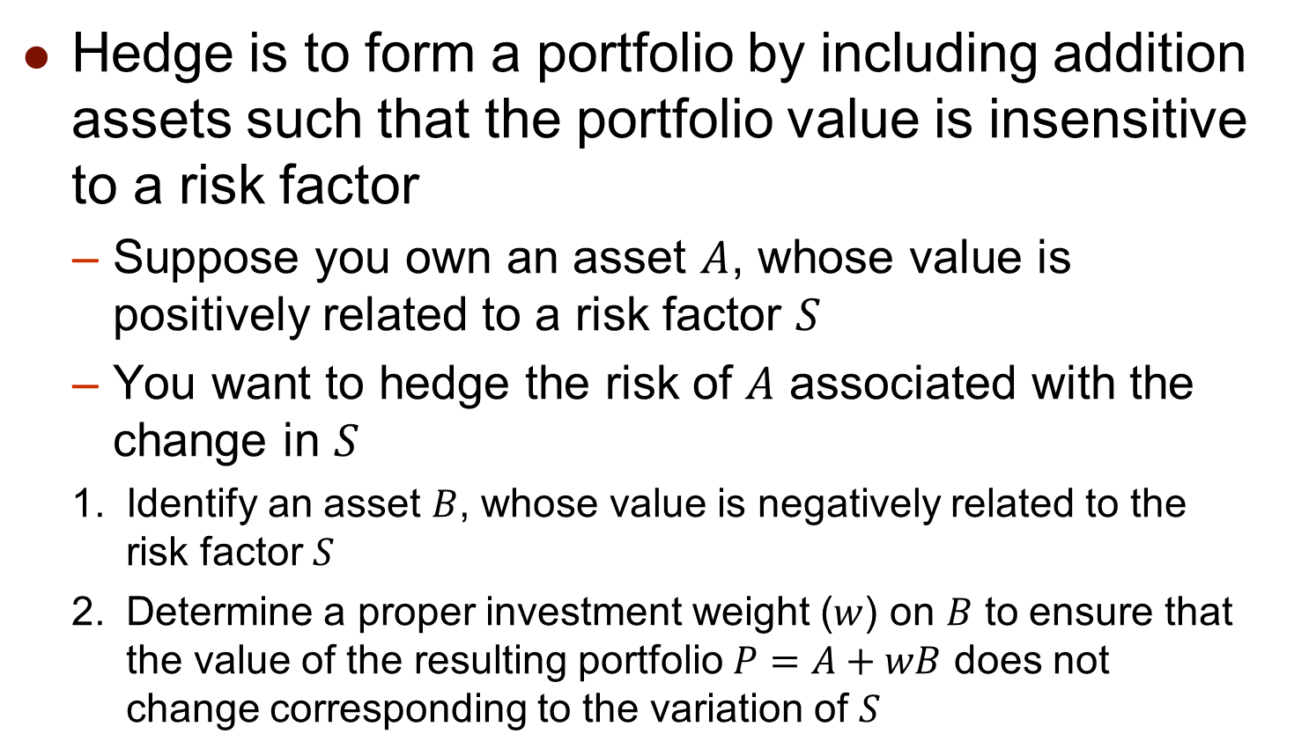
True Meaning of Hedge
Hedge is to form a portfolio by including addition assets such that the portfolio value is insensitive to a risk factor
  Suppose you own an asset $A$, whose value is positively related to a risk factor $S$
  You want to hedge the risk of $A$ associated with the change in $S$
  Identify an asset $B$, whose value is negatively related to the risk factor $S$
  Determine a proper investment weight ($w$) on $B$ to ensure that the value of the resulting portfolio $P=A+wB$ does not change corresponding to the variation of $S$

Slide 7
Arguments in Favor of Hedging
Companies should focus on their main business and minimize risks arising from IRs, FX rates, or other market variables
  They have no expertise in predicting market variables
  Save the cost to undertake the job of prediction
A stable profit or cost can enhance the company’s ability to allocate production factors more efficiently, especially for CF management
More stable series of incomes ⇒ Lower financial risk ⇒ enjoy lower funding costs on both equities and debts ⇒ a lower WACC implies a higher value of the company

Slide 8
Arguments against Hedging
Shareholders are usually well diversified and can make their own hedging decisions
  Hedging by firms is redundant if shareholders can hedge by themselves through diversification
  Save hedging costs by hedging only net exposure
Hedging may increase risk when competitors do not
  No hedge: floating cost and floating prices of products and services imply a stable profit margin
  Hedge to fix cost (or the selling prices): fixed cost and floating income (or floating cost and fixed income) result in a unstable profit margin

Slide 9
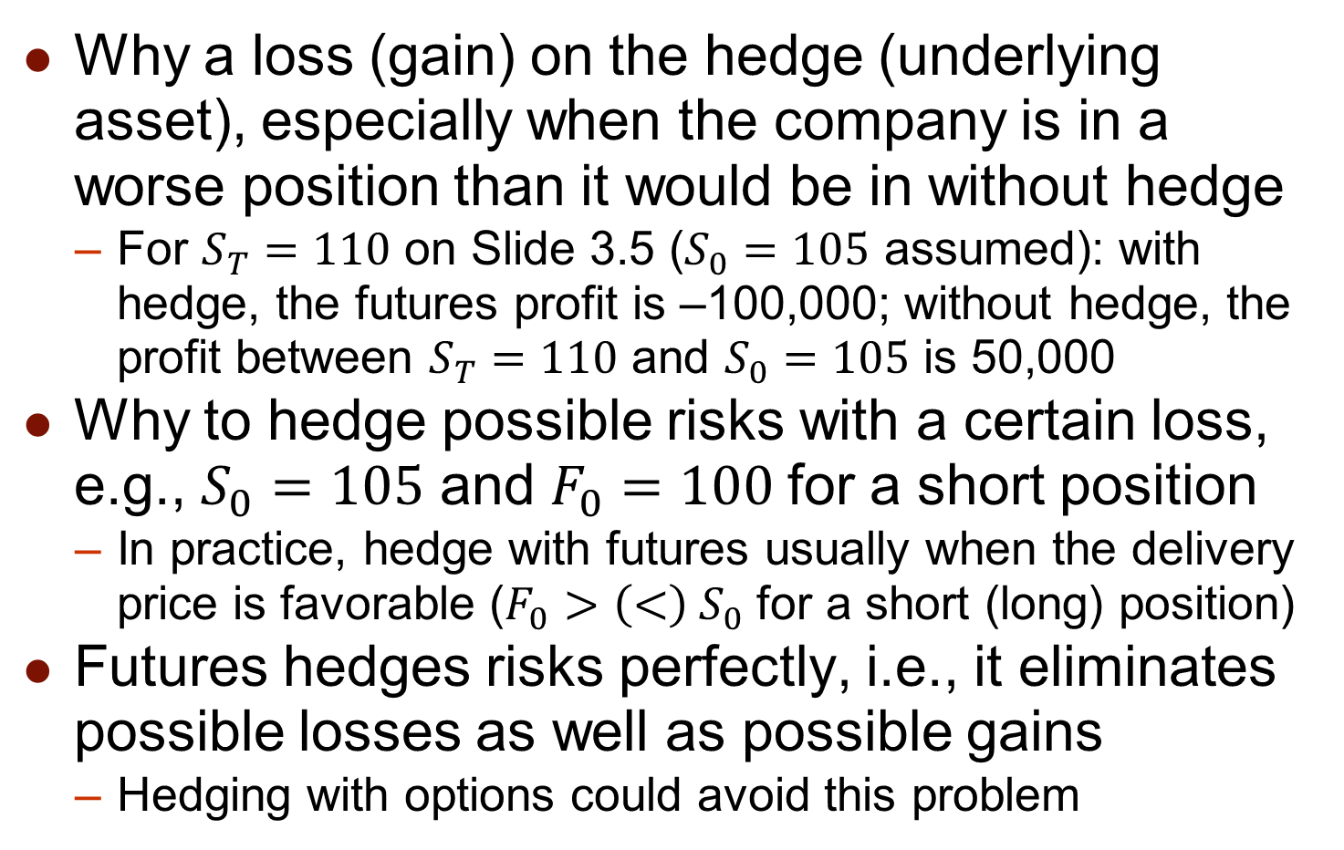
Arguments against Hedging
Why a loss (gain) on the hedge (underlying asset), especially when the company is in a worse position than it would be in without hedge
  For $S_{T}=110$ on Slide 3.5 ($S_{0}=105$ assumed): with hedge, the futures profit is –100,000; without hedge, the profit between $S_{T}=110$ and $S_{0}=105$ is 50,000
Why to hedge possible risks with a certain loss, e.g., $S_{0}=105$ and $F_{0}=100$ for a short position
  In practice, hedge with futures usually when the delivery price is favorable ($F_{0}>\left(<\right) S_{0}$ for a short (long) position)
Futures hedges risks perfectly, i.e., it eliminates possible losses as well as possible gains
  Hedging with options could avoid this problem

Slide 10
3.2 Three Types of Basis Risk (基差風險)

Slide 11
Basis Risk
  The first type of basis risk is due to a mismatch between the expiration date of the futures and the actual trading date of the asset

Slide 12
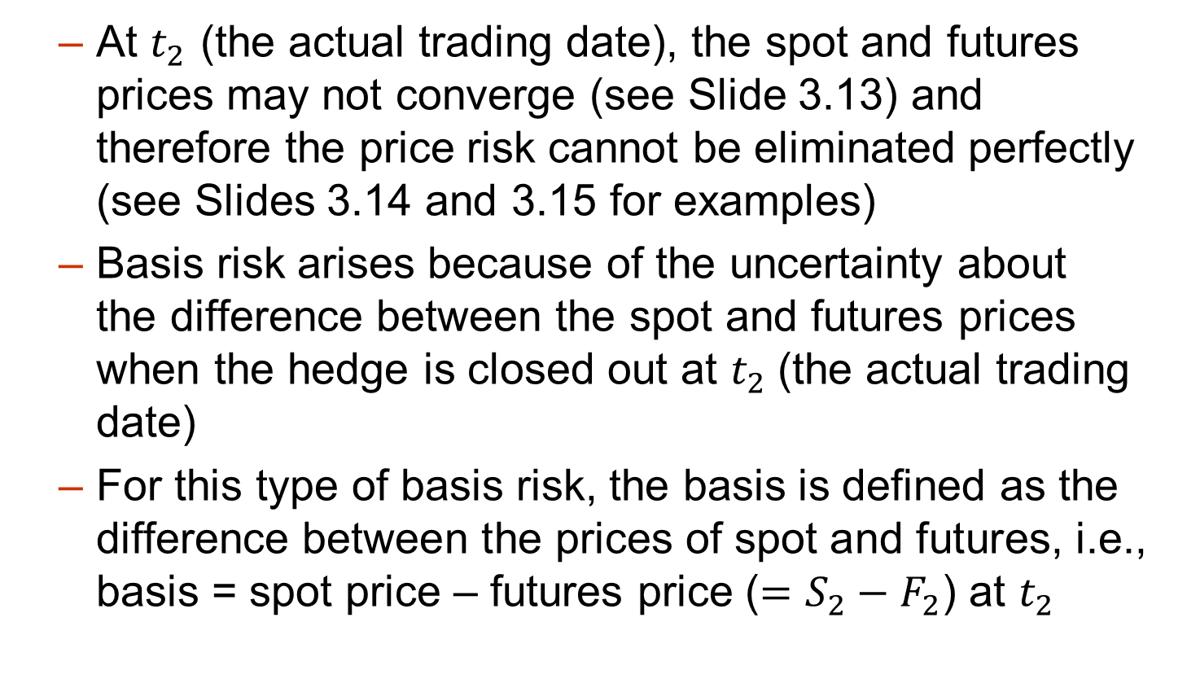
Basis Risk
  At $t_{2}$ (the actual trading date), the spot and futures prices may not converge (see Slide 3.13) and therefore the price risk cannot be eliminated perfectly (see Slides 3.14 and 3.15 for examples)
  Basis risk arises because of the uncertainty about the difference between the spot and futures prices when the hedge is closed out at $t_{2}$(the actual trading date)
  For this type of basis risk, the basis is defined as the difference between the prices of spot and futures, i.e., basis = spot price – futures price ($=S_{2}−F_{2}$) at $t_{2}$

Slide 13
Convergence of Futures to Spot
(Hedge initiated at time t₁ and closed out at time t₂)
Futures Price
Spot Price
Spot Price
Futures Price
Time
Time
t₁
t₂
t₁
t₂
Basis < 0
Basis > 0
※ Basis = spot price – futures price
※ As long as the basis is not zero, no matter positive or negative, there is a basis risk

Slide 14
Basis Risk for Long Hedge
    At t₁, consider to purchase gold at t₂, but the delivery date of considered long-position futures is slightly later than t₂
    F₁: futures price at t₁
    F₂ and S₂: futures and spot prices at t₂
Cost of acquiring gold:
S₂ – (F₂ – F₁) = F₁ + (S₂ – F₂) = F₁ + Basis
  S₂ is the price to purchase gold in the market, and (F₂ – F₁) is the profit from the long position of the futures
  If F₁ = 1000, F₂ = 1005, S₂ = 1004, the cost of acquiring gold is 999
  Since the basis cannot be known until t₂, the cost of acquiring gold is uncertain (not perfectly hedged)

Slide 15
Basis Risk for Short Hedge
    At t₁, consider to sell gold at t₂, but the delivery date of considered short-position futures is slightly later than t₂
    F₁: futures price at t₁
    F₂ and S₂: futures and spot price at t₂
Income from selling gold:
S₂ + (F₁ – F₂) = F₁ + (S₂ – F₂) = F₁ + Basis
  S₂ is the price to sell gold in the market, and (F₁ – F₂) is the profit from the short position of the futures
  If F₁ = 1000, F₂ = 1005, S₂ = 1004, the income of selling gold is 999
  Since the basis cannot be known until t₂, the income of selling gold is uncertain (not perfectly hedged)

Slide 16
Basis Risk
  The second type of basis risk: the asset being hedged is different from the asset underlying futures, e.g., jet fuel price vs. heating oil futures
  t₂ (actually trading date) is the delivery date: Basis risk is the uncertain difference between the price changes for jet fuel and heating oil

Slide 17
Basis Risk
  t₂ (actual trading date) is not the delivery date: Basis risk is the uncertain difference between the price changes for jet fuel and heating oil futures (more generalized case and common in practice)
  The optimal hedge ratio of the cross hedge introduced in Section 3.3 can minimize this type of basis risk

Slide 18
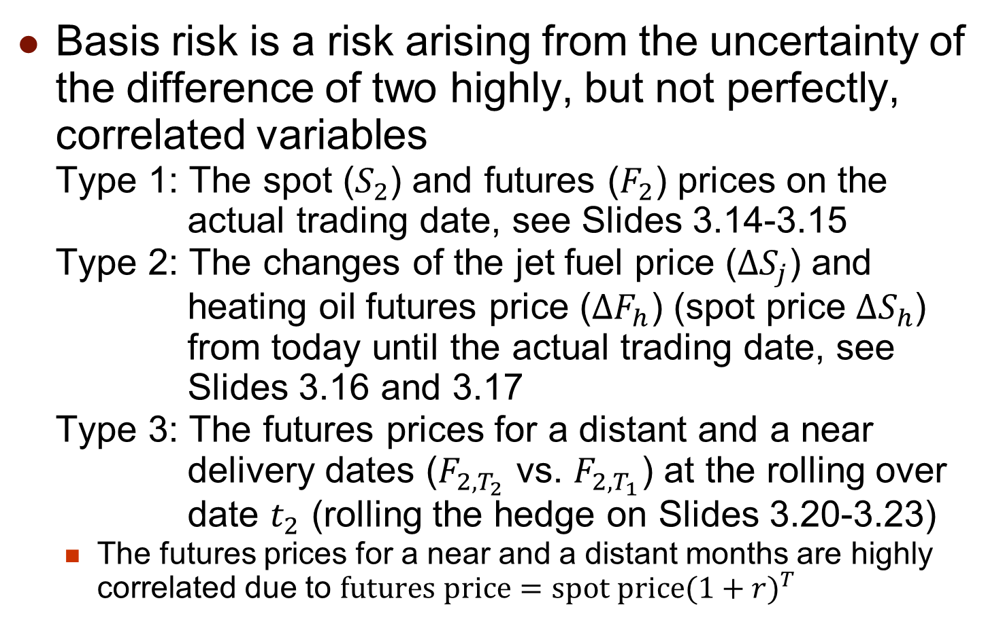
Three Types of Basis Risk
  Basis risk is a risk arising from the uncertainty of the difference of two highly, but not perfectly, correlated variables
  Type 1: The spot ($S_{2}$) and futures ($F_{2}$) prices on the actual trading date, see Slides 3.14-3.15
  Type 2: The changes of the jet fuel price (${∆S}_{j}$) and heating oil futures price (${∆F}_{h}$) (spot price ${∆S}_{h}$) from today until the actual trading date, see Slides 3.16 and 3.17
  Type 3: The futures prices for a distant and a near delivery dates ($F_{2,T_{2}}$ vs. $F_{2,T_{1}}$) at the rolling over date $t_{2}$ (rolling the hedge on Slides 3.20-3.23)
    The futures prices for a near and a distant months are highly correlated due to $futures price=spot price{(1+r)}^{T}$

Slide 19
Basis Risk Minimization
Two criteria for choosing contracts to minimize the basis risk
  Choose a delivery date that is as close as possible to, but later than, the end of the life of the hedge
    The basis risk increases with the distance between the actual trading date and the delivery date
    If the delivery date is earlier than the hedging expiration date, the extreme price movement in the unhedged period could result in a huge loss
  When there is no futures contract on the asset to be hedged, choose the contract whose futures price is most highly correlated with the asset price (introduced in Section 3.3)

Slide 20
Rolling The Hedge Forward
Sometimes the required hedge period is longer than the lives of all available futures contracts
  One can use a series of futures contracts to increase the life of a hedge
  Each time when switching from a near-maturity futures contract to another (entering into the new one and closing out the old one), a basis risk is incurred
  ※ This method is called rolling the hedge forward
  ※ Rolling futures contracts (期貨合約轉倉) refers to extending the maturity of a futures position forward by simultaneously closing out the in-hand contract and entering a new contract for the same underlying asset at the then-prevailing futures prices

Slide 21
Rolling The Hedge Forward
On 1st April 2022, a company realizes that it will have 100,000 bbl. of oil to sell on 30th June 2023
  Suppose that only the futures contracts within six delivery months have sufficient liquidity to meet the company’s need
  1. Short 100 Oct. 2022 futures contracts (with 6-month time to maturity) today
  2. Roll the hedge into the Mar. 2023 futures contracts (with 6-month time to maturity) in Sept. 2022
  3. Roll the hedge into the July 2023 futures contracts (with 5-month time to maturity) in Feb. 2022
  ※ The switch usually occurs near, but before the delivery date of the in-hand futures (not necessarily one-month before). A favorable basis risk could trigger an early switch

Slide 22
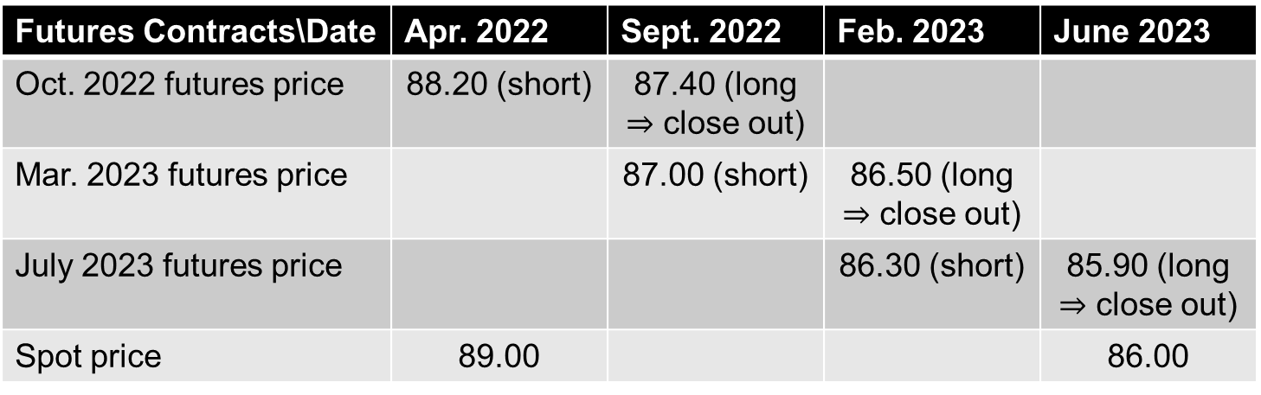
Rolling The Hedge Forward
  One possible scenario is analyzed as follows
Futures Contracts\Date | Apr. 2022 | Sept. 2022 | Feb. 2023 | June 2023
Oct. 2022 futures price | 88.20 (short) | 87.40 (long $⇒$ close out)
Mar. 2023 futures price |  | 87.00 (short) | 86.50 (long $⇒$ close out)
July 2023 futures price |  |  | 86.30 (short) | 85.90 (long $⇒$ close out)
Spot price | 89.00 |  |  | 86.00
※ The payoff from rolling the short positions of futures is
(88.20 – 87.40) + (87.00 – 86.50) + (86.30 – 85.90) = 1.70
※ The selling price in June 2023 (86.00) plus the profit from futures (1.70) equals 87.70, which is lower than the original futures price expired in Oct. 2022 (88.20)

Slide 23
Rolling The Hedge Forward
  Basis risk
    In Sept. 2022, the futures price for Oct. 2022 (87.40) is different from the futures prices for Mar. 2023 (87.00) (Type 3 basis risk)
    In Feb. 2023, the futures price for Mar. 2023 (86.50) is different from the futures prices for July 2023 (86.30) (Type 3 basis risk)
    In June 2023, the futures price for July 2023 (85.90) is different from the spot price (86.00) (Type 1 basis risk)
    The total payoff from the basis risk in this scenario
(87.00 – 87.40) + (86.30 – 86.50) + (86.00 – 85.90) = –0.5,
    which reflects the difference between the original futures price (88.20) and the final payoff when the rolling hedge strategy is considered (87.70)

Slide 24
3.3 Cross Hedge and Optimal Hedge Ratio

Slide 25
Cross Hedge and Optimal Hedge Ratio
Cross hedge (交叉避險) example:
  An airline that concerns about the future price of jet fuel
  Since the jet fuel futures are not actively traded, it might choose heating oil futures contracts to hedge its exposure
When the asset underlying the futures is the same as the asset being hedged, it is natural to use a hedge ratio of 1.0 (Slides 3.4 and 3.5)
For the cross hedge, an optimal hedge ratio to minimize the net variance of sum of the hedged and hedging positions can be derived

Slide 26
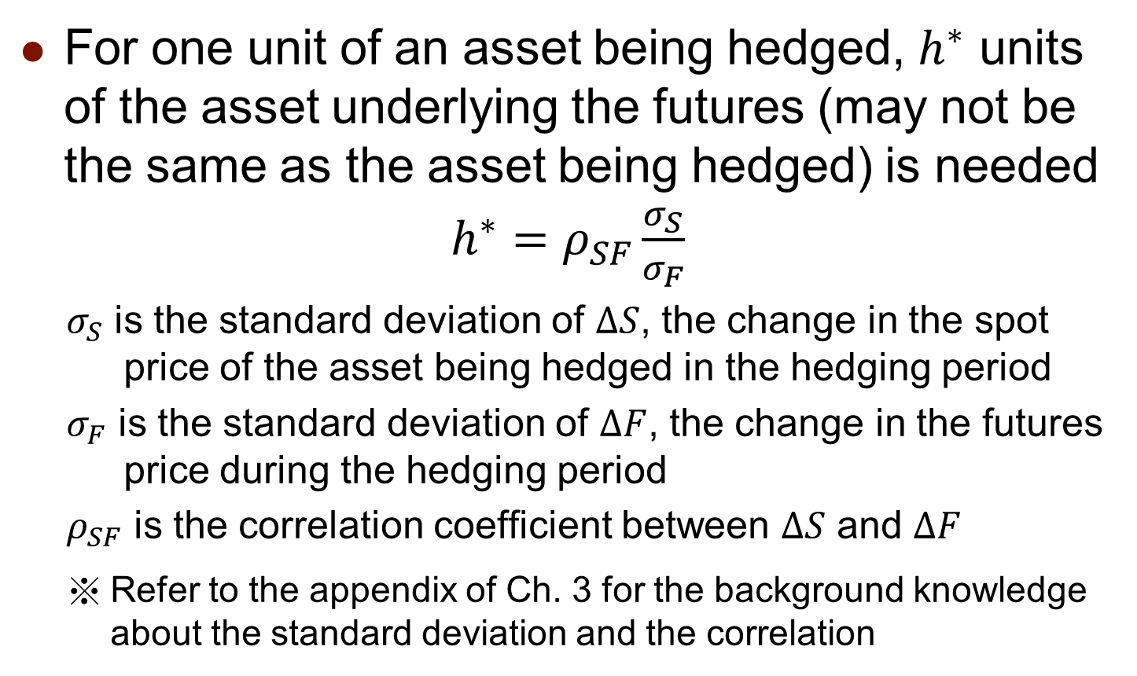
Cross Hedge and Optimal Hedge Ratio
For one unit of an asset being hedged, $h^{∗}$ units of the asset underlying the futures (may not be the same as the asset being hedged) is needed
$h^{∗}=ρ_{SF}\frac{σ_{S}}{σ_{F}}$
$σ_{S}$ is the standard deviation of $ΔS$, the change in the spot price of the asset being hedged in the hedging period
$σ_{F}$ is the standard deviation of $ΔF$, the change in the futures price during the hedging period
$ρ_{SF}$ is the correlation coefficient between $ΔS$ and $ΔF$
Refer to the appendix of Ch. 3 for the background knowledge about the standard deviation and the correlation

Slide 27

Cross Hedge and Optimal Hedge Ratio
Solve $h^{∗}$ from $\min_{h}{var\left(ΔS−hΔF\right)}$

Slide 28
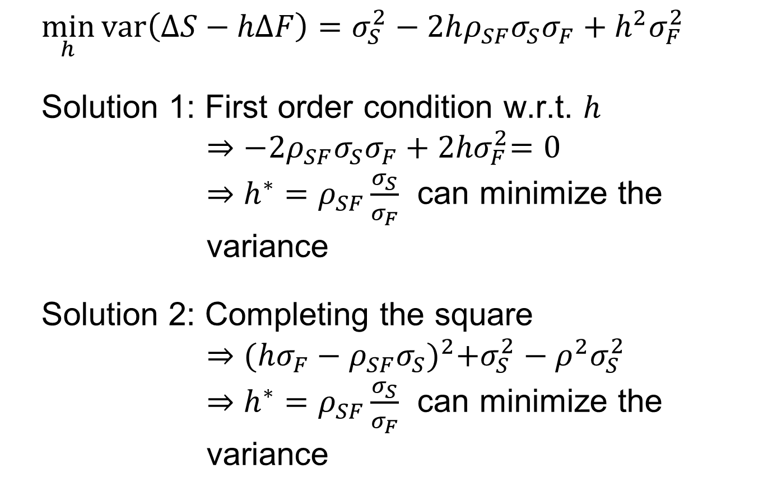
Cross Hedge and Optimal Hedge Ratio
$$\min_{h}{var\left(ΔS−hΔF\right)=σ_{S}^{2}−2hρ_{SF}σ_{S}σ_{F}+h^{2}σ_{F}^{2}}$$
Solution 1: First order condition w.r.t. $h$
$$⇒{−2ρ_{SF}σ_{S}σ_{F}+2hσ}_{F}^{2}=0$$
$⇒h^{∗}=ρ_{SF}\frac{σ_{S}}{σ_{F}}$ can minimize the variance
Solution 2: Completing the square
$$⇒{(hσ_{F}−ρ_{SF}σ_{S})}^{2}+σ_{S}^{2}−ρ^{2}σ_{S}^{2}$$
$⇒h^{∗}=ρ_{SF}\frac{σ_{S}}{σ_{F}}$ can minimize the variance

Slide 29
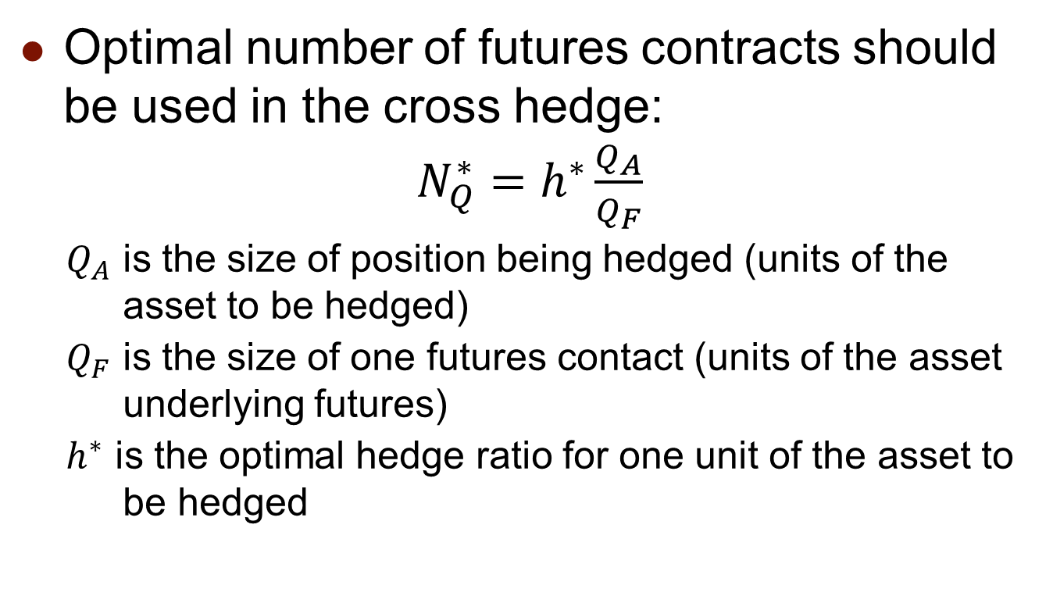
Cross Hedge and Optimal Hedge Ratio
Optimal number of futures contracts should be used in the cross hedge:
$N_{Q}^{∗}=h^{∗}\frac{Q_{A}}{Q_{F}}$
$Q_{A}$ is the size of position being hedged (units of the asset to be hedged)
$Q_{F}$ is the size of one futures contact (units of the asset underlying futures)
$h^{∗}$ is the optimal hedge ratio for one unit of the asset to be hedged

Slide 30
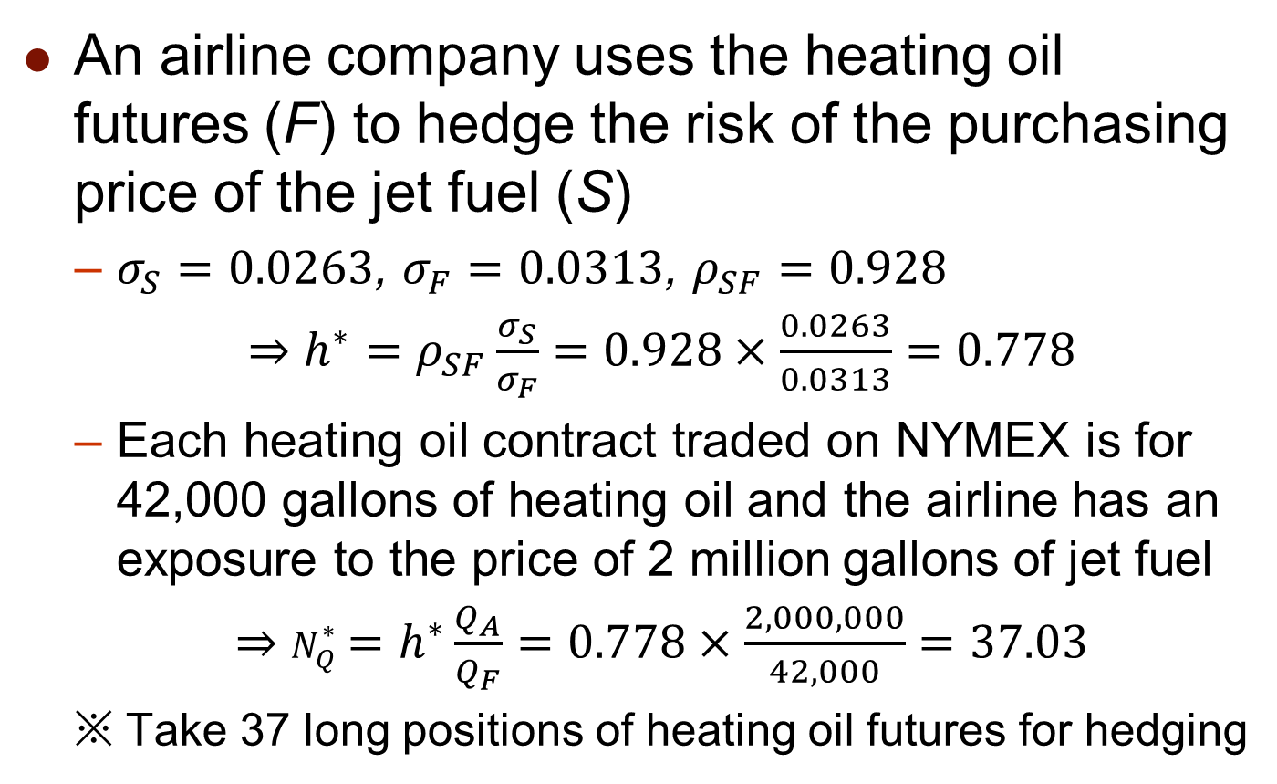
Cross Hedge and Optimal Hedge Ratio
An airline company uses the heating oil futures (F) to hedge the risk of the purchasing price of the jet fuel (S)
  $σ_{S}=0.0263$, $σ_{F}=0.0313$, $ρ_{SF}=0.928$
  $⇒h^{∗}=ρ_{SF}\frac{σ_{S}}{σ_{F}}=0.928×\frac{0.0263}{0.0313}=0.778$
  Each heating oil contract traded on NYMEX is for 42,000 gallons of heating oil and the airline has an exposure to the price of 2 million gallons of jet fuel
  $⇒N_{Q}^{∗}=h^{∗}\frac{Q_{A}}{Q_{F}}=0.778×\frac{2,000,000}{42,000}=37.03$
  ※ Take 37 long positions of heating oil futures for hedging

Slide 31
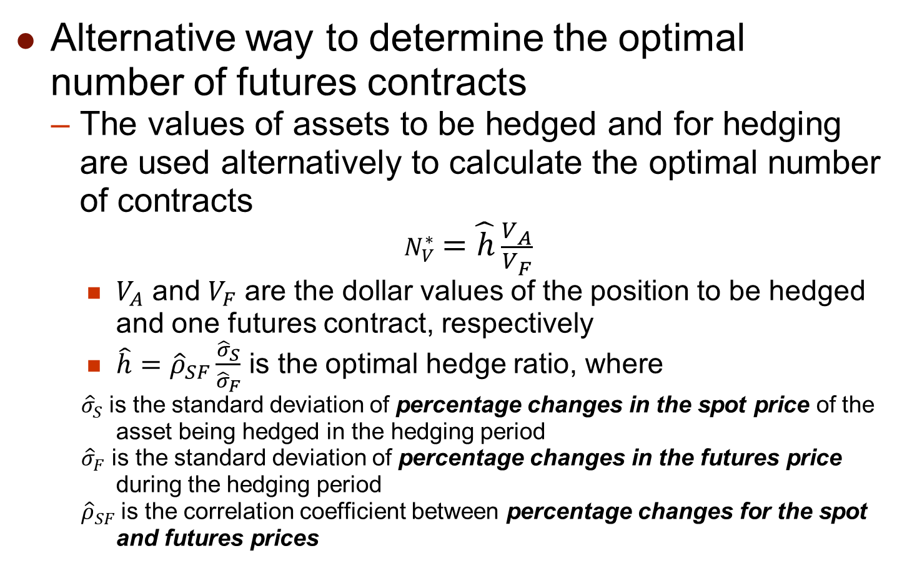
Cross Hedge and Optimal Hedge Ratio
Alternative way to determine the optimal number of futures contracts
  The values of assets to be hedged and for hedging are used alternatively to calculate the optimal number of contracts
  $N_{V}^{∗}=\hat{h}\frac{V_{A}}{V_{F}}$
    $V_{A}$ and $V_{F}$ are the dollar values of the position to be hedged and one futures contract, respectively
    $\hat{h}={\hat{ρ}}_{SF}\frac{{\hat{σ}}_{S}}{{\hat{σ}}_{F}}$ is the optimal hedge ratio, where
  ${\hat{σ}}_{S}$ is the standard deviation of percentage changes in the spot price of the asset being hedged in the hedging period
  ${\hat{σ}}_{F}$ is the standard deviation of percentage changes in the futures price during the hedging period
  ${\hat{ρ}}_{SF}$ is the correlation coefficient between percentage changes for the spot and futures prices

Slide 32


Cross Hedge and Optimal Hedge Ratio
  $N_{V}^{∗}$ is used particularly when the asset to be hedged or the asset underlying the futures cannot be counted in units, e.g., stock indexes or temperature degrees, which can be underlying variables but cannot be counted in units
$$\min_{N_{V}^{∗}}{var\left(V_{A}\frac{ΔS}{S}−N_{V}^{∗}V_{F}\frac{ΔF}{F}\right)=V_{A}^{2}{\hat{σ}}_{S}^{2}−2{\hat{ρ}}_{SF}V_{A}N_{V}^{∗}V_{F}{\hat{σ}}_{S}{\hat{σ}}_{F}+{\left(N_{V}^{∗}\right)}^{2}V_{F}^{2}{\hat{σ}}_{F}^{2}}$$
First order condition w.r.t. $N_{V}^{∗}$
$$⇒−2{\hat{ρ}}_{SF}V_{A}V_{F}{\hat{σ}}_{S}{\hat{σ}}_{F}+2N_{V}^{∗}V_{F}^{2}{\hat{σ}}_{F}^{2}=0$$
$⇒N_{V}^{∗}={\hat{ρ}}_{SF}\frac{V_{A}{\hat{σ}}_{S}}{V_{F}{\hat{σ}}_{F}}=\hat{h}\frac{V_{A}}{V_{F}}$ can minimize the variance
  ※ In theory, $N_{V}^{∗}$ could change due to the changes in $V_{A}$ and $V_{F}$. In practice, day-to-day changes in $N_{V}^{∗}$ are small and often ignored

Slide 33
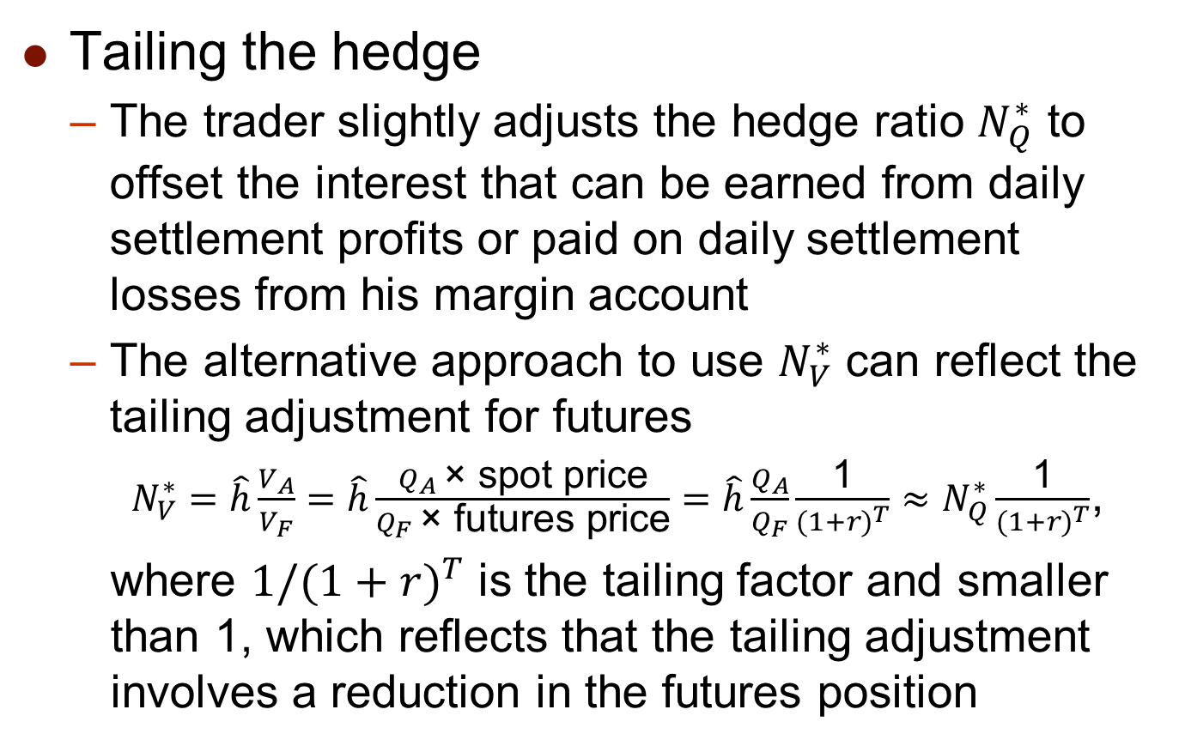
Cross Hedge and Optimal Hedge Ratio
Tailing the hedge
  The trader slightly adjusts the hedge ratio $N_{Q}^{∗}$ to offset the interest that can be earned from daily settlement profits or paid on daily settlement losses from his margin account
  The alternative approach to use $N_{V}^{∗}$ can reflect the tailing adjustment for futures
  $N_{V}^{∗}=\hat{h}\frac{V_{A}}{V_{F}}=\hat{h}\frac{Q_{A} \text{× }\text{spot} \text{price}}{Q_{F} \text{× }\text{futures} \text{price}}=\hat{h}\frac{Q_{A}}{Q_{F}}\frac{\text{1}}{{(1+r)}^{T}}≈N_{Q}^{∗}\frac{\text{1}}{{(1+r)}^{T}}$,
  where $1/{(1+r)}^{T}$ is the tailing factor and smaller than 1, which reflects that the tailing adjustment involves a reduction in the futures position

Slide 34
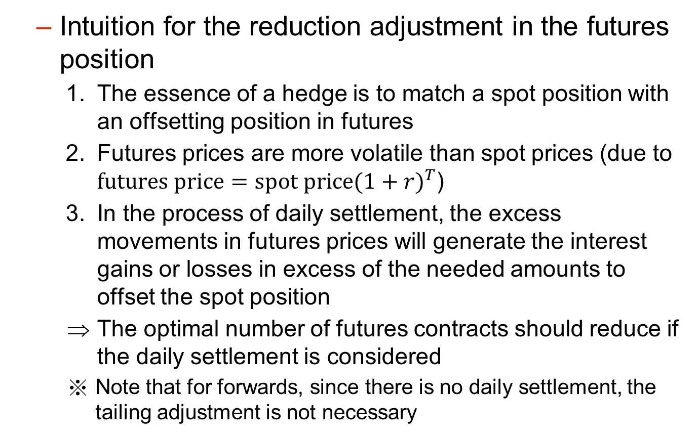
Cross Hedge and Optimal Hedge Ratio
  Intuition for the reduction adjustment in the futures position
    The essence of a hedge is to match a spot position with an offsetting position in futures
    Futures prices are more volatile than spot prices (due to $futures price=spot price{(1+r)}^{T}$)
    In the process of daily settlement, the excess movements in futures prices will generate the interest gains or losses in excess of the needed amounts to offset the spot position
    The optimal number of futures contracts should reduce if the daily settlement is considered
    Note that for forwards, since there is no daily settlement, the tailing adjustment is not necessary

Slide 35
3.4 Stock Index Futures and Hedge Equity Portfolios

Slide 36
Stock Index Futures (股票指數期貨)
A stock index tracks percentage changes in the value of a virtual portfolio of stocks
  S&P 500 index
    Based on a virtual portfolio of 500 largest-cap stocks
    The weights of individual stocks in the portfolio are proportional to their market capitalization (市值)
  E-mini S&P 500 futures contract on CME is on $50 times the index
    Standard-size S&P 500 index futures ($250 times the index) is delisted since Sept. 17, 2021
    For a long position of S&P 500 index futures with F = 1300, if the S&P 500 index level on the settlement date is 1400, its payoff is (1400 – 1300) × $50
  ※ For Taiwan Weighted Stock Index futures listed on TAIFEX, one index point is worth NT$200

Slide 37
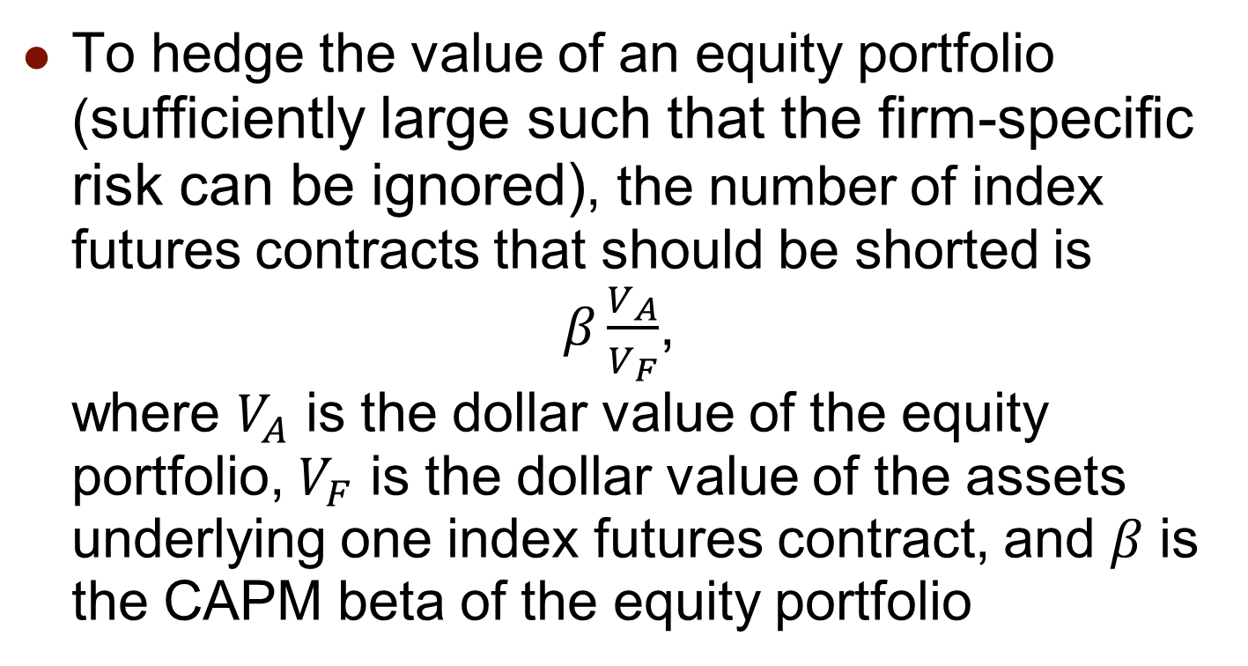
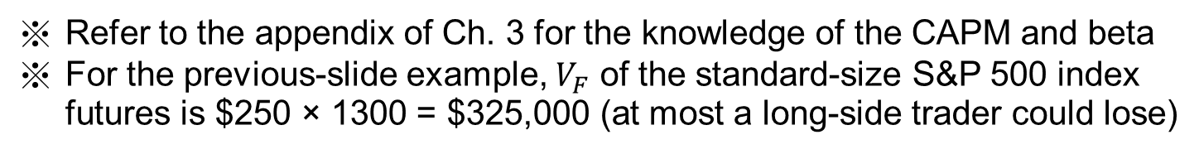
Hedging Using Index Futures
To hedge the value of an equity portfolio (sufficiently large such that the firm-specific risk can be ignored), the number of index futures contracts that should be shorted is
$β\frac{V_{A}}{V_{F}}$,
where $V_{A}$ is the dollar value of the equity portfolio, $V_{F}$ is the dollar value of the assets underlying one index futures contract, and $β$ is the CAPM beta of the equity portfolio
Refer to the appendix of Ch. 3 for the knowledge of the CAPM and beta
For the previous-slide example, $V_{F}$ of the standard-size S&P 500 index futures is $250 × 1300 = $325,000 (at most a long-side trader could lose)

Slide 38
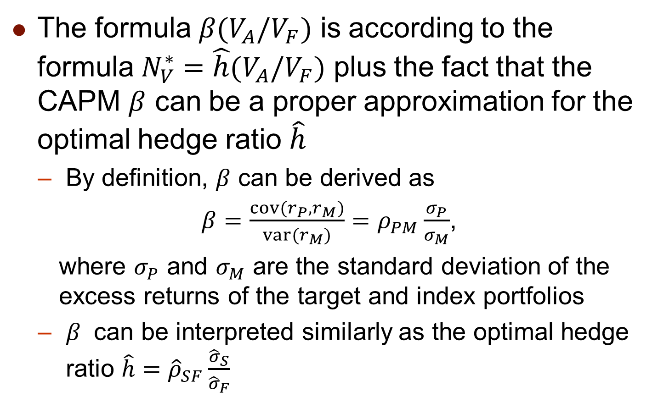
Hedging Using Index Futures
The formula $β(V_{A}/V_{F})$ is according to the formula $N_{V}^{∗}=\hat{h}(V_{A}/V_{F})$ plus the fact that the CAPM $β$ can be a proper approximation for the optimal hedge ratio $\hat{h}$
  By definition, $β$ can be derived as
$β=\frac{cov(r_{P},r_{M})}{var(r_{M})}=ρ_{PM}\frac{σ_{P}}{σ_{M}}$,
where $σ_{P}$ and $σ_{M}$ are the standard deviation of the excess returns of the target and index portfolios
  $β$ can be interpreted similarly as the optimal hedge ratio $\hat{h}={\hat{ρ}}_{SF}\frac{{\hat{σ}}_{S}}{{\hat{σ}}_{F}}$

Slide 39
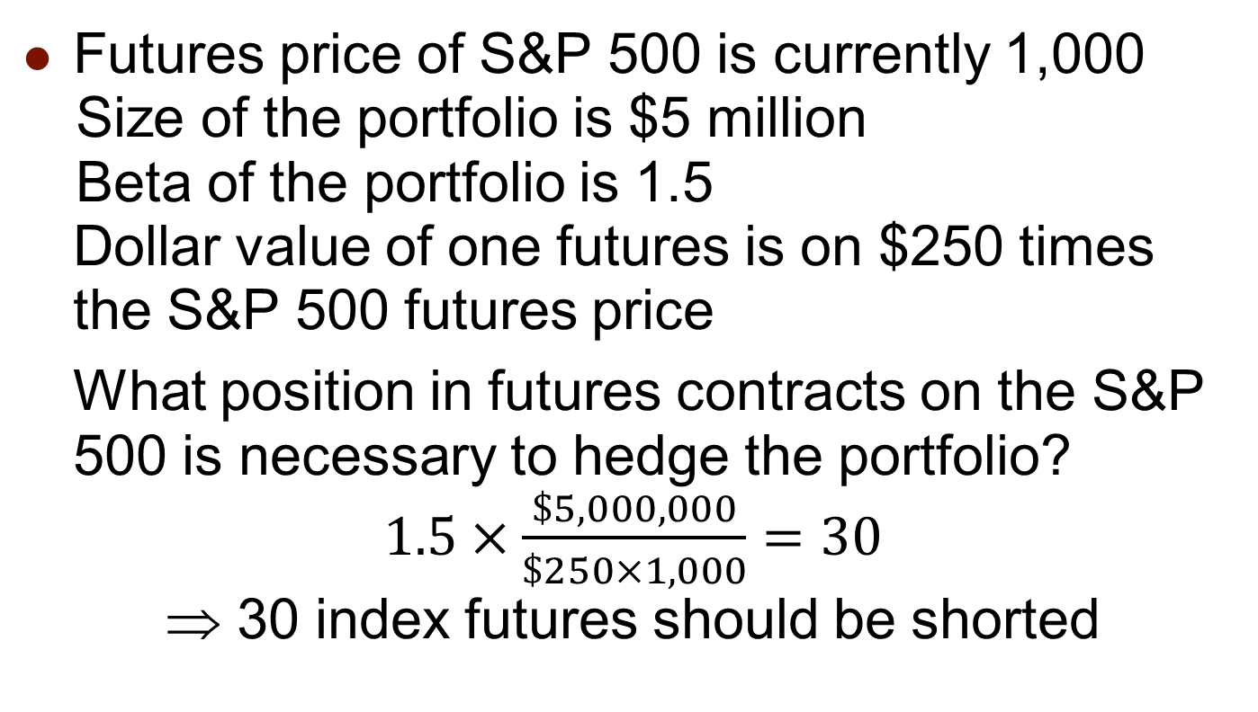
Hedging Using Index Futures
Futures price of S&P 500 is currently 1,000
Size of the portfolio is $5 million
Beta of the portfolio is 1.5
Dollar value of one futures is on $250 times the S&P 500 futures price
What position in futures contracts on the S&P 500 is necessary to hedge the portfolio?
$1.5×\frac{\$5,000,000}{\$250×1,000}=30$
⇒ 30 index futures should be shorted
※ Shorting 30 index futures reduces the portfolio beta to be 0 approximately
※ Therefore, the combined portfolio is roughly immunized to the change of S&P 500 index (or say the market risk)

Slide 40
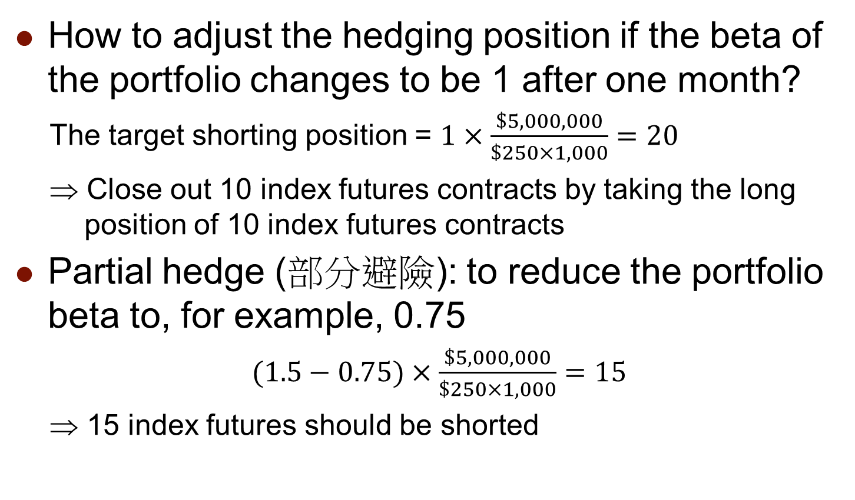
Changing Beta
How to adjust the hedging position if the beta of the portfolio changes to be 1 after one month?
The target shorting position = $1×\frac{\$5,000,000}{\$250×1,000}=20$
⇒ Close out 10 index futures contracts by taking the long position of 10 index futures contracts
Partial hedge (部分避險): to reduce the portfolio beta to, for example, 0.75
$(1.5−0.75)×\frac{\$5,000,000}{\$250×1,000}=15$
⇒ 15 index futures should be shorted

Slide 41
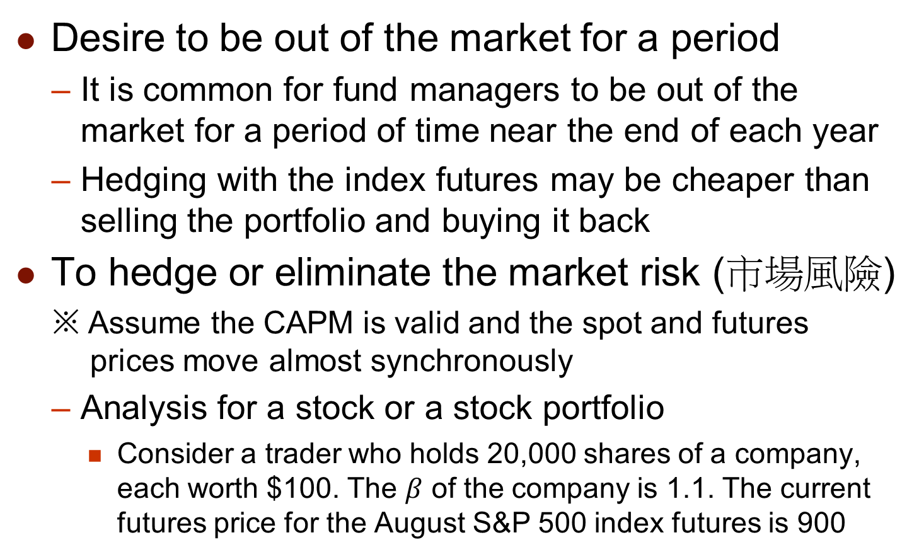
Reasons for Hedging an Equity Portfolio
Desire to be out of the market for a period
  It is common for fund managers to be out of the market for a period of time near the end of each year
  Hedging with the index futures may be cheaper than selling the portfolio and buying it back
To hedge or eliminate the market risk (市場風險)
※ Assume the CAPM is valid and the spot and futures prices move almost synchronously
  Analysis for a stock or a stock portfolio
    Consider a trader who holds 20,000 shares of a company, each worth $100. The $β$ of the company is 1.1. The current futures price for the August S&P 500 index futures is 900

Slide 42
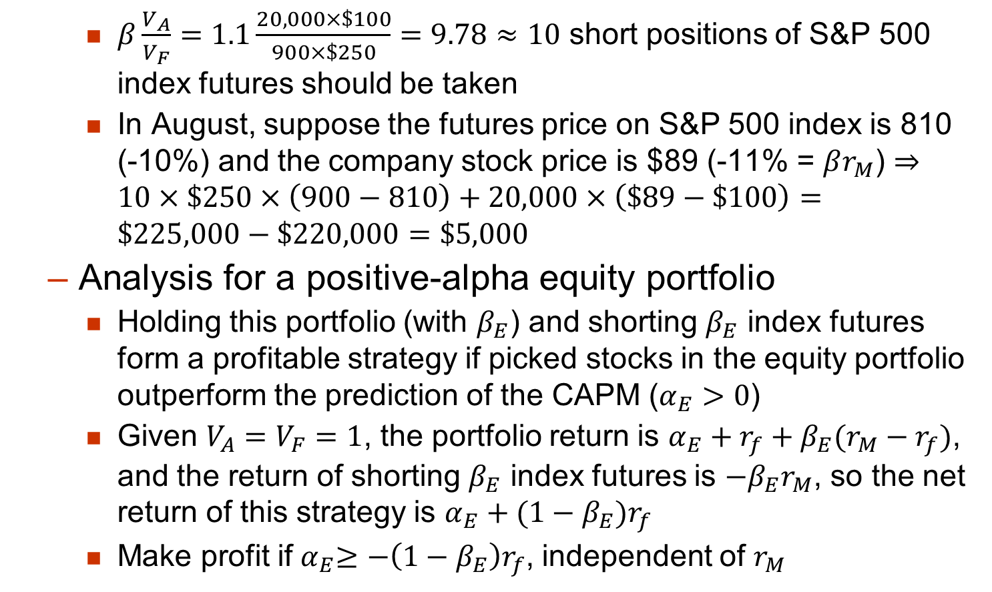
Reasons for Hedging an Equity Portfolio
    $β\frac{V_{A}}{V_{F}}=1.1\frac{20,000×\$100}{900×\$250}=9.78≈10$ short positions of S&P 500 index futures should be taken
    In August, suppose the futures price on S&P 500 index is 810 (-10%) and the company stock price is $89 (-11% = $βr_{M}$) $⇒10×\$250×\left(900−810\right)+20,000×\left(\$89−\$100\right)=\$225,000−\$220,000=\$5,000$
  Analysis for a positive-alpha equity portfolio
    Holding this portfolio (with $β_{E}$) and shorting $β_{E}$ index futures form a profitable strategy if picked stocks in the equity portfolio outperform the prediction of the CAPM ($α_{E}>0$)
    Given $V_{A}=V_{F}=1$, the portfolio return is $α_{E}+r_{f}+β_{E}(r_{M}−r_{f})$, and the return of shorting $β_{E}$ index futures is ${−β}_{E}r_{M}$, so the net return of this strategy is $α_{E}+{(1−β_{E})r}_{f}$
    Make profit if${ α}_{E}≥{−\left(1−β_{E}\right)r}_{f}$, independent of $r_{M}$

