Slide 1
Futures Markets and Central Counterparties
Chapter 2

Slide 2
Goals of Chapter 2
Details of trading futures on exchanges
Underlying asset (標的物), contract size (合約大小), delivery month (交割月), delivery place (交割地點)
Margin (保證金) account requirement and default risk (違約風險)
Different types of orders to trade futures
Regulation, accounting, and tax
Differences between forward (in OTC markets) and futures (on exchanges)
Reforms in OTC markets to reduce default risks
Patterns of futures (or forward) prices
Notes:
2

Slide 3
2.1 Details of Trading Futures Contracts

Slide 4
Futures Contracts
Traded on exchanges (交易所)
Standardized contracts defined by exchanges
Delivery price is filled as the prevailing futures price when a futures contract is initiated
What can be delivered (quantity and quality of the underlying asset or some alternatives)
Quantity: choice of the contract size (合約大小), e.g., 5,000 bushels for a CBOT corn futures
Too large ⇒ traders who wish to hedge or speculate relatively small positions are unable to use this contract
Too small ⇒ trading may be expensive since there is a transaction cost associated with each single contract traded
Appropriate contract size to maximize the trading volume

Slide 5
Futures Contracts
Quality of the underlying asset (標的物品質)
For FINANCIAL underlying assets, such as Google stock shares, it is generally unambiguous about their quality
One exception is the delivery alternative for the futures on Treasury bonds and notes (introduced in Ch. 6)
For COMMODITY underlying assets, usually a range of different grades of commodities is qualified for delivery
For the corn futures on CBOT, the standard grade is “#2 Yellow” (delivered for the delivery price), but “#1 Yellow” (“# 3 Yellow”) is also deliverable for 1.5 cents (2 to 4 cents) per bushel higher (lower) than the delivery price since March of 2019
The short-side trader of futures can choose any eligible (有資格的) underlying asset to deliver, but the selling price received by the short-side trader is according to the chosen grade

Slide 6
Futures Contracts
When the underlying asset can be delivered
For example, the delivery months of CBOT corn futures include March, May, July, September, and December
Last trading date: for example, the last business day prior to the 15th calendar day of the delivery month
Last delivery date: for example, the second business day following the last trading day of the delivery month
Where the underlying asset can be delivered
Important for commodities with high transportation costs
There may be several places designated to deliver the underlying assets
These places are usually warehouses (倉庫) or largest trading markets of underlying assets
For corn futures on CBOT, the five largest warehouses for corn storage in the U.S. are the places to deliver the corn

Slide 7
Futures Contracts
Price and position limits (漲跌停限制與部位限制)
The daily price limits prevent unreasonably large price movements due to excess speculation
For corn futures on CBOT in 2022, the price limit is $0.35 per bushel expandable to $0.55 when the market closes at limit up or limit down
In such cases, CBOT matches the orders which can be executed within the $0.55 price limit after the market close
Position limits on the number of contracts that a speculator can hold: to prevent the undue influence because of the trading behavior of a few speculators
On CBOT, the position limit of corn futures for a delivery month is 57,800 net futures contracts in 2022

Slide 8
Margin Mechanism
Futures contracts are traded with the margin mechanism (保證金機制)
A margin (保證金) is cash or marketable securities deposited by a trader with his broker
The balance in the margin account (保證金餘額) is daily adjusted to reflect the traders’ gains or losses
This practice is referred to as daily settlement (每日結算) or marking to market (按市價計值) (an example shown on Slide 2.10)
This mechanism minimizes the possibility of a loss due to a default (違約) on a transaction

Slide 9
Example of Margin Mechanism
A trader takes a long position in two December gold futures contracts on June 5
Contract size is 100 oz.
Current futures price is $1,650/oz. (delivery price)
Initial margin (初始保證金) is $6,000/contract
To satisfy the initial margin requirements (but not the subsequent margin calls), a trader can sometimes deposit securities with the broker
Treasury bills (stock shares) is accepted as the equivalent cash deposit amount at 90% of their face value (50% of their market value) (This reduction is known as a haircut)
Maintenance margin (維持保證金) is $4,500/contract
※ Note that margin requirements are the same on short positions as they are on long positions

Slide 10
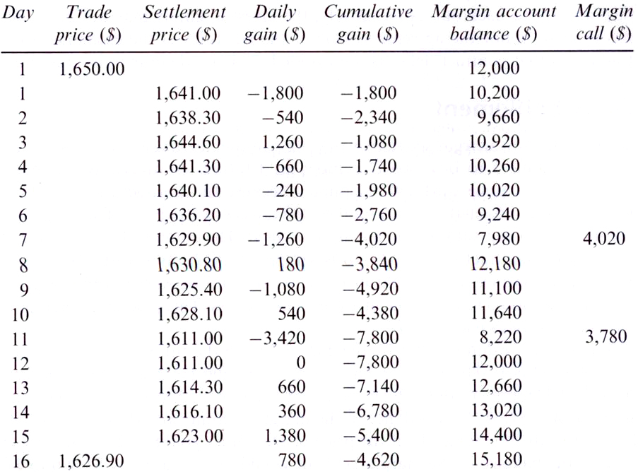
Example of Margin Mechanism
※ This table ignores the daily interest rate income calculated according to the day-end margin account balance
※ When the market closes on each day, a decline (rise) in futures price implies a loss (profit) of the balance in the margin account for a trader with a long position of futures
※ The decrement amount, e.g., $1,800 on Day 1, is transferred to the margin account of a trader with a short position
※ If the balance falls below the maintenance margin, the trader receives a margin call and needs to top up (補值) the margin account to the initial margin level the next day. The extra funds deposited are known as variation margin (追加保證金)

Slide 11
Margin Mechanism
By daily marking to market (with margin accounts), a futures position can be always regarded as a futures with the most recent futures price as the delivery price
Because all gains or losses are already reflected via the changes in the balance of margin accounts
Closing out (平倉) a futures position involves entering into an offsetting trade
The long and short positions are cancelled automatically at maturity
Also due to the margin mechanism, there is no cash flow involved when closing out futures

Slide 12
Margin Mechanism
If a trader does not provide the variation margin, his position is forced to be closed out by the broker
For a trader who does not meet margin calls on Day 7, two short-position gold futures with the futures price $1,629.9 are purchased by the broker on behalf of that trader
Two long-position futures ($1,650/oz.) and two short- position futures ($1,629.9/oz.) ⇒ –$20.1×100×2 = –$4,020
No cash flow involved: the deduction in margin accounts already reflects this loss amount, and these long and short positions are cancelled automatically at maturity
Most futures contracts are closed out before maturity (期貨大多到期前平倉) for saving the delivery cost

Slide 13
Margin Mechanism
Clearing house (結算所) and clearing margin
A clearing house acts as an intermediary in futures transactions, with the main task to calculate the net position of each of exchange members (usually larger brokers or security firms) (see Slides 2.14 and 2.15)
A broker are required to post margin with a clearing house member and clearing house members are required to maintain margin (also known as clearing margin) with the clearinghouse
Clearing margin, only initial margin required but no maintenance margin applicable, i.e., every day the account balance must be maintained as the initial margin per contract times the number of all or net (for most cases) outstanding contracts

Slide 14
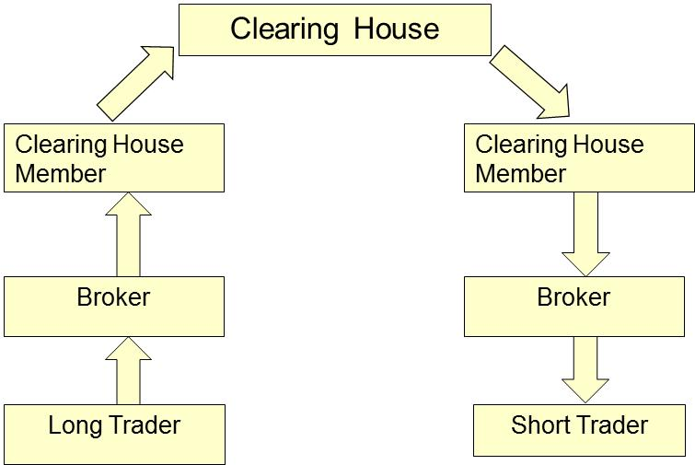
Margin Mechanism
Margin cash flows when futures price decreases (long position loses, e.g., Day 1 scenario)
$1800
$1800

Slide 15
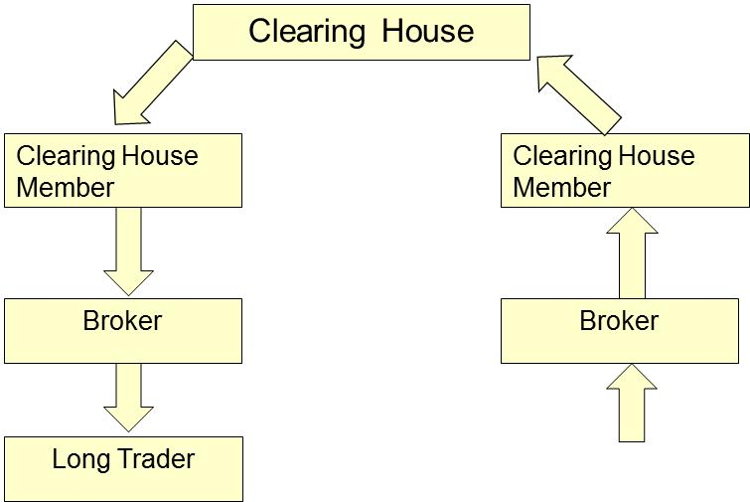
Margin Mechanism
Margin cash flows when futures price increases (long position gains, .e.g., Day 3 scenario)
$1260
$1260

Slide 16
Some Terminologies
Open interest (未平倉合約數): the total number of contracts outstanding
Equal to the number of unclosed long/short positions
Settlement price (結算價格): the price just before the final bell on each day
Used for the daily settlement and delivery process
Volume of trading: the number of trades in 1 day
Q: When a new trade is completed, what are the possible effects on the open interest? A: (+1,0,-1)
Q: Can the volume of trading in a day be greater than the open interest? A: Yes

Slide 17
Physical Delivery (實物交割) vs. Cash Settlement (現金結算)
If a futures is not closed out before maturity, it is settled by delivering the underlying assets at the latest settlement price
Short position parties can choose among alternatives about what, when, and where to deliver
Some contracts are settled in cash (現金結算)
For example, stock indices and Eurodollars futures
Settled by paying directly the profit or loss of the futures contract, which is the difference between the spot and the delivery price at maturity
Due to the margin mechanism, gains/losses are already reflected in margin accounts, so all contracts are declared automatically to be closed out after the last trading day

Slide 18
Types of Orders to Trade Futures
Market order (市價單):
A request that a trade will be executed immediately at the best futures price available in the market
Limit order (限價單):
Executed only at the specified futures price or at the futures prices more favorable to the trader
Stop order (停損單):
Executed at the best available futures price once the specified price level is triggered
Specifically, a stop-loss (stop-buy) order becomes a market sell (buy) order as soon as the specified price has been hit from above (from below)

Slide 19
Types of Orders to Trade Futures
Stop-limit order:
A combination of a stop and a limit orders. If the specified price in the stop order is triggered, it becomes a limit order with another specified price
Market-if-touched order:
Becomes the market sell order if the specified price is triggered from below (to realized the sufficiently large gains)
Discretionary order (market-not-held order):
Traded as a market order except that execution may be delayed at the broker’s discretion (斟酌) in an attempt to get a better price

Slide 20
Types of Orders to Trade Futures
Unless otherwise stated, an order is a day order and expires at the end of the trading day
Orders in effect for a period of time (rather than for a trading day)
Time of day order: specify a particular period of time during a day when the order can be executed
Open order (good-till-canceled order): being in effect until either executed or until the maturity of trading in the particular contract
Fill-or-kill order: a type of time-in-force order (usually for trading many contracts concurrently), which must be executed immediately and completely or not at all

Slide 21
Regulation, Accounting, and Tax
Futures markets in the U.S. are currently regulated federally by the Commodity Futures Trading Commission (CFTC)
CFTC, established in 1974, is responsible for licensing futures exchanges and approving futures contracts
CFTC tries to prevent questionable trading practices and designs regulations to protect the public interest
The accounting and tax treatment of futures trading in the U.S. is introduced on the next slide:

Slide 22
Regulation, Accounting, and Tax
For speculating purpose transactions:
Profits/losses from speculation should be recognized on a mark-to-market basis annually
Mark-to-market gains or losses are classified as capital gains or losses annually
Annual net capital gains are subject to the capital-gain tax
Capital losses are not deductible from ordinary income
For hedging purpose transactions:
Hedging profits/losses should be recognized in the same period as the profits/losses on the item being hedged are recognized (this treatment is known as hedge accounting)
Hedging gains (losses) increase (decrease) ordinary income, subject to personal or firm income tax
If the asset price $↑$, buying cost $↑$ (selling price $↑$), taxable income $↓$ ($↑$)

Slide 23
2.2 Differences Between Forward and Futures Contracts

Slide 24
Forward Contracts
A forward contract is an OTC agreement between 2 parties to buy or sell an asset at a certain time in the future for a certain price
Most forward contracts lead to delivery of the asset physically or final settlement in cash
Custom-made contracts suited for hedgers
Rarely used for speculation and arbitrage due to extra transaction cost from bid-ask spreads
No margin requirement or daily settlement process
Unless a collateralization agreement requires it
Notes:
10

Slide 25
Forward Price and Forward Value
The forward price is the delivery price that would be applicable to the contract if it were negotiated by the two parties today
It makes the contract worth exactly zero today (or the contract to be equally fair for both parties today)
Since the initial value of the contract is zero, no money changes hands when first negotiated (also true for futures contracts) (explained in Ch. 5)
The forward value is how much the forward contract is worth, but the forward price is an item in the contract to specify the trading price of the underlying asset in the future
Notes:
10

Slide 26
Forward Contracts vs. Futures Contracts
Forward | Futures
Private contract between two parties (traded in OTC markets) | Traded on an exchange
Not standardized contract | Standardized contract
The trading counterparty is known | The trading counterparty is unknown
Usually one specified delivery date | Range of delivery dates, e.g., the week following the maturity date
Delivery or final settlement usual | Usually closed out prior to maturity
Settled at the end of contract | Settled daily with margin mechanism
Some credit risk | Virtually no credit risk
※ The issues of settlement process and credit risk associated with forward contracts will be discussed in the next section
Notes:
16

Slide 27
Foreign Exchange Quotes for Futures and Forward Contracts
Another difference between futures and forward contracts (exclusively for foreign currencies futures and forward contracts (只有對於外幣期貨與遠期合約而言))
Futures exchange rates are always quoted as the number of USD per unit of the foreign currency
Forward exchange rates are quoted in the same way as spot exchange rates. This means that, for example, GBP, EUR, AUD, and NZD are quoted in USD for per unit of foreign currency. Other currencies (e.g., CAD and JPY) are quoted as units of the foreign currency per USD
Notes:
17

Slide 28
2.3 Reforms in OTC Market to Reduce Default Risks of Forward Contracts

Slide 29
Collateralization Process in OTC Markets
Credit (or default) risk (違約風險) is an undesirable feature in OTC markets
If the contract value is positive to B (A), the default of A (B) results in a loss of B (A)
After the 2007-2009 crisis, some new regulations are introduced in OTC markets to diminish contract-wise and market-wise (systematic) default risk
Standard OTC products (such as interest rate or currency swaps) between financial institutions must be traded on swap execution facilities (SEFs)

Slide 30
Collateralization Process in OTC Markets
SEF is an electronic platform to link market participants, which allows for transparency and provides a complete record and audit trail of trades
Trades must be reported to a central registry
Use collateral (使用抵押品) in OTC markets more commonly
A simple 2-way agreement (between 2 counterparties):
A is required to post collateral with B, the value of which equals the value of a contract with B if this value is positive to B
If A defaults, B is entitled to take possession of the collateral
If the contract value to A is positive, B is required to post collateral with A

Slide 31
Collateralization Process in OTC Markets
It is similar to futures contracts to be settled regularly (e.g., every day or every week)
Note that in the margin mechanism for futures, the cash or marketable securities serve as the collateral (抵押品)
To use the terminology of exchange-traded markets, traders would be required to post variation margin (補足追加保證金), but no initial margin (沒有初始保證金)
Collateralization significantly reduces the default risk for OTC

Slide 32
Clearing Process in OTC Markets
Recently, there has been a requirement for some standardized OTC derivatives between financial institutions being cleared though central clearing parties (CCP, 集中清算方)
Traditionally, transactions have been cleared bilaterally (兩造之間結算) in OTC markets
Bilateral clearing
Central clearing

Slide 33
Clearing Process in OTC Markets
For a standardized forward contract presented to the CCP where A agrees to buy an asset from B in one year for a certain price, the CCP becomes the counterparties to both A and B and agrees to
Buy the asset from B in one year for the agreed price
Sell the asset to A in one year for the agreed price
The CCP bears both default risks from A and B
The CCP could manage the default risk by requiring a daily collateral adjustment from either A or B
For different types of standardized contracts in OTC markets, there may be a different CCP
On exchanges, all contracts are settled with clearing houses

Slide 34
2.4 Patterns of Futures (or Forward) Prices

Slide 35
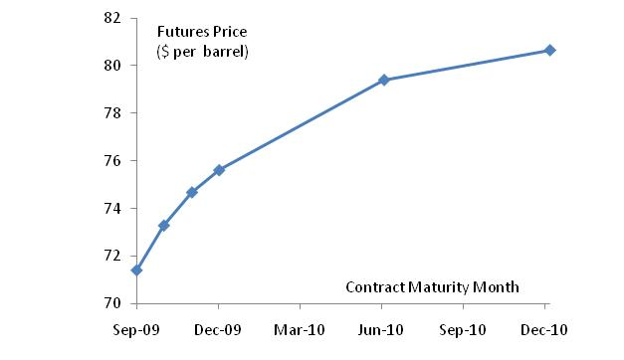
Futures Prices for Different Maturities
Futures price as a function of maturity: (a) crude oil; (b) soybeans; (c) lean hogs (瘦肉豬)
(a) Crude oil
※ Normal market (positive relationship with the time to maturity): a situation in which the futures prices for distant months are at a premium (溢價) to those for near months and also for the spot price

Slide 36
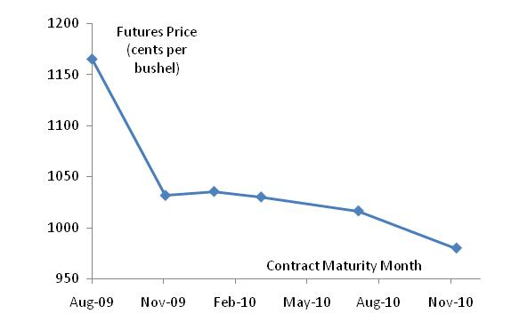
Futures Prices for Different Maturities
(b) Soybeans
※ Inverted market (negative relationship with the time to maturity): a situation in which the futures prices for distant months are at a discount (折價) to those for near months and also for the spot price

Slide 37
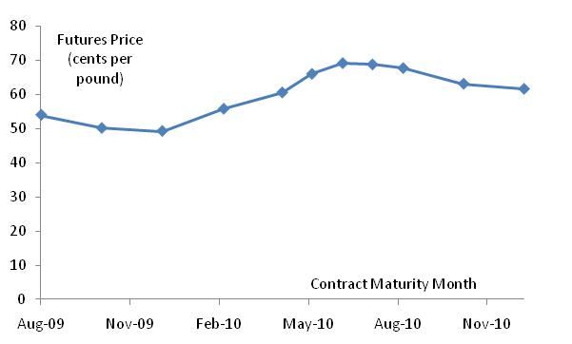
Futures Prices for Different Maturities
(c) Lean hogs
Mixture of normal and inverted markets
※ The reasons behind these different patterns are explained in Ch. 5

Slide 38
Convergence of Futures ($F_{T}$) to Spot ($S_{T}$) on Delivery day ($T$)
(a)
(b)
Futures
Price
Spot Price
Spot Price
Futures
Price
Time
Time
$$T$$
$$T$$
※ Convergence to the spot price from above is shown in (a)
※ Convergence to the spot price from below is shown in (b)
※ The two diagrams do not deny possible intersections of spot and futures prices (現貨與期貨還是有可能相交)
※ Note that the futures price should equal the spot price on the delivery day (explained on the next slide)

Slide 39
Convergence of Futures ($F_{T}$) to Spot ($S_{T}$) on Delivery day ($T$)
Convergence should happen according to no- arbitrage argument
Futures price ($F_{T}$) > spot price ($S_{T}$), the following strategy can earn arbitrage profits
1. Enter into a short position of the futures with the current futures price
2. Buy the underlying asset at the current spot price
3. Since the futures price is higher than the current spot price, making the deliver can earn the spread between them
(As a result, the spot rate rises and the futures price declines, and the arbitrage opportunity disappears quickly)
Futures price ($F_{T}$) < spot price ($S_{T}$), short sell the underlying asset and enter into a long position of futures

Slide 40
Profit from a Long Forward/Futures Position
Profit
Price of Underlying on
The Delivery Date ($S_{T}$)
Delivery price ($K$)
Profit for longing forward$=S_{T}−K$
Profit for longing futures $=F_{T}−F_{0}=S_{T}−K$, since the delivery price in futures is set to be $F_{0}$ when it is initiated
Notes:
14

Slide 41
Profit from a Short Forward/Futures Position
Profit
Price of Underlying on
The Delivery Date ($S_{T}$)
Delivery price ($K$)
Profit for shorting forward $=K−S_{T}$ ($=−\left(S_{T}−K\right)$)
Profit for shorting futures $=F_{0}−F_{T}=K−S_{T}$, since the delivery price in futures is set to be $F_{0}$ when it is initiated
Notes:
15

