Slide 1
Introduction
Chapter 1

Slide 2
Goals of Chapter 1
Define derivatives (衍生性商品)
Introduce futures, forward, and option contracts briefly
Including their definitions, payoff functions, and the markets at which they are traded
Examples of hedging (避險), speculating (投機), arbitraging (套利) using derivatives
Hedgers (避險者), speculators (投機者), and arbitrageurs (套利者)
Determining theoretical futures price by arbitrage
Summarize ways derivatives are used
Notes:
2

Slide 3
1.1 Derivatives

Slide 4
Definition of Derivatives
A derivative is an instrument whose value depends on the values of other more basic underlying variables (標的變數)
Four types of derivatives
Futures contracts (期貨合約), Forward contracts (遠期合約), Swaps (交換), and Options (選擇權)
Prices of any commodity assets (such as gold or oil) or financial assets (such as equity shares or bonds) are typical examples of underlying variables, and these assets is called underlying assets (標的物)
Notes:
2

Slide 5
1.2 Futures Contracts

Slide 6
Futures Contracts
A futures contract is an agreement to buy or sell an asset at a certain time point in the future for a certain price
An agreement means both the right and obligation for two trading parties
The party who agrees to buy (sell) the underlying asset has a long (short) position
The traded asset is called the underlying asset (標的物)
The time point and the price to settle (交割) futures contracts (i.e., to physically trade the underlying asset) are called the delivery date (交割日) and delivery price (交割價)
※ A spot (現貨) contract is to trade the asset immediately
Notes:
7

Slide 7
Examples of Futures Contracts
Examples of futures contracts on NYMEX
The New York Mercantile Exchange (NYMEX), founded in 1882, is now a commodity futures exchange owned and operated by the CME Group (introduced on Slide 1.10)
NYMEX specializes in the trading of futures on energy and metal products
Futures contracts specify long/short position, size, delivery price, and delivery month
buy 100 oz. of gold @ US$1750/oz. in December (long position)
sell 1,000 bbl. of oil @ US$85/bbl. in April (short position)
Notes:
9

Slide 8
Profit of Futures Contracts
In February, an investor enters into a long futures contract to buy 100 oz. of gold @ US$1750/oz. in December
In December, if the price of gold is $1600 ($1800) per oz., what is the investor’s profit/loss?
In the case of $1600/oz., the investor suffers a loss of $150/oz.
In the case of $1800/oz., the investor enjoys the gains of $50/oz.
Notes:
11

Slide 9
Exchanges Trading Futures
Futures and options exchanges (交易所)
Chicago Board of Trade (CBOT) (U.S.)
Established in 1848 to bring farmers and merchants together to trade grains
Its initial task is to standardize the quantities and qualities (標準化數量與品質) of the traded contracts of grains
In 1864, first futures-type contracts on grains was presented, which was known as a to-arrive contract
Grains’ prices fixed today but traded on future dates, a win-win arrangement for both farmers and merchants
CBOT is famous for futures contracts on grains, such as futures on corn, soybeans, or wheat, etc.
It also offers futures contracts on Treasury bonds and notes (美國政府公債期貨) (introduced in Ch. 6)

Slide 10
Exchanges Trading Futures
Chicago Mercantile Exchange (CME) (U.S.)
Established in 1919 for futures trading, especially for the live cattle (活牛) and live hogs (活豬)
Proposed foreign currency futures (外幣期貨) in 1972 and S&P 500 index futures (股價指數期貨) in 1982
Note that S&P 500 index is non-tradable, so S&P 500 index futures is settled (結算) in cash
Offers the most popular interest rate futures contracts (利率期貨) in the U.S., which is the three-month Eurodollar futures contract (introduced in Ch. 6)
Proposes weather futures (天氣期貨) in 1999
The underlying variable is the temperature degree over a period
In 2007, CBOT is merged with CME to form CME Group, which is now the largest futures and options exchange

Slide 11
Exchanges Trading Futures
LIFFE (London International Financial Futures Exchange) (U.K.)
Euronext (The result of the mergence of the exchanges of Amsterdam, Brussels, and Paris in 2000. Merge LIFFE in 2002)
※ Euronext was merged with NYSE in 2007 to form NYSE Euronext
Eurex (Deutsche Börse AG and SWX Swiss Exchange) (Germany and Swissland)
BM&F (Bolsa de Mercadoriasy Futures) (Brazil)
TIFFE (Tokyo International Financial Futures Exchange) (Japen)
Shanghai (上海) Futures Exchange, Zhengzhou (鄭州) Commodity Exchange, Dalian (大連) Commodity Exchange (China)
TAIFEX (Taiwan Futures Exchange) (Taiwan)

Slide 12
Futures Price
Futures price (期貨價格) is the price at which you agree to trade the underlying asset in the future
Futures price is changing over time and determined by the supply and demand of futures contracts
If more traders intend to buy (sell) the underlying asset via a futures contract, its futures price is bidden up (driven down)
When one enters into a futures contract, the delivery price in it is set to be the prevailing futures price (新成立的期貨合約，其交割價就是當時市場上的期貨價格)
Futures prices (期貨價格) and futures values (期貨合約價值) are different (introduced in Ch. 5)
Futures value indicates the value at which the futures itself is worth, i.e., the price to trade the futures
Notes:
8

Slide 13
Electronic Trading
Traditionally, futures contracts have been traded using the open outcry (公開喊價) system where traders physically meet on the exchanges
Use a complicated set of hand signals to indicate the orders they want to trade
Best prices win the trade
Most futures exchanges are entirely electronic now–matching buyers and sellers by computers
Electronic trading leads to a growth in algorithmic trading (演算法交易), which is initiated by computer programs, often without human intervention

Slide 14
1.3 Forward Contracts

Slide 15
Forward Contracts (遠期合約)
Forward contracts are similar to futures except that they are traded in the over-the-counter market (OTC, 櫃檯買賣市場) (see the next two slides)
Forward contracts are popular on foreign currencies and interest rates (遠期外匯與利率)
Foreign currency quotes for USD (in NTD)
March 5, 2023 | Bid | Ask
Spot (現貨) price | 30.225 | 30.895
1-month forward price | 30.470 | 30.591
3-month forward price | 30.264 | 30.404

Slide 16
Over-the-Counter Markets
The OTC market is an important alternative to exchanges
It is a telephone and computer-linked network of traders who do not physically meet
Dealers, also known as market makers (造市者), are always prepared to quote both a bid price (at which they are prepared to buy) and an ask (or called offer) price (at which they are prepared to sell)
Traders are usually financial institutions, corporate treasurers (公司財務人員), and fund managers
Forward contract: large size and custom-made (合約客製化)
Default (違約) risk: contracts may not be honored

Slide 17
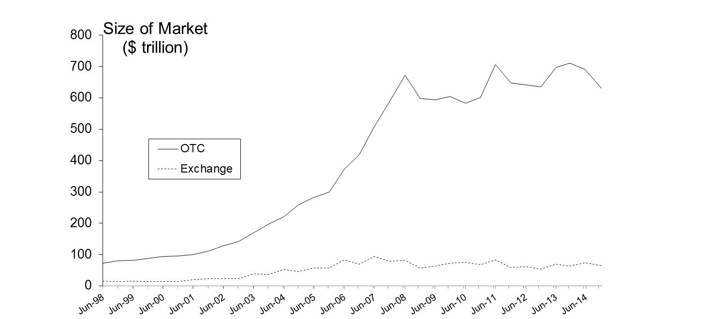
Size of OTC and Exchange-Traded Derivatives Markets (1998-2014)
※ This figure shows the size of OTC and exchange-traded derivatives markets
※ The size is defined as the notional principal (名目本金) of derivative contracts or the total value of the asset underlying the derivative contracts (標的物總價值)
※ OTC markets are much larger than exchange-traded markets in terms of derivative trading
※ One possible reason is that the contracts on exchanges are with the standard size, which is on average smaller than the size of the custom-made contracts in OTC markets

Slide 18
1.4 Options

Slide 19
Options
A call (買權) (put (賣權)) option is a right to buy (sell) an asset by a certain date for a certain price
Maturity date (到期日): the date to settle the contract
Underlying asset (標的物): the target asset that could be traded at maturity
Strike price (執行價): the specified price to trade the underlying asset
European vs. American (歐式 vs. 美式)
A European option can be exercised only at maturity
An American option can be exercised at any time during its life

Slide 20
Google Call Prices (June 25th, 2019; Stock Price is $561.51)
Strike Price ($) | July Bid | July Ask | Sept Bid | Sept Ask | Dec Bid | Dec Ask
520 | 46.50 | 47.20 | 55.40 | 56.80 | 67.70 | 70.00
540 | 31.70 | 32.30 | 41.60 | 42.50 | 55.30 | 56.20
560 | 20.00 | 20.40 | 30.20 | 30.70 | 44.20 | 45.00
580 | 11.30 | 11.60 | 20.70 | 21.20 | 34.50 | 35.30
600 | 5.60 | 5.90 | 13.50 | 13.90 | 26.30 | 27.10
※ Options prices (or option premiums, 選擇權權利金) are the prices to buy or sell options (not the price to trade the underlying asset)
※ On June 25th, a trader sells a call option at $34.50 (to the option dealer), which grants the option dealer a right to purchase one share of Google from the trader at $580 in Dec. 2019
※ For calls, there are more valuable for lower strike prices
※ In general, the longer time to maturity implies higher option prices
※ The properties of options will be discussed further in Ch. 10

Slide 21
Google Put Prices (June 25th, 2019; Stock Price is $561.51)
Strike Price ($) | July Bid | July Ask | Sept Bid | Sept Ask | Dec Bid | Dec Ask
520 | 5.00 | 5.30 | 13.60 | 14.00 | 25.30 | 26.10
540 | 10.20 | 10.50 | 19.80 | 20.30 | 32.80 | 33.50
560 | 18.30 | 18.70 | 28.10 | 28.60 | 41.50 | 42.30
580 | 29.60 | 30.00 | 38.40 | 39.10 | 51.80 | 52.60
600 | 43.80 | 44.40 | 51.10 | 52.10 | 63.50 | 64.90
※ On June 25th, a trader pays $28.60 to buy a put option (from the option dealer) to acquire a right to sell one share of Google to the dealer at $560 in September 2019
※ For puts, there are more valuable for higher strike prices
※ In general, the longer time to maturity implies higher option prices

Slide 22
Exchanges Trading Options
Exchanges trading options
Chicago Board Options Exchange (CBOE) (U.S.)
The first and largest exchange in the world for trading stock options
The stock options traded on the CBOE, e.g., the Google example on Slides 1.20 and 1.21, are all American-style options
Pacific Exchange (U.S.)
Began trading options in San Francisco in 1976 and was merged with NYSE in 2006
Philadelphia Stock Exchange (U.S.)
Oldest stock exchange founded in 1790 in the U.S.
The pioneer to trade foreign exchange options (外匯選擇權)
Merged with NASDAQ in 2007

Slide 23
Exchanges Trading Options
NYSE Euronext (U.S.)
International Securities Exchange (U.S.)
Launched as the first fully electronic US options exchange
Offers equity, index, and foreign exchange options
Eurex (Germany and Swissland)
※ When an exchange trades a futures contract, it often also trades options on that futures contracts, e.g., CME group also offers options on corn futures (known as futures options (期貨選擇權) and introduced in Ch. 9)
※ The OTC options markets grew rapidly since 1980s and is now bigger than the exchange options markets
※ The advantage of the OTC markets is the tailored-made option contracts to meet special needs

Slide 24
Options vs. Futures/Forwards
An option gives the holder the right to buy or sell the underlying asset at a certain price
A futures/forward contract gives the holder both the right and obligation to buy or sell the underlying asset at a certain price
For options, in addition to the dimension of different maturities, there are a series of strike prices for each maturity date that traders can choose
Futures/forwards consider only the dimension of different maturities (compare Slides 1.15 with 1.20 and 1.21)

Slide 25
1.5 Types of Traders

Slide 26
Types of Traders
Due to different trading purposes, there are three types of derivatives traders:
Hedgers (避險者): use derivatives to reduce (hedge) the risk that they face from potential future movements in a market variable
Speculators (投機者): use derivatives to bet on the future direction of a market variable (The leverage effect of derivatives is attracted, since it can amplify the gains or losses in returns)
Arbitrageurs (套利者): take offsetting positions in two or more instruments to lock in profit
※ Different motives and expectations of different types of traders provide the liquidity for derivatives markets
Notes:
15

Slide 27
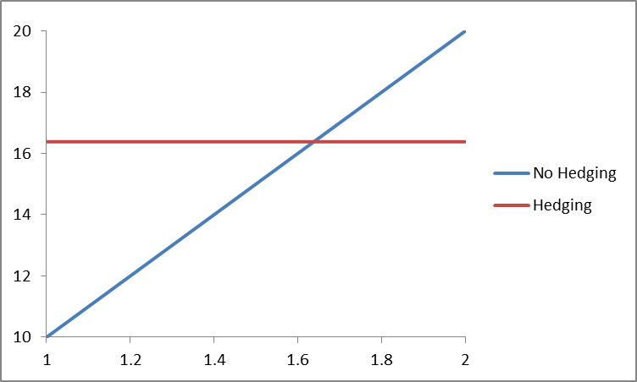
Hedging Examples
Using forward:
A US company will pay £10 million for imports from Britain in 3 months and decides to hedge the foreign exchange risk using a long position in a forward contract (with the delivery price to be $1.6384/GBP)
Cost ($ million)
USD/GBP
Notes:
16

Slide 28
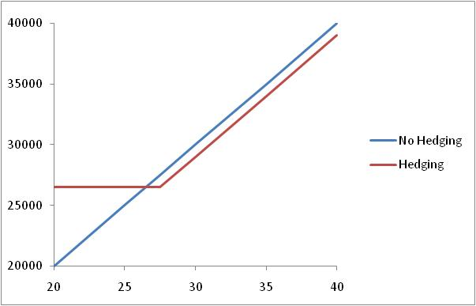
Hedging Examples
Using options:
An investor owns 1,000 Microsoft shares currently worth $28 per share. A two-month put with a strike price of $27.50 costs $1. He decides to hedge by buying 10 contracts, each of which can sell 100 shares
Sales of 1000 MS shares ($)
Stock price
Notes:
16

Slide 29
Speculation Example
Using futures:
In February, an investor thinks that the GBP will strengthen relative to the USD over the next two months. He considers either to purchase £250,000 in the spot market or to take a long position in four futures contracts on GBP, each of which is for the purchase of £62,500 with the delivery price $1.5410/GBP in April and with the margin requirement (保證金) to be $5,000
※ The leverage effect of futures allows speculators to amplify returns
Notes:
17

Slide 30
Speculation Example
Using options:
An investor with $2,000 to invest feels that a stock price will increase over the next 2 months. The current stock price is $20 and the price of a 2-month call option with a strike price of $22.50 is $1
※ Note that the cost to purchase options is a sunk cost, which cannot be recovered even if the investor does not exercise options
※ With these call options, the downside risk is the losses of $2,000, but the upside gains could be infinitely large
※ The leverage effect amplifies both the returns in gains and losses
Notes:
17

Slide 31
Arbitrage Example for Spots
A stock price is quoted as £100 in London and $152 in New York. In addition, the current exchange rate is known to be 1.5500
The strategy to arbitrage from the distortion:
Buy stock shares at $152/share in New York and sell stock shares in London at £100/share, which is equivalent to $155/share ⇒ earn $3/share
The arbitrage opportunity disappears quickly
The buying behavior bids the share price in NY up and the selling behavior drive the share price in London down until the price parity holds again

Slide 32
Arbitrage Example for Spot and Futures without Storage Costs
Suppose that
The spot price of gold is US$1000
The quoted 1-year futures price of gold is US$1100
The 1-year US$ interest rate is 5% per annum
No income or storage costs for gold
The arbitrage strategy
Buy the gold spot with the borrowed fund and enter a short position of selling gold after 1 year
The cost to acquire the gold is $1,000×(1+5%)=$1,050, and the payoff to sell gold via futures is $1,100 ⇒ earn $50
Notes:
18

Slide 33
Arbitrage Example for Spot and Futures without Storage Costs
Suppose that
The spot price of gold is US$1000
The quoted 1-year futures price of gold is US$990
The 1-year US$ interest rate is 5% per annum
No income or storage costs for gold
The arbitrage strategy
Short sell the gold spot, deposit the proceeds, and enter a long position of buying gold after 1 year
The future value of the proceeds of selling the gold spot is $1,000×(1+5%)=$1,050, and the cost to buy gold back via futures is $990 ⇒ earn $60 (note the purchased gold should be returned to the lender)
Notes:
18

Slide 34
Theoretical Futures Price without Storage Costs
If the spot price of gold is $S_{0}$ and the futures price for a contract deliverable in $T$ years is $F_{0}$, then the following relationship should hold
$F_{0}=S_{0}(1+r)T$,
where $r$ is the 1-year (domestic currency) risk-free rate of interest
In the previous examples, $S_{0}$=1000, $T$=1, and $r$=0.05, so that the theoretical futures price is
$$F_{0}=1000{(1+0.05)}^{1}=1050$$
Notes:
20

Slide 35
Arbitrage Example for Spot and Futures with Storage Costs
Suppose that
The spot price of oil is US$70
The quoted 1-year futures price of oil is US$80
The 1-year US$ interest rate is 5% per annum
The storage cost of oil is 2% per annum of the oil spot price (a simplified assumption)
The arbitrage strategy
Buy the oil spot with the borrowed fund and enter a short position of selling oil after 1 year
The cost to acquire and store the oil is $70×(1+5%+2%)=$74.9, and the payoff to sell oil via futures is $80 ⇒ earn $5.1
Notes:
21

Slide 36
Arbitrage Example for Spot and Futures with Storage Costs
Suppose that
The spot price of oil is US$70
The quoted 1-year futures price of oil is US$65
The 1-year US$ interest rate is 5% per annum
The storage cost of oil is 2% per annum of the oil spot price
The arbitrage strategy
(Short) sell the oil spot, deposit the proceeds, and enter a long position of buying oil after 1 year
The future value of the selling proceeds for the oil spot together with the saved storage cost is $70×(1+5%+2%)=$74.9, and the cost to buy oil back via futures is $65 ⇒ earn $9.9
Notes:
21

Slide 37
Theoretical Futures Price with Storage Costs
If the spot price of gold is $S_{0}$ and the futures price for a contract deliverable in $T$ years is $F_{0}$, then the following relationship should hold
$F_{0}=S_{0}(1+r+storage cost)T$,
where $r$ is the 1-year (domestic currency) risk-free rate of interest
In the previous examples, $S_{0}$=70, $T$=1, $r$=0.05, and the storage cost is 2%, so that the theoretical futures price is
$70×(1+5%+2%)=$74.9
Notes:
20

Slide 38
Roles of Financial Institutions
For most financial institutions,
The need to hedge the interest rate and foreign exchange risk ⇒ hedgers
To earn trading profit with speculation ⇒ speculators
To earn trading profit with arbitrage ⇒ arbitrageurs
※ Arbitrage is usually less risky and less profitable than speculation
※ Bankruptcy due to derivatives trading is often because traders who had a mandate to be hedgers or arbitrageurs switched to be speculators secretly
Notes:
15

Slide 39
Summary: Ways Derivatives are Used
To hedge risks
To speculate (take a view on the future direction of the market)
To lock in an arbitrage profit
To change the nature of a liability or an investment with swaps (introduced in Ch.7)
Interest rate swaps: from floating to fixed interest rates debt
Equity swaps: exchange equity returns with a fixed rate or the LIBOR plus a spread
Notes:
4

