Slide 1
Chapter 9 Linear Programming
9.1 Systems of Linear Inequalities
9.2 Linear Programming Involving Two Variables
9.3 The Simplex Method: Maximization
9.4 The Simplex Method: Minimization
9.5 The Simplex Method: Mixed Constraints
9.6 Homework 3
9.1

Slide 2
9.1 Systems of Linear Inequalities
Linear inequalities (線性不等式):
For example, 3x – 2y < 6 and x + y ≥ 6 are linear inequalities involving two variables
Solution of an inequality:
An ordered pair (a, b) is a solution of an inequality in x and y if the inequality is true when a and b are substituted for x and y, respectively
The graph of an inequality:
The collection of all solutions of the inequality
9.2

Slide 3
Ex 1:
Sketch the graph of the inequalities (a) x > – 2 and (b) y ≤ 3
Sol:
Step 1: Replace the inequality sign with an equal sign, and sketch the graph of the corresponding equation, e.g., x = – 2
Step 2: Test one points in each of the regions separated by the corresponding equation in step 1. If the point satisfies the inequality, then shade the entire region to denote that every point in the region satisfies the inequality
Notes: The corresponding equation separates the plane into two regions, and one of the following two statements is true
(1) All points in the region are solutions of inequality
(2) No points in the region are solutions of the inequality
9.3

Slide 4
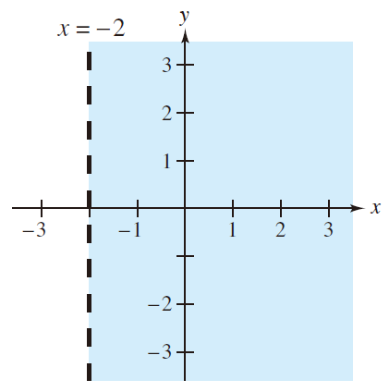
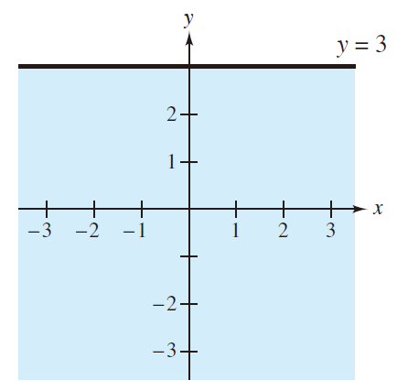
※ It is common to test the point of origin due to the least computational effort
The solutions of x > –2 are points lying to the right of x = –2 (A dashed line is used for > or <)
The solutions of y ≤ 3 are points lying below (or on) the line of y = 3 (A solid line is used for ≥ or ≤)
9.4

Slide 5
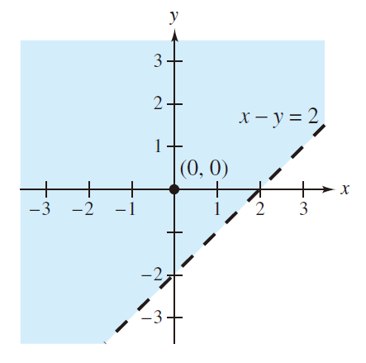
Ex 2:
Sketch the graph of the inequalities x – y < 2
Sol:
※ Draw the graph of the corresponding equation x – y = 2 first
※ Because the origin (0, 0) satisfies the inequality, the solution region is the half-plane lying above (or to the left of) the line x – y = 2
9.5

Slide 6
Systems of linear inequalities:
For example,
is a system of linear inequalities
Solution of a system of inequalities:
A solution is an ordered pair (x, y) satisfying each inequality in the system
The graph of a system of inequalities:
The collection of all solutions of the system
9.6

Slide 7
Ex 3: Solving a system of inequalities
Sketch the graph and label the vertexes (頂點) of the solution set of the system shown below
Sol:
Vertex A(–2, –4): the intersection of x – y = 2 and x = –2
Vertex B(5, 3): the intersection of x – y = 2 and y = 3
Vertex C(–2, 3): the intersection of x = –2 and y = 3
9.7

Slide 8
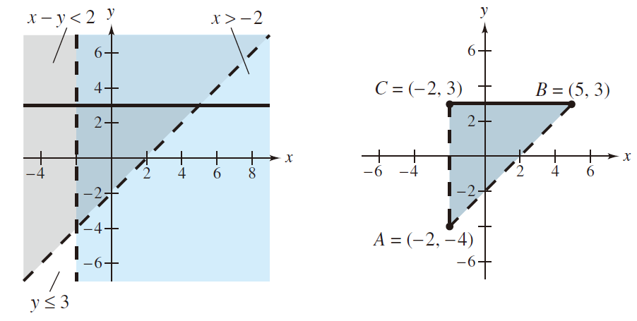
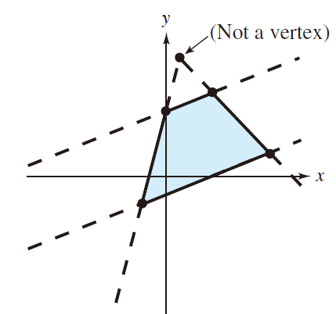
Notes: For complicated regions, two border lines could intersect at a point that is not a vertex of the solution region
9.8

Slide 9
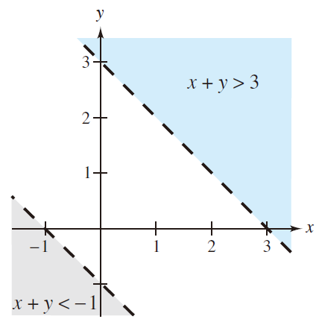
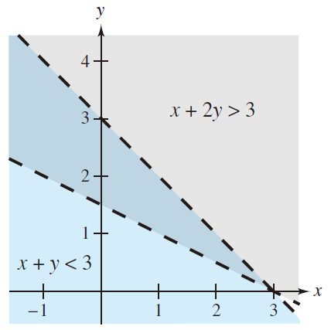
Notes: The system might have no solution or the solution set of a system can be unbounded
No solution
Solution region is unbounded
9.9

Slide 10
Keywords in Section 9.1:
linear inequalities: 線性不等式
solution of an inequality: 線性不等式的解
systems of linear inequalities: 線性不等式系統
solution of a system of inequalities: 線性不等式系統的解
vertexes: 頂點
9.10

Slide 11
9.2 Linear Programming Involving Two Variables
Linear programming problems (線性規劃問題)
The linear programming problem is a type of optimization problem consisting of a linear objective function (線性目標函數) and a system of linear inequalities called constraints
Note: The objective function gives the quantity that is to be maximized (or minimized), and the constraints determine the set of feasible solutions
※ Many applications in business and economics involve a process called optimization (最佳化), e.g., to find the minimum cost, the maximum profit, or the minimum consumption of resources
※ The linear programming problem is one of the simplest and most widely used optimization problems
9.11

Slide 12
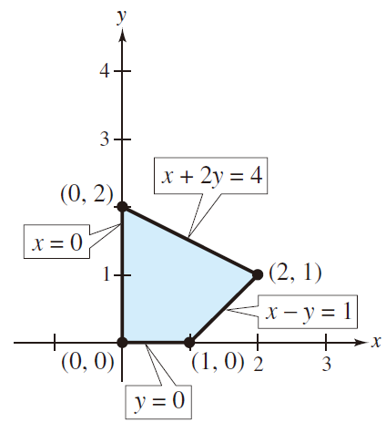
Ex 1: Solving a linear programming problem
Find the maximum value of z = 3x + 2y subject to the constraints listed below
Sol:
At (0, 0): z = 3(0) + 2(0) = 0
At (1, 0): z = 3(1) + 2(0) = 3
At (2, 1): z = 3(2) + 2(1) = 8
At (0, 2): z = 3(0) + 2(2) = 4
(maximum value of z)
※ Try testing some interior points in the region. You will see that corresponding value of z are less than 8
9.12

Slide 13
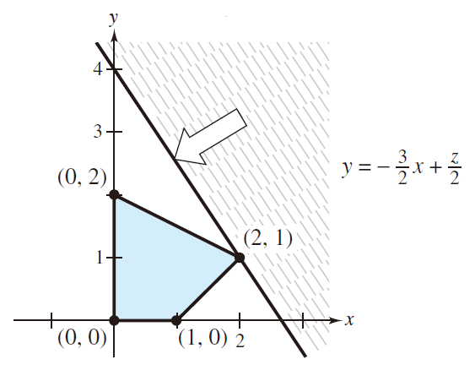
Why the maximum value of the objective function must occur at a vertex?
Consider to rewrite the objective function in the form
※ First, the above equation represents a family of parallel lines given different values of z, each of which is with the slope to be –3/2
※ Second, if you want to find the maximum value of z for the solution region, it is equivalent to find the line with the largest y-intercept
※ Finally, it is obvious that such a line must pass through one (or more) of the vertexes of the solution region
9.13

Slide 14
Note: The linear programming problem involving two variables can be solved by the graphical method (圖示解法):
1. Sketch the region corresponding to the system of constraints (The points inside or on the boundary of the region are called feasible solutions)
2. Find the vertexes of the region
3. Test the objective function at each of the vertexes and select the values of the variables that optimize the objective function (For a bounded region, both a minimum and maximum value will exist at vertexes. For an unbounded region, if an optimal solution exists, it must occur at a vertex)
9.14

Slide 15
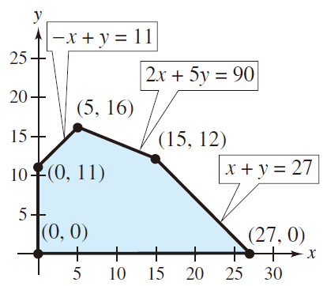
Ex 2: Solving a linear programming problem
Find the maximum value of z = 4x + 6y, where x ≥ 0 and y ≥ 0, subject to the constraints
Sol:
At (0, 0): z = 4(0) + 6(0) = 0
At (0, 11): z = 4(1) + 6(11) = 66
At (5, 16): z = 4(5) + 6(16) = 116
At (15, 12): z = 4(15) + 6(12) = 132
At (27, 0): z = 4(27) + 6(0) = 108
So the maximum value of z is 132, and this occurs when x = 15 and y = 12
9.15

Slide 16
Ex 3: Minimizing an objective function
Find the minimum value of the objective function
z = 5x + 7y,
where x ≥ 0 and y ≥ 0, subject to the constraints
9.16

Slide 17
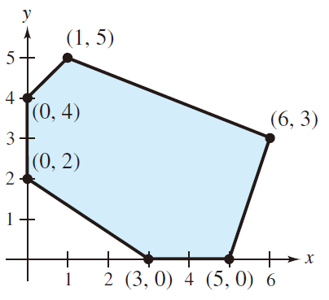
Sol:
At (0, 2): z = 5(0) + 7(2) = 14
At (0, 4): z = 5(0) + 7(4) = 28
At (1, 5): z = 5(1) + 7(5) = 40
At (6, 3): z = 5(6) + 7(3) = 51
At (5, 0): z = 5(5) + 7(0) = 25
At (3, 0): z = 5(3) + 7(0) = 15
So the minimum value of z is 14, and this occurs when x = 0 and y = 2
9.17

Slide 18
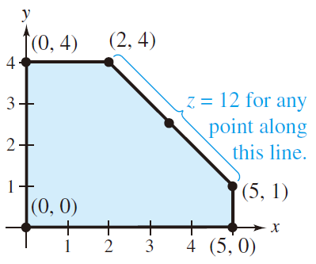
Ex: The maximum (or minimum) value occurs at two different vertexes
To maximize the objective function z = 2x + 2y given the following shaded region
At (0, 0): z = 2(0) + 2(0) = 0
At (0, 4): z = 2(0) + 2(4) = 8
At (2, 4): z = 2(2) + 2(4) = 12
At (5, 1): z = 2(5) + 2(1) = 12
At (5, 0): z = 2(5) + 2(0) = 10
(maximum value of z)
(maximum value of z)
The maximum value occurs not only at the vertexes (2, 4) and (5, 1), but also occurs at any point on the line segment connecting these two vertexes
9.18

Slide 19
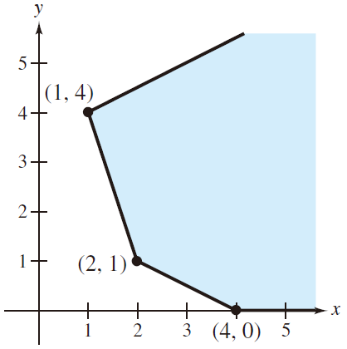
Ex: An unbounded region
To maximize the objective function z = 4x + 2y given the following shaded region
For this unbounded region, there is no maximum value of z. By choosing points (x, 0) for x ≥ 4, you can obtain values of z = 4(x) + 2(0) = 4x that are as large as you want
9.19

Slide 20
Ex 5: An application: minimum cost
The liquid portion of a diet is to provide at least 300 calories, 36 units of vitamin A, and 90 units of vitamin C daily. A cup of dietary drink X provides 60 calories, 12 units of vitamin A, and 10 units of vitamin C. A cup of dietary drink Y provides 60 calories, 6 units of vitamin A, and 30 units of vitamin C.
Now suppose the dietary drink X cost $.12 per cup and drink Y costs $.15 per cup. How many cups of each drink should be consumed each day to minimize the cost and still meet the stated daily requirements?
9.20

Slide 21
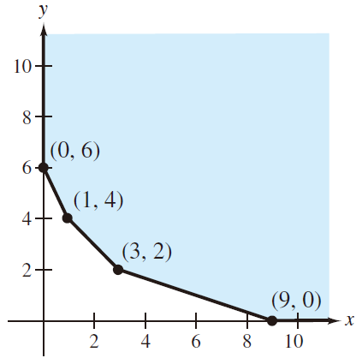
Sol:
At (0, 6): C = 0.12(0) + 0.15(6) = 0.90
At (1, 4): C = 0.12(1) + 0.15(4) = 0.72
At (3, 2): C = 0.12(3) + 0.15(2) = 0.66
At (9, 0): C = 0.12(9) + 0.15(0) = 1.08
So the minimum cost is $.66 per day, and this occurs when 3 cups of drink X and 2 cups of drink Y are consumed each day
9.21

Slide 22
Keywords in Section 9.2:
linear programming problems: 線性規劃問題
graphical method: 圖示解法
9.22

Slide 23
9.3 The Simplex Method: Maximization
The graphical method is convenient to solve linear programming problems involving only two variables. However, for problems involving more than two variables or problems involving large numbers of constraints, it is better to use a more systematic solution, which is called the simplex method
Slack variables (for smaller-than-or-equal-to constraints) (鬆弛變數)
The nonnegative numbers s₁, s₂, and s₃ are called slack variables because they represent the “slackness” in each inequality
9.23

Slide 24
Standard form of a maximization problem
A linear programming problem is in standard form if it seeks to maximize the objective function z = c₁x₁ + c₂x₂ + · · · + c_{n}x_{n} subject to the smaller-than-or-equal-to constraints
where b_{i} ≥ 0 and x_{i} ≥ 0. After adding slack variables, the corresponding system of constraint equations is
for s_{i} ≥ 0
9.24

Slide 25
Note: For the standard form of a maximization problem, the constraints involve only the smaller-than-or-equal-to signs and all x_{i} ≥ 0 and all b_{i} ≥ 0
Basic solution (基本解):
A basic solution is a solution (x₁, x₂,…, x_{n}, s₁, s₂,…, s_{m}) for a linear programming problem in standard form in which at most m variables are nonzero
The variables that are nonzero are called basic variables (基本變數), and the variables that are zero are called nonbasic variables (非基本變數)
9.25

Slide 26
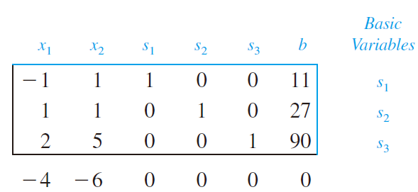
Simplex tableau (單形法表格):
This tableau consists of the augmented matrix corresponding to the constraint equations together with slack variables and the objective function in the following form
Ex:
The corresponding simplex tableau is
current z-value
9.26

Slide 27
Note: For this initial simplex tableau, the basic variables are s₁, s₂, and s₃, and the nonbasic variables are x₁ and x₂, i.e., x₁ = x₂ = 0. As a consequence, the coefficient 1’s for s₁, s₂, and s₃ are similar to leading 1’s and these basic variables have initial values of s₁ = 11, s₂ = 27, and s₃ = 90
Note: The initial solution for the simplex tableau is
(x₁, x₂, s₁, s₂, s₃) = (0, 0, 11, 27, 90)
and for the objective function, the current z-value is 4(0) + 6(0) = 0
Optimality check: Observing the bottom row of the tableau, if any of these entries (except the current z-value) are negative, the current solution is not optimal (so the initial values for (x₁, x₂, s₁, s₂, s₃) are not optimal)
9.27

Slide 28
Iteration of Simplex Method: An improvement process for finding larger z-value, which brings a new nonbasic variable into the solution, the entering variable (進入變數), and in the meanwhile one of the current basic variables (the departing variable (離開變數)) must leave
1. The entering variable corresponds to the smallest (the most negative) entry in the bottom row of the tableau
2. The departing variable corresponds to the smallest nonnegative ratio of b_{i}/a_{ij} in the column j determined by the entering variable
3. The entry in the simplex tableau in the entering variable’s column and the departing variable’s row is called the pivot entry
4. Use elementary row operations so that the pivot entry is 1, and all other entries in the entering variable column are 0
9.28

Slide 29
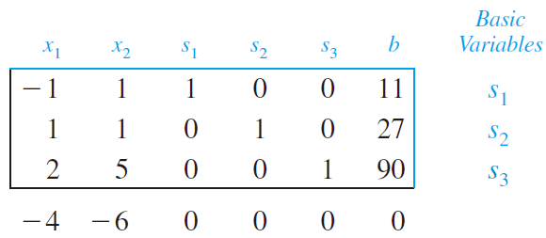
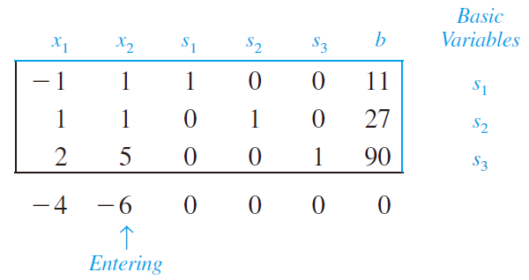
Ex 1: Pivoting to find an improved solution
Use the simplex method to find an improved solution for the linear programming problem represented by the tableau shown below
※ Since –6 is the smallest entry in the bottom row, we choose x₂ to be the entering variable
※ Because the objective function is z = 4x₁ + 6x₂, a unit increase in x₂ produce an increase of 6 in z, whereas a unit increase in x₁ produces an increase of only 4 in z. Thus, adjusting x₂ brings larger improvement for finding a larger z-value
9.29

Slide 30
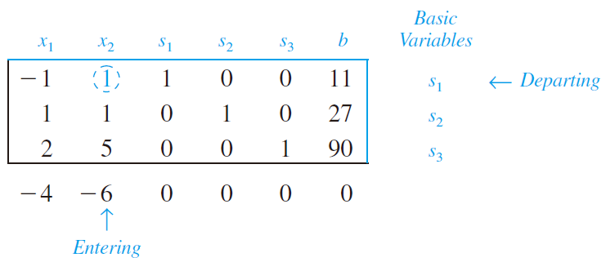
To find the departing variable, identify the row with the smallest nonnegative b_{i}/a_{ij} for the entering variables column, i.e., for j = 2 and examine b₁/a₁₂, b₂/a₂₂, and b₃/a₃₂
(Since 11 is the smallest nonnegative ratio, we choose s₁ as the departing variable)
9.30

Slide 31
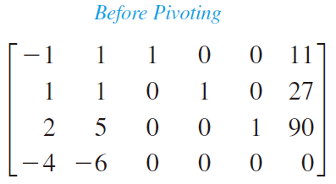
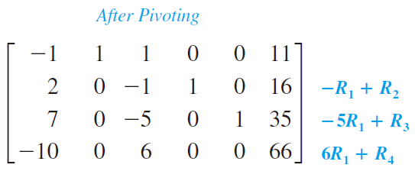
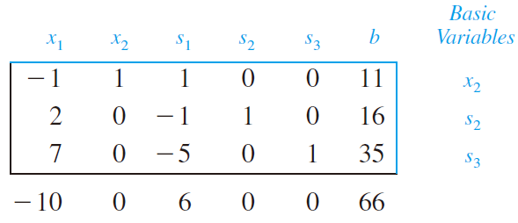
This process is called pivoting
Therefore, the new tableau now becomes as follows
Note: x₂ has replaced s₁ to be a basic variable and the improved solution is (x₁, x₂, s₁, s₂, s₃) = (0, 11, 0, 16, 35) with a z-value of 4x₁ + 6x₂ = 4(0) + 6(11) = 66
9.31

Slide 32
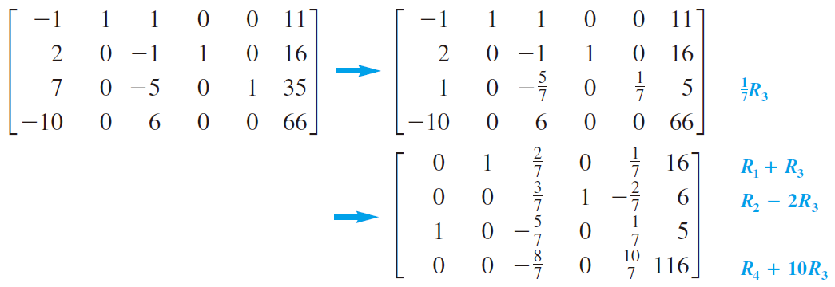
※ The improved solution is not yet optimal because the bottom row still has a negative entry
※ Since –10 is the smallest number in the bottom row, we choose x₁ as the entering variable
※ Moreover, the smallest nonnegative ratio among 11/(–1) = –11, 16/2 = 8, and 35/7 = 5 is 5, so s₃ is the departing variable and a₃₁ is the pivot entry
pivot entry
9.32

Slide 33
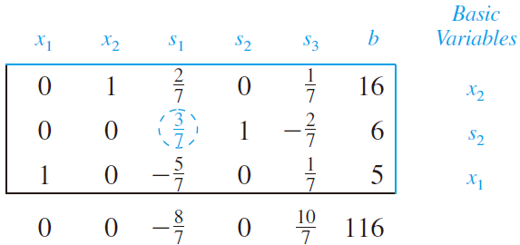
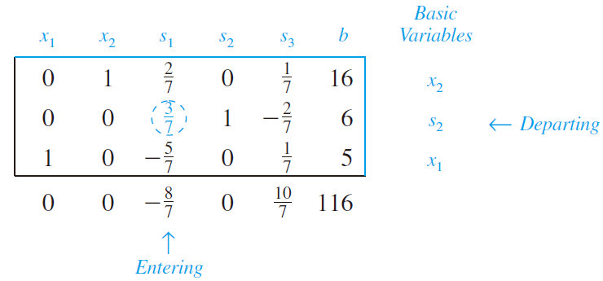
So, the new tableau is as follows
※ (x₁, x₂, s₁, s₂, s₃) = (5, 16, 0, 6, 0) with a z-value of 4x₁ + 6x₂ = 4(5) + 6(16) = 116
Following the same rule, we can identify s₁ to be the entering variable and s₂ to be the departing variable
9.33

Slide 34
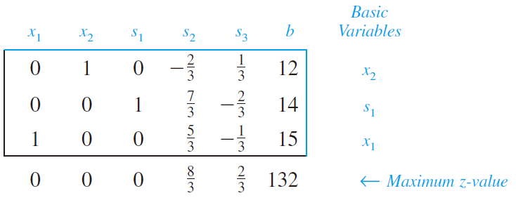
By performing one more iteration of the simplex method, you can obtain the following tableau
In this tableau, there are no negative elements in the bottom row. So, the optimal solution is determined to be
(x₁, x₂, s₁, s₂, s₃) = (15, 12, 14, 0, 0)
with
z = 4x₁ + 6x₂ = 4(15) + 6(12) = 132
9.34

Slide 35
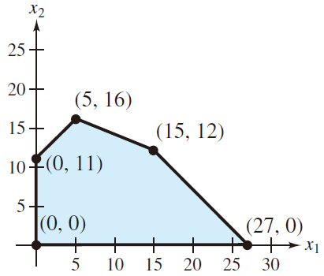
Note: For the linear programming problem in Example 1 involving two variables, you could also employ the graphical method to solve this problem as follows
※ Note that each iteration in the simplex method corresponds to moving from a given vertex to an adjacent vertex with an improved z-value
※ In addition, why we choose (x₁, x₂, s₁, s₂, s₃) = (0, 0, b₁, b₂, b₃) = (0, 0, 11, 27, 90) as the initial basic solution is that (x₁, x₂) = (0, 0) must be a vertex of the feasible solution region because all x_{i} ≥ 0 in the standard form of maximization problems
9.35

Slide 36
(x₁, x₂) = (0, 0) (intersection of x = 0 and y = 0)
(x₁, x₂) = (0, 11) (intersection of x = 0 and –x + y = 11)
(x₁, x₂) = (5, 16) (intersection of –x + y = 11 and 2x + 5y = 90)
(x₁, x₂) = (15, 12) (intersection of x + y = 27 and 2x + 5y = 90)
※ The above analysis shows that two nonbasic variables represent two straight lines (corresponding equations) that determine the vertex we examine
※ The intuition of the simplex method is to test different combinations of nonbasic variables, which is equivalent to testing different vertexes of the solution region
9.36

Slide 37
Ex 2: The simplex method with three variables
Use the simplex method to find the maximum value of
z = 2x₁ – x₂ + 2x₃,
subject to the constraints
where x₁ ≥ 0, x₂ ≥ 0, and x₃ ≥ 0
Sol:
First, construct the initial simplex tableau with the initial basic solution (x₁, x₂, x₃, s₁, s₂, s₃) = (0, 0, 0, 10, 20, 5)
9.37

Slide 38
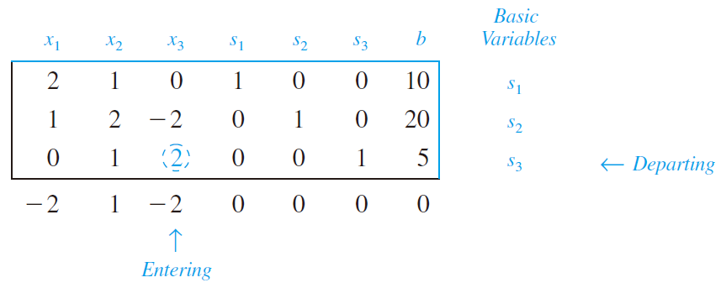
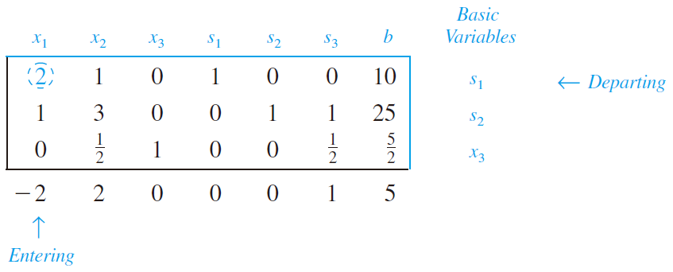
※ Note that the “tie” occurs when choosing the entering variable. Here we arbitrarily choose x₃ as the entering variable
9.38

Slide 39
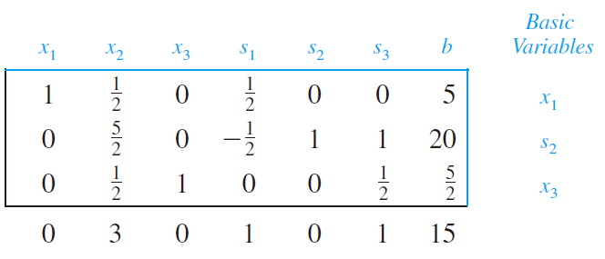
So the optimal solution is
(x₁, x₂, x₃, s₁, s₂, s₃) = (5, 0, 5/2, 0, 20, 0)
with
z = 2x₁ – x₂ + 2x₃ = 2(5) – (0) + 2(5/2) = 15
Note: Since s₁ = s₃ = 0, the optimal solution satisfies the first and third constraints. The result of s₂ = 20 indicates that the second constraint has a slack of 20
9.39

Slide 40
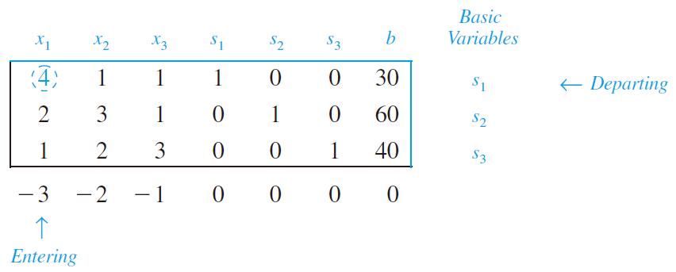
Ex 3: The simplex method with equality constraints
Use the simplex method to find the maximum value of
z = 3x₁ + 2x₂ + x₃,
subject to the constraints
where x₁ ≥ 0, x₂ ≥ 0, and x₃ ≥ 0
Sol:
※ The initial basic solution is (x₁, x₂, x₃, s₁, s₂, s₃) = (0, 0, 0, 30, 60, 40)
※ The variable s₁ is an artificial variable, rather than a slack variable
※ Since the first constraint is an equality, s₁ in the optimal solution must be zero, i.e., s₁ must be the nonbasic variable and thus be 0 in the optimal solution
9.40

Slide 41
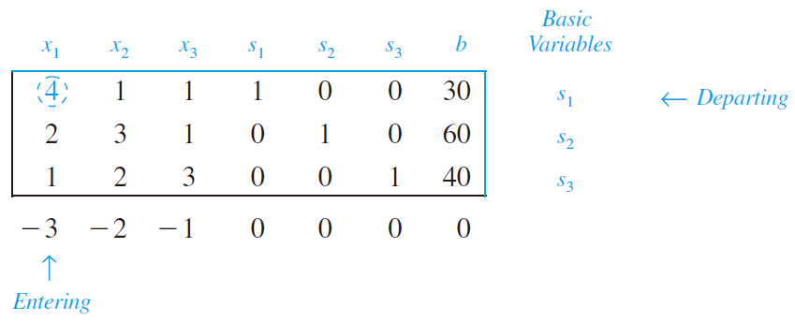
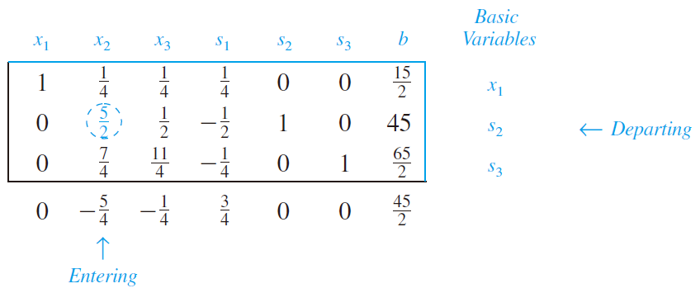
9.41

Slide 42
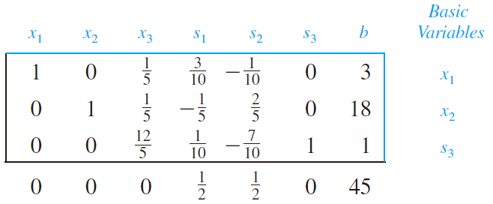
So the optimal solution is
(x₁, x₂, x₃, s₁, s₂, s₃) = (3, 18, 0, 0, 0, 1)
with
z = 3x₁ + 2x₂ + x₃ = 3(3) + 2(18) + 1(0) = 45
Note: Since s₁ is not a basic variable and thus s₁ = 0 in the optimal solution, this solution satisfies the first constraints (4(3) + 1(18) + 1(0) = 30)
9.42

Slide 43
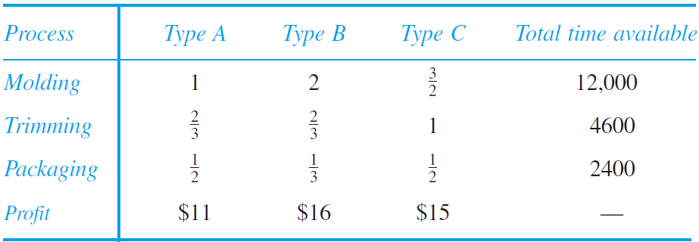
Ex 4: A business application: maximum profit
A manufacturer produces three types of plastic fixtures (塑膠配件). The times required for molding (鑄模), trimming (修整), and packaging are presented as follows. (Times and profits are displayed in hours and dollars for per dozen fixtures)
How many dozen of each type of fixture should be produced to obtain a maximum profit?
9.43

Slide 44
Sol:
Let x₁, x₂, x₃ represent the numbers of dozens of types A, B, and C fixtures, respectively. The objective function is expressed as
profit = P = 11x₁ + 16x₂ + 15x₃,
subject to the constraints
where x₁ ≥ 0, x₂ ≥ 0, and x₃ ≥ 0
9.44

Slide 45
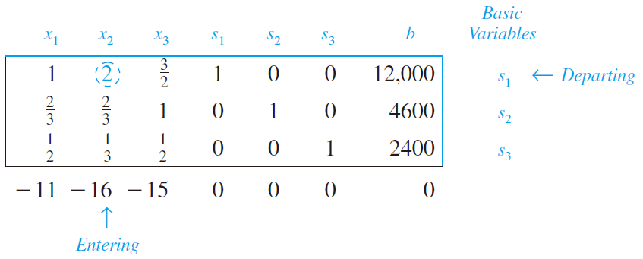
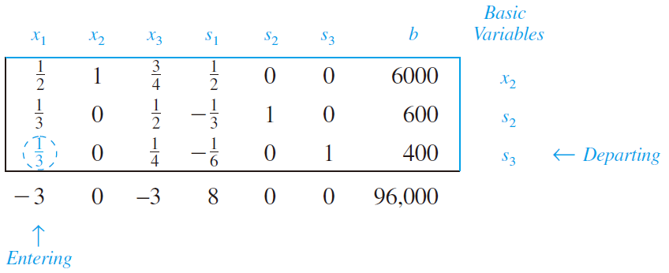
Apply the simplex method with the initial basic solution (x₁, x₂, x₃, s₁, s₂, s₃) = (0, 0, 0, 12000, 4600, 2400)
9.45

Slide 46
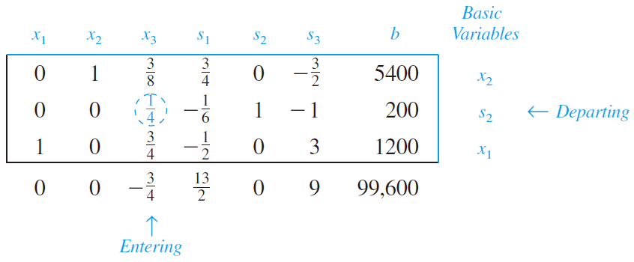
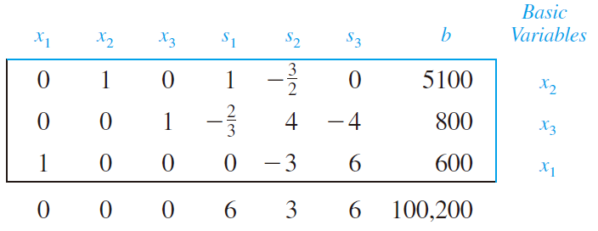
So the optimal solution is (x₁, x₂, x₃, s₁, s₂, s₃) = (600, 5100, 800, 0, 0, 0) with the maximum profit to be $100,200
9.46

Slide 47
Ex 5: A business application: media selection
The advertising alternatives for a company include television, radio, and newspaper advertisements. The costs and estimates of audience coverage are provided as follows
Moreover, in order to balance the advertising among the three types of media, no more than half of the total number of advertisements should occur on the radio, no more than 10 advertisements should occur on the newspaper, and at least 10% should occur on the television. The weekly advertising budget is $18,200. How many advertisements should be run on each media to maximize the total audience?
9.47

Slide 48
Sol:
Let x₁, x₂, x₃ represent the numbers of advertisements in television, newspaper, and radio, respectively. The objective function is expressed as
z = 100000x₁ + 40000x₂ + 18000x₃,
where x₁ ≥ 0, x₂ ≥ 0, and x₃ ≥ 0, and subject to the constraints
9.48

Slide 49
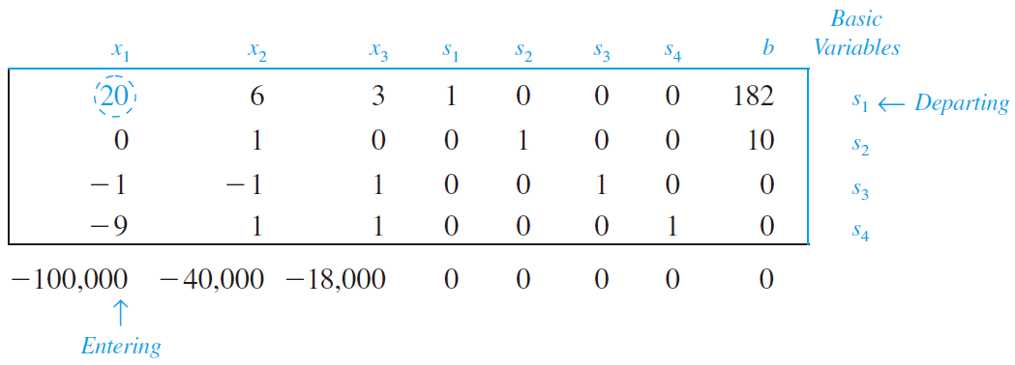
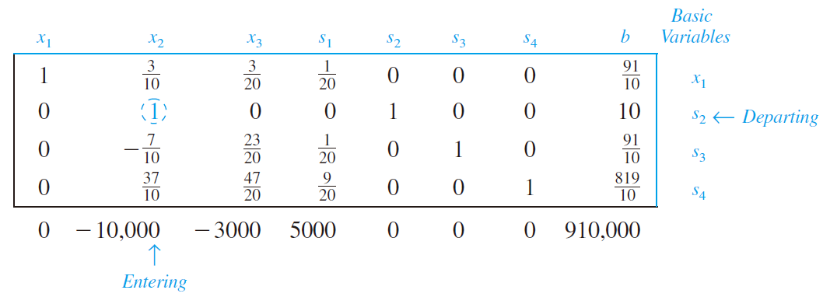
Apply the simplex method with the initial basic solution (x₁, x₂, x₃, s₁, s₂, s₃, s₄)= (0, 0, 0, 182, 10, 0, 0)
9.49

Slide 50
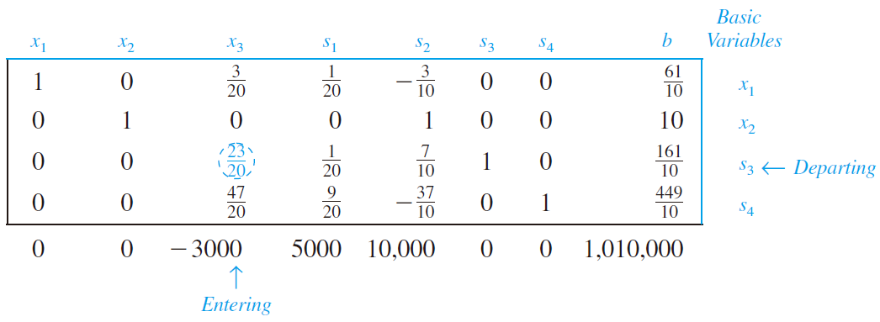
So the optimal solution is (x₁, x₂, x₃, s₁, s₂, s₃, s₄) = (4, 10, 14, 0, 0, 0, 12) with the maximum weekly audience to be 1,052,000
9.50

Slide 51
Keywords in Section 9.3:
simplex method: 單形法
slack variable: 鬆弛變數
basic solution: 基本解
basic variable: 基本變數
nonbasic variable: 非基本變數
simplex tableau: 單形法表格
entering variable: 進入變數
departing variable: 離開變數
artificial variable: 人工變數
9.51

Slide 52
9.4 The Simplex Method: Minimization
In Section 9.3, the simplex method is applied only to linear programming problems in standard form where the objective function is maximized. In this section, we will study the minimization problem
Standard form for a minimization problem
If w = c₁x₁ + c₂x₂ + · · · + c_{n}x_{n} is to be minimized, subject to the constraints
where x_{i} ≥ 0 and b_{i} ≥ 0
Note that in the standard form for maximization problems, those are “≤” signs (see Slide 9.24)
9.52

Slide 53
To find the Dual Maximization Problem (corresponding to the minimization problem that we want to solve)
Considering Example 5 in Section 9.2, we want to minimize
subject to the constraints
where x₁ ≥ 0 and x₂ ≥ 0
※ We cannot apply directly the simplex method because the simplex method introduced in Section 9.3 is for maximization problems
※ There is a dual relationship between minimization problems in standard form and maximization problems in standard form
9.53

Slide 54
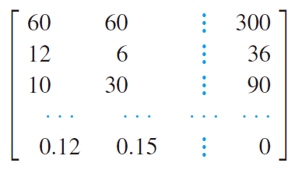
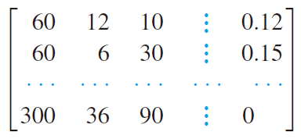
The steps to convert this problem into a maximization problem
1. Form the augmented matrix as follows
2. Find the transpose of this matrix
3. Interpret the transposed matrix as a maximization problem
9.54

Slide 55
※ The corresponding maximization problem is called the dual maximization problem of the original minimization problem, which is as follows
※ The solution of the original minimization problem can be found by applying the simplex method to the new dual maximization problem
9.55

Slide 56
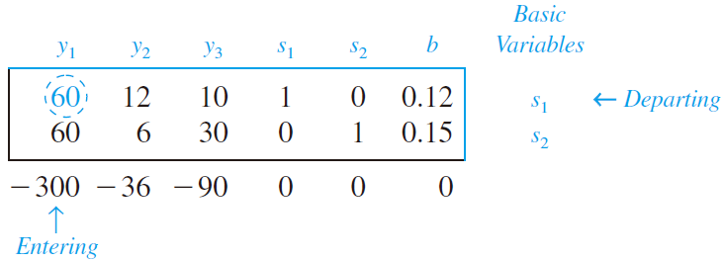
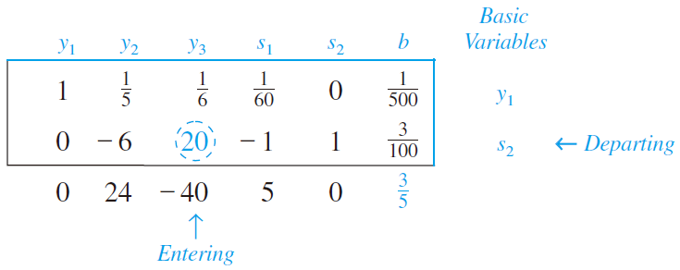
Apply the simplex method with the initial basic solution (y₁, y₂, y₃, s₁, s₂) = (0, 0, 0, 0.12, 0.15)
9.56

Slide 57
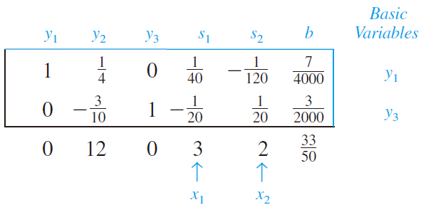
So the optimal solution is (y₁, y₂, y₃, s₁, s₂) = (7/4000, 0, 3/2000, 0, 0) with the maximum value to be 300(7/4000)+36(0)+90(3/2000) = 33/50 = 0.66
※ The optimal values of x_{i}’s for the original minimization can be obtained from the entries in the bottom row corresponding to slack variable columns, i.e., x₁ = 3 and x₂ = 2
※ The minimum value for the original objective function is 0.12(3)+0.15(2) = 0.66, which is exactly the maximum value for the dual maximization problem (It is the same as that derived by the graphical method in Sec. 9.2)
※ This dual relationship is called the von Neumann Duality Principle, introduced by the American mathematician John von Neumann (1903-1957)
9.57

Slide 58
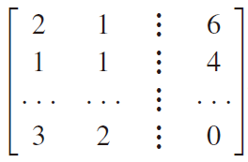
Ex 1: Solving a minimization problem
Find the minimum value of w = 3x₁ + 2x₂, subject to the constraints
where x₁ ≥ 0 and x₂ ≥ 0
Sol:
1. The augmented matrix corresponding the this minimization problem
9.58

Slide 59
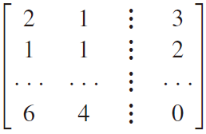
2. Derive the matrix corresponding to the dual maximization problem by taking transpose
The above augmented matrix implies the following maximization problem:
Find the maximum value of z = 6y₁+ 4y₂, subject to the constraints
where y₁ ≥ 0 and y₂ ≥ 0
9.59

Slide 60
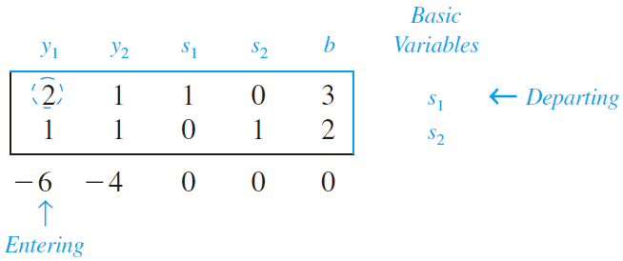
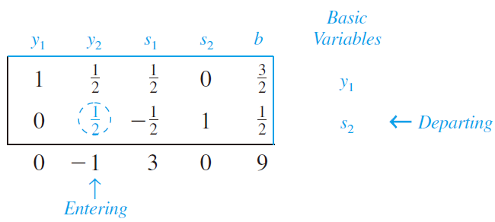
Apply the simplex method with the initial basic solution (y₁, y₂, s₁, s₂)= (0, 0, 3, 2)
9.60

Slide 61
From this final simplex tableau, you can see the maximum value of z is 10. So the solution of the original minimization problem is w =10, and this occurs when (x₁, x₂) = (2, 2)
9.61

Slide 62
Ex 2: Solving a minimization problem
Find the minimum value of w = 2x₁ + 10x₂ + 8x₃, subject to the constraints
where x₁ ≥ 0, x₂ ≥ 0, and x₃ ≥ 0
Sol:
First, transpose the augmented matrix
9.62

Slide 63
The corresponding maximization problem:
Find the maximum value of z = 6y₁ + 8y₂ + 4y₃, subject to the constraints
where y₁ ≥ 0, y₂ ≥ 0, and y₃ ≥ 0
The initial simplex tableau
9.63

Slide 64
From the last row of this final simplex tableau, you can see the maximum value of z is 36. So the solution of the original minimization problem is w =36, and this occurs when (x₁, x₂ , x₂) = (2, 0, 4)
9.64

Slide 65
Ex 3: A business application: minimum cost
A small petroleum company owns two refineries. Refinery 1 costs $20,000 per day to operate, and it can produce 400 barrels of high-grade oil, 300 barrels of medium-grade oil, and 200 barrels of low-grade oil each day. Refinery 2 is newer and more modern. It costs $25,000 per day to operate, and it can produce $300 barrels of high-grade oil, 400 barrels of medium-grade oil, and 500 barrels of low-grade oil each day
The company has orders totaling 25,000 barrels of high-grade oil, 27,000 barrels of medium-grade oil, and 30,000 barrels of low-grade oil. How many days should this petroleum company run each refinery to minimize its costs and still refine enough oil to meet its orders?
9.65

Slide 66
Sol:
Let x₁ and x₂ represent the numbers of days on which the two refineries are operated. Then the total cost is represented by
C = 20,000x₁ + 25,000x₂,
and the constraints are
where x₁ ≥ 0 and x₂ ≥ 0
9.66

Slide 67
Now apply the simplex method to the dual problem
9.67

Slide 68
From this final simplex tableau, you can see the solution for the original minimization problem is C = $ 1,750,000 and this occurs when x₁ = 25 and x₂ = 50, i.e., the two refineries should be operated for 25 and 50 days, respectively
9.68

Slide 69
Keywords in Section 9.4:
dual maximization problem: 對偶極大化問題
9.69

Slide 70
9.5 The Simplex Method: Mixed Constraints
In Sections 9.3 and 9.4, we learn how to solve linear programming problems in the standard forms, i.e., the constraints for the maximization problem involve only “≤” inequalities, and the constraints for the minimization problem involve only “≥” inequalities
Mixed-constraint problems: the constraints involve both types of inequalities
For example, find the maximum value of z = x₁ + x₂ + 2x₃, subject to the constraints
where x₁ ≥ 0, x₂ ≥ 0, and x₃ ≥ 0
Because of these two ≥ inequalities, this is not the standard form for a maximization problem
9.70

Slide 71
For the first inequality, it does involve ≤ inequalities, so we add a slack variable to form the equation as before
For the last two inequalities, a new type of variable, called a surplus variable (剩餘變數), is introduced as follows
Note: The variable s₂ and s₃ are called the surplus variables because they represent the amounts by which the left sides of the inequalities exceed the right sides
Note: The surplus variables as well as the slack variables must be nonnegative, i.e., s₁ ≥ 0, s₂ ≥ 0, and s₃ ≥ 0 in the above case
9.71

Slide 72
The initial simplex tableau can be formed as follows
Note: According to the rules introduced in the Section 9.3, the initial basic solution is (x₁, x₂, x₃, s₁, s₂, s₃) = (0, 0, 0, 50, –36, –10), which is not a feasible solution because the values of the two surplus variables are negative
In other words, the point (x₁, x₂, x₃) = (0, 0, 0) is not an vertex of the feasible solution region (In fact, (0, 0, 0) is not even in the feasible solution region)
So, we cannot apply the simplex method directly from this initial basic solution
9.72

Slide 73
We need to use the “trial and error” method (試誤法) to find a feasible solution for the initial basic solution for the simplex method, that is, arbitrarily choosing new entering variable to replace the negative surplus variables (It is equivalent to jump from the intersection of x₁ = 0, x₂ = 0, and x₃ = 0 to the intersection of other three corresponding equations)
Note: Here we choose x₃ as the entering variable and s₃ as the departing variable arbitrarily, i.e., we do not follow the pivoting process introduced on Slide 9.28 to select the entering and departing variables
9.73

Slide 74
After pivoting, the new simplex tableau is as follows
※ It means that we consider the intersection of x₁ = 0, x₂ = 0, and x₁ + x₃ = 10 (because s₃ = 0)
The current solution (x₁, x₂, x₃, s₁, s₂, s₃) = (0, 0, 10, 40, –36, 0) is not feasible because the value of s₂ is still negative
So we choose x₂ as the entering variable and s₂ as the departing variable and pivot to obtain the following simplex tableau
9.74

Slide 75
※ The above tableau suggests that we consider the intersection of x₁ = 0, 2x₁ + x₂ = 36 (because s₂ = 0), and x₁ + x₃ = 10 (because s₃ = 0)
We finally obtain a feasible solution, which is (x₁, x₂, x₃, s₁, s₂, s₃) = (0, 36, 10, 4, 0, 0)
From here on, you can apply the simplex method as usual, i.e., we choose s₃ as the entering variable because of its smallest entry in the bottom row, and then compare b_{i}/a_{ij} in the entering variable column to find s₁ to be the departing variable
9.75

Slide 76
After pivoting, you can obtain the following simplex tableau
Note that it is the final tableau because it represents a feasible solution and there are no negative entries in the bottom row
So, you can conclude that the maximum value of z = 64 and this occur when (x₁, x₂, x₃, s₁, s₂, s₃)= (0, 36, 14, 0, 0, 4)
9.76

Slide 77
For the minimization problem with mixed-constraints, the situation is more difficult because we cannot apply the dual principle to find the corresponding maximization problem if there are mixed constraints
Another technique is introduced to change a mixed-constraint minimization problem to a mixed-constraint maximization problem by multiplying each coefficient in the objective function by –1
This technique is demonstrated in the next example
9.77

Slide 78
Ex 2: A minimization problem with mixed constraints
Find the minimum value of w = 4x₁ + 2x₂ + x₃, subject to the constraints
where x₁ ≥ 0, x₂ ≥ 0, and x₃ ≥ 0
Sol:
First, rewrite the objective function by multiplying each of its coefficients by –1, i.e., z = –4x₁ – 2x₂ – x₃ (maximizing this new objective function is equivalent to minimizing the original objective function)
9.78

Slide 79
Next, add a slack variable to the first inequality and subtract surplus variables from the second and third inequalities, and the initial simplex tableau is as follows
※ Note that there is no negative entry in the bottom row because it contains the negatives of the coefficients of the new objective function
※ The current solution (x₁, x₂, x₃, s₁, s₂, s₃) = (0, 0, 0, 14, –4, –6) is not a feasible solution
※ So, what we need to do is to arbitrarily choose the entering and departing variables to find a feasible solution
※ Here we choose x₂ as the entering variable and s₂ as the departing variable
9.79

Slide 80
※ The current solution (x₁, x₂, x₃, s₁, s₂, s₃) = (0, 4, 0, 2, 0, 10) is a feasible solution. From now on, we can apply the standard simplex method
※ We choose x₃ as the entering variable because –9 is the smallest entry in the bottom row and choose s₃ as the departing variable because b₃/a₃₃ is the smallest nonnegative ratio in the third column
After pivoting, we can obtain the following simplex tableau
9.80

Slide 81
After pivoting around a₂₅, we can obtain the following simplex tableau
The maximum value of the new objective function is z = –2, so the minimum value of the original objective function is w = 2. This occurs when x₁ = 0, x₂ = 0, and x₃ = 2
※ The solution of x₃ is according to the third row since it is a basic variables, and x₁ = 0 and x₂ = 0 are due to the fact that they are nonbasic variables
9.81

Slide 82
Ex 3: A business application: minimum shipment costs
An automobile company has two factories. One factory has 400 cars (of a certain model) in stock and the other factory has 300 cars (of the same model) in stock. Two customers order this car model. The first customer needs 200 cars, and the second customer needs 300 cars. The costs of shipping cars from the two factories to the customers are shown in the following table.
How should the company ship the cars in order to minimize the shipping costs?
9.82

Slide 83
Sol:
Let x₁ and x₂ represent the numbers of cars shipped from factory 1 to the first and second customers, respectively. The total cost of shipping to be minimized is
C = 30x₁ + 25x₂ + 36(200 – x₁) + 30(300 – x₂)
= 16,200 – 6x₁ – 5x₂
and the constraints are
where x₁ ≥ 0 and x₂ ≥ 0 and the second inequality can be rewritten as x₁ + x₂ ≥ 200
9.83

Slide 84
Multiply the objective function by –1 to convert it into a maximization problem, i.e., to maximize z = 6x₁ + 5x₂ – 16,200. So, the initial simplex tableau is as follows
※ The current solution (x₁, x₂, s₁, s₂, s₃, s₄) = (0, 0, 400, –200, 200, 300) and the current z-value is –16,200
※ Since the current solution is not a feasible solution (due to the negative value of s₂), in addition to choosing s₂ as the departing variable, we arbitrarily choose x₁ to be the entering variable
9.84

Slide 85
After pivoting, we can obtain the following simplex tableau
※ The current solution (x₁, x₂, s₁, s₂, s₃, s₄) = (200, 0, 200, 0, 0, 300) is a feasible solution
※ So, from now on, we can apply the standard simplex method. Following the rule on Slide 9.28, we choose s₂ as the entering variable and s₃ as the departing variable
9.85

Slide 86
After pivoting, we can obtain the following simplex tableau
※ Following the rule on Slide 9.28, we choose x₂ as the entering variable and s₁ as the departing variable. After pivoting around the entry a₁₂, we can obtain the following simplex tableau
9.86

Slide 87
※ Since all entries except the z-value in the bottom row are nonnegative, it is the final simplex tableau
※ The minimum shipping cost is $14,000, and this occurs when x₁ = 200 and x₂ = 200, i.e., the numbers of cars shipped from the two factories are as follows
9.87

Slide 88
Linear Programming under x_{i} ≥ 0 and b_{i} ≥ 0
Max. problems in standard form, i.e., involving only “≤” in constraints
Min. problems in standard form, i.e., involving only “≥” in constraints
dual transformation
Add slack variables to form constraint equations
Perform the simplex method
There are two kinds of methods to solve this problem
Max. problems with mixed constraints
Min. problems with mixed constraints
Add slack variables and subtract surplus variables to form constraint equations
Try to find a feasible solution by trial and error
Apply the simplex method
Multiply the objective function by –1 to convert it into a max. problem
Add slack variables and subtract surplus variables to form constraint equations
Try to find a feasible solution by trial and error
Apply the simplex method
9.88

Slide 89
Exercise in Section 9.4 on Slide 9.53: Do not apply the dual principle to solving the minimization problem in standard form
We want to minimize subject to the constraints
where x₁ ≥ 0 and x₂ ≥ 0
Sol:
First, rewrite the objective function by multiplying each of its coefficients by –1, i.e., z = –0.12x₁ – 0.15x₂ (maximizing this new objective function is equivalent to minimizing the original objective function)
9.89

Slide 90
Next, subtract surplus variables for these three inequalities, and the initial simplex tableau is as follows
※ The current solution (x₁, x₂, s₁, s₂, s₃) = (0, 0, –300, –36, –90) is not a feasible solution
※ What we need to do is to arbitrarily choose the entering variables and choose negative surplus variables as the departing variables to find a feasible solution
※ Here we choose x₂ as the entering variable and s₂ as the departing variable
9.90

Slide 91
After pivoting, we can obtain the following simplex tableau
※ The current solution (x₁, x₂, s₁, s₂, s₃) = (0, 6, 60, 0, 90) is a feasible solution. From now on, we can apply the standard simplex method
※ We choose x₁ as the entering variable because –0.18 is the smallest (or the most negative) entry in the bottom row except the z-value and choose s₁ as the departing variable because b₁/a₁₁ is the smallest nonnegative ratio in the first column
※ After performing the pivoting process based on a₁₁, we can obtain the following simplex tableau
9.91

Slide 92
※ Since all entries except the z-value on the bottom row is nonnegative, it is the final simplex tableau
※ The minimum value for w is 0.66, and this occurs when x₁ = 3 and x₂ = 2
※ This method can generate the same result as that in the method combining the dual transformation and the standard simplex method (comparing to Slide 9.57)
9.92

Slide 93
Keywords in Section 9.5:
mixed-constraint problems: 混合限制問題
surplus variable: 剩餘變數
9.93

Slide 94
9.6 Homework 3
Solving the linear programming problem by the function “Solver” in Excel (see Homework3_Portfolio_frontier.xls”)
Not only linear programming problems (線性規劃問題) but also nonlinear programming problems can be solved by “Solver”
The nonlinear programming problem (非線性規劃問題) means the objective function and/or one or more constraints are nonlinear
The quadratic programming problem (二次規劃問題) is a special case of the nonlinear programming problem, in which the objective function contains squared terms and the constraints are all linear
Finding the portfolio frontier is a quadratic programming problem
9.94

Slide 95
Portfolio frontier problem: Given an expected portfolio return, find the optimal weights on assets to construct a portfolio with a minimum variance
For a portfolio return r_{p} = w₁r₁ + w₂r₂ + ··· + w_{n}r_{n}, given any specified value of E(r_{p}), the portfolio frontier problem is to solve optimal weights w₁, w₂,…, w_{n} in the following quadratic programming problem:
* Suppose the expected returns E(r_{i}) and variances and covariance among individual assets cov(r_{i}, r_{j}) are known
9.95

Slide 96
Homework 3
(10 points) Find the portfolio frontier based on at least 5 stocks in S&P 500, i.e., solve the above quadratic programming problem for n ≥ 5
Note that r_{i}’s of all stocks are total returns, so you need to find adjusted closing prices or adjusted returns
Today is assumed to be July 1st, 2018 and you need to find one-year historical returns for each stock
Estimate the expected values and standard deviations for r_{i}’s of all stocks and the correlations among the r_{i}’s of all stocks as well, i.e., to calculate sample averages (for estimating E(r_{i})) , σ_{i}, and ρ_{ij} from the historical data
Annualization: daily average return × 252 = annual average return; daily s.d. × sqrt(252) = annual s.d.
For different portfolio returns, e.g., E(r_{p}) = 0, 1%, 2%,…, 40%, solve w_{i} for each E(r_{p}) by the function “Solver” in Excel
For each solution set of w_{i}, plot a point according to the portfolio return and standard deviation on the E(r)-σ plane
9.96

Slide 97
Bonus:
Compare the portfolio frontiers of at least three industries (1 point)
Compare the portfolio frontiers given different values of n (With the increase of n, the portfolio frontier should move further toward left theoretically, i.e., given the same E(r_{p}), you can generate a smaller portfolio standard deviation given more stocks) (1 point)
Examine the special case for n = 2: (1 point)
Check that the point of (E(r_{i}), σ_{i}) for each of the two stocks lies on the portfolio frontier
Consider the case of ρ₁₂ = 1 (simply setting ρ₁₂ to be 1) and demonstrate that the portfolio frontier is a straight line in this case
Consider the case of ρ₁₂ = –1 (simply setting ρ₁₂ to be –1) and demonstrate that the portfolio frontier is a saw-like, piecewise linear curve and there is a portfolio with zero standard deviation
Compare with the portfolio frontier with the short sales constraints (i.e., w₁, w₂,…, w_{n} are nonnegative) (1 point)
※ The basic requirement is 10 points, and the bonus is at most 3 additional points
9.97

Slide 98
Implement Homework 3 with VBA
Basic requirement (with one CommandButton):
Inputs: Time series of r_{i,t} of the five firms
Outputs: For each portfolio frontier,
1. Calculate (E(r_{i}), σ_{i}) and correlation ρ_{ij} for all i, j
2. Solve w_{i} to minimize the portfolio variance and next obtain the pair (E(r_{p}), σ_{p})
3. Based on the generated 41 points of (E(r_{p}), σ_{p}), plot the portfolio frontier
Bonus (with another CommandButtons):
Inputs: Time series of r_{i,t}
Outputs: (E(r_{i}), σ_{i}), ρ_{ij}, (E(r_{p}), σ_{p}), and the diagram of the portfolio frontier
※ VBA編輯器中，「工具」→「設定引用項目」→ 勾選Solver
※ 如何在程式中勾選 “將未設限的變數設為非負數”？在程式碼中 “SolverOk…” 這行上面，手動加上 SolverOptions AssumeNonNeg:=True
※ SolverSolve UserFinish:=True 可消除[規劃求解結果] 對話方塊
※ 微軟 SolverSolve函數介紹 https://docs.microsoft.com/zh-tw/office/vba/excel/Concepts/Functions/solversolve-function

