Slide 1
Chapter 7 Eigenvalues and Eigenvectors
7.1 Eigenvalues and Eigenvectors
7.2 Diagonalization
7.3 Symmetric Matrices and Orthogonal Diagonalization
7.4 Application of Eigenvalues and Eigenvectors
7.5 Principal Component Analysis
7.1

Slide 2
7.1 Eigenvalues and Eigenvectors
Eigenvalue problem (特徵值問題) (one of the most important problems in the linear algebra):
If A is an n×n matrix, do there exist nonzero vectors x in R^{n} such that Ax is a scalar multiple of x?
(The term eigenvalue is from the German word Eigenwert, meaning “proper value”)
Eigenvalue (特徵值) and Eigenvector (特徵向量):
A: an n×n matrix
λ: a scalar (could be zero)
x: a nonzero vector in R^{n}
※ Geometric Interpretation
Eigenvalue
Eigenvector

Slide 3
Ex 1: Verifying eigenvalues and eigenvectors
Eigenvalue
※ In fact, for each eigenvalue, it has infinitely many eigenvectors. For λ = 2, [3 0]^{T} or [5 0]^{T} are both corresponding eigenvectors. Moreover, ([3 0] + [5 0])^{T} is still an eigenvector. The proof is in Thm. 7.1.
Eigenvector
Eigenvalue
Eigenvector

Slide 4
Thm. 7.1: The eigenspace corresponding to λ of matrix A
If A is an n×n matrix with an eigenvalue λ, then the set of all eigenvectors of λ together with the zero vector is a subspace of R^{n}. This subspace is called the eigenspace (特徵空間) of λ
Pf:
x₁ and x₂ are eigenvectors corresponding to λ
Since this set is closed under vector addition and scalar multiplication, this set is a subspace of R^{n} according to Theorem 4.5

Slide 5
Ex 3: Examples of eigenspaces on the xy-plane
For the matrix A as follows, the corresponding eigenvalues are λ₁ = –1 and λ₂ = 1:
Sol:
For the eigenvalue λ₁ = –1, corresponding vectors are any vectors on the x-axis
※ Thus, the eigenspace corresponding to λ = –1 is the x-axis, which is a subspace of R²
For the eigenvalue λ₂ = 1, corresponding vectors are any vectors on the y-axis
※ Thus, the eigenspace corresponding to λ = 1 is the y-axis, which is a subspace of R²

Slide 6
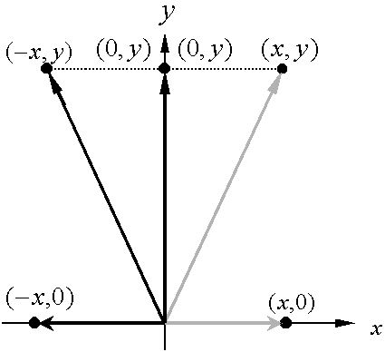
※ Geometrically speaking, multiplying a vector (x, y) in R² by the matrix A corresponds to a reflection to the y-axis, i.e., left multiplying A to v can transform v to another vector in the same vector space

Slide 7
Thm. 7.2: Finding eigenvalues and eigenvectors of a matrix A∈M_{n×n}
Let A be an n×n matrix.
(1) An eigenvalue of A is a scalar λ such that
(2) The eigenvectors of A corresponding to λ are the nonzero
solutions of
Note: follwing the definition of the eigenvalue problem
(homogeneous system)
has nonzero solutions for x iff
(The above iff results comes from the equivalent conditions on Slide 4.101)
Characteristic equation (特徵方程式) of A:
Characteristic polynomial (特徵多項式) of A∈M_{n×n}:

Slide 8
Ex 4: Finding eigenvalues and eigenvectors
Sol: Characteristic equation:
Eigenvalue:

Slide 10
Ex 5: Finding eigenvalues and eigenvectors
Find the eigenvalues and corresponding eigenvectors for the matrix A. What is the dimension of the eigenspace of each eigenvalue?
Sol: Characteristic equation:
Eigenvalue:

Slide 11
The eigenspace of λ = 2:
Thus, the dimension of its eigenspace is 2

Slide 12
Notes:
(1) If an eigenvalue λ₁ occurs as a multiple root (k times) for the characteristic polynominal, then λ₁ has multiplicity (重數) k
(2) The multiplicity of an eigenvalue is greater than or equal to the dimension of its eigenspace. (In Ex. 5, k is 3 and the dimension of its eigenspace is 2)

Slide 13
Ex 6：Find the eigenvalues of the matrix A and find a basis
for each of the corresponding eigenspaces
Sol: Characteristic equation:
※ According to the previous slide, the dimension of the eigenspace of λ₁ = 1 is at most to be 2
※ For λ₂ = 2 and λ₃ = 3, the demensions of their eigenspaces are at most to be 1
Eigenvalues:

Slide 14
is a basis for the eigenspace corresponding to
※The dimension of the eigenspace of λ₁ = 1 is 2

Slide 15
is a basis for the eigenspace corresponding to
※The dimension of the eigenspace of λ₂ = 2 is 1

Slide 16
is a basis for the eigenspace corresponding to
※The dimension of the eigenspace of λ₃ = 3 is 1

Slide 17
Thm. 7.3: Eigenvalues for triangular matrices
If A is an n×n triangular matrix, then its eigenvalues are the entries on its main diagonal
Ex 7: Finding eigenvalues for triangular and diagonal matrices
Sol:
※According to Thm. 3.2, the determinant of a triangular matrix is the product of the entries on the main diagonal

Slide 18
Eigenvalues and eigenvectors of linear transformations:
※ The definition of linear transformation functions should be introduced in Ch 6
※ Here I briefly introduce the linear transformation and its some basic properties
※ The typical example of a linear transformation function is that each component of the resulting vector is the linear combination of the components in the input vector x
An example for a linear transformation T: R³→R³

Slide 19
Theorem: Standard matrix for a linear transformation

Slide 20
Consider the same linear transformation T(x₁, x₂, x₃) = (x₁ + 3x₂, 3x₁ + x₂, –2x₃)
Thus, the above linear transformation T is with the following corresponding standard matrix A such that T(x) = Ax
※ The statement on Slide 7.18 is valid because for any linear transformation T: V →V, there is a corresponding square matrix such that T(x) = Ax. Consequently, the eignvalues and eigenvectors of a linear transformation T are in essence the eigenvalues and eigenvectors of the corresponding square matrix A

Slide 21
Ex 8: Finding eigenvalues and eigenvectors for standard matrices
※ A is the standard matrix for T(x₁, x₂, x₃) = (x₁ + 3x₂, 3x₁ + x₂, –2x₃) (see Slides 7.19 and 7.20)
Sol:

Slide 22
Transformation matrix for nonstandard bases
※ On the next two slides, an example is provided to verify numerically that this extension is valid

Slide 23
EX. Consider an arbitrary nonstandard basis to be {v₁, v₂, v₃}= {(1, 1, 0), (1, –1, 0), (0, 0, 1)}, and find the transformation matrix such that corresponding to the same linear transformation T(x₁, x₂, x₃) = (x₁ + 3x₂, 3x₁ + x₂, –2x₃)

Slide 24
Consider x = (5, –1, 4), and check that corresponding to the linear transformation T(x₁, x₂, x₃) = (x₁ + 3x₂, 3x₁ + x₂, –2x₃)

Slide 25
For a special basis $B^{′}=\left\{v_{1},v_{2},…,v_{n}\right\}$, where $v_{i}$’s are eigenvectors of the standard matrix $A$, $A^{′}$is obtained immediately to be diagonal due to
$T\left(v_{i}\right)=Av_{i}=λ_{i}v_{i}$
and
$${\left[λ_{i}v_{i}\right]}_{B^{′}}={\left[0v_{1}+0v_{2}+⋯+λ_{i}v_{i}+⋯+0v_{n}\right]}_{B^{′}}={\left[0⋯0 λ_{i} 0⋯0\right]}^{T}$$

Slide 26
Keywords in Section 7.1:
eigenvalue problem: 特徵值問題
eigenvalue: 特徵值
eigenvector: 特徵向量
characteristic equation: 特徵方程式
characteristic polynomial: 特徵多項式
eigenspace: 特徵空間
multiplicity: 重數
linear transformation: 線性轉換
diagonalization: 對角化

Slide 27
7.2 Diagonalization
Diagonalization problem (對角化問題):
For a square matrix A, does there exist an invertible matrix P such that P^{–1}AP is diagonal?
Diagonalizable matrix (可對角化矩陣):
Definition 1: A square matrix A is called diagonalizable if there exists an invertible matrix P such that P^{–1}AP is a diagonal matrix (i.e., P diagonalizes A)
Definition 2: A square matrix A is called diagonalizable if A is similar to a diagonal matrix
※ In Sec. 6.4, two square matrices A and B are similar if there exists an invertible matrix P such that B = P^{–1}AP.
Notes:
This section shows that the eigenvalue and eigenvector problem is closely related to the diagonalization problem

Slide 28
Thm. 7.4: Similar matrices have the same eigenvalues
If A and B are similar n×n matrices, then they have the same eigenvalues
Pf:
For any diagonal matrix in the form of D = λI, P^{–1}DP = D
Consider the characteristic equation of B:
Since A and B have the same characteristic equation, they are with the same eigenvalues
※ Note that the eigenvectors of A and B are not necessarily identical

Slide 29
Ex 1: Eigenvalue problems and diagonalization programs
Sol: Characteristic equation:

Slide 30
Note: If
※ The above example can verify Thm. 7.4 since the eigenvalues for both A and P^{–1}AP are the same to be 4, –2, and –2
※ The reason why the matrix P is constructed with the eigenvectors of A is demonstrated in Thm. 7.5 on the next slide

Slide 31
Thm. 7.5: Condition for diagonalization
An n×n matrix A is diagonalizable if and only if it has n linearly independent eigenvectors
※ If there are n linearly independent eigenvectors, it does not imply that there are n distinct eigenvalues. In an extreme case, it is possible to have only one eigenvalue with the multiplicity n, and there are n linearly independent eigenvectors for this eigenvalue
※ On the other hand, if there are n distinct eigenvalues, then there are n linearly independent eigenvectors (see Thm. 7.6), and thus A must be diagonalizable
Pf:

Slide 33
※

Slide 34
Ex 4: A matrix that is not diagonalizable
Sol: Characteristic equation:
Since A does not have two linearly independent eigenvectors, A is not diagonalizable

Slide 35
Steps for diagonalizing an n×n square matrix:
Step 1: Find n linearly independent eigenvectors for A with corresponding eigenvalues
Step 2: Let
Step 3:

Slide 36
Ex 5: Diagonalizing a matrix
Sol: Characteristic equation:

Slide 39
Note: a quick way to calculate A^{k} based on the diagonalization technique

Slide 40
Thm. 7.6: Sufficient conditions for diagonalization
If an n×n matrix A has n distinct eigenvalues, then the corresponding eigenvectors are linearly independent and thus A is diagonalizable according to Thm. 7.5.
Pf:
Let λ₁, λ₂, …, λ_{n} be distinct eigenvalues and corresponding eigenvectors be x₁, x₂, …, x_{n}. In addition, consider that the first m eigenvectors are linearly independent, but the first m+1 eigenvectors are linearly dependent, i.e.,
where c_{i}’s are not all zero. Multiplying both sides of Eq. (1) by A yields

Slide 41
On the other hand, multiplying both sides of Eq. (1) by λ_{m+1} yields
Now, subtracting Eq. (2) from Eq. (3) produces
Since the first m eigenvectors are linearly independent, we can infer that all coefficients of this equation should be zero, i.e.,
Because all the eigenvalues are distinct, it follows all c_{i}’s equal to 0, which contradicts our assumption that x_{m+1} can be expressed as a linear combination of the first m eigenvectors. So, the set of n eigenvectors is linearly independent given n distinct eigenvalues, and according to Thm. 7.5, we can conclude that A is diagonalizable

Slide 42
Ex 7: Determining whether a matrix is diagonalizable
Sol: Because A is a triangular matrix, its eigenvalues are
According to Thm. 7.6, because these three values are distinct, A is diagonalizable

Slide 43
Ex 8: Finding a diagonalized matrix for a linear transformation
Sol:
The standard matrix for T is given by
From Ex. 5 you know that λ₁ = 2, λ₂ = –2, λ₃ = 3 and thus A is diagonalizable. So, similar to the result on Slide 7.25, these three linearly independent eigenvectors found in Ex. 5 can be used to form the basis . That is

Slide 44
The matrix for T relative to this basis is
※ Note that it is not necessary to calculate through the above equation. According to the result on Slide 7.25, we already know that is a diagonal matrix and its main diagonal entries are corresponding eigenvalues of A

Slide 45
Keywords in Section 7.2:
diagonalization problem: 對角化問題
diagonalization: 對角化
diagonalizable matrix: 可對角化矩陣

Slide 46
7.3 Symmetric Matrices and Orthogonal Diagonalization
Symmetric matrix (對稱矩陣):
A square matrix A is symmetric if it is equal to its transpose:
Ex 1: Symmetric matrices and nonsymetric matrices
(symmetric)
(symmetric)
(nonsymmetric)

Slide 47
Thm 7.7: Eigenvalues of symmetric matrices
If A is an n×n “symmetric” matrix, then the following properties are true
(1) A is diagonalizable (symmetric matrices (except the matrices in the form of A = aI, in which case A is already diagonal) are guaranteed to have n linearly independent eigenvectors and thus be diagonalizable)
(2) All eigenvalues of A are real numbers
(3) If λ is an eigenvalue of A with the multiplicity to be k, then λ has k linearly independent eigenvectors. That is, the eigenspace of λ has dimension k
※ The above theorem is called the Real Spectral Theorem (實數頻譜理論), and the set of eigenvalues of A is called the spectrum (頻譜) of A

Slide 48
Ex 2:
Prove that a 2 × 2 symmetric matrix is diagonalizable
Pf: Characteristic equation:
As a function in λ, this quadratic polynomial function has a nonnegative discriminant (判別式) as follows

Slide 49
※ Note that in this case, A has one eigenvalue, a, whose multiplicity is 2, and the two eigenvectors are linearly independent
The characteristic polynomial of A has two distinct real roots, which implies that A has two distinct real eigenvalues. According to Thm. 7.6, A is diagonalizable

Slide 50
Orthogonal matrix (正交矩陣):
A square matrix P is called orthogonal if it is invertible and
Thm. 7.8: Properties of orthogonal matrices
An n×n matrix P is orthogonal if and only if its column vectors form an orthonormal set
Pf: Suppose the column vectors of P form an orthonormal set, i.e.,
It implies that P^{–1} = P^{T} and thus P is orthogonal

Slide 51
Ex 5: Show that P is an orthogonal matrix.
Sol: If P is a orthogonal matrix, then

Slide 53
Thm. 7.9: Properties of symmetric matrices
Let A be an n×n “symmetric” matrix. If λ₁ and λ₂ are distinct eigenvalues of A, then their corresponding eigenvectors x₁ and x₂ are orthogonal. (Thm. 7.6 states that for “any” matrix, eigenvectors corresponding to distinct eigenvalues are linearly independent)
Pf:
※ For distinct eigenvalues of a symmetric matrix, their corresponding eigenvectors are orthogonal and thus linearly independent to each other
(Theorem 5.10 states that orthogonality implies linear independence)
※ Note that there may be multiple x₁’s and x₂’s corresponding to λ₁ and λ₂

Slide 54
Orthogonal diagonalization (正交對角化):
A matrix A is orthogonally diagonalizable if there exists an orthogonal matrix P such that P^{–1}AP = D is diagonal
Thm. 7.10: Fundamental theorem of symmetric matrices
An n×n matrix A is orthogonally diagonalizable and has real eigenvalues if and only if A is symmetric
Pf:
See the next two slides

Slide 55
Orthogonal diagonalization of a symmetric matrix:
Let A be an n×n symmetric matrix.
(1) Find all eigenvalues of A and determine the multiplicity of each
(2) For each eigenvalue of multiplicity 1, choose the unit eigenvector
(3) For each eigenvalue of the multiplicity to be k ≥ 2, find a set of k linearly independent eigenvectors. If this set {v₁, v₂, …, v_{k}} is not orthonormal, apply the Gram-Schmidt orthonormalization process
※ According to Thm. 7.9, eigenvectors corresponding to distinct eigenvalues are orthognoal

Slide 56
(4) The composite of steps (2) and (3) produces an orthonormal set of n eigenvectors. Use these orthonormal and thus linearly independent eigenvectors as column vectors to form the matrix P.
i. According to Thm. 7.8, the matrix P is orthogonal
ii. Following the diagonalization process on Slide 7.35, D = P^{–1}AP is diagonal
Therefore, the matrix A is orthogonally diagonalizable

Slide 57
Ex 7: Determining whether a matrix is orthogonally diagonalizable
Symmetric
matrix
Orthogonally
diagonalizable

Slide 58
Ex 9: Orthogonal diagonalization
Sol:
※ Verify Thm. 7.9 that v₁·v₂ = v₁·v₃ = 0
orthogonal

Slide 59
※If v₂ and v₃ are not orthogonal, the Gram-Schmidt Process should be performed. Here we simply normalize v₂ and v₃ to find the corresponding unit vectors
※ Note that there are some calculation error in the solution of Ex.9 in the text book

Slide 60
Summary of Sections 7.2 and 7.3:
Thm. 7.5: $n×n$矩陣能被對角線化 $⇔$ 其有$n$個線性獨立的eigenvectors
Thm. 7.6: $n×n$矩陣有$n$個不同的eigenvalues $⇒$ 所對應的$n$個的eigvenvectors為線性獨立 $⇒$ 此矩陣能被對角線化
Thm. 7.7: 對稱矩陣必能被對角線化 (即使有某個eigenvalue為$k$重根，其也會有$k$個對應的且線性獨立的eigvenvectors)
Thm. 7.9: 對稱矩陣的不同eigenvalues，其所對應的eigvenvectors必定orthogonal (且也線性獨立 (根據Thm. 5.10))
Thm. 7.10: 對稱矩陣是orthogonally diagonalizable，即$D=P^{−1}AP$，其中$P$是orthogonal，$D$為一diagonal矩陣

Slide 61
Keywords in Section 7.3:
symmetric matrix: 對稱矩陣
orthogonal matrix: 正交矩陣
orthonormal set: 單範正交集
orthogonal diagonalization: 正交對角化

Slide 62
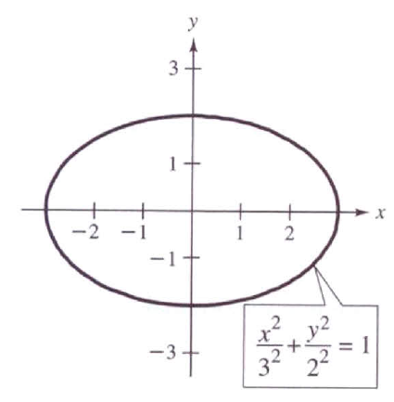
7.4 Applications of Eigenvalues and Eigenvectors
The rotation for quadratic equation: ax² + bxy + cy² + dx + ey + f = 0
Ex 5: Identify the graphs of the following quadratic equations
Sol:
※ Since there is no xy-term, it is easy to derive the standard form and it is apparent that this equation represents an ellipse.

Slide 63
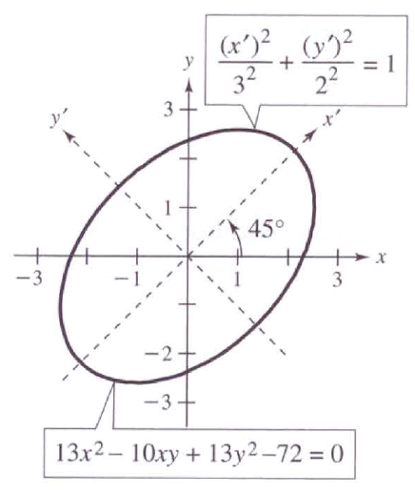
※ Since there is a xy-term, it is difficult to identify the graph of this equation. In fact, it is also an ellipse, which is oblique on the xy-plane.
※ There is a easy way to identify the graph of quadratic equation. The basic idea is to rotate the x- and y-axes to x’- and y’-axes such that there is no more x’y’-term in the new quadratic equation.
※ In the above example, if we rotate the x- and y-axes by 45 degree counterclockwise, the new quadratic equation can be derived, which represents an ellipse apparently.
※ In Section 4.8, the rotation of conics is achieved by changing basis, but here the diagonalization technique based on eigenvalues and eignvectors is applied to solving the rotation problem

Slide 64
Quadratic form (二次形式):
ax² + bxy + cy²
is the quadratic form associated with the quadratic equation ax² + bxy + cy² + dx + ey + f = 0
Matrix of the quadratic form:
If we define X = , then X^{T}AX= ax² + bxy + cy² . In fact, the quadratic equation can be expressed in terms of X as follows
※ Note that A is a symmetric matrix

Slide 65
Principal Axes Theorem (主軸定理)
For a conic whose equation is ax² + bxy + cy² + dx + ey + f = 0, the rotation to eliminate the xy-term is achieved by X = PX’, where P is an orthogonal matrix that diagonalizes A. That is,
where λ₁ and λ₂ are eigenvalues of A. The equation for the rotated conic is given by

Slide 66
Pf:
According to Thm. 7.10, since A is symmetric, we can conclude that there exists an orthogonal matrix P such that P^{–1}AP = P^{T}AP = D is diagonal
Replacing X with PX’, the quadratic form becomes
※ It is obvious that the new quadratic form in terms of X’ has no x’y’-term, and the coefficients for (x’)² and (y’)² are the two eigenvalues of the matrix A
※

Slide 67
Ex 6: Rotation of a conic
Perform a rotation of axes to eliminate the xy-term in the following quadratic equation
Sol:
The matrix of the quadratic form associated with this equation is
The eigenvalues are λ₁ = 8 and λ₂ = 18, and the corresponding eigenvectors are

Slide 68
After normalizing each eigenvector, we can obtain the orthogonal matrix P as follows.
※ According to the results on p. 268 in Ch4, X=PX’ is equivalent to rotate the xy-coordinates by 45 degree to form the new x’y’-coordinates, which is also illustrated in the figure on Slide 7.62
Then by replacing X with PX’, the equation of the rotated conic is
which can be written in the standard form
※ The above equation represents an ellipse on the x’y’-plane

Slide 69
In three-dimensional version:
ax² + by² + cz² + dxy + exz + fyz
is the quadratic form associated with the equation of quadric surface: ax² + by² + cz² + dxy + exz + fyz + gx + hy + iz + j = 0
Matrix of the quadratic form:
If we define X = [x y z]^{T}, then X^{T}AX= ax² + by² + cz² + dxy + exz + fyz, and the quadratic surface equation can be expressed as
※ Note that A is a symmetric matrix

Slide 70
Keywords in Section 7.4:
quadratic form (二次形式)
principal axes theorem (主軸定理)

Slide 71
7.5 Principal Component Analysis (主成分分析)
Principal component analysis
It is a way of identifying the underlying patterns in data
It can extract information in a large data set with many variables and approximate this data set with fewer factors
In other words, it can reduce the number of variables to a more manageable set
Steps of the principal component analysis
Step 1: Get some data
Step 2: Subtract the mean
Step 3: Calculate the covariance matrix
Step 4: Calculate the eigenvectors and eigenvalues of the
covariance matrix
Step 5: Deriving the transformed data set
Step 6: Getting the original data back

Slide 72
Step 1:
Step 2:
x* | y*
2.5 | 2.4
0.5 | 0.7
2.2 | 2.9
1.9 | 2.2
3.1 | 3.0
2.3 | 2.7
2.0 | 1.6
1.0 | 1.1
1.5 | 1.6
1.1 | 0.9
1.81 | 1.91
x | y
0.69 | 0.49
-1.31 | -1.21
0.39 | 0.99
0.09 | 0.29
1.29 | 1.09
0.49 | 0.79
0.19 | -0.31
-0.81 | -0.81
-0.31 | -0.31
-0.71 | -1.01
0 | 0
Step 3:

Slide 73
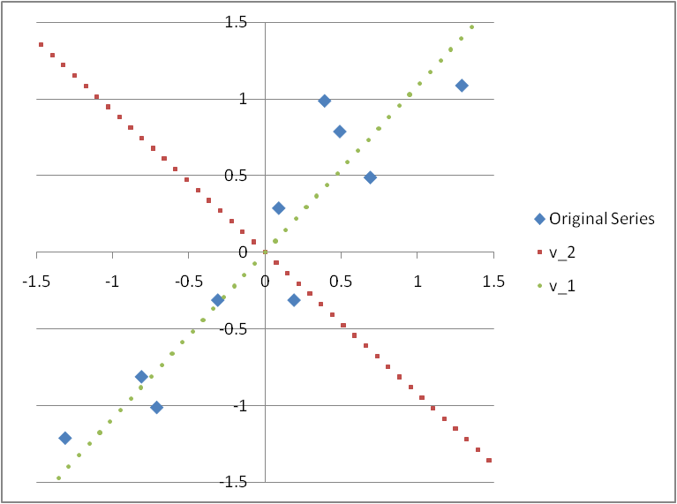
Step 4: Calculate the eigenvectors and eigenvalues of the covariance matrix A
1. The two eigenvectors are perpendicular (orthogonal) to each other according to Thm. 7.9 (In fact, they are orthonormal here)
2. v₁ eigenvector (corresponding to the largest eigenvalue $λ_{1}$) is just like a best-fit regression line
3. v₂ seems less important to explain the data since the projection of each node on the v₂ axis is very close to zero
4. The interpretation of v₁ is the new axis which retains as much as possible the interpoint distance information (or said the variance information) that was contained in the original two dimensions

Slide 74
※ The intuition behind the principal component analysis:
(It also implies that the new series of x’ and y’ are independent)

Slide 75
Step 5: Deriving the transformed data set:
x’ | y’
-0.82797 | -0.17512
1.77758 | 0.14286
-0.99220 | 0.38437
-0.27421 | 0.13042
-1.67580 | -0.20950
-0.91295 | 0.17528
0.09911 | -0.34982
1.14457 | 0.04642
0.43805 | 0.01776
1.22382 | -0.16268
0 | 0
x’ | y’
-0.82797 | 0
1.77758 | 0
-0.99220 | 0
-0.27421 | 0
-1.67580 | 0
-0.91295 | 0
0.09911 | 0
1.14457 | 0
0.43805 | 0
1.22382 | 0
0 | 0

Slide 76
Step 6: Getting the original data back:
case 1 case 2
x* | y*
2.5 | 2.4
0.5 | 0.7
2.2 | 2.9
1.9 | 2.2
3.1 | 3
2.3 | 2.7
2 | 1.6
1 | 1.1
1.5 | 1.6
1.1 | 0.9
1.81 | 1.91
x* | y*
2.37 | 2.52
0.61 | 0.60
2.48 | 2.64
2.00 | 2.11
2.95 | 3.14
2.43 | 2.58
1.74 | 1.84
1.03 | 1.07
1.51 | 1.59
0.98 | 1.01
1.81 | 1.91
※ We can derive the original data set if we take both v₁ and v₂ and thus x’ and y’ into account when deriving the transformed data
※ Although when we derive the transformed data, only v₁ and thus only x’ are considered, the data gotten back is still similar to the original data. That means, x’ can be a common factor almost able to explain both series x and y

Slide 77
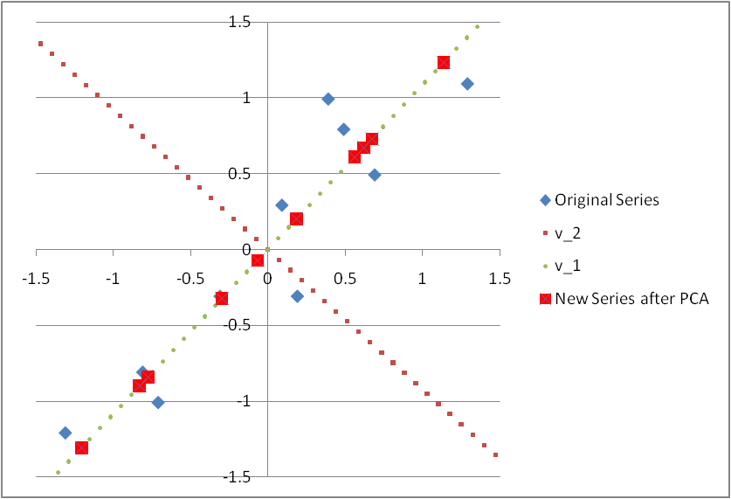
※ If only the principal component x’ is considered in the Principal Component Analysis, it is equivalent to project all points onto the v₁ vector
※ It can be observed in the above figure that the projection onto v₁ vector can retains as much as possible the interpoint distance information (variance) that was contained in the original series of (x, y)

Slide 78
Factor loadings: the correlations between the principal components (F₁ = x’ and F₂ = y’) and the original variables (x₁ = x and x₂ = y) (Note that x and y should be expressed as the linear combination of x’ and y’ for deriving factor loadings)
Factor loadings are used to identify and interpret the unobservable principal components
※ The factor loadings of x’ on x and y are close to 1 in absolute levels, which implies the principal component x’ can explain x and y quite well and thus x’ can viewed as an index to represent the combined information of x and y

Slide 79
※ Questionnaire (問卷) analysis: salary vs. personality and learned-courses information
i. If there are five variables (the results of five problems), x₁ to x₅, x₁ to x₃ are about personality information of the respondent (作答者), and x₄ and x₅ are about the course information which this respondent had learned
ii. Suppose there are two more important principal components x₁’ and x₂’ (x₃’ , x₄’ , and x₅’ are less important principal components), and the principal component x₁’ is highly correlated with x₁ to x₃ and the principal component x₂’ is highly correlated with x₄ and x₅
iii. x₁’ can be interpreted as a general index to represent the personal characteristic, and x₂’ can be interpreted as a general index associated with the course profile that the respondent had learned
iv. Study the relationship between the salary level and the personal-characteristic index x₁’ and education index x₂’

