Slide 1
CHAPTER 17
Futures Markets and Risk Management

Slide 2
17.1 THE FUTURES CONTRACT

Slide 3
Futures and Forwards
Forward - an agreement calling for a future delivery of an asset at an agreed-upon price
Futures - similar to forward but feature formalized and standardized characteristics
Key difference in futures
Secondary trading - liquidity
Marked to market
Standardized contract units
Clearinghouse warrants performance

Slide 4
Key Terms for Futures Contracts
Futures price - agreed-upon price at maturity
Long position - agree to purchase
Short position - agree to sell
Profits on positions at maturity
Long = spot minus original futures price
Short = original futures price minus spot

Slide 5
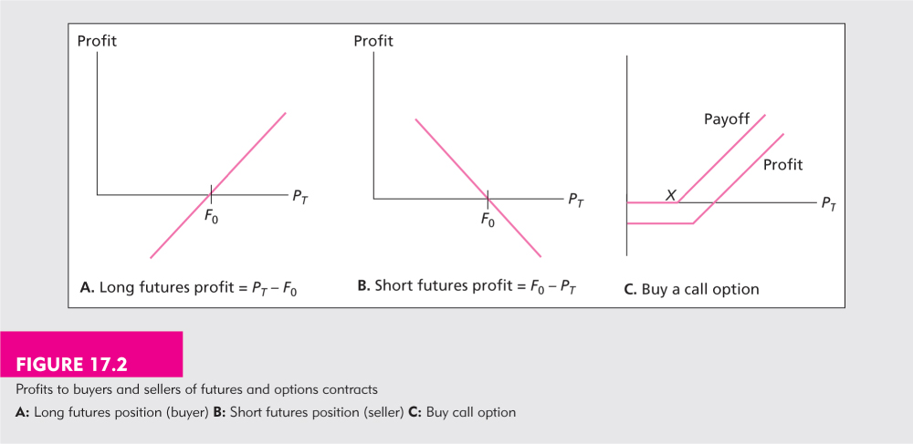
Figure 17.2 Profits to Buyers and Sellers of Futures and Options Contracts

Slide 6
Types of Contracts
Agricultural commodities
Metals and minerals (including energy contracts)
Foreign currencies
Financial futures
Interest rate futures
Stock index futures

Slide 7
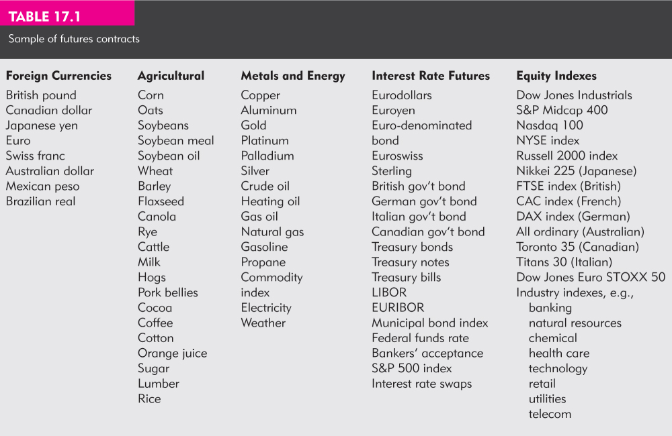
Table 17.1 Sample of Futures Contracts

Slide 8
17.2 MECHANICS OF TRADING IN FUTURES MARKETS

Slide 9
The Clearinghouse and Open Interest
Clearinghouse - acts as a party to all buyers and sellers.
Obligated to deliver or supply delivery
Closing out positions
Reversing the trade
Take or make delivery
Most trades are reversed and do not involve actual delivery
Open Interest

Slide 10
Figure 17.3 Trading With and Without a Clearinghouse

Slide 11
Marking to Market and the Margin Account
Initial Margin - funds deposited to provide capital to absorb losses
Marking to Market - each day the profits or losses from the new futures price and reflected in the account.
Maintenance or variance margin - an established value below which a trader’s margin may not fall.

Slide 12
Margin and Trading Arrangements
Margin call - when the maintenance margin is reached, broker will ask for additional margin funds
Convergence of Price - as maturity approaches the spot and futures price converge
Delivery - Actual commodity of a certain grade with a delivery location or for some contracts cash settlement
Cash Settlement – some contracts are settled in cash rather than delivery of the underlying assets

Slide 13
17.3 FUTURES MARKET STRATEGIES

Slide 14
Trading Strategies
Speculation -
short - believe price will fall
long - believe price will rise
Hedging -
long hedge - protecting against a rise in price
short hedge - protecting against a fall in price

Slide 15
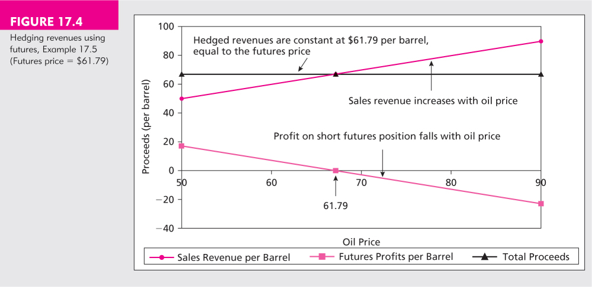
Figure 17.4 Hedging Revenues Using Futures, Example 17.5 (Futures Price = 61.79)

Slide 16
Basis and Basis Risk
Basis - the difference between the futures price and the spot price
over time the basis will likely change and will eventually converge
Basis Risk - the variability in the basis that will affect profits and/or hedging performance

Slide 17
17.4 THE DETERMINATION OF FUTURES PRICES

Slide 18
Futures Pricing
Spot-futures parity theorem - two ways to acquire an asset for some date in the future
Purchase it now and store it
Take a long position in futures
These two strategies must have the same market determined costs

Slide 19
Parity Example Using Gold
Strategy 1: Buy gold now at the spot price (S₀) and hold it until time T when it will be worth S_{T}
Strategy 2: Enter a long position in gold futures today and invest enough funds in T-bills (F₀) so that it will cover the futures price of S_{T}

Slide 20
Parity Example Outcomes
Strategy A: Action Initial flows Flows at T
Buy gold -So ST
Strategy B: Action Initial flows Flows at T
Long futures 0 ST - FO
Invest in Bill
FO(1+rf)T - FO(1+rf)T FO
Total for B - FO(1+rf)T ST

Slide 21
Price of Futures with Parity
Since the strategies have the same flows at time T
F_{O} / (1 + r_{f})^{T} = S_{O}
F_{O} = S_{O} (1 + r_{f})^{T}
The futures price has to equal the carrying cost of the gold

Slide 22
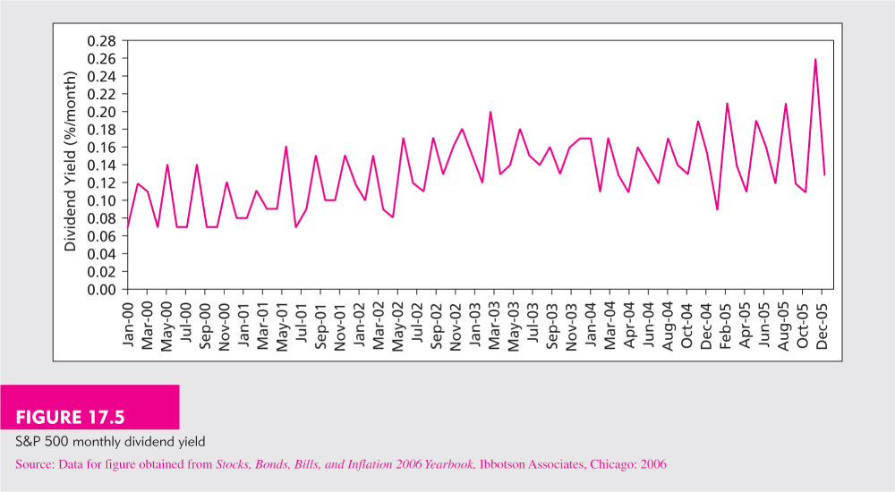
Figure 17.5 S&P 500 Monthly Dividend Yield

Slide 23
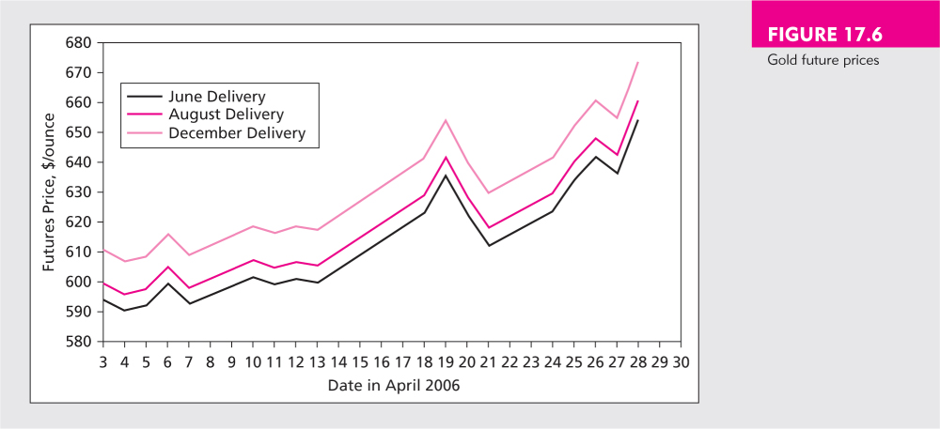
Figure 17.6 Gold Futures Prices

Slide 24
17.5 FINANCIAL FUTURES

Slide 25
Stock Index Futures
Available on both domestic and international stocks
Advantages over direct stock purchase
lower transaction costs
better for timing or allocation strategies
takes less time to acquire the portfolio

Slide 26
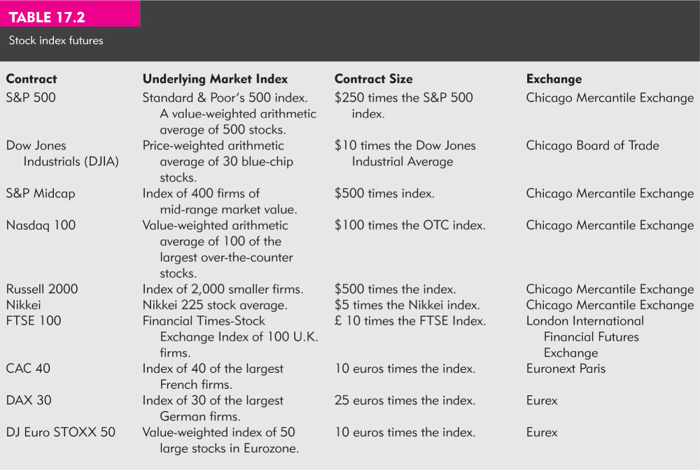
Table 17.2 Stock Index Futures

Slide 27
Table 17.3 Correlations Among Major US Stock Market Indexes

Slide 28
Creating Synthetic Stock Positions
Synthetic stock purchase
Purchase of the stock index instead of actual shares of stock
Creation of a synthetic T-bill plus index futures that duplicates the payoff of the stock index contract
Shift between Treasury bills and broad-based stock market holdings

Slide 29
Index Arbitrage
Exploiting mispricing between underlying stocks and the futures index contract
Futures Price too high - short the future and buy the underlying stocks
Futures price too low - long the future and short sell the underlying stocks
Difficult to do in practice
Transactions costs are often too large
Trades cannot be done simultaneously

Slide 30
Additional Financial Futures Contracts
Foreign Currency
Forwards versus futures
Interest Rate Futures

Slide 31
Figure 17.7 U.S. Dollar Foreign-Exchange Rates

Slide 32
17.6 SWAPS

Slide 33
Swaps
Large component of derivatives market
Over $200 trillion outstanding
Interest Rate Swaps
Currency Swaps
Interest rate swaps are based on LIBOR

Slide 34
Figure 17.8 Interest Rate Swap

