Slide 1
CHAPTER 16
Option Valuation

Slide 2
16.1 OPTION VALUATION: INTRODUCTION

Slide 3
Option Values
Intrinsic value - profit that could be made if the option was immediately exercised
Call: stock price - exercise price
Put: exercise price - stock price
Time value - the difference between the option price and the intrinsic value
Notes:
2

Slide 4
Figure 16.1 Call Option Value Before Expiration

Slide 5
Determinants of Call Option Values
Stock price
Exercise price
Volatility of the stock price
Time to expiration
Interest rate
Dividend rate of the stock

Slide 6
Table 16.1 Determinants of Call Option Values

Slide 7
16.2 BINOMIAL OPTION PRICING

Slide 8
Binomial Option Pricing: Text Example
120
10
100
C
90
0
Call Option Value
if X = 110
Stock Price
Notes:
5

Slide 9
Binomial Option Pricing: Text Example (cont.)
Alternative Portfolio
Buy 1 share of stock at $100
Borrow $81.82 (10% Rate)
Net outlay $18.18
Payoff
Value of Stock 90 120
Repay loan - 90 -90
Net Payoff 0 30
30
18.18
0
Payoff Structure
is exactly 3 times
the Call
Notes:
6

Slide 10
Binomial Option Pricing: Text Example (cont.)
30
10
18.18
C
0
0
3C = $18.18
C = $ 6.06
Notes:
7

Slide 11
Another View of Replication of Payoffs and Option Values
Alternative Portfolio - one share of stock and 3 calls written (X = 110)
Portfolio is perfectly hedged
Stock Value 90 120
Call Obligation 0 - 30
Net payoff 90 90
Hence 100 - 3C = 81.82 or C = 6.06
Notes:
8

Slide 12
Generalizing the Two-State Approach
121
110
100
104.50
95
90.25

Slide 13
Generalizing the Two-State Approach
C_{uu}
C_{u}
C
C_{ud}
C_{d}
C _{dd}

Slide 14
Figure 16.2 Probability Distributions

Slide 15
16.3 BLACK-SCHOLES OPTION VALUATION

Slide 16
Black-Scholes Option Valuation
C_{o} = S_{o}e^{-δT}N(d₁) - Xe^{-rT}N(d₂)
d₁ = [ln(S_{o}/X) + (r – δ + σ²/2)T] / (σ T^{1/2})
d₂ = d₁ - (σ T^{1/2})
where
C_{o} = Current call option value.
S_{o} = Current stock price
N(d) = probability that a random draw from a normal dist. will be less than d.
Notes:
9

Slide 17
Black-Scholes Option Valuation
X = Exercise price.
δ = Annual dividend yield of underlying stock
e = 2.71828, the base of the natural log
r = Risk-free interest rate (annualizes continuously compounded with the same maturity as the option.
T = time to maturity of the option in years.
ln = Natural log function
σ = Standard deviation of annualized cont. compounded rate of return on the stock
Notes:
10

Slide 18
Figure 16.3 A Standard Normal Curve

Slide 19
Call Option Example
S_{o} = 100 X = 95
r = .10 T = .25 (quarter)
σ = .50 δ = 0
d₁ = [ln(100/95)+(.10-0+(.5 ²/2))]/(.5 .25^{1/2})
= .43
d₂ = .43 - ((.5)( .25)^{1/2}
= .18
Notes:
11

Slide 20
Probabilities from Normal Distribution
N (.43) = .6664
Table 17.2
d N(d)
.42 .6628
.43 .6664 Interpolation
.44 .6700
Notes:
12

Slide 21
Probabilities from Normal Distribution
N (.18) = .5714
Table 17.2
d N(d)
.16 .5636
.18 .5714
.20 .5793
Notes:
13

Slide 22
Call Option Value
C_{o} = S_{o}e^{-δT}N(d₁) - Xe^{-rT}N(d₂)
C_{o} = 100 X .6664 - 95 e^{- .10 X .25} X .5714
C_{o} = 13.70
Implied Volatility
Using Black-Scholes and the actual price of the option, solve for volatility.
Is the implied volatility consistent with the stock?
Notes:
14

Slide 23
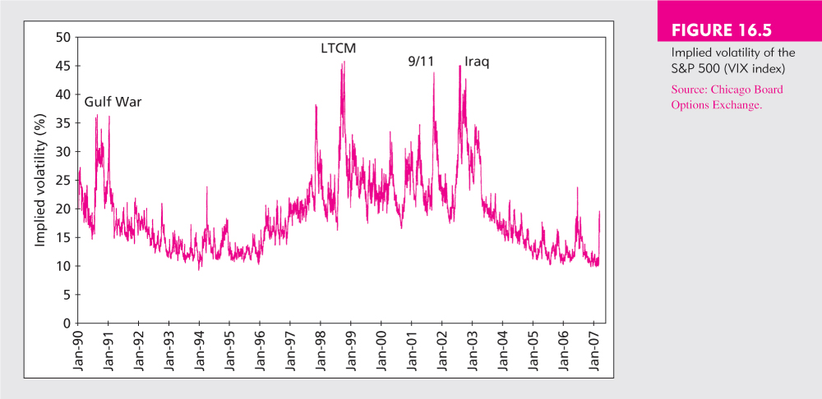
Figure 16.5 Implied Volatility of the S&P 500 (VIX Index)

Slide 24
Put-Call Parity Relationship
S_{T} < X S_{T} > X
Payoff for
Call Owned 0 S_{T} - X
Payoff for
Put Written -( X -S_{T}) 0
Total Payoff S_{T} - X S_{T} - X

Slide 25
Figure 16.6 The Payoff Pattern of a Long Call – Short Put Position

Slide 26
Arbitrage & Put Call Parity
Since the payoff on a combination of a long call and a short put are equivalent to leveraged equity, the prices must be equal.
C - P = S₀ - X / (1 + r_{f})^{T}
If the prices are not equal arbitrage will be possible

Slide 27
Put Call Parity - Disequilibrium Example
Stock Price = 110 Call Price = 17
Put Price = 5 Risk Free = 5%
Maturity = .5 yr Exercise (X) = 105
C - P > S₀ - X / (1 + r_{f})^{T}
14- 5 > 110 - (105 e ^{(-.05 x .5)})
9 > 7.59
Since the leveraged equity is less expensive;
acquire the low cost alternative and sell the high cost alternative

Slide 28
Example 16.3 Put-Call Parity

Slide 29
Put Option Valuation
P=Xe^{-rT} [1-N(d₂)] - S₀e^{-δT} [1-N(d₁)]
Using the sample data
P = $95e^{(-.10X.25)}(1-.5714) - $100 (1-.6664)
P = $6.35

Slide 30
Put Option Valuation: Using Put-Call Parity
P = C + PV (X) - S_{o} + PV (Div)
= C + Xe^{-rT} - S_{o} + 0
Using the example data
C = 13.70 X = 95 S = 100
r = .10 T = .25
P = 13.70 + 95 e ^{-.10 X .25} – 100 + 0
P = 6.35
Notes:
15

Slide 31
16.4 USING THE BLACK-SCHOLES FORMULA

Slide 32
Black-Scholes Formula
Hedging: Hedge ratio or delta
The number of stocks required to hedge against the price risk of holding one option
Call = N (d₁)
Put = N (d₁) - 1
Option Elasticity
Percentage change in the option’s value given a 1% change in the value of the underlying security
Notes:
16

Slide 33
Figure 16.7 Call Option Value and Hedge Ratio

Slide 34
Portfolio Insurance - Protecting Against Declines in Stock Value
Buying Puts - results in downside protection with unlimited upside potential
Limitations
Tracking errors if indexes are used for the puts
Maturity of puts may be too short
Hedge ratios or deltas change as stock values change
Notes:
17

Slide 35
Figure 16.8 Profit on a Protective Put Strategy

Slide 36
Figure 16.9 Hedge-Ratios Change as the Stock Price Fluctuates

Slide 37
16.5 EMPIRICAL EVIDENCE

Slide 38
Empirical Tests of Black-Scholes Option Pricing
Implied volatility varies with exercise price
If the model were accurate, implied volatility should be the same for all options with the same expiration date
Implied volatility steadily falls as the exercise price rises

Slide 39
Figure 16.10 Implied Volatility as a Function of Exercise Price

