Slide 1
CHAPTER 14
Financial Statement Analysis

Slide 2
Learning Goals of Chapter 14
Introduce the standard financial ratios (財務比率) from the accounting data
E.g., profitability ratios (獲利能力比率), asset utilization ratios (資產利用率), liquidity ratios (流動比率), leverage ratios (槓桿比率), and market price ratios (市價比率)
Introduce the ratio decomposition analysis (比率解分析)
Discuss the comparability (可比較性) problems arising from the flexibility of GAAP (generally accepted accounting principles) in the U.S.

Slide 3
14.1 THE MAJOR FINANCIAL STATEMENTS

Slide 4
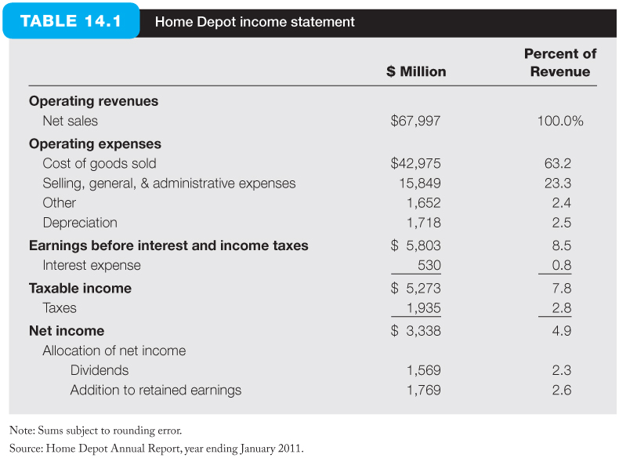
Income Statement (損益表)
A summary of the revenues and expenses of a firm during a specified period
The costs incurred for generating the revenues, including a depreciation allowance
EBIT measures what the firm have earned if not for obligations to its creditors and tax authorities

Slide 5
Income Statement
Four classes of expenses:
Cost of goods sold (銷售成本)
Direct cost attributable to producing the product sold by the firm
General and administrative expenses (一般管理費用)
Include overhead expenses (經常費用), salaries, advertising, and other operating costs that are not directly attributable to production
Interest expense (利息費用)
The cost of the firm’s debt
Taxes (稅)
Federal or local government tax
Common-size statement (百分比報表)
All items on the income statement are expressed as a fraction of total revenue

Slide 6
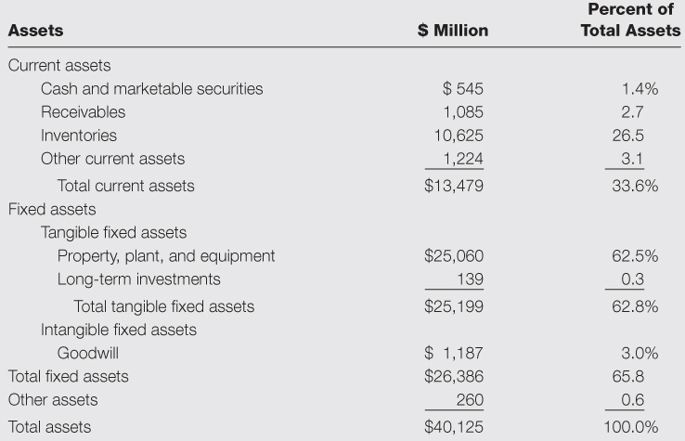
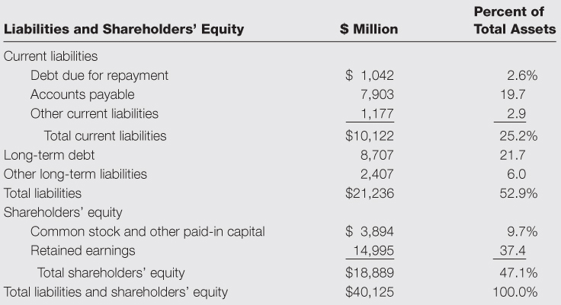
Balance Sheet (資產負債表)
An accounting statement of a firm’s financial position at a specified time
Balance Sheet for Home Depot, 2011
※ The goodwill (商譽) is the amount paid in excess of the book value of the acquired firm, i.e., the purchasing premium over the book value of the acquired firm

Slide 7
Statement of Cash Flows (現金流量表)
The income statements and balance sheets are based on accrual methods (應計基礎), which means revenues and expenses are recognized at the time of a sale even if no cash has yet been exchange
In contrast, the statement of cash flows recognizes a firm’s cash receipts and cash payments during a specified period
The statement of cash flows reports cash flows separately for operations, investing, and financing activities

Slide 8
Statement of Cash Flows (現金流量表)
For operations:
The depreciation cost should be added back since this cost is not a real cash outflow
Increases in accounts receivable (payable) reduce (increase) the cash flows realized from operations
Increases in inventory reduce the realized cash flow
For investments:
Instead of “smooth” capital expenditures over time via the account of depreciation, the cash outflow of a capital expenditure is recognized when it occurs
For financial activities:
Issuance of securities will contribute cash inflows, while redemption of outstanding securities will use up cash
The cash dividend distribution results in a cash outflow

Slide 9
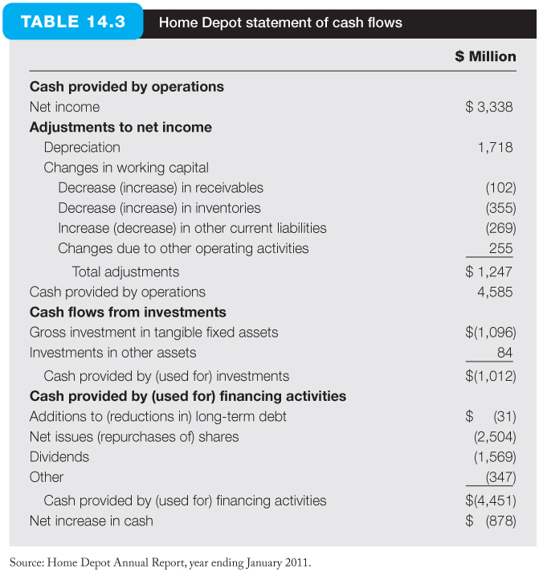
Home Depot Statement of Cash Flows

Slide 10
14.2 MEASURING FIRM PERFORMANCE

Slide 11
Measuring Firm Performance
Financial analysts measure firm performance by a list of financial ratios
These financial ratios are affected by investments and financing decisions
Section 14.3 will show how to calculate and interpret some of these financial ratios and analyze the relationships between them

Slide 12
14.3 PROFITABILITY MEASURES

Slide 13
ROA, ROC, and ROE
The most common profitability measures are return on assets (ROA, 資產收益率), return on capital (ROC, 資本收益率), and return on equity (ROE, 股權收益率)
ROA equals EBIT / (Total assets), measuring the profitability for all contributors of capital
ROC = EBIT / (Long-term capital), the income earned per dollar of long-term capital in the firm
ROE, defined as after-tax profits (net income) divided by the book value of equity, measures the profitability for equityholders
The ROA and ROE is linked as a function of the leverage ratio of a firm: Consider two firms, Nodett and Somdett, and corporate tax is 40%

Slide 14
ROA, ROC, and ROE
Nodett is an all-equity firm with $100 mil. assets
Somdett is an otherwise identical firm to Nodett, but $40 mil. of its $100 mil. of assets are financed with debt bearing an interest rate of 8%
※ Note that financial leverage increases the risk of the equityholder return
※ Since these two firms have equal business risk, Somdett’s equityholders carry greater financial risk than Nodett’s because all business risk is absorbed by a smaller base of equity investors

Slide 15
Financial Leverage and ROE
The relationship among ROA, ROE, and leverage:
※ If ROA > (<) Interest rate, since the firm earn more (less) on its borrowing amount than it pays out to borrowers, the equityholders can earn more (less) with increased use of debt

Slide 16
Economic Value Added
Economic value added (EVA, 經濟附加價值)
EVA is the spread between ROA and the opportunity cost of capital multiplied by the capital invested in the firm, i.e., (ROA – WACC) × total capital = EBIT – WACC × total capital
A measure of the dollar value of a firm’s return in excess of its opportunity cost
It provides a way to determine the extra value created, taking the required weighted average return into account, for the equityholders
EVA treats the opportunity cost of capital as a real cost that should be deducted from revenues to reflect a meaningful value added to the equityholders of a firm
Also known as residual income

Slide 17
Economic Value Added
EVA vs. net income
Net income considers the interest payments and the taxes, but it does not take the required rate return of the equity into account
EVA considers the opportunity costs of debt and equity, but it does not consider the effect of taxes (based on the definition in the text book)
The definition of EVA in practice
The difference between the net operating profit after tax (NOPAT) and the opportunity cost of invested capital, i.e., NOPAT – WACC × total capital

Slide 18
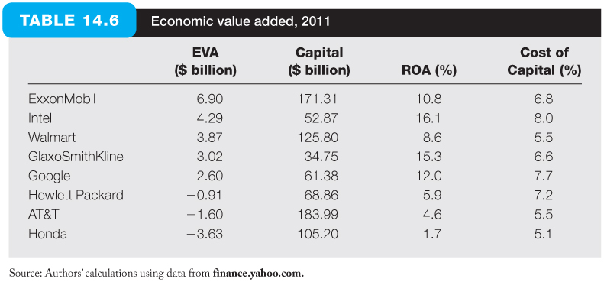
Economic Value Added, 2011
※ Based on the value of ROA, HP was profitable in 2011
※ However, due to its high cost of capital at 7.7%, HP did not cover its opportunity cost of capital, and thus the EVA of HP was negative

Slide 19
14.4 RATIO ANALYSIS

Slide 20
Summary of Financial Ratios
Profitability ratios (獲利能力比率)
ROA, ROE, return on sales (profit margin)
Turnover or Asset utilization ratios (總資產周轉率或資產利用率)
Fixed-asset turnover ratio (固定資產周轉率)
Ratios of sales to fixed assets
The turnover ratios is useful to estimate the efficiency of a subcategory of assets
Industry turnover ratio (存貨周轉率)
Cost of goods sold divided by average inventory (note that the inventory is valued at cost)
Measure the speed with which inventory is turned over

Slide 21
Summary of Financial Ratios
Average collection period (應收帳款平均收帳期)
Equals (average accounts receivables) / (daily sales)
Also known as days sales in receivables
This ratio approximates the average lag between the date of sale and the date payment is received
A longer collection period implies less bargaining power of a firm
Liquidity ratios (流動性比率)
Current ratio (流動比率), quick ratio (速動比率), and cash ratio (現金比率)
Leverage ratios (槓桿比率)
Interest burden ratio (利息負擔率), interest coverage ratio (利息覆蓋率), leverage ratio (槓桿比率), compound leverage factor (複合槓桿因子)

Slide 22
Financial Ratios Summary
Market price ratios (市價比率)
Market-to-book ratio (市價帳面比), price-earnings ratio (本益比), earnings yield (盈利收益率)
※ This section first introduces the DuPont system to analyze ROE and ROA
※ An example of Growth Industries (GI) company is then used to calculate all financial ratios in 2014

Slide 23
Ratio Analysis
Decomposition of ROE (ROE分解)
To understand the factors affecting a firm’s ROE, including its trend over time and its performance relative to competitors, analysts decompose ROE into the product of a series of ratios
One useful decomposition of ROE is the DuPont system (杜邦系統分析法)

Slide 24
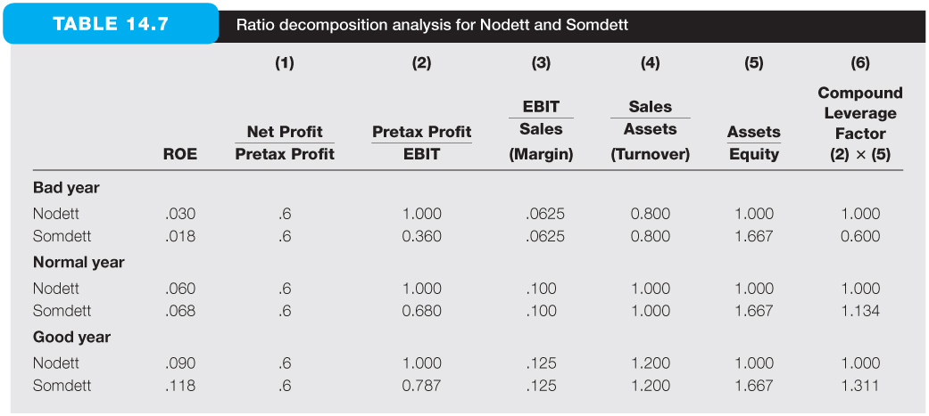
Ratio Analysis
※ Factor (1) is called the tax-burden ratio (賦稅負擔率), which reflects both the government’s tax code and the policies pursued by the firm in trying to minimize its tax burden. A higher value of (1) implies a lower tax burden
※ Factor (2) is called the interest-burden ratio (利息負擔率), because it equals (EBIT – Interest expense) / EBIT. A higher value of (2) implies a lower interest rate burden
(A closely related ratio: Interest coverage ratio (利息覆蓋率) = EBIT / Interest expense. A high coverage ratio indicates that the likelihood of bankruptcy is low because annual earnings are significantly greater than annual interest obligations)

Slide 25
Ratio Analysis
※ Factor (3) is known as the firm’s operating profit margin (營業利益率, or margin for short), or return on sales (銷售報酬率). A higher value of (3) implies a higher operating profit per dollar of sales
※ Factor (4) is known as total asset turnover (ATO, 總資產周轉率, or simply turnover), which indicates the efficiency of the firm’s use of assets. In a normal year, Nodett’s ATO is 1 per year, meaning one dollar of assets can generate one dollar of sales. A higher value of (4) implies the higher efficiency of the firm’s use of assets
(Note that comparison of margin and turnover is meaningful only in evaluating firms in the same industry)
※ Factor (5) is called the leverage ratio (槓桿比率), which measures the degree of financial leverage of the firm. A higher value of (5) implies more percentage of debt employed and thus a high level of the leverage
※ Define the compound leverage factor (複合槓桿因子) = (2) × (5) = Interest Burden × Leverage, and since ROA = EBIT/Assets = (EBIT/Sales) × (Sales/Assets) = Margin × Turnover = (3) × (4), we can decompose ROE equivalently as follows

Slide 26
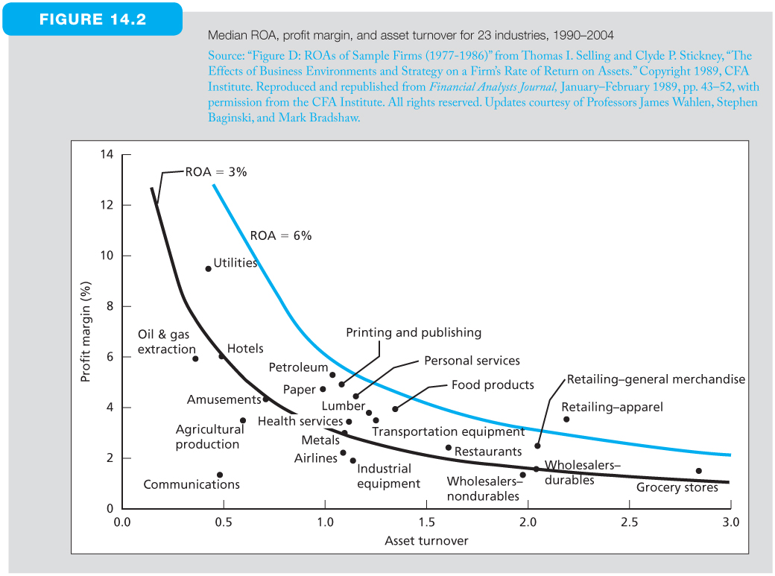
Ratio Analysis
※ Empirical evidences to show that ROA = Margin × Turnover = (3) × (4)

Slide 27
Ratio Analysis
※ The meaning of the compound leverage factor (CLF)
CLF > 1: reflecting that when ROA > interest rate, ROE increases with increased leverage ratio (see Nodett and Somdett cases in normal and good years)
CLF < 1: reflecting that when ROA < interest rate, ROE falls with increased leverage ratio (see Nodett and Somdett cases in bad years)

Slide 28
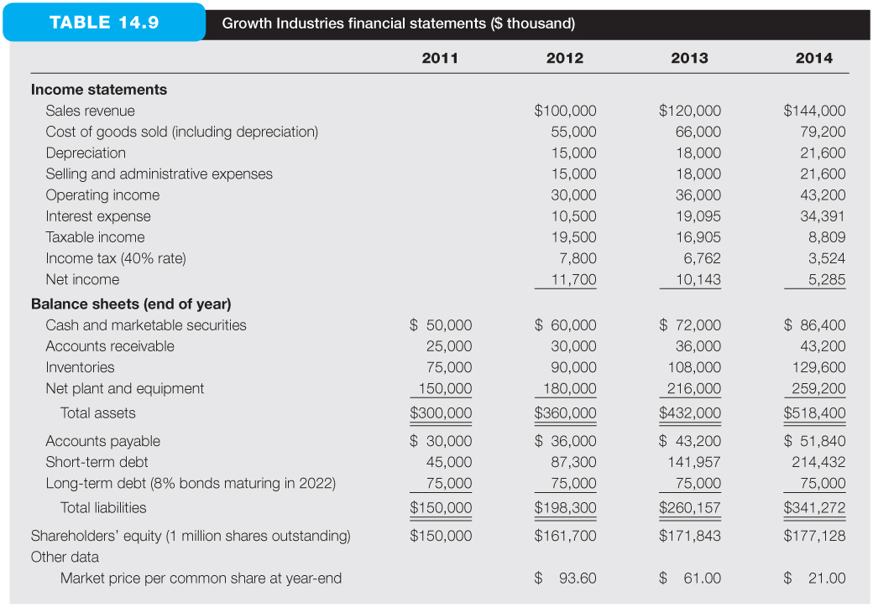
Financial Ratios
Financial statements for GI company
(EBIT)

Slide 29
Profitability Ratios

Slide 30
Turnover and Other Asset Utilization Ratios
※ For turnover ratios, if they include one item from the income statement, which covers a period, and another from the balance sheet, which is a snapshot at a particular time, the practice is to take the average of the beginning and end-of-year balance sheet figures
※ It measures sales per dollar of the firm’s money tied up in fixed assets
※ The time period for which inventory is turned over is 0.485 years
※ If there is only one product, this ratio ≈ (per-unit cost × number of units sold) / (per-unit cost × number of units in inventory) = number of units sold / number of units in inventory

Slide 31
Turnover and Other Asset Utilization Ratios
※ A popular variant of the Inventory turnover ratio is to convert it into an average days to sell the inventory in terms of days

Slide 32
Liquidity Ratios
※ This ratio measures the ability of the firm to pay off its short-term liabilities by liquidating its current assets
※ This ratio is also called the acid test ratio
※ The quick ratio is a better measure of liquidity than the current ratio for firms whose inventory is not readily convertible into cash
※ Since AR is less liquid than cash and cash equivalents, in addition to the quick ratio, analysts are also interested in a firm’s cash ratio
※ Lower liquidity ratios suggest a lower credit rating of the firm

Slide 33
Leverage Ratios
※ Interest coverage ratio is a measure of a company's ability to honor its debt payments
※ The above two leverage ratios measure a company‘s solvency (償付能力)
※ The higher these ratios, the greater risk will be associated with the firm's operation
※ In addition, high debt to assets ratio may indicate low borrowing capacity of a firm, which in turn will lower the firm's financial flexibility

Slide 34
Market Price Ratios
※ Analysts sometimes consider the stock of a firm with a low market-to-book value to be a “safer” investment by treating the book value as a “floor” supporting the market price, because they believe that the firm has the option to liquidate its assets for their book values
※ However, some firms do sometimes sell for less than book value, so the book value is not a very good estimation for the floor of the market price. In Ch 13, we learn that the liquidation value or the replacement cost are better alternatives
※ Even so, recall that in Ch 8 we also learn that high book-to-market (or low P/B) firms indeed provide a “value premium”
※ The P/E ratio discussed here use the most recent historical accounting earnings per share, but the P/E multiple discussed in Ch. 13 uses expected future economic earnings per share
※ Many security analysts try to find stocks with lower P/E ratio because they believe that they can acquire one dollar of earnings more cheaply if the P/E ratio is low
※ However, note that current earnings may differ substantially from future earnings, so the above strategy does not always work well
※ In addition, in an efficient market, if there are some low P/E stocks comparing to some high P/E stocks with the same risk, all investors will buy these low P/E stocks and thus bid their prices as well as P/E ratios up to reasonable levels

Slide 35
Market Price Ratios
※ The above equation describes the relationship between P/B ratio, P/E ratio, and ROE
※ Since P/B is usually larger than 1, the earnings yield is usually smaller than the ROE
※ This equation indicates that a high ROE is not necessary to imply a high earnings yield if its P/B ratio is high
※ This is because the stock price (P) could already be bid up to reflect an attractive ROE, that will result in a lower earnings yield

Slide 36
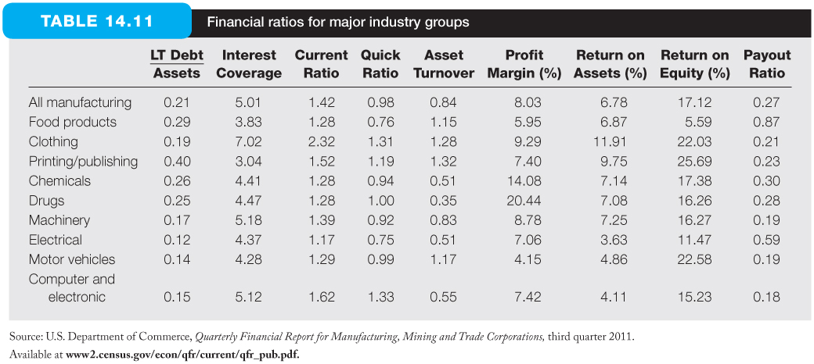
Financial Ratios for Major Industry Groups
※ The above table presents average values of financial ratios for major industries
※ It is helpful to compare financial ratios of a firm to those of the industry average or other firms in the same industry
※ Note that while some ratios such as asset turnover or total debt ratio tend to be relatively stable, others such as return on assets or equity are more sensitive to current business conditions

Slide 37
14.6 AN ILLUSTRATION OF FINANCIAL STATEMENT ANALYSIS

Slide 38
Ratio decomposition analysis for GI
※ ROE has been declining steadily from 7.51% in 2012 to 3.03% in 2014, and because ROA remained the same, the declining trend in GI’s ROE must be due to financial issues
※ In fact, the interest-burden ratio (2), the leverage ratio (5), and the compound leverage factor (6) all indicate the problem of employing too much debt
※ From the data of GI on Slide 14.28, it is obvious that GI has incurred sizable amounts of short-term debt, and the interest rate for the short-term debt is very high in 2014 at about 20% (= (total interest expense – long-term interest expense) / short-term debt = ($34,391,000 - $75,000,000 × 8%) / $214,432,000)
※ In a word, GI borrows more and more short debt each year to maintain its growth in assets and income. However, the new assets are not able to generate enough cash flow to support the extra interest burden of the debt (ROA ≈ 9%, but the shot-term debt rate ≈ 20%)
※ Due to its low P/E and P/B ratios, GI is an attractive candidate for a takeover by another firm that can replace GI’s management and adopt a more efficient capital structure for GI

Slide 39
14.7 COMPARABILITY PROBLEMS

Slide 40
Comparability Problems
Since there is more than one acceptable way to calculate various items of revenue and expense according to GAAP, it is possible for two firms with exactly the same economic condition yet very different account incomes
Comparability problems can arise out of the flexibility of GAAP guidelines in accounting for inventories (存貨) and depreciation expenses (折舊費用)
Other comparability problems
Capitalization (資本化) of leases (租賃) or other expenses, treatment of pension costs (退休金費用) (beyond the scope of the text book)

Slide 41
Comparability Problems
Inventory valuation
LIFO (last-in, first-out) vs. FIFO (first-in, first-out)
Suppose a firm has a constant inventory of 1 mil. units of produced goods, and this firm sells 1 mil. units of goods per year. The cost of the goods sold rises from $1 to $1.1 during a year
LIFO: the cost of good sold is $1.1 mil. and the ending inventory is $1 mil.
FIFO: the cost of good sold is $1 mil. and the ending inventory is $1.1 mil.
LIFO is preferred over FIFIO in computing economics earnings (i.e., real sustainable cash flow), because it uses up-to-date prices to evaluate the cost of goods sold
On the contrary, LIFO induces balance sheet distortion because it values investment in inventory at original cost

Slide 42
Comparability Problems
Depreciation expenses
Accounting depreciation is the amount of the original acquisition cost of an asset that is allocated to each accounting period over an arbitrarily specified life of the asset
After the specified life of the asset, even though it remains a productive asset, there is no weight of the asset on the balance sheet
During (after) the specified period, the depreciation expense is overestimated (underestimated), so the accounting net incomes is understated (overstated) compared with economic earnings
Furthermore, there are differences across firms in selection depreciation methods and estimating the depreciable life of their assets

Slide 43
Fair Value Accounting
Fair value accounting (FVA, 公平價值會計): use of current market values rather than historical cost in the firm’s financial statements
Also known as mark-to-market (按市價計值) accounting
Some assets or liabilities do not have easily observable values
E.g., Employee stock options, health care benefits for retired employees, or complex derivatives contracts
Opponents:
FVA relies too much on estimates, that introduce considerable noise and volatility for items in financial statements
Subject valuation may offer management a tempting tool to manipulate earnings
Regulators in both the U.S. and Europe are gradually moving toward greater use of fair value accounting

Slide 44
Quality of Earnings
Since many firms choose to present their financial statements in the best possible light, not only the comparability problems but also the problem of quality of earnings rise
Examples of the accounting choices that influence quality of earnings:
Allowance for bad debts (容許壞帳)
An unrealistically low allowance together with a rising collection period on accounts receivable reduces the quality of reported earning

Slide 45
Quality of Earnings
Non-recurring items (非經常性項目)
Some items that affect earnings should not be expected to recur regularly, e.g., asset sales, effects of accounting changes
These non-recurring items should be considered a “low-quality” components of earnings
Earnings smoothing (利潤平滑)
Offset earnings with extra reserves in good years, and release earnings by reducing the reserves in bad years
Stock options (股票選擇權)
After more than a decade of debate, the Financial Accounting Standards Board decided to require firms to recognize stock options grants as an expense starting in 2005
However, how to value employee options is not uniform
Use “market to model” (按模型計值) rather than mark to market

Slide 46
Quality of Earnings
Revenue recognition (收入認定)
Recognize revenue at the time point of sales vs. recognize yearly revenue during the contact period
Channel stuffing: firms “sell” large quantities of goods to customers, but give them the right to later either refuse delivery or return the product
The above fraud can be detected if accounts receivable increases far faster than sales or becomes larger percentage of total assets
Off-balance sheet (表外) assets and liabilities
For example, the guarantee for the outstanding debt of another firm (contingent liability) or leasing some equipments (operating lease vs. capital lease)
Since firms wildly try to manipulate revenue (accounting earnings), many analysts choose to focus on cash flow, which is harder to manipulate and more proper to reflect economic earnings

Slide 47
International Accounting Conventions
Accounting practices are different from the U.S. standing (GAAP) in various countries
Reserving practices
Many countries allow firms, e.g., Germany, allow firms more discretion (斟酌的自由) in setting aside reserves (儲備金) for future contingencies than is typical in the U.S.
The case of Daimler-Benz listing on NYSE in 1993 ($370 mil. profit in German rules becomes $1 mil. loss in U.S. rules)
Depreciation
Most countries do not allow dual sets of accounts for taxes and public reporting
Most firms in foreign countries use accelerated depreciation to minimize taxes, although it results in lower reported earnings
Intangibles
Treatment of intangible assets can vary widely, e.g., are they amortized or expensed? If amortized, over what period?

Slide 48
International Accounting Conventions
IFRS vs. GAAP
The European Union and even many non-EU countries (more than 100 countries) have adopted common international financial reporting standards (IFRS)
The major difference between IFRS and GAAP is “principles” vs. “rules”
U.S. rules are detailed, explicit, and lengthy
European rules are more flexible, but firms must be prepared to demonstrate that they have conformed to general accounting principles
Negotiations have been ongoing for nearly a decade to narrow differences between IFRS and U.S. GAAP rules, with the ultimate goal being a truly global set of accounting standards
IFRS is adopted in Taiwan for public firms since 2013 for private firms since 2015

Slide 49
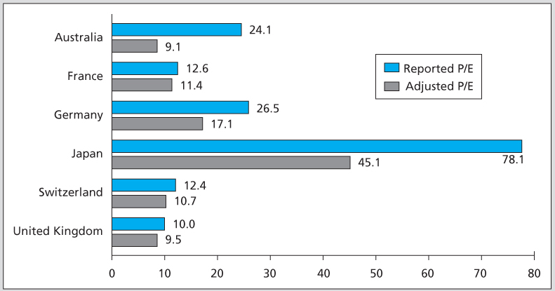
Adjusted Versus Reported P/E Ratios
※ Speidell and Bavishi (1992) recalculated the financial statement of firms in several countries using common accounting rules toward the U.S./U.K. convention
※ They found that the P/E ratios under different accounting standards have changed considerably
※ In addition to the P/E ratios, their results illustrate how different rules can have a big impact on accounting numbers or ratios, including net incomes, book values, P/B ratios, etc.

