Slide 1
CHAPTER 13
Equity Valuation

Slide 2
Learning Goals of Chapter 13
Introduce several fundamental analysis models (基本分析模型), which helps to discover mispriced securities
Four basic stock analysis models
Valuation by comparables (比較法)
Dividend discount models (股利折現模型)
Price/Earnings ratios (本益比法)
Free cash flow valuation model (自由現金流量評價法)
Analysis models for aggregate stock markets
Earnings multiplier approach (收益倍數法)

Slide 3
13.1 VALUATION BY COMPARABLES

Slide 4
Models of Equity Valuation
Valuation models using comparable information
Analyze the relationship between stock prices and various determinant factors for similar firms
Internet information source
EDGAR (Electronic Data Gathering, Analysis, and Retrieval System) provided by SEC
All public companies are required to file registration statements, periodic reports, and other forms electronically through EDGAR
finance.yahoo.com
www.google.com/finance/

Slide 5
Microsoft, 2019
<
Valuation Ratios associated with the share price
>
<
Profitability Indicators
>
※ P/E of Microsoft should be 137.41 / 4.31 = 31.88
※ PEG ratio is defined as (P/E ratio) / (earnings growth rate), discussed on 13-39
※ More rigorous valuations models are needed to rank securities: Although the profitability of Microsoft is in general better than that the rests in the same industry, the comparison results by the valuation ratios are mixed

Slide 6
Limitations of Book Value
Book value (帳面價值)
The net worth (淨值) of common equity according to a firm’s balance sheet
Price-to-book value ratio: treat the book value as the floor value that a firm is at least worth and this quantity estimates how many multiples the market value is higher than this floor value of the firm
Problems of the book value
According to the accounting principle, the asset value is recorded as the difference between the historical acquisition cost and the cumulative depreciation expense
Some intangible assets (無形資產) such as the brand name or specialized skills are not on balance sheets
Since the book value does not reflect the current market value of assets, the book value per share is NOT suitable to represent a “floor” for the stock price

Slide 7
Limitations of Book Value
Liquidation value (清算價值)
Net amount that can be realized by selling the assets of a firm at market prices and paying off the debt
Since the liquidation value reflects the current market value of assets, it can be viewed as a better floor for the stock price than the book value
A buying signal occurs if the market price of equity is lower than the liquidation value per share
Buy enough shares to gain control of the firm and then actually liquidate the firm

Slide 8
Limitations of Book Value
Replacement cost (重置成本)
Cost to replace a firm’s assets (less its liabilities)
Difference comparing to the liquidation value
Taking inventories for example, the liquidation value is the market price at which they are sold, but the replacement cost is the cost to reproduce these inventories
The ratio of market price to replacement cost per share is known as Tobin’s q, which tends toward 1 in the long run
If Tobin’s q > 1, competitors could replicate the firm at costs lower than the market value, enter into the market, share the firm’s profit, and drive down the firm’s value
If Tobin’s q < 1, competitors would buy the firm rather than start a new business, which bid the firm’s value up
In reality, this ratio could differ significantly from 1 for a long time (may attribute to the different management styles of firms)

Slide 9
13.2 INTRINSIC VALUE VERSUS MARKET PRICE

Slide 10
Expected Holding Period Return (HPR)
The expected HPR on a stock investment comprises forecasted cash dividends and capital gains or losses
The one-year expected HPR
Ask yourself whether the expected HPR seems attractively enough relative to the risks you bear
The most common comparison benchmark is the required rate of return (or termed the opportunity cost of capital) suggested by the CAPM

Slide 11
Required Return and Intrinsic Value
If the stock is priced “correctly,” it will offer investors a “fair” return, i.e., its expected return will equal its required return
Because the expected return (16.7%) is higher than the required return (12%) in CAPM, it is a positive-alpha stock and a good investment target
Another way to value stocks is to compare the intrinsic value (內含價值) (or said theoretical value) of a stock to its market price
The intrinsic value is the PV of a stock’s expected future net cash flows discounted by the required rate of return

Slide 12
Intrinsic Value (IV) and Market Price (MP)
Trading Signal
IV > MP ⇒ MP is undervalued ⇒ Buy
IV < MP ⇒ MP is overvalued ⇒ Sell or Short Sell
IV = MP ⇒ Fairly Priced ⇒ Not a target to trade
Market Capitalization Rate (市場資本化率)
Current market share price, P₀, reflects the intrinsic values estimated by all market participants, so P₀ is the consensus intrinsic value of a stock share
Given P₀, the consensus value of the required ROR, k, is computed by equating V₀ and P₀, that is
The consensus required rate of return, k, is also known as the market capitalization rate

Slide 13
13.3 DIVIDEND DISCOUNT MODELS (DDM, 股息折現模型)

Slide 14
General Formula for the Dividend Discount Model (DDM)
V_{t} = intrinsic value at t, D_{t} = expected dividend payment at t,
P_{t} = expected stock price at t, k = required rate of return
※ Here the expectations for D_{t} and P_{t} are ignored for simplicity. Please keep in mind that the future dividends and prices are uncertain
※ The differences compared with the bond pricing formula are the uncertainty of future dividend payments and the lack of a fix maturity date

Slide 15
No Growth Model
For stocks that have earnings and dividends that are expected to remain constant
This formula is suited for pricing preferred stocks
Considering a preferred stock paying a fixed dividend of $2 per share and the discount rate is 8%, then the value of this preferred stock can be computed as follows

Slide 16
Constant Growth Model
For stocks that have dividends that are expected to grow at a constant rate, g
※ The constant growth DDM is valid only when g is less than k
※ In practice, g is higher than k occasionally, but it cannot maintain for a long run. Because you can treat k as the average return that a firm should offer (or can generate), it is impossible for a firm to generate 20% returns but with the dividends to grow at 30% for a long run
※ The stock value will be greater for 1) the larger expected dividend payment, D₁; 2) the lower required rate of return, k; 3) the higher expected growth rate of dividends, g
※ This model is also known as Gordon Model

Slide 17
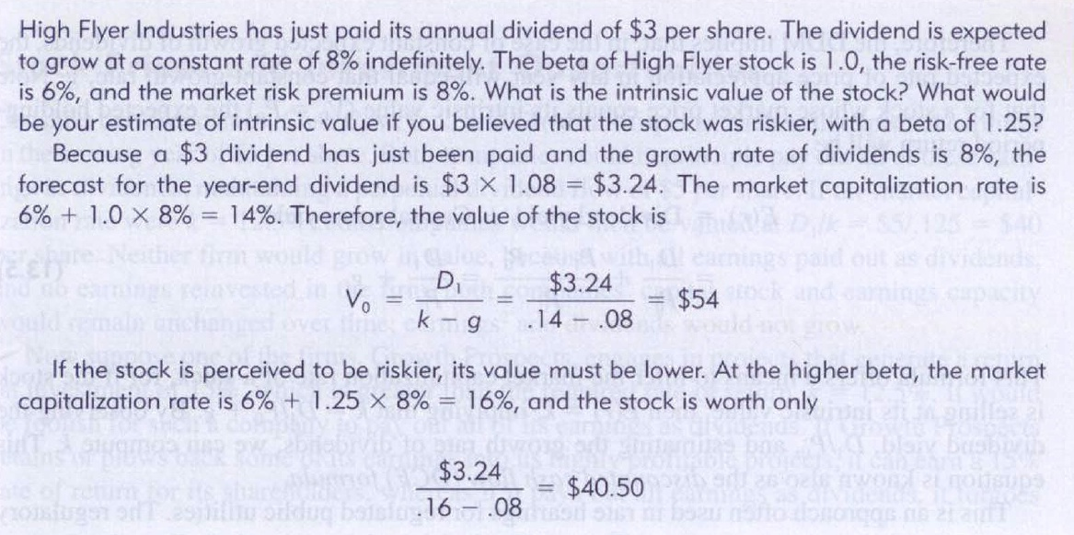
Constant Growth Model: Example
Changing to “market capitalization rate (using the CAPM)” in the 12th ed.
※ The above example shows that for firms with higher beta and thus higher degree of the systematic risk, they are with lower intrinsic values

Slide 18
Discounted Cash Flow (DCF) Formula
※ By estimating the expected dividend yield D₁/P₀ and the growth rate of dividends, we can derive the market capitalization rate (or the consensus required rate of return), k
※ This is another way to estimate the expected required rate of return other than the CAPM, and the advantage of this kind of estimation is to take the information of the stock price today into consideration
※ This equation is known as the discounted cash flow formula (DCF formula)

Slide 19
Dividend Payout Ratio and Plowback Ratio
Dividend payout ratio (股息分配率)
Percentage of earnings paid out as dividends
Plowback ratio (盈餘轉投資比例)
The proportion of the firm’s earnings that is reinvested in the business (not paid out as dividends)
※ Plowback ratio + Dividend payout ratio = 1

Slide 20
Dividend Payout Ratio and Plowback Ratio
Dividend growth rate (g)
= Return on equity (ROE) × Plowback ratio (b)
Suppose asset = equity = $25, and ROE = 20%
⇒ The earnings for the first year is $25×20% = $5
If the plowback ratio = 40%, which implies the dividend payout ratio is 60%
⇒ The shareholders receive $5×60% = $3 dividends
The remaining $2 is reinvested into the firm. As a result, the asset value becomes $27
⇒ The earnings for the second year is $27×20% = $5.4
If the plowback ratio is still 40%, the shareholder will receive $5.4×60% = $3.24, which implies a 8% (($3.24–$3)/$3) growth of the dividends
※ Note that the earnings also grow at g = 8% (($5.4–$5)/$5)

Slide 21
Present Value of Growth Opportunities (PVGO, 增長機會現值)
Present Value of Growth Opportunities (PVGO) = Share value of a constant-growth firm – Share value under no-growth assumption
D₁ / k is the intrinsic value under the no-growth assumption
For no-growth firms, since g = b = 0 implies all earnings are paid to shareholders as cash dividends, i.e., D₁ = E₁, and there is not growth for the dividends and earnings, i.e., D₁ = E₁ = D₀ = E₀
Next example shows if all earnings paid out as dividends, firms lose growth opportunities (if any), and thus share prices should be lower

Slide 22
Present Value of Growth Opportunities (An example)
A firm traditionally pays a $5.00 dividend every year, which represents 100% of its earnings. This year, it decides to start plowing back 40% of the earnings to reinvest at the firm’s current return on equity of 20% at the end of the year. If the required rate of return of this firm is 12%, what is the value of the stock before and after the plowback decision?
No Growth
With Growth
⇒ PVGO = $75 – $41.67 = $33.33

Slide 23
Present Value of Growth Opportunities (An example)
If the ROE is only 12%, what is the value of PVGO?
No Growth
With Growth
※ When ROE = k, the PVGO is zero, i.e., there is no advantage to plow funds back into the firm
※ Moreover, if ROE < k, the PVGO is negative, i.e., it is a hurt for shareholders to plow funds back into the firm
※ The reason is that shareholders can earn the required rate of return k =12% by investing dividend incomes on other firms with similar risk level. So, when the ROE is lower than 12%, higher plowback ratio hurts investors because it means more money is sunk into prospects with lower ROE

Slide 24
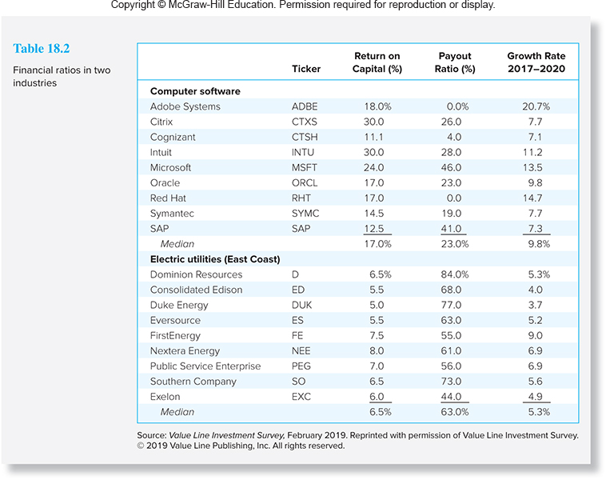
Payout Ratios and Growth Rates in Different Industries, 2019
※ The payout ratio is in general low in computer software industry, but the payout ratio is high in electric utilities industry
※ In contrast, the growth rate of the computer software industry is substantially higher than that of the electric utilities industry
※ Higher plowback ratios (lower payout ratios) imply high growth rates
※ Growth stock: low payout ratio (thus low dividends), but high growth rate
※ Income stock: high payout ratio (thus high dividends), but low growth rate

Slide 25
Life Cycles and Multistage Growth Models
Although the constant growth DDM formula is useful, it is based on a simplified assumption that the dividend growth rate is constant forever
Even the ROE being constant, the plowback ratio may change at different stages of development of firms
In early years, there are many profitable opportunities for the firm, so the plowback ratio is high and thus g is high
When the firm matures, and the attractive opportunities for reinvestment is hardly to find, so the plowback ratio may decrease, implying a lower g
Two-stage DDM: consider higher g for early years and lower g for later years

Slide 26
Life Cycles and Multistage Growth Models
What is P₀ based on the two-stage DDM
g = 20% until t = 3 years
g_{S} = 5% since the start of the 4th year
D₀ = $1 and k = 12%
$$P_{0}=\frac{D_{0}(1+g)}{(1+k)}+⋯+\frac{D_{0}{\left(1+g\right)}^{t}}{{\left(1+k\right)}^{t}}+\frac{D_{0}{\left(1+g\right)}^{t}\left(1+g_{S}\right)}{{\left(1+k\right)}^{t}\left(k−g_{S}\right)}$$
$($To obtain the last term, replace $D_{t+1}$ with $D_{0}{\left(1+g\right)}^{t}\left(1+g_{S}\right)$and $g$ with $g_{S}$ in the constant growth DDM model and finally discount it at ${\left(1+k\right)}^{t}$)
$$=\frac{\$1(1+0.2)}{(1+0.12)}+⋯+\frac{\$1{\left(1+0.2\right)}^{3}}{{\left(1+0.12\right)}^{3}}+\frac{\$1{\left(1+0.2\right)}^{3}\left(1+0.05\right)}{{\left(1+0.12\right)}^{3}\left(0.12−0.05\right)}$$
$$=\$1.07+\$1.15+\$1.23+\$18.45=\$21.90$$

Slide 27
Variant of Two-stage DDM
A variant of the two-stage DDM is to employ the forecasted dividends per share for the near future and applies the steady-state growth rate to the long future
For Honda in 2018, it is projected to grow rapidly in the near term and the forecast of dividends are
For years after 2022, the dividend payout ratio and the ROE are forecasted to be 0.3 and 11%, implying the long-term growth rate g = 11%×(1 – 0.3) = 7.70%
Year | Dividends per share
2019 | $0.90
2020 | $0.98
2021 | $1.06
2022 | $1.15

Slide 28
Variant of Two-stage DDM
Honda’s intrinsic value today is therefore
The IV at 2022, according to the constant growth DDM, should be
※Alternative method to estimate V₂₀₂₂ by using earnings multiple terminal value: average P/E = 20 and forecasted E = 1.5, then V₂₀₂₂ = 20 x 1.5 = 30
$$V_{2018}=\frac{D_{2019}}{(1+k)}+\frac{D_{2020}}{(1+k)^{2}}+\frac{D_{2021}}{(1+k)^{3}}+\frac{D_{2022}+V_{2022}}{(1+k)^{4}} \\ =\frac{0.90}{(1+k)}+\frac{0.98}{(1+k)^{2}}+\frac{1.06}{(1+k)^{3}}+\frac{1.15+V_{2022}}{(1+k)^{4}}$$
$$V_{2022}=\frac{D_{2023}}{k−g}=\frac{D_{2022}(1+g)}{k−g}=\frac{1.15×1.077}{k−0.077}$$

Slide 29
Variant of Two-stage DDM
Suppose the risk-free rate is 3.5% and market risk premium is 8%, and the beta of Honda is 1.05
The forecast for the share value at 2022 is
Today’s estimate of the intrinsic value is
※ The extension from two-stage DDM to multistage DDM is similar
The required rate of return $k=r_{f}+β[E(r_{M})−r_{f}]$ $=3.5\%+1.05\left(8\%\right)$
$=11.9\%$)
$$V_{2022}=\frac{1.15×1.077}{0.119−0.077}=\$29.49$$
$$V_{2018}=\frac{\$0.9}{(1.119)}+\frac{\$0.98}{(1.119)^{2}}+\frac{\$1.06}{(1.119)^{3}}+\frac{\$1.15+\$29.49}{(1.119)^{4}}=\$21.88$$

Slide 30
13.4 PRICE-EARNINGS RATIOS

Slide 31
P/E Ratio and Growth Opportunities
P/E Ratios (本益比)
Defined as the ratio of a stock’s current price to its EXPECTED earnings per share in the FOLLOWING period
P/E ratio can be explained conceptually with the DDM
When deriving theoretical P/E ratio, it is assumed that the stock is traded at its intrinsic value, i.e., P_{t} = V_{t}

Slide 32
P/E Ratio and Growth Opportunities
Without expected growth
With constant growth
※ P/E ratio is a function of three factors:
1) required rate of return, k
2) expected growth rate in dividends, g
3) plowback ratio, b

Slide 33
P/E Ratio and Growth Opportunities
Interpretation of the P/E ratio formula
※ k ↑ ⇒ P/E ↓ (inverse relationship), g ↑ ⇒ P/E ↑ (direct relationship)
※ ROE ↑ ⇒ P/E ↑
Given the same plowback ratio b, a higher ROE contributes more to the expected growth rate g in dividends, so firms command higher P/E ratios
※ If ROE > (<) k, b ↑ ⇒ P/E ↑(↓)
When a firm has good investment opportunities (i.e., ROE > k), the market will reward this firm with a higher P/E if it exploits those opportunities more aggressively by plowing back more funds (i.e., b ↑) to invest in those opportunities

Slide 34
P/E Ratio and Growth Opportunities
※ Numerical analyses to explain that if ROE > (<) k, b ↑ ⇒ P/E ↑(↓)
※ In a word, plowing back more funds into the firm increases P/E only if the firm earns a higher rate of return on the reinvested funds than the opportunity cost of capital, k
※ The optimal plowback policy: If ROE > (<) k, adopt high (low) plowback ratio policy

Slide 35
P/E Ratio and Growth Opportunities
Another form for P/E ratio
※ If the term PVGO (reflecting the growth opportunity) is large, the firm commands a high P/E ratio
※ Therefore, in practice, a high P/E ratio is usually interpreted as that a firm is endowed with abundant growth opportunities
※ According to the analysis on previous two slides and this slide, we can conclude that the P/E ratio can reflect the growth opportunity of a firm (examples in the real world are shown on the next three slides)

Slide 36
P/E Ratio and Growth Opportunities
P/E Ratios and Growth Opportunities
From 2001 to 2016, PepsiCo’s average P/E is significantly higher than Consolidated Edison’s average P/E (see Slide 13-37)
Consolidated Edison (Con Ed) is an energy company
This phenomenon results from the greater growth opportunities of PepsiCo, i.e., the earnings of PepsiCo would grow faster (see Slide 13-38)

Slide 37
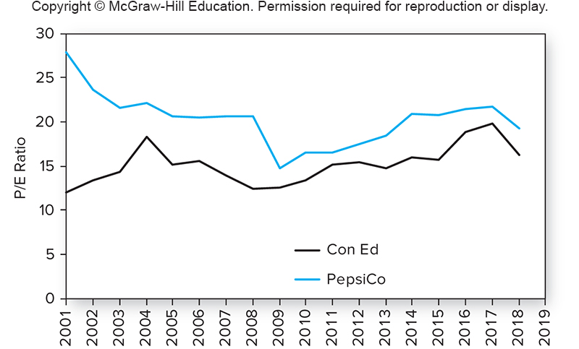
P/E Ratios for PepsiCo and Con Ed
※ The P/E ratio of PepsiCo is significantly higher than that of Consolidated Edison from 2001 to 2019

Slide 38
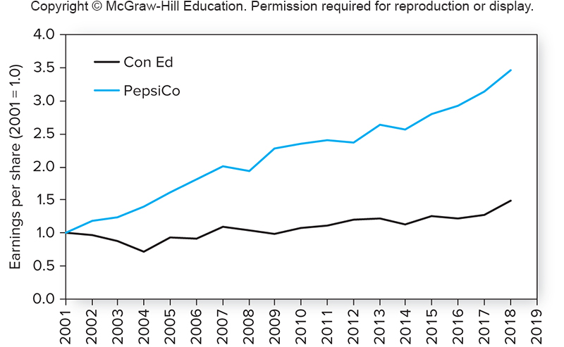
Earnings Growth for PepsiCo and Con Ed
※ Actually, during 2001 to 2019, the EPS of PepsiCo grew three times (with a compound growth rate of 6.9%), while Con Ed’s EPS is almost constant (with a compound growth rate of 1.7%)

Slide 39
PEG Ratios
PEG ratio
Defined as P/E over earnings growth rate, g (× 100) $⇒$ normalizing the P/E by the growth rate
A common Wall Street rule of thumb is that the growth rate, g (× 100), ought to be roughly equal to the P/E rate (proposed by Peter Lynch, a famous portfolio manager), i.e., PEG ≈ 1
PEG < 1 indicates that the stock is undervalued
The PEG ratio for the S&P 500 over the last 30 years typically has fluctuated between 1 and 1.5
Low PEG $⇒$ P/E is low given the same growth rate $⇒$ P/E (or P) is not high enough to reflect growth opportunities $⇒$ buying signal
Both levels of P/E and g differ across industries $⇒$ PEG may be a relatively fair indicator (compared with P/E) to compare two stocks in different industries

Slide 40
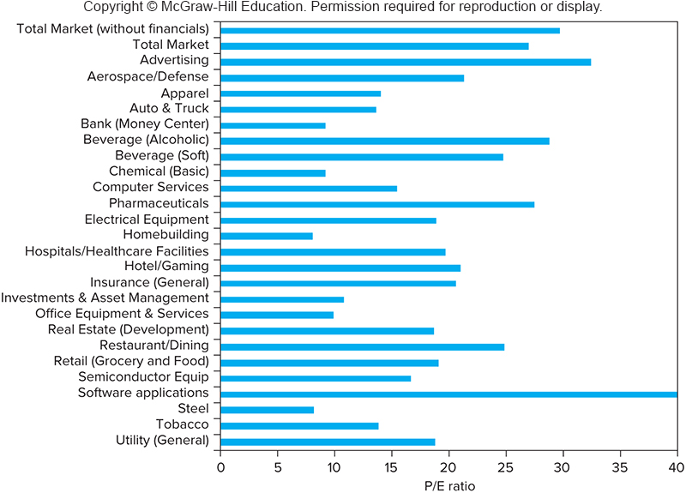
P/E Ratios for Different Industries in 2019
P/E ratios vary across industries
※ The industries with the higher P/E ratios have attractive investment opportunities and relatively high growth rates (e.g., Software applications)
※ This phenomenon again reflects a general rule that the P/E ratio tracks growth opportunities

Slide 41
Notes on P/E Ratios
The pitfalls of P/E analysis
Earning reports are not reliable: Different accounting rules to calculate earnings (e.g., different depreciation rules, earnings management, etc.)
Earnings management is using flexibility in accounting rules to manipulate the apparent profitability of firms
P/E Ratios on financial pages employ the current price and the most recent past accounting earnings rather than estimated next-period earnings E₁
Since P/E ratios can be explained by the DDM, P/E ratios implicitly assume that the earnings will grow at a constant rate forever

Slide 42
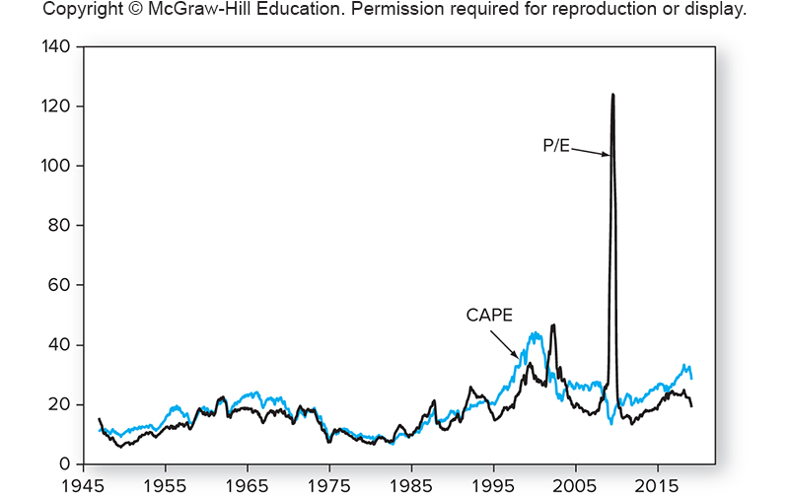
Notes on P/E Ratios
Earnings (E) are usually more sensitive to the business cycle than market prices (P), so P/E ratio is influenced by the business cycle
Cyclically adjusted P/E ratio (CAPE) proposed by Robert Shiller: Dividing stock price by long-term (10 years) inflation-adjusted earnings rather than current earnings

Slide 43
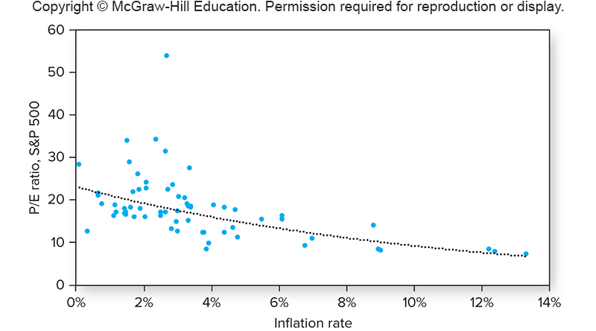
Notes on P/E Ratios
P/E ratios could be distorted by high inflation rates
S&P 500
※ Since the depreciation expenses and the inventory valuation are based on the historical prices, they are undervalued in the high inflation period
※ Undervalued costs leads to overvalued accounting earnings and thus generates lower P/E ratios

Slide 44
Other Comparative Valuation Ratios
Price-to-book
The ratio of price per share over book value per share
The reciprocal of the B/M ratio in the FF three-factor model
Price-to-cash flow
Cash flows are less affected by accounting decisions
So, some analysts prefer to use price-to-cash flow ratios rather than P/E ratios
Some prefer operating CF (營運現金流); others prefer free CF (自由現金流), which is defined as operating CF less new investment
Price-to-sales
Many start-up firms have no earnings
The price-to-sales ratio is sometimes taken as a valuation benchmark for these firms

Slide 45
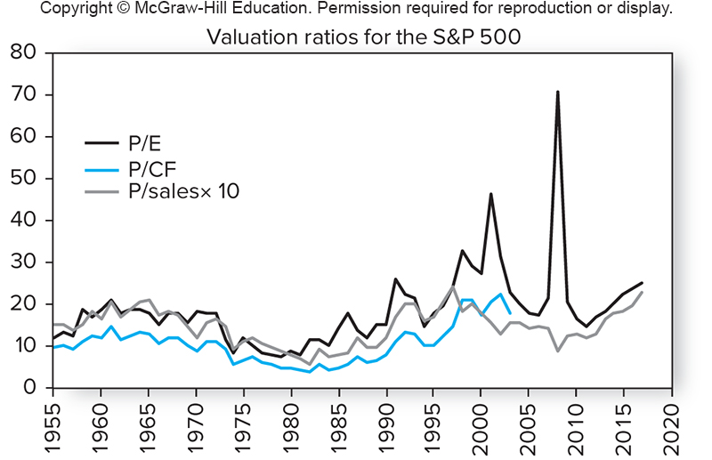
Valuation Ratios for S&P 500
The behaviors of P/E, price-to-cash flow, and price-to-sale for the S&P 500 are very similar
※ Although the levels of these ratios differ considerably (this is why this figure uses ten times price-to-sales instead), for most time they track each other fairly closely

Slide 46
13.5 FREE CASH FLOW VALUATION APPROACHES

Slide 47
Free Cash Flow
Alternative approach to the dividend discount model by using free cash flows to value firms
Especially suited for firms paying no or little dividends, e.g., the computer software industry on Slide 13-24
Alleviate the earnings manipulation problem
One approach is to discount the free cash flow of the firm (FCFF) at the weighted-average cost of capital (WACC)
From the viewpoint of the entire firm
WACC = (D/A)r_{d}(1 – t_{c}) + (E/A)k_{E}
FCFF equals CIF from operation (營運現金流入), less COF on capital expenditures (資本支出) and COF on the investments of working capital (營運資金)

Slide 48
Free Cash Flow
FCFF = EBIT×(1 – t_{c}) + Depreciation – Capital expenditures – Increase in NWC
where EBIT = earnings before interest and taxes
t_{c} = the corporate tax rate
NWC = net working capital (= current asset – current liability) (e.g., investment in inventory or accounts receivable results in the increase of NWC)
The pricing formula for values of firms
where g is the expected growth rate for FCFF_{t} after T and Firm Value_{T} can be alternatively estimated as a multiple of EBIT, book value, sales, free cash flow, etc.
Equity value = Firm value – Value of existing debt

Slide 49
Free Cash Flow
Another approach focuses on the free cash flow to the equity holders (FCFE) and discounts the cash flows directly at the cost of equity
From the point of view of the equity of the firm
FCFE = FCFF – Interest expense×(1 – t_{c}) + Increases in net debt
Issuance (repurchase) of debt indicates the increase (decrease) in net debt and thus free cash inflows (outflows)
The pricing formula for equity values
where k_{E} is the cost of equity, and FCFE_{t} is assumed to grow at the rate of g after time point T

Slide 50
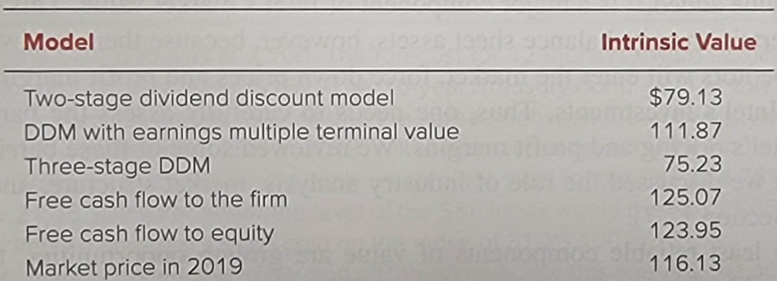
Problems with DCF Models
Model values differ in practice, may stemming from simplified assumptions or poor estimations of parameters (Chevron case)
Investors may employ hierarchy of valuation
Real estate, plant, equipment: most reliable components as the items on the balance sheet for which estimates of market values are available
Economic profit on assets in place: a high ROE and thus high economic value of a factory is less reliable
Growth opportunities: least reliable components

Slide 51
13.6 THE AGGREGATE STOCK MARKET

Slide 52
Earnings Multiplier Approach (收益倍數法)
The most popular approach to forecast the performance of an overall stock market is the earnings multiplier approach
1. Forecast the aggregate corporate earnings underlying the market index for the coming period
2. Derive an estimate for the aggregate P/E ratio using long-term interest rates (10-year treasury yield on the next page)
3. Product of the above two forecasts is the estimate of the end-of-period level of the stock market
Suppose you stand in late 2019 (current S&P 500 index is 3,100) and want to estimate the index level of S&P 500 in late 2020

Slide 53
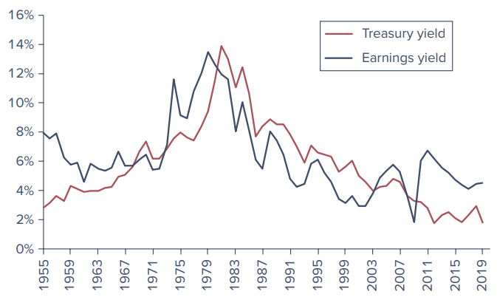
Earnings Yield (盈利收益率) of the S&P 500 Versus 10-year Treasury Bond Yield
※ Earnings yield is defined as earnings per share over price per share, which is exactly the reciprocal of P/E
※ The above figure illustrates that the earnings yield for S&P 500 and the 10-year treasury yield move in tandem (一前一後地)
※ One might use this relationship and the estimated 10-year treasury yield to forecast the earnings yield for S&P 500

Slide 54
S&P 500 Index Forecasts
※ We might posit that the spread between the earnings yield and the Treasury yield, around 2.75% and the 10-year T-bond yield to be 2.0% will remain for one year, so the predicted year-end earnings yield on the S&P 500 is 2.0% + 2.75% = 4.75%
※ It implies a predicted P/E ratio of 1/4.75% = 21.0526
※ The forecast for the 12-month forward earnings per share for the S&P 500 portfolio in late 2020 is about $162, so the forecast for the index level of S&P 500 in late 2020 would be 21.0526 × 162 = 3,411

