Slide 1
CHAPTER 12
Macroeconomic and Industry Analysis

Slide 2
Framework of Security Analysis
Security Analysis (證券分析) (or Fundamental analysis (基本分析))
The analysis to determine firm values, by predicting earnings and dividends with publicly economic and accounting information
Three levels of security analysis
Global and domestic economic analysis (Ch 12)
Industry analysis (Ch 12)
Company analysis (equity valuation in Ch 13 and financial statement analysis in Ch 14)
Why use the top-down sequence
Macroeconomic and industry circumstances might have a greater influence on profits than the firm’s relative competitiveness within its industry

Slide 3
Learning Goals of Chapter 12
International economic analysis (國際經濟分析) and the exchange rate risk
Domestic economic analysis (本國經濟分析)
Introduce key domestic economic variables
Analysis of demand and supply shocks
Fiscal and monetary policies (財政與貨幣政策)
Business cycle analysis (景氣循環分析)
Industry analysis (產業分析)
Sensitivity of industry performance to business cycle
Sector rotation strategy (產業輪動策略)
Life cycles of an industry (產業生命週期)
※ 本章主要介紹可觀察那些變數來分析「國際間與各國之經濟情況」和「整體與產業景氣循環」。若在效率市場，由大眾共識決定的資產價格已反映這些變數，唯有做出比其他交易者更準確的預測，才能賺到超額報酬

Slide 4
12.1 THE GLOBAL ECONOMY

Slide 5
Global Economic Analysis
International economic risks (國際經濟風險)
International economy affects a firm’s export prospects (前景), price competition with foreign competitors, profits on international investments, etc.
The subprime and credit crises in 2008-2009
The euro zone debt crisis (歐債危機) in 2010-2011 affects many (particularly euro zone) countries
The Covid-19 pandemic since 2020 affects the whole world
Economic performance in 2018 (see the next slide)
In January 2018, U.S. President Trump began setting tariffs and other trade barriers on China with the goal of forcing it to make changes to longstanding unfair trade practices and intellectual property theft
The China–United States trade war is still ongoing

Slide 6
Economic Performance, 2018
※ Stock market returns, which reflect future expectations, did not always align with macroeconomic performance (measured by GDP), such as China
※ Exchange rate risk (外匯風險): the stock market return in U.S. dollars is sometimes significantly different from that in the local currency, e.g., Brazil and Russia

Slide 7
U.S. Dollar vs. Major Currencies in Real Exchange Rate, 2010-2018
※ Real exchange rate is the inflation-adjusted exchange rate
※ U.S. dollar appreciated in real terms (positive values in the above figure) means the dollar has gained purchasing power relative to another currency
※ Goods priced in foreign currencies have become less expensive to U.S. consumers; goods priced in U.S. dollars have become less affordable to consumers abroad

Slide 8
12.2 THE DOMESTIC MACROECONOMY

Slide 9
Key Economic Variables
Introduce some domestic economic variables
Note that one must forecast better than other competitors to earn abnormal profits
Gross domestic product (GDP, 國內生產總額)
The market value of the economy’s total production of goods and services over a period of time
Rapidly growing GDP indicates an expanding economy
Industrial production (工業生產總額)
A measure of economic activity more narrowly focused on the manufacturing side of the economy

Slide 10
Key Economic Variables
Unemployment rate (失業率)
(Persons are unemployed but actively seeking and willing to work) / (Total labor force)
(1 – unemployment rate) measures the extent to which the economy is operating at full capacity
Inflation (通貨膨脹)
The rate at which the general level of prices is rising
High inflation rates are often associated with “overheated” economies, i.e., the demand for goods and services exceeds productive capacity, which leads to upward pressure on prices
Trade-off between inflation and unemployment: governments stimulate the economy enough to maintain nearly full employment, but not so much as to bring inflationary pressures

Slide 11
Key Economic Variables
Interest rates (利率)
High interest rates reduce the PV of future CFs, thereby reducing the attractiveness of investment opportunities
Therefore, high interest rates could restrain the overheated economy
Budget Deficits (預算赤字)
The budget deficit of the government is the difference between government spending and taxes
Any budgetary shortfall must be offset by government borrowing (through issuing T-bonds)
Large amounts of government borrowing could force up the interest rate and thus “crowd out” (排擠) private borrowing and investing

Slide 12
Key Economic Variables
Sentiment indicator (心理因素指標)
Consumers’ and producers’ attitude to anticipate the future of a market
E.g., attention (Google trends), confidence (consumer confidence index (CCI, 消費者信心指數)), optimism or pessimism (AAII Investor Sentiment: individual investors’ viewpoint for the following 6 months)
Sentiment, which is not a observable financial factor, could influence how much consumption and investment will pursued and thus affect the aggregate demand for goods and services
P/E ratio (本益比) rule:
For S&P 500 index, the P/E ratio tends to be in the range of 12 to 25 (see the next slide)
The exact P/E ratios for market indexes vary with the above mentioned economic variables

Slide 13
S&P 500 versus EPS Estimate
※ EPS is defined as the earnings per share for the S&P 500 index portfolio
※ The series of S&P 500 is almost between the series of 12 × EPS and 25 × EPS, which implies that the P/E ratio is on average in the range from 12 to 25

Slide 14
12.3 INTEREST RATES

Slide 15
Interest Rates (IRs)
The level of IRs is one of the most important macroeconomic factor to be considered in one’s investment analysis
Forecasts of IRs affect present values and thus expected returns for investments (especially fixed-income investments)
For stock markets, increases in IRs tend to be bad news
High IRs reduce the PVs of stock investment
High IRs attract investors to deposit capital in banks (or invest in fixed-income securities offering high yields) and thus affect the incentive to invest in stocks
Forecasting IRs is one of the most difficult parts in both macroeconomics and finance

Slide 16
Interest Rates (IRs)
Four factors determining the IRs
※ The first three factors determine the level of real interest rates (實質利率) (see Slides 12-16 and 12-17) and the last factor (see Slide 12-18) is the expected inflation rate (期望物價成長率)
1. Supply of funds from savers, primarily households
Supply ↑ ⇒ the supply curve is shifted to the right ⇒ equilibrium real IR ↓
2. Demand for funds from businesses
Demand ↑ ⇒ the demand curve is shifted to the right ⇒ equilibrium real IR ↑ (from point E to point E’)
3. Government’s net supply or demand for funds
Money supply ↑ ⇒ real IR ↓ (stimulate economic growth)
Government borrowing demand ↑ ⇒ real IR ↑

Slide 17
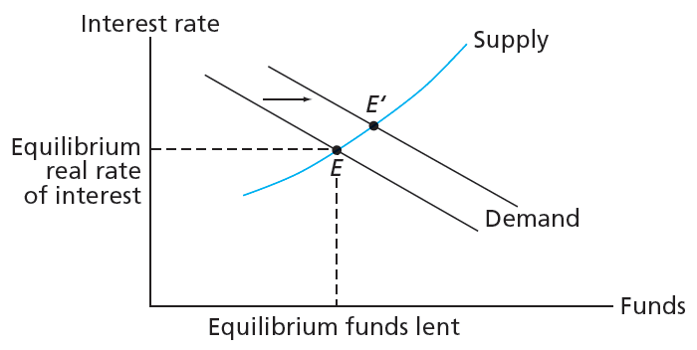
Determination of the Equilibrium Real Interest Rate
※ The fund-supply curve slopes up from left to right because the higher the real interest rate, the greater the fund supply from household savings
※ The fund-demand curve slopes down from left to right because the lower the real interest rate, the more projects firms will undertake, due to the lower capital cost

Slide 18
Interest Rates (IRs)
4. Expected rate of inflation
(Nominal) interest rates contain a premium for expected inflation
The Federal Reserve typically raises (nominal) interest rates proactively when inflation is expected to increase
※ To obtain the nominal interest rate (名目利率), one needs to add the expected inflation rate to the equilibrium real rate (均衡實質利率)

Slide 19
12.4 DEMAND AND SUPPLY SHOCKS

Slide 20
Demand Shocks
Demand shock (需求衝擊)
An event that affects the aggregate demand for goods and services (整體對貨物與服務的需求)
Demand could increase due to, e.g.,
Reduction in tax rates
Increases in the money supply, governmental spending, and foreign export demand
Positive demand shocks is usually associated with the increases of IRs and inflation rates
(demand ↑ ⇒ demand > supply ⇒ price and thus inflation rate ↑ ⇒ nominal IR ↑; or demand ↑ ⇒ funds needed by firms ↑ ⇒ IR ↑)
Increases of demand generally implies the expansion and boom of the economy

Slide 21
Supply Shocks
Supply shock (供給衝擊)
An event that influences the total production capacity and costs (整體製造能力與製造成本)
Supply decreases due to, e.g.,
Increases of prices of raw materials
Unfavorable exchange rate movements for importers
Freezes, floods, or droughts that may destroy agricultural crops
Increases in the wage rates
Negative supply shocks are usually associated with the increases of IRs and inflation rates (supply ↓ ⇒ demand > supply ⇒ price and thus inflation rate ↑ ⇒ nominal IR ↑)
Negative supply shocks result in reduced output, leading to slower economic growth

Slide 22
Demand and Supply Shocks
Covid-19 pandemic caused both
Disrupted supply chain
Higher unemployment and thus less demand
How to relate the above knowledge to investment analyses?
Choose industries that will be helped by your expectation about the change of the demand and supply and avoid those that will be hurt
For example, positive demand shock ⇒ choose the automobile or luxury producers (cyclical firms), which benefit most from the positive demand shock
(In contrast, firms producing consumer necessities (e.g., food producers or utility company, also benefit from the positive demand shock but not much)

Slide 23
12.5 FEDERAL GOVERNMENT POLICY

Slide 24
Government Policy
Demand-side policy
The economy will not by itself arrive at a full employment equilibrium, so macroeconomic policies are used to affect the demand for goods and services to stimulate (刺激) the economy toward this goal
Most fiscal and monetary policies introduced later are based on this demand-oriented argument
Supply-side policy
The goal is to induce (引起) workers and owners of capital to have the maximum incentive and ability (動機與能力) to produce and develop goods
For example, lowering tax rates will elicit (引出) more investment and improve incentives to work, thereby enhancing economic growth

Slide 25
Fiscal Policy
Fiscal policy (財政政策)
Government’s budget deficit or surplus:
Tax income < government spending ⇒ budget deficit (預算赤字)
Tax income > government spending ⇒ budget surplus (預算盈餘)
The effect of budget deficits: increase the demand for goods and services (via government spending) by more than it reduces the demand for goods and services (via taxes collection), and therefore stimulate the economy
(For most nations, they adopt the budget-deficit policy to stimulate the economy)

Slide 26
Fiscal Policy
Fiscal policy is to use government spending and taxing actions to stabilize (穩定) or spur (刺激) the economy
Increases in government spending (rising budget deficits) directly inflate the demand for goods and services (used in recessions)
Increases in tax rates (lower budget deficits) siphon (虹吸, 輸送) income from consumers and result in fairly rapid decreases in consumption (used in inflationary booms)
With most direct impact on the economy
However, slowly implemented because of the requirement the negotiation and compromise between executive and legislative branches
So, the fiscal policy cannot in practice be used to quickly fine-tune the economy

Slide 27
Monetary Policy
Monetary Policy (貨幣政策)
Federal Reserve Board (center banks) manipulates money supply to influence economic activity
Different from the direct influence from fiscal policies, monetary policies work indirectly through their impact on interest rates (e.g., federal funds rate) and thus on the incentive to purchase and invest
Short- and long-term monetary effects
Increases in the money supply lower short-term real and thus nominal IRs, encouraging investment and consumption
In the long run, it is believed that a higher money supply leads only to a higher price level (thus a higher inflation rate) and does not have a permanent effect on economic activity
※ The stimulation/inflation trade-off is the major consideration to determine how to use monetary policy

Slide 28
12.6 BUSINESS CYCLES

Slide 29
The Business Cycle
Recurring patterns of recession and recovery are called business cycles (see Slide 12-30)
Peak (高峰): The transition from the end of an expansion (擴張) to the start of a contraction (緊縮)
Trough (低谷): Occurring at the bottom of a recession just before the economy entering a recovery (expansion)
Industry relationship to business cycles (cyclical vs. defensive industries) (週期性 vs. 防禦性產業)
Cyclical industries
Industries with above average sensitivity to the state of the economy, e.g., the producers of durable goods (e.g., cars) or capital goods (that are used by other firms to produce their own products)
Firms in cyclical industries tend to have high betas

Slide 30
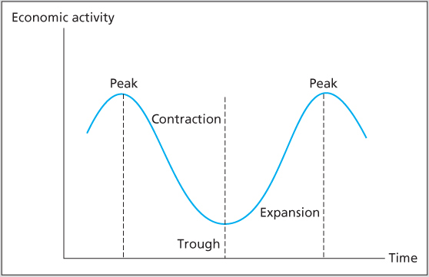
Four Phases of a Business Cycle

Slide 31
The Business Cycle
Defensive industries
Industries with below-average sensitivity to the state of the economy
For example, food producers, pharmaceutical firms, and public utilities
The demand of food, drugs, electricity, and gas is consistent regardless of the business cycle
Firms in defensive industries tend to have low betas
The trading strategy based on the business cycle
Optimistic about the economy, hold cyclical stocks
Pessimistic about the economy, hold defensive (or counter-cyclical) stocks

Slide 32
Economic Indicators (經濟指標)
Leading Indicators (領先指標) – economic series tend to rise and fall in advance of the economy, for example,
Stock prices (S&P 500 stock index)
Stock prices are forward-looking estimates for future profitability and thus able to be a leading indicator
Since the stock prices themselves are leading indicators, the information of other leading indicators contributes little for stock investment – by the time they predict an upturn, the stock market has already made its move
Stock prices can be a leading indicator for the business cycle, but there is no leading indictor for stock prices
Money supply growth rate
Due to the indirect and lag influence of the monetary policy on the economy

Slide 33
Economic Indicators (經濟指標)
Coincident Indicators (同期指標) – indicators that tend to change in tandem (一前一後地) with the economy, e.g.,
Industrial production
Manufacturing and trade sales
Lagging Indicators (落後指標) – indicators that tend to rise or fall behind the rest of the economy, e.g.,
Ratio of inventories to sales (high inventories suggest the economy is in recession)
Ratio of consumer installment credit (消費者分期付款信貸) outstanding to personal income
Cyclical indicators are summarized on Slide 12-34

Slide 34
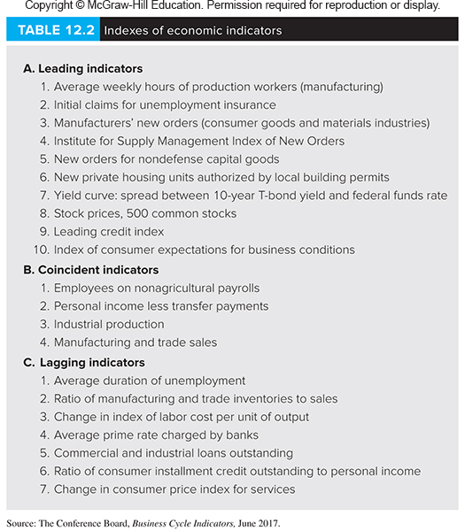
Economic Indicators (經濟指標)

Slide 35
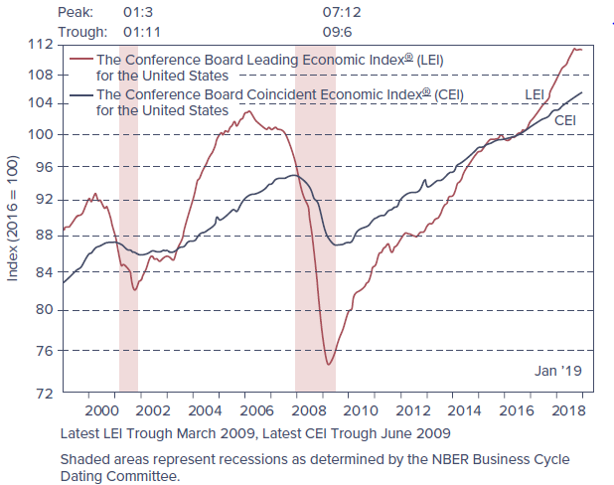
Economic Indicators
※ The shaded areas represent periods of recession
※ The dates at the top of the chart are formatted as year:month

Slide 36
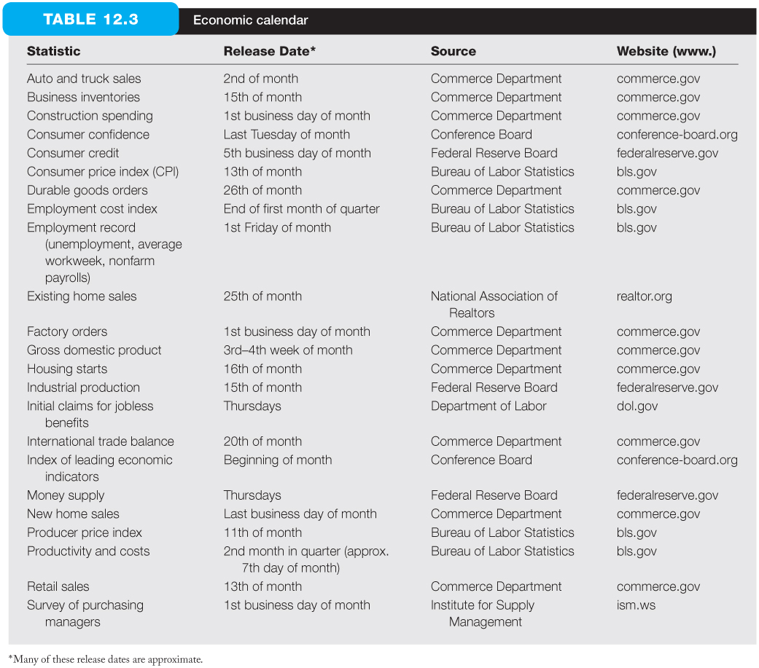
Economic Calendar
※ A wide range of economic indicators are released to the public on a regular “economic calendar”

Slide 37
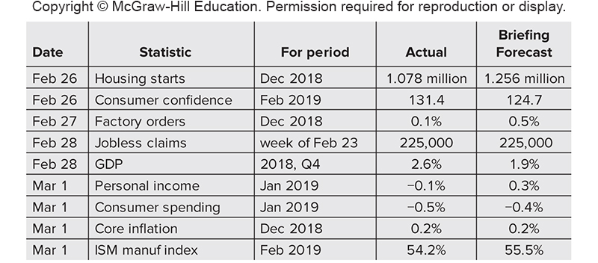
Excerpt (摘錄) of Economic Calendar, week of February 25, 2019
※ The “forecasts” of each variable are provided along with the “actual” value of each statistic
※ In an efficient market, security prices already reflect market expectation, so only the new information (deviation from forecasts) on the announcement day causes subsequent price movements
※ Therefore, if you can forecast more accurately than others, you may enjoy the benefit from the price movements after the announcement

Slide 38
12.7 INDUSTRY ANALYSIS

Slide 39
Industry Analysis
The industry analysis (產業分析) is as important as the macroeconomic analysis because it is unusual for a firm in a troubled industry to perform well
Performance of return on equity (ROE) varies across industries (see Slide 12-40)
ROEs can range from -2.5% for the Tobacco industry to 41.5% for the Grocery and Food industry
ROEs of firms in the same industry, e.g., application software, also varies substantially
Stock price performance also varies a lot for different industries (see Slide 12-41)

Slide 40
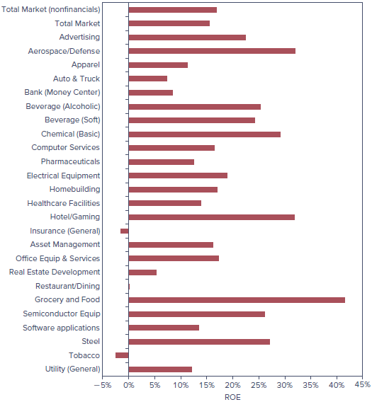
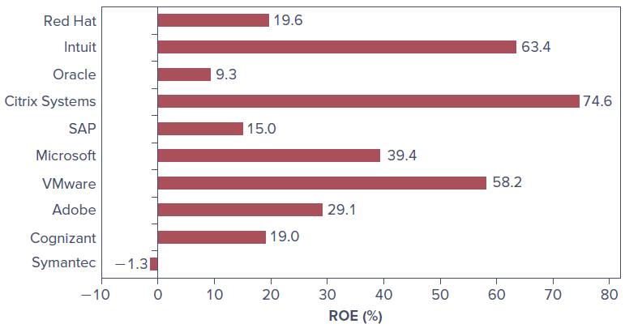
Returns on Equity
※ ROEs for different industries in late 2018
※ ROEs for firms in application software industry on March 1, 2019

Slide 41
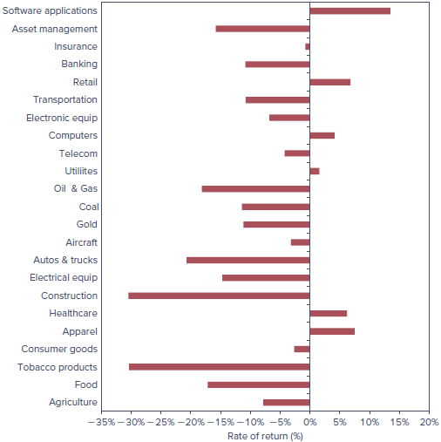
Industry Stock Price Performance, 2018
※ In 2018, stock prices of different industries perform diversely. However, there are 17 of the 23 industries showing negative returns, a testament (證據) to the significant influence of some systematic factors on stock prices

Slide 42
Defining an Industry
Where to draw the line between one industry and another
North American Industry Classification System (北美產業分類系統) or NAICS Codes
There are codes assigned to group firms for statistical analysis (see Slide 12-43)
Firms with the same 4-digit NAICS codes are commonly taken to be in the same industry
S&P classifies firms into about 100 industry groups, and Value Line Investment Survey groups firms into about 90 industries
Industry classifications are never perfect
For example, both Kohl’s (high-volume “value” store) and Bloomingdale’s (high-margin elite retailer) might be classified as department stores

Slide 43
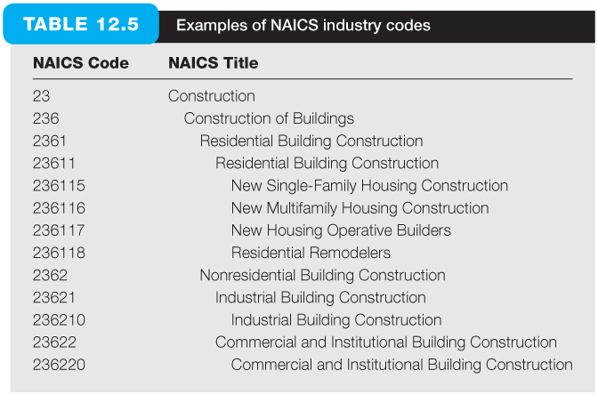
Examples of NAICS Industry Codes
※ The first two digits define the major industry group, e.g., NAICS code 23 = construction

Slide 44
Sensitivity to Business Cycle
It is interesting to see how business cycles affect the performance of specific industries
Three factors affecting sensitivity of earnings (收益敏感度) to business cycles
Sensitivity of sales (銷售敏感度)
Sales of necessities will show little sensitivity to business conditions, e.g., food, drugs, medical services
Sales of luxuries or discretionary goods are more sensitive to business conditions, e.g., jewelry, autos, recreational services
Sale growths of jewelry stores vs. grocery stores on the next slide

Slide 45
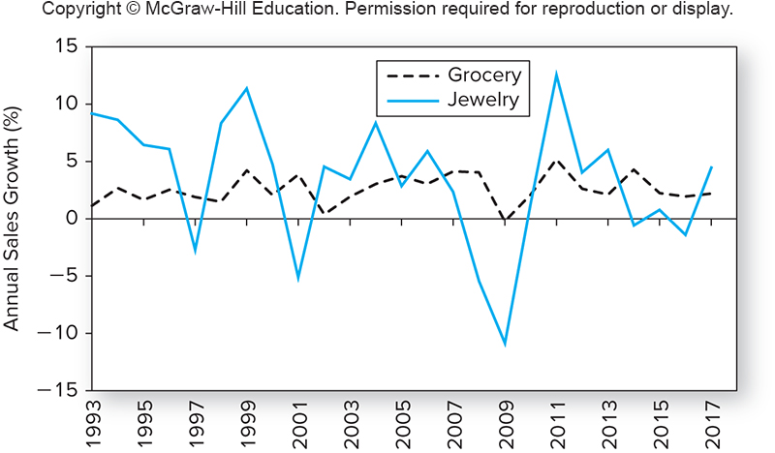
Industry Cyclicality
※ Sales of jewelry stores fluctuate more widely than those of grocery stores

Slide 46
Sensitivity to Business Cycle
Financial leverage (財務槓桿)
Since interest expenses on debt must be paid regardless of sales, they will increase the sensitivity of profits to sales
Profits for high-financial-leverage industries swing more widely with sales (business cycles)
Operating leverage (營運槓桿)
The degree to which the operating costs are fixed
Fixed operating costs (固定營運成本) are those the firm incurs regardless of its production level; Variable operating costs (變動營運成本) are those that rise or fall as the firm produces more or less products
Fixed operating costs ↑ ⇒ the costs is without flexibility with sales ⇒ profits for high-fixed-costs industries swing more widely with sales (business cycles) ⇒ using high fixed operating costs is equivalent to increase operating leverage
※ Note that the above inference is based on the assumption that sales are positively correlated with business conditions

Slide 47
Sector Rotation (產業輪動)
An investment strategy to select industries in different phases of a business cycle
Peak (高峰): invest in natural resource firms
The economy might be overheated with high inflation
Invest in natural resource firms to against the inflation
Contraction (緊縮): invest in defensive firms, e.g., food, drugs, or other necessities
These firms are less affected by the contraction
Low IR rates (high borrowing demand) favor financial firms
Trough (低谷): invest in equipment, transportation and construction firms
Firms might purchase new equipment to meet anticipated increases in demand in the following expansion
Expansion (擴張): invest in cyclical industries, e.g., consumer durables and luxury items
These firms are the most profitable in this phase

Slide 48
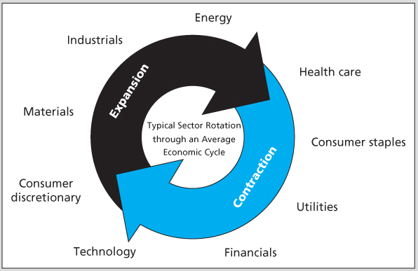
Sector Rotation (產業輪動)
※ The typical sector rotation across different states of a business cycle is shown in the above figure
※ Each sector historically had their “day in the sun” during a typical economic cycle
※ Consumer staples (必需性消費類股); Consumer discretionary (非必需性消費類股)

Slide 49
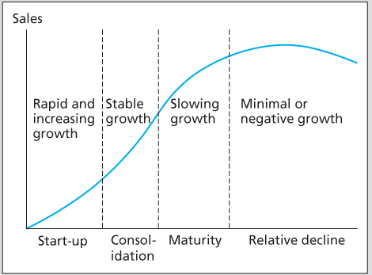
Industry Life Cycle (產業生命週期)
Stage Sales Growth
Start-up (初始階段) Rapid & Increasing
Consolidation (強化階段) Stable
Maturity (成熟階段) Slowing
Relative Decline (相對衰退階段) Minimal or Negative
(Each stage will be discussed in details)

Slide 50
Industry Life Cycle (產業生命週期)
Start-up stage (初始階段)
The early stages of an industry are often characterized by a new technology or product, e.g., PC in the 1980s, smart phone since 2007
At this stage, sales and earnings grow at an rapid rate since the new product has not yet saturated in market
Consolidation stage (強化階段)
The industry survivors and leaders begin to emerge
The performance of the surviving firms will closely track the performance of the overall industry
The industry will grow faster than the rest of the economy

Slide 51
Industry Life Cycle (產業生命週期)
Maturity stage (成熟階段)
The product is used extensively in the market
The product has become far more standardized
There is price competition among firms in the industry
Firms at this stage are called as “cash cows,” which are with stable CF but offering little opportunity for profitable expansion
Relative decline stage (相對衰退階段)
The industry might grow as less than the rate of the overall economy, or it might even shrink
This could be due to the product being out of date or the competition from new products

Slide 52
Industry Life Cycle (產業生命週期)
The logic behind the necessary progression from one stage of the industry life cycle to the next
High growth and fat profits bring new competitors and thus generate new sources of supply to reduce prices, profits, and growth finally
Are high-growth industries good investment targets?
The historical records tells us they are, as long as they offer high enough expected return to compensate the risks you bear
But if the security prices already reflect the likelihood for high growth, then it is too late to make money from this strategy

Slide 53
Industry Competition and Structure
A highly competitive industry must has lower profit margin and thus is not a good investment target
Five determinants of competition:
Threat of entry
New entrants to an industry pressure prices/profits
First mover advantage (先驅者優勢), entry barriers (進入障礙), brand loyalty (品牌忠誠度), proprietary knowledge (專有資訊) or patent (專利) can reduce the threat
Rivalry (對抗競爭行為) between existing competitors
Market share competition pressures prices/profits
Slow industry growth (減緩產業成長) and homogeneity of goods exacerbate (使惡化) the decline in prices/profits
Often occurs in the maturity stage

Slide 54
Industry Competition and Structure
Pressure from substitute products (替代產品) in related industries
Sugar vs. corn syrup (玉米糖漿), Wool vs. synthetic fiber (人造纖維)
Limit the prices of products
Bargaining power of buyers (買家議價能力)
Large-scale buyers have considerable bargaining power
For example, auto producers can put pressure on supplier of auto parts and thus reduce the profits of the auto parts industry
Bargaining power of suppliers (供應商議價能力)
Large-scale suppliers have considerable bargaining power and can demand higher prices for the good of the industry
Bargaining power of suppliers also depends on the availability of substitute products

