Slide 1
CHAPTER 11
Managing Bond Portfolios

Slide 2
Learning Goals of Chapter 11
Discuss the interest rate (IR) risk (利率風險)
Introduce the notion of duration (存續期間), commonly used to measure IR risks
Introduce the immunization method (免疫法) to manage bond portfolios
A passive management method based on the duration hedge (存續期間避險)
Discuss the error of the duration hedge
Measured by the convexity (曲度) of the (percentage price change)-(yield change) curve of bonds
Introduce several methods to improve the performance of bond portfolios

Slide 3
11.1 INTEREST RATE RISK

Slide 4
Interest Rate Risk
Interest rate (IR) risk (利率風險)
The sensitivity that the value of an investment will change due to a change in the level of IRs
The IR risk affects the value of bonds more directly than stocks
This is because that the IR is the dominant factor to determine bond prices, but there are many other factors to affect stock prices, e.g., the expected future cash flows
This chapter focuses on the IR risk for bonds

Slide 5
Six Characteristics for IR Sensitivity
1. Inverse relationship between price and yield
As IRs rise (fall), bondholders experience capital losses (gains)
IR risk for bonds: The fluctuation of the IRs makes the values of a fixed-income security risky, even if its coupon and principal payments are guaranteed
2. The price decline from an increase in yield (e.g. ↑ 1%) is smaller than the price rise from a decrease in yield of equal magnitude (e.g., ↓ 1%)
The slope of the price-yield curve becomes steeper when the yield decreases, i.e., |slope| is inversely related to the current yield

Slide 6
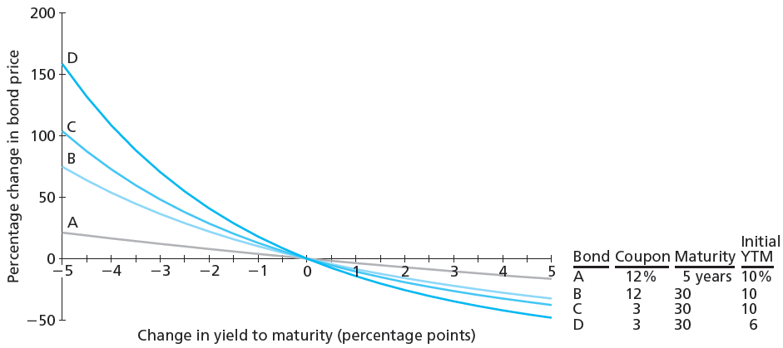
Percentage Change in Bond Price as a Function of Change in YTM
※ Explain the following four characteristics with the above figure, where the y-axis is normalized to be the percentage change in bond price and the x-axis represents the change in yield to maturity

Slide 7
Six Characteristics for IR Sensitivity
3. Long-term bonds tend to be more price sensitive than short-term bonds
When computing bond prices, it is obvious that the impact of the IR change is more significant on the PVs of longer-maturity cash flows
Bond A (12%, 5yr) vs. bond B (12%, 30yr) on 11-6
4. Sensitivity of bond prices to yield changes increases at a decreasing rate as maturity increases
The IR risk is less than proportional to bond maturity
The maturity of Bond B is six times longer than that of bond A, but it has less than six times the IR sensitivity of bond A (yield ↓ 5%, A ↑ 20% and B ↑ 75%)

Slide 8
Characteristics for IR Sensitivity
5. IR risk is inversely related to bond’s coupon rate
Bond B (12%, 30yr) is less sensitive than bond C (3%, 30yr) to IR change on Slide 11-6
Explained by analyzing the duration later
6. IR risk of bonds is inversely related to the current level of the yield to maturity
Bond C (at YTM=10%) is less sensitive than bond D (at YTM=6%) to IR change on Slide 11-6
Explained by analyzing the duration later

Slide 9
Duration
Duration (存續期間) (or called Macaulay duration) is a measure of the effective (or average) maturity to receive the payments of a bond
It is defined as the weighted average of the time points for each payment of a bond
The weight of each payment is the ratio of the present value of that payment over the bond price
(Note that the cash flows C_{t} include both the coupon payments and the principal repayment)

Slide 10
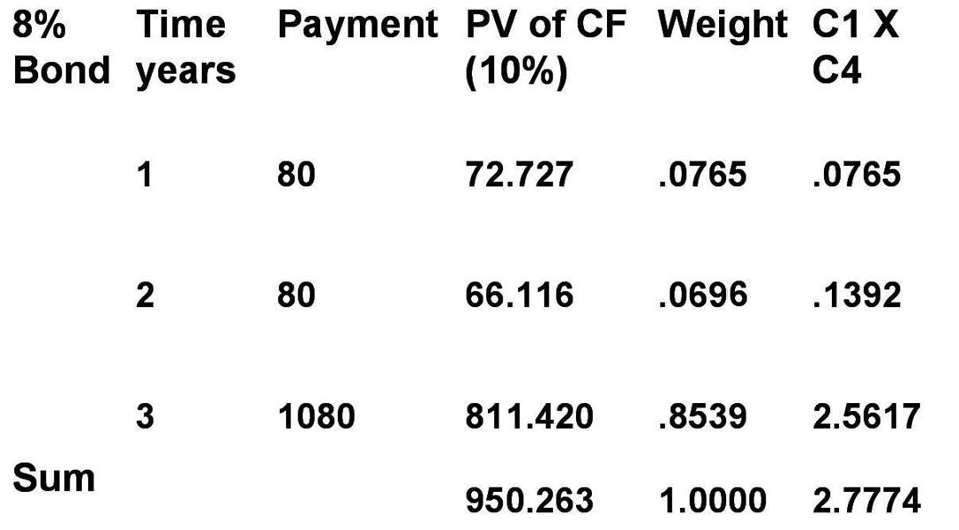
Duration Calculation
72.727
950.263
66.116
950.263
811.420
950.263
The Macaulay duration for this 3-year bond
※ The duration is essentially the average time (or the effective maturity) to receive payments of a bond
※ Thus, the unit for the duration is “years”
※ Duration is shorter than maturity for all bonds except zero coupon bonds
※ Duration is equal to the maturity for a zero coupon bond since the weight for the final payment (the only payment) is 100%

Slide 11
Duration Measures the IR Risk
For economists, to study the relationship between the bond price (P) and the yield (y) (or said the IR risk), the most common way is to calculate the sensitivity dP/dy and the elasticity (dP/P)/(dy/y)
dP/dy is called the Duration Dollars, which is the sensitivity of the bond price w.r.t. the yield
dP/dy is size dependent, i.e., for P₁ = 100P₂, with other features held the same, dP₁/dy = 100 dP₂/dy
The aspect of Duration Dollars is very important for the IR risk management in practice. However, this chapter does not put focus on this topic

Slide 12
Duration Measures the IR Risk
The elasticity (dP/P)/(dy/y) is an alternative to measure the IR risk and it is size independent since it measures the impact of the percentage change in the yield on the percentage change in the bond price
Calculating (dP/P)/(dy/y) is meaningless because we never talk about the percentage change of IRs in the financial market
How to describe the change of the IR from 5% to 6%?
So, we calculate (dP/P)/dy, which measures the sensitivity of the percentage change in the bond price with the level change of the yield

Slide 13
Duration Measures the IR Risk
D*= –(dP/P)/dy is called the modified duration (修正存續期間), which equals the Macaulay duration over (1+y), where y is the per-period yield
※ Due to the inverse relationship between the percentage change of the bond price and the change of the yield, adding the negative sign makes the modified duration be positive
※ By analyzing the units for the numerator and denominator, it can be inferred that the modified duration is with the unit of years
※ The geometric meaning of the modified duration is the negative of the slope of the tangent line of the (percentage price change)-(yield change) curve on Slide 11-6)

Slide 14
Duration Measures the IR Risk
Modified duration = Duration / (1+y)
Since the modified duration is defined as the sensitivity of the percentage change in bond price for the change in yield, it measures the IR risk
If the per-period yield y is very small, the modified duration and the duration are very close
The duration, in essence like the modified duration, is an estimate of the IR risk (sensitivity) of bonds, although the duration is the weighted average of the time points for each cash flow
The larger the duration (or the modified duration), the higher the IR risk for that bond, i.e., a small IR changes will result in a large percentage change in bond price

Slide 15
Characteristics for Durations
Revisit the Characteristics 5 and 6 about the bond’s IR risk
The increase of the coupon rate means the increase of weights of short-term-maturity payments relative to the final principal repayment
⇒ coupon rate ↑ ⇒ duration ↓ ⇒ IR risk ↓
The higher YTM means the larger weights for short-term-maturity payments (because the higher YTM generate smaller present values of longer-term-maturity payments)
⇒ YTM ↑ ⇒ duration ↓ ⇒ IR risk ↓

Slide 16
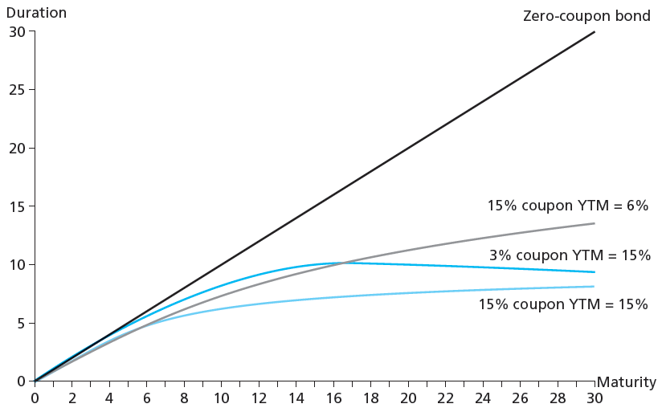
Duration as a Function of Maturity
※ A bond’s duration (or said the magnitude of the IR risk) generally increases with the time to maturity, except some extremely deeply discounted bonds (e.g., the bond with 3% coupon arte and 15% YTM in the above figure)
※ For virtually all traded bonds, however, it is safe to assume the duration increases with maturity

Slide 17
Durations for Perpetual Bonds
The duration of a perpetuity (無限年金) is
A perpetuity is equivalent to a perpetual bond
Since the PV of a perpetuity is P = C/y, the modified duration D* is –(dP/P) / dy = –(dP/dy) / P = –(–C/y²) / (C/y) = 1/y and thus the duration D is (1+y)/y (because of the relation D/(1+y) = D*)
Two special properties associated with the duration of a perpetuity
Although the time to maturity is infinite, the duration of a perpetuity is finite
The duration is independent of the level of the perpetuity, C

Slide 18
Duration/Price Relationship
The percentage change of the bond price is proportional to the duration and yield change
Revisit the example on Slide 11-10
$$950.263=\frac{\text{80}}{(\text{1+10\%})}+\frac{\text{80}}{(\text{1+10\%})^{2}}+\frac{\text{1080}}{(\text{1+10\%})^{3}}$$
$$947.869=\frac{\text{80}}{(\text{1+10.1\%})}+\frac{\text{80}}{(\text{1+10.1\%})^{2}}+\frac{\text{1080}}{(\text{1+10.1\%})^{3}}$$
$$\frac{ΔP}{P}=\frac{947.869−950.263}{950.263}=−0.2519\% \\ −\frac{D}{1+y}Δy=−\frac{2.7774}{1+10\%}0.1\%=−0.2525\%$$

Slide 19
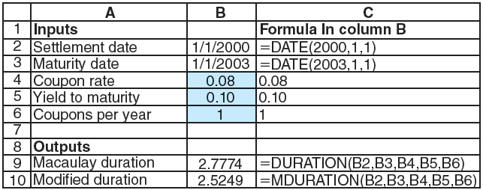
Calculate Durations using Excel
※ DURATION(settlement date, maturity date, annual coupon rate, yield to maturity, number of coupon payments per year, different day count convention) : return the duration of a bond
※ MDURATION(settlement date, maturity date, annual coupon rate, yield to maturity, number of coupon payments per year, different day count convention) : return the modified duration of a bond
※ Different day count convention (計日慣例): 0 is 30/360 in USA; 1 is actual/actual; 2 is actual/360; 3 is actual/365; 4 is 30/360 in European

Slide 20
11.2 PASSIVE BOND MANAGEMENT

Slide 21
Immunization
Immunization (免疫法): A strategy to shield asset values from the impact of the IR movement
Duration matching strategy (存續期間配適法) (the most common method in the banking industry)
Cash flow matching strategy (現金流量配適法)
※ Note that the immunization method is not a trading strategy for bonds, and its goal is to control (or eliminate) the IR risk
※ Therefore, the immunization methods are viewed as passive bond management strategies

Slide 22
Duration Matching
Duration matching strategy (存續期間配適法) : ensure that both assets and liabilities react equally to IR fluctuations, for example,
An insurance company issues a 5-year guaranteed investment contract (GIC), for $10,000. If the guaranteed IR is 8%, the insurance company is obligated to pay $10,000 × (1.08)⁵ = $14,693.28 after 5 years
The insurance company chooses to invest this $10,000 in a 6-year bonds with 8% annual coupon (paid annually) (assume the YTM is 8%)
The changes of the present values of the asset (the 6-year bond) and the liability (the 5-year GIC) w.r.t. the IR are shown in the following table

Slide 23
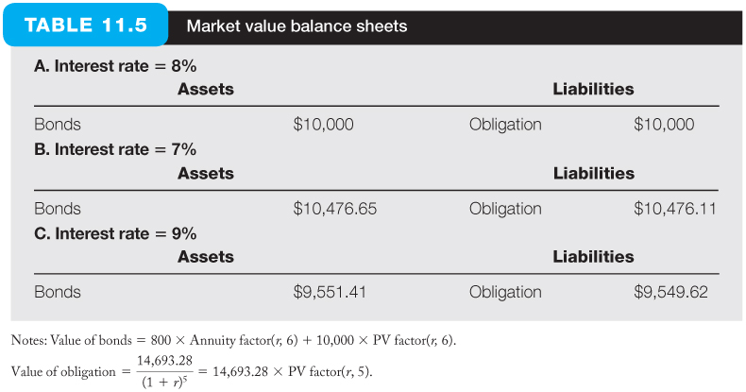
Duration Matching
※ The interest changes affect the asset and the liability by nearly the same magnitude, so the net worth of the insurance company is almost immunized about the IR risk
※ The reason behind this phenomenon is due to the same duration for this two positions. The GIC, like a zero-coupon bond, with the duration to be 5 years, and the 6-year bond is with the duration to be 5 years as well (checking it by yourself)

Slide 24
Duration Matching
Why the duration matching strategy can eliminate the IR risk?
$$\text{Suppose} \text{PV} \text{of} \text{Asset} P_{A}=\text{PV} \text{of} \text{Liability} P_{L} \text{and} \text{Duration} D_{A}=\text{Duration} D_{L}, \\ \text{according} \text{to} \text{the} \text{formula} \frac{ΔP}{P}=−D^{∗}Δy=−\frac{D}{(1+y)}Δy \\ ⇒\text{For}\text{ 1\% }\text{decrease} \text{in} \text{the} \text{yield} y\text{, }\text{the} \text{PV} \text{of} \text{the} \text{asset} \text{will} \text{rise} \text{by} D_{A}/(1+y)\% \\ \text{and} \text{the} \text{PV} \text{of} \text{the} \text{liability} \text{obligation} \text{will} \text{increase} \text{by} D_{L}/(1+y)\% \\ ⇒\text{In} \text{other} \text{words}\text{, }\text{the} \text{increase} \text{amount} \text{of} \text{the} \text{PV} ​\text{of} \text{the} \text{asset} \text{will} \text{be} P_{A}×D_{A}/(1+y)\%, \\ \text{and} \text{the} \text{increase} \text{amout} \text{of} \text{the} \text{PV} \text{of} \text{the} \text{liability} \text{obligation} \text{will} \text{be} P_{L}×D_{L}/(1+y)\% \\ ⇒\text{Since} \text{the} \text{increases} \text{of} \text{the} \text{asset} \text{and} \text{the} \text{liability} \text{obligation} \text{can} \text{offset} \text{each} \text{other} \text{when} \\ \text{calculating} \text{the} \text{net} \text{worth}\text{, }\text{the} \text{net} \text{worth} \text{of} \text{the} \text{insurance} \text{company} \text{will} \text{not} \text{be} \text{affected} \\ \text{by} \text{the} \text{decrease} \text{of} \text{the} \text{yield} \text{in} \text{the} \text{previous} \text{example}$$

Slide 25
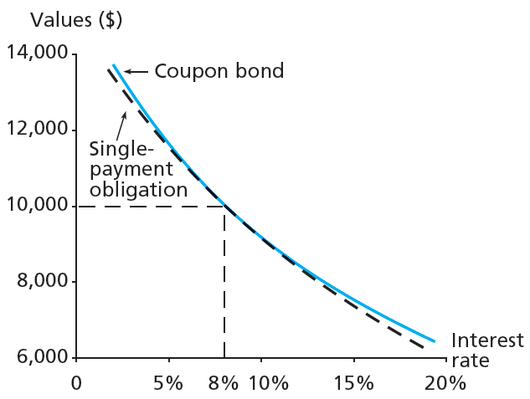
Duration Matching Immunization
※ The above figure shows the value of the 6-year bond and the GIC as a function of the yield
※ For minor yield changes, the changes in values of both the asset and the obligation are almost the same, that is why the duration matching immunization works
※ For larger yield changes, the values of these two instruments diverge, that means the power of immunization method is reduced

Slide 26
Duration Matching
The power of duration matching diminishes for large yield changes suggest the need for rebalancing immunized portfolios
Rebalancing (再平衡) is to change the portfolio of fixed-income assets to realign its duration with the duration of the obligation
Note that even if yields do not change, durations of assets and liabilities still change due to the passage of time (see the next two examples)

Slide 27
Duration Matching-rebalancing
The duration of a portfolio is the weighted average of the durations of each component

Slide 28
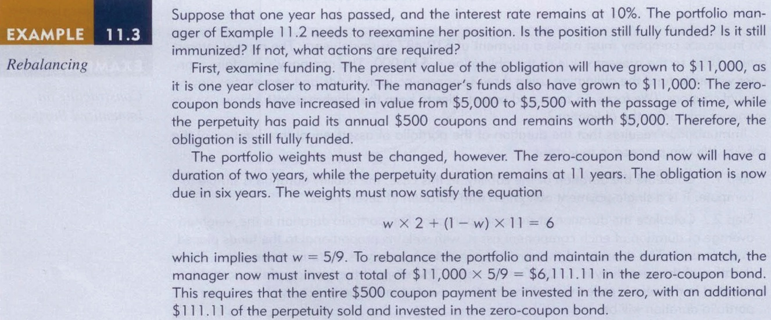
Duration Matching-rebalancing
※ Note that to examine whether the funding is matched, an addition assumption of the coupon rate to be 10% for the perpetuities is required
※ According to the above two examples, it can be concluded that rebalancing is required when the IR changes significantly or required over time even the IR remains the same
※ Note that rebalancing of the portfolio periodically incur transaction costs, which is a disadvantage of the duration matching strategy

Slide 29
Duration Matching
For a future time point, the IR risk for bonds consists of two types of risk
Price risk (價格風險): investors cannot sell the bond for as much as anticipated in the future
Reinvestment risk (再投資風險): investors will not be able to reinvest the coupons at the promised yield rate
※ The two types of risk are potentially offsetting: IR ↑ ⇒ sale price ↓ and the future value of the reinvested coupons ↑
Two effects of the duration matching
Protect the current value against the IR risk today
Make sure that the price risk and reinvestment risk almost cancel out for a horizon equal to the portfolios’ duration

Slide 30
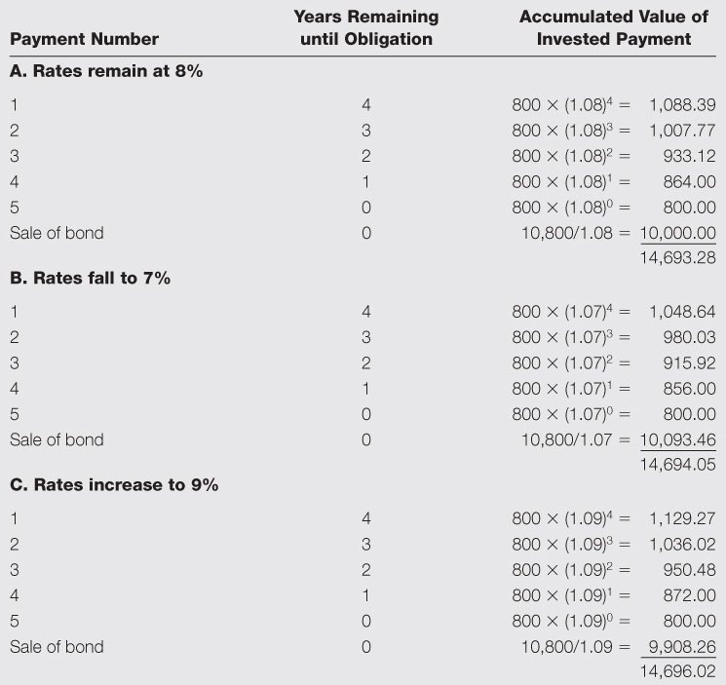
Duration Matching
Exactly meet the obligation (see Slide 11-22)
※ No matter the yield rises or falls, the expected cash flow from the coupon bond is almost the same as the obligation after 5 years because the price risk and the reinvestment risk offset for each other at that time point

Slide 31
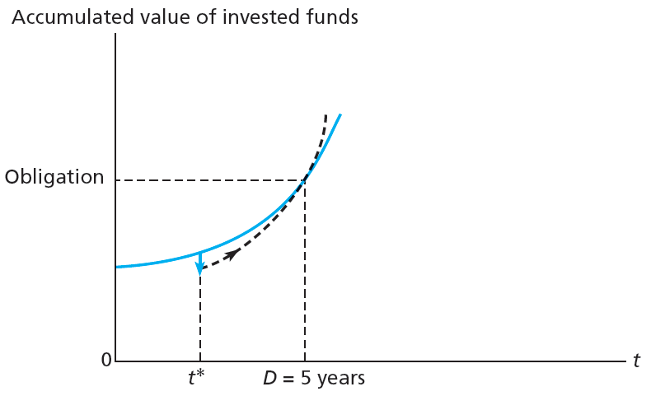
Growth of Invested Funds
※ The solid curve traces the accumulated future value of the coupon bond if yields remain at 8%
※ The dashed curve shows the value of the coupon bond if yields increase
※ The initial impact is a capital loss, but this loss eventually is offset by the now-faster growth rate of reinvested funds
※ At the five-year horizon date, equal to the bond’s duration, the net effect of these two opposite forces just cancel for each other, leaving the company able to satisfy its obligation

Slide 32
Cash flow matching
Cash flow matching (現金流量配適法):
Dedication strategy (專項策略): matching cash flows of a fixed-income portfolio with those of an obligation on a multiperiod basis
Can be achieved by constructing a portfolio of (zero-coupon) bonds
Automatically immunizing a portfolio from yield movements because the cash inflows from the asset portfolio and the obligation exactly offset each other
Eliminate IR risk perfectly due to zero net cash flows
Cash flow matching implies the duration matching, since the asset and obligation are with the identical series of cash flows and thus have the same duration

Slide 33
Cash flow matching
The advantage of this method is that it is a once-and-for-all approach to eliminate the IR risk, i.e., it does not rebalance the portfolio to maintain duration matching
This method is sometimes difficult to implement in practice due to the lack of proper asset which can generate matching cash flows
For example, if you need $11049.42 at the maturity of 13 years and 20 days, a security providing the cash flow exactly equal to such amount at the specified time point may not exist

Slide 34
11.3 CONVEXITY (凸性)

Slide 35
Limitations of Duration
Duration is only a linear approximation
Duration asserts that the percentage price change in bond is directly proportional to the change in the yield when the change of yield is small (see the figure on the next slide)
When the change of yield is large
Underestimates the gains in bond prices when the yield falls
Overestimates the losses in bond prices when the yield rises
This phenomenon is also shown in the figure on the next slide

Slide 36
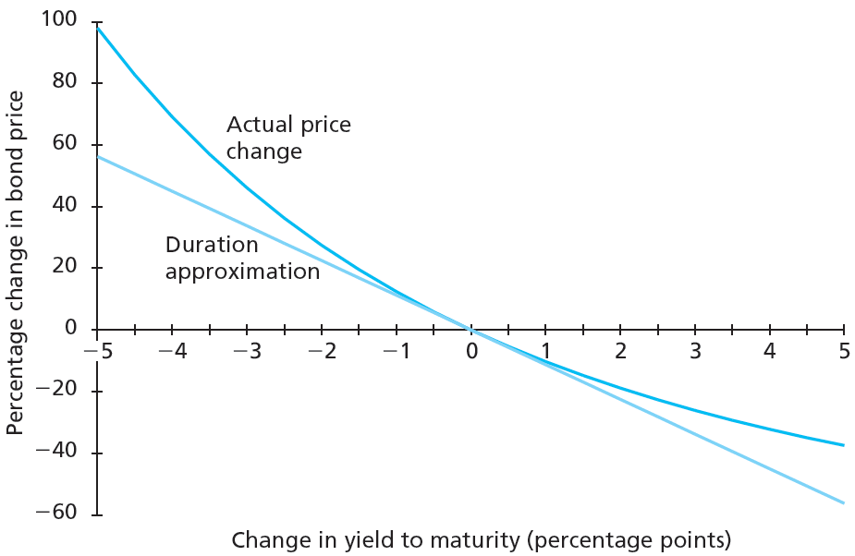
Bond Price Convexity
※ The approximation error of the duration is from the fact that the relationship between bond prices and yields is not linear
※ Note that the two curves are tangent at the current yield. Thus, for small changes in yields, the duration approximation is quite accurate
※ The approximation errors for large yield changes are proportional to the curvature (曲度) (or convexity (凸性)) of the actual price change curve

Slide 37
Correction for Convexity
Accounting for convexity (凸性), the duration/price relationship can be modified based on the Taylor expansion as follows
The convexity of a bond, defined as the second derivative of the bond price with respect to yield over the bond price, is positive
※ Since all bonds are with positive convexity, the second-degree term in the modified equation is positive, regardless of rise and fall in yields

Slide 38
Pricing Error from Convexity
Price
Improved curve after taking the convexity into account
Duration
Yield
※ If the change in yield is small, the convexity term, which is multiplied by (Δy)², will be extremely small and add little to the duration approximation
※ When yield falls considerably, adding the convexity term can offset the underestimate of the gains in bond prices, and when yield rises considerably, adding the convexity can offset the overestimate of the losses in bond prices
※ The modified duration/price relationship after taking the convexity into account will provide a much better approximation (see Slide 11-39)

Slide 39
Pricing Error from Convexity

Slide 40
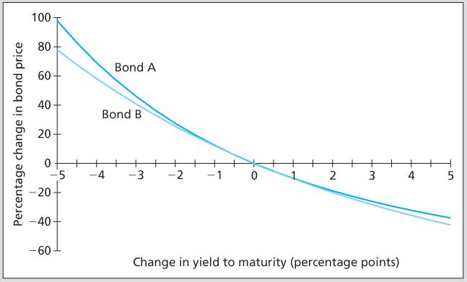
Investors like convexity
※ Bonds A and B have the same duration at the current yield
※ However, bond A is more convex than bond B, so bond A enjoys greater price increase and smaller price decrease when the yield falls and rises
※ Thus, the convexity is a desired feature for investors
※ For two bonds, the bond with greater convexity is worth a higher price if all others associated with these two bonds are the same

Slide 41
11.4 ACTIVE BOND MANAGEMENT

Slide 42
Swapping Strategies
Pure yield pickup swap (收益率純選交換)
Exchange of a shorter duration bond for a longer duration bond: Bear higher IR risks and thus receive higher yields on average
Note that the yield is not the only factor to evaluate the performance of a bond fund manager
Longer duration ⇒ higher IR risk ⇒ higher yield
Rate anticipation swap (利率預期交換)
A switch made in response to forecasts of IR changes
If an investor believes IRs will fall (rise), he may swap into bonds of longer (shorter) duration, that can improve the gains (decrease the losses) if the IRs move as he believes

Slide 43
Swapping Strategies
Intermarket swap (市場間價差交換)
Switch (or trade) between two segments of the bond market
When an investor believes the current yield spread between BBB-rated corporate bonds and T-bonds is too wide, he may consider selling T-bonds and purchasing BBB-rated corporate bonds
If the yield spread eventually narrows, the BBB-rated corporate bond will outperform the T-bonds
It is profitable to close out (反向平倉) the position by selling BBB-rated bonds and buy back T-Bonds
A strategy commonly adopted by hedge funds
Tax swap
Swapping two similar bonds to receive a tax benefit

Slide 44
Swapping Strategies
Substitution swap (替代交換)
Exchange of one bond for a bond with similar attributes but with a more attractive price (or yield)
Similar attributes indicate similar coupon rates, maturities, credit qualities, call features, sinking fund provisions, etc.
Sell Toyota bond (8%, 20yr) with YTM of 8.05% and buy Honda bond (8%, 20yr) with YTM of 8.15%
Two main categories of the active bond management methods
Based on IR forecasts, like pure yield pickup swap or rate anticipation swap
Based on the mispricing between different instruments or markets, like intermarket swap, tax swap, or substitution swap

