Slide 1
CHAPTER 9
Behavioral Finance and Technical Analysis

Slide 2
Learning Goals of Chapter 9
Introduce important findings in behavioral finance (行為財務學)
Behavioral finance, a relatively new field in finance, is proposed to explain some anomalies (異常現象)
Discuss the consistence between the technical analysis and behavioral finance
Behavioral finance can provide the theoretical foundation to explain why the technical analysis sometimes works even in an efficient market
Introduce several classic technical analysis methods (技術分析方法)
※ There is a lot of descriptive content in Ch. 9, so I rearrange the lecture slides in a more logical and succinct way

Slide 3
9.1 THE BEHAVIORAL CRITIQUE

Slide 4
Behavioral Finance
Proponents of the EMH believe that the competition among many professional (rational) investors ensures that security prices ought to be correct
They take advantage of distorted prices, thus driving prices back to their proper levels
Premise (前提) of behavioral finance: the actions of such arbitrageurs are limited (套利有極限) (see Slides 9.17-9.19) and insufficient to force prices to match their intrinsic values
Price distortions or anomalies may exist
In 1990s, the overall P/E ratios (本益比) are too high than the theoretical estimation in the U.S.

Slide 5
Behavioral Finance
Behavioral finance explores “irrational” behaviors (非理性行為) on decision making to interpret the anomalies (異象) or the distortion
“Irrational” behaviors are common for humans, and some are already discovered in psychology but not consistent with the assumptions of human behavior in Economics and Finance
In addition to risk and return, behavior finance focuses as well on affect, which is a “good” or “bad” feeling attached to investment decisions
Investors favor stocks with good affect (e.g., firms with reputations for social responsibility or attractive working conditions) and drive up (down) their prices (rates of return)

Slide 6
Behavioral Finance
Irrationalities fall into two categories:
Information Processing Problems (資料處理問題): Investors do not always process information correctly, e.g., infer (推論) incorrect probability distributions about future rates of return
Behavioral Biases (行為偏誤): Investors often make inconsistent or suboptimal decisions

Slide 7
Information Processing Problems
Forecasting errors (預測誤差)
People weight recent experience too much (太看重近期經驗)
Thus, people extrapolate (外插) trends too far into the future or make too extreme forecasts
Also known as the memory bias (記憶偏誤)
De Bondt and Thaler (1990) employ forecasting errors to explain the P/E ratio effect:
Recent good (poor) performance ⇒ investors tend to forecast the firm’s future profitability too high (low) ⇒ stock price and P/E becomes relatively high (low), so high (low) P/E stocks tend to perform poor (well) when investors recognize and correct their errors
The above inference also can explain the reversal effect for recent extremely performing stocks

Slide 8
Information Processing Problems
Overconfidence (過度自信)
People tend to overestimate the precision of their beliefs or forecasts, i.e., they tend to overestimate their abilities to predict future returns
For overconfident investors
Trading volume may be relatively high (交易量大)
Turnover rate is high (轉換率高)
Such overconfidence may be responsible for the overly frequent trading and the widely adopted active management for mutual funds
It is mostly wasted to adopt the active management in efficient markets
It is difficult to become a fund manager, and once people become fund managers, it is possible that they are too confident of their investment abilities

Slide 9
Information Processing Problems
Conservatism (保守主義)
A conservatism bias means that investors are too slow (or said too conservative) in updating their beliefs in response to new evidence
Or called anchoring bias (定錨偏誤) since people become anchored to their ideas and will not update their expectations when new information arrives
This underreaction to news leads to momentum effect (動量效應) in stock returns
Investors may underreact to news, so market prices, determined by the consensus belief of investors, reflect news gradually

Slide 10
Information Processing Problems
Representativeness bias (代表性偏誤)
People are too prone to believe that a small sample is representative of a population (小樣本可代表母體) and thus infer patterns too quickly based on small samples (觀察少許樣本、太快推論出模式)
Also called the sample size neglect bias (忽略樣本大小偏誤) because people often neglect that the sample size is too small to derive reliable forecasts
Gambler’s fallacy (賭博者的謬誤)
To flip a coin, the previous ten results are all heads
Since the numbers of heads and tails should be very close in the long run, the gambler concludes that it is with higher probability to have tail results for the following games
In fact, for each flip, the probabilities of head and tail are both 50% regardless of prior results
The forecasting errors (memory bias) can be regarded as a type of representativeness bias

Slide 11
Behavioral Biases
Framing effect (框架效果)
Decisions are affected by how choices are posed (決策會被選項如何提出影響)
Ex1. 600 patients, 4 treatments
Patients prefer treatment A to treatment B, and prefer treatment D to treatment C
However, treatment A is equivalent to treatment C, and treatment B is equivalent to treatment D
Ex2. Gains (losses) relative to lower (higher) baseline level could be amplified illusively

Slide 12
Behavioral Biases
Mental accounting (心理帳戶)
Individuals segregate decisions into different accounts
For example, people with insurance policies (conservative account) also buy lotteries (risk-taking account)
Statman (1997) employs the mental accounting to explain the irrationality that some investors would like to spend cash dividends but refuse to sell stock dividends for consumption
Treat cash dividend (like salary) in the income account, but treat stock dividend (like asset) in the wealth account
Use “capital gains account” vs. “initial investment account” to explain the momentum effect: “capital gains account” is more tolerant of risk, discounts cash flows at a lower rate, and thus further pushes prices up

Slide 13
Behavioral Biases
Regret avoidance (避免後悔) and Disposition effect (處分效果)
Regret is a post-decision feeling of pain regarding not having chosen a better alternative and people tend to avoid regret (個人覺得此為正確定義，不知為何課本將後悔與是否做 (非) 常規決定做聯結)
Disposition effect: investors try to avoid regret by realizing capital-gain stocks too early and keeping capital-loss stocks too long
For a capital-gain stock, investors are afraid that once the price falls, they cannot sell shares at such high level ⇒ realize the capital-gain stock too early to avoid regret
For a capital-loss stock, investors are afraid that the price moves reversely and goes upward after they sell shares ⇒ selling the capital-loss stock too late to avoid regret

Slide 14
Behavioral Biases
Prospect theory (展望理論)
Proposed by Kahneman and Tversky (1979), and Kahneman is the Nobel Prize winner in 2002
The most important theory in behavioral finance
They design some psychological experiments to examine how people make decisions when they face different kinds of gambles
1. The results show that what affects people's decisions is not their wealth level after the gamble, but the amount of gains or losses from the gamble
2. Loss averse attitude: people are more sensitive about the losses than the gains
The decrease of the utility (效用) from $1 loss is larger than the increase of the utility from $1 gain

Slide 15
Behavioral Biases
3. People will become more willing to take risks to avoid losses (individuals are risk averse when facing gains but become risk loving when facing losses)
※ Risk aversion for gains and risk loving for losses can explain the disposition effect
Prospect utility reflects the above three findings

Slide 16
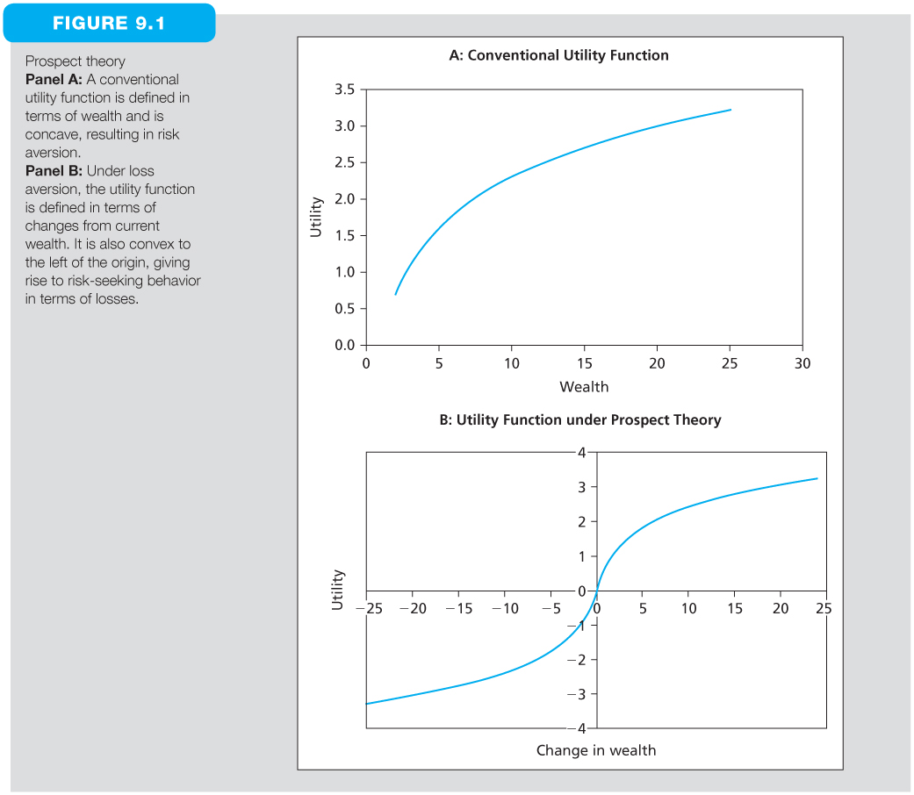
Prospect Theory
※ In traditional economics, people are assumed to be risk averse and with a concave utility function (in Diagram A)
※ In Prospect Theory, people are risk averse (thus with concave utility function) when facing gains and risk loving (thus with convex utility function) when facing losses (in Diagram B)

Slide 17
Limitations to Arbitrage
Fundamental risk
The distortion could get worse or maintain for a long enough horizon such that the exploitation of that distortion to profit is limited (e.g., a trader may run out of his capital or a fund manager may lose his job before the prices go back to the fair level)
Implementation difficulties
The short sell constraint for mutual fund managers
Or short-sellers may have to return the borrowed securities soon after the notification from the broker, that makes the horizon of the short sale uncertain
Model risk
One worries about that an apparent profit opportunity is due to using a faulty model to value the security

Slide 18
Examples for Violation of Law of One Price
Siamese twin (連體人) companies
In 1907, Royal Dutch Petroleum (RDP) and Shell Transport (ST) merged their operations into one firm
RDP receives 60% cash income, and ST receives 40% cash income, so it can be expected that the price of a RDP share is 1.5 times as high as the price of a ST share (see the figure on the next slide)
Closed-end funds
Shares of closed-end funds are traded at substantial discounts or premiums from their net asset values
Ross (2002) mathematically proves that if the abnormal return (α) is larger (lower) than the expense ratio, the closed-end funds should be traded at a premium (discount) to NAV

Slide 19
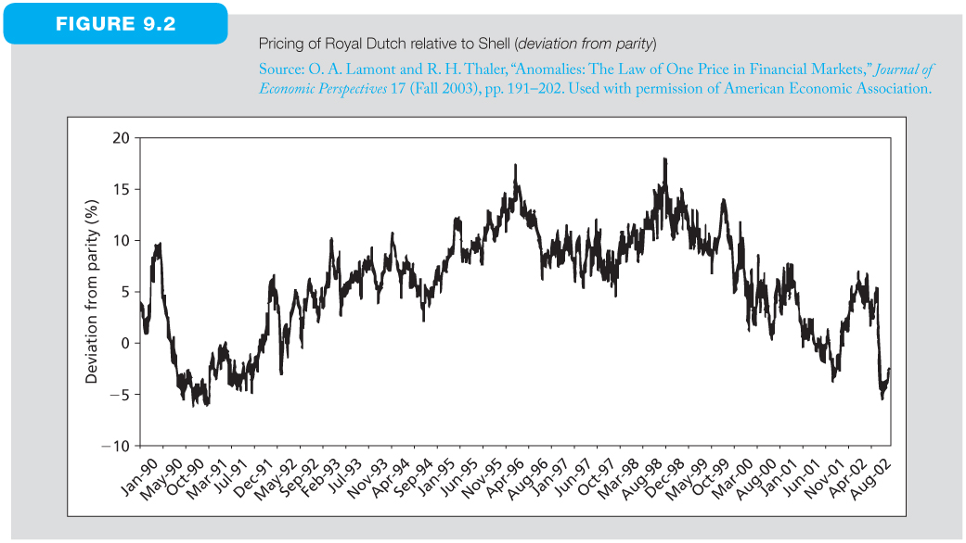
Pricing of RDP Relative to ST (Deviation from Parity)
Consistently positive deviation lasts more than 7 years
※ The y-axis is the percentage deviation from the parity ratio of 1.5
※ This figure shows that the relative value of the two firms departed form this ratio for a long time (From Feb. 1993 to Mar. 2000, the ratio between the prices of RDP and ST is constantly higher than 1.5 for more than 7 years)

Slide 20
Bubbles (泡沫) and Behavioral Economics
From 1995 to 2001, the Nasdaq index increased by a factor of more than 6
This dot-com boom development could be explained by some irrationalities in behavioral finance
In this period, investors were increasingly confident of their forecasts (overconfidence bias) and apparently extrapolate short-term patterns into the distant future (memory or representativeness bias)
The overconfidence arises from the situation in which investors always earn huge capital gains regardless of what to buy and when to buy
The interaction of these two biases can explain the bubble from 1995 to 2001

Slide 21
Critiques for Behavioral Finance
Behavioral finance tries to explain anomalies but DOES NOT give guidance of how to exploit these irrationalities
Behavioral finance explains each anomaly by some subjective combination of irrationalities from the list of behavioral biases. There is no unified behavioral theory to explain a range of anomalies
It is possible to have conflicts between different theories, e.g., overreaction (from memory or representativeness bias) vs. underreaction (from conservatism bias)

Slide 22
9.2 TECHNICAL ANALYSIS AND BEHAVIORAL FINANCE

Slide 23
Technical Analysis and Behavioral Finance
Consistence between the technical analysis and behavioral finance
Technicians believe that prices only gradually go back to their fair values, and they can exploit the slow adjustments to make profit
momentum effect and conservatism bias
Behavioral biases are also consistent with technical analysts’ use of volume data to form trading strategy
As traders become more overconfident, they may trade more, inducing an association between trading volume and market returns
Technicians as well as some proponents of behavioral finance believe that market fundamentals could be affected by irrational or behavioral factors, sometimes labeled sentiment variables (情緒變數)

Slide 24
Technical Analysis and Behavioral Finance
In summary, the authors of this text book believe that
The reason why the technical analysts can make profits is actually from exploiting irrationalities of investors rather than finding some useful information or patterns
Behavioral finance, which is proposed to explain these irrationalities, may provide the theoretical foundation for the feasibility of technical analyses in financial markets

Slide 25
Some Technical Analysis Method
Dow theory (道氏理論)
The ancestor of trend analyses or technical analyses, created by Charles Dow, who is a journalist, the founder and first editor of the Wall Street Journal, and co-founder of Dow Jones & Company
Following Dow’s death, Hamilton, Rhea, and Schaefer organized and collected “Dow Theory,” based on Dow’s editorials about financial markets
Six basic principles of the Dow theory
The market has three factors simultaneously affecting stock prices: primary trends, intermediate trends, and minor trends, see the figures on the next two slides

Slide 26
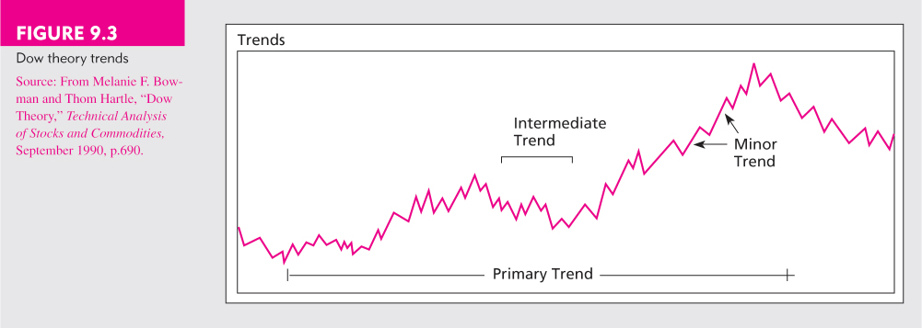
Dow Theory Trends
※ Primary trend: long-term movements, continuing from months to years
※ Intermediate trend: short-term deviations from the underlying primary trend, which could retrace from 33% to 66% of the primary movement
※ Minor trend: daily fluctuations which are with little importance in the trend analysis of the Dow theory

Slide 27
Some Technical Analysis Method
A trend has three phases
Accumulation phase: some foresighted investors are actively trading stock against the general opinion of the market
Rapid price change phase: the trend followers or other technically oriented investors catch on to these foresighted investors
Final phase: the second phase continues until rampant speculation occurs, and at this point, the foresighted investors begin to distribute their holdings to the market
The stock market reflects all news quickly: Dow agreed with the efficient market hypothesis in some degree
Stock market averages must confirm each other
Dow believed that if manufacturer’s profits are rising, more products should be shipped to customers ⇒ The performance of shipping companies, which are mostly railroad companies in the Dow’s era, should also rises ⇒ The industrial average index and the transportation average index should move in the same direction in a real trend

Slide 28
Some Technical Analysis Method
Trends are confirmed by volume
When price movements are accompanied by high volume, Dow believed this represented the “true” market view
To him, it is a signal that a trend is developing
Trends exist until definitive signals (最終的、具有決定性的信號) prove that they have ended
Dow believed that trends exist despite “market noise”
However, determining whether a reversal is the start of a new trend or a temporary deviation in the current trend is very difficult
When there are definitive signals to prove the existence of a trend, usually the trend is almost ended, i.e., the trends are always recognized after the fact

Slide 29
Some Technical Analysis Method
Moving averages (移動平均)
For each day, the moving average of a specified period of time, e.g., 4 weeks, is recomputed by dropping the oldest observation and adding the latest
By definition, the long-term moving average is a more smooth series than the short-term moving average
When the short-term moving average crosses the long-term moving average, a trading signal occurs
Bullish (bearish) signals occur when the short-term moving average penetrates the long-term moving average from below (above) (In Taiwan, this bullish (bearish) signals are called “黃金交叉” (“死亡交叉”))
This is because when the recent performance is significantly superior (inferior) to the past performance in a longer period, it is expected that this time point is the beginning of a rising (falling) trend

Slide 30
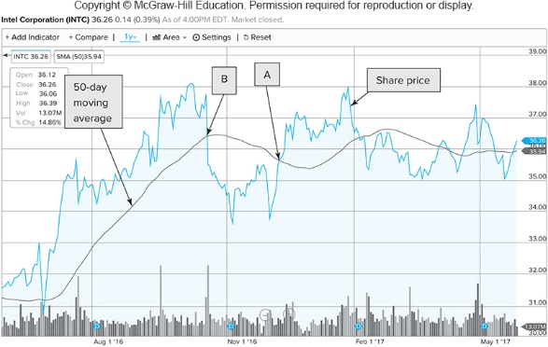
Share Price and 50-Day Moving Average for Intel
Perfect selling point
Bearish signal
Bullish signal
Perfect purchasing point
※ The curve in blue represents the daily share prices, which can be viewed as the shortest-term (1-day) moving average, and the line in black represents the 50-day moving average
※ In this case, both signals provide good forecast about the future movement although they cannot identify the perfect selling and purchasing time points

Slide 31
Some Technical Analysis Method
Point and figure charts (點數圖)
In a rising (falling) trend, whenever the stock price increases (decreases) by, for example, $2, mark an X (O) corresponding to the current stock price in the grid of the point and figure chart
It traces significant upward or downward movements in stock prices regardless of their timing
The aim of this chart is to filter out the “noise” (unimportant price movements) and focus on finding the main direction of the price trend
Different from other technical analyses, this chart has no time dimension
Log scaling point and figure charts: X’s and O’s are marked according to a percentage change, which allows the sensitivity of this method to remain constant for high and low stock price levels

Slide 32
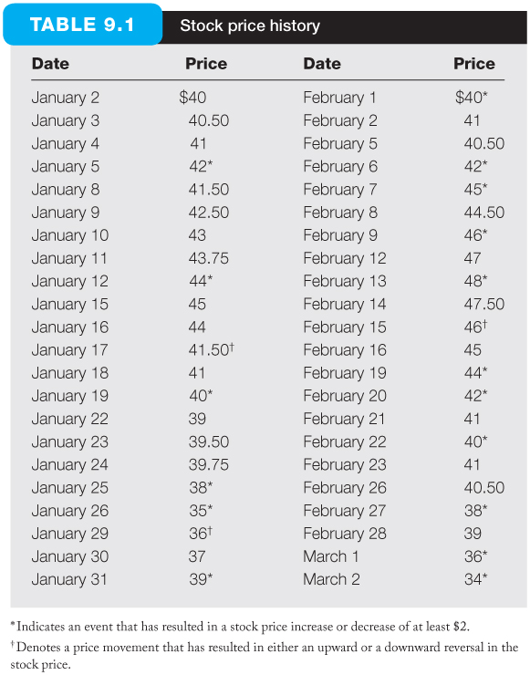
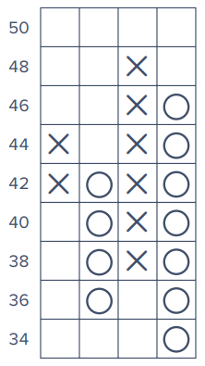
Stock Price History and Point and Figure Chart
※ Each column consists of only one letter (either X or O)–never both
※ New columns are placed to the right of the previous column and are only added once the price changes direction by more than a predefined minimal change amount

Slide 33
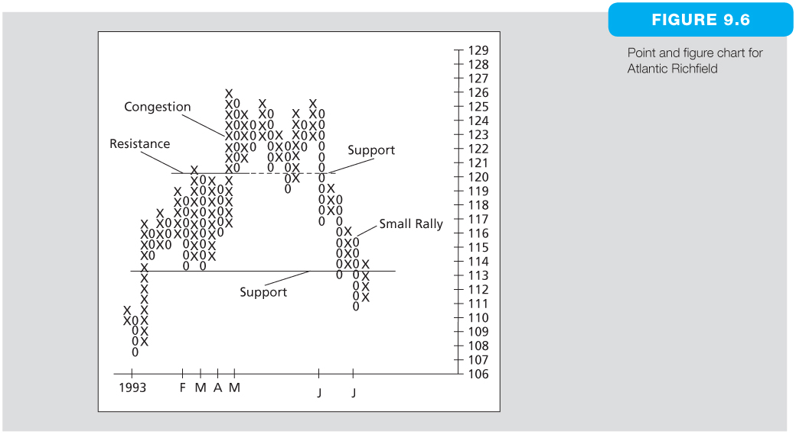
Point and Figure Chart for Atlantic Richfield
Buy Signal
Sell Signal
※ An congestion area (稠密區) is a horizontal band created by several price reversals, i.e., consisting of alternate columns of X’s and O’s, and the upper and lower bounds for an congestion area correspond to the resistance and support levels (阻力線與支撐線)
※ When the stock price penetrates (穿過) the resistance (support) level from below (above), it means the market consensus about the prospect of the stock is significantly better (worse) than that in the previous congestion area and thus a buy (sell) signal is generated

Slide 34
Some Technical Analysis Method
Breadth (廣泛度)
The extent to which the trend of the broad market index is widely reflected in movements of individual stock prices
Breadth is measured as the difference between the number of advancing stocks (上漲股票) and declining stocks (下跌股票)
If the advances outnumber declines by a wide margin, then the stock market is viewed as being stronger because the upward rally is widespread (see the next slide)

Slide 35
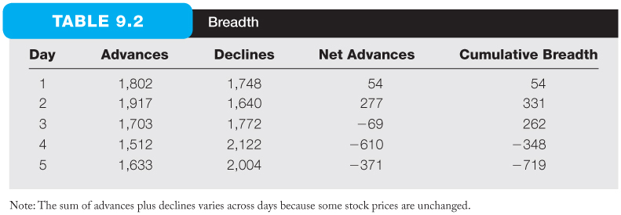
Breadth
※ The direction of the cumulated breadth series is used to discern stock market trends
※ When the cumulative breadth increases (decreases), the market is viewed as being stronger (weaker) because the upward (downward) rally is more widespread
※ Analysts might use a moving average of cumulative breadth to gauge (估量) stock market trends

Slide 36
Some Technical Analysis Method
Relative strength (相對強度)
Defined as the ratio of the price of an individual stock over the level of an industry index
Also can be defined as stock vs. market or industry vs. market
A rising (falling) ratio implies security has outperformed (underperfomed) the particular industry average and generates a signal to buy (sell)
Make profit if the relative strength can persist over time
Buy relatively strong and short relatively weak stocks in the same industry: The market and industry risks can be eliminated and earn purely the performance difference between the two stocks
E.g., buy shares of TSMC and short shares of UMC

Slide 37
Sentiment Indicators (情緒指標)
TRIN (交易指數):
TRIN is the short of TRading INdex
The TRIN ratio above 1.0 are considered bearish (熊市 (市況悲觀)) because the declining stocks would have higher average volume than the advancing stocks, indicating net selling pressure
Note carefully that since for every seller, there must be a buyer, the TRIN ratio above 1.0 also indicates that there is more buying activity in declining stocks than in rising stocks

Slide 38
Sentiment Indicators (情緒指標)
Confidence index (信心指數)
Ratio of the average yield on 10 top-rated corporate bonds (e.g., 4%) over the average yield on 10 intermediate-grade corporate bonds (e.g., 7%)
This ratio is always smaller than 1 because higher rated bonds will offer lower promised yields to maturity
The increase of this index indicates bullish (牛市 (市況樂觀)) signals in the stock market because when investors become optimistic about the future, they require small default premium and thus the yield spread is narrowed
Additional assumption: actions of bond traders reveal trends that will emerge soon in the stock market

Slide 39
Sentiment Indicators (情緒指標)
Put/call ratio (賣買權比例)
Call options grant holders the right to buy at a fixed exercise price (often used when it is believed the market will rise) and a put option is the right to sell at a fixed exercise price (often used when it is believed the market will fall)
The ratio of outstanding put options to outstanding call options is called the put/call ratio
The increase of this ratio indicates bearish signals

Slide 40
Sentiment Indicators (情緒指標)
Short interest (空單餘額)
Total number of shares that are sold short but not yet closed out
When the short interest is high, a bearish signal occurs
Furthermore, since short-sellers tend to be larger, more sophisticated investors, which often “know something inside,” the increase of this number indicates the bearish sentiment of those investors

Slide 41
A Warning
Although we cannot deny the ability and effort of investors to discern apparent patterns in stock market prices–it is also possible to perceive patterns that may not exist
(It is a major shortcoming for the technical analysis)
The actual and randomly simulated stock prices are shown on the next slide

Slide 42
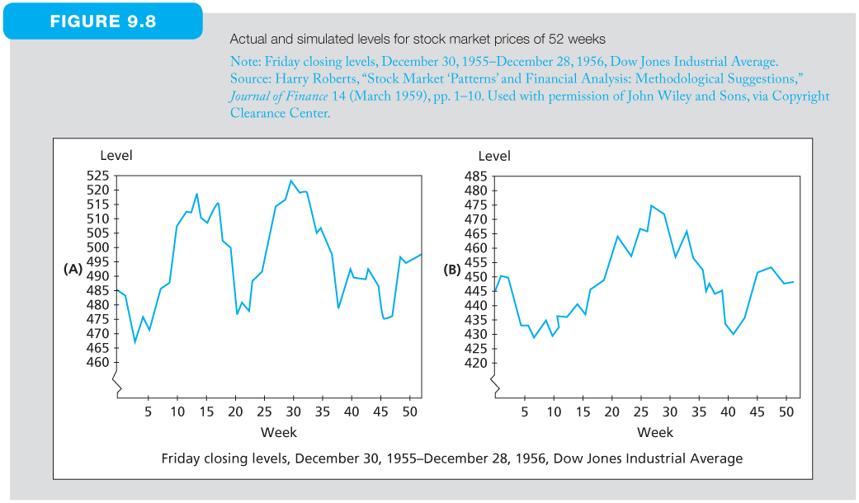
Actual and Simulated Levels for Stock Market Prices of 52 Weeks
Upward primary trend from the Dow theory
Selling signal based on the point and figure chart
※ If you employ the technique analysis techniques we learned in this chapter, maybe you can find some pattern in the right figure
※ However, the right figure is constructed from totally RANDOM simulations
※ Since there should be patternless for the movements in the right figure theoretically, how could it possible to identify any pattern in this figure?

