Slide 1
CHAPTER 7
Capital Asset Pricing Model and Arbitrage Pricing Theory

Slide 2
Learning Goals of Chapter 7
Introduce the Capital Asset Pricing Model (CAPM, 資本資產評價模型) and the Security Market Line (SML, 證券市場線)
Discuss the relationship between the single-index model and the CAPM
Introduce the multi-factor model and the Fama-French three-factor model
Eugene Fama won the Nobel Prize in 2013
Introduce the Arbitrage Pricing Theory (APT, 套利評價理論)

Slide 3
7.1 THE CAPITAL ASSET PRICING MODEL

Slide 4
Capital Asset Pricing Model (CAPM)
The CAPM is a centerpiece of modern financial economics, which was proposed by William Sharpe, who was awarded the 1990 Nobel Prize for economics
It is an “equilibrium” model (均衡模型) derived using principles of diversification and some simplified assumptions for the behavior of investors and the market condition
The market equilibrium refers to a condition in which for all securities, market prices are established to balance the demand of buyers and the supply of sellers. These prices are called equilibrium prices
The assumptions are listed on Slides 7-6 and 7-7

Slide 5
Capital Asset Pricing Model (CAPM)
The CAPM is a model that relates the expected required rate of return for any security to its risk as measured by beta
The expected return-beta relationship in the CAPM is
E(r_{i}) = r_{f} + β_{i} [E(r_{M}) – r_{f}]
If we know the expected rate of return of a security, the theoretical price of this security can be derived by discounting the cash flows generated from this security at this expected rate of return
So, this expected return-beta relationship is viewed as a kind of asset pricing model

Slide 6
Assumptions for CAPM
Single-period investment horizon
Investors can invest in (short sell) the universal set of publicly traded financial assets
Investors can borrow or lend at the risk-free rate unlimitedly
No taxes and transaction costs
Information is costless and available to all investors
Assumptions associated with investors
Investors are price takers (there is no sufficiently wealthy investor such that his will or behavior can influence the whole market and thus security prices)

Slide 7
Assumptions for CAPM
All investors have the homogeneous (同質的) expectations about the expected values, variances, and correlations of security returns
All investors attempt to construct efficient frontier portfolios, i.e., they are rational mean-variance optimizers
(Investors are all very similar except their initial wealth and their degree of risk aversion)
※ Actually, in this simplified economy, we can derive abundant results, like the composition of the market portfolio, the risk premium of the market portfolio, the relationship between the risk premiums of any risky asset and the market portfolio (CAPM), etc

Slide 8
Resulting Equilibrium Conditions
Identical efficient frontier
All investors are mean-variance optimizers and face the same universal set of securities, so they all derive the identical efficient frontier and the same tangent portfolio (O) and the corresponding CAL given the current risk-free rate
The market portfolio is the tangent portfolio O
All investors will put part of their wealth on the same risky portfolio O and the rest on the risk-free asset
The market portfolio is defined as the aggregation of the risky portfolios held by all investors
Hence, the composition of the market portfolio must be identical to that of the tangent portfolio O, and thus E(r_{M}) = E(r_{O}) and σ_{M} = σ_{O}

Slide 9
Resulting Equilibrium Conditions (cont.)
The capital market line (CML, 資本市場線)
As a result, all investors hold the same portfolio of risky assets–market portfolio, which contains all publicly traded risky assets in the economy
The market portfolio is of course on the efficient frontier, and the line from the risk-free rate through the market portfolio is called the capital market line (CML)
※ Which implies that the passive strategy is efficient
We call this result the mutual fund theorem (共同基金理論): Only one mutual fund of risky assets–the market portfolio–is sufficient to satisfy the investment demands of all investors

Slide 10
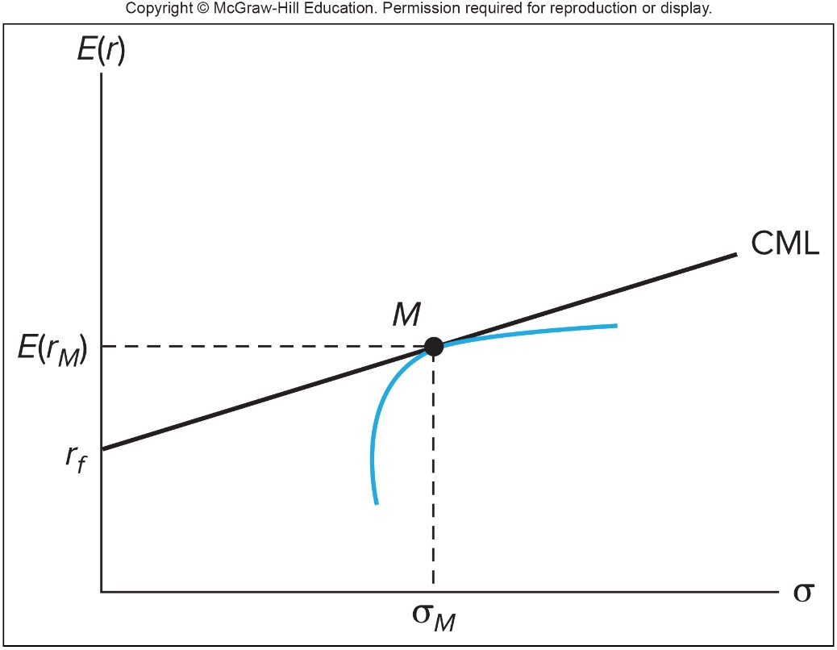
The Efficient Frontier and the Capital Market Line
※ Note that the CML is on the E(r)-σ plane
M = Market portfolio
r_{f} = Risk free rate
E(r_{M}) - r_{f} = Market risk premium
[E(r_{M}) – r_{f}] / σ_{M} = Slope of the CML
= Sharpe ratio for the market portfolio or for all combined portfolios on the CML

Slide 11
Expected Returns On Individual Securities
Derive the CAPM in an intuitive way:
Since the firm-specific risk can be diversified, investors do not require a risk premium as compensation for bearing it ⇒ Investors need to be compensated only for bearing market risk
The risk premium, defined as the expected return in excess of r_{f} , reflect the compensation for securities holders
Since the market risk of an asset is measured by its beta, it is reasonable that the risk premium of an asset should be proportional to its beta
In the equilibrium, the ratio of risk premium to beta should be the same for any two securities or portfolios (including the market portfolio)

Slide 12
Expected Returns On Individual Securities
Therefore, for all securities and the market portfolio,
※ Competition among investors for pursuing the securities with higher risk premiums and smaller betas results in the above equation
The CAPM’s expected return-beta relationship for any security (except the market portfolio)
or
※ Recall the theoretical risk premium of the market portfolio is
where A is the risk aversion coefficient of the representative investor

Slide 13
Expected Returns On Portfolios
Since the expected return-beta relationship according to the CAPM is linear and holds not only for ALL INDIVIDUAL ASSETS but also for ANY PORTFOLIO, the beta of a portfolio is simply the weighted average of the betas of the assets in the portfolio
Assets | Portfolio Weight | Beta | Risk Premium
Microsoft | 0.5 | 1.2 | 9% (=1.2*7.5%)
Con Edison | 0.3 | 0.8 | 6% (=0.8*7.5%)
Gold | 0.2 | 0 | 0% (=0*7.5%)
Portfolio | 1 | 0.84 (=0.5*1.2+0.3*0.8+0.2*0) | 6.3% (=0.5*9%+0.3*6%+0.2*0%) (=0.84*7.5%)

Slide 14
Security Market Line (SML) Relationships
E(r_{i}) = r_{f} + β_{i} [E(r_{M}) – r_{f}]
β_{i} = cov(R_{i},R_{M}) / var(R_{M})
E(r_{M}) – r_{f} = market risk premium
For example: E(r_{M}) – r_{f} = 8% and r_{f} = 3%
β_{x} = 1.25 ⇒ E(r_{x}) = 3% + 1.25 × (8%) = 13%
β_{y} = 0.6 ⇒ E(r_{y}) = 3% + 0.6 × (8%) = 7.8%
※ SML (證券市場線): graphical representation of the expected return-beta relationship of the CAPM (on the E(r)-beta plane)
※ For the stock with a higher beta, since it is with higher market risk, it needs to offer a higher expected return to attract investors

Slide 15
Graph of Security Market Line
E(r)
SML
E(r_{x})=13%
slope is 0.08, which is the market risk premium
E(r_{M})=11%
E(r_{y})=7.8%
3%
β
0.6
1
1.25
β_{y}
β_{M}
β_{X}
※ The CAPM implies that all securities or portfolios should lie on this SML
※ Note that the SML is on the E(r)-β plane, and CML is on the E(r)-σ plane

Slide 16
Applications of the CAPM
In reality, not all securities lie on the SML
Underpriced (overpriced) stocks plot above (below) the SML: Given their betas, their expected rates of return are higher (lower) than the predication by the CAPM and thus the securities are underpriced (overpriced) (see the next slide)
The difference between the expected and actually rate of return on a security is the abnormal rate of return (異常報酬率) on this security, which is often denoted as alpha (α)
Use SML as benchmark for fair return (or hurdle rate (最低報酬率)) for risky assets or portfolios

Slide 17
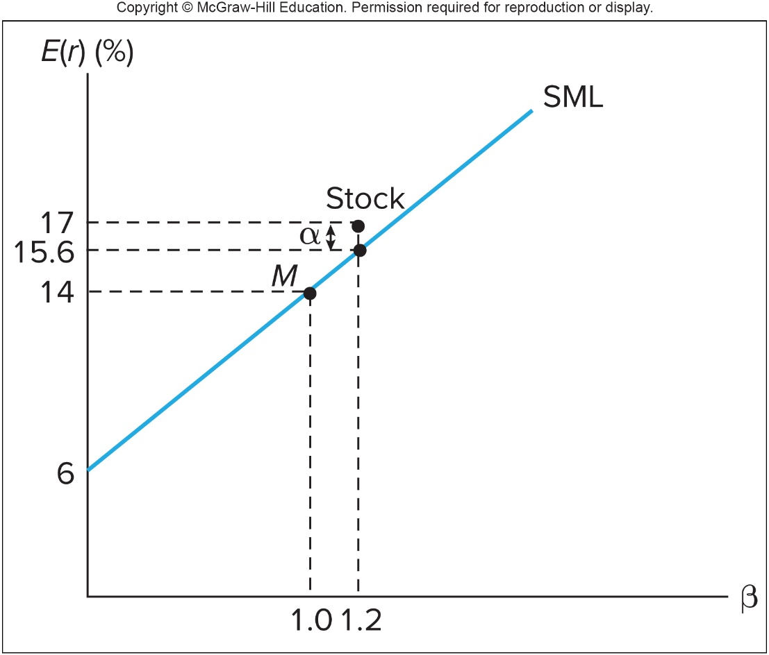
The Security Market Line and Positive Alpha Stock
※ Note that the security with a positive α is with an abnormally higher expected return than the prediction of the CAPM, which implies that security is undervalued comparing to its equilibrium price
※ A positive α security is a more attractive investment target

Slide 18
CAPM vs. Smoothing Consumption
The most important goal for investment is to smooth the individual’s consumption
Suppose R_{M} can reflect the business cycle, i.e., R_{M} ↑, then individual’s consumption ↑ due to the booming economy
β_{A} > 0 ⇒ cov(R_{A},R_{M}) > 0 ⇒ R_{M} ↑, R_{A} ↑ and thus bring more consumption, and R_{M} ↓, R_{A} ↓ and thus reduce consumption
β_{B} < 0 ⇒ cov(R_{B},R_{M}) < 0 ⇒ R_{M} ↑, R_{B} ↓ and thus reduce consumption, and R_{M} ↓, R_{B} ↑ and thus bring more consumption
From the viewpoint of smoothing consumption, individuals prefer B and thus bid up the price of B, which implies a lower expected return of B in the equilibrium
On the contrary, individuals do not like A, so the price of A decreases, which implies a higher expected return of A
Preference for smoothing consumption is consistent with the CAPM

Slide 19
Complementary Issues Associated CAPM
CAPM implies that the passive strategy
Everyone invests in the combination of the market portfolio and the risk-free asset ⇒ All investors adopt the passive strategy
Several flaws of CAPM
Unreal assumptions, e.g., homogeneous expectations of security returns and variance, borrowing funds at the risk-free interest rate
Logical inconsistency:
If a passive strategy is costless and efficient, why would anyone follow an active strategy?
If no one does any security analysis, what brings about the efficiency of the market portfolio?

Slide 20
7.2 THE CAPM AND INDEX MODELS

Slide 21
Estimating the Index Model
The CAPM has two limitations:
It relies on the theoretical market portfolio, which includes all assets (not only domestic stocks but also bonds, foreign stocks and bonds, real estates, etc.)
It deals with expected returns, which cannot be observed in advance in the market
For the single index model (單一指數模型)
The stock index return, rather than the performance of the theoretical market portfolio, is employed to approximate the market factor of the economy
In addition, the index model is based on actually realized returns

Slide 22
Estimating the Index Model
Similarities between the CAPM and the single-index model
The CAPM (E(r_{i}) = r_{f} + β_{i} [E(r_{M}) – r_{f}]) implies that the expected return of the market portfolio is the single factor to explain all expected returns in the economy
By taking the expectation on the both sides of the single-index model, i.e.,
r_{i} – r_{f} = α_{i} + β_{i} (r_{M} – r_{f}) + e_{i},
where E(e_{i}) = 0, cov(r_{M} – r_{f}, e_{i}) = 0, and cov(e_{i} ,e_{j}) = 0, we can derive E(r_{i}) = r_{f} + α_{i} + β_{i} [E(r_{M}) – r_{f}]
Thus, the CAPM provides the theoretical foundation for the single-index model, and single-index model can be employed to examine the CAPM empirically

Slide 23
Estimating the Index Model
Since the CAPM predicts α_{i} = 0, we can convert the examination of correctness of the CAPM by analyzing the intercept in a regression of observed variables
Using historical series of returns on T-bills (for r_{f}), S&P 500 index (for r_{M}) and individual securities (for r_{i}), regress excess returns for individual stocks against the excess returns for the S&P 500 index
If α_{i} equals zero statistically (or equivalently α_{i} is not significant), the CAPM holds

Slide 24
Estimating the Index Model
The difference between the actual excess return and the predicted excess return is called a residual
where t = 1,…, T and T is the number of observations for each series
The least squares regression (最小平方回歸) is to find the optimized values for α_{i} and β_{i} by minimizing the sum of the squared residual over T observations

Slide 25
Estimating the Index Model
We use the monthly series over Jan/2006 -Dec/2010 for the T-bills rate, the Google stock price, and the S&P 500 index for regression (For Google and S&P 500, their rates of return must be adjusted for stock splits, stock dividends, and cash dividends)
The unadjusted price series counts only capital gains, but here we need total returns
We can calculate the excess returns of the Google stock and the S&P 500 index for each month, and plots each pair of these excess returns on the xy-plane (see the scatter diagram on the next slide)

Slide 26
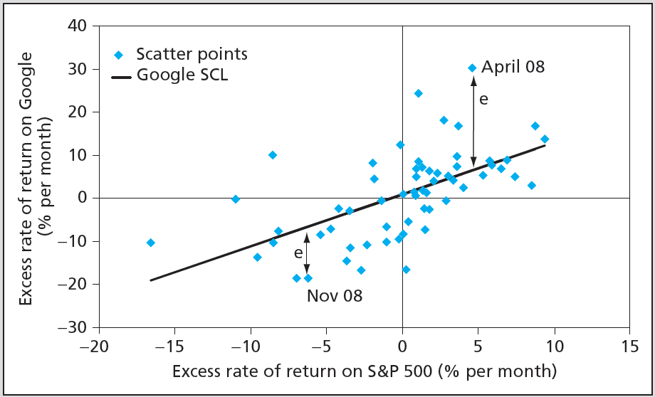
Scatter Diagram (點散圖) and the Security Characteristic Line (證券特徵線) for Google
※ The security characteristic line (SCL) describes the linear function of security’s expected excess return with respect to the excess return on the market index
※ The level of dispersion of the points around the SCL measures firm-specific risk. The corresponding statistic is sd(e_{i}) = σ_{e}

Slide 27
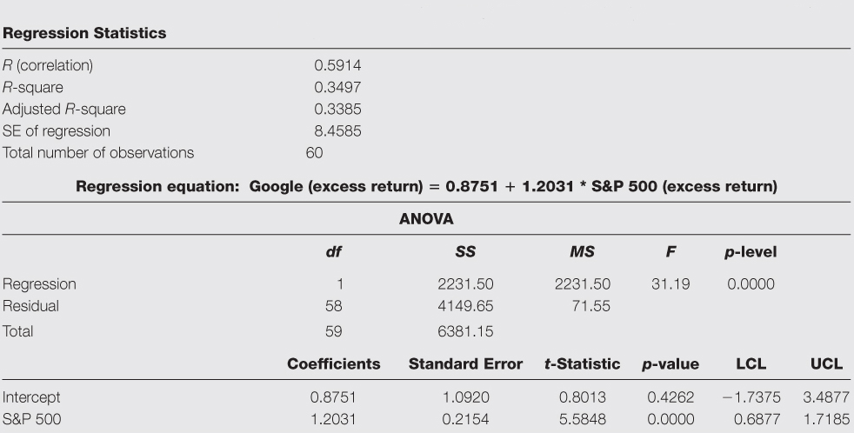
Regression Results for Google
Correlation coefficient and R² between R_{Google} and R_{S&P 500}
sd(e_{i}) = σ_{e} = 8.4585%
98% confidence interval =
[estimated coeff.+t_{1%}(T-2)×standard error, estimated coeff.+t_{99%}(T-2)×standard error]
Analysis of Variance
※ The R-square, equal to the square of the correlation coefficient, measures the relative importance of market risk to total variance (which equals $β_{i}^{2}σ_{M}^{2}/σ_{i}^{2}$ shown on Slide 6-52)
※ The R-square tells us that about 34.97% of the variation in Google’s excess returns is explained by the variation in the excess returns of the market index (or the market risk represents about 34.97% of the total risk)

Slide 28
Supplement: Statistical Inference
※ The estimates of the intercept (α) and the slope (β) are 0.8751% and 1.2031, respectively
※ The t-statistic is defined as
Without further specification, the hypothesis value is assumed to be zero, e.g., the t-statistic for S&P 500 is (1.2031 – 0) /0.2154 = 5.5848
※ Note that the t-statistic follows the t distribution with the degree of freedom of (T–n), where T and n are the numbers of observations and explanatory variables (including the intercept)
※ If the t-statistic is more positive or negative (given zero hypothesis value), the estimated value is more significantly positive and negative
※ If the hypothesis value is set to be the true value, we can derive the distribution for the true value
$$t=\frac{Estimated value−Hypothesis value}{Standard error of estimate}$$
$$\frac{Estimated value−True value}{Standard error of estimate}\sim t\left(T−n\right)$$
$$⇒True value\sim Estimated value−t\left(T−n\right)×Standard error of estimate$$
$$⇒True value\sim Estimated value+t\left(T−n\right)×Standard error of estimate$$

Slide 29
Supplement: Statistical Inference
※ The (1–y)-level confidence interval is [estimated value + t_{(y/2)}(T–n)×standard error, estimated value + t_{(1–y/2)} (T–n)×standard error], where t_{k}(T–n) is the k-th percentile of the t distribution with the degree of freedom of (T–n)
※ In Google example, y = 2% (i.e., considering 98% confidence interval), T = 60, and n = 2 ⇒ t_{(y/2)} (T–n) = –2.3924 and t_{(1–y/2)} (T–n) = 2.3924
※ When T approaches infinity, the t distribution converges to the standard normal distribution and thus t_{(y/2)} (T–n) and t_{(1–y/2)} (T–n) can be approximated with z_{(y/2)} and z_{(1–y/2)}, which are the (γ/2)-th and (1−γ/2)-th percentiles, respectively, of the standard normal distribution
※ The 98% confidence interval for α is [–1.7375%, 3.4877%], which means that with the likelihood (可能性) of 98%, the true alpha lies in this interval, which includes zero. That means the estimate for α in this regression is not significantly different from zero
※ The 98% confidence interval for β is [0.6877, 1.7185]. Since the confidence interval does not include zero, we can conclude that the estimate for β is significantly different from zero

Slide 30
Google Regression: What We Can Learn
Since the beta of Google is 1.2031, we can expect Google’s excess return to vary, on average, 1.2031% for 1% variation in the market index
Google is a cyclical stock due to its positive beta and if the assumption that the r_{S&P 500} is a good approximation for the business cycle
Suppose the current T-bill rate is 2.75%, and our forecast for the market risk premium is 5.5%. The expected required rate of return for Google stock can be calculated as

Slide 31
7.3 THE CAPM AND THE REAL WORLD

Slide 32
CAPM and the Real World
The CAPM proposed by Sharpe was first published on Journal of Finance in 1964
Many tests for CAPM are conducted following the Roll’s critique in 1977 and the Fama and French’s three-factor model (三因子模型) (1992, 1996)
Roll argued that since the true market portfolio can never be observed, the CAPM is untestable
Some tests suggest that the error introduced by using a stock index (such as the S&P 500 index) as a proxy for the unobserved market portfolio (by including more than 4000 stocks in the U.S.) is not serious in testing the CAPM

Slide 33
CAPM and the Real World
Fama and French add the firm size and book-to-market ratio into the CAPM to explain expected returns
Motivated by two observations: average stock returns for smaller firms and firms with a high book-value-per-share to market-value-per-share ratio are historically higher than the predictions according to the CAPM
Possible reasons are that the size (市值) or the book-to-market ratio (帳面市價比) may be proxies for other sources of systematic risk not captured by the CAPM beta, and thus result in return premiums
Details of Fama and French’s three-factor model will be introduced in the next section

Slide 34
CAPM and the Real World
However, the principles we learn from the CAPM are still entirely valid
Investors should diversify (invest in the market portfolio)
Differences in risk tolerances can be handled by changing the asset allocation decisions in the market portfolio
Market risk is the only risk that matters (thus we have the relationship between the expected return and the beta of each security)
The intuition behind CAPM is consistent with smoothing investors’ consumption

Slide 35
7.4 MULTIFACTOR MODELS AND THE CAPM

Slide 36
Multifactor Models
The systematic risk may be not from one source in reality
It is obvious that developing models that allow for several systematic risks can provide better descriptions of security returns
Suppose that the two macroeconomic sources of risk are “uncertainties surrounding the state of the business cycle” and “unanticipated change in interest rates”. The two-factor CAPM model could be
where the interest rate risk is approximated by the risk associated with the T-bond rate

Slide 37
Multifactor Models
An example for the above two-factor CAPM
Northeast Airlines has a market beta of 1.2 and a T-bond beta of 0.7. Suppose the risk premium of the market index is 6%, while that of the T-bond portfolio is 3%. Then the overall risk premium on Northeast stock is the sum of the risk premiums required as compensation for each source of systematic risk

Slide 38
Fama-French Three-Factor Model
How to identify meaningful factors to increase the explanatory or predictive power of the CAPM is still an unsolved problem
In addition to the market risk premium (市場風險溢酬), Fama and French propose the size premium (市值溢酬) and the book-to-market premium (帳面市價比溢酬)
The size premium is constructed as the difference in returns between small and large firms and is denoted by SMB (“small minus big”)
The book-to-market premium is calculated as the difference in returns between firms with a high versus low B/M ratio, and is denoted by HML (“high minus low”)

Slide 39
Fama-French Three-Factor Model
The Fama-French three-factor model is
r_{SMB} is the return of a portfolio consisting of a long position of $1 in a small-size-firm portfolio and a short position of $1 in a large-size-firm portfolio
r_{HML} is the return of a portfolio consisting of a long position of $1 in a higher-B/M (value stock) portfolio and a short position of $1 in a lower-B/M (growth stock) portfolio
r_{SMB} (r_{HML}) represents the average reward compensating holders of the security i exposed to the sources of risk for which r_{SMB} (r_{HML}) proxies (代理)
Note that it is not necessary to calculate the excess return for r_{SMB} and r_{HML}

Slide 40
Fama-French Three-Factor Model
Two reasons for why there is no (–r_{f}) term for the size and book-to-market premiums
SMB and HML are not real investment assets
Constructing the portfolio to earn r_{SMB} and r_{HML} costs noting initially (SMB and HML are self-financing portfolios)
Similar to the CAPM, we can use a three-factor model to examine the Fama-French model empirically

Slide 41
Empirical Test of the CAPM and Fama-French Three-Factor Model for Disney
※ The differences in alpha and beta between the single-index and Fama-French three-factor models are minor
※ The Fama-French three-factor model improves the fitting performance (although not much):
The R-square value increases
The residual standard deviation decreases
The absolute value of alpha decreases

Slide 42
Interpretation of Fama-French Three-factor Model for Disney
※ The SMB beta is -0.243 (not significantly), which indicates negative tendency for Disney’s returns to be correlated with r_{SMB} and thus returns of small firms. In fact, Disney is a big company
※ The HML beta is 0.217 (not significantly), which implies that Disney’s returns are positively correlated with r_{HML} and thus returns of higher-B/M firms. Therefore, investors may view Disney as a value stock (which may distribute more dividends)
※ Suppose the T-bill rate is 2%, the market risk premium is 8.3%, and the forecasted return on the SMB and HML portfolios are 3.2% and 4.7%. The respective expected required rates of return of Disney derived from the CAPM and Fama-French model are
(Note that it is not necessary to consider $α$ for calculating expected returns, especially when $α$ is not significant)
$$E\left(r_{i}\right)=r_{f}+β_{iM}\left[E\left(r_{M}\right)−r_{f}\right]=2\%+1.046×8.3\%=10.68\%$$
$$E(r_{i})=r_{f}+β_{iM}[E(r_{M})−r_{f}]+β_{i\text{SMB}}E(r_{\text{SMB}})+β_{i\text{HML}}E(r_{\text{HML}}) \\ =2\%+1.066×8.3\%−0.243×3.2\%+0.217×4.7\%=11.09\%$$

Slide 43
7.5 FACTOR MODELS AND THE ARBITRAGE PRICING THEORY

Slide 44
Arbitrage Pricing Theory
Arbitrage (套利)–Creation of riskless profits by trading relative mispricing among securities
1. Constructing a zero-investment portfolio today and earn a profit for certain in the future (see Slide 7-45)
2. Or if there is a security priced differently in two markets, a long position in the cheaper market financed by a short position in the more expensive market will lead to a profit as long as the position can be offset each other in the future
Since there is no risk for arbitrage, an investor creates arbitrarily large positions to obtain large levels of profit
No arbitrage argument (無套利論點): in efficient markets, profitable arbitrage opportunities will quickly disappear

Slide 45
Arbitrage Pricing Theory
Example for the first type of arbitrage: if all the following stocks are worth $8 today, are there any arbitrage opportunities?
Long (A+B)/2 and short C can create an arbitrage portfolio
Stock | Recession | Normal | Boom
A | $12 | $5 | $15
B | $4 | $13 | $5
C | $7 | $8 | $9
Portfolio | Cash flow today | Final payoff for different scenarios Recession Normal Boom
Long (A+B)/2 | –$8 | $8 $9 $10
Short C | $8 | –$7 –$8 –$9
Total | $0 | $1 $1 $1

Slide 46
Arbitrage Pricing Theory
The Arbitrage Pricing Theory (APT, 套利評價理論) was introduced by Ross (1976), and it is a theory of risk-return relationship derived from no-arbitrage arguments in large capital markets
Large capital markets mean that the number of assets in those markets can be arbitrarily large
Considering any well-diversified (large enough) portfolio such that the firm-specific risk (e_{P}) is negligible, the single-index model implies
R_{P} = α_{P} + β_{P}R_{M}
where R_{P} = r_{P} – r_{f} and R_{M} = r_{M} – r_{f} are excess rates of return of the well-diversified portfolio and the market portfolio, respectively

Slide 47
Arbitrage Pricing Theory
The APT concludes that only value for alpha that rules out arbitrage opportunities is zero
The proof is as follows

Slide 48
Arbitrage Pricing Theory
For all “well-diversified portfolios”, APT ⇒ CAPM
R_{P} = β_{P}R_{M} ⇒ E(R_{P}) = β_{P}E(R_{M})
The apagoge (反證法) logic for that the APT can be applied to “individual stocks”
The apagoge proves a thing by showing the impossibility or absurdity (荒謬) of the contrary
If the expected return-beta relationship (with zero alpha) were violated by many individual securities, it is impossible for all well-diversified portfolios to satisfy the relationship like the CAPM
So the expected return-beta relationship must hold true almost surely for individual securities
Thus, with APT, it is allowed for a small portion of individual stocks to be mispriced–not on the SML

Slide 49
Arbitrage Pricing Theory
The APT seems to obtain the same expected return-beta relationship as the CAPM with fewer objectionable assumptions
However, the absence of riskless arbitrage cannot guarantee that, in equilibrium, the expected return-beta relationship will hold for any individual assets and portfolios
In contrast, it is suggested in the CAPM that all individual assets and portfolios in the economy should satisfy the famous expected return-beta relationship

Slide 50
Multifactor Generalization of the APT
Consider any well-diversified portfolio (e_{P} = 0) whose return can be specified as follows according to a two-factor model:
R_{P} = α_{P} + β_{P1}R_{M1} + β_{P2}R_{M2},
where R_{M1} and R_{M2} are the excess returns for the first- and second-factor portfolios
Factor portfolios are well-diversified portfolios designed to track the systematic factors
Assumptions:
First factor portfolio with a beta of 1 (0) on the first factor (the other factors) has an excess return R_{M1}
Second factor portfolio with a beta of 1 (0) on the second factor (the other factors) has an excess return R_{M2}

Slide 51
Multifactor Generalization of the APT
The APT proves that only value for alpha that rules out arbitrage opportunities is zero
$$\text{Constructing} \text{another} \text{portfolio} P^{′} \text{by} \text{investing} \text{the} \text{weight} β_{P1} \text{in} \text{the} \text{first} \\ \text{factor} \text{portfolio}\text{, }\text{the} \text{weight} β_{P2} \text{in} \text{the} \text{second} \text{factor} \text{portfolio}\text{, }\text{and} \text{the} \text{weight} (1−β_{P1}−β_{P2}) \text{in} \text{the} \text{risk}\text{−}\text{free} \text{asset}, \text{then} \\ r_{P^{′}}=(1−β_{P1}−β_{P2})r_{f}+β_{P1}r_{M1}+β_{P2}r_{M2} \\ =r_{f}+β_{P1}(r_{M1}−r_{f})+β_{P2}(r_{M2}−r_{f})=r_{f}+β_{P1}R_{M1}+β_{P2}R_{M2} \\ ⇒R_{P^{′}}=β_{P1}R_{M1}+β_{P2}R_{M2}$$
$$(R_{P^{′}}=r_{P^{′}}−r_{f}\text{, }R_{M1}=r_{M1}−r_{f}, \text{and} R_{M2}=r_{M2}−r_{f})$$
$$\text{Next}\text{, }\text{consider} \text{the} \text{value} \text{of} α_{P} \text{in} R_{P}=α_{P}+β_{P1}R_{M1}+β_{P2}R_{M2}: \\ \left\{\begin{matrix}\begin{aligned}&\text{If} α_{P}>0, \text{long}\text{ \$1 }\text{in} P \text{and} \text{short}\text{ \$1 }\text{in} P^{′} \\ & ⇒ \text{the} \text{positions} β_{P1}R_{M1} \text{and} β_{P2}R_{M2} \text{are} \text{offset} \text{for} \text{each} \text{other} \\ & ⇒ \text{earn} \text{a} \text{riskless} \text{positive} \text{rate} \text{of} \text{return} α_{P} \end{aligned} \\ \begin{aligned}&\text{If} α_{P}<0, \text{short}\text{ \$1 }\text{in} P \text{and} \text{long}\text{ \$1 }\text{in} P^{′} \\ & ⇒ \text{the} \text{positions} β_{P1}R_{M1} \text{and} β_{P2}R_{M2} \text{are} \text{offset} \text{for} \text{each} \text{other} \\ & ⇒ \text{earn} \text{a} \text{riskless} \text{positive} \text{rate} \text{of} \text{return} −α_{P}\end{aligned}\end{matrix}\right.$$

Slide 52
Multifactor Generalization of the APT
Another way to explain that it does not need to calculate the excess return for r_{SMB} and r_{HML}

