Slide 1
CHAPTER 6
Efficient Diversification

Slide 2
Learning Goals of Chapter 6
Introduce the market risk (市場風險) and the firm-specific risk (公司特定風險)
Portfolio Theory (投資組合理論):
Diversification in the case of two risky assets without or with the risk-free asset
Extension to the multiple risky-asset case
Introduce the single-factor model (單一指數模型), which is a statistical model
To identify the components of firm-specific and market risks
To develop the Treynor-Black model to construct portfolios with higher Sharpe ratios
To examine the CAPM (discussed in Ch7)

Slide 3
6.1 DIVERSIFICATION AND PORTFOLIO RISK

Slide 4
Diversification and Portfolio Risk
Firm-specific risk (公司特定風險)
Risk factors that affect an individual firm without noticeably affecting other firms, like the results of R&D, the management style, etc.
Due to the possible offset of the firm-specific risks from different firms in a portfolio, this risk can be eliminated through diversification
Also called unique, idiosyncratic (特質的), diversifiable, or nonsystematic risk
Market risk (市場風險)
Risk factors common to the whole economy, possibly from business cycles, inflation rates, interest rates, exchange rates, etc.
The risk cannot be eliminated through diversification
Also called nondiversifiable or systematic risk

Slide 5
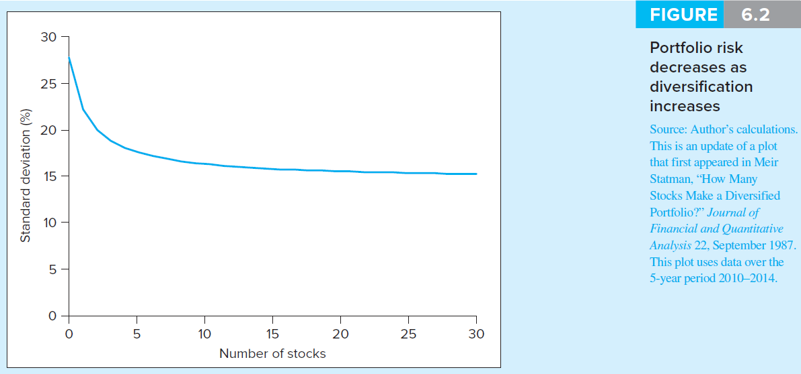
Portfolio Risk as a Function of Number of Securities on NYSE
Firm-specific risk
Market risk
1
※ For one single stock, the average total risk can be measured as the standard deviation of 27%. The market and firm-specific risks represent about 53% and 47% of the total risk, respectively
※ The extremely diversified portfolio will be the whole market portfolio traded on NYSE
※ International diversification may further reduce the portfolio risk, but global risk factors affecting all countries will limit the extent of risk reduction

Slide 6
6.2 ASSET ALLOCATION WITH TWO RISKY ASSETS

Slide 7
Diversification and Portfolio Theory
The portfolio theory was first introduced by Harry Markowitz in 1952, who is a Nobel Prize laureate in 1990
Sections 6.2 to 6.4 will introduce the results of Markowitz’s work of showing how to make the most of the power of diversification
In this section, the effect of diversification is illustrated by a case of two risky assets

Slide 8
Two Asset Portfolio Return – Stock and Bond Funds
Here we assumed that the risky portfolio comprised a stock and a bond fund, and investors need to decide the weight of each fund in their portfolios

Slide 9
Scenario Analysis-Mean and Variance
Mean (Expected Return):
Variance:
※ A property for variance

Slide 10
Scenario Analysis-Covariance (共變異數)
Covariance between r_{S} and r_{B}: a measure of co-varying behavior of returns on two assets
※ Three properties for covariance

Slide 11
Scenario Analysis-Covariance (共變異數)
※ Another expression for covariance

Slide 12
Scenario Analysis-Correlation Coefficient
Correlation Coefficient (相關係數): standardize the covariance with two standard deviations
Range of possible values for ρ_{ij}
–1.0 < ρ_{ij} < 1.0
※ ρ_{ij} = 1 (perfectly positively correlated): the strongest tendency for two returns to vary in the same direction
※ ρ_{ij} = 0: the returns on two assets are unrelated to each other
※ ρ_{ij} = –1 (perfectly negatively correlated): the strongest tendency for two returns to vary inversely

Slide 13
Sample Covariance
For two series of returns in the same period (with n pairs of observations), the covariance is computed as follows
※ To correct the underestimation of the covariance when using sample average to estimate the true mean, the sum of the product of deviations are divided with (n–1) instead of n
※ In Excel, the function “COVARIANCE.S” takes the (n–1) adjustment into account (but “COVARIANCE.P” does not) and thus can be applied to computing the covariance between two historical return series

Slide 14
An Simple Example for Diversification
Expected Return (%):
Variance (%²) and Standard Deviation (%):

Slide 15
An Simple Example for Diversification
Covariance (%²) and Correlation:
Effect of Diversification (reducing risk (s.d.)):
※ Portfolio risk heavily depends on the covariance or correlation between the returns of the assets in the portfolio

Slide 16
An Simple Example for Diversification
Summary:
 | Expected Return (E(r_{i})) | Standard Deviation (σ_{i}) | Sharpe Ratio (r_{f} = 1%)
Stock fund (i = S) | 10% | 18.63% | 0.483
Bond fund (i = B) | 5% | 8.27% | 0.484
Combined Portfolio (i = P) | 7% | 6.65% | 0.902
※ Since E(r_{P}) > E(r_{B}) and σ_{P} < σ_{B}, the combined portfolio is strictly better than the bond fund according to the mean-variance analysis
※ Because the stock fund is with higher return and higher standard deviation than those of the portfolio, it is difficult to choose between the stock fund and the combined portfolio
※ With the help of the Sharpe ratio, we can identify that the combined portfolio is the best investment target

Slide 17
Three Rules of Two-Risky-Asset Portfolios
Rate of return on the portfolio:
Expected rate of return on the portfolio:
Variance of the rate of return on the portfolio (proved on Slide 5-43):

Slide 18
Standard Deviation of the Portfolio of Two Assets
※ Alternative way to derive the formula of the portfolio variance: Calculating the sum of the covariances of different combinations of the terms in r_{P}
(In this two-asset case, the four combinations of w_{B}r_{B} and w_{S}r_{S} are considered)

Slide 19
Standard Deviation of the Portfolio of Two Assets
※ Verify the above formula numerically by the above two-asset example
※ Equipped with the above formula, it is not necessary to calculate r_{p} in different scenarios. We can derive the portfolio variance directly if we know the weights for each asset, the variances of the return of each asset, and the covariance between the returns of these two assets

Slide 20
Three Rules for an n-Security Portfolio:

Slide 21
Numerical Example: Portfolio Return and S.D. of Bond and Stock Funds
Returns
Bond fund E(r_{B}) = 5% Stock fund E(r_{S}) = 10%
Standard deviations
Bond fund σ_{B} = 8% Stock fund σ_{S} = 19%
Weights
Bond fund W_{B} = 0.6 Stock fund W_{S} = 0.4
Correlation coefficient between returns of the bond fund and stock fund = 0.2

Slide 22
Numerical Example: Portfolio Return and S.D. of Bond and Stock Funds
Portfolio return
0.6(5%) + 0.4(10%) = 7%
Portfolio standard deviation
[(0.6)²(8%)² + (0.4)²(19%)² + 2(0.6)(0.4) (0.2)(8%)(19%)]^{½} = 9.76%

Slide 23
Numerical Example: Portfolio Return and S.D. Given Different Correlation Coefficients
Different values of the correlation coefficient (given w_{B} = 0.6 and w_{S} = 0.4)
ρ_{SB} | –1 | –0.5 | 0 | 0.5 | 1
E(r_{P}) | 7% | 7% | 7% | 7% | 7%
σ_{P} | 2.80% | 6.66% | 8.99% | 10.83% | 12.40%
※ If the correlation between the component securities (or portfolios) is small or negative, there is a greater tendency for the variability in the returns on the two assets to offset each other, and thus the portfolio is with a smaller σ_{P}

Slide 24
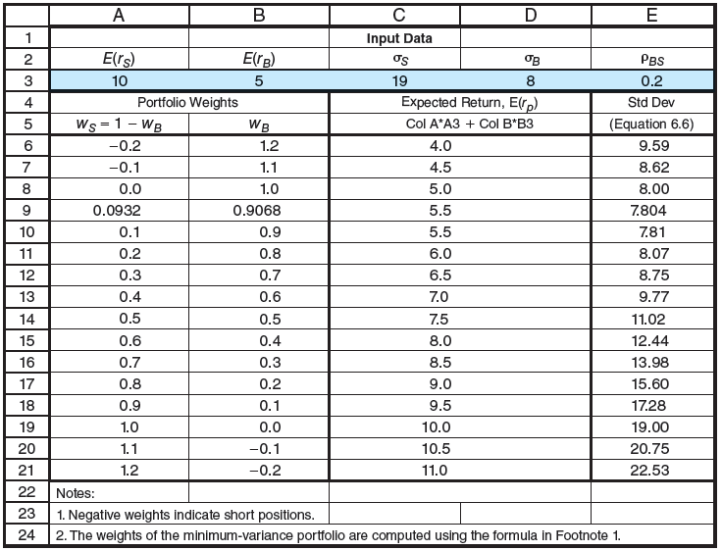
Numerical Example: Portfolio Return and S.D. Given Different Weights
Different weights on the bond and stock funds
minimum-variance portfolio

Slide 25
Numerical Example: Portfolio Return of Bond and Stock Funds (Page 155)
The weights for the minimum-variance portfolio

Slide 26
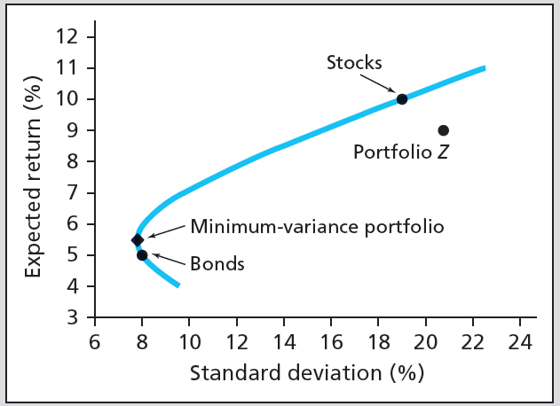
Investment Opportunity Set (投資機會集合) for the Stock and Bond Funds
※ By varying different weights on the bond and stock funds, we can construct the investment opportunity set (投資機會集合), which is a set of all available portfolio risk-return combinations
※ The blue curve is the investment opportunity set for these two risky portfolios with the correlation coefficient to be 0.2

Slide 27
Mean-Variance Criterion
Investors prefer portfolios with higher expected return and lower volatility
Portfolio A is said to dominate (宰制) Portfolio B
if E(r_{A}) ≥ E(r_{B}) and σ_{A} ≤ σ_{B}
(Thus, the stock fund dominates the portfolio Z on Slide 6-26)
An important feature of the portfolios in the investment opportunity set:
Under the same expected return, the portfolio in the investment opportunity set dominates all portfolios to its right due to the smaller s.d.
This feature will be employed to define the investment opportunity set in the n risky-asset case in Section 6.4
Notes:
Although we call it mean-”variance” criterion, we actually compare s.d. rather than variance. Note that higher s.d. leads to higher variance, so ranking results based on s.d. and variance are identical.

Slide 28
Mean-Variance Criterion
Efficient vs. Inefficient Portfolios (效率與非效率投資組合)
Any portfolios that lies below the minimum-variance portfolio (MVP) can therefore be viewed as inefficient portfolios because it must be dominated by a counterpart portfolio above the MVP with the same volatility but with higher expected return
For the investment opportunity set above the MVP, because higher expected return is accompanied with greater risk, the best choice depends on the investor’s willingness to trade off risk against expected return

Slide 29
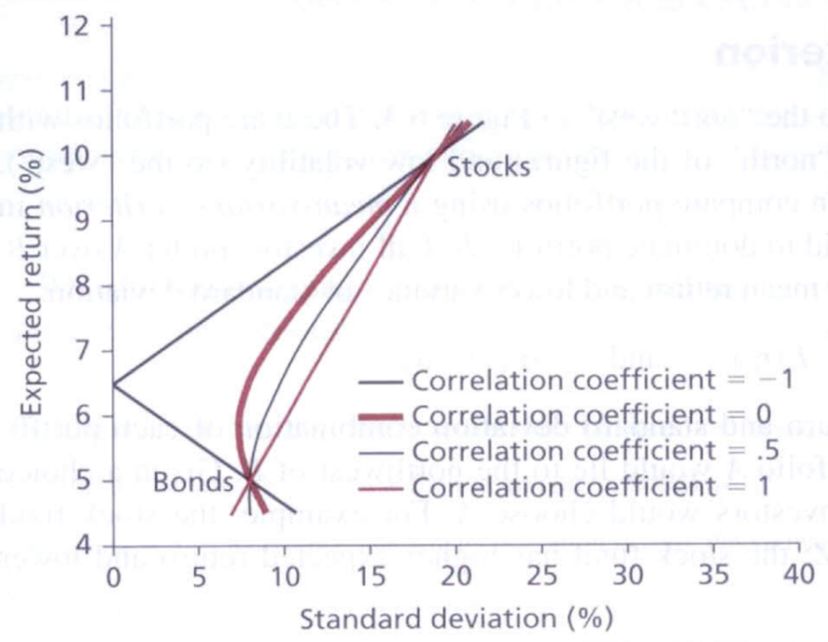
Investment Opportunity Sets for the Stock and Bond Funds with Various Correlations
※ For more negative ρ_{SB}, it tends to generate investment opportunity sets with smaller s.d. (Recall that on Slide 6-23, the risk (s.d.) reduces with a more negative correlation)
※ For ρ_{SB} = –1, since the movements of r_{S} and r_{B} are always in opposite directions, one can construct a zero s.d. portfolio with a positive return
This positive return can be earned without uncertainty, so it should be comparable to the risk-free rate to exclude arbitrage opportunities

Slide 30
6.3 THE OPTIMAL RISKY PORTFOLIO WITH A RISK-FREE ASSET

Slide 31
Extension to Include the Risk-Free Asset
Combinations of any risky portfolio P and the risk-free asset are in a linear relation on the E(r)-σ plane:

Slide 32
Extension to Include the Risk-Free Asset
Combinations with different weights form a capital allocation line (CAL)
According the derivation on the previous slide, the reward-to-volatility ratio of any combined portfolio is the slope of the CAL, i.e.,
Recall that a numerical example of the above result is illustrated on Slide 5-46

Slide 33
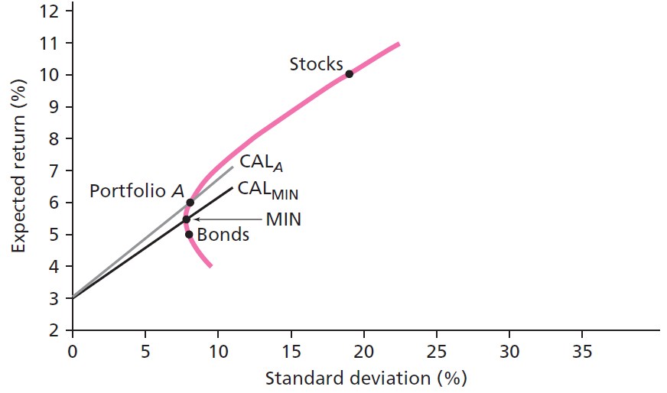
Investment Opportunity Set Using Portfolio MVP or A and the Risk-Free Asset
Consider the combination of any efficient portfolio above the MVP and r_{f} = 3%
It is obvious that the reward-to-volatility ratio of portfolio A is higher than that of MVP
Mean-variance criterion also suggests that portfolios on CAL_{A} is more preferred than those on CAL_{MIN}

Slide 34
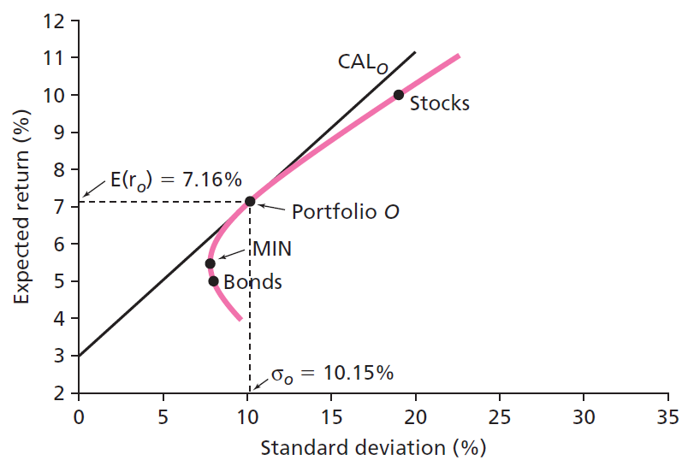
Figure 6.6 Dominant CAL associated with the Risk-Free rate
We can continue to choose the CAL upward until it reaches the ultimate point of tangency with the investment opportunity set, i.e., finding the tangent portfolio O as follows

Slide 35
Dominant CAL with the Risk-Free Asset
CAL_{O} dominates other CALs and all portfolios in the investment opportunity set: it has the best risk/return or the largest slope
Note that the mean-variance criterion also suggests the same conclusion
The tangent portfolio O is the optimal risky portfolio conditional on a given risk-free rate
Given a different risk-free rate, one can find a different portfolio O such that the combinations of the risk-free asset and the portfolio O are the most preferred portfolios

Slide 36
Dominant CAL with the Risk-free Asset
Since portfolios on the CAL_{O} are with the same reward-to-volatility ratio, investors will choose their preferred complete portfolios along the CAL_{O}
Among different combinations of the portfolio O and the risk-free asset, more risk-averse (risk-tolerant) investors prefer low-risk, lower-return (higher-risk, higher-return) portfolios near r_{f} (near r_{O} or even to the right of r_{O})
Recall that on Slide 5-48, the optimal weight on Portfolio O can be derived as

Slide 37
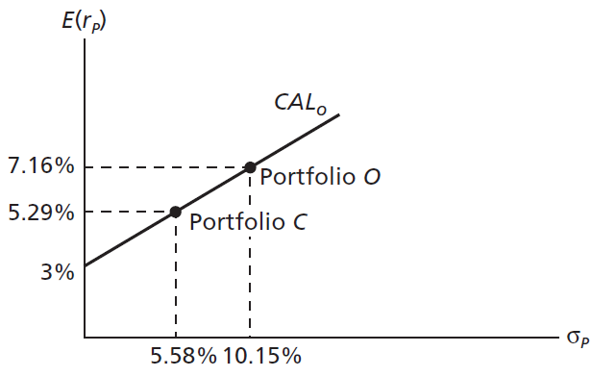
The Complete Portfolio
※ For point O, the investor allocates 100% of asset in portfolio O (with expected return of 7.16% and the s.d. of 10.15%)
※ For point C, the investor allocates 55% of his asset in portfolio O and 45% of his asset in the risk-free asset

Slide 38
Dominant CAL with the Risk-free Asset
In this two-asset case, the weights in the stock and bond funds of the optimal tangent portfolio O can be derived through Eq. (6.10)
The expected return and the standard deviation of the portfolio O thus can be derived through
$$E(r_{O})=w_{B}^{∗}E(r_{B})+w_{S}^{∗}E(r_{S})$$
$$σ_{O}^{2}\text{= }(w_{B}^{∗})^{2}σ_{B}^{2}+2w_{B}^{∗}w_{S}^{∗}ρ_{SB}σ_{B}σ_{S}+(w_{S}^{∗})^{2}σ_{S}^{2}$$

Slide 39
6.4 EFFICIENT DIVERSIFICATION WITH MANY RISKY ASSETS

Slide 40
Extension to All Securities
For n-risky assets, the investment opportunity set consists of portfolios with optimal weights (could be negative) on assets to minimize variance given the expected portfolio return, i.e.,
In other words, for given expected portfolio returns E(r_{p}), the portfolios on the investment opportunity set dominate other portfolios, i.e., with less risk given the same expected return

Slide 41
Extension to All Securities
The curve for the investment opportunity set is also called the portfolio frontier (投資組合前緣)
The upper half of the portfolio frontier is called the efficient frontier (效率前緣), which represents a set of efficient portfolios that offer higher expected return at each level of portfolio risk (comparing to the lower half of the portfolio frontier) (see the next slide)

Slide 42
The Efficient Frontier of Risky Assets and Individual Assets
※ For rational investors, they prefer the portfolio of risky assets on the efficient frontier due to the mean-variance criterion

Slide 43
Extension to All Securities
Using the current risk-free rate, we can search for the CAL with the highest reward-to-volatility ratio and thus find the optimal risky portfolio O (see Slides 6-33 and 6-34)
Finally, investors choose the appropriate mix between the optimal risky portfolio O and the risk-free asset (see Slide 6-37)
Separation property: the process to choose portfolio combinations can be separated into two independent tasks
Determination of the optimal risky portfolio O given the current risk-free rate, which is a technical problem
The personal choice of the mix of the risky portfolio and the risk-free asset depending on his preference

Slide 44
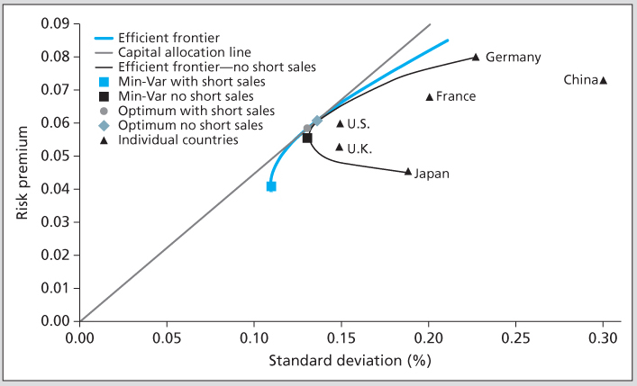
Extension to All Securities
An illustrative example: Construct a global portfolio using six stock market indices
※ To take the forbiddance of short sales into account, one needs an additional constraint that $w_{1}$, $w_{2}$,…, $w_{n}≥0$ in the minimization problem specified on Slide 6-40

Slide 45
6.5 SINGLE-INDEX MODEL

Slide 46
Index models
The index model (指數模型) is a statistical model to measure or identify the components of firm-specific and systematic risks for a particular security or portfolio
William Sharpe (1963), who is a Nobel Prize laureate in 1990, used the single-index model (單一指數模型), also known as the market model (市場模型), to explain the benefits of diversification
To separate the systematic and nonsystematic risks in the single-index model, it is intuitive to use the rate of return on a broad portfolio of securities, such as the S&P 500 index, as a proxy for the common macro factor (market risk factor)

Slide 47
Specification of a Single-Index Model of Security Returns
Excess return of security i can be stated as:
R_{i} (= r_{i} – r_{f}) denotes the excess return on security i
R_{M} (= r_{M} – r_{f}) denotes the excess return on the market index
e_{i} denotes the unexpected risk relevant only to this security (but not relevant to R_{M} and other securities) and E(e_{i}) = 0, var(e_{i}) = σ²(e_{i}), cov(R_{M}, e_{i}) = 0, and cov(e_{i}, e_{j}) = 0
α_{i} is the security’s expected excess return if R_{M} is zero
β_{i} measures the sensitivity of the excess return R_{i} with respect to the market excess return R_{M}
This model specifies two sources of risks for securities:
Common macro factor (R_{M}) (or the market risk factor): represented by the fluctuation of the market index return
Firm-specific components (e_{i}): representing the part of uncertainty specific to individual firms but independent of the market risk factor

Slide 48
Scatter Diagram (點散圖) for R_{i} and R_{M}
※ The linear relation is drawn so as to minimize the sum of all the squared errors (which is measured as the vertical distance between each node and the examined straight line) around it. Hence, we say the regression line “best fits” the data in the scatter diagram
※ The line is called the security characteristic line (SCL, 證券特徵線)

Slide 49
Scatter Diagram (點散圖) for R_{i} and R_{M}
Geometric interpretation of α_{i} and β_{i}
The regression intercept is α_{i}, which is measured as the intercept (截距) of the regression line with the vertical axis (see the previous slide)
The regression coefficient β_{i} is measured as the slope (斜率) of the regression line
The larger the beta of a security ⇒ the greater sensitivity of the security price in response to the market index ⇒ the higher the security’s systematic risk

Slide 50
Deriving α_{i} and β_{i} using Historical Data
The slope and intercept of the best-fit regression line can be derived as follows
 | Annualized Rates of Return (%) |  |  |  |  | Excess Returns (%)
Month | ABC | XYZ | Mkt. Index | Risk Free |  | ABC | XYZ | Market
1 | 2.81 | 4.23 | 3.71 | 1.02 |  | 1.79 | 3.21 | 2.69
2 | -1.89 | -0.78 | 0.28 | 1.06 |  | -2.95 | -1.84 | -0.78
3 | 1.85 | 3.02 | 2.84 | 1.11 |  | 0.74 | 1.91 | 1.73
4 | -1.36 | -2.98 | -1.51 | 1.04 |  | -2.40 | -4.02 | -2.55
5 | -3.31 | -2.34 | -1.86 | 0.98 |  | -4.29 | -3.32 | -2.84
6 | 9.72 | 2.03 | -2.29 | 1.03 |  | 8.69 | 1.00 | -3.32
7 | 0.91 | -0.56 | -1.77 | 1.06 |  | -0.15 | -1.62 | -2.83
8 | -5.09 | -6.45 | -8.49 | 1.05 |  | -6.14 | -7.50 | -9.54
9 | 3.63 | 6.85 | 4.39 | 1.05 |  | 2.58 | 5.80 | 3.34
10 | -3.21 | -3.09 | -2.63 | 1.07 |  | -4.28 | -4.16 | -3.70
11 | 2.81 | 2.63 | 1.37 | 1.04 |  | 1.77 | 1.59 | 0.33
12 | 2.82 | 6.95 | 5.39 | 1.01 |  | 1.81 | 5.94 | 4.38
 |  |  |  |  | Average: | -0.236 | -0.251 | -1.091
 |  |  |  |  |  | COVARIANCE MATRIX
 |  |  |  |  |  | ABC | XYZ | Market
 |  |  |  |  | ABC | 16.416
 |  |  |  |  | XYZ | 12.462 | 17.491
 |  |  |  |  | Market | 7.884 | 14.899 | 15.028
SUMMARY OUTPUT OF EXCEL REGRESSION
Regression Statistics
Multiple R | 0.502
R-square | 0.252
Adj. R-square | 0.177
Standard Error | 0.037
Observations | 12
 | Coefficients | Std. Error | t-statistic | p-value
Intercept (%) | 0.336 | 1.106 | 0.304 | 0.767
Market Return | 0.525 | 0.286 | 1.835 | 0.096
$$β_{ABC}=\frac{cov(R_{ABC},R_{M})}{var(R_{M})}=\frac{7.884}{15.028}=0.525$$
$$(β_{ABC}=\frac{ρ_{ABC,M}σ_{ABC}σ_{M}}{σ_{M}^{2}}=\frac{ρ_{ABC,M}σ_{ABC}}{σ_{M}})$$
$$∵E\left(R_{ABC}\right)=α_{ABC}+β_{ABC}E(R_{M})$$
$$∴α_{ABC}=E\left(R_{ABC}\right)−β_{ABC}E(R_{M})$$
$$={\overline{R}}_{ABC}−β_{ABC}{\overline{R}}_{M}$$
$$=−0.236\%−0.525×−1.091\%$$
$$=0.336\%$$
※ The SCL of ABC is given by
R_{ABC} = 0.336% + 0.525 R_{M}
※ The regression results in the left table are generated by the Data Analysis tool in Excel

Slide 51
Components of Risk
Because the firm-specific components of the firm’s return is uncorrelated with the market return, we have the following equation
The systematic risk of each security depends on both the volatility in R_{M} (that is, σ_{M}) and the sensitivity of the security to fluctuations in R_{M} (that is, β_{i})
The firm-specific risk is the variance in the part of the stock’s return that is independent of market return (that is, σ²(e_{i}))

Slide 52
Components of Risk
One method to measure the relative importance of systematic risk is to calculate the ratio of systematic variance to total variance
A larger correlation coefficient (in absolute value terms) indicates that the systematic risk represents a larger portion of the total risk and is more important
At the extreme, when the correlation is either 1 or –1, the return of the individual stock is perfectly positively or negatively correlated with the market return. Thus the security return can be fully explained by the market return and there are no firm-specific effects
※This ratio is also called R-square, which measures how well the market return can explain the individual return

Slide 53
Interpretation of Regression Lines and Scatter Diagrams
※ For R₁ to R₆, β > 0, and for R₇ and R₈, β < 0; For R₁, R₂, and R₆, β’s are larger (higher market risk) because the regression lines are steeper
※ For R₂, R₃, and R₇, the degree of deviations from the regression line are smaller and relatively stable, which implies a smaller σ²(e_{i}) (smaller firm-specific risk) or a higher R-squared value
※ For R₁, R₄, and R₈, α > 0, which is a preferred feature because for stocks with the same β, a higher α means a higher expected excess return for that stock
※ Total risk (= market risk + firm-specific risk) is measured by the total variance, i.e., var(R_{i}). Note that undiversified investors care about total risk rather than only firm-specific risk (There is an error in the solution manual, see Slide 6-63)

Slide 54
Predicting Betas
The beta from the regression equation is an estimate based on past history, but we want to forecast beta in the future
Betas exhibit a statistical property called “regression toward the mean” (向平均回歸)
High (low) beta (that is beta > (<) 1) securities in one period tend to exhibit a lower (higher) beta in the future (Blume (1975))
Adjusted betas (proposed by Klemkosky and Martin (1975) and adopted by Merrill Lynch)
A common weighting scheme is 2/3 on the historical estimate and 1/3 on the value of 1
Based on the results of ABC on Slide 6-50, the adjusted beta is (2/3)×0.525+(1/3)×1=0.6833

Slide 55
Diversification in a Single-Index Security Market
The systematic component of each security return β_{i}R_{M} is perfectly correlated with the systematic part of any other security’s return
Thus there are no diversification effects on systematic risk no matter how many securities are involved
The beta of a portfolio is the weighted average of the individual security betas in that portfolio
This is why the systematic risk is also called the nondiversifiable risk

Slide 56
Diversification in a Single-Factor Security Market
Since the firm-specific risks (e_{i}) are independent of each other, their effects could be offset or almost eliminated through diversification, i.e., through investing in many securities
Consider a equally weighted portfolio
So the firm-specific risk is also called the diversifiable risk

Slide 57
The Treynor-Black (1973) Model
To improve the Sharpe ratio of the market portfolio based on stocks with nonzero α’s in the single-index model
Construct a new portfolio based on the market portfolio M and these non-zero alpha stocks
First, construct the active portfolio A by optimally combining non-zero alpha stocks with the weights
Positive (negative) α_{i} ⇒ positive (negative) w_{i} ⇒ purchase (short) the stock i ⇒ w_{i} α_{i} always has positive contribution to α_{A}
Smaller σ²(e_{i}) ⇒ Higher R² based on the market model ⇒ higher confidence level of the accuracy of α_{i} ⇒ higher weight w_{i} on the stock i

Slide 58
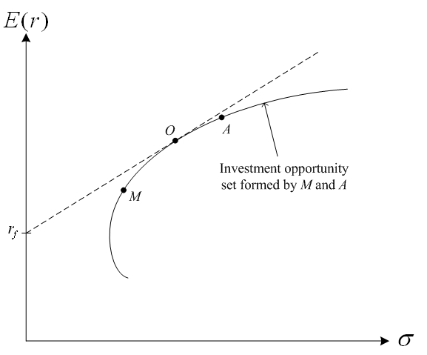
The Treynor-Black (1973) Model
Second, construct the investment opportunity set using the portfolios M and A, and find the optimal tangent portfolio O given the risk-free rate r_{f}
The improvement of the Sharpe ratio

Slide 59
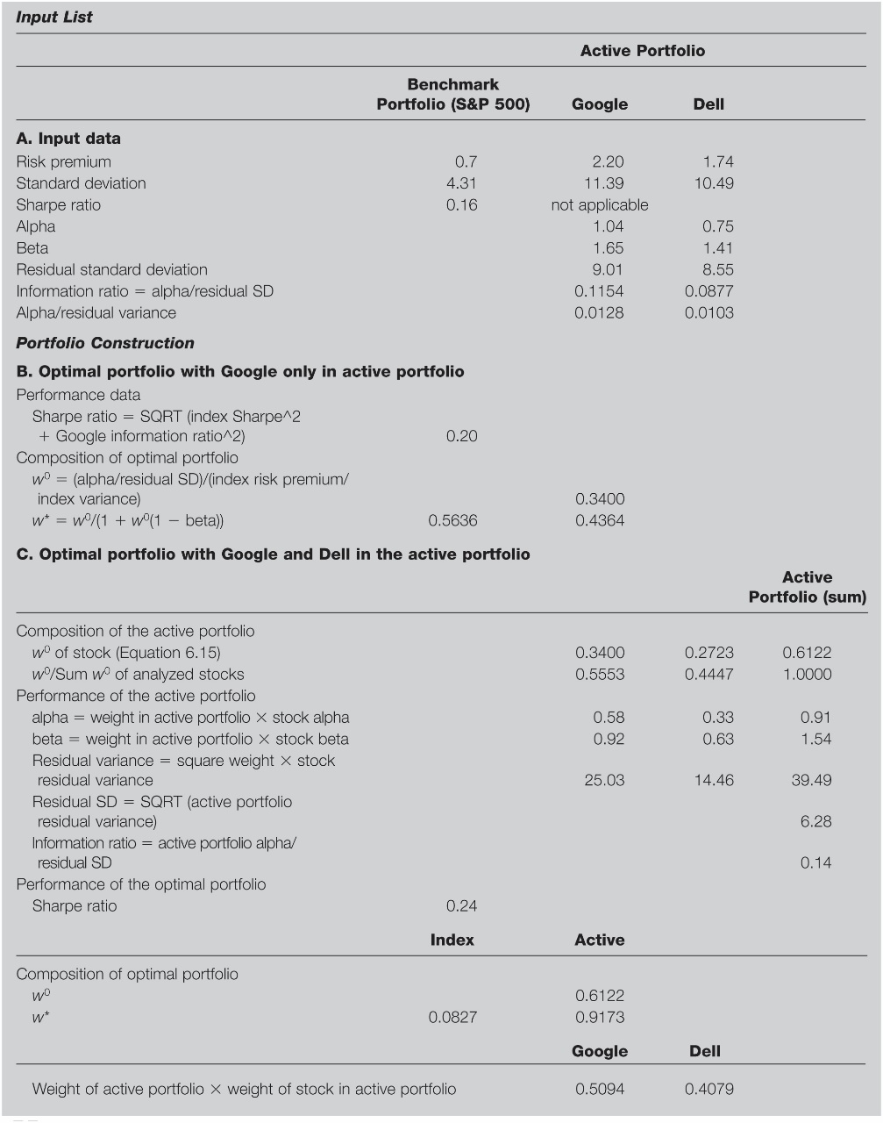
The Treynor-Black (1973) Model
※ Note that the performance of the Treynor-Black model critically depends on the accuracy of the prediction of α_{i}‘s and β_{i}‘s for a “future” period of time

Slide 60
6.6 TIME DIVERSIFICATION AND RISK SHARING

Slide 61
Risk of Long-Term Investments
Vast majority of financial advisers believe that stocks are “less risky” if held for the long run
The simplified assumptions for the i-th year excess return, $R_{i}$
$E\left(R_{i}\right)=R$, $var\left(R_{i}\right)=σ^{2}$, and $R_{i}$’s are serially uncorrelated (時間序列上不相關，但實務上未必正確)
Risk premium for the T-year (investment) return is $E\left(\sum_{i=1}^{T}{R_{i}}\right)=RT$
Variance for the T-year return is $Tσ^{2}$ (= var($R_{1}$ + $R_{2}$ + … + $R_{T}$) = var($R_{1}$) + var($R_{2}$) + … + var($R_{T}$))
Standard deviation for the T-year return is σ$\sqrt{T}$
The Sharpe ratio becomes RT / σ$\sqrt{T}$ = R$\sqrt{T}$ / σ, which is increasing with T $⇒$ T-year investment seems preferred (comparing to 1-year investment)

Slide 62
Risk of Long-Term Investments
Time diversification effect:
The overperforming and underperforming effects could offset for each other such that the variance of a T-year return is proportional to T rather than T ²
Thus, the variance of the “average return” decreases with T:
$var\left(\frac{1}{T}\sum_{i=1}^{T}{R_{i}}\right)=$ $\frac{1}{T^{2}}var\left(\sum_{i=1}^{T}{R_{i}}\right)=\frac{1}{T^{2}}Tσ^{2}=\frac{σ^{2}}{T}$
However, the variance of a T-year return still increases with T, i.e., the total risk increases with T
In contrast, the portfolio diversification effect does work (provided that $R_{j}$’s are independent and total investment amount is fixed):
$var\left(\frac{1}{n}\sum_{j=1}^{n}{R_{j}}\right)=$ $\frac{1}{n^{2}}var\left(\sum_{j=1}^{n}{R_{j}}\right)=\frac{1}{n^{2}}n\overline{σ^{2}}=\frac{\overline{σ^{2}}}{n}$
(the risk (variance of the portfolio return) decreases with n)

Slide 63
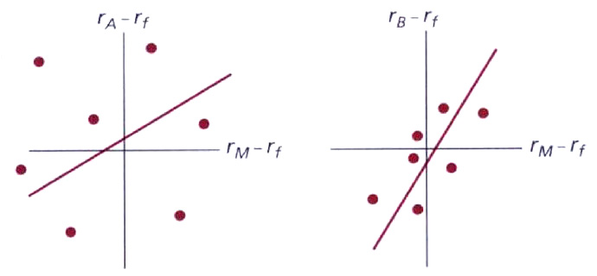
Exercise 6.21
Which stock is riskier to an investor currently holding a diversified portfolio of common stock?
He should care about the systematic risk that is measured by $β$
Which stock is riskier to an undiversified investor who puts all of his funds in only one stock?
He should care about the total risk (rather than the firm-specific risk suggested in the solution manual) that is measured by the variance of the levels of $r_{A}−r_{f}$ or $r_{B}−r_{f}$
In contrast, the firm-specific risk is measured by the vertical distance of each observation from the SCL

