Slide 1
CHAPTER 5
Risk and Return: Past and Prologue

Slide 2
Learning Goals of Chapter 5
Introduce methods to calculate the holding period return (HRP, 持有期間收益率)
Consider the inflation rate (通貨膨脹率) and real return (實質報酬率)
Introduce the estimation of risk (the uncertainty of returns) and the risk premium (風險溢酬)
Show the historical return-risk patterns
Asset allocation (資產配置) between the risky and riskless portfolios
Introduce the capital market line (CML, 資本市場線), which is the foundation of the CAPM (資本資產定義理論)
Supplement: Value at Risk (VaR, 風險值)

Slide 3
5.1 RATES OF RETURN (報酬率)

Slide 4
Holding Period Return (HPR, 持有期收益率): Single Period Example
Beginning Price = 20, Ending Price = 24, Cash Dividend = 1
HPR = (24 – 20 + 1) / (20) = 25%
※ For assets other than stocks, $D_{1}$ represents the sum of all cash incomes generated from the assets during the investment period
※ HPR is also known as the rate of return (ROR) (報酬率) for an investment period
※ HPR and ROR will be used interchangeably in my lecture

Slide 5
Measuring Investment Returns Over Multiple Periods
HPR is a simple and unambiguous measure of investment return over ONE period (單期HPR)
However, investors are often interested in average returns over MULTIPLE periods (多期平均報酬率)
In this case, return measurement is more ambiguous, i.e., there may be different methods to measure multi-period returns
Arithmetic average return (算術平均報酬率)
Geometric average return (幾何平均報酬率)
Dollar-weighted return (資金加權報酬率)

Slide 6
Measuring Investment Returns Over Multiple Periods
A two-year example of investing in a stock
Arithmetic average return
The sum of returns in each period divided by the number of periods
The simplest and most common method
Ignores the compounding effect (忽略複利效果) over time
Time | Action | Cash flows
0 | $50 to purchase the first share | -$50
1st year | $53 to purchase the second share | In addition to spending $53 to buy one additional share, you also receive the $2 dividend from the first share
2nd year | Selling both shares at $54 | $4 dividend from the 2 shares held in the second year, plus $108 received from the sale of both shares

Slide 7
Measuring Investment Returns Over Multiple Periods
Geometric average return
The per-period return generating identical compounding performance of a sequence of actual returns
It ignores different amounts of money invested in each period (忽略每期投資金額不同)
Thus it is also called a time-weighted average return (returns in each period are with the same weight)
Dollar-weighted return
The internal rate of return (IRR) (內部報酬率) of a series of cash flows associated with an investment
Like geometric average, it considers the compounding effect over time
It further accounts for the varying amounts you invest in a target at different time points

Slide 8
Measuring Investment Returns Over Multiple Periods
Arithmetic average return:
Geometric average return:
Dollar-weighted return:
※ Dollar-weighted returns give you average compounding returns based on the stock’s performance and dollar amount invested in each period (Invest $50 for 10% in the first period and $103 for 5.66% in the second period)

Slide 9
Rates of Return: Multiple Periods Example for Investments in a Fund
Consider an 4-year example in which you invest $100 into a fund at the beginning of the first year
Time | 1st year | 2nd year | 3rd year | 4th year
Initial investment value | $100 | $120 | $200 | $80
Holding period return | 10% | 25% | –20% | 20%
Total investment value (before net new Investments) | $110 | $150 | $160 | $96
Net new investments | $10 | $50 | –$80 | $60
Period-end investment value | $120 | $200 | $80 | $156

Slide 10
Returns Based on Different Methods
Arithmetic average return
r_{A} = (10% + 25% – 20% + 20%) / 4 = 8.75%
Geometric average return
r_{G} = {[(1+10%) (1+25%) (1–20%) (1+20%)]}^{1/4} – 1
= (1.5150)^{1/4} – 1 = 7.19%
Dollar-weighted return
※ The dollar-weighted return is much smaller than the arithmetic and geometric average returns because the return of the fund was the worst (–20%) when most money is invested ($200), i.e., the situation in the third year
※ The dollar-weighted return can be much better as long as the fund performs well in those periods when you invest more and performs poor in those periods when you invest less

Slide 11
Returns Based on Different Methods
Use different average methods for different purposes
Arithmetic average
Used if you DO NOT REINVEST any received cash flows before the end of the investment horizon
Commonly used to estimate an ex-ante (事前) expected asset return based on the historical data
Geometric average
Used if you REINVEST any received cash flows before the end of the investment horizon
Past returns earned by mutual funds are usually calculated with this method
Dollar-weighted average
Used to calculate the ex-post (事後) returns for your multi-period investments

Slide 12
Conventions (市場慣例) for Quoting Rates of Return
Annual Percentage Rate (APR) annualizes per-period rates using the simple interest approach
Returns on assets with regular cash flows, such as mortgages (with monthly payments, e.g., 3%/12) and bonds (with semiannual coupons, e.g., 8%/2), usually are quoted as APRs
Effective Annual Rate (EAR) annualizes per-period rates via the compound interest approach
※ For the monthly interest rate to be 1%, different quotes are
APR = 1% × 12 = 12% and EAR = (1.01)¹² – 1 = 12.68%

Slide 13
5.2 INFLATION AND REAL RATES OF RETURN

Slide 14
Real vs. Nominal Rates
Nominal and real interest rates (名目利率與實質利率)
Real interest rates are equal to the nominal interest rates adjusted by the inflation rate:
where R is the nominal interest rate, r is the real interest rate, and i is the inflation rate (物價成長率)
The approximation equation

Slide 15
Real vs. Nominal Rates
Example: R = 9%, i = 6%
r = 2.83% = (9% – 6%) / (1.06) (the exact solution)
r = 3% = 9% – 6% (the approximation solution)
Fisher Effect: Because all investors concern about the real returns (i.e., the growth of their purchasing power), as the inflation is expected to increase, investors will demand higher nominal returns such that the real return can maintain relatively stable
R = r + E(i)
Nominal interest rate and inflation rate should move in tandem (同步移動)
※ The difference between the approximated and exact real interest rates is minor
※ Thus, the approximation formula is commonly used to calculate the real interest rate or the real return

Slide 16
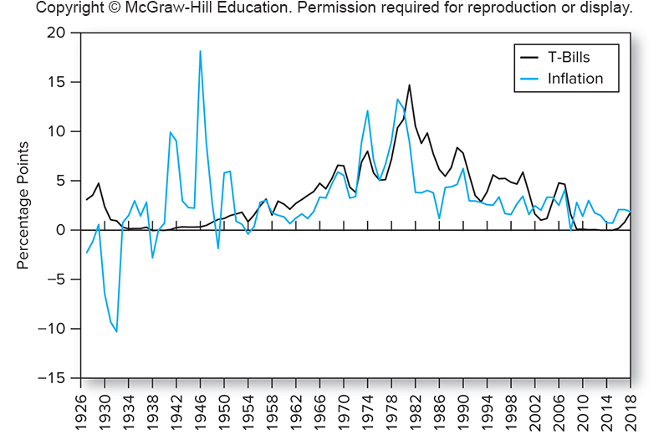
T-bill Rates and Fisher Effect, 1927-2018
※ Since 1952, higher nominal T-bill rates are usually accompanied with higher inflation rates, and thus the real T-bill rates are relatively smooth because the increase in the nominal risk-free interest rate offsets the increase in the inflation rate (R = 4.29%, r = 0.81%, and i = 3.46% on average in 1952–2018)
※ This figure suggests that the Fisher effect holds for the T-bills since 1952 (although not very tight)
※ However, the Fisher effect does not hold for T-bonds or corporate bonds

Slide 17
5.3 RISK AND RISK PREMIUMS
(風險與風險溢酬)

Slide 18
Risk
Definition: the uncertainty about future holding period returns (風險是未來持有期間收益率的不確定性) for an investment
This definition of risk is the most common and classical assumption in finance and economics
Risk is NOT how much you could LOSE from the investment (風險並非投資的可能損失)
As long as the realized returns deviate from your expectation, it is risk
※ At the end of this chapter, another definition of risk, Value at Risk (VaR, 風險值), which considers possible losses given a probability level as risk, is introduced

Slide 19
Scenario Analysis and Probability Distributions
Four key statistics (統計量) for probability distributions of the rate of return (ROR)
1) Mean (平均數) (E(r)): anticipated value for outcomes
2) Variance (變異數) (σ²) or standard deviation (σ): estimation for the degree of dispersion of outcomes (實現的結果之離散程度)
※ Since the risk is defined as the uncertainty about the future returns, it is natural to use the standard deviation of returns to estimate the risk of an investment
3) Skewness (偏態): measures the asymmetry of a probability distribution (see Slides 5.21 and 5.22)
4) Kurtosis (峰態): measures the fatness of the tails of a probability distribution (higher values imply the higher frequency for extreme results) (see Slides 5.23)

Slide 20
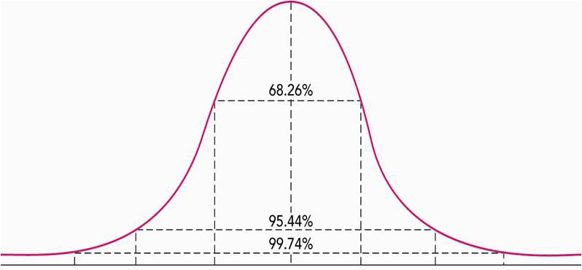
Normal Distribution
Symmetric distribution (E(r) = median (中位數))
(zero skewness and kurtosis to be 3)
※ A normal distribution can be described by only its mean and standard deviation because the skewness and the kurtosis of a normal distribution can be expressed as the functions of its mean and standard deviation
※ Returns over very short time periods distribute nearly to normal, e.g., it is common to assume that HPRs up to 1 month are normally distributed

Slide 21
Negative Skewed Distribution
Prob.
Median
–∞
E(r)
+∞
※ As long as the mean of return is lower than the median (中位數) of return, we say the return is with a negative skewed distribution (負偏或是左偏態分配)
※ It is common to observe negatively skewed distributed returns in aggregate stock markets (due to deep decline in crises)

Slide 22
Positive Skewed Distribution
Prob.
Median
–∞
E(r)
+∞
※ As long as the mean of return is higher than median (中位數) of return, we say the return is with a positive skewed distribution (正偏或是右偏態分配)
※ A stock with a high degree of positive skewness is sometimes known as a lottery-like stock

Slide 23
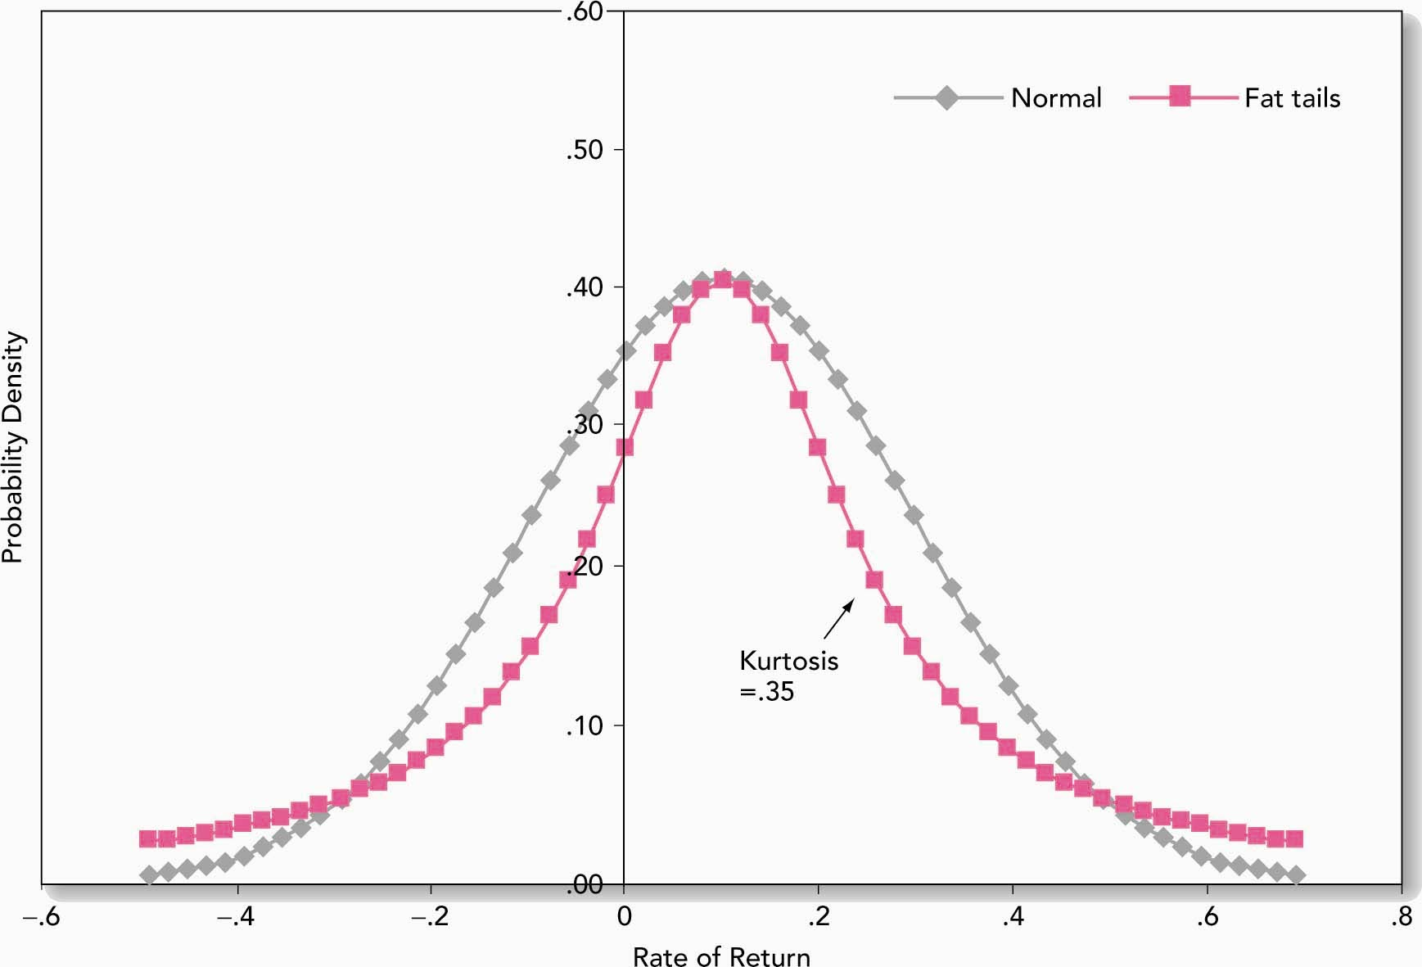
Kurtosis and Fat tails
Kurtosis=3
Kurtosis=3.35
※ A higher value of kurtosis implies fatter tails of the distribution
※ It is common to find fat tails for the returns of financial instruments

Slide 24
Measuring Mean (Expected Return)
Scenario analysis (情境分析) to calculate the mean and the standard deviation of the future returns
1. Suppose there are several possible scenarios of the future ROR
2. Estimate the probability and the ROR for each scenario
Definition of the mean
The expected value of the future return
p(k) = probability for a scenario k
r(k) = ROR if the scenario k occurs

Slide 25
Numerical Example
Scenario Prob. of Scenario r
1 0.1 –.05
2 0.2 .05
3 0.4 .15
4 0.2 .25
5 0.1 .35
E(r) = (.1)(–.05) + (.2)(.05) + (.4)(.15) + (.2)(.25) + (.1)(.35)
E(r) = .15 or 15%

Slide 26
Measuring Variance or Dispersion of Returns
Definition of the variance:
The expected value of the squared deviation from the mean
Definition of the standard deviation:
The square root of the variance
$\text{var}\left(r\right)=σ^{2}=E\left([r−E(r)]^{2}\right)=\sum_{k=1}^{s}{p(k)[r(k)−E(r)]^{2}}$
$\text{sd}(r)=\sqrt{\text{var}(r)}=σ$
※ Both the variance and the standard deviation measure the dispersion condition of the return, which reflects the risk associated with the investment

Slide 27
Measuring Variance or Dispersion of Returns
Based on the same example:
var = (.1)(-.05 -.15)² + (.2)(.05 - .15)² + (.4)(.15 - .15)² + (.2)(.25 - .15)² + (.1)(.35 -.15)² = 0.01199
s.d. = (0.01199)^{0.5} = 0.1095 or 10.95%
Alternative definition of the standard deviation:
$\text{var}(r)=E\left([r−E(r)]^{2}\right)=\sum_{k=1}^{s}{p(k)[r(k)−E(r)]^{2}}$ $=\sum_{k=1}^{s}{p(k)[r(k)^{2}−2r(k)E(r)+{(E(r))}^{2}]}$ $=\sum_{k=1}^{s}{p(k)r(k)^{2}}−2E(r)\sum_{k=1}^{s}{p(k)r(k)}+{(E(r))}^{2}\sum_{k=1}^{s}{p(k)}$ $=E(r^{2})−2E(r)E(r)+{(E(r))}^{2}=E(r^{2})−2{(E(r))}^{2}+{(E(r))}^{2}$ $=E(r^{2})−{(E(r))}^{2}$

Slide 28
Mean and Standard Deviation of a Time Series of Returns
For a time series of n returns, the mean and standard deviation are computed as follows
※ Note that each return is with the probability weight (1/n)
※ Since we use “sample average” to estimate the true mean, the variance will be slightly underestimated if the probability weight (1/n) is employed to compute the variance
※ This problem can be corrected by dividing the sum of the squared deviations from $\overline{r}$ with (n–1) rather than with n
※ In Excel, the function “VAR.S” (“VAR.P”), which calculates the sample (population) variance, (does not) takes the (n–1) adjustment into account

Slide 29
Risk Premiums and Risk Aversion
Denote r_{f} and r_{P} as the HPRs of the risk-free asset and a risky portfolio, respectively
The excess return (超額報酬) of the risky portfolio is the rate of return in excess of r_{f}, i.e., r_{P} – r_{f}
The risk premium (風險溢酬) of that portfolio is the EXPECTED excess return, i.e., E(r_{P}) – r_{f}
※ It is common to use the HPR of T-bills to be the risk-free interest rate r_{f}
※ For the risk premium: there is no expectation for r_{f} because the HPR of T-bills is known at the beginning of the holding period, but we cannot know the HPR of the risky portfolio r_{P} until the end of the holding period
※ The name of risk premium: if you would like to bear some risk, you can earn the premium corresponding to that risk on average
※ It is common to estimate E(r_{P}) from the series of historical returns
※ However, note that the return of T-bills also varies for each period, so in practice we usually estimate the risk premium as a whole directly by calculating the average of historical excess returns

Slide 30
Risk Premiums and Risk Aversion
Risk aversion is the degree of the reluctance of a person to accept risk, i.e., risk averse investors do not like the uncertainty of the return of their investment
Risk averse (風險趨避) vs. Risk neutral (風險中立) vs. Risk loving (風險愛好)
The risk averse attitude is reflected by the phenomenon that investors require higher risk premium for assets with higher risk
For a more risk averse investor, he needs higher risk premium to attract him to invest in a risky portfolio

Slide 31
Risk Premiums and Risk Aversion
The riskiness level of the portfolio and the degree of risk aversion codetermine the required risk premium for a portfolio
If σ_{P}² denotes the variance of HPRs of a portfolio and A denotes the degree of risk aversion of an investor, his required risk premium for that portfolio is:
Since σ_{P}² and A are both nonnegative, the required risk premium increases positively with either σ_{P}² or A
The risk premium to variance ratio, [E(r_{P}) – r_{f}]/σ_{P}², is also called the price of risk (風險的價格) of the portfolio P
A high risk premium (thus a high price of risk) is preferred, so the degree of risk aversion A can be interpreted as an investor’s required price of risk (必須的風險價格)

Slide 32
Risk Premiums and Risk Aversion
Considering that a representative investor holding the market portfolio, the degree of risk aversion of this typical investor can be derived from the characteristic of the market portfolio
※ The representative investor (代表性投資人) is a virtual investor who can represent the aggregate behavior of all investors in the market
※ The market portfolio (市場投資組合) is the universal portfolio of the market, which includes all securities traded in the market
※ Since the aggregate portfolio of all investors in the economy should be the market portfolio, the representative investor holds the market portfolio
※ Investors’ degree of risk aversion is likely in the range of 1.5 to 4, i.e., to accept an increase of 0.01 in portfolio variance (or 0.1 in portfolio standard deviation), investors would require an increase in the risk premium between 1.5% and 4%

Slide 33
The Sharpe (Reward-to-Volatility) Ratio
Due to the risk-return trade-off, is there any indicator that can rank portfolios?
The Sharpe ratio (夏普比率) is a quantity commonly used to rank portfolios in terms of this risk-return trade-off
A higher Sharpe ratio indicates a better reward for per unit of volatility, in other words, a more attractive portfolio
Mean-variance analysis (平均變異數分析): Ranking portfolios by their Sharpe ratio, i.e., analyzing portfolios in terms of the trade-off between the mean and the standard deviation of excess returns

Slide 34
5.4 THE HISTORICAL RECORD

Slide 35
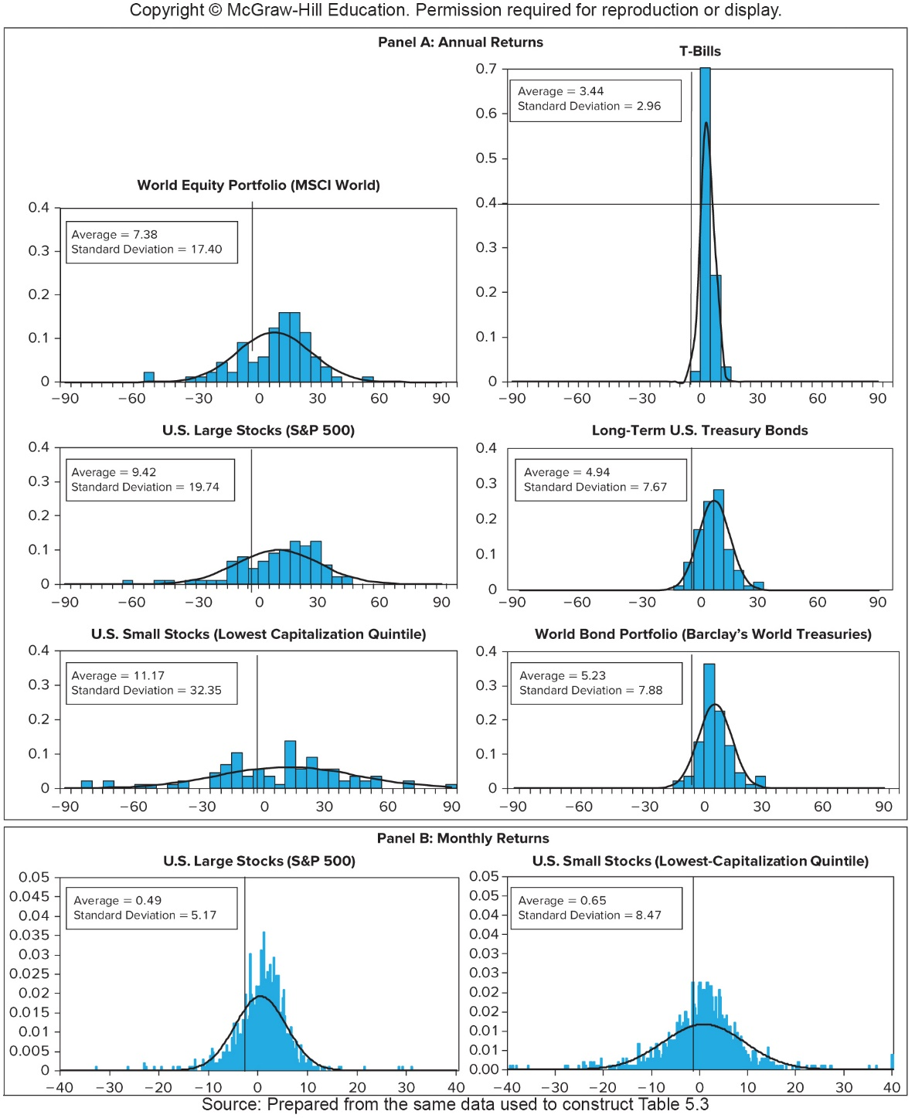
Frequency Distributions of HPRs, 1926-2015
※ A higher s.d. ⇒ a greater degree of dispersion (uncertainty) of HPRs
※ Ranking in terms of s.d. (or equivalently the degree of risk):
U.S. Small Stocks >
U.S. Large Stocks >
World Equity Portfolio >
World Bond Portfolio >
Long-Term U.S. T-Bonds >
U.S. T-Bills
※ A higher s.d. is usually accompanied with a high average return
※ Black curves are the normal distributions with corresponding averages and standard deviations ⇒ Higher kurtosis (fatter tails) than the normal distribution

Slide 36
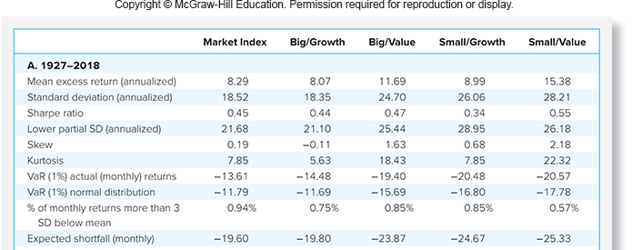
Return and Risk of Different Assets
※ Big/Small represents firm sizes above/below median levels of market capitalization
※ Firms in the top/bottom 30% of Book/Market ratio are treated as Value/Growth firms

Slide 37
5.5 ASSET ALLOCATION ACROSS RISKY PORTFOLIOS AND THE RISK-FREE ASSET

Slide 38
Allocating Capital
Two major studying fields in finance
Asset pricing (資產定價): to derive the theoretical price of a financial asset (or equivalently, to derive the required return for a series of future cash flows)
Asset allocation (資產配置): to study portfolio choice among broad investment classes (the goal is to form a portfolio with higher expected returns and lower risks)
This section studies the basic concept of asset allocation
To simplify the analysis, we focus on the allocation between the risk-free asset and a portfolio of risky assets

Slide 39
Allocating Capital
Risk-free asset: T-bills (a common proxy for the risk free asset)
Risky assets: a portfolio of stocks, long-term bonds, or both
Two issues about the asset allocation are discussed in this section
Examine risk/return tradeoff ⇒ capital allocation line (資本配置線) and Sharpe ratio
Demonstrate how different degrees of risk aversion will affect allocations between the risky and risk free assets

Slide 40
The Example in the Text
Total portfolio value = $300,000
Risk-free value = $90,000
Risky portfolio P (Vanguard and Fidelity) = $210,000
Vanguard S&P 500 Index Fund (V) = 54% × P
Fidelity Investment Grade Bond Fund (F) = 46% × P
※ When we change the amount invested in P, the weights of these two funds remain fixed within the portfolio P
※ As a result, the expect value and the standard deviation of the return of P do not vary when we change the amount invested in P

Slide 41
Calculating the Expected Return for the Text Example
r_{f} = 7%
σ_{rf} = 0%
E(r_{P}) = 15%
σ_{P} = 22%
y = % in P
(1–y) = % in r_{f}
⇒ Total return = yr_{P} + (1 – y)r_{f}
※ Since the risk-free rate for the examined period is a known constant at the beginning of the examined period, by definition,
1. The variance (or s.d.) of the risk-free rate, σ_{rf} , should be zero
2. r_{P} should be independent of r_{f} $⇒$ cov(r_{P}, r_{f}) = 0

Slide 42
Expected Returns for Combinations
E(r_{c}) = yE(r_{P}) + (1 – y)r_{f}
r_{c}: return of the complete or combined portfolio
(complete portfolio: the entire portfolio
including both risky and risk-free assets)
For example, if y = 0.75,
E(r_{c}) = 0.75(0.15) + 0.25(0.07)
= 0.13

Slide 43
Variance or Standard Deviation for Combinations
Since σ_{rf} = 0, then σ_{c} = yσ_{P}
var(ar_{i}+br_{j}) = E((ar_{i}+br_{j})²) – (E(ar_{i}+br_{j}))² (defined on Slide 5-27)
= E(a²r_{i}² + 2abr_{i}r_{j} + b²r_{j}²) – (aE(r_{i}) + bE(r_{j}))²
= a²E(r_{i}²) + 2abE(r_{i}r_{j}) + b²E(r_{j}²) – a²(E(r_{i}))² – 2abE(r_{i})E(r_{j}) – b²(E(r_{j}))²
= [a²E(r_{i}²) - a²(E(r_{i}))²]+[2abE(r_{i}r_{j}) – 2abE(r_{i})E(r_{j})]+[b²E(r_{j}²) – b²(E(r_{j}))²]
= a²var(r_{i}) + 2abcov(r_{i}, r_{j}) + b²var(r_{j})
(cov(r_{i}, r_{j}) ≡ E(r_{i}r_{j}) – E(r_{i})E(r_{j}) will be formally introduced in Ch. 6)
With a = y, r_{i} = r_{P}, b = 1 – y, r_{j} = r_{f} , then σ_{c}²= var(yr_{P} + (1 - y)r_{f}) = y²var(r_{P}) + 2abcov(r_{P}, r_{f}) + (1 – y)²var(r_{f}) = y²var(r_{P}) = y²σ_{P}²
⇒ If y = 0.75, σ_{c} = 0.75 × (0.22) = 0.165

Slide 44
Combinations Without Leverage
If 0 ≤ y ≤ 1, the complete portfolio is constructed without borrowing money from others
 | E(r_{c}) = yE(r_{P}) + (1 – y)r_{f} | σ_{c} = yσ_{P}
y = 0 (invest 100% in the risk-free asset) | 7% | 0%
y = 0.75 | 13% | 16.5%
y = 1 (invest 100% in the risky portfolio) | 15% | 22%
※ With the increase of the percentage invested in the risky portfolio, there is a higher expected return and s.d. for the complete portfolio

Slide 45
Combinations With Leverage
If y > 1, the complete portfolio is constructed with leverage, i.e., borrowing at the risk-free rate and investing in the risky portfolio
Using 25% leverage (i.e., y = 1.25)
E(r_{c}) = (1.25) (0.15) + (–0.25) (0.07) = 0.17
σ_{c} = (1.25) (0.22) = 0.275
※ The leverage can further increase both the expected return and the standard deviation of the complete portfolio

Slide 46
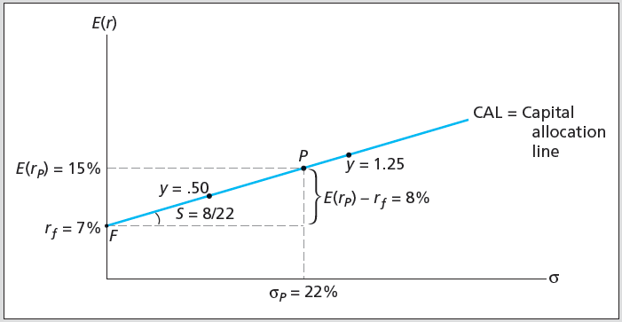
Investment Opportunity Set (投資機會集合) with a Risk-Free Investment
※ By varying the value of y, we have the possible investment opportunity set, which is also known as the capital allocation line (CAL, 資本配置線), of a risky and risk-free assets
※ The slope of the CAL equals the increase in expected return for bearing per unit of standard deviation
※ The slope is called the reward-to-volatility ratio, or Sharpe ratio
※ All portfolios formed by mixing the risky portfolio P and the risk-free asset are with the same Sharpe ratio (=8/22)

Slide 47
Risk Tolerance and Allocation
Investors confront a risk-return trade-off choice among all feasible combinations on the CAL (because they all have the same Sharpe ratio)
Greater levels of risk aversion lead to larger proportions of the risk free rate (near point F)
Moderate levels of risk aversion lead to larger proportions of the portfolio of risky assets (near point P)
Willingness to accept high levels of risk for high levels of returns would result in leveraged combinations (to the right of point P)

Slide 48
Risk Aversion and Capital Allocation
How to find the best allocation between the risky and risk-free assets for a particular investor with the degree of risk aversion A?
The preferred capital allocation, y, can be derived by
If A = 2, y = [15% – 7%] / 0.22² / 2 = 1.6529 / 2 = 82.64% in the above example
Given y = 82.64%, E(r_{c}) = 82.64% × 15% + (1 – 82.64%) × 7% = 13.61% and σ_{c} = 82.64% × 22% = 18.18%, so [E(r_{c}) – r_{f}]/σ_{c}² = A = 2
$y=\frac{\text{Price} \text{of} \text{risk} \text{of} \text{the} \text{risky} \text{portfolio}}{\text{Required} \text{price} \text{of} \text{risk} \text{of} \text{the} \text{examined} \text{investor}}$ $=\frac{[E(r_{P})−r_{f}]/σ_{P}^{2}}{A}$ ($⇒A↑$ (more risk averse), $y↓$)
Notes:
If y = 90%, E(r_{c}) = 90% × 15% + (1 – 90%) × 7% = 14.2% and σ_{c} = 90% × 22% = 19.8%, so [E(r_{c}) – r_{f}]/σ_{c}² = 1.84
If y = 70%, E(r_{c}) = 70% × 15% + (1 – 70%) × 7% = 12.6% and σ_{c} = 70% × 22% = 15.4%, so [E(r_{c}) – r_{f}]/σ_{c}² = 2.36
If y = 50%, E(r_{c}) = 50% × 15% + (1 – 50%) × 7% = 11.0% and σ_{c} = 50% × 22% = 11.0%, so [E(r_{c}) – r_{f}]/σ_{c}² = 3.31
If y = 0%, E(r_{c}) = 0% × 15% + (1 – 0%) × 7% = 7% and σ_{c} = 0% × 22% = 0%, so [E(r_{c}) – r_{f}]/σ_{c}² = 0 / infinity

Slide 49
5.6 PASSIVE STRATEGIES AND THE CAPITAL MARKET LINE

Slide 50
Costs and Benefits of Passive Investing
Investors can choose the assets included in the risky portfolio using passive or active strategies
Active strategy entails both costs on security analysis and on trading transaction, in exchange for potentially higher returns
Passive strategy is based on the premise that most securities are fairly priced, so it selects a diversified portfolio of common stocks
It is common to invest in an index fund which requires the least effort to manage the portfolio and thus the lowest operating expenses among all mutual stock funds
※ Expense ratios of index funds are usually around 1%
※ Expense ratios of hedge funds average 1%-2%, plus 10% of return above the risk-free rate

Slide 51
Costs and Benefits of Passive Investing
Free-rider (免費享用者) benefit: If there are many active, knowledgeable investors who quickly bid up prices of undervalued assets and offer down overvalued assets, most of the time most assets are fairly priced
Therefore, the performance of the passive strategy may not be inferior to that of the active strategy

Slide 52
Costs and Benefits of Passive Investing
The combined portfolio based on the passive strategy
Short-term T-bills
Portfolio of common stocks that mirrors the stock market portfolio
We call the capital allocation line (CAL) provided by one-month T-bills (the risk-free asset) and a market-index portfolio (the risky asset) capital market line (CML, 資本市場線)

Slide 53
Average and Standard Deviation of Excess Return and Sharpe Ratio
Sharpe ratios of CML in different time periods
※ For the first row, the passive risky portfolio has offered an average excess return of 8.34% with a standard deviation of 20.36%, resulting in a reward-to-volatility ratio of 0.41 in the U.S. market

Slide 54
Value at Risk (VaR) (風險值)

Slide 55
Value at Risk (VaR)
VaR (風險值) attempts to answer
The maximum possible amount to lose on a given portfolio at a specified level of probability
The typical specified probability level is 5%, i.e., to find the critical HPR (that is VaR) corresponding to the worst 5% probability
The probability that the loss exceeds VaR is less than 5%
VaR is another measure of risk and measures losses that will be suffered given an extreme, adverse, price change
If returns are normally distributed, a function in Excel can be employed to determine how many standard deviations below the mean represents a 5% cumulative probability from the negative infinity:
Norminv (0.05,0,1) = –1.64485 standard deviations

Slide 56
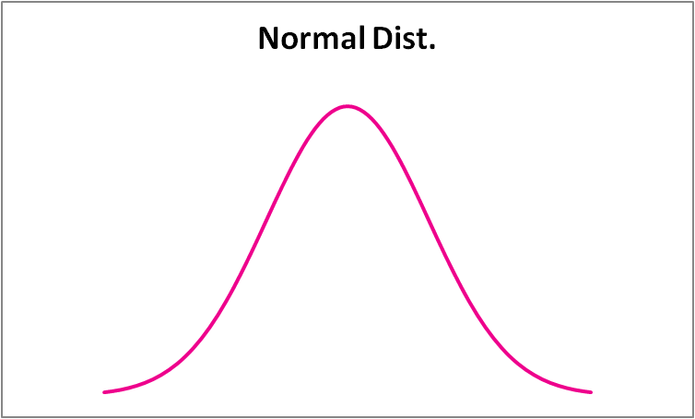
Value at Risk (VaR)
Therefore, we can find the corresponding level of the portfolio return: VaR = E(r) – 1.64485σ
5%

Slide 57
Value at Risk (VaR)
A $500,000 stock portfolio has an annual expected return of 12% and a standard deviation of 35%. What is the portfolio VaR at a 5% probability level?
VaR = 12% – 1.64485 × 35% = –45.57%
VaR$ = $500,000 × –45.57% = –$227,850
※The probability for the losses larger than $227,850 is smaller than 5% (or said there is 95% that the maximum losses will not exceed $227,850)

Slide 58
Value at Risk (VaR)
For non-normally distributed portfolio returns
VaR = -37%
Revisit the above case by following the normal distribution assumption
⇒ E(r) = 0.1 and σ = 0.1863 for the corresponding normal distribution
⇒ VaR = E(r) – 1.64485σ = -20.58%
※ The normal distribution assumption is convenient and easy-to-calculate but could be misleading
Probability | 0.05 | 0.25 | 0.4 | 0.3
Return | -37% | -11% | 14% | 30%

