Slide 1
CHAPTER 3
Securities Markets

Slide 2
Learning Goals of Chapter 3
How to issue securities (如何發行證券)
Discuss the role of investment bankers in the underwriting process (承銷過程)
How to trade securities
Introduce various types of security markets, e.g., dealer (自營商), specialist (特種經紀商), or electronic network markets
Introduce different types of orders
Introduce stock exchanges in the U.S. and in other countries
Analyze the structure of trading costs
Introduce the margin trade (保證金交易)
※Regulations of security markets in the U.S. are skipped

Slide 3
3.1 HOW FIRMS ISSUE SECURITIES

Slide 4
Primary Versus Secondary Markets
Primary market (初級市場)
For trading new issues of securities
Key function: issuers receive the proceeds from the sale of newly issued stocks or bonds
Secondary market (次級市場)
Market for already-existing securities
Trading of already-issued securities among investors
Issuing firms are not involved and do not receive proceeds
Ownership is simply transferred from one investor to another, so trading in secondary markets does not affect the outstanding amount of securities
The stock exchanges we are familiar with all belongs to secondary markets, e.g., NYSE, Tokyo Stock Exchange, Taiwan Stock Exchange, etc.

Slide 5
How Securities Are Issued
Private Placement (私下募集) vs. Public Offering (公開發行) (both in primary markets)
Private placement (a relatively simple process)
Firms (which may or may not use investment banks) sell newly issued securities to LIMITED sophisticated institutional or wealthy investors (up to 2000 shareholders) without the registration process (沒有註冊過程)
Lack of the registration process
Private placement is thus cheaper than public offering
Information is not fully disclosed following laws ⇒ Private placements cannot be traded in the secondary market ⇒ Their liquidity is restricted, and maybe the prices of them are reduced due to the illiquidity
Common for bond securities (sold to banks or insurance companies and held until maturity), but rare for stock shares

Slide 6
How Securities Are Issued
Public offering (a more complicated process)
Common for issuing stock shares
Two types of public offering of common stock: initial public offerings (IPOs) (首次公開募股) and seasoned equity offerings (SEOs) (股權增資 (台灣稱現金增資))
IPOs are stocks issued by a formerly privately owned company that is going public, i.e., selling stock to the public for the first time
Privately held firms: up to 2000 shareholders and fewer obligations to release financial statements to the public
SEOs are offered by companies that already have sold equity to the public before
Discuss three topics associated with public offering
Investment banks (投資銀行)
Shelf registration (上架登記)
Initial public offerings (IPOs)

Slide 7
Investment Banking Arrangements
Public offerings are typically marketed by investment banks who in this role are called underwriters (承銷商)
A preliminary registration statement must be filed to the Securities and Exchange Commission (SEC, 證券交易委員會), describing the issue information and the prospects (展望) of the company
SEC is the authority in the U.S. responsible for the affairs of securities issuance and trading
The final form of the statement, approved by the SEC, is called the prospectus (公開說明書)
One function of the investment banks is to help the issuing firm to prepare this statement

Slide 8
Investment Banking Arrangements
Underwriting process (承銷過程):
Investment banks purchase the securities from the issuing company at the public offering price less a spread, which serves as compensation to underwriters, and then resell them to the public or other financial institutions or intermediaries
The above procedure is called a firm commitment (包銷) because the investment banker commits (guarantees) to buy and resell an entire issue of securities and takes all financial responsibility for any unsold shares
Firm commitment (包銷) vs. Best efforts (代銷)
Best efforts: underwriters help for selling but make no firm commitment

Slide 9
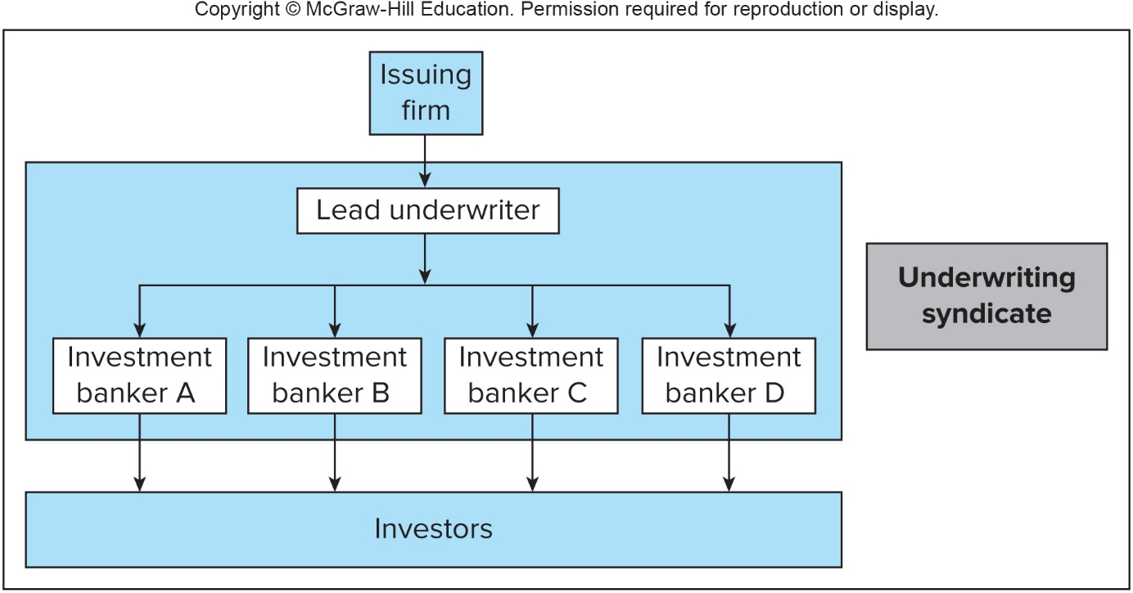
Relationship Among the Issuing Firm, the Underwriters and the Private Investors in the Underwriting Syndicate (聯合承銷)
※ Usually, an investment bank does not underwrite the securities alone. Instead, the arrangement of underwriting syndicate is often adopted
※ The term “syndicate” means that several investment banks are united to conduct the underwriting business for an issuing firm
※ In most cases, a leading investment bank organizes an underwriting syndicate of several investment banks to market the new issues of securities and share the responsibility for selling these securities

Slide 10
Shelf Registrations (登記核備註冊)
SEC Rule 415, introduced in 1982
Allowing firms to register a large amount of securities and gradually issue and sell registered securities to the public for the next TWO YEARS following the initial registration
After a notice for 24 hours, part or all of the preregistered amount may be offered
The registered securities are “on the shelf,” ready to be issued, and hence with the name shelf registration
Advantages for shelf registrations
Firms can issue and sell securities in small amounts without incurring substantial registration costs
Allows timing of the issues

Slide 11
Initial Public Offerings (首次公開募股)
The most complicated public offering because the issuing firm is usually new and not well-known to investors
After the preparation of the prospectus,
Roadshows (巡迴發表會) to promote the new securities
To provide information about the offering and generate interest among potential investors
To collect information for the issuing firm about the price and amount at which they can market the securities
Bookbuilding process to record potential investors
※ It is common for investment banks to revise both their initial estimates of the public offering price and the number of shares offered based on the feedback from roadshows

Slide 12
Initial Public Offerings
Underpricing (價格低估) for IPOs
The reason is possible to attract potential institutional investors to participate in bookbuilding process and share their information
Also due to the large-scale purchase, institutional investors have the bargaining power to buy securities at a undervalued price
For IPOs, in addition to the explicit cost of around 7% of the fund raised, underpricing can be viewed as another implicit cost of the issuing firm
Such underpricing is reflected in price jumps that occur on the date when the IPO shares are first traded in public security markets (see Slide 3-13)
The long term performance of IPOs and non-IPOs (see Slide 3-14)

Slide 13
Average First Day Returns for IPOs
※ This figure shows pronounced average first-day returns on IPOs in the U.S.
※ Note that the underpricing for IPOs and attractive first-day returns are universal phenomena around the world

Slide 14
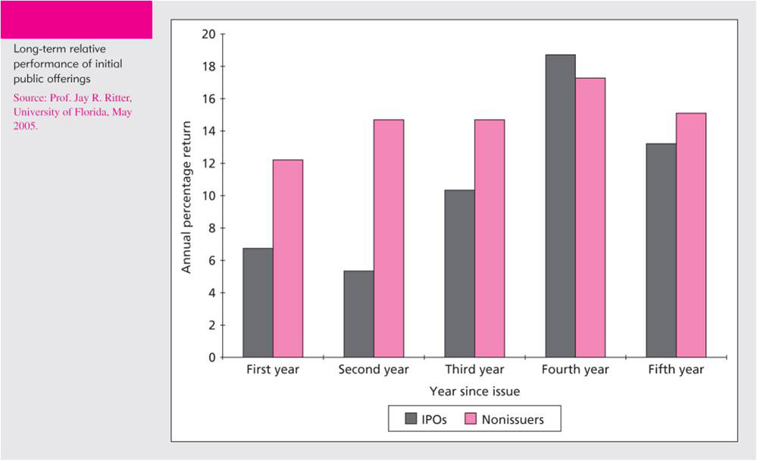
Long-term Relative Performance of Initial Public Offerings, 1970-2006
※ This figures compares the performance of IPOs with shares of other firms of the same size in the same industry for the following 5 years after the issue of IPOs
※ The underperformance of the IPOs suggests that, on average, the investing public may be too optimistic about the prospects of these firms

Slide 15
3.2 HOW SECURITIES ARE TRADED

Slide 16
Types of Markets
Financial markets exist to facilitate low-cost investment process
Bring together buyers and sellers at low cost
Provide adequate liquidity (流動性) to minimize time and cost to trade (節省交易時間與成本) and promote price continuity (增進價格連續性)
Update and quote prices of financial assets (reducing information costs (減少資訊取得成本) for investors)
Different types of financial markets introduced here:
Direct search markets, brokered markets, dealer markets, and auction markets

Slide 17
Types of Markets
Direct search markets (直接搜尋市場)
Buyers and sellers must seek each other out directly
For example, to sell your used furniture by advertising on the newspaper or internet
The liquidity in this market is poor, so this market is not suited for securities trading
Brokered market (經紀商市場)
In active markets, brokers find it profitable to offer search services to buyers and sellers, e.g., the real estate market
Brokers earn commissions (佣金) for matching buyers and sellers rather than buy and sell assets for themselves
In primary markets, investment bankers marketing a firm’s securities to the public act as brokers

Slide 18
Types of Markets
Dealer markets (自營商市場)
Dealers specialize in trading several assets, and make profits by purchasing these assets for their own accounts and sell them later
Dealers act as intermediate buyers/sellers
Bid (asked) price is the price at which a dealer is willing to buy (sell) the asset
The bid-asked spreads are the source of profit for dealers
The competition among dealers narrows the bid-ask spreads
Dealer markets save traders the search costs (節省搜尋成本) because traders can easily look up the quoted prices at which they can buy from or sell to dealers

Slide 19
Types of Markets
Auction market (集中競價市場)
The most integrated market is an auction market, in which all traders meet at one place to buy or sell an asset
The buyer who offers the highest price or the seller who would like to sell the asset at the lowest price can buy or sell the asset with the highest priority (出最高價者可買進，要求最低價者可賣出)
NYSE and Taiwan Stock Exchange are examples of auction markets
An advantage of auction markets over dealer markets is that traders need not search across dealers to find the best prices and thus save the bid-asked spread

Slide 20
Types of Orders
Orders: Instructions to brokers on how to complete the trade
Market orders (市價委託單)
Market orders are buy or sell orders that are to be executed immediately at current market prices, i.e., they are with the highest priority to be executed
Price-contingent (視價格而定的) orders:
Limit orders (限價委託單)
A limit buy (sell) order instructs the broker to buy (sell) shares once the share price is obtained at or below (above) a specified limit (買 (賣) 在限制價格之下 (上))
For limit buy (sell) orders, it is impossible to buy (sell) shares higher (lower) than the specified price
A collection of limit orders waiting to be executed is called a limit order book (限價單委託簿) (The rule to match limit and market orders is discussed on the next slide)

Slide 21
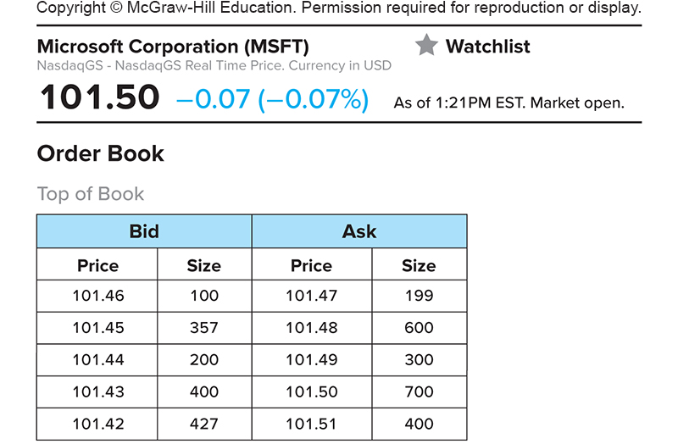
Types of Orders
Constructed with limit buy orders
Constructed with limit sell orders
※ In limit order books, limit buy prices cannot be higher than limit sell prices. Once it happens, those limit buy and sell orders can be matched and executed immediately, also known as crossing the orders
※ A market buy (sell) order is matched with the limit sell (buy) order with the lowest (highest) limit sell (buy) price ⇒ Trade the asset at the price specified in the limit sell (buy) order ⇒ The final settlement price (結算價格) for a market order is uncertain

Slide 22
Market Depth (市場深度)
Market depth: the total number of shares offered for trading at the best bid and ask prices
If the number of shares of a market buy order (e.g., 1500 shares) is more than the number of total shares of limit sell orders (e.g., 1000 shares) at the same asked price (e.g., $20/per share), the market buy order will be filled as multiple prices
The last 500 shares may be traded at $20.5/per share, which is not the best asked price
The depth is considerably higher for large stocks than for small stocks (see the next slide)
Depth is considered to measure liquidity (深度越深，市場流動性好)

Slide 23
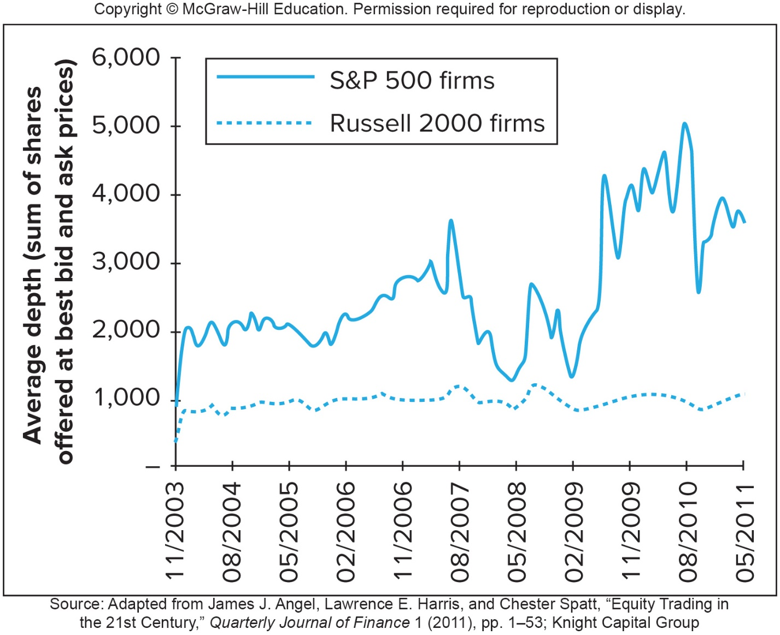
Market Depth
※ The average size of firms listed on S&P 500 is much larger than that on Russell 2000

Slide 24
Trading Mechanisms
Three trading systems in the U.S.: OTC dealer markets, ECNs, and specialist market (特種經紀商市場)
OTC dealer markets
In the over-the-counter (OTC) (櫃檯買賣市場) market, dealers quote prices at which they are willing to buy or sell securities, and a broker executes a trade by contacting a dealer listing the most attractive quotes
OTC market: A decentralized market where market participants trade over the telephone, fax, or electronic network instead of a physical trading floor
National Association of Securities Dealers Automatic Quotation System (NASDAQ) was developed in 1971 to link brokers and dealers to negotiate sales of securities on a computer network

Slide 25
Trading Mechanisms
Electronic communication networks (ECNs)
ECNs allow subscribers (institutional investors, broker-dealers, and market makers) to post market and price-contingent orders over computer networks, so limit order books are public and governed by computers
Make a market (造市): be always ready, willing, and able to trade a particular security at quoted bid and asked prices
Individual investors need a broker to execute trades
Orders that can be crossed are executed automatically, and thus ECNs are trading systems, not merely price quotation systems

Slide 26
Trading Mechanisms
Thus, you can treat ECNs as auction markets operated by computers
The attraction of a ECN is due to its speed, modest transaction costs, and anonymity (匿名)
Specialist markets (特種經紀商市場)
Specialists were used by NYSE before
All orders of a stock are sent to a specialist, who helps to handle all trading affairs and maintain the limit-order book of the stock
The specialist’s role as a broker is simply to execute the orders from other brokers and earn commission fees
To act as a dealer, specialists are also required and permitted by the stock exchange to maintain an orderly market by buying and selling shares for their own account and thus earn the bid-asked spread

Slide 27
Trading Mechanisms
NYSE replaced specialists with designated market makers (DMMs) (指定造市商)
DMMs are market makers designated by the exchange that accepts the obligation to commit its own capital to provide quotes and help maintain a fair and orderly market of their assigned securities
Manage a physical auction along with an automated auction
DMMs enhance price continuity by posting bid and ask prices at a narrower spread if the spread between the highest bid price and lowest ask price is too wide
DMMs enhance market depth by offering trades for the weak side of the market when there are imbalances in buy and sell orders
In return for assuming their obligations, DMMs are given some advantages in trade execution
Unlike the specialists, DMMs are not given advanced looks at the trading orders of other market participants
Since all orders for one security come to be executed centrally by a DMM, NYSE is an auction market

Slide 28
3.3 THE RISE OF ELECTRONIC TRADING

Slide 29
Timeline of Market Changes
Rise of electronic trading (timeline of market changes)
1969: Instinet (the first ECN) is established
1975: Fixed commissions on NYSE are eliminated
In the same year, U.S. Congress amends Securities and Exchange Act to create National Market System (NMS), which intends to propose a centralized quotation system among exchanges such that traders can route orders to the market makers displaying the best price nationwide
1994: NASDAQ scandal
NASDAQ dealers collude (串通) to maintain wide bid-asked spreads
SEC institutes new order-handling rules: Published dealer quotes had to reflect limit orders of customers, allowing them to effectively compete with dealers to capture trades

Slide 30
Timeline of Market Changes
NASDAQ integrates ECN quotes into display, enabling the electronic exchanges to compete for trades
SEC adopts Regulation Alternative Trading Systems, giving ECNs the right to register as stock exchanges
1997: SEC drops minimum tick size from 1/8 to 1/16 of $1 and further reduce it to $0.01 in 2001, which effectively narrows bid-asked spreads (see Slide 3-31)
2000: National Association of Securities Dealers splits from NASDAQ, which effectively becomes a large ECN
2005: SEC adopts Regulation NMS to link exchanges electronically (fully implemented in 2007)
Require exchanges to obtain the best price (among all exchanges) for investors when such price is represented by automated quotations that can be immediately executed
2006: NYSE acquires Archipelago Exchanges and renames it as NYSE Arca

Slide 31
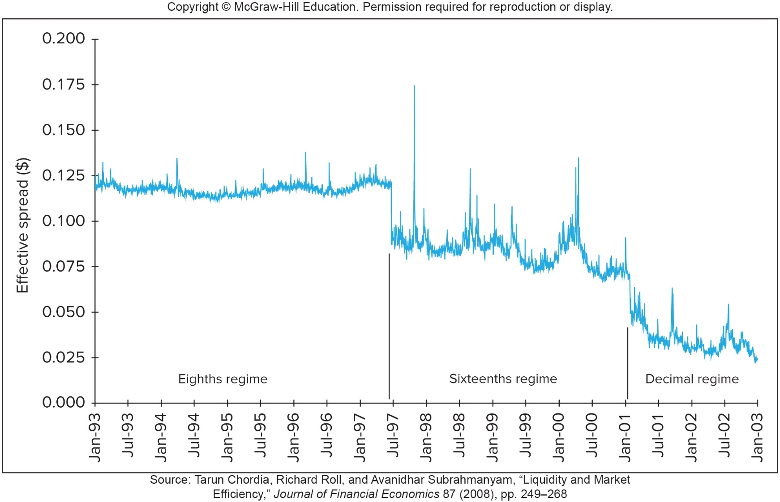
Timeline of Bid-Asked-Spread Changes

Slide 32
3.4 U.S. SECURITIES MARKETS

Slide 33
NASDAQ
National Association of Security Dealers Automated Quotation System (NASDAQ, 那斯達克):
An quotation and information system for individuals, brokers, and dealers and largest organized stock market for OTC trading (lists around 3500 firms)
Three listing options:
Global select market (largest firms), Global market (the next tier of firms), and Capital market (the third tier of firms)
Because NASDAQ does not use DMMs, and OTC trades do not require a centralized trading floor as do exchanged-listed stocks, dealers can be located anywhere as long as they can communicate effectively with other traders

Slide 34
NASDAQ
Three levels of subscribers for quotations
Level 3 (for dealers): receive all bid and asked quotes and can input the bid and asked prices for their own
Level 2 (for brokers): receive all bid and asked quotes
Level 1 (for investors who is not actively trading securities but interested in current prices): receive the highest bid and lowest asked prices (also called inside quotes) on each stock
NASDAQ was originally more a price quotation system than a trading system
NASDAQ introduced the electronically trading platforms, called the NASDAQ Market Center, to handle the majority of its trade since 2004

Slide 35
New York Stock Exchange
NYSE (紐約證券交易所), the largest stock exchange in the world
Founded in 1817, merged with Euronext in 2007, acquired American Stock Exchange in 2008, was acquired by Intercontinental Exchange (ICE) in 2013
By 2022
Over 2,400 listings globally
With a combined market capitalization of its listed companies to be $26.2 trillion
Average daily trading is $123 billion (3 billion shares)
NYSE is a continuous auction market
It requires very heavy trading to cover the expense of maintaining the market
Listing requirements limit the stocks traded on NYSE to those with sufficient trading interests from the public

Slide 36
New York Stock Exchange
Computer network in NYSE
SuperDOT (Designated Order Turnaround, 指定下單轉送系統) is an electronic order-routing system that enables NYSE member firms to send market and limit orders directly to the specialist over computer lines
Direct+, launched in 2000, can automatically cross trades without human intervention
NYSE Hybrid market launched in 2006: allow brokers to send orders either for electronic execution or to floor brokers (to specialists in the past), who could seek price improvement form other traders
Floor broker (場內經紀商): a member of an exchange who can act as a broker for other members or other non-member brokerage firms

Slide 37
New York Stock Exchange
The Hybrid system allowed NYSE to qualify as a fast market for the purposes of Regulation NMS but still offer the advantages of human intervention for more complicated trades
In contrast, NYSE’s Arca marketplace is fully electronic

Slide 38
Other Exchanges
American Stock Exchange (AMEX, 美國證券交易所)
Founded in 1908
Merged by NYSE in 2008, and has been renamed NYSE AMEX
List smaller and younger firms than NYSE
It is a leader in the development of exchange-traded funds (ETF,交易所買賣基金或是指數型股票基金), which are securities that represent claims to entire portfolios of stock markets (ETF will be introduced in detail in Ch 4)

Slide 39
Other Exchanges
Electronic Communication Networks (ECNs)
The first ECN, Instinet, was established in 1969
Some ECNs: Direct Edge, BATS, and NYSE Arca
BATS and Direct Edge have merged to be BATS Global Markets, which was acquired by the CBOE
Latency time (等待時間): The time it takes to accept, process, and deliver a trading order
BATS advertises the latency time of around 0.0001 seconds
Financial markets are moving to automated electronic trading
Result in 24-hour global markets
Moving toward market integration

Slide 40
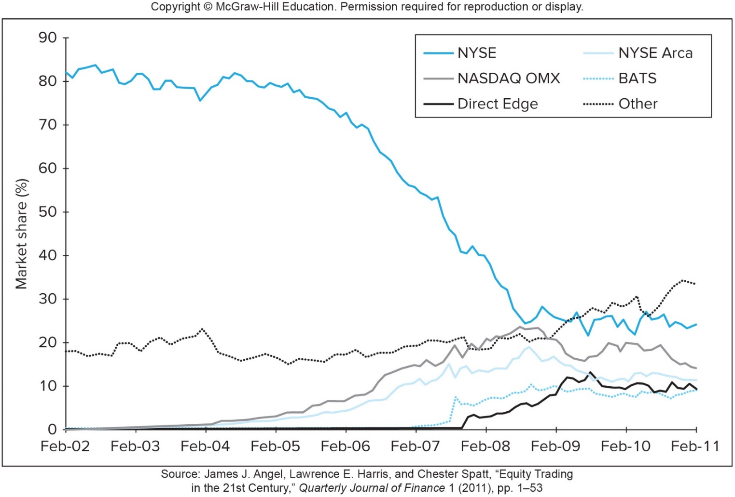
Other Exchanges
ECNs grows rapidly
※ The “Other” category, which now exceeds 30%, includes so-call dark pools, which will be discuss later

Slide 41
3.5 NEW TRADING STRATEGIES

Slide 42
New Trading Strategies
Algorithmic trading (演算法交易): Use computer programs to monitor and trade securities
High-frequency trading: Computer programs make very rapid trading decisions for very small profits, e.g., exploiting short-term trends or conducting pairs trade
Block trading (大額交易)
Large transactions in which over 10,000 shares of stock are traded (too large for specialists to handle)
“Block houses,” which are brokerage firms specializing in matching block buyers and sellers, are involved to aid in the placement for block trades

Slide 43
New Trading Strategies
Block houses discreetly (不引人注意地) arrange large trades out of the public eye to avoid moving prices against their clients
Dark pools (暗池): electronic trading networks where participants can anonymously trade large blocks of securities (handling most block trading today)
Limit orders are not visible to the general public
Traders’ identities can also be kept private
Trades are not reported until after they are crossed
Rather than cross limit orders, many dark pools accept “unpriced orders” and execute them at the midpoint of the bid and ask prices reported on other markets
Many large traders gravitate toward dark pools because it makes them less vulnerable to high-frequency traders
Many dark pools claim to exclude better-informed traders such as hedge funds

Slide 44
3.6 GLOBALIZATION OF STOCK MARKETS

Slide 45
Other Countries
London Stock Exchange (LSE, 倫敦證券交易所)
Similar to NASDAQ, it starts from a quotation system and introduces electronic executing system later
London security firms act as both dealers and brokers, i.e., both making a market in securities and executing trades for their clients
Euronext Exchange (泛歐交易所)
It was formed in 2000 by a merger of the Paris, Amsterdam, and Brussels exchanges
In 2002, it acquired LIFFE, the London International Financial Futures and Options Exchange
In 2007, Euronext merged with the NYSE group to become NYSE-Euronext

Slide 46
Other Countries
Tokyo Stock Exchange (TSE, 東京證券交易所)
The largest stock exchange in Japan, accounting for about 80% total trading in Japan
In addition to TSE, there are also Osaka Securities Exchange (大阪證券交易所) and Nagoya Securities Exchange (名古屋証券交易所)
There is no DMM on TSE
Before 1999, a saitori (才取會員, 經紀商) maintains the limit order book and matches market and limit orders. However, saitoris do not trade for their own accounts
In 1999, TSE closed its trading floor and switched to all-electronic trading
Three sections for different size firms, including the First (large), Second (midsized), and “Mothers” (emerging and high-growth) sections

Slide 47
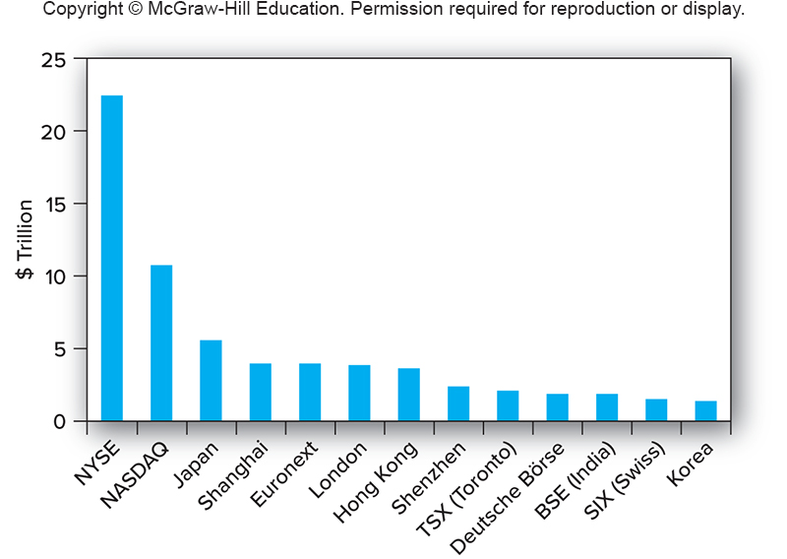
Market Capitalization of Listed Firms, 2019
※ In 2007, NASDAQ merged with OMX, which operated seven Nordic and Baltic (北極與波羅的海) stock exchanges, to form NASDAQ OMX Group

Slide 48
3.7 TRADING COSTS

Slide 49
Trading Costs
Commission (佣金): fee paid to brokers for making the transaction
Full-service vs. Discount brokers
Some customers allow a full-service broker to make buy and sell decisions for them by establishing a discretionary account (授權帳戶)
Spread (價差): cost of trading with dealers
Ask: price at which dealer will sell to you
Bid: price at which dealer will buy from you
Spread: ask minus bid
Combination: on some trades both are paid
In a well-functioning market, the trading cost is lower due to the competition in the market
Stock trading costs fell steadily and dramatically

Slide 50
3.8 BUYING ON MARGIN (保證金交易)

Slide 51
Buying on Margin
When purchasing securities, investors can access to a source of debt financing provided by brokers (called broker’s call loans), and then can buy on margin (保證金交易) in the U.S.
Buying on margin means using only a portion of the proceeds for an investment, and the remainder is borrowed from the broker
Investors need to pay the interest for the borrowing
※ 台灣稱這個機制為“融資”交易
The Board of Governors of the Federal Reserve System (Federal Reserve Board,美國聯邦儲備委員會) set the limit of using margin loans

Slide 52
Buying on Margin
Initial margin (初始保證金) is currently set to be 50%, which means at least 50% of the purchase price must be paid from the investor, with the rest borrowed
Maintenance margin (維持保證金): minimum percentage for equity in trading (the part belongs to the investor = position value – borrowing + additional funds) can be before additional funds must be put into the account
If the percentage margin (保證金成數) falls below this level, the broker will issue a margin call
Margin call (追繳保證金): notification from the broker you must put up additional funds

Slide 53
Margin Trading - Initial Conditions
X Corp $70
50% Initial margin
40% Maintenance margin
1000 Shares purchased
Initial Balance Sheet Position:
Stock $70,000 Borrowed $35,000
Equity 35,000
Percentage margin = equity in account /
value of stock
= $35,000/$70,000 = 50%

Slide 54
Margin Trading - Maintenance Margin
Stock price falls to $60 per share
New Balance Sheet Position:
Stock $60,000 Borrowed $35,000
Equity 25,000
Percentage margin = $25,000/$60,000
= 41.67%

Slide 55
Margin Trading - Margin Call
How far can the stock price fall before a margin call if the maintenance margin is 40%?
Since position value – borrowing + additional funds = equity, then
(1000×P – $35,000 + 0) / 1000×P = 40%
P = $58.333 (now Equity = $23,333)
※ The rule for how much money you need to deposit into your margin account when you receive a margin call (追繳保證金) is as follow:
The additional funds needed to deposit should increase the percentage margin to go back to the initial margin level (回補到原始保證金水準), i.e.,
($23,333 + additional funds) / ($58.333×1000) = 50%
⇒ additional funds = $5,834

Slide 56
The Reason for Margin Trading
Change in Stock Price | End-of-Year Value of Shares | Repayment of Principal and Interest (10%) for the borrowing | Investor’s Rate of Return
30% increase | $91,000 | $38,500 | 50%
No change | $70,000 | $38,500 | -10%
30% decrease | $49,000 | $38,500 | -70%
※ Due to the financial leverage (財務槓桿) from the use of margin accounts, the investor’s rate of return is amplified effectively

Slide 57
3.9 SHORT SALES (放空)

Slide 58
Short Sales
The sale of shares not owned by the investor but borrowed from a broker and later purchased to replace the shares loan
Purpose: to profit from a decline in the price of a stock or security
Process of short sales with a margin account:
Borrow stock shares from a broker (跟券商借券)
Sell them and deposit proceeds from the sale plus the margin in the margin account (the sale proceeds and the margin serve as the collateral for the shares loan)
Closing out the position (結清部位): buy the stock shares and return them to the broker

Slide 59
Short Sales
Short-sellers not only return the shares but also pay the lender any dividends which should be received during the period of short sale
Make the lender feel as if he continued to own these shares
The short sale may have indefinite term
With the dynamic management of the stock share accounts by the brokerage firm
If the brokerage firm cannot locate new shares to replace the ones sold, the short-seller needs to purchase shares in the market and return them to the brokerage firm immediately

Slide 60
Short Sale - Initial Conditions
Z Corp 100 shares
50% Initial margin required for short sales
30% Maintenance margin
$100 Initial price
Sale Proceeds $10,000
Margin 5,000
Stock Owed $100 x 100 shares
Initial Balance Sheet Position:
Cash $10,000 Value of stock owed $10,000
Margin $5,000 Equity $5,000
position value
addition funds
borrowing
※ The initial margin requirement for short sales means that you must have another $5,000 cash in your account that serves as margin on the short sales
※ Percentage margin = equity in trading / value of stock owed

Slide 61
Short Sale - Maintenance Margin
Stock Price Rises to $110
Sale Proceeds $10,000
Initial Margin 5,000
Stock Owed $110 x 100 shares
New Balance Sheet Position:
Cash $10,000 Value of stock owed $11,000
Margin $5,000 Equity $4,000
Percentage margin = (4000/11000) = 36%
※ Equity in trading = position value – borrowing + additional funds = $10,000 – $11,000 + $5,000 = $4,000

Slide 62
Short Sale - Margin Call
How much can the stock price rise before a margin call if the maintenance margin is 30%?
Since equity in trading = position value – borrowing + additional funds = $10,000 – 100×P + $5,000, then
($15,000 – 100×P) / (100×P) = 30%
$⇒$ P = $115.38
※ The additional funds you need to deposit in the margin account should increase the percentage margin to go back to the initial margin level

