Slide 1
CHAPTER 2
Asset Classes and Financial Instruments

Slide 2
Learning Goals of Chapter 2
Introduce financial instruments (金融工具)
Fixed income securities
Money market instruments (貨幣市場工具) (maturity shorter than 1 year and safer)
Capital market instruments (資本市場工具) (maturity longer than 1 year and more risky): Bond (債券) securities
Equity (權益) securities
Derivatives (衍生性金融商品)
※ Riskiness levels based on cash flow patterns and schedules: Fixed income securities < Equity securities < Derivatives
Introduce the stock indexes (股價指數)

Slide 3
Different Financial Instruments in Different Financial Markets
Money market (貨幣市場) | Bond market (債券市場)
Treasury bills | Treasury bonds and notes
Commercial paper | Federal agency debt
Certificates of deposit | International bonds
Banker’s acceptances | Municipal bonds
Eurodollars | Corporate bonds
Repos and reverses | Mortgage-backed securities
Brokers’ calls | Equity markets (權益市場)
Federal funds | Common stocks
 | Preferred stocks
 | Depository receipts
 | Derivative markets (衍生性商品市場)
 | Options
 | Futures or forwards

Slide 4
2.1 MONEY MARKET INSTRUMENTS

Slide 5
Money Market Instruments
Short-term, highly liquid, and relatively low-risk debt instruments
Treasury bills (T-bills, 短期政府公債或國庫券)
Short-term government debt securities issued at a discount from the face value (面額) (usually $10,000) and returning the face amount at maturity
T-bills with initial maturities of 4, 13, 26, or 52 weeks are issued weekly
Federal taxes owed, exempt from state and local taxes (在台灣，對一般投資人，公債與公司債利息收入分離課稅 (10%稅率)，不再併計綜合所得總額課稅)
Traded in a dealer market: dealers can earn the bid-asked spreads for providing the liquidity to the market
Asked (Bid) price (賣出 (買入) 價): the price that a dealer would like to receive (pay) for selling (buying) an asset with a trader
Next slide shows quoted yields and prices of T-bills

Slide 6
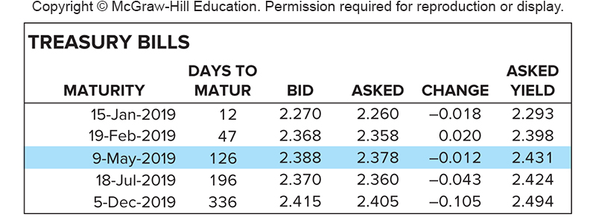
Quotations of Treasury Bills
$$2.388\%×\frac{126}{360}=0.8358\% \\ \$10,000×(1−0.8358\%)=\$9,916.42$$
$$2.378\%×\frac{126}{360}=0.8323\% \\ \$10,000×(1−0.8323\%)=\$9,916.77$$
$$\frac{\$10,000−\$9,916.77}{\$9,916.77}×\frac{365}{126}=2.431\%$$
※ Bid and asked quotes are annual discount rates of the face value (面額的年折現率): quoted rate = ($10,000 – P) / $10,000 × (360 / n), where P is the bid or asked price of a Treasury bill and n is its days to maturity
※ The above quotation method is also known as the bank-discount method (銀行折現法), which generates approximated rate of returns
※ Two flaws for the bank-discount method: (1) Assume that one year has 360 days; (2) The quoted rates are expressed as a fraction of face value rather than of the purchasing price
※ The -0.012 change means that the asked quote decreased by 0.012 today
※ Asked yields in the last column are known as T-bill’s bond-equivalent yield (國庫券的債券等值收益率)
※ T-bill’s bond-equivalent yields are comparable with the yield to maturity (到期收益率) of fixed income securities like bonds (see Slide 2-17). Higher quoted yields indicate investment targets with higher rates of return if all other covenants (契約條款) are the same

Slide 7
Money Market Instruments
Commercial Paper (CP, 商業本票)
Creditworthy companies often issue their own short-term unsecured debt notes, CPs, directly to the public, rather than borrowing money from banks (direct vs. indirect financing)
CPs, similar to T-bills, are quoted and traded at a discount
CP maturities range up to 270 days
CPs are quite liquid and fairly safe assets
The asked yield on a CP depends on its time to maturity and the credit rating (信用評等) of the issuer
Interest incomes from CPs are taxable
Financial institutions may issue asset-backed CPs, e.g., issue CPs based on a pool of mortgage loans as collateral
Earn the spread between the CP and mortgage rates
Need to issue new CPs to refinance their positions as the old CPs matured
This rollover (發新債還舊債) arrangement did not work in 2008-2009 due to the default (違約) of Lehman Brothers

Slide 8
Money Market Instruments
Certificate of deposit (CD, 定期存單)
A CD is a certificate issued by depository institutions for a time deposit (定存), which is the money deposit in a bank that cannot be withdrawn (提領) for a certain time period
At maturity, holders of CDs receive the interest income and principal from the issuing depository institutions
CDs with the denominations (面額) larger than $100,000 are usually negotiable, i.e., they can be sold to another investors if CD holders need cash before the maturity date
CDs of 3 months or less are highly liquid and marketable
CDs are treated as bank deposits by the Federal Deposit Insurance Corporations (聯邦存款保險公司), so they are insured for up to $250,000 in the event of a bank insolvency (銀行無償付能力)
Interest incomes from CDs are taxable

Slide 9
Money Market Instruments
Bankers’ Acceptance (BA, 銀行承兌匯票)
Start as an order sent by a customer to a bank for paying a sum of money on a future date ⇒ The endorsement (背書) of the bank to pay this amount is called a BA (which is similar to a guaranteed check (保證支付支票))
BAs are used widely in international trades where the credit quality (信用品質) of the trading company is unknown to the producer because they are not familiar with each other
BAs allow traders to substitute the bank’s credit standing for their own
BA holders can trade (cash in) it in secondary markets
BAs are traded at a discount from the face value of the payment order (similar to T-bills and CPs)

Slide 10
Money Market Instruments
Federal Funds (聯邦基金)
A depository institution in the U.S. is required to deposit part of its deposits made by his customers, e.g., 2% (0% since March 26, 2020), in a reserve account in the Federal Reserve Bank (美國聯邦儲備銀行)
(在台灣，這稱為存款準備率，其平均約7%)
Funds in that account are called Federal funds, which can generate interest income for depository institutions
Federal funds are prepared for the liquidity of withdrawal
Federal funds market: banks with excess funds can lend to those with a shortage (for satisfying reserve requirement in the past). These loans, which are unsecured, usually overnight transactions, are arranged at a rate called Federal funds rate (聯邦基金利率), which is a key interest rate for lending and borrowing among depository institutions
※ Federal Open Market Committee (聯邦公開市場委員會) 調升或調降利息，即是調降Federal funds rate之目標利率，其利用公債公開市場操作來達成此目標

Slide 11
Money Market Instruments
Eurodollar (歐洲美元)
Dollar-denominated deposits at foreign banks (not necessary to be European banks) or foreign branches of American banks
By locating outside the U.S., these banks escape regulations by the Federal Reserve Board (聯邦儲備委員會), e.g., no federal funds required and saving them some costs
Eurodollar pay higher interest rate than U.S. deposits
Eurodollar time deposits and Eurodollar CDs
Eurodollar CDs are less liquid than domestic CDs
※ LIBOR Market (倫敦銀行同業拆放利率市場)
London Interbank Offer Rate (LIBOR) is the lending rate for different currencies among large banks in London market
British regulators proposed to phase out LIBOR by 2021
Secured Overnight Financing Rate (SOFR) in the U.S. and Sterling Over Night Index Average (SONIA) in the U.K. are established to replace LIBOR

Slide 12
Money Market Instruments
Repurchase Agreement (repo or RP, 附買回協定) and Reverse RP (附賣回協定)
Short-term sales of government securities with an agreement to repurchase the securities at a higher price
Dealers (自營商) in government securities use repos as a form of short-term, usually overnight, borrowing, in which the government securities serve as collaterals for the loan
In a reverse repo, dealers buy government securities from a trader (lending money with a collateral) and promise to resell them at a specified higher price on the future date
Brokers’ Call (經紀商融資貸款)
Investors who buy stocks on margin (保證金交易) borrow part of funds to pay for the stocks from their broker, who in turn borrow the funds from a bank, and agree to repay the bank immediately if the bank requests it
The borrowing rate is known as the call money rate (活期貸款利率) (usually equal to T-bill’s rate + 1%)

Slide 13
Yield Spreads (收益率利差) between Federal Funds Rate and T-bills Rate
Oil crisis
Black Monday in 1987
Financial Tsunami
Hedge fund bankruptcy
※ Risk-return tradeoff: higher yields (收益率) are accompanies with higher degrees of default risk
※ This yield spread reflects the difference of the credit quality between banks (federal funds rates) and the government (T-bill rates)
※ Whenever there are crises in the market, the repayment ability of banks becomes more doubtful, and thus the spread widens

Slide 14
2.2 BOND MARKET INSTRUMENTS

Slide 15
Bond Market Instruments
The bond market is composed of longer-term debt instruments than those traded in the money market
Traditionally, both bond- and money-market instruments are called fixed income securities (固定收益證券) (although some debt securities today are composed of a floating (浮動) stream of cash flows)
Treasury Notes and Bonds (政府公債)
The U.S. government borrows funds in large part by selling Treasury notes and bonds
T-notes – maturities up to 10 years; T-bonds – maturities in excess of 10 years

Slide 16
Bond Market Instruments
Par (face) value (面值) is $1,000
T-bonds and T-notes make semiannual interest payments called coupon (票息) payments (台灣公債每年付息一次)
The origin for the name of “coupon rate” (票面利率) or “coupon payments”: in precomputer days, bond holders would clip off a coupon attached to a bond and present it to the issuer to receive the interest payment
T-bonds quotes are percentages of their par (see Slide 2-17)
Inflation-Protected Treasury Bonds (Treasury Inflation-Protected Securities, TIPS) (通膨保護公債)
The face values on these bonds are adjusted in proportion to the Consumer Price Index. Thus, TIPS provide a stream of constant income in real (實質) (inflation-adjusted) dollars
The coupon rate and the yield of TIPS can be interpreted as the real interest rates (實質利率) earned by investors
Marked with an “i” after the maturity date on quote sheets

Slide 17
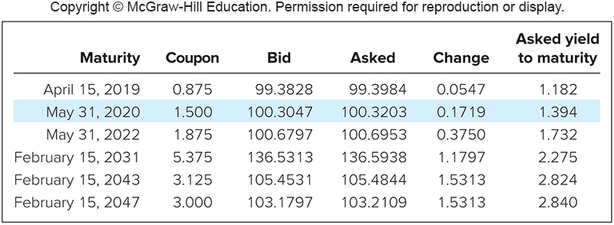
Quotations of Treasury Bonds from the Wall Street Journal on April 18, 2017
※ Bid and asked prices are quoted provided that the par value being $100
※ Bid and asked quotes imply that T-notes and T-bonds are traded in dealer markets
※ The minimum tick size (price increment) in the T-bond market is generally 1/128 of a dollar, e.g., the highlighted asked price is 100.3203 = 100 + 41/128
※ The 0.1719 change means that the asked price increased by 0.1719% of the par value (equivalently, by 22 ticks or 22/128) (One can infer that the closing price on the previous trading day is 100 + 41/128 – 22/128 = 100 + 19/128 = 100.1484)
※ The “Asked yield to maturity” (賣價到期收益率) measure the annualized rate of return for purchasing the bond at the asked price and holding it until maturity
※ The numbers in Figure 2.3 of the textbook are not exactly correct

Slide 18
Bond Market Instruments
Federal Agency Debt (政府機構債券)
Mortgage-related agencies: Federal National Mortgage Association (FNMA or Fannie Mae) (房利美), Government National Mortgage Association (GNMA or Ginnie Mae), Federal Home Loan Mortgage Corporation (FHLMC or Freddie Mac) (房地美), Federal Home Loan Bank (FHLB)
These federal agencies are established by the U.S. government for public policy reasons to channel credit to a particular section of the economy (e.g., poor households or veterans) that can not receive adequate credit through normal private source
To achieve the above goal, as long as the mortgage loans conducted by banks can satisfy some criteria, these federal agencies would like to purchase the mortgage loans with funds through issuing creditworthy federal agency bonds

Slide 19
Bond Market Instruments
In 1970s, these federal agencies guarantee the timely payment of principal and interest (即時償付本息) if the borrowers delay the payments and then issue mortgage-backed securities (MBSs, 不動產貸款抵押證券) based on these loans
Therefore, MBSs are considered extremely safe assets
From the whole procedure, the federal agencies provide opportunities for investors to participate in the mortgage market, and in the meanwhile, they channel money to the particular section of the economy to achieve its social function
The change of the role for these federal agencies: from taking risk (earning interest spread) to providing service (earning management fee)
The most popular and simplest MBSs is the pass-through MBS (過手不動產貸款抵押證券), which is one of the most important financial innovations in 1980s

Slide 20
Bond Market Instruments
International Bond (國際債券)
Eurobonds: A Eurodollar (Euroyen) bond is a dollar-denominated (yen-denominated) bond but sold outside the U.S. (Japan)
A Yankee (Samurai) bond is a dollar-denominated (yen-denominated) bond sold in the U.S. (Japan) by a non-U.S. (non-Japanese) issuer
Municipal Bond (地方政府債券)
Municipal bonds are tax-exempt bonds issued by state and local governments
Interest income on municipal bonds is not subject to federal and sometimes state and local taxes (therefore, investors are willing to accept lower yields)
Note that capital gains taxes must be paid if the bonds mature or are sold for more than investor’s purchase price

Slide 21
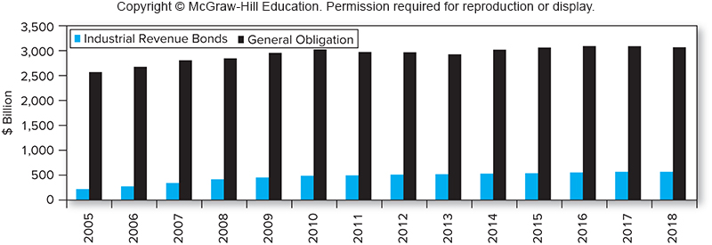
Outstanding Tax-exempt Debt
Type 1: General obligation bonds (一般責任債券) (backed by the credit of the local government)
Type 2: (Industrial) revenue bonds (特定收益債券) (issued to finance particular projects and backed by the income from those projects)
※ (Industrial) revenue bonds are riskier than general obligation bonds due to the higher likelihood of defaults

Slide 22
Bond Market Instruments
To compare yields on other taxable fixed-income securities, an Equivalent Taxable Yield (應稅等值收益率) is constructed
This is the yield a taxable bond would need to offer to match the tax-exempt yield of municipal bonds
$$r_{taxable}(1−t)=r_{muni}$$
$$r_{taxable}\text{: }\text{total} \text{(}\text{before}\text{−}\text{tax}\text{)} \text{rate} \text{of} \text{return} \text{available} \text{on} \text{taxable} \text{bonds} (\text{Equivalent} \text{Taxable} \text{Yield})$$
$$r_{muni}\text{: }\text{tax}\text{−}\text{exempt} \text{yield} \text{on} \text{municipal} \text{bonds} \\ t: \text{combined} \text{federal} \text{plus} \text{local} \text{marginal} \text{tax} \text{rate} \text{for} \text{individuals}$$

Slide 23
Bond Market Instruments
Corporate Bond (公司債)
Issued by business firms
Semi-annual interest payments (但台灣公司債每年付息一次)
Subject to larger default risk than government securities
Options in corporate bonds
Callable bonds (可贖回債券): give the issuing firm the option to repurchase the bond from the holder at a stipulated call price
When r↓, bond price↑, the issuer has the motive to issue new bonds with a lower interest rate and use the raised funds to redeem (贖回) the old bonds
Convertible bonds (可轉換債券): give the bondholder the option to convert each bond into a stipulated (規定好的) number of shares of stock
For investors, enjoy the potential rises of stock prices; for issuers, save interest expense

Slide 24
Bond Market Instruments
Mortgage Loan (不動產抵押借款) and Mortgage-Backed Security (MBS, 抵押借款與抵押擔保證券)
A mortgage loan is a loan with the real properties as the collateral
The conventional mortgage loans are with a fixed interest rate and equal monthly payment, also termed as the equal installment plan (平均分期付款), which is the most common amortization (分期償還) schedule
Adjustable-rate (浮動利率) mortgage loan:
The interest the borrower needs to pay is determined by some index interest rate plus a spread
Transfer the risk of fluctuations in interest rates from the bank to the borrower
An MBS is the security generated from the securitization process, which represents the ownership of a pool of mortgages loans

Slide 25
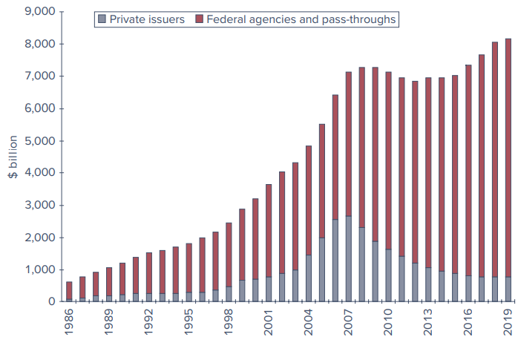
Mortgage-Backed Securities Outstanding
Market size from 1986 to 2019
※ The rapid growth in the outstanding amount reflects the importance and popularity of the MBS in bond markets
※ The growing trend is stopped by the financial crisis in 2008

Slide 26
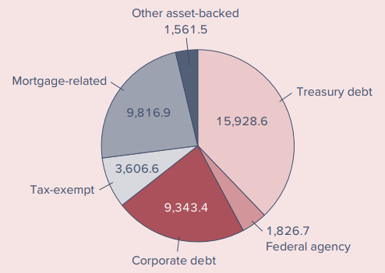
Outstanding Amounts of Different Categories in the U.S. Bond Market, September, 2019

Slide 27
2.3 EQUITY MARKET INSTRUMENTS

Slide 28
Equity Market Instruments
Different equity shares of corporations
Common stock (普通股)
Ownership in a corporation ((股份)公司)
Shareholders of common stock have voting rights (投票權) and may receive dividends (股利收入)
Residual claim (剩餘請求權) means stockholders are the last in line of all those who have a claim on the assets and income of the corporation
Limited liability (有限清償責任) means that the maximum amount that shareholders can lose in the event of default of the corporation is their original investments

Slide 29
Stock Market Listings on NYSE, September 4, 2019
※ “DIV” is computed from 4 times the last quarterly cash dividend payment
※ “YIELD” is the dividend yield (股息收益率), defined as DIV / (CLOSE PRICE)
※ “P/E” means price-to-earnings ratio (本益比), which is the ratio of the current share price to last year’s earnings per share
※ A firm with a smaller P/E ratio is a better investment target (discussed in Part 4)
※ The blank space for “DIV”, “YIELD”, or “P/E” means the firms have zero dividends last quarter, or zero or negative earnings last year

Slide 30
Equity Market Instruments
Preferred stock (特別股)
Nonvoting shares in a corporation, usually receiving a fixed stream of dividends (hence the preferred stock has features similar to both equity and debt)
Preferred dividends are usually cumulative; that is, unpaid dividends cumulate and must be paid in full before any dividends paid to common stock holders
Preferred stock payments are treated as dividends, so they cannot provide the tax-shield (稅盾) benefit for firms
A special tax rule for dividend income in the U.S.
Corporations may exclude 50% of dividends earned from other domestic corporations when calculating taxable incomes (Until 2018, the dividend exclusion was 70%)
Therefore, preferred stocks make desirable fixed-income investments for some corporations in the U.S.
Priority of the claim over the firm’s income and asset: Debt > Preferred Stock > Common Stock

Slide 31
Equity Market Instruments
Depository receipt (存託憑證)
American Depository Receipts (ADRs, 美國存託憑證) are certificates traded in U.S. markets that represent ownership in shares of a foreign company (for example, ADRs of TSMC (台積電))
ADRs are quoted and traded in US$
Advantages of ADRs:
ADRs are created to make it easier for foreign firms to satisfy U.S. security registration requirements
ADRs provide a way for foreign firms to raise money in the U.S., which is the largest capital market in the world
On the other hand, ADRs provide the most convenient way for U.S. investors to invest in and trade shares of foreign corporations
In a word, the creation of ADR benefits both foreign firms outside the U.S. and investors in the U.S.

Slide 32
2.4 STOCK MARKET INDEXES

Slide 33
Stock Market Indexes
There are many stock indexes worldwide, e.g.,
Dow Jones Industrial Average (DJIA, 道瓊工業平均指數), Financial Times Index (金融時報指數) of London, Nikkei (日經) 225 Average of Tokyo, CAC 40 index of French stock markets, etc.
Functions of stock indexes
Track average returns of a portfolio
Measure the performance of the economy
As underlying assets of derivatives, e.g., index futures or options (introduced in the next section)
How is the stock index weighted?
Price weighted (DJIA)
Market value weighted (S&P 500 and NASDAQ)
Equally weighted (Value Line Index)

Slide 34
Dow Jones Industrial Average (DJIA)
History for DJIA
It is created by three journalists, Charles Dow, Edward Jones, and Charles Bergstresser, who all are co-founders of the Dow Jones & Company
In 1884, Dow initially composed Dow Jones Average, which contained nine railroads and two industrial companies and appeared in the Customer's Afternoon Letter, a daily two-page financial news, which was the precursor to The Wall Street Journal
In 1896, DJIA was formally founded and calculated as the simple average of the stock prices of 12 industrial companies
Today, DJIA is constructed by 30 largest publicly held companies in the U.S. and the average is computed via the price-weighted method

Slide 35
Examples of Other Indexes - Domestic
Standard & Poor’s 500 Composite Index (S&P 500 index, 標準普爾500指數)
Constructed by 500 largest-capitalization common stocks actively traded in the U.S.
NASDAQ Composite Index (3765 components in 2022)
Lists technology and growth companies or ADRs
NYSE (New York Stock Exchange) Composite Index (more than 2400 components in 2022)
Including ADR, real estate investment trusts (REITs), tracking stocks, and foreign listings listed on NYSE
Wilshire 5000 Index (3660 components in 2022)
Ultimate U.S. equity index including all NYSE, American Stock Exchange (AMEX), actively traded NASDAQ common stocks and REITs
※ All above are market value-weighted indexes

Slide 36
Hypothetic Data to Construct Stock Price Indexes

Slide 37
DJIA Price-Weighted Average
Using the hypothetic data on Slide 2-36 to illustrate the price-weighted method
The price-weighted method is essentially to compute the simple average of the prices of the stock included in the index
Initial index value = (25 + 100)/2 = 62.5
Final index value = (30 + 90)/2 = 60
Percentage change in index = –2.5/62.5 = –4%
It is equivalent to say that the price-weighted method measures the return on a portfolio that holds one share of each stock
Initial value = $25 + $100 = $125
Final value = $30 + $90 = $120
Percentage change in portfolio value = –5/125 = –4%

Slide 38
DJIA Price-Weighted Average
The reason for the name of price-weighted average
Employ the initial prices as the weights for rates of return of individual stocks
※ Note that price-weighted averages give higher-priced shares more weights in determining the performance of the stock index

Slide 39
DJIA Price-Weighted Average
The updating rule of the divisor of the price-weighted method for the event of stock splits
Since there are only two stocks in the index, the original divisor is 2
Suppose the share XYZ were to split two for one so that its share price fell to $50
Stock | Initial Price | Final Price | Shares (mil.)
ABC | $25 | $30 | 20
XYZ | $50 | $45 | 2

Slide 40
DJIA Price-Weighted Average
Adjust the divisor, d, to let the stock index unchanged after the stock split
At the end of the period, the new value of the price-weighted average is (30+45)/1.2 = 62.5, so the percentage change in index become 0%
※ For the price-average index, the stock split does not affects the level of the index at that time point, but it will affect the percentage change of the index in the following period

Slide 41
DJIA Price-Weighted Average
The return 0% can also be derived via
※ The effect of distributing the stock dividend is equivalent to that of stock split $⇒$ The same rule introduced on Slide 2-40 is applied
※ If one firm is dropped from the index and another firm with a different price is added, the divisor has to be updated to leave the index unchanged after the substitution

Slide 42
S&P’s 500 Composite Market Value-Weighted Index
Given the data on Slide 2-36:
The percentage increase in the total market value from one day to the next represents the percentage increase in the stock index
Percentage change in index = (690 – 600)/600 = 15%
Since ABC is five times the weight relative to XYZ, the index return also can be derived via

Slide 43
Value Line Equally Weighted Index
Places equal weight on each individual return
Based on the data on Slide 2-36
※You can imagine to start with investing equal dollars in each stock at the beginning of the period. Then at the end of the period, the return of this portfolio reflects the percentage change of the equally weighted index

Slide 44
Examples of Indexes - International
FTSE (Financial Times Index, jointly owned by Financial Times and the London Stock Exchange)
CAC 40 (France)
Nikkei 225 (Japan)
Dax (Germany)
Hang Seng (Hong Kong)
MSCI (Morgan Stanley Capital International)
Computes over 50 country indexes and several regional indexes (see the table on the next slide)
Representativeness? (usually approximated by firm size)
Broad-base or narrow-base? (regional index vs. country index vs. industry index)

Slide 45
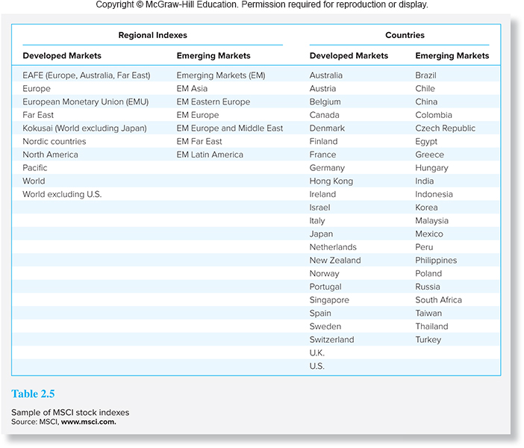
MSCI Stock Indexes
※ When calculating the Taiwan MSCI index, MSCI only chooses firms that are large enough and can represent the economic condition of Taiwan (87 firms in 2022, which cover approximately 85% of the free float-adjusted market capitalization in Taiwan)

Slide 46
2.5 DERIVATIVE MARKET INSTRUMENTS

Slide 47
Derivative Market Instruments
Futures (期貨)
Basic Positions
Long
Short
Terms
Delivery price (交割價)
Delivery date (交割日)
Underlying asset (標的物)
Options (選擇權)
Basic Positions
Call (買權) (Buy or sell)
Put (賣權) (Buy or sell)
Terms
Exercise price (執行價)
Expiration date (到期日)
Underlying asset (標的物)
※ For futures, the delivery price, which is the current futures price determined by the demand and supply of the futures contracts, is the price at which the underlying asset is traded on the delivery date
※ Note that for both buyers and sellers of futures, they cannot choose but only accept the current futures price as the delivery price
※ For options, there are a series of exercise prices that investors can choose
※ The introduction of futures and options will be postponed until Chapters 15-17

