Slide 1
Gender Equality Incidents on Campus
Gender Equity Education Committee
National Taiwan University

Slide 2
Outline
GEEC
Seek Help
Cases Sharing
What GEEC is
What GEEC Does
Gender Equality incidents
Gender Equality Grievance Process
Cases
Concept on Gender Equality
2

Slide 3
What Does GEEC Do?
Investigate gender equality incidents on campus
Organize and maintain gender-friendly campus
Educate and promote
source：Unsplash

Slide 4
Structure of GEEC
Chair person
President
Vice Chair
1 Faculty
Assistant
Ex-officio Representative
Faculty Representatives
Staff representatives
Student Representatives
３person
９person
２ person
５person

Slide 5
What Is Campus Sexual Harassment?
According to Gender Equity Education Act, Article3,Subparagraph3,
Item2:
Sexual harassment: acts meeting one of the following criteria but not constituting sexual assault:
Engaging in unwelcome sex- or gender-related speech or behavior, whether explicit or implied, which adversely affect the other party's personal dignity, learning, or work opportunities or performance.
Sex- or gender-related behavior that serves as the condition for oneself or others to gain or lose rights or interests in learning or work.

Slide 6
What Is Campus Sexual Bullying?
According to Gender Equity Education Act, Article3,Subparagraph3,Item3 :
Sexual bullying:
ridicule, attacks, or threats directed at another person’s gender characteristics, gender temperaments, sexual orientation, or gender identity by using verbal, physical or other forms of violence will be under the category of sexual bullying not sexual harassment.
source：istock

Slide 7
What Is Campus Sexual Assault?
Sexual assault is an act of sexual intrusion with an improper purpose.
According to Criminal Code, Article10, Paragraph5:
The term “sexual intercourse” means the following listed sexual acts that are not based on rightful purposes: Insertion of a reproductive organ into the reproductive organ, anus, or mouth of another person or an act of making them connected.
Insertion of a body part or an object other than a reproductive organ into the reproductive organ or anus of another person or an act of making them connected. For instance: entering another person's reproductive organ and/or anus with fingers; or inserting another person's reproductive organ and/ or anus with massage sticks, vibrating eggs, bottles, or other objects.
As for the two people who have sexual intercourse, it is not exclusively limited to males and females, but also same-sex sexual intercourse.

Slide 8
SOP on Gender Equality incidents
Implement
Punishment
Educational counseling measures
Result
Transfer to committees at all levels for deliberation
06
Investigation
Fact finding
Punishment suggestion
05
Acceptance
Confirm within 20 days
04
Application
Emergency Response
Statutory Notification
03
Activation
Application
Notification
02
01

Slide 9
Legal Remedy System
If a party disagrees with the outcome of the proceedings or the results of the investigation, s/he may file a complaint!
Appeal
File a complaint
Petition
Administrative Litigation
Submit to the university
Submit to the Ministry of Education
Submit to the court
Submit to the university

Slide 10
If sexual harassment occurs, we suggest you
Trust your intuition
Although not every incident will constitute sexual bullying/ harassment/ assault, trust your instincts.
Seek help
source：beauty-upgrade
Keep related evidence
Witnesses/related persons, monitor screens, any communication records between you and the other party. Or if you have discussed this incident with others in the communication software, it can be used as relevant evidence.
Keep a detailed record
and document everything to file a complaint anytime when ready.

Slide 11
Common Gender Myths
Gender stereotypes: men work outside, and women stay at home; women should be submissive, but men, active.
Gender discrimination goes a step further by adding value differences and taking related measures, such as male superiority and female inferiority.
Condemning "sex victims": Emphasize the appearance, dress, and character of the victim, implying that the victim should be held responsible for the victimization.
Women's words and deeds are inconsistent: when they say "no", they are just pretending to be reserved, so men don't need to pay attention, and any man could "force himself on her."
示意圖片來源：Unsplash

Slide 12
Cases of Sexual Harassment
inappropriate
touching
Candid voyeur
Hamper the secret
Gender
Discrimination
Unwanted
Pursuit
Sexual invitation
Sexual suggestion
A likes B very much but doesn’t know how to get closer. He often haunts B’s classroom to create opportunities for a talk. He sends her hundreds of messages a day. B feels uncomfortable, troubled, and fearful.
In the orientation activities, student A asked freshman B several times, "Do you have any go-steady friends? Do you want a date?" "I'm good at massage," putting his hand on her shoulder.
Professor A said to student B, "You can come to my place to discuss your studies, or play with my cat. My massage chair is very comfortable."
"I know a lot of people. I can get you jobs. Come to my house to have dinner and discuss."
When A was using the toilet in the dorm, he suddenly saw a mobile phone sticking through the door to take a candid photo.
Prof. A provides different salaries for assistants of different genders. Prof. A thinks that men's work is harder.

Slide 13
Cases of Sexual Assault
Sexual
Molestation
Forced
Indecency
Sexual Acts with
One under 16
Sexual
Coercion
Sexual
Molestation
Prof. A often gives student B a ride home. One day, Prof. A invited B to watch the night scene. Prof. A became horny, so he rolled over and kissed B, stroking her chest and lower body. Student B struggled to resist and shouted. Prof. A then stopped his behavior.
Student B has a favorable impression of Student A, the senior. After the two dated at the hotel, Student A asked Student B to have sex; otherwise, he would stop interacting with Student B. Student B was unwilling, and Student A forced Student B to have sex.
While camping, as B was asleep, A put his hand into B‘s sleeping bag, stroked his/her body, and inserted his fingers into his/her lower body.
Student A met a 14-year-old junior high student B on the Internet. The two had a crush on each other. After Student A brought B to MTV, the two had sex.
Student A and Student B are good friends. The two often met to chat and drink for fun. One day, as Student B couldn't hold much liquor, Student A pulled down Student B's underwear and had oral sex.

Slide 14
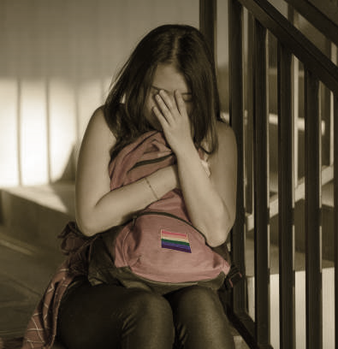
Cases of Sexual Bullying
Gender
Traits
Gender
Characteristics
Sexual
Orientation
Woman A has a flat chest, and students B often openly jokes about Woman A’s small chest. Later, other students also laughs at Woman A.
Student A is transgender. One day he went to the women's toilet and was seen by Student B. B told A to have sex reassignment surgery.
Student A has feminine personality traits. In PE class, teacher B said that he is not like a man, and his reaction is always slow. The other guys laughed at Student A and said he should stay under the tree shade like a girl.
示意圖片來源：istock

Slide 15
Gender Equality Incidents on the Internet
Demean
gender traits
Distributing
lewd photos
Invasion of
privacy
After Student B broke up with her boyfriend A, Student A maliciously spread past private photos on the Internet, causing Student B to be physically and psychologically traumatized.
Student B shared the content of the quarrel with his partner on Dcard, Student A left a message, "Bitch", and Student C, "Slut, go to hell."
Student B rejected Student A, so A asked netizen C to help make fake private photos of Student B for his masturbation. Later other friends discovered it.
示意圖片來源：istock

Slide 16
Myths and Clarification
"A girl who says NO means yes"?
Expecting guys to be "bossy and considerate"?
Once a man takes control of the woman, the relationship between the oppressor and the repressed can easily lead to conflict.
Important elements of a relationship:
Respect & communication
示意圖片來源：istock

Slide 17
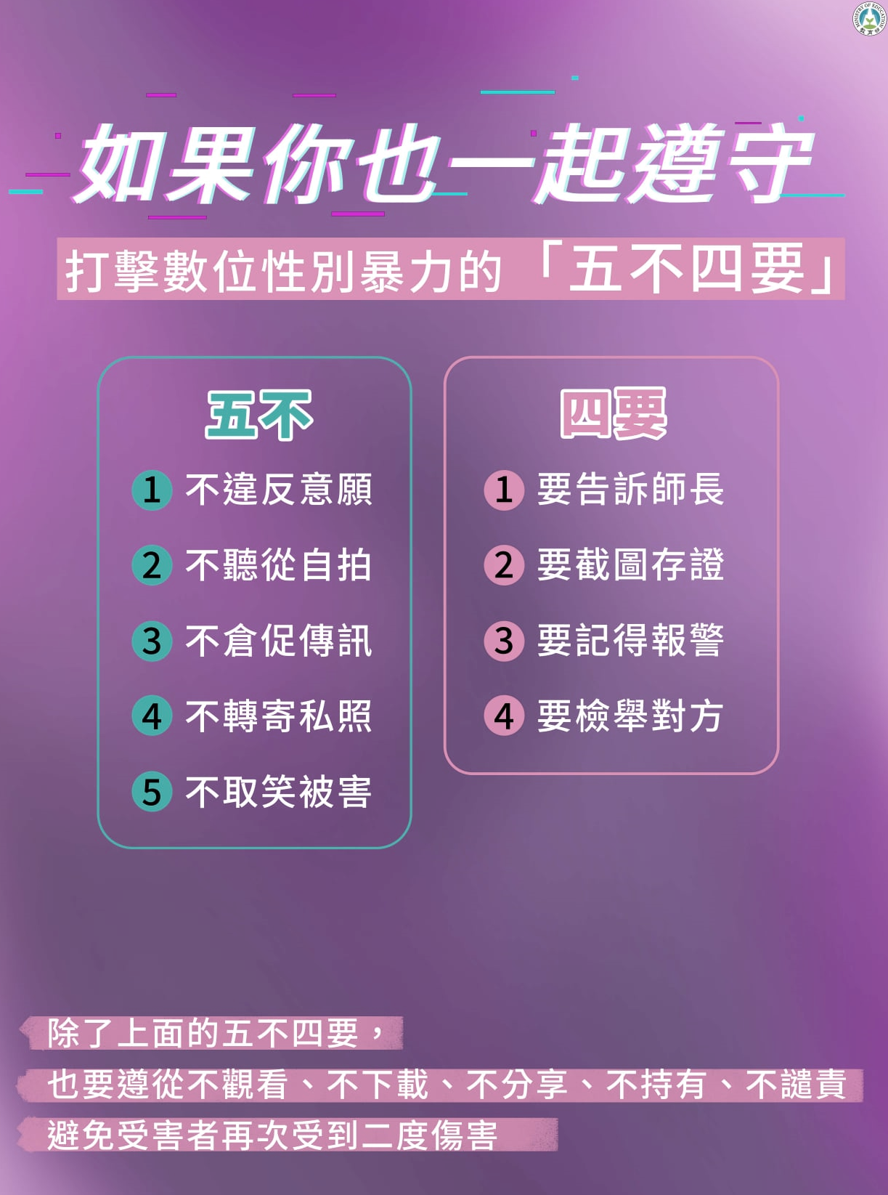
Myths and Clarification
Internet sex incidents do not happen only among strangers, but the acquaintances. Familiarity does not guarantee safety. When chatting with relatives and friends through the Internet, you still need to be discreet in your speech. Both parties should have mutual respect to avoid misunderstandings or online sexual harassment.
Due to the rapid spread of communication technology, the impact of speech amplifies in a short period. For example, in the wink of an eye, hundreds of people can watch an embarrassing video, which means the victim can suffer hundreds of injuries.
Students must observe etiquette in their speeches on the Internet. Using content that slanders specific biological gender, gender identity, gender characteristics, sexual orientation, or has sexual connotations or sexism may constitute sexual harassment or sexual bullying.
圖片來源：教育部

Slide 18
How NOT to Be a Perpetrator
Respect
Friendly speech & attitude
Respect bodily autonomy
Respect each
other's choices
Do not take pictures / peep at others
without consent
Avoid unwanted pursuit behavior
Replacing bad habits with good habits
Examine your gender stereotypes and develop a gender equality concept.
Do not demean any gender, tell dirty jokes, spread erotic letters, or
engage in other sex-related
harassment.
Stop immediately when you feel your behavior makes others uncomfortable, preferably with consent before any physical contact

Slide 19
Responsibilities of the Perpetrator
For the student perpetrator, demerits, labor services, psychological counseling, gender equality education, an apology to the victim, etc.
For the faculty perpetrator, admonishment, demerit, dismissal, job loss, psychological counseling, an apology to the victim, and eight hours of gender equality education courses.
In addition, the perpetrator will face administrative fines, and criminal and civil liability may follow.
示意圖片來源：istock

Slide 20
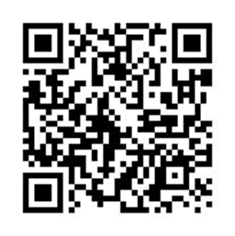
Contact GEEC
Come in person:
3rd Floor, the front building of Jan Shu Hall on campus
Tel: 02-33669607, 02-33669608
EMAIL: gender@ntu.edu.tw
Call outside working hours:
School Safety Center (24 hr) emergency call: 02-3366 9119
性平會官網

Slide 21
Other help channels
Get help from the nearest units on campus (dormitory, department office …)
24-hour emergency call to the school guards: 02-33669110
School Safety Center 02-33662060
Emergency call 02- 33669119
Hotline 113 (24 H)
Report directly to the police station or dial 110

Slide 22
Thanks 謝謝聆聽

