Slide 1
Phonetics the sounds of language
Roger Cheng-yen Liu
TA session for Articulatory Phonetics, F2019
Dec. 10, 2019

Slide 2
Outline
Acoustic phonetics: an overview
Basic acoustics
Basic properties of sound waves
Periodicity and Fourier transform
Acoustic vs. auditory properties
Three acoustic models
Acoustic properties of speech sounds
Visualization: waveform, spectrum, spectrogram
Standing waves, harmonics, and resonance
Source-filter theory
Tube models
Perturbation theory

Slide 3
0. Acoustic phonetics: an overview

Slide 4
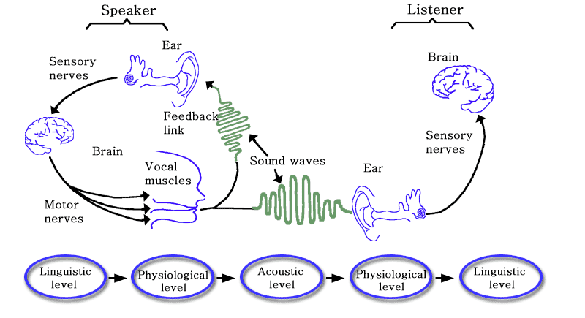
The Speech Chain
Articulatory
phonetics
Acoustic
phonetics
Auditory
phonetics
Denes & Elliot (1993)

Slide 5
Approaches to phonetics
Articulatory phonetics 生理/構音語音學 involves analyzing physiological mechanisms of speech production.
Acoustic phonetics 聲學語音學 is concerned with measuring and analyzing the physical properties of the sound waves that propagates (or travels).
Auditory phonetics 聽覺語音學 studies how speech signals are registered and processed by the human auditory system and how we differentiate classes of speech sounds. (a.k.a. speech perception 言語感知)

Slide 6
Acoustic phonetics (1/2)
Big questions
What are the relationships between articulatory movements and the acoustic properties of the speech signal?
When the tongue moves from a position high in the mouth to a position lower in the mouth, how does the sound pattern change (and why)?
How does the sound pattern change when the velum is up versus down (and why)?
How can we measure these (physical) properties?

Slide 7
Acoustic phonetics (2/2)
Big questions
Can we make sense of phonetic categories in terms of their underlying acoustic properties?
What acoustic properties do all the [t] sounds have in common? (→ Why & how?)
What acoustic features are seen for sounds that are voiced (i.e., involving vocal cord vibration) vs. those that are unvoiced (voiceless)?
What acoustic features distinguish voices that sound breathy from those that do not?

Slide 8
What have we learned so far?
Phonetics is the study of characteristics of human speech sounds.
Taxonomic phonetics 分類的語音學
Transcription
Ear training
Mouth training (“Articulatory”)
Scientific phonetics 科學的語音學
Experimental studies
Instruments
A.k.a. speech science
Description
Classification
Palatography (PG)
fMRI, Ultrasound
Electroglottograph (EGG)
Data analysis
Articulatory (& acoustic) properties
Labels

Slide 9
Resources

Slide 10
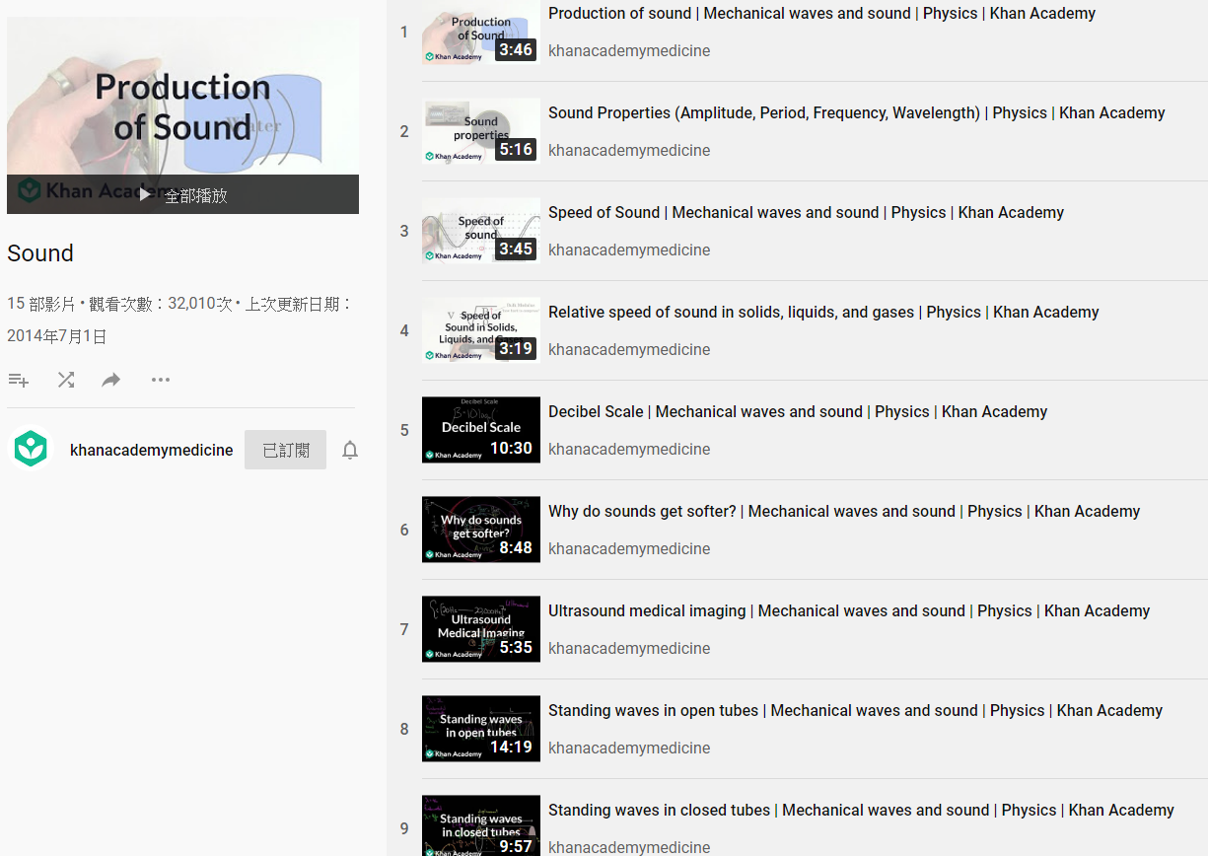
Khan Academy: Sound _{[in English]}

Slide 11
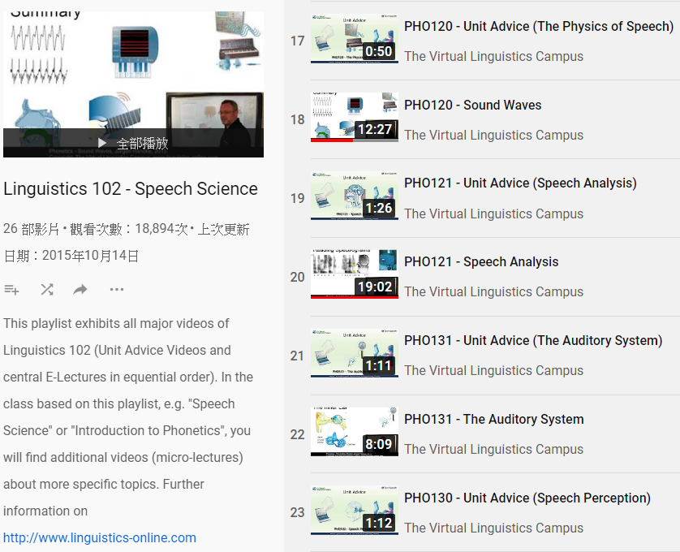
The Virtual Linguistics Campus

Slide 12
https://www.acs.psu.edu/drussell/demos.html

Slide 13
均一教育平台：波動與聲音 [國中理化]
均一教育平台：波動與聲音 [in Mandarin]

Slide 14
均一教育平台：波動 [高三選修物理]
均一教育平台：波動 [in Mandarin]

Slide 15
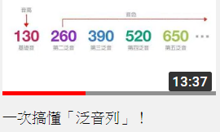
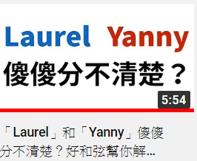
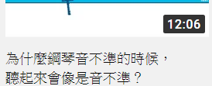
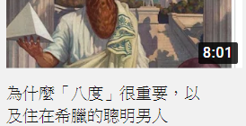
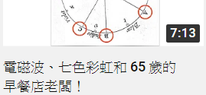
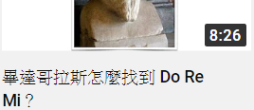
Pitch, frequency
Harmonic series
Sampling
Quantization
Noise
Acoustic filter
speech and acoustics: applications

Slide 16
Let us begin!: I. Basic Acoustics
Part 1: Basic properties of sound waves

Slide 17
Sound
It is the energy that is transported!
(not the particles)
Sound energy can be transported from one place to another through a medium_{介質} (such as air, water, or wood) by causing particles to vibrate.
As the sound wave vibrates, individual medium particles simply oscillate in place (moving back and forth rapidly).
A sound is heard when . . .
Oscillations (at 20–20,000 times per second) reach the listener’s ears, causing the eardrum to move.
Sustained movements of high pressure alternating with low pressure
There is a sudden change in pressure

Slide 18
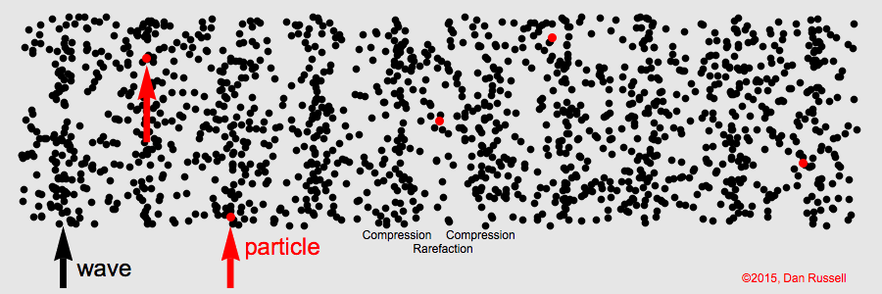
Transverse vs. longitudinal waves
Transverse wave 橫波
Longitudinal wave 縱波
The particle displacement is perpendicular (⊥) to the direction of wave propagation.
Examples
Rope waves 繩波
S waves (Secondary waves) in an earthquake
The particle displacement is parallel (∥) to the direction of wave propagation.
Examples
Sound waves 聲波
P waves (Primary waves) in an earthquake

Slide 19
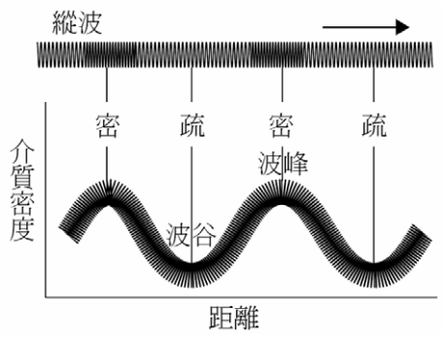
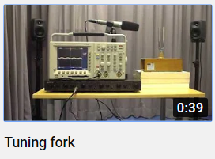
Representing a longitudinal wave
Longitudinal wave
compression
rarefaction
/trɔf/ trough
crest
Density / Pressure of air particles
distance
http://www.moseleytw.com/uploads/1/6/0/4/16043318/103_83_u3.pdf

Slide 20
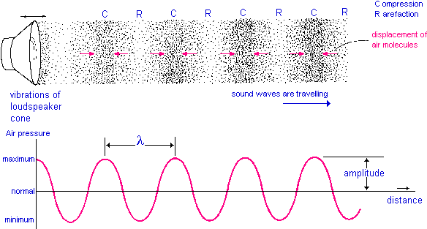
Representing a longitudinal wave
https://www.seekpng.com/png/full/280-2800688_pix-1fig7-sound-wave-pressure-wave.png

Slide 21
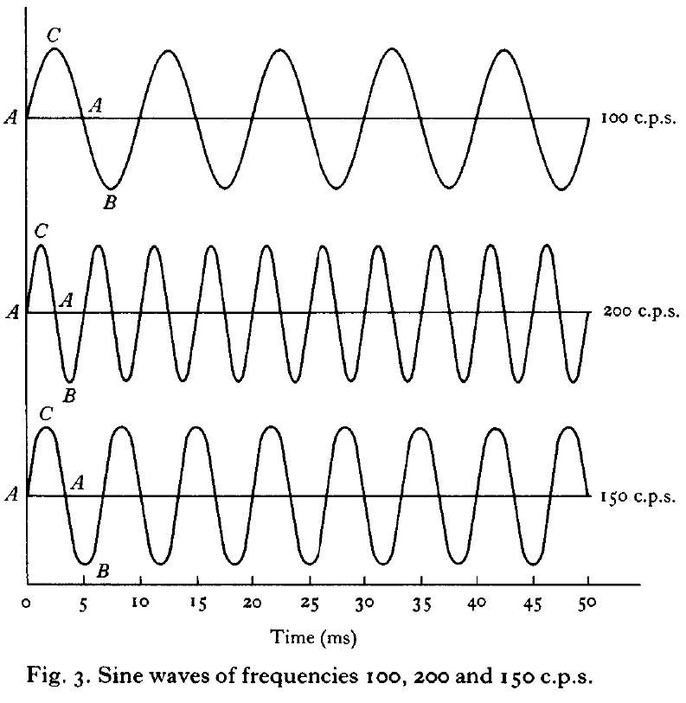
Waves: basic properties (1)
Frequency (頻率, f)
The number of times the sine wave repeats, in a given unit time (e.g., 1s = 1000 ms)
Hz = cycle per second
Period (週期, T) is the time span that a wave takes to finish a cycle (A-B-A-C-A).
f = 1/T
Auditory correlate: pitch 音高
Fry (1979)

Slide 22
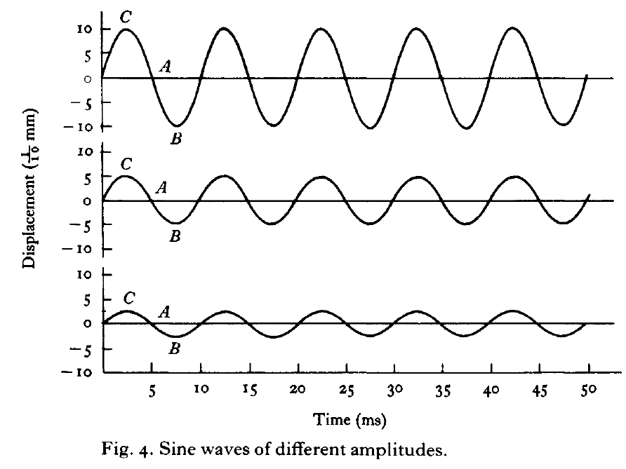
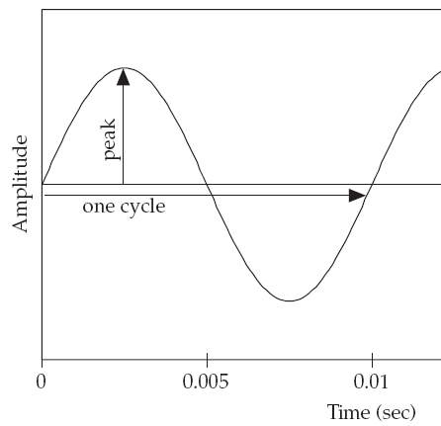
Waves: basic properties (2)
Amplitude 振幅
The amount of pressure fluctuation from normal (atmospheric) pressure
Represented on the vertical axis of the waveform
Auditory correlate: loudness 響度
Johnson (2012); Fry (1979)

Slide 23
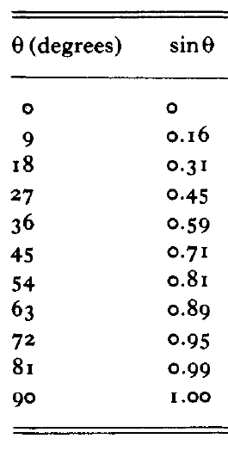
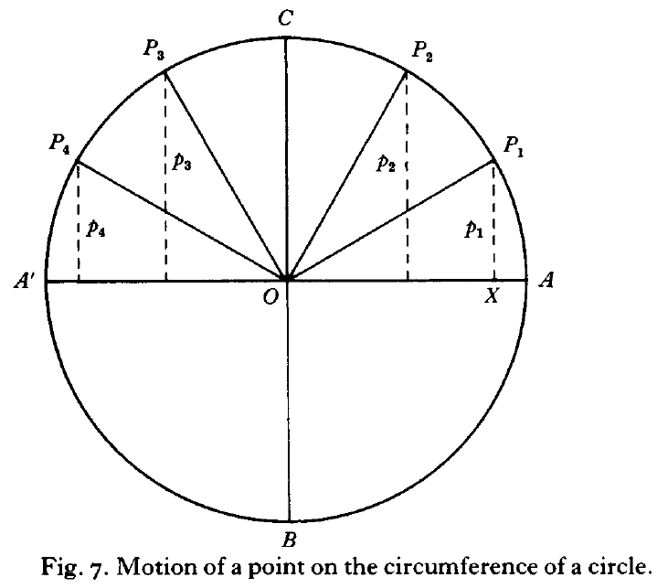
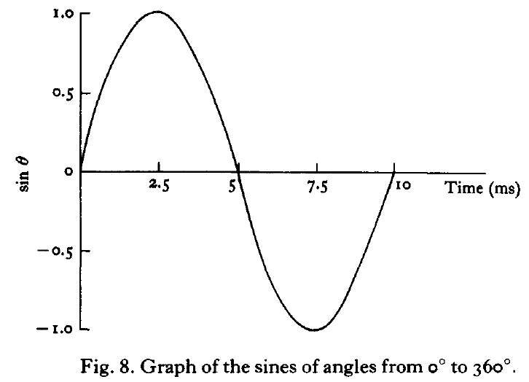
Waves: basic properties (3)
Phase 相位
Timing of the waveform relative to some reference point
Auditory correlate: (none)
But bear this in mind, b.c. we will use this concept to understand perturbation theory!
0°
0°
90°
180°
270°
360°
π/2
π
2π
Fry (1979)

Slide 24
Exercise 6.2
What is the frequency (in Hz) if the period of a sine wave is:
0.25 s
0.05 s
20 ms
25 ms

Slide 25
Exercise 6.2
What is the frequency (in Hz) if the period of a sine wave is:
0.25 s
1 cycle per 0.25 s = 4 cycles per 1 second ⇒ 4 Hz
1/0.25 = 4 (Hz)
0.05 s
1/0.05 = 20 (Hz)
20 ms = 0.02 s
1/0.02 = 50 (Hz)
25 ms = 0.025 s
1/0.025 = 40 (Hz)

Slide 26
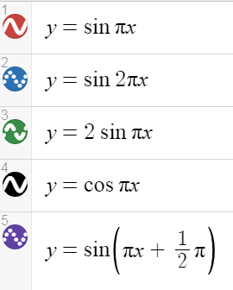
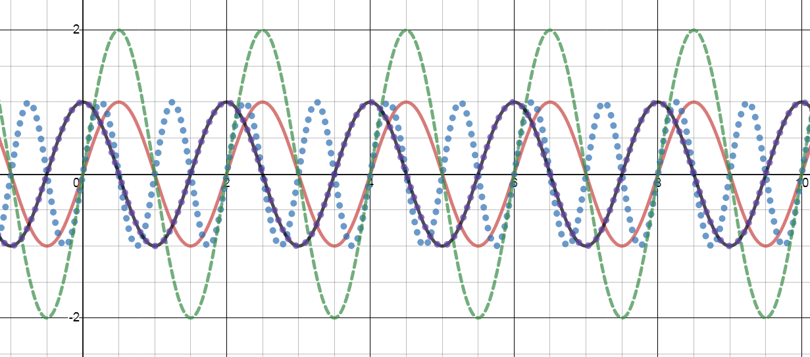
Sine waves as functions
https://www.desmos.com/calculator

Slide 27
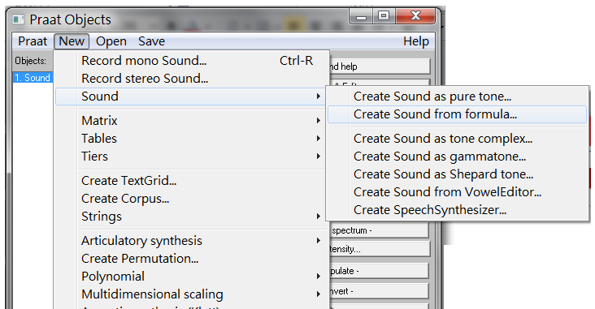
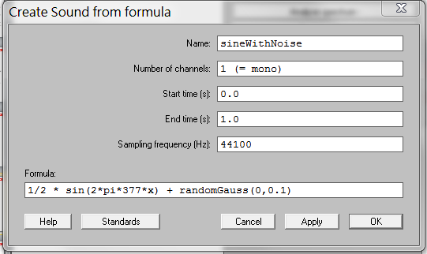
Generating sine waves with Praat

Slide 28
What I don’t cover here . . .
Wavelength 波長 (λ)
Velocity of wave c
c = λ / T = λ * f
Amplitude/intensity in dB 分貝
Need logarithm 對數. Please Google it yourself.

Slide 29
I. Basic Acoustics
Part 2: Periodicity and Fourier transform

Slide 30
Periodic vs. aperiodic waves
Ashby & Maidment (2005)

Slide 31
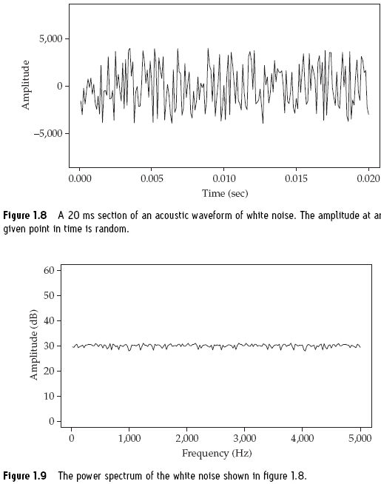
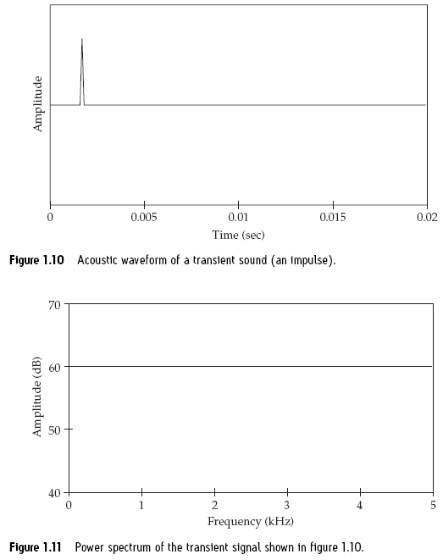
(White) Noise vs. transient
FYI: “White noise, pink noise...orange noise?” (Karen Chung)
Johnson (2012)

Slide 32
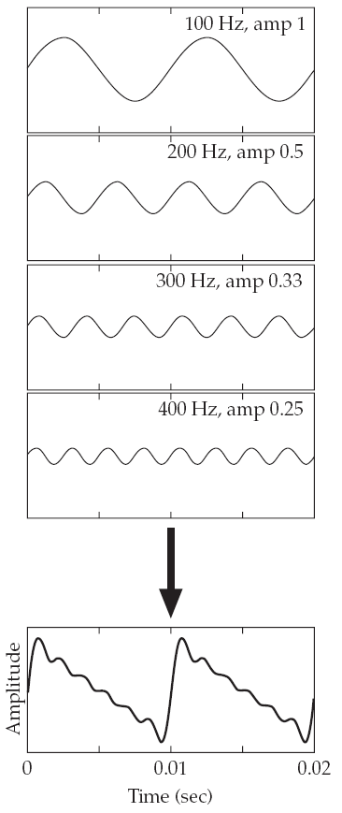
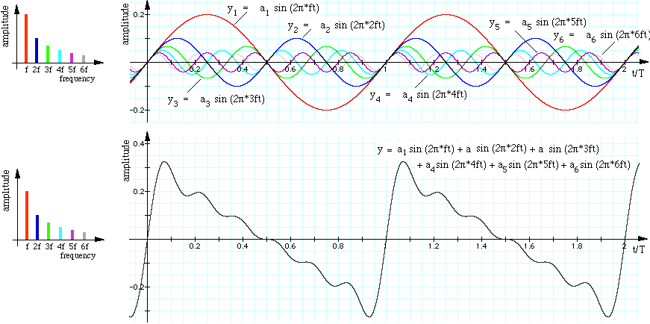
Simple vs. complex periodic wave

Slide 33
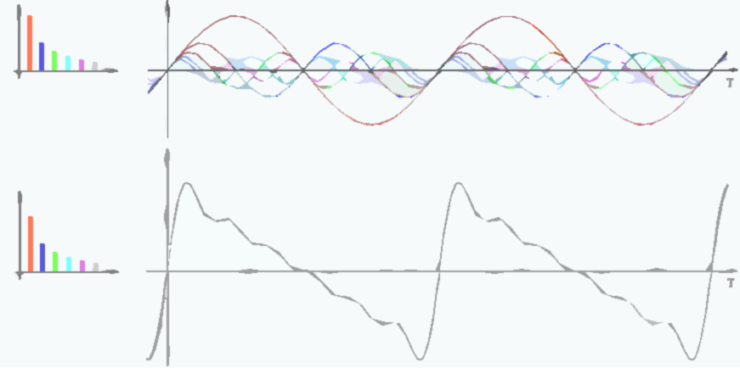
Fourier transform
All we have to know:
A power spectrum “sorting” these component waves by frequency
Combination of different
component sine waves
Fourier transform
Any waveform

Slide 34
Fundamental frequency
FYI: The Case of the Missing Fundamental (Karen Chung)
The rate at which the complex pattern repeats
It is the greatest common denominator (GCD_{公因數}) of the frequencies of the component sine waves.
F0 of a complex periodic wave with these components:
200, 400, 600, 800, 1200 Hz
300, 400, 500, 600, 1000 Hz
Ashby & Maidment (2005)
T = (10.7-2.6) = 8.1 (ms) = 0.0081 s
F0 = 1/T = 123.456790 (Hz)

Slide 35
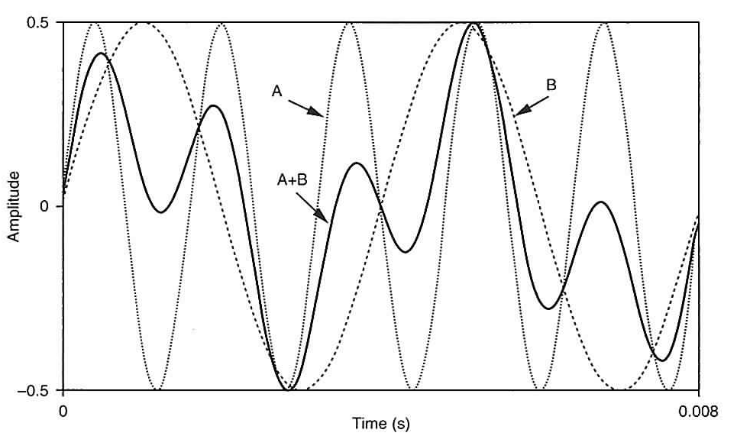
Exercise 6.4
What are the frequencies of waves A and B?
What is the fundamental frequency of wave A+B?

Slide 36
Exercise 6.4
What are the frequencies of waves A and B?
A: 5 cycles per 0.008 s = 625 cycles per second (= 625 Hz)
B: 2 cycles per 0.008 s ⇒ 2/0.008 = 250 (Hz)
What is the fundamental frequency of wave A+B?
GCD (625, 250) = 125 (Hz) (period = 0.008 s)

Slide 37
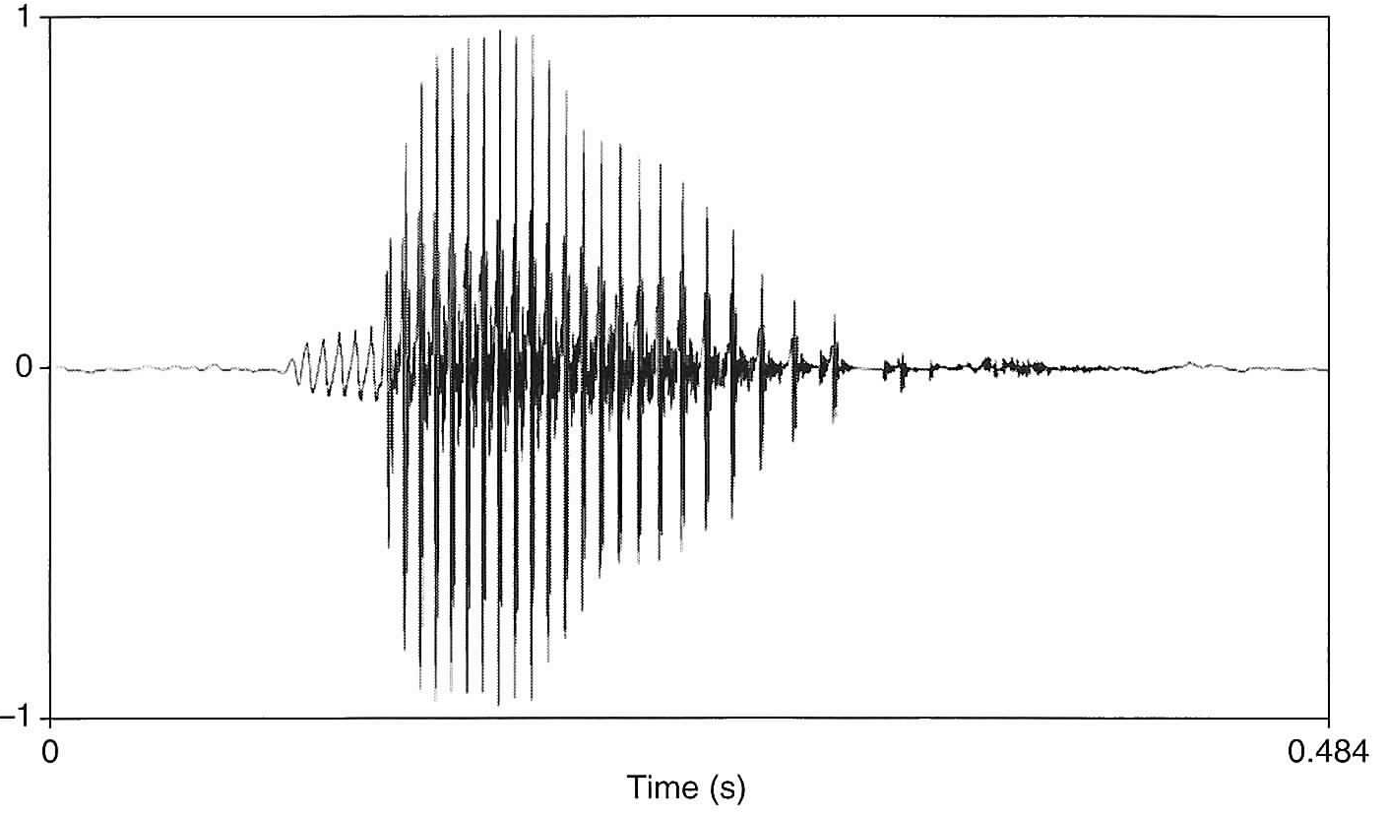
Exercise 6.10
Look at the waveform. Does the sound has a falling or rising pitch? Why?

Slide 38
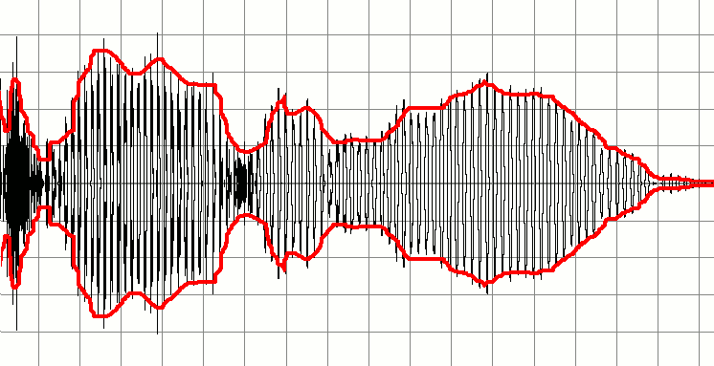
Acoustic vs. auditory properties
Acoustic property |  | Auditory property
Amplitude 振幅 | (μPa; dB SPL) | Loudness 響度 | (sone)
Frequency 頻率 | (Hz = c.p.s.) | (Frequency response) 頻率響應 | (Bark)
F₀ 基頻 | (Hz = c.p.s.) | Pitch 音高 | (Bark; semitone)
Phase 相位 | (degree; π) | (none)
Sound quality |  | Timbre [ˈtæm.bɚ] 音色
Very roughly speaking, “the shape of the wave”
It is a cover term affected by:
Spectral property (e.g., piano vs. violin; [a] vs. [i] vs. [u])
Timing envelope
etc.
A signal and its envelope marked with red

Slide 39
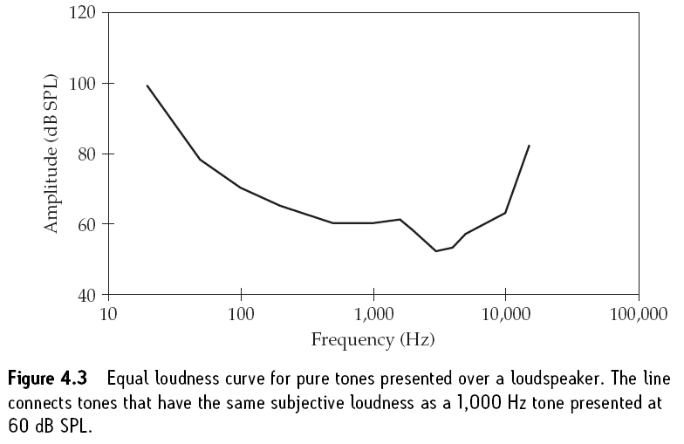
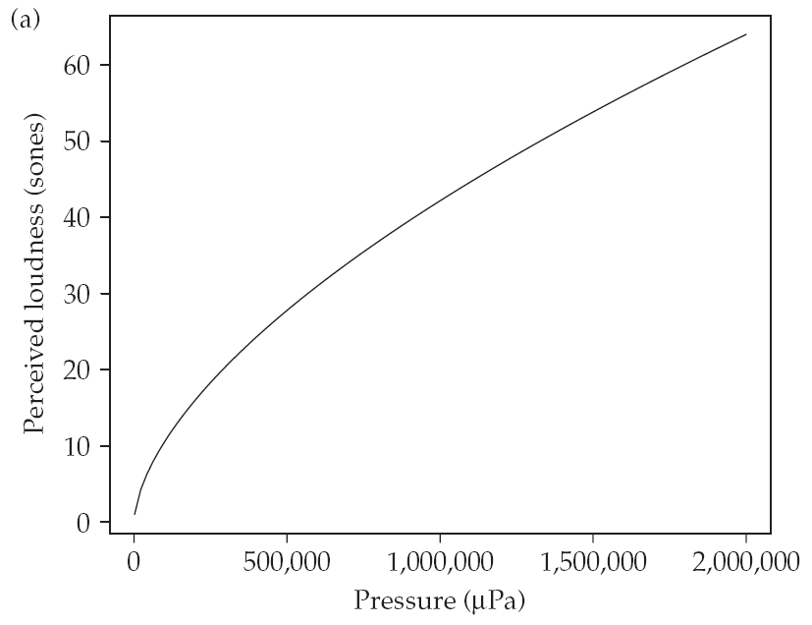
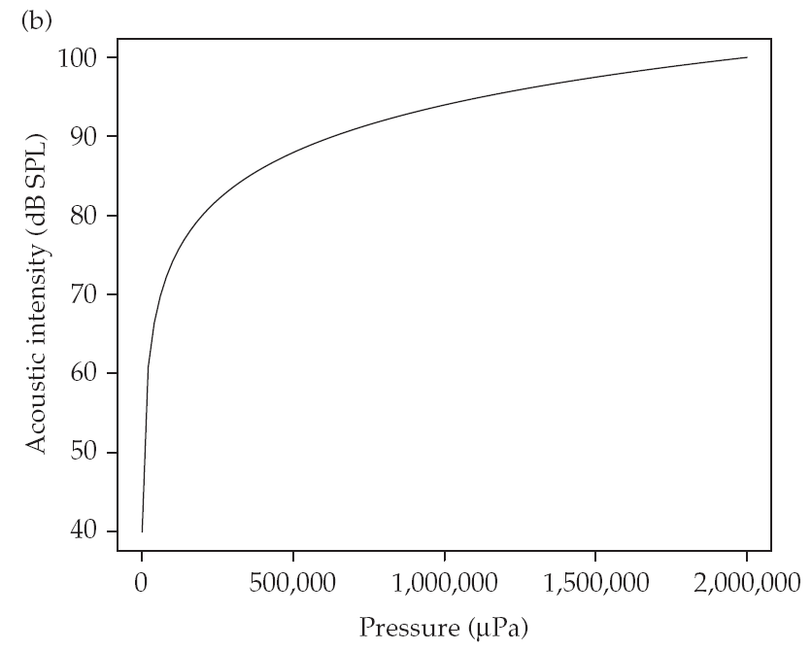
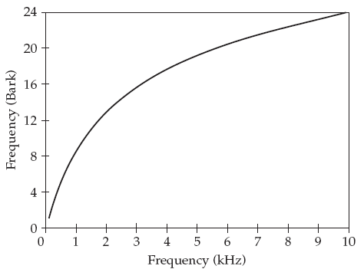
Basic audition (hearing)
Acoustic and auditory properties are mapped in a non-linear manner.
Johnson (2012)

Slide 40
Phonetics the sounds of language
Roger Cheng-yen Liu
TA session for Articulatory Phonetics, F2019
Dec. 17, 2019

Slide 41
Outline
Acoustic phonetics: an overview
Basic acoustics
Basic properties of sound waves
Periodicity and Fourier transform
Acoustic vs. auditory properties
Three acoustic models
Acoustic properties of speech sounds
Visualization: waveform, spectrum, spectrogram
Standing waves, harmonics, and resonance
Source-filter theory
Tube models
Perturbation theory

Slide 42
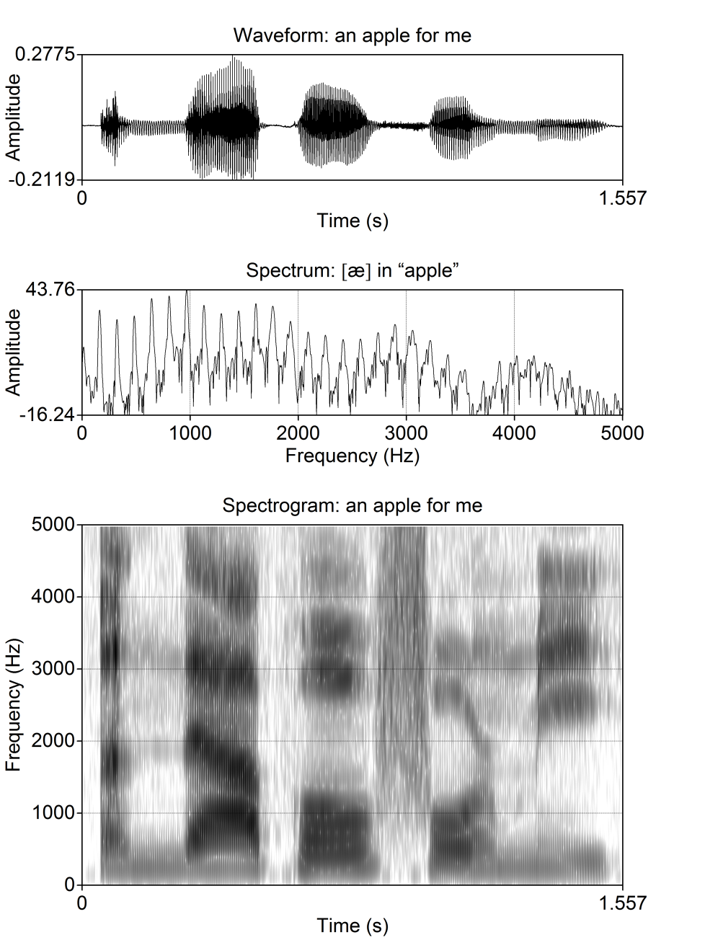
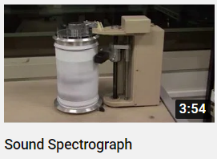
“Visible” sounds
Waveform 波形圖 (a.k.a. oscillogram 示波圖)
The “transverse version” of the sound wave
Horizontal axis: time
Vertical axis: amplitude/intensity
(Power) Spectrum 頻譜圖
A Fourier-analyzed frequency distribution
Horizontal axis: frequency (Hz)
Vertical axis: amplitude/intensity (dB)
Spectrogram 時頻譜; 聲譜圖
Running spectral slices through time
Horizontal axis: time
Vertical axis: frequency (Hz)
Darkness: amplitude/intensity

Slide 43
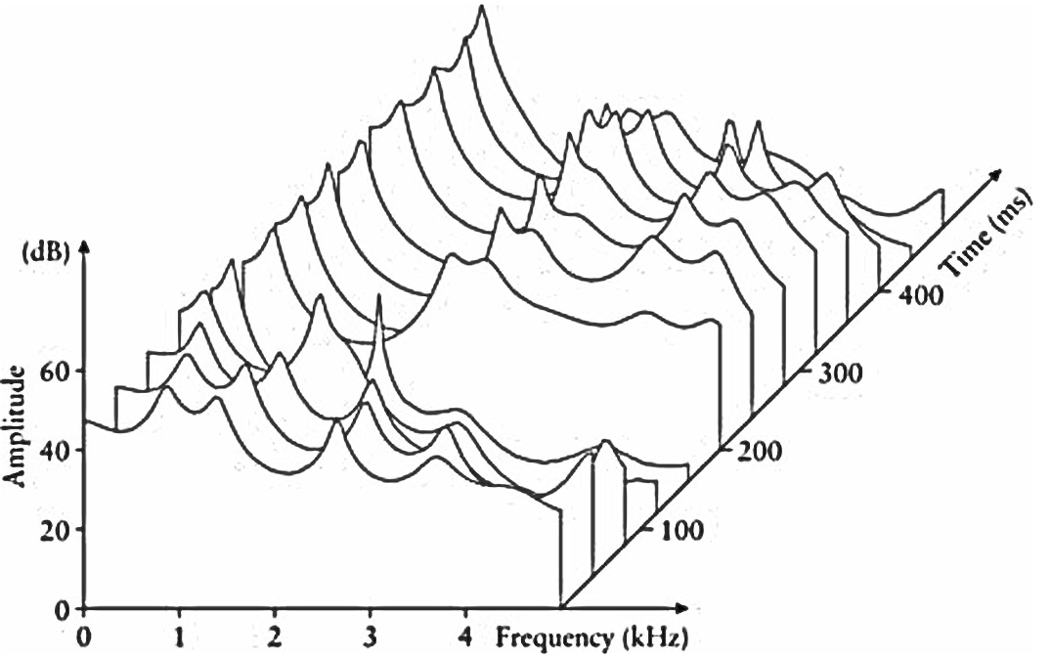
A waterfall display
A waterfall display of a sequence of spectra. Each individual “slice” represents the spectrum of a single time window.
Reetz & Jongman (2009: 156)

Slide 44
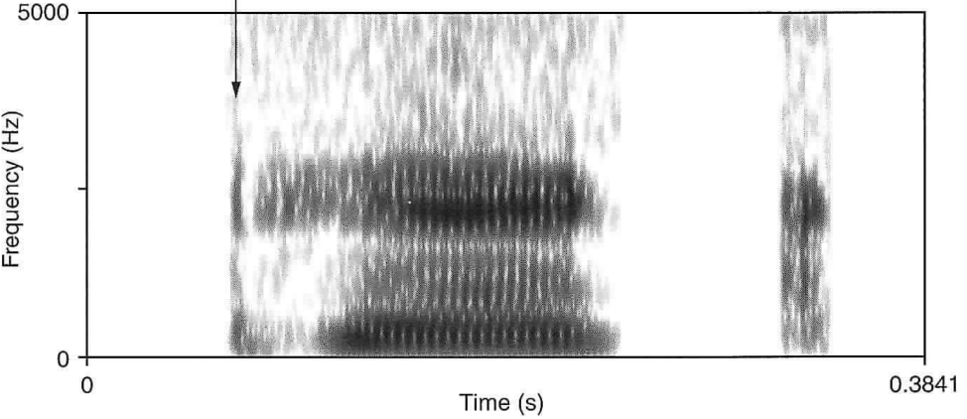
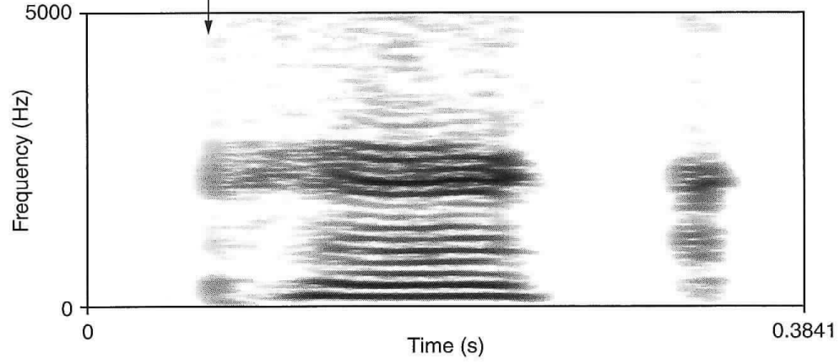
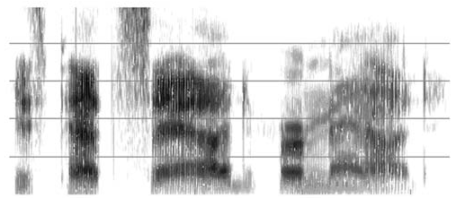
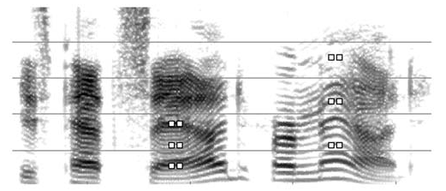
Bandwidth of spectrum/spectrogram
a.k.a. wide-band
 | Broad-band spectrogram | Narrow-band spectrogram
Temporal resolution e.g. glottal pulse; transient | Clear | Vague
Frequency resolution i.e. individual harmonics vs. a bunch of harmonics | Vague But clear enough to find formants | Clear
pick
Is Pat sad, or mad?

Slide 45
I. Basic Acoustics
Part 3: Standing waves, harmonics, and resonance

Slide 46
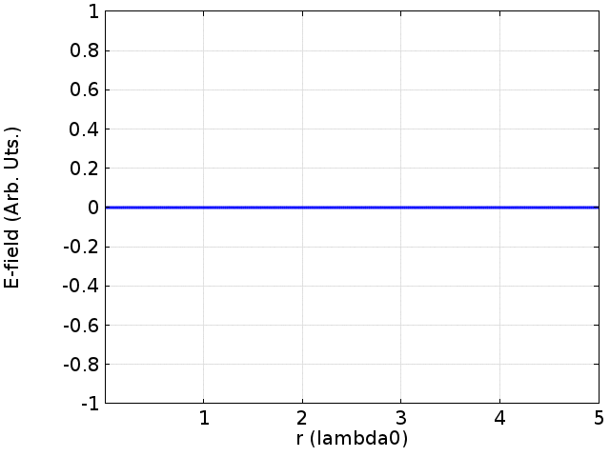
Standing waves 駐波
兩個相向行進的正弦波，其波長、頻率、波速皆相同。
這兩個波相互干涉（相加）形成的合成波，稱為駐波。
e.g. 入射波 + 反射波
A standing wave is a wave pattern as a result of a perfectly timed interference between two waves of the same frequency and amplitude traveling in opposite directions in the same medium.
維基共享資源: Davidjessop

Slide 47
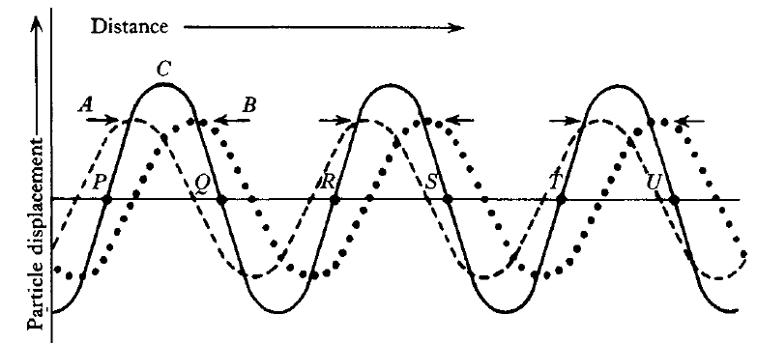
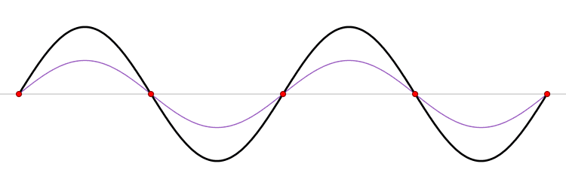
Standing waves 駐波
紅點：節點/波節 (node)
At any time, the amplitude of node is 0.
The distance between neighboring nodes = λ / 2 (or T/2)
節點間的中點為腹點/波腹/反節點 (antinode)
The antinode is at the midpoint between two nodes.
Antinodes have the largest potential amplitude (twice of the original sine wave)
Fry (1979: 40-41)

Slide 48
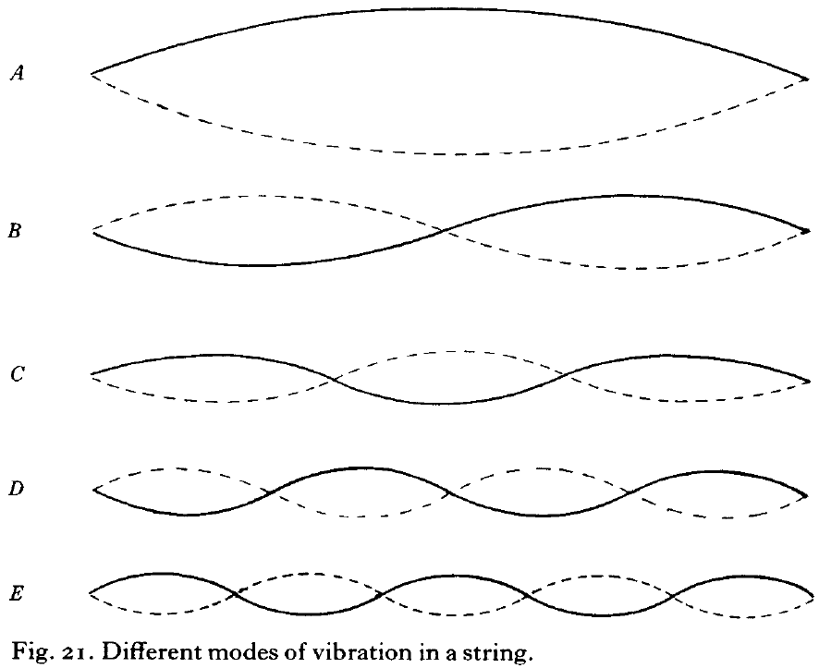
Modes of vibration
In a standing wave, adjacent nodes are separated by a half-wavelength.
The frequency of the note given by the string will be equivalent to a wavelength twice the length of the string.
For a stretched string, Many different standing waves occur in the course of its motion.
Requirement: such standing waves fit exactly into the length of the string— each must have nodes at both ends.
Each wave pattern is called a mode of vibration, with frequencies at
2, 3, 4, 5, … times of F0.
Fry (1979)

Slide 49
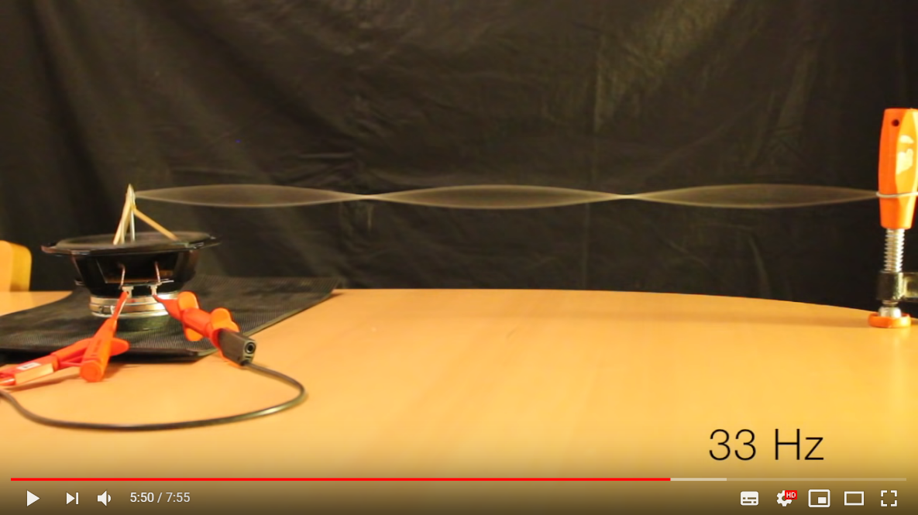
Modes of vibration
Modes on a String (by Geoff Martin)

Slide 50
What did we see in the video?
Free vibration
If we pluck the string in that specific setting, then it will vibrate with a fundamental frequency of 11 Hz.
Its natural frequency is 11 Hz (plus its overtones_{倍音}/harmonics_{泛音}).
Its harmonics are multiples of F0: 11, 22, 33, 44, 55, … Hz.
“Modes of vibration” tells us about this. (Think about it!)
There is a system which can vibrate the string at any given frequency.
When we vibrate the string at frequencies other than 11 * n Hz, the string does not vibrate that much.
The system absorbs the energy at these frequencies.
When we vibrate the string at frequencies of 11, 22, 33, … Hz, the string “responds to” that frequency by vibrating at that f.
Resonance 共振/共鳴 (tuned selectively to certain frequencies)
Forced vibration
force the string to vibrate

Slide 51
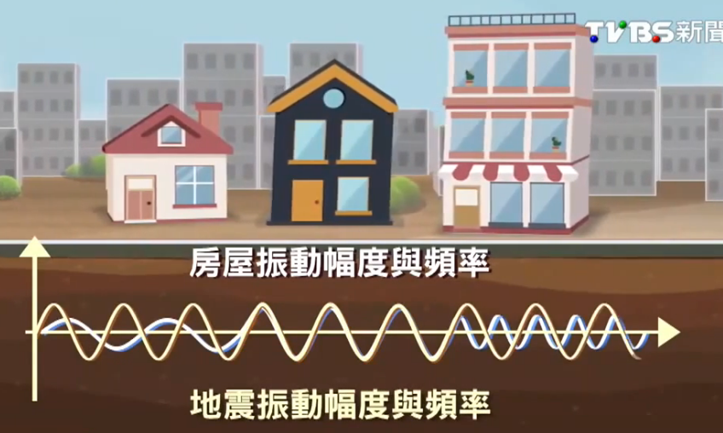
與振動頻率同 地震「共振」破壞力加倍
Resonance of earthquakes

Slide 52
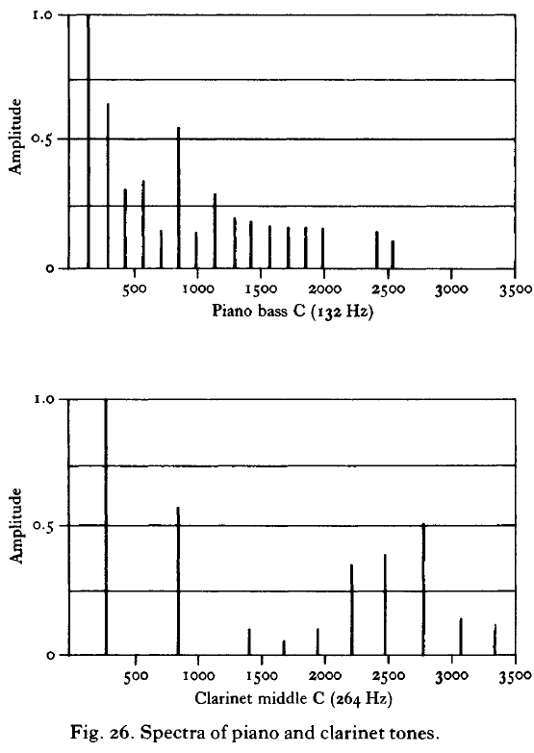
F0 and harmonics
In a spectrum diagram, wherever a vertical line is drawn, there is a component of that frequency present in the mixture with the amplitude indicated.
At all other frequencies, there is zero sound energy.
Piano (F0 = 132 Hz) have consecutive harmonics at 132, 264, 396, 528, … Hz.
Clarinet (F0 = 264 Hz) have a F0 an octave higher than the piano.
The distance between harmonics is doubled: 264, (528), 792, … Hz.
鋼琴
單簧管
Fry (1979)

Slide 53
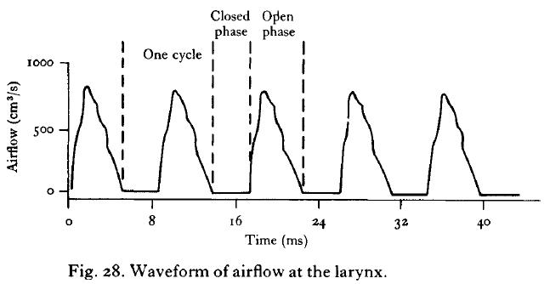
The glottal tone
The glottal wave is periodic.
F0 depends on the cycle of laryngeal pulses.
Quasi-triangular wave
The spectrum
F0 has the greatest amplitude.
Each succeeding harmonic has an amplitude falling off progressively as the frequency increases.
There are several (sporadic) dips.
Fry (1979)

Slide 54
Resonance as a filter
Resonators are NOT amplifiers. The energy they give out as sound waves is always less than the amount put into the system.
In this resonating system, it will respond with high amplitude of forced vibrations in the region of 500, 1500, and 2500 Hz.
It will absorb energy in 0–400, 600–1400, 1600–2400, … Hz.
Formants: the resonance frequencies of a vowel
Frequencies where acoustic energy is concentrated in the vocal tract filter are called formant frequencies.
Fry (1979)

Slide 55
Vowel formants: a first impression
F2
F1
Height: inversely correlated with F1
Low vowels have a higher F1.
High vowels have a lower F1.
Backness: correlated with F2
Front vowels have a higher F2.
Back vowels have a lower F2.
Rounded vowels have a lower F2 & F3.
Rhotacized vowels & [ɻ] have a low F3.
ə
Ladefoged & Johnson (2011)

Slide 56
Exercises 6.7–6.8
 | F1 | F2 | F3
[ɑ] | 700 | 1100 | 2800
[i] | 270 | 2200 | 3100
[u] | 300 | 900 | 2700
The formant frequencies of an adult male’s voice are as follows.
If the first formant frequency (F1) of [ɑ] changes from 700 Hz to 350 Hz, will [ɑ] shift in phonetic quality toward [u] or [i]? Why?
If the fundamental frequency (F0) of [ɑ] changes from 200 Hz to 300 Hz, will [ɑ] shift in phonetic quality toward [u] or [i]? Why?

Slide 57
II. Three acoustic models

Slide 58
Three acoustic models
Source (the larynx) determines F0.
Filter made by the shape of vocal tract determines formants and sound quality.
聲源─濾波理論 Source-filter
擾動理論 Perturbation
節管模型 Tube Models
An ideal vocal tract makes a [ə].
More complex models for [a, i, u]
Constrictions near point A lower the formant frequency.
Constrictions near point N raises the formant frequency.
位移波 & 壓力波的 90 度相角差
velocity maxima
$$F_{n}= \frac{\left(2n−1\right) c}{4L}$$
pressure maxima

Slide 59
Source-Filter Theory
Speech signal
(spectrum)
Vocal tract filter
(spectrum)
Larynx source signal
(spectrum)
Reetz & Jongman (2009: 176)

Slide 60
Source-Filter Theory (cont.)
Source: may be either or both of the following
Glottal source: voicing of the vocal folds generated at the larynx
F0: male ~120 Hz; female ~225 Hz; child ~300 Hz
Supra-glottal source: noise generated in the vocal tract
Vocal tract filter (recall: “resonance as a filter”)
Resonators include: pharynx, oral cavity, and nasal cavity
Radiation at the lips and nostrils
Some of the air molecules propagate outward.
The high-frequency components are able to move with greater amplitude than low-frequency ones by 6dB/octave.

Slide 61
http://newt.phys.unsw.edu.au/jw/graphics/voice3.gif

Slide 62
Radiation at the lips and nostrils
Once the air molecules leave the mouth and the nose, their movement encounters the giant air mass in the room. This phenomenon can be compared to a group of people walking through a long corridor (the trachea). This corridor contains a door (the glottis), which is alternately opened and closed. This causes the people, once they have passed the door, to walk in groups, the size of which depends on how long and how wide the door was opened. They continue to walk, through narrower and wider corridors (the vocal tract), until the end of the corridor (the lips), where they encounter a large, immobile crowd of people (the mass of air in the room). Upon entering the crowd, they bump into several people standing there, who in turn bump into their neighbors, etc. As a result, a small movement spreads through the crowd. When encountering a large crowd, a small group easily merges into the crowd. A larger group has more trouble entering the crowd. In this example, small crowds correspond to high frequencies and large crowds to low frequencies.
Exactly this phenomenon is expressed by the fact the high frequencies are “favored” by 6 dB per octave when the signal leaves the vocal tract and enters the open air. In other words, at the projection of a sound from the mouth, the higher frequencies undergo an increase in amplitude relative to the lower frequencies by roughly 6 dB/oct.
(Reetz & Jongman 2009: 175)

Slide 63
More on lip/nose radiation
Arnela, M. et al. 2016. Influence of lips on the production of vowels based on finite element simulations and experiments. JASA 139(5):2852–2859.
http://www.gipsa-lab.grenoble-inp.fr/~annemie.vanhirtum/_publi/Arnela_JASA2016.pdf
(n.b. it is a model instead of a theory/explanation.)
“Radiation losses take place when sound waves propagating through the vocal tract emanate from the mouth aperture towards infinity.”
Harrington, Jonathan, & Steve Cassidy. 1999. Techniques in Speech Acoustics.
“In recording speech, what is measured however is not the volume velocity of airflow at the lips, but the acoustic speech pressure waveform at a distance from the lips (using a pressure-sensitive microphone). We must therefore consider the final correction that must be made to the resonance curve to take into account this transformation from volume-velocity to air pressure at a distance from the lips.”
“A further detailed investigation of the effects of sound radiation about the head is given in Flanagan (1972, pp. 34–36)”
Flanagan, James L. 1972. Speech Analysis, Synthesis, and Perception. 2nd Ed.

Slide 64
Standing waves 駐波
兩個相向行進的正弦波，其波長、頻率、波速皆相同。
這兩個波相互干涉（相加）形成的合成波，稱為駐波。
Fry (1979: 40-41)
紅點：節點/波節 (node)
節點間距離 = λ / 2
節點間的中點為 腹點/波腹/反節點 (antinode)
維基共享資源: Davidjessop

Slide 65
One-Tube Model 單節管模型
A tube with one open end
The closed end must be the node of a standing wave (displacement = 0).
The open end must be the antinode of a standing wave (with the largest possible displacement).
Tube length = ¼, ¾, 5/4, 7/4, … of the wavelength of resonance frequency.
Node
Antinode
N
A
N
A
N
A
N
A
N
A
$$F_{n}= \frac{\left(2n−1\right) c}{4L}$$
Johnson (2012)

Slide 66
單節管模型
一端開放的管子，封閉端位移 = 0， 為駐波的波節。
開放端可能的 位移量最大， 為駐波的波腹。
節管長度為 共振波波長的 ¼ 的 奇數倍。
Node
Antinode
N
A
N
A
N
A
N
A
N
A
$$F_{n}= \frac{\left(2n−1\right) c}{4L}$$
Johnson (2012)

Slide 67
Exercise 6.5–6.6
Using the formula [c = 35000 cm/s], what are the first three formants (resonances) for the [ə] produced by a speaker whose vocal tract is 10 cm long?
Using the same formula, calculate the first three resonances of a speaker whose vocal tract is 15 cm long.
How about a speaker whose vocal tract is 17.5 cm long?
$$F_{n}= \frac{\left(2n−1\right) c}{4L}$$

Slide 68
Exercise 6.5–6.6
Using the formula [c = 35000 cm/s], what are the first three formants (resonances) for the [ə] produced by a speaker whose vocal tract is 10 cm long?
875, 2625, 4375 Hz
Using the same formula, calculate the first three resonances of a speaker whose vocal tract is 15 cm long.
583, 1750, 2917 Hz
How about a speaker whose vocal tract is 17.5 cm long?
500, 1500, 2500 Hz
$$F_{n}= \frac{\left(2n−1\right) c}{4L}$$

Slide 69
Experiment with a bottle
n-th | Resonant frequency (Hz)
1 | 371
2 | 1205
3 | 2093
4 | 2806
5 | (~3600)
6 | 4263
7 | (~5000)
8 | 5539

Slide 70
Complex tube models
[a]
[i]
[u]
Stevens (1989)

Slide 71
Phase difference
Node for displacement (& velocity);
Antinode for pressure
Antinode for displacement (& velocity);
Node for pressure
When velocity is at a +/− maximum, pressure equals 0.
When pressure is at a +/− maximum, velocity equals 0.
In a standing wave,
The node (N) for displacement/velocity (the closed end) is the antinode for pressure.
Pressure maximum (P)
The antinode (A) for displacement/velocity (the open end) is the node for pressure.
Velocity maximum (V)
Daniel A. Russell (2012) Acoustics and Vibration Animations

Slide 72
壓力波與位移波的相位差
Node for displacement (& velocity);
Antinode for pressure
Antinode for displacement (& velocity);
Node for pressure
壓力波與位移波有 90 度的相角差。
聲波駐波的位移波波節，位移恆=0，壓力變化最大 (P) ⇒ 為壓力波的波腹
位移波的波腹， 位移變化最大 (V)， 壓力恆定 ⇒ 為壓力波的波節
Daniel A. Russell (2012) Acoustics and Vibration Animations

Slide 73
Perturbation Theory 擾動理論
The Node of displacement is called the Pressure maximum; the Antinode of displacement is called the Velocity maximum.
In the vocal tract:
Glottis is a P, and the lips are at V.
For the n-th harmonic, there are n * P’s and V’s respectively.
If the vocal tract is constricted at a point of high kinetic energy (V), air particle movement is impeded, and consequently the frequency decreases.
If … at a high potential energy (P), air particle movement is enhanced, and consequently the frequency increases.
P₁
V₁
P’₂
V’₂
P₂
V₂
P”₃
V”₃
P’₃
V’₃
P₃
V₃
Johnson (2012)

Slide 74
擾動理論 Perturbation Theory
位移波的波腹及壓力波的波腹分別為速率最大點 (Velocity maximum) 及 壓力最大點 (Pressure maximum)。
聲門處必為 P ，嘴脣處必為 V
第 n 共振峰就有 n 個 P 和 V
擠壓速率最大點 → 減低動能 → 對應的共振頻率下降
擠壓壓力最大點 → 促進位能 (勢能)轉換為動能 → 對應的共振頻率上升
P₁
V₁
P’₂
V’₂
P₂
V₂
P”₃
V”₃
P’₃
V’₃
P₃
V₃
Johnson (2012)

Slide 75
Prediction of Perturbation Theory
Constriction at point V_{n} (A_{n}) → F_{n} decreases.
Constriction at point P_{n} (N_{n}) → F_{n} increases.
Recall the neutral vowel [ə] (500, 1500, 2500)
[a]: constriction near P₁、V’₂
A higher F1, a lower F2
[i]: constriction near V₁、P₂
A lower F1, a higher F2
[ɹ]: constrictions near all three V₃’s
An extremely low F3
[i]
[ɹ]
[a]
V₁
P₁
V₂
P₂
V’₂
P’₂
V₃
P₃
V’₃
P’₃
V’’₃
P’’₃
V₄
P₄
V’₄
P’₄
V’’₄
P’’₄
V’’’₄
P’’’₄
Johnson (2012)

Slide 76
擾動理論預測的共振峰頻率
擠壓 V 點 → 對應的共振峰頻率下降
擠壓 P 點 → 對應的共振峰頻率上升
沒有擾動的預設狀態：[ə] (500, 1500, 2500)
[a]: 緊縮處近 P₁、V’₂
F1 較高、F2 較低
[i]: 緊縮處近 V₁、P₂
F1 較低、F2 較高
[ɹ]: 緊縮處近三個 V₃
F3 超‧級‧低
[i]
[ɹ]
[a]
V₁
P₁
V₂
P₂
V’₂
P’₂
V₃
P₃
V’₃
P’₃
V’’₃
P’’₃
V₄
P₄
V’₄
P’₄
V’’₄
P’’₄
V’’’₄
P’’’₄
Johnson (2012)

Slide 77
Exercise 6.9
Explain why [u] has a lower F2 than [i].
Johnson (2012)

Slide 78
III. Acoustic properties of vowels & consonants

Slide 79
Vowels
Vowels are produced with a relatively open vocal tract, and the airstream is not severely impeded.
The resulting acoustic signal is therefore relatively loud.
An acoustic cue consists of one or more acoustic properties that are considered to provide unique information about the identity of a particular segment.
F1–F3 provide acoustic cues to vowel quality.
Height is inversely correlated with the frequency of F1.
Backness is reflected in F2, or F2 − F1
Rounding lowers all three formants, esp. F2 & F3.
Rhotacization (r-coloring) lowers F3.
Duration: long vs. short; steady-state portion
Diphthongs: change in formant pattern due to a change in articulatory shape during their production

Slide 80
Formants of monophthongs
F2
F1
Height: inversely correlated with F1
Low vowels have a higher F1.
High vowels have a lower F1.
Backness: correlated with F2
Front vowels have a higher F2.
Back vowels have a lower F2.
Rounded vowels have a lower F2 & F3.
Rhotacized vowels & [ɻ] have a low F3.
ə
Ladefoged & Johnson (2011)

Slide 81
Ladefoged & Johnson (2011)

Slide 82
Lip rounding lowers F2 & F3

Slide 83
Formant patterns of diphthongs

Slide 84
Central approximants
The glides [j, w] shares similar acoustic properties with the corresponding vowel [i, u].
Due to the smaller aperture, there are, still, more airflow impedance and weaker amplitude in glides.
Glides are shorter and weaker than neighboring vowels.
The alveolar approximant [ɹ] is characterized by a very low F3.
Constrictions including: tip-alveolar ridge proximity, lip rounding, pharyngeal narrowing
Cf. Perturbation Theory
[aja]
[awa]
Ladefoged & Johnson (2011)

Slide 85
A quick reference of acoustic cues
Ladefoged & Johnson (2011)

Slide 86
Three types of turbulence
Janice Fon (2017) (lecture PPT slides)
Channel turbulence
Produced when a fast-moving airstream exits a narrow channel
Noise is generated beyond the constriction.
Obstacle turbulence
Produced when a fast-moving airstream hits an obstacle
Noise is generated at the constriction.
Obstacle source (⊥)
Wall source (~∥)

Slide 87
Fricatives (1): noise frequency
The location of the turbulence spectral peak depends on the length of oral cavity anterior (front) to the constriction.
1st harmonic of the front tube (Cf. Johnson 2012: Ch. 7)
Ladefoged (2003); Johnson (2012)

Slide 88
Fricatives (2): manner [sibilant]
Sibilants [s, ʃ] have a larger amplitude than non-sibilants [f, θ].
Acoustic energy of non-sibilants are spread across a range of frequencies.
Sibilants tend to be longer than non-sibilants.

Slide 89
Fricatives (3): voicing
The higher-frequency amplitude of the voiced fricatives are weaker than voiceless ones.

Slide 90
Plosives (1): release bursts
Release burst (除阻瞬噪_{我自己翻的}) is a transient noise produced right at the release of stop closure.
Burst frequency varies, depending on the length of the vocal tract in front of the constriction.
1st harmonic of the front tube (Cf. Johnson 2012: Ch. 6–8)
BL: 500–1500 Hz; AL: 2500–4000 Hz; VL: 1500–2500 Hz

Slide 91
Plosives (2): formant transitions
F2 and F3 transitions vary according to place of articulation.
Bilabial: both F2 and F3 relatively low
Alveolar: locus of F2 about 1700–1800 Hz
Velar: high F2 locus; common F2 & F3 origin (velar pinch)
Ladefoged & Johnson (2011)

Slide 92
Plosives (3): VOT
Voice onset time (VOT) is the time lapse between constriction release and the onset of vocal fold vibration.
VOT = t_{voicing} − t_{release}
Phonation type | Ref. VOT
Voiced unaspirated | < 0 ms
Voiceless unaspirated | 0–20 ms
Voiceless aspirated | > 30 ms
(Henton, Ladefoged, & Maddieson 1992: 66)

Slide 93
Plosives (3): VOT
帶聲起始時間 (voice onset time) 為塞音除阻到帶聲開始產製之間的時間長度，用以區分有聲、無聲不送氣、無聲送氣三種不同發聲態的塞音。
VOT = t_{帶聲} − t_{除阻}
發聲態 | VOT 參考值
有聲塞音 | < 0 ms
無聲不送氣塞音 | 0–20 ms
無聲送氣塞音 | > 30 ms
(Henton, Ladefoged, & Maddieson 1992: 66)

Slide 94
Plosives (3): VOT (cont’d)
Ladefoged & Johnson (2011); Ladefoged (2003)

Slide 95
Plosives (4): voice bar

Slide 96
Affricates
An affricate waveform shows a release burst followed by a frication.
Frication amplitude rise-time
Johnson (2012); Ashby & Maidment (2005)

Slide 97
Nasal stops (1): nasal formants

Slide 98
Nasal stops (2) anti-formants
Resonant frequencies near the resonances of the side branch (oral) are removed (subtracted) from the output spectrum.
Johnson (2012)

Slide 99
Nasal stops (2) anti-formants
Reetz & Jongman (2009)

Slide 100
Lateral approximants
Anti-formants appear at approx. 850, 2000, and 3400 Hz, attenuating F2 & F4, relative to F1 and F3.
Johnson (2012)

Slide 101
Nasalized vowels
Anti-formants
Lower amplitude
Wider formant bandwidths
Low-frequency nasal formant
Higher energy in the second harmonic (H2)
Johnson (2012)

Slide 102
References and suggested readings
Introductory readings (general phonetics)
The Ohio State University. 2011/2016. Language Files. 11th/12th ed. Bookman.
Ladefoged, Peter, & Keith Johnson. 2011. A Course in Phonetics. 6th ed. Wadsworth Cengage Learning.
Ladefoged, Peter, & Sandra Ferrari Disnter. 2012. Vowels and Consonants. 3rd ed. Wiley-Blackwell.
Ratree Wayland. 2019. Phonetics: A Practical Introduction. Cambridge UP.
Ashby, Michael, & John Maidment. 2005. Introducing Phonetic Science. Cambridge UP.
Reetz, Henning, & Allard Jongman. 2009. Phonetics: Transcription, Production, Acoustics, and Perception. Wiley-Blackwell.
Karen Steffen Chung’s (史嘉琳) homepage: http://homepage.ntu.edu.tw/~karchung/
Advanced readings (with a focus on acoustic phonetics)
Fry. D. B. 1979. The Physics of Speech. Cambridge UP.
Pickett, J. M. 1999. The Acoustics of Speech Communication. Allyn and Bacon.
Johnson, Keith. 2012. Acoustic and Auditory Phonetics. 3rd ed. Oxford: Wiley-Blackwell.
Ladefoged, Peter. 2003. Phonetic Data Analysis: An Introduction to Fieldwork and Instrumental Techniques. Blackwell.
鄭靜宜. 2011. 《語音聲學：說話聲音的科學》。心理出版社。

